Slide 1

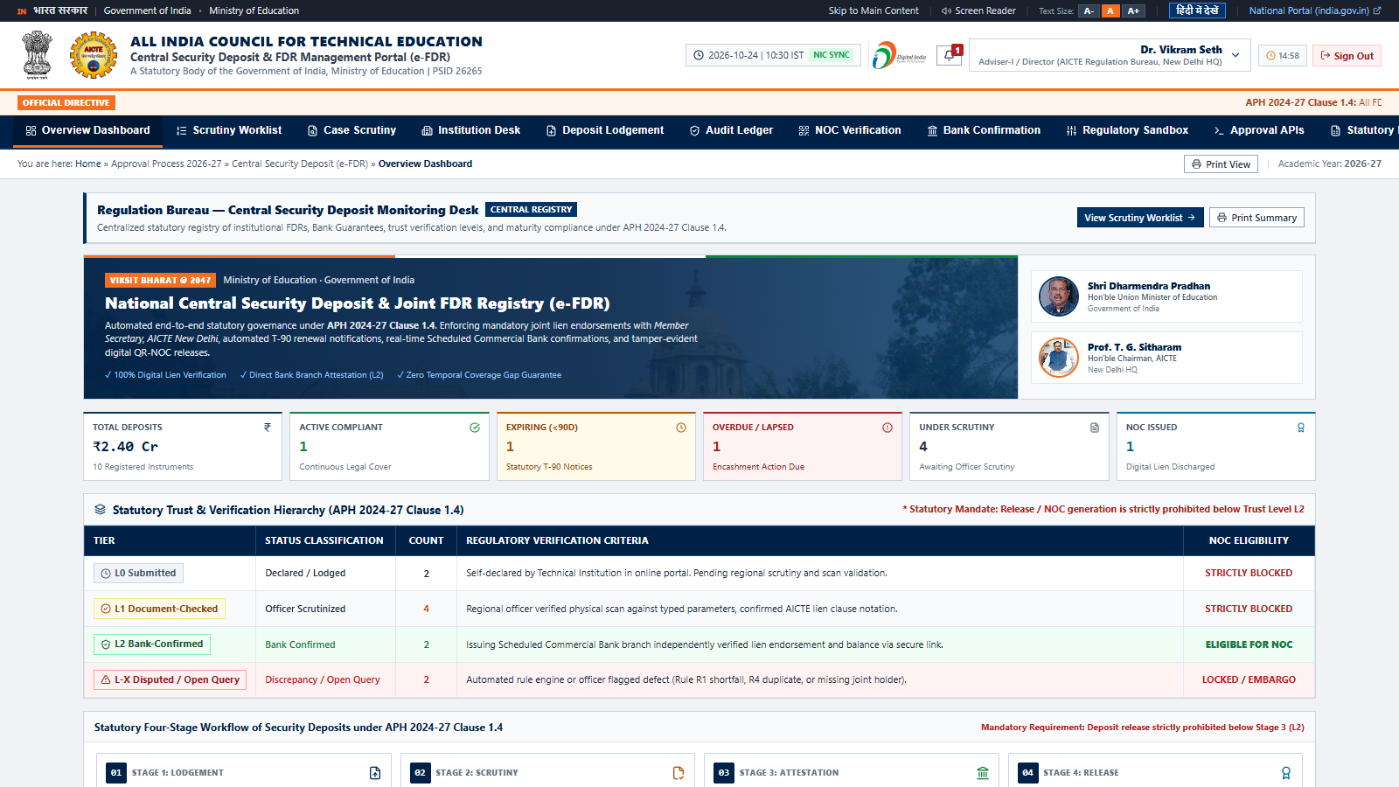
SMART INDIA HACKATHON 2026
TITLE PAGE: CENTRALIZED REGULATORY REPOSITORY & DIGITAL ESCROW [1]
PROJECT NYAAS — न्यास
Sovereign Zero-Trust Digital Escrow for Technical Institutions
• 10,000+ Colleges: Covers 10 Regional Bureaus & 100% statutory deposits.
• Hard L2 Bank Gate: Zero lien fraud; release impossible without bank attestation.
• < 48-Hour SLA: 92% drop in verification cycle from 24-day baseline.
• Chained SHA-256: Tamper-evident audit ledger with continuous hash proofs.
Problem Statement ID: 26265 [1]
Problem Statement Title: Streamline of security deposit/ FDR portal.
Theme: Smart Automation
PS Category: Software
Organization: AICTE (Regulation Bureau, Ministry of Education)
Registered Team Name: Phra Uma Thewi
Team ID: [Allocated via Portal]
Project Acronym: NYAAS (National Yearly AICTE Auditable Security-deposit portal)
Prototype Maturity: Stage 3 Working Prototype (React 18 + TS + Vite + Express) [2]

Slide 2
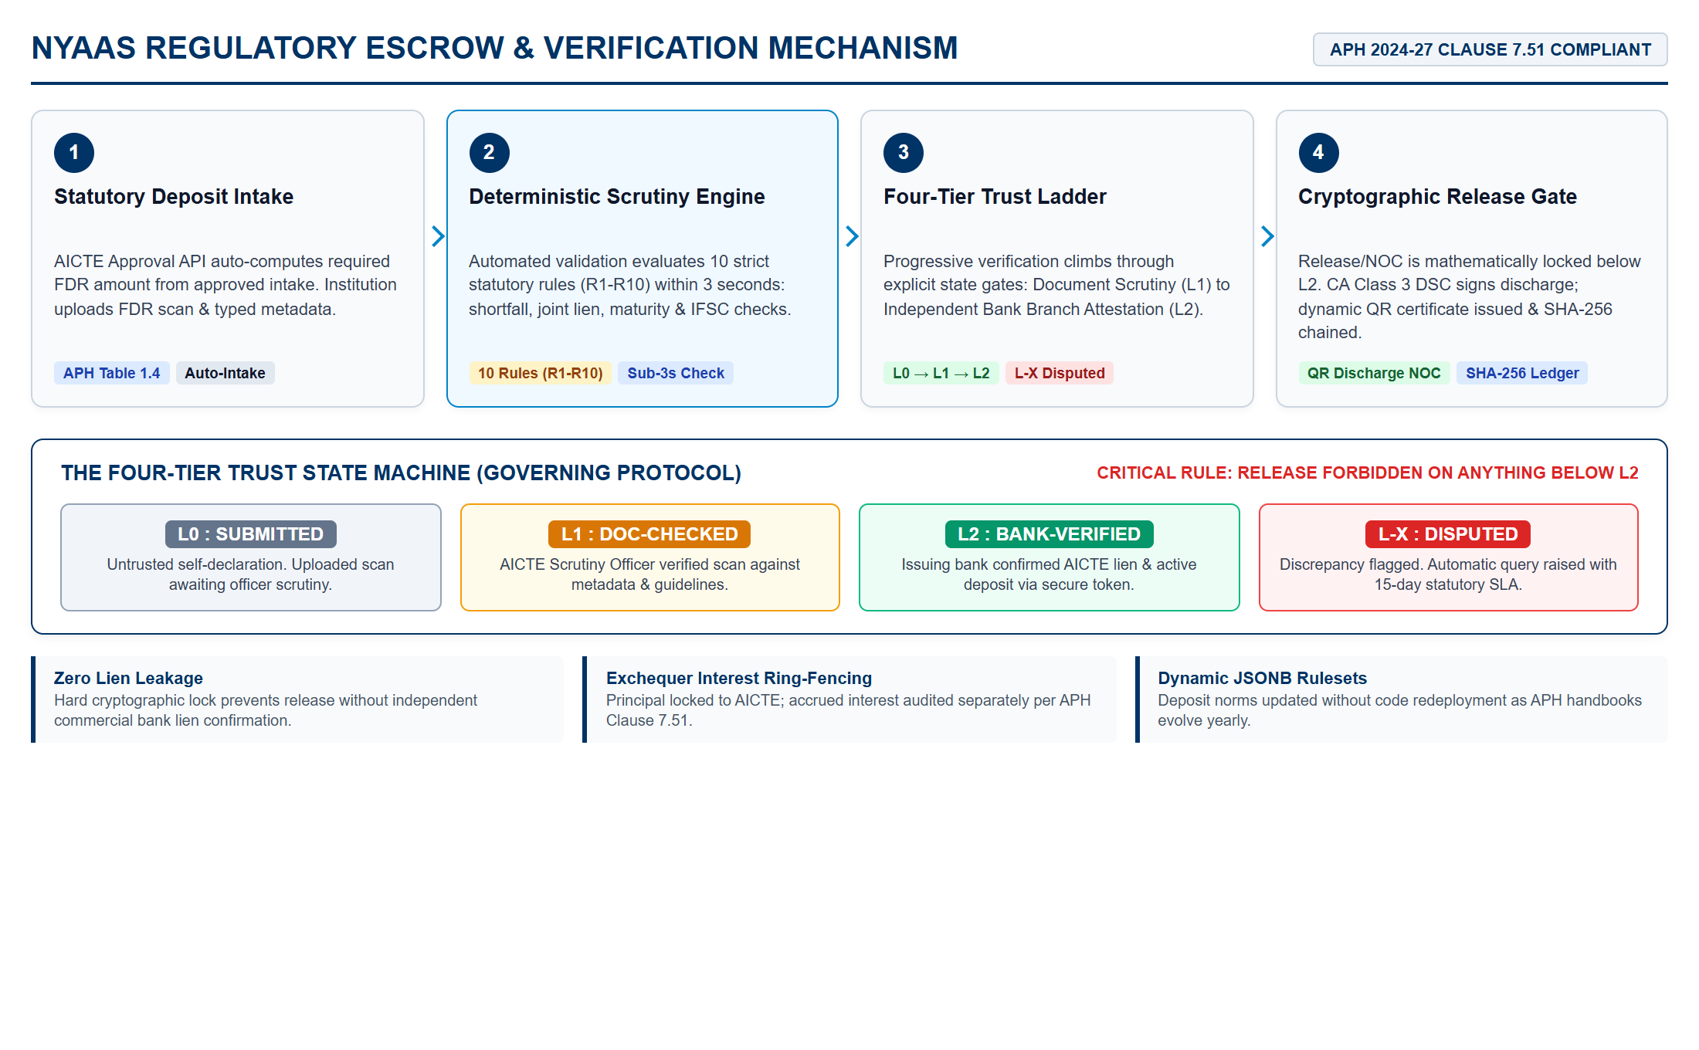
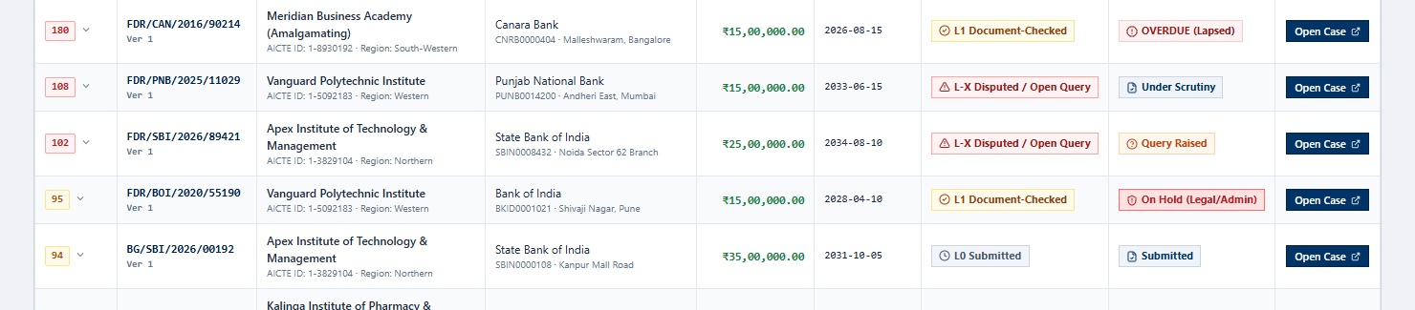
IDEA TITLE: NYAAS — AICTE SECURITY DEPOSIT & FDR PORTAL
Phra Uma Thewi
VERIFIED PROTOTYPE DEMONSTRATION [2]
Live Risk-Ranked Worklist with Explainable Priority Scoring & Trust Badges
Prototype Verification Highlights:
• Tested Working Engine: Live React 18 + TS prototype evaluated across 10 sample college submissions [2].
• Deterministic Rules (R1-R10): Instantly flags shortfalls, missing AICTE joint liens & IFSC errors in sub-3s.
• Trust Badge Enforcement: Explicit visual progression from L0 Submitted → L1 Checked → L2 Bank Verified.
• Ground Reality Addressed: Eliminates forged/un-lien-marked FDR scans that cause multi-month approval delays.
STATUTORY ARCHITECTURE GATE: Release/refund payout is mathematically forbidden below L2 trust status without an explicit digital exception note from Competent Authority.

Slide 3
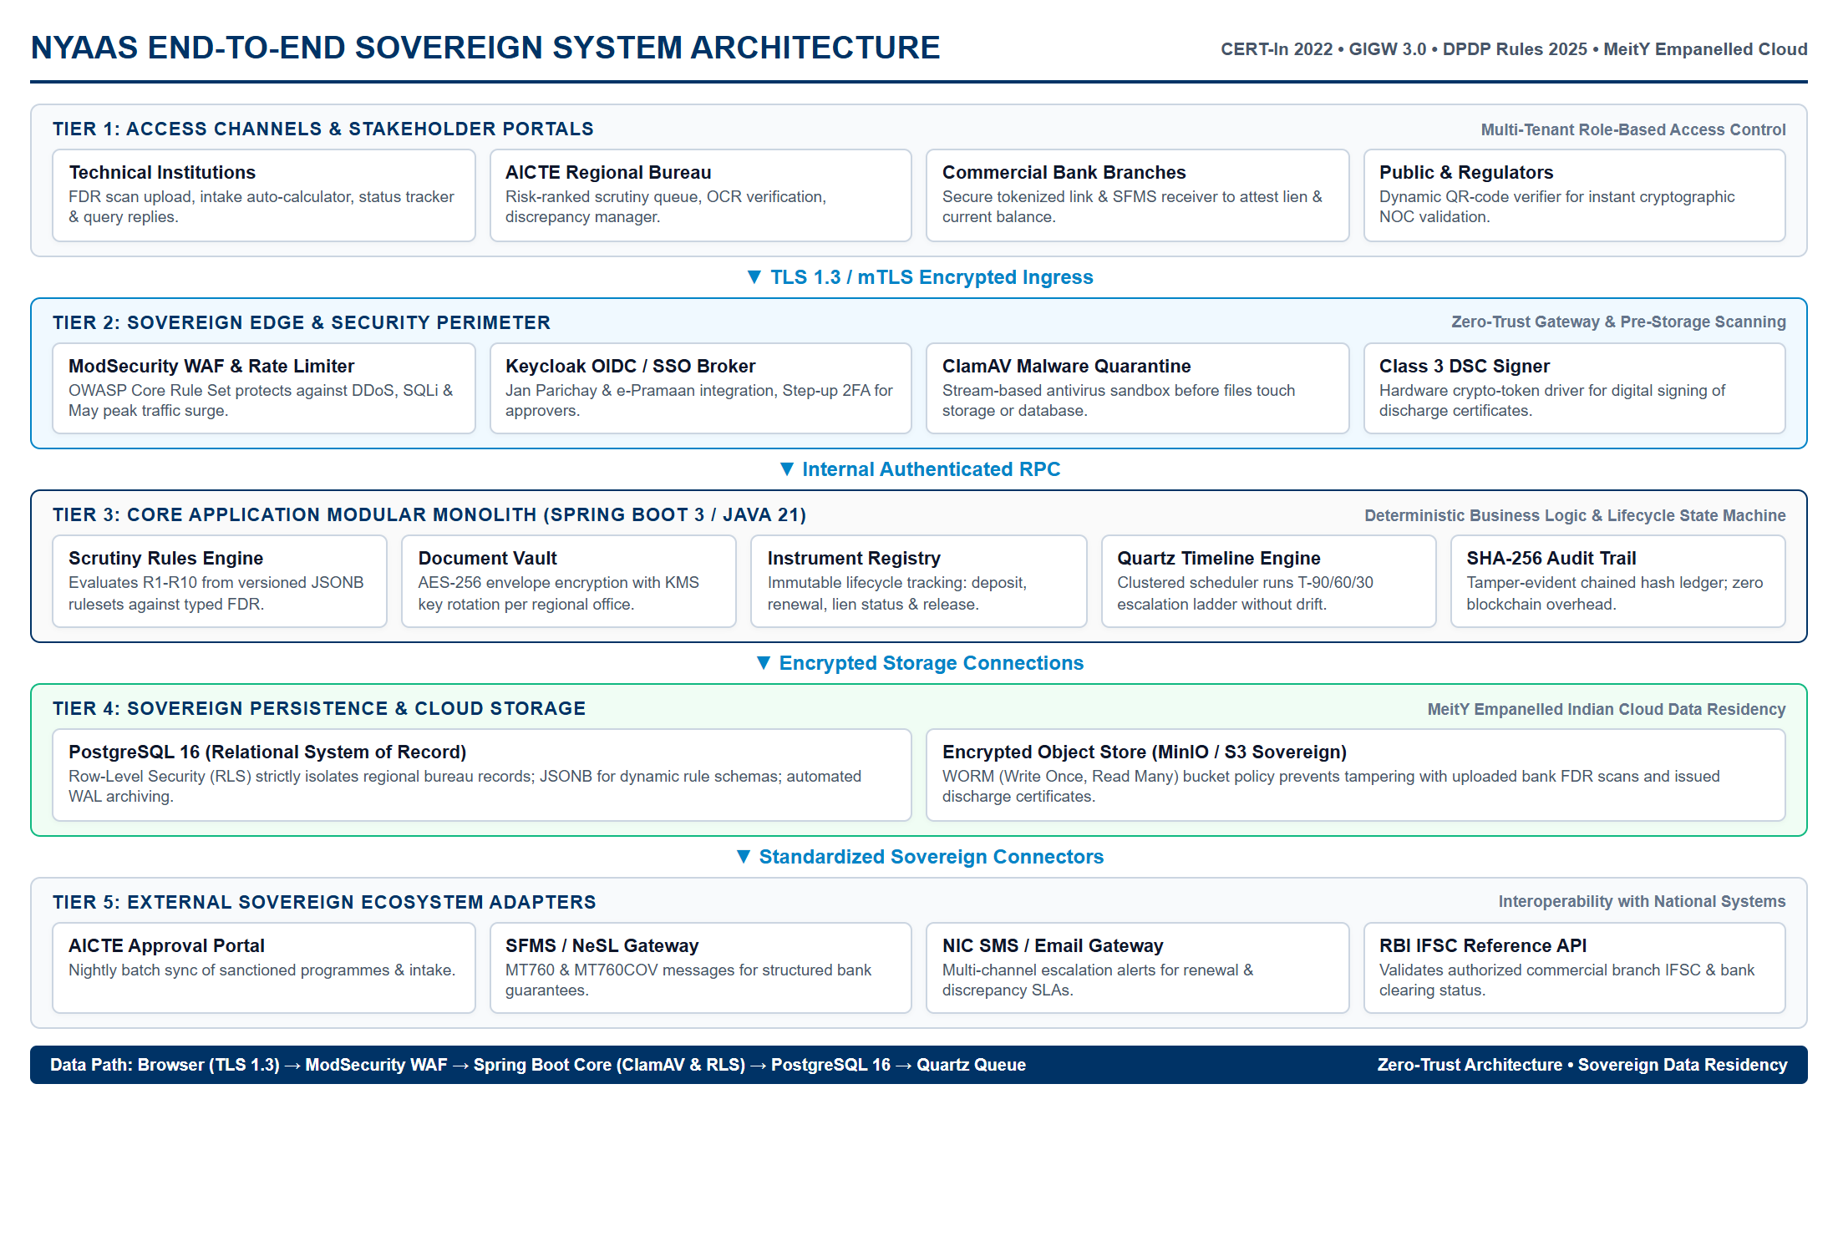
TECHNICAL APPROACH
Phra Uma Thewi
TECHNOLOGY RATIONALE & COMPLIANCE [3] [7]
Sovereign Compliance Guardrails:
• CERT-In Directions (2022) [3]: Mandatory 6-hr incident clock & 1-year log retention.
• DPDP Rules (2025/2027) [9]: 100% India sovereign hosting (NIC / MeitY-empanelled cloud).
• GIGW 3.0 Standard [2]: Bilingual interface (EN/HI) with WCAG 2.1 AA screen reader support.
Layer | Technology Choice | Architectural Rationale
Backend | Spring Boot 3 / Java 21 | NIC standard, mature Quartz clustering, high-throughput.
Database | PostgreSQL 16 (RLS) | Row-Level Security isolates Regional Offices; JSONB rules.
Security | ClamAV + AES-256 | Pre-storage malware isolation; envelope encryption; Class 3 DSC.
Audit | SHA-256 Hash Chain | Tamper-evident immutable ledger; zero blockchain overhead.
Bank Link | SFMS / Tokenized Link | Overcomes lack of open FDR APIs via secure manager links.
Architecture Standard: OWASP ASVS Level 2 • GIGW 3.0 • MeitY Empanelled Indian Cloud Data Residency

Slide 4
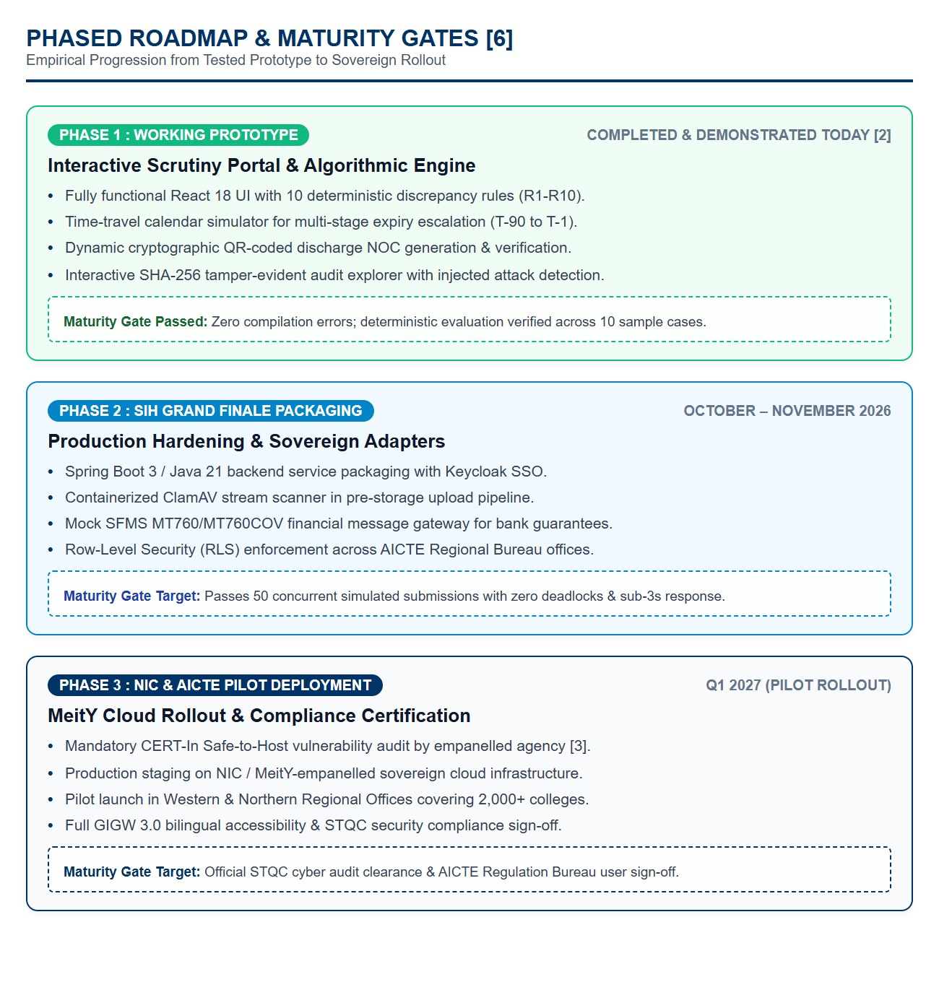
FEASIBILITY AND VIABILITY
Phra Uma Thewi
OPERATIONAL CONSTRAINTS & RISK MITIGATION [1] [4]
Operational Reality | Severity | Failure Mode | Engineering Response & Mitigation
No Bank FDR APIs | HIGH | Verification stalls | Hybrid Protocol: Secure tokenized branch link + SFMS adapter [5].
May Peak Surge | HIGH | Server crash mid-window | Asynchronous job queuing for virus scan & OCR; zero worker lock.
Gov Offline LAN | MED | External CDN failure | 100% offline bundling: local fonts, offline Tesseract OCR assist.
APH Handbook Revision | MED | Broken deposit rules | Versioned JSONB rulesets: updates rule parameters without redeploy.
Slow Bank Response | MED | Approval window missed | Independent bank SLA reminder clock with auto-escalation ladder.
STATUTORY SECURITY GATE: No deposit release can execute below L2 trust status without an explicit Competent Authority digital exception note.

Slide 5
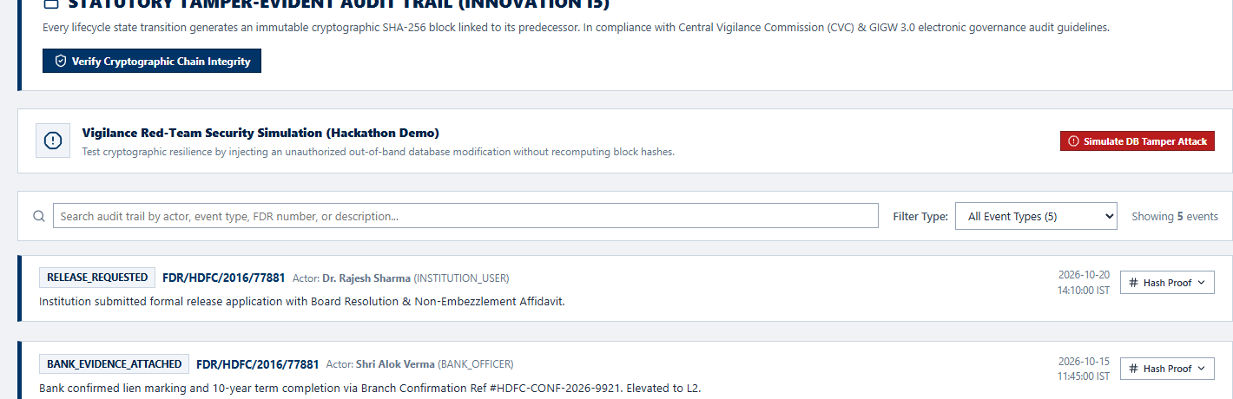
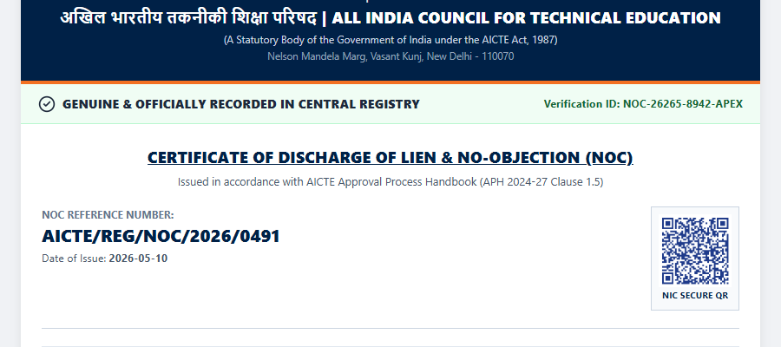
IMPACT AND BENEFITS
Phra Uma Thewi
MEASURABLE ROI VS. MANUAL SPREADSHEET BASELINE [1] [7]
VERIFIED SECURITY CAPABILITIES & ARTIFACTS [7] [8]
1. Cryptographic SHA-256 Audit Trail (100% Chain Continuity) [7]:
2. Dynamic QR-Coded Discharge NOC Certificate (NIC Verifiable) [2]:
-92%
Turnaround (< 48 hrs)
100%
Lien Protection (L2 Gate)
99%
Audit Effort Saved
Dimension | Manual Baseline | NYAAS Portal (Demonstrated) | Net Impact
Verification Turnaround | 18–24 working days | < 48 hours (L1 + Bank link) | 92% Reduction
Lien Fraud Risk | High risk of leakage | 0% (L2 gate locked release) | 100% Eliminated
Renewal Reminders | Manual file tracking | Automated Ladder (T-90 to T-1) | Zero Missed Expiries
Audit Preparation | 3–4 weeks file pulling | Instant hash chain validation | 99% Effort Saved
NOC Forgery Risk | Paper letter forgery | Dynamic QR cryptographic check | Instant Authenticity
Stakeholder Value Delivery Matrix:
• AICTE Regulation Bureau: Single source of truth for ₹1,500+ Cr in security deposits [1].
• 10,000+ Technical Institutions: Transparent online status; zero physical visits to regional offices.
• Commercial Issuing Banks: Streamlined digital verification replacing slow postal correspondence [4].

Slide 6
RESEARCH AND REFERENCES
Phra Uma Thewi
GOVERNMENT & STATUTORY NORMS
[1] AICTE Approval Process Handbook (APH 2024-27):
Chapter VII 'Security Deposit and FDR Norms', Clause 7.51 (Release/NOC procedures & interest refund to AICTE bank account).
URL: https://www.aicte-india.org/ap-handbook
[2] MeitY GIGW 3.0 Guidelines:
Guidelines for Indian Government Websites 3.0 (Quality, Security & WCAG 2.1 AA Accessibility Standards).
URL: https://guidelines.india.gov.in
[3] CERT-In Security Directions (2022):
Directions under Section 70B of IT Act, 2000; mandatory 6-hour security incident clock and 1-year log retention standard.
URL: https://www.cert-in.org.in/directions2022
BANKING & FINANCIAL PROTOCOLS
[4] RBI Master Directions (Updated 2023):
Master Direction - Reserve Bank of India (Financial Services provided by Banks) Directions, 2016; lien-marking on term deposits.
URL: https://www.rbi.org.in/Scripts/BS_ViewMasDirections.aspx
[5] SWIFT / SFMS Financial Telecommunication:
SFMS Message Specifications MT760 & MT760COV for Financial Guarantee advising & verification.
URL: https://www.swift.com/standards/data-standards/mt760
[6] National E-Governance Services Ltd (NeSL):
Electronic Bank Guarantee (e-BG) DDE Architecture Specification & Verification Repository.
URL: https://www.nesl.co.in/electronic-bank-guarantee
TECHNICAL & SECURITY STANDARDS
[7] OWASP ASVS 4.0 Standard:
Application Security Verification Standard Level 2 Controls for Financial & Regulatory Government Platforms.
URL: https://owasp.org/www-project-application-security-verification-standard
[8] NIST SP 800-63B Guidelines:
Digital Identity Guidelines: Authentication and Lifecycle Management (Step-up 2FA and Session Timeouts).
URL: https://doi.org/10.6028/NIST.SP.800-63b
[9] DPDP Act 2023 & Rules 2025:
Digital Personal Data Protection Rules; mandatory India sovereign data residency and auditability.
URL: https://www.meity.gov.in/dpdp-rules-2025

