Slide 1
FLIPROBO TECHNOLOGIES
TELECOm MICRO CREDIT PROJECT

Slide 2
PROBLEM STATEMENT
This project was highly motivated project as it includes the real time problem for Microfinance Institution (MFI), and to the poor families in remote areas with low income, MFI to provide micro-credit on mobile balances to be paid back in 5 days. The Consumer is believed to be defaulter if he deviates from the path of paying back the loaned amount within the time duration of 5 days. For the loan amount of 5 (in Indonesian Rupiah), payback amount should be 6 (in Indonesian Rupiah), while, for the loan amount of 10 (in Indonesian Rupiah), the payback amount should be 12 (in Indonesian Rupiah).
Generally, Credit Scores plays a vital role for loan approvals, and is very important in today’s financial analysis for an individual, Most of the loan lending vendors rely heavily on it, so in our case users has 5 days’ time to pay back the loan or else they are listed as defaulters which will impact the loan the credit score heavily, so there are few thing to lookout in this dataset as users who are taking extensive loans, user who have most frequent recharges in their main account have a good chance of 100% payback rate, and user who never recharged their main account for them loan should have never been approved as there is high chance for single user or default user taking multiple connections in name or documents of the family members.

Slide 3
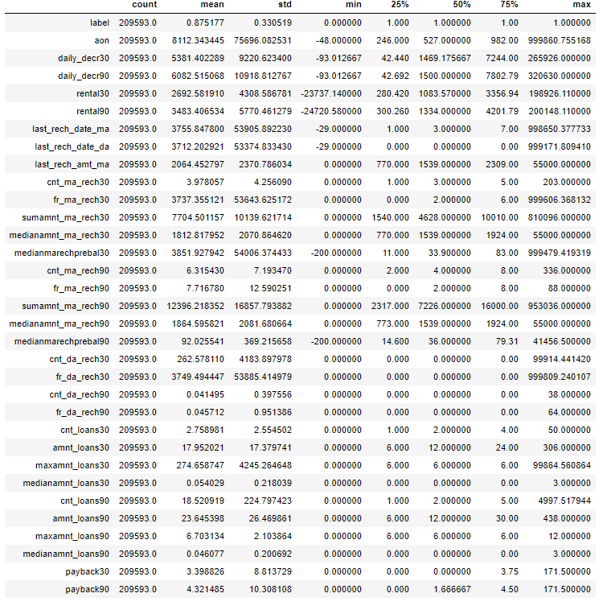
ANALYTICAL PROBLEM FRAMING
From the above statistical summary of the above part of the dataset, the important thing is that Some features even have negative values like the age on cellular network, main account last recharge date, data account last recharge date. Negative values in these features make no sense thus these values should be removed.
The Dataset we are having, consists of some features giving information about the user for the time span of 30 days and 90 days. According to me if we have data of large number of days for a particular user then we could interpret User's behavior more precisely because many users have the tendancy of repeating the same things. Thus the features having the data with a time span of 90 days gives more information about the user as compared to the features with a time span of 30 days.
All the categories that is being made to make the visualizations easy are solemnly based on the Description i.e statistical summary of the data plotted above for instance low comes under(0-25%), average comes under(25-75%) and high comes over 75% of the data values in a given feature.
Using MS EXCEL I have found the maximum values a feature can have, beyond these values the values are unimaginable.
**(for an example beyond the value [2500], the very next value in "aon" feature comes out to be around 2379 years, which means a user is using the telephone services from 359 BCE which is clearly not possible).**
I checked the correlation of the independent and dependent features and from the correlation table it is also clear that the features with time span of 30 and 90 days almost have the same correlation thus we can drop one for the same information.

Slide 4
DATA PRE-PROCESSING
I checked the correlation of the independent and dependent features and from the correlation table it is also clear that the features with time span of 30 and 90 days almost have the same correlation thus we can drop one for the same information.
There were data for 30 and 90 days, so considering data for 90 days is adding more information rather than then data of 30 days.
Some features can’t have any negative value, so those features were treated accordingly.
Outliers are treated manually for the features giving some important information, and then the threshold values were set to make the data free from outliers.
Data lost is very less i.e. 5.9% which is less than the 7% which was stated in the documentation.
Applied SMOTETomek, to balance the dataset as the dataset was imbalanced dataset.
Applied StandardScaler to our dependent features.
Applied various machine learning model and compared it.
Applied hyper tuning several models, but couldn’t achieve much better results.
Saving final predictions in file.csv format.

Slide 5
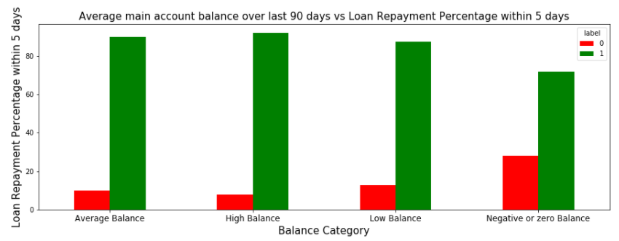
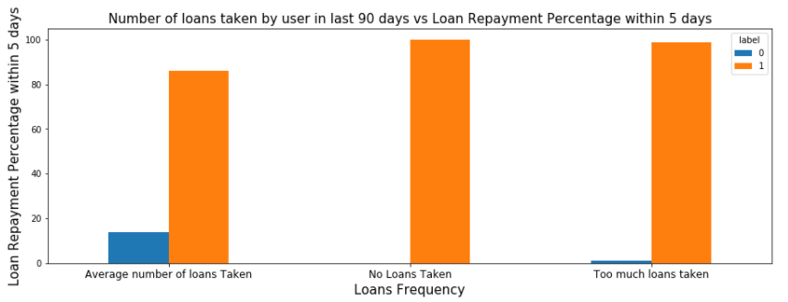
DATA INPUT- LOGIC-OUTPUT RELATIONSHIPS
From the above Graph and the crosstab table it is clear that:
1) 28% of Users having negative or zero balance are defaulters, which is very high. 2) 10% to 12% Users are defaulters which falls in the category of Average and Low balance category. 3) Users having high balance and are defaulters are very less in number
From the above graph it is clear that:
1) Users who take more number of loans are non-defaulters (i.e. 98% of the category) as they repays the loan within the given time i.e. 5 days. 2) 14% of the Users are are among the average number of loan taken category are defaulters.

Slide 6
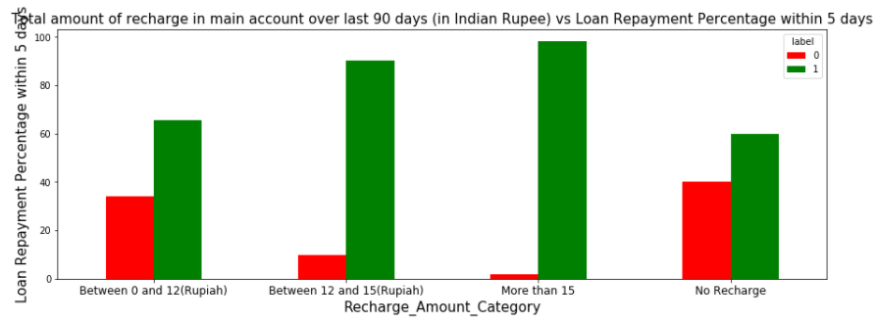
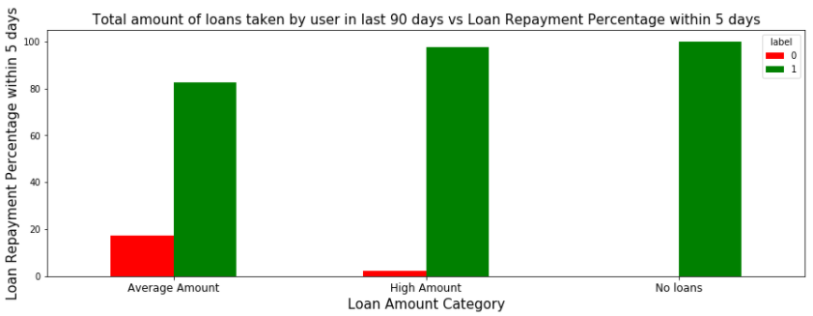
DATA INPUT- LOGIC-OUTPUT RELATIONSHIPS
From the above graph it is clear that
1) 40 % of the Users who do not even recharged in the 90 days are defaulters only. 2) Users who do very high amount of recharge always pays their loans on time. i.e 98% of them are non-defaulters. 3) 34% of the Users who do less amount of recharge are defaulters.
From the above graph it is clear that:
1) Users who did not take any loans are non-defaulters. 2) Most of the Users (i.e. 97%) who take large amount of loans comes under non defaulter category. 3) 17% of the users who take small loans are defaulters.

Slide 7
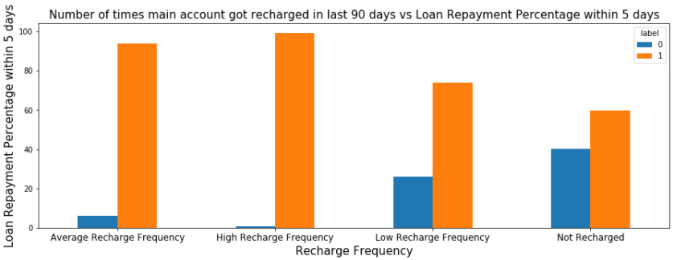
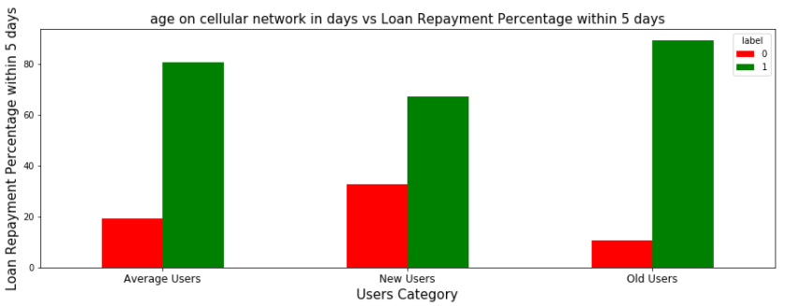
DATA INPUT- LOGIC-OUTPUT RELATIONSHIPS
From the above graph it is clear that:
1) Among the Users who have not done a single recharge in 3 months 40% are defaulters. 2) Among the Users who are very frequent in recharging and who always pay their loans on time are more in number i.e 99% of the total category, which is a good news for the company.
From the above graph it is clear that:
1) 32% of the users who are defaulters are the new users. 2) Old Users are trusted and they are mostly non defaulters.

Slide 8
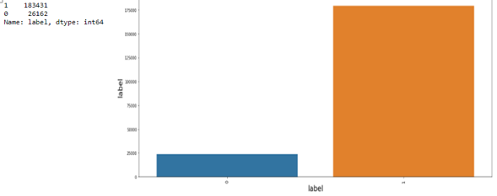
MODEL/S DEVELOPMENT AND EVALUATION
From the above graph it is clear that the data set is highly imbalanced dataset, so applied SMOTETomek to balance the dataset.

Slide 9
MODEL/S DEVELOPMENT AND EVALUATION
Testing of Identified Approaches (Algorithms)
lr=LogisticRegression()
DT=DecisionTreeClassifier()
GBC=GradientBoostingClassifier()
RF=RandomForestClassifier()
AD=AdaBoostClassifier()
ETC=ExtraTreesClassifier()

Slide 10
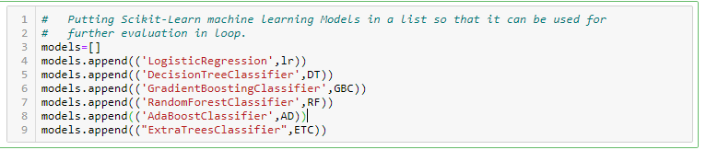
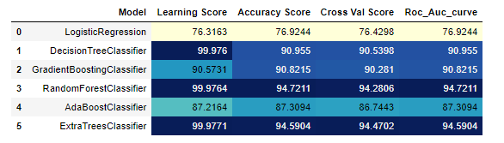
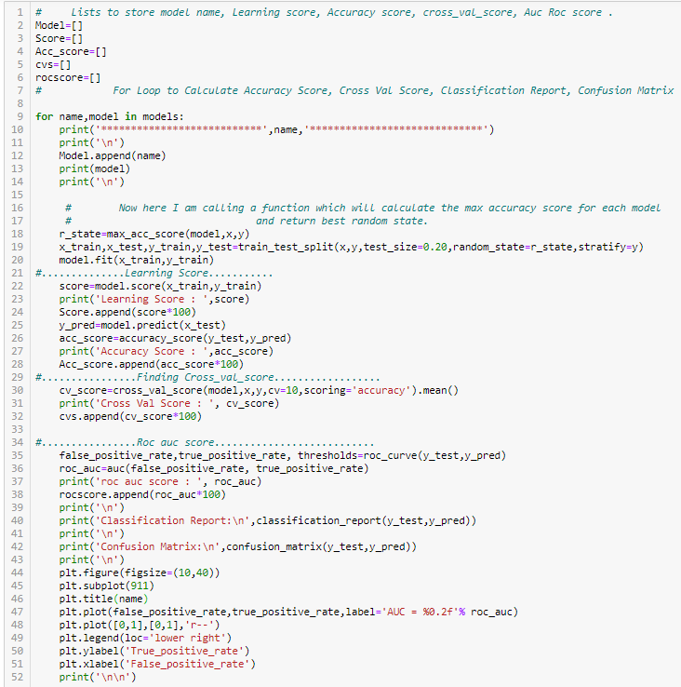
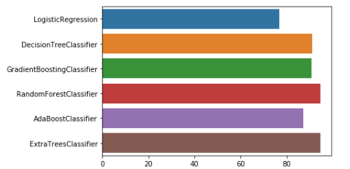
MODEL/S DEVELOPMENT AND EVALUATION
Run and Evaluated Some Selected models
Key Metrics for success in solving problem under consideration
From the above Metrics result It is clear that Random Forest Classifier and Extra Tree Classifier are performing best for Roc-Auc, cross-val score and accuracy score metric.

Slide 11
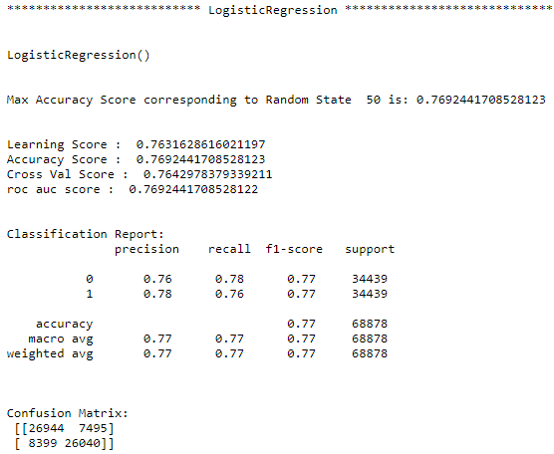
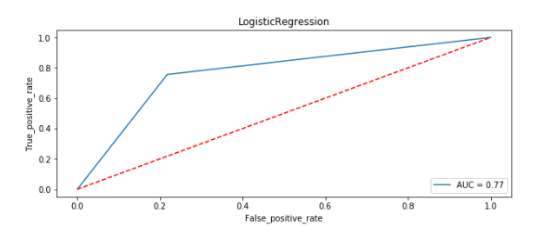
MODEL/S DEVELOPMENT AND EVALUATION
Logistic Regression Visualization:

Slide 12
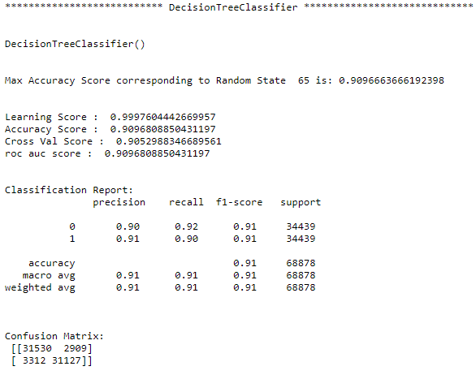
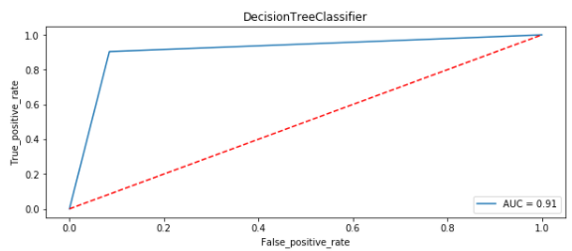
MODEL/S DEVELOPMENT AND EVALUATION
Decision Tree Classifier Visualization:

Slide 13
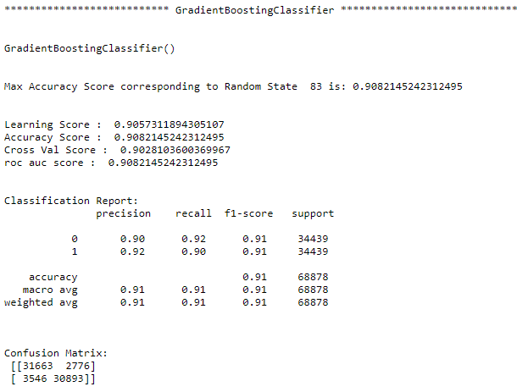
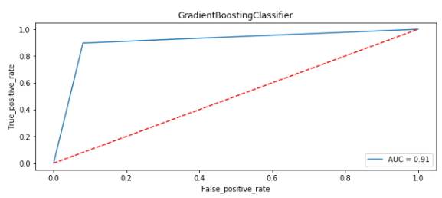
MODEL/S DEVELOPMENT AND EVALUATION
Gradient Boosting Classifier Visualization:

Slide 14
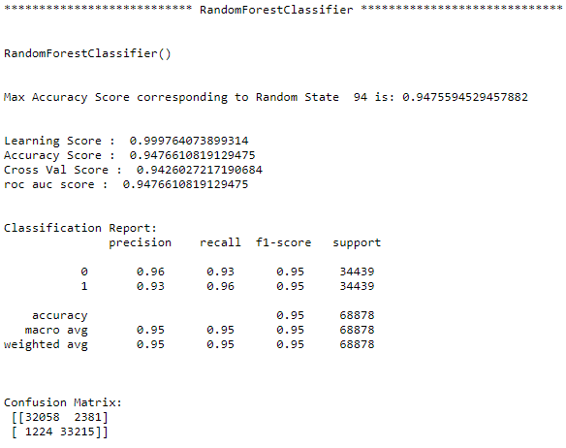
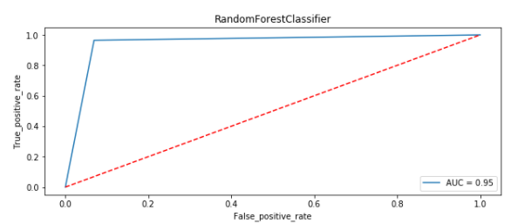
MODEL/S DEVELOPMENT AND EVALUATION
Random Forest Classifier Visualization:

Slide 15
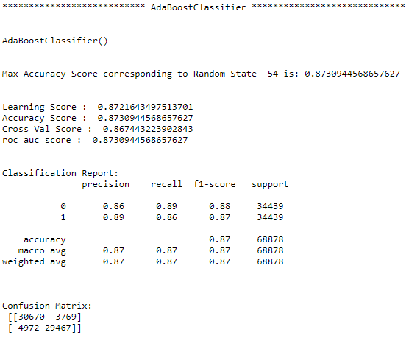
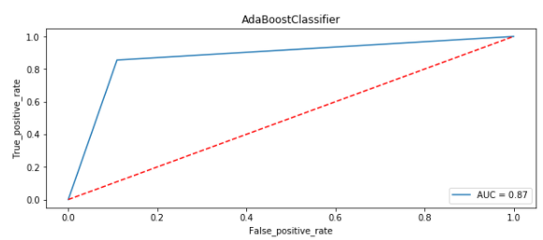
MODEL/S DEVELOPMENT AND EVALUATION
Ada Boost Classifier Visualization:

Slide 16
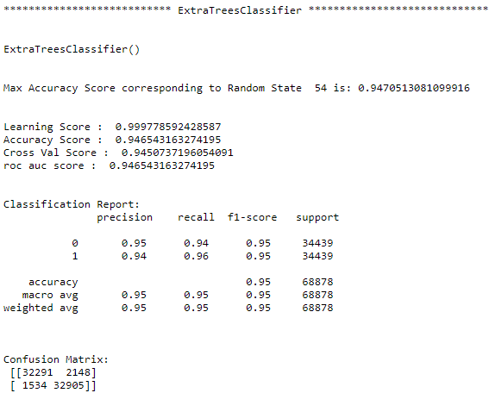
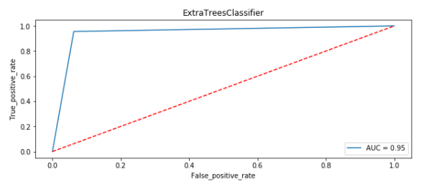
MODEL/S DEVELOPMENT AND EVALUATION
Extra Tree Classifier Visualization:

Slide 17
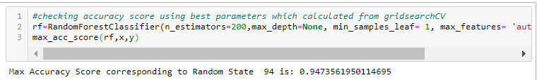
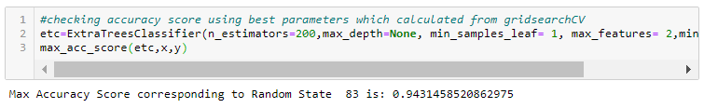
Hyper parameter tuning
After all this process conclusion is that Random Forest Classifier and Extra Tree Classifier are performing well in terms of Accuracy score, Cross val score and Roc_Auc score as compared to other models. Now doing Hyper Parameter Tuning
After Hyper Parameter tuning conclusion is that Random Forest Classifier is giving accuracy of 94.73%. So now I am making a final model using Random Forest Classifier.

Slide 18
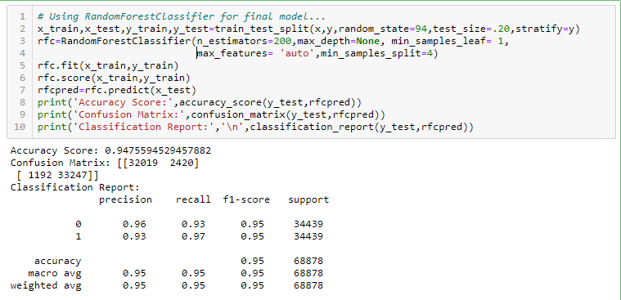
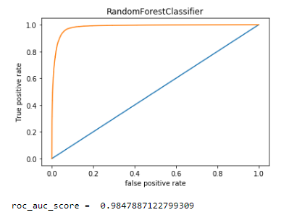
Final model
From the above visualization and matrices found that the RandomForest Classifier performed the best 98.47% AOC_ROC_SCORE, with precision accuracy score of 96% and recall 97%.

Slide 19
CONCLUSION
Key Findings and Conclusions of the Study
1) 28% of Users having negative or zero balance are defaulters, which is very high.
2) 10% to 12% Users are defaulters which falls in the category of Average and Low balance category. 3) Users having high balance and are defaulters are very less in number. 4) Users who take more number of loans are non-defaulters (i.e 98% of the category) as they repays the loan within the given time i.e. 5 days. 5) 14% of the Users are among the average number of loan taken category are defaulters. 6) 40 % of the Users who do not even recharged in the 90 days are defaulters only. 7) Users who do very high amount of recharge always pays their loans on time. i.e 98% of them are non-defaulters. 8) 34% of the Users who do less amount of recharge are defaulters. 9) Users who did not take any loans are non-defaulters. 10) Most of the Users (i.e. 97%) who take large amount of loans comes under non defaulter category. 11) 17% of the users who take small loans are defaulters. 12) Among the Users who have not done a single recharge in 3 months 40% are defaulters. 13) Among the Users who are very frequent in recharging and who always pay their loans on time are more in number i.e. 99% of the total category, which is a good news for the company. 14) 32% of the users who are defaulters are the new users. 15) Old Users are trusted and they are mostly non defaulters.
16) Random Forest Classifier performed the best AUC_ROC_SCORE i.e. 94.7%.

