Slide 1
EIOT Mini Project Laser Tripwire Security Sensor
Group 2 –
PE 46 – Abhijeet Bakale
PE 48 – Aniket Sharma
PE 49 – Shubh Sharma
PE 50 – Akshit Langeh
PE 56 – Sairaj Khandare

Slide 2
Introduction
Purpose
Security is the most important factor in day to-day life. The need for security is the basic necessity of every individual. The sensation that we are safe and everything around us is fine is imperative for peaceful living. Be that because it may, during this unsafe world, when crime, terror, and dangers are at their pinnacle, how might one achieve that suspicion of safety? Here, a laser security system provides us with an answer and for this reason, more and more people are installing them so as to remain order safe and secure. They once accustomed to being very expensive solutions for security needs. Owing to cost-cutting and fast technological advancements, this type of security system is becoming more pocket friendly. During this project, we've designed Laser Light Security System Using Arduino with Alarm and LED with the applying of Laser Diode Module and Laser sensor module, and for extra Security, an alert system using SIM900A to send SMS alert to the user. Many people secure their homes, office, shops, warehouses, etc with the Tripwire security system of the document, cut and paste into it, and/or use markup styles

Slide 3
Introduction
Need/Motivation
A laser tripwire Security system may be a system used for security purposes. It's a large application in fields of security and defence ranging from the protection of a simple household material to an awfully high valued material of a corporation.
Scope/applications
Can be used to secure homes, office, shops, warehouses, etc
A handy, portable, cost-effective, and highly effective security alarm systems are hugely in demand for security purposes, and thus the given system is often proved useful and effective see able of the above features.

Slide 4
Literature Survey
Security could be the most important factor in daily life. Need of security is that the basic necessity of every individual. The Sensation/feeling that we are safe and everything around us is all right is imperative for peaceful living. Here, a laser tripwire security system provides us with a solution and for this reason, more and more people are installing them so as to remain to stay safe and secured. Different electronic security systems are often utilized at the house and other significant working spots for security and safety purposes. A laser tripwire Security system/ alarm is a device used for Safeguard/security purposes. It's a good application in fields of security and defence ranging from the security of a straightforward household material to a very high valued material of an organization. When the bad guys try to sneak up in the mid night, they kick the wire and pull over, making a rattle that awakens the sleeping good guys, who win the day. A laser tripwire security system works with the identical principle and working. Instead of a string, there's a ray of light surrounding the area, and instead of a can of rocks, there’s an alarm of one sort or another.

Slide 5
Requirements
Hardware
Arduino Uno R3
SIM900A GSM module
Laser Module
Laser Sensor
Buzzer
3mm LED
Breadboards
Jumper Cables
Software
Arduino IDE

Slide 6
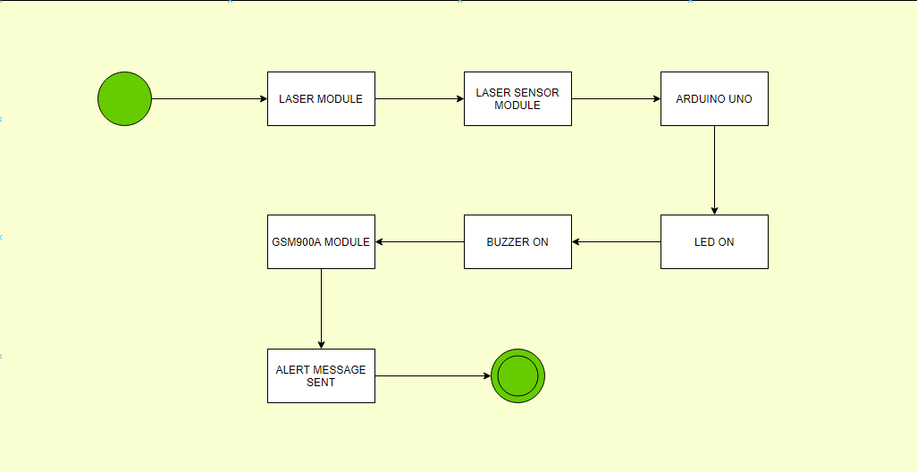
System Architecture
Block Diagram

Slide 7
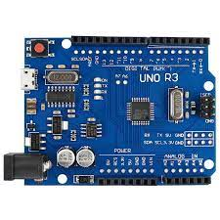
System Architecture
Function/working
Arduino Uno:
The Arduino UNO is that the best board to get started with electronics and coding. If this can be your first experience tinkering with the platform, the UNO is that the most robust board you'll start fiddling with. The UNO is that the most used and documented board of the whole Arduino family

Slide 8
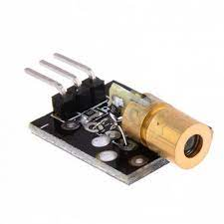
System Architecture
Laser Diode Module:
Laser Transmitter module for Arduino emits a dot-shaped, red light of laser beam. Laser transmitter module consists of a 650nm red laser diode head and a resistor. The specification of Laser Transmitter Module is as follows:
Operating Voltage – 5V
Output Power – 5mW
Wavelength – 650nm
SIM000A GSM Module:
Quad-Band GSM/ 850/900/1800/1900MHz
Compatible with arduino, raspberry pi, arm, avr, pic, 8051
power supply 12v 1amp to 2 amps max

Slide 9
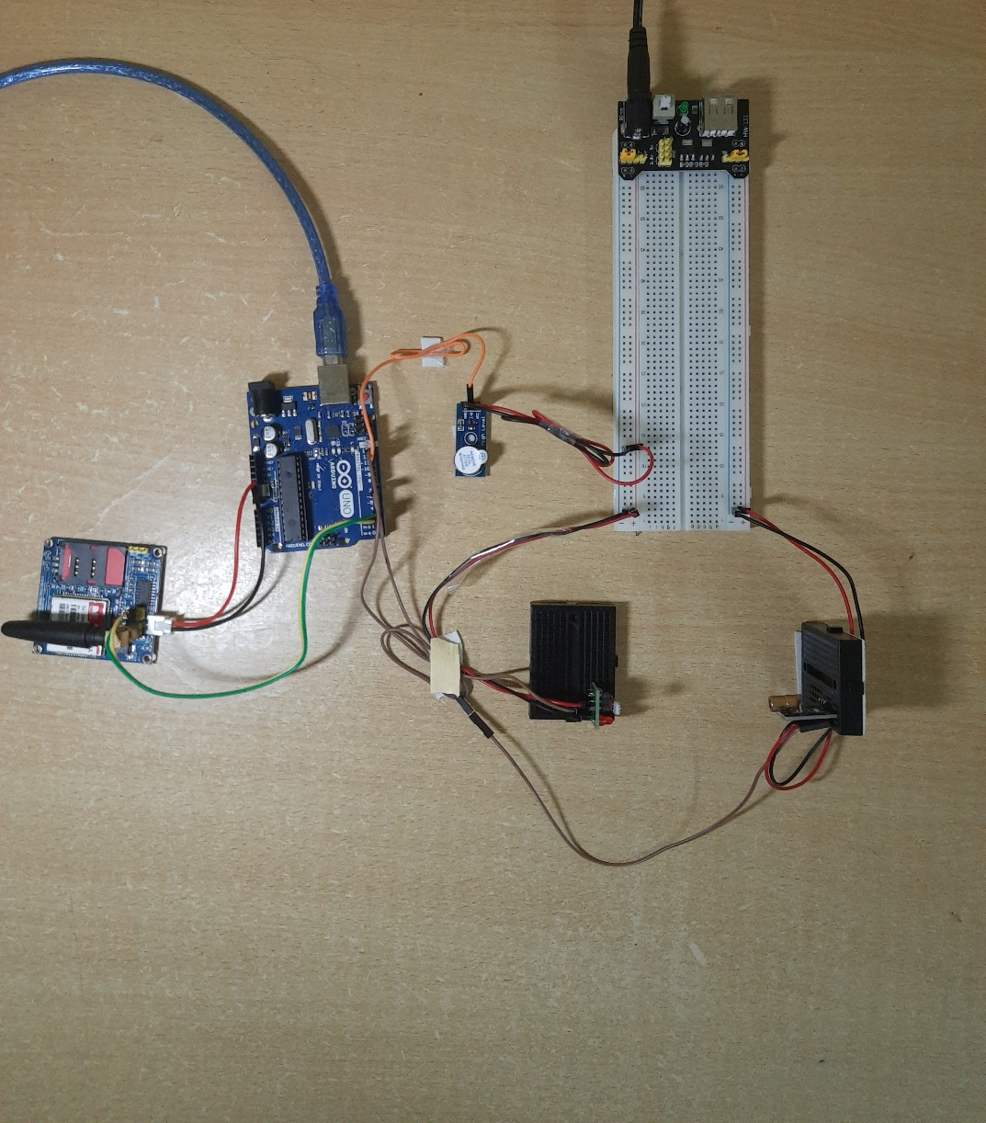
Design and Implementation
Features
Simple small sized design makes it appropriate for small scale security measures and laser moreover provides stealth making the whole system better as security measurement.
Snapshots

Slide 10
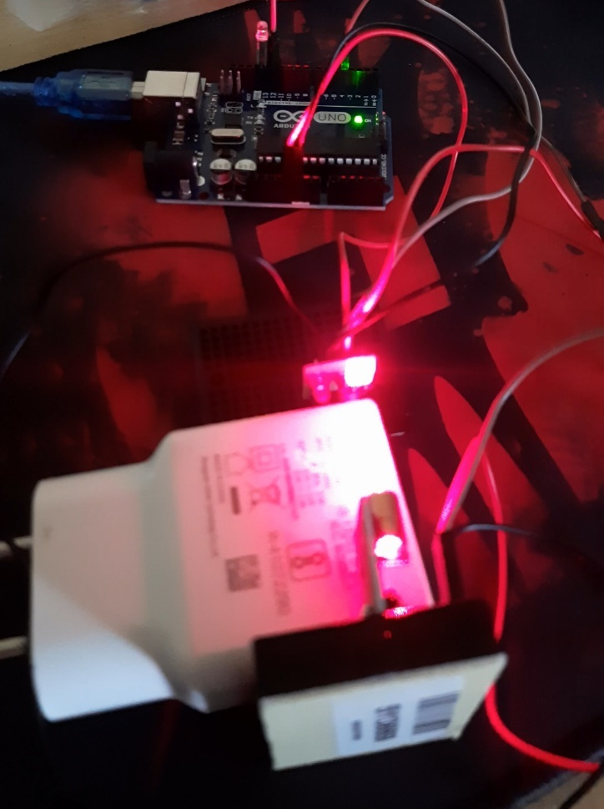
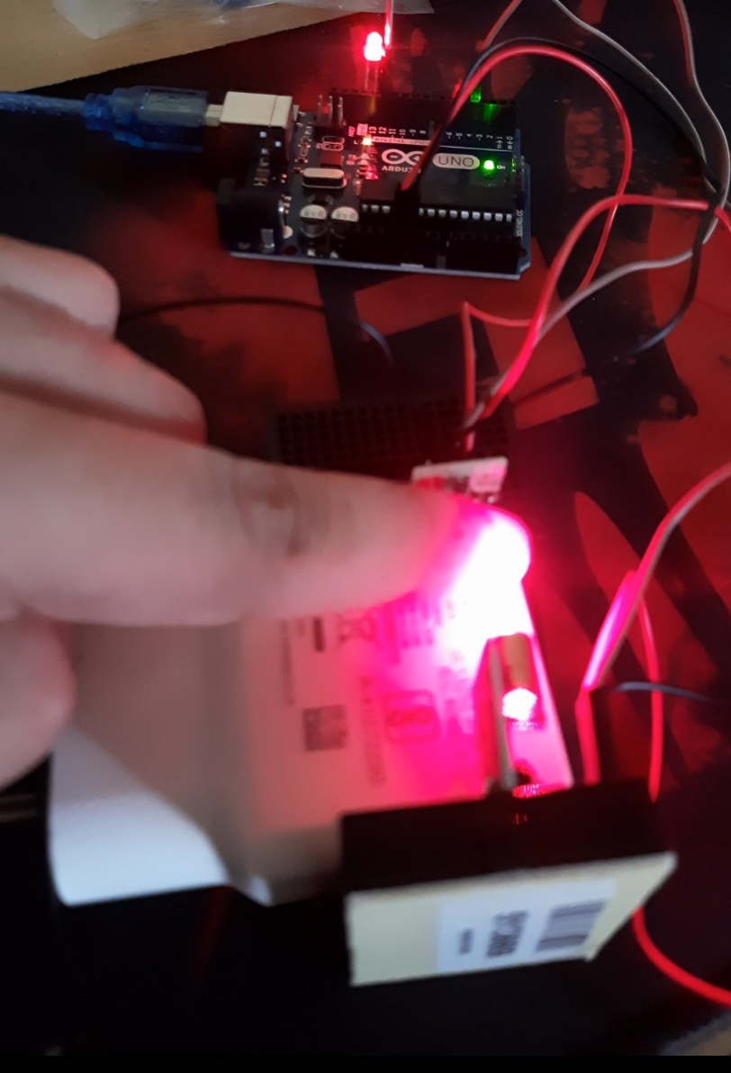
Testing and Results
Case 1:
No obstacle, LED off, Buzzer off
Laser Sensor returning Value ‘HIGH’ (Normal Condition)
Case 2:
Obstacle, LED On, Buzzer On, Alert message “Intruder Alert!” sent to concerned person’s mobile phone
Laser Sensor returning Value ‘LOW’

Slide 11
Conclusion
Laser Security System gives us protection from any crime, theft in our standard of living thus individuals are installing them so on to remain sheltered, secure and sound. Various electronic security systems will be used at the house and other important working places for security and safety purposes. It's one among the simple opportunities and source of saving manpower contributing no wastage of electricity. Avoiding thieves end up in the protection of our financial assets and thereby their system provides us protection against all. The laser beam and LDR module system is extremely sensitive with a great range of work. The model senses the light emitted by the laser falling over the LDR connected with the circuit. Whenever the beam of laser light is interrupted by any means, it triggers the alarm or siren. This highly reactive approach has low computational requirement therefore it's the similar temperament to surveillance, industrial application, and smart environments.

Slide 12
References
https://store.arduino.cc/products/arduino-uno-rev3
https://www.instructables.com/
https://create.arduino.cc/projecthub/
https://harshsharmatechnicals.com/
https://www.electronicaembajadores.com/en/

Slide 13
Thank you
Group 2 –
PE 46 – Abhijeet Bakale
PE 48 – Aniket Sharma
PE 49 – Shubh Sharma
PE 50 – Akshit Langeh
PE 56 – Sairaj Khandare

