Slide 1
EDA Case study
By lekha

Slide 2
Steps in EDA
Data collection
Data understanding
Data cleaning – missing value and outlier treatments
Data analysis
Results

Slide 3
Data collection
Public
private

Slide 4
Data understanding
What data says
No gaps in data – outlier
Data types and wrong data
Anomalies in data

Slide 5
Data cleaning
Missing value treatment
Remove
Or impute
Mean
Median
Mode imputations
Drop na
Fill na

Slide 6


Slide 7
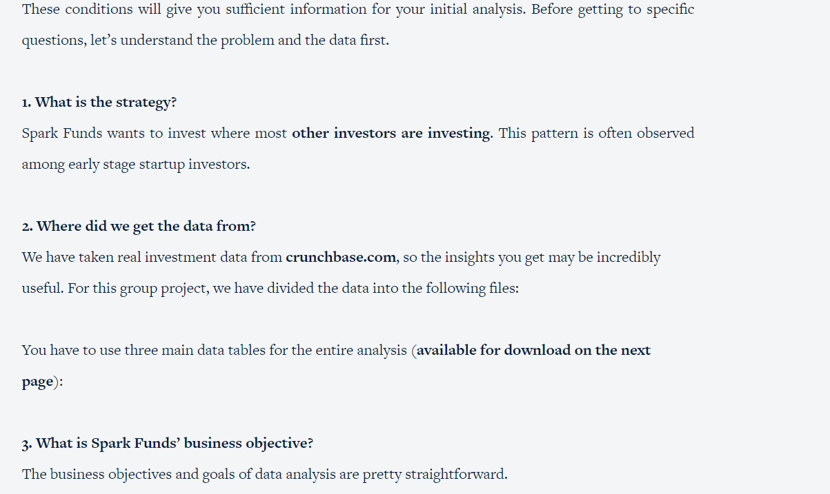

Slide 8
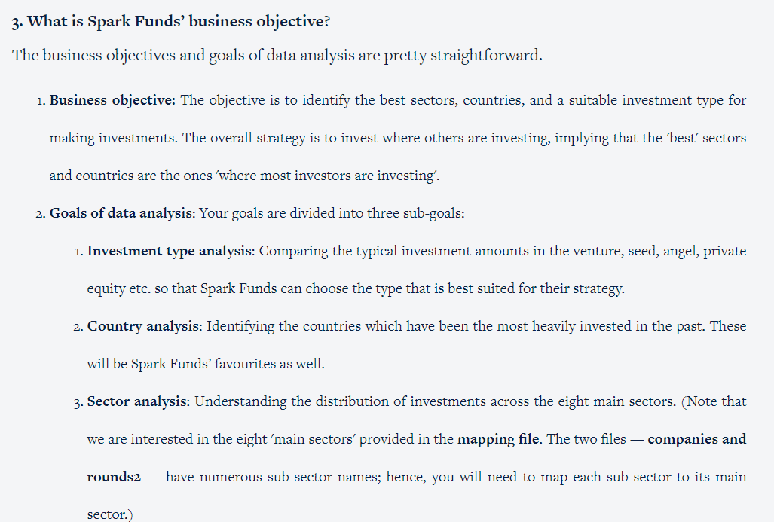

Slide 9
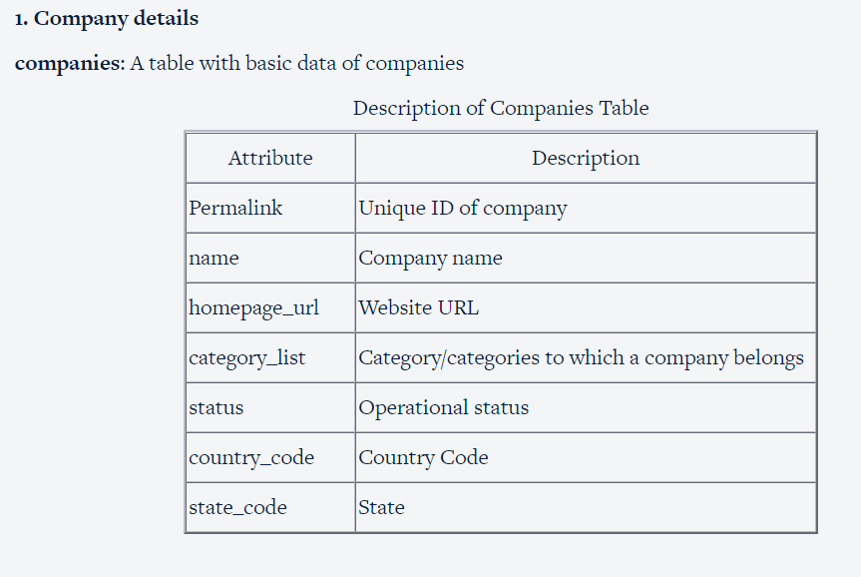

Slide 10
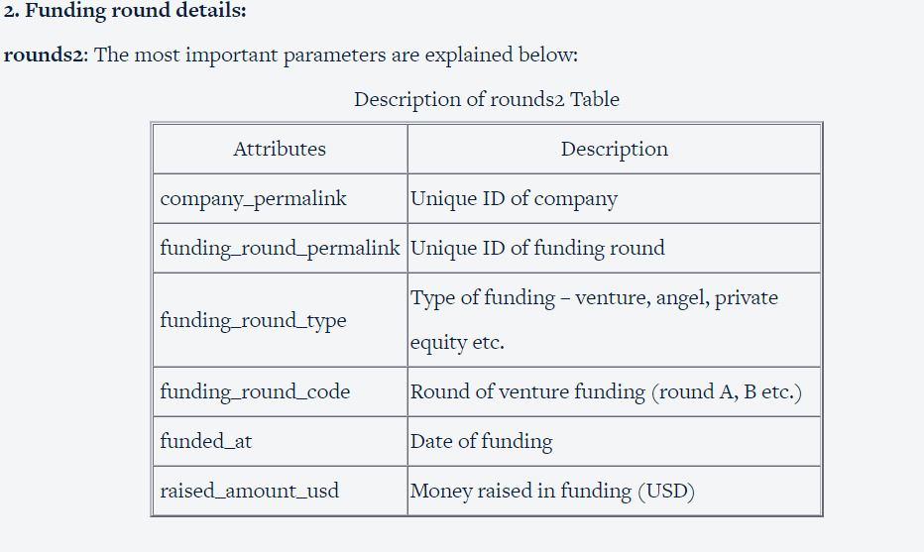

Slide 11
