Slide 1
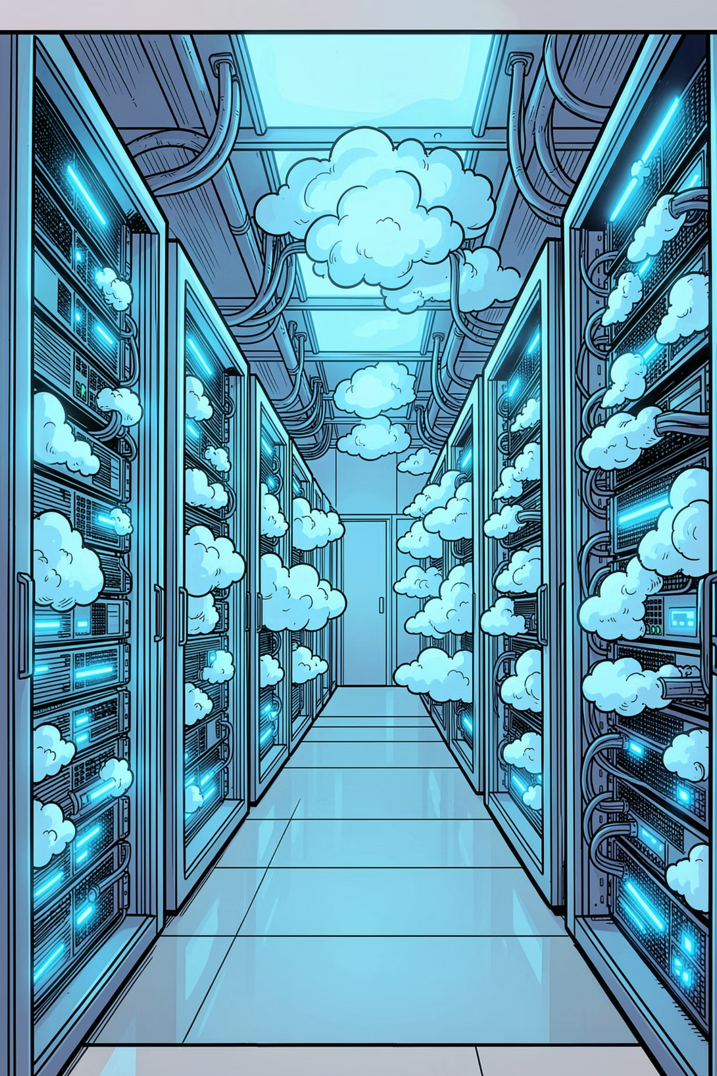


AZURE
TERRAFORM
Organic Ghee Enterprise Azure Cloud Architecture
Production-Grade Secure Food Ordering Platform — Built with Terraform Infrastructure as Code
Presented by: Senior Cloud & Terraform Architect

Slide 2
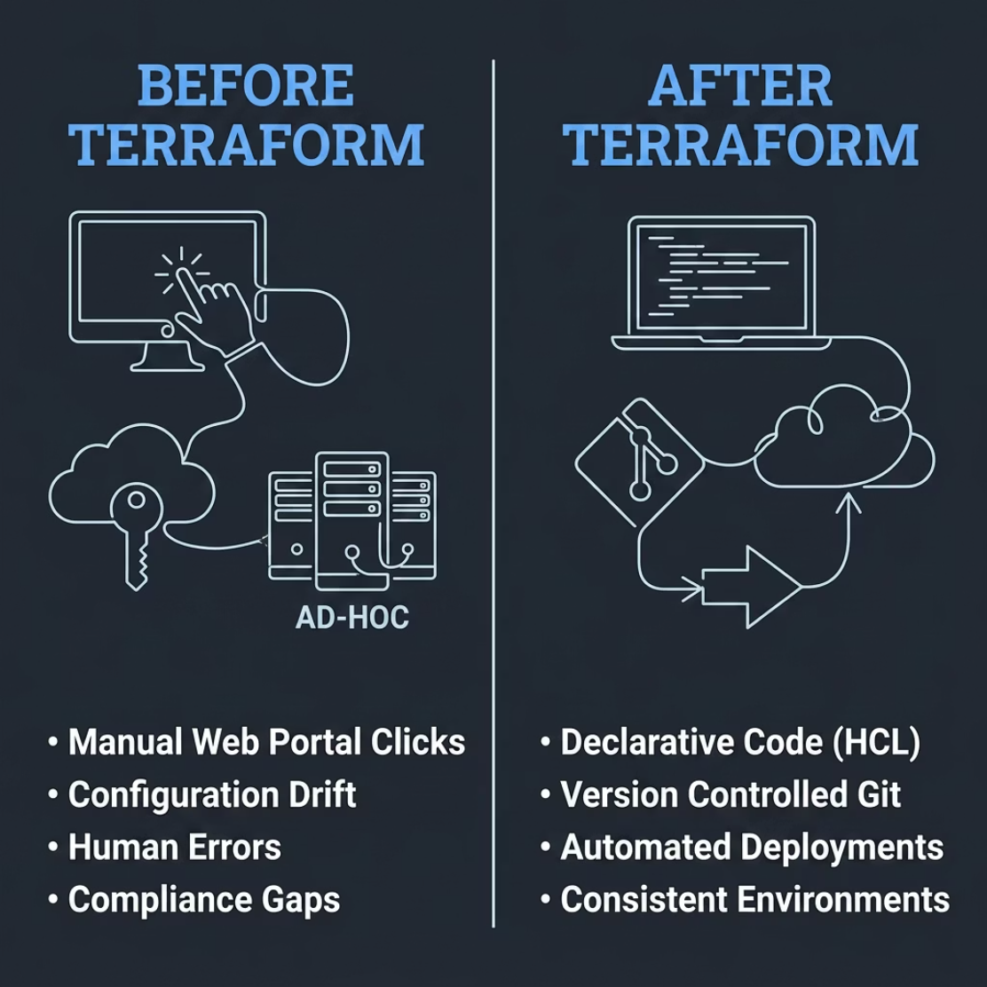

Why Terraform? The Case Against Manual Deployments
Manual Azure provisioning introduces risk, inconsistency, and operational debt. Terraform eliminates these challenges through declarative, version-controlled infrastructure.
Configuration Drift
No Version Control
Human Error
Scaling & Compliance
Environments diverge without code enforcement
Changes untracked, unreviewable, unrecoverable
Manual clicks create unpredictable outcomes
Manual processes fail at enterprise scale and audit requirements

Slide 3


Project Overview
Organic Ghee is a full-featured restaurant food ordering platform deployed on Azure with Terraform-managed infrastructure — designed for security, scalability, and production readiness.
Customer Ordering
Secure, intuitive ordering experience
Admin Portal
Menu management & contact requests
Notifications
Real-time order & system alerts
Secure Auth
Entra ID authentication & RBAC
Objectives: Secure Architecture · Infrastructure as Code · Automated Deployments · High Availability · Scalability · Production Readiness

Slide 4
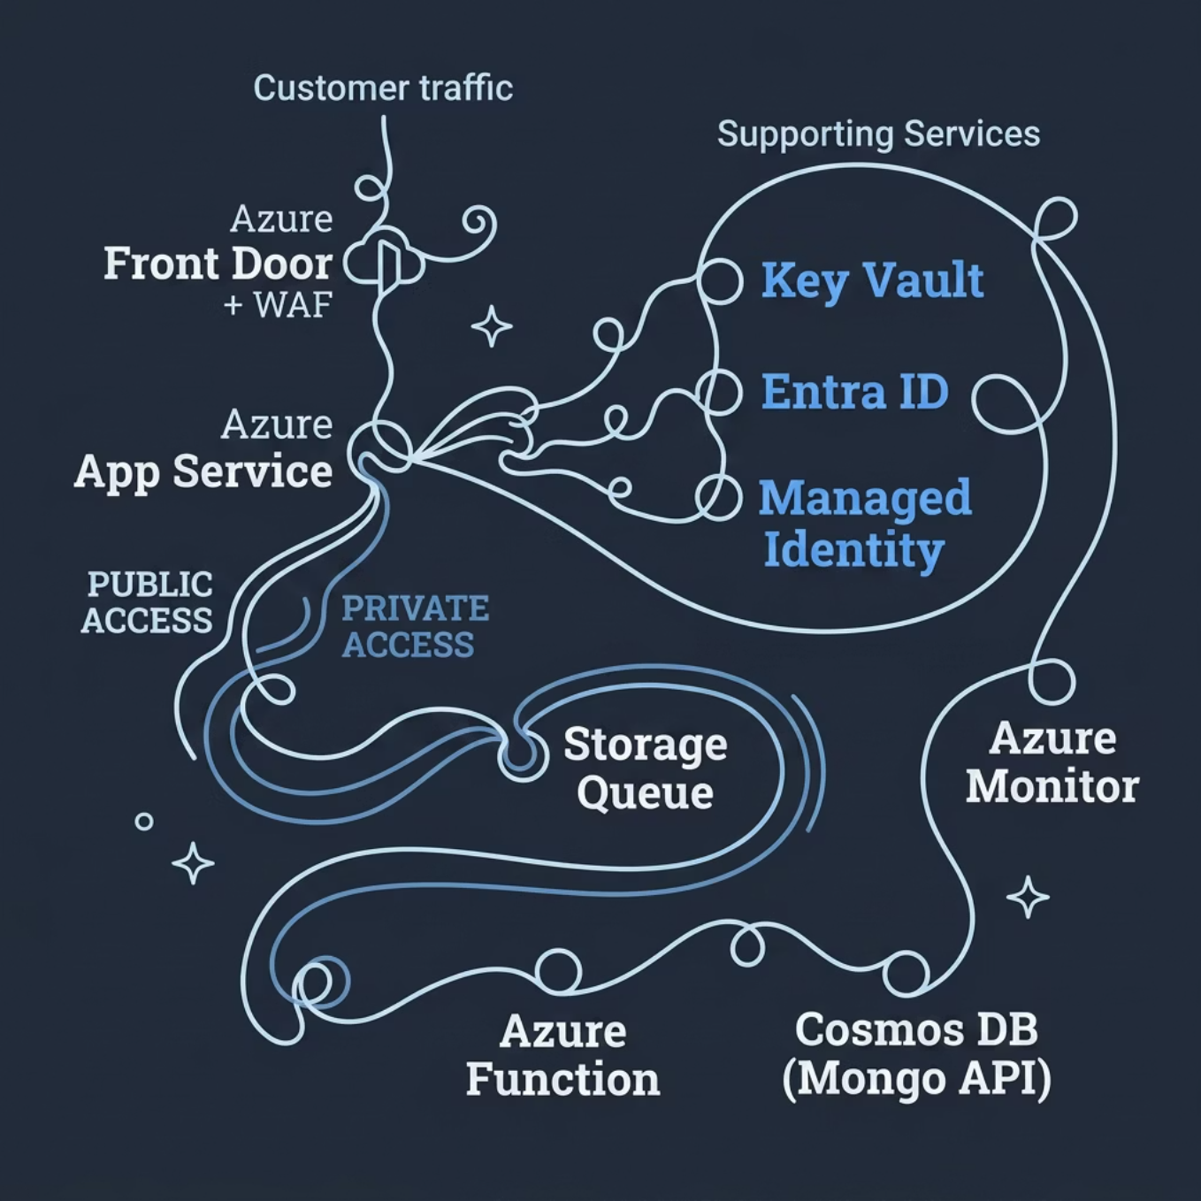

Azure Solution Architecture
Traffic Flow
All public traffic enters through Azure Front Door + WAF, which filters threats before reaching the App Service. Backend communication between services uses private endpoints — no public exposure of data stores.
Public Zone
Private Zone
Identity Layer
Front Door, WAF, App Service
Storage, Functions, Cosmos DB
Entra ID, Managed Identity

Slide 5



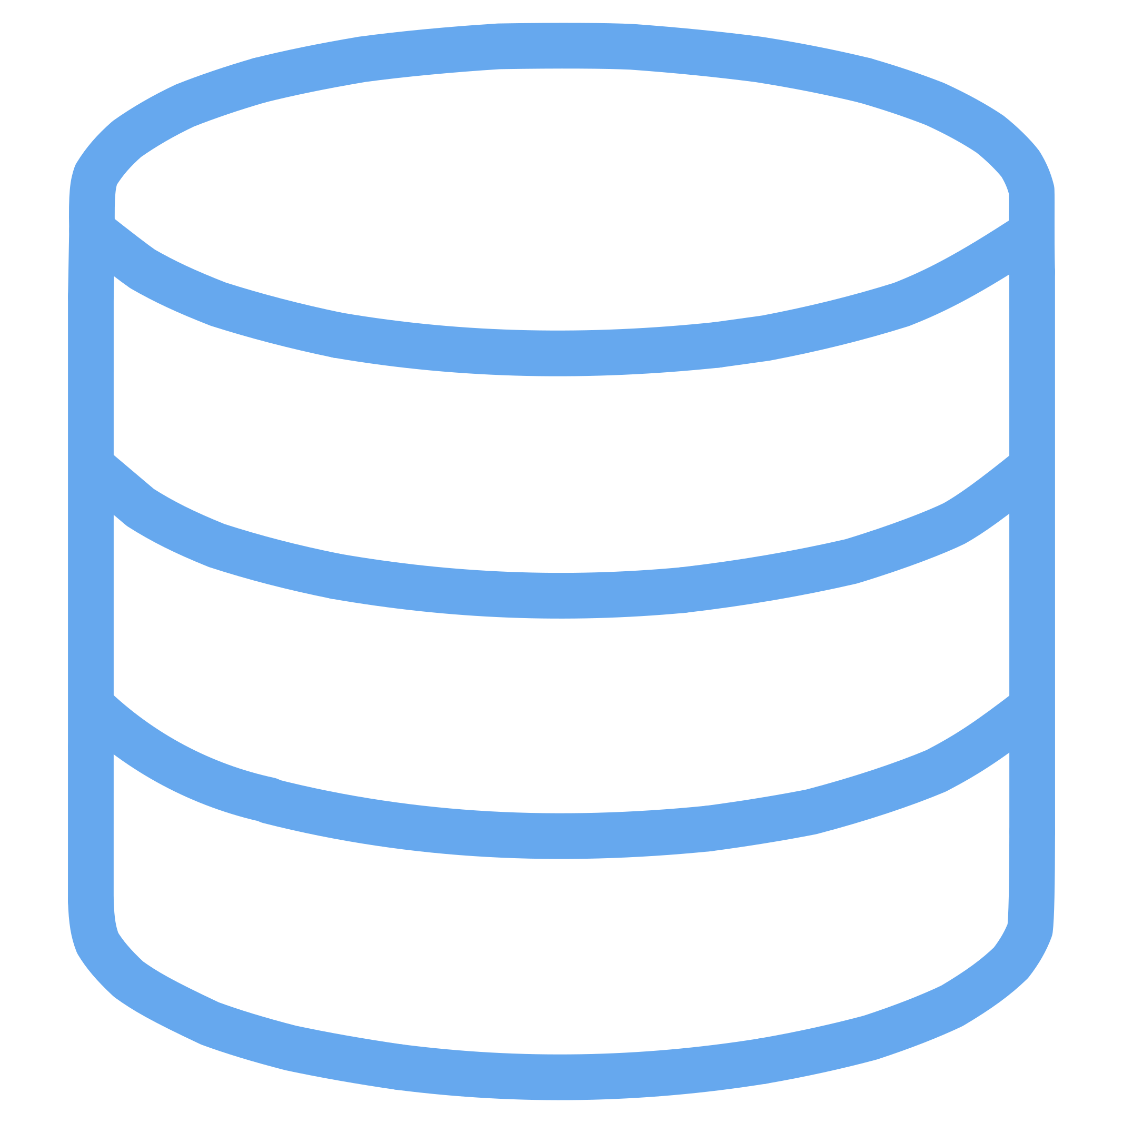

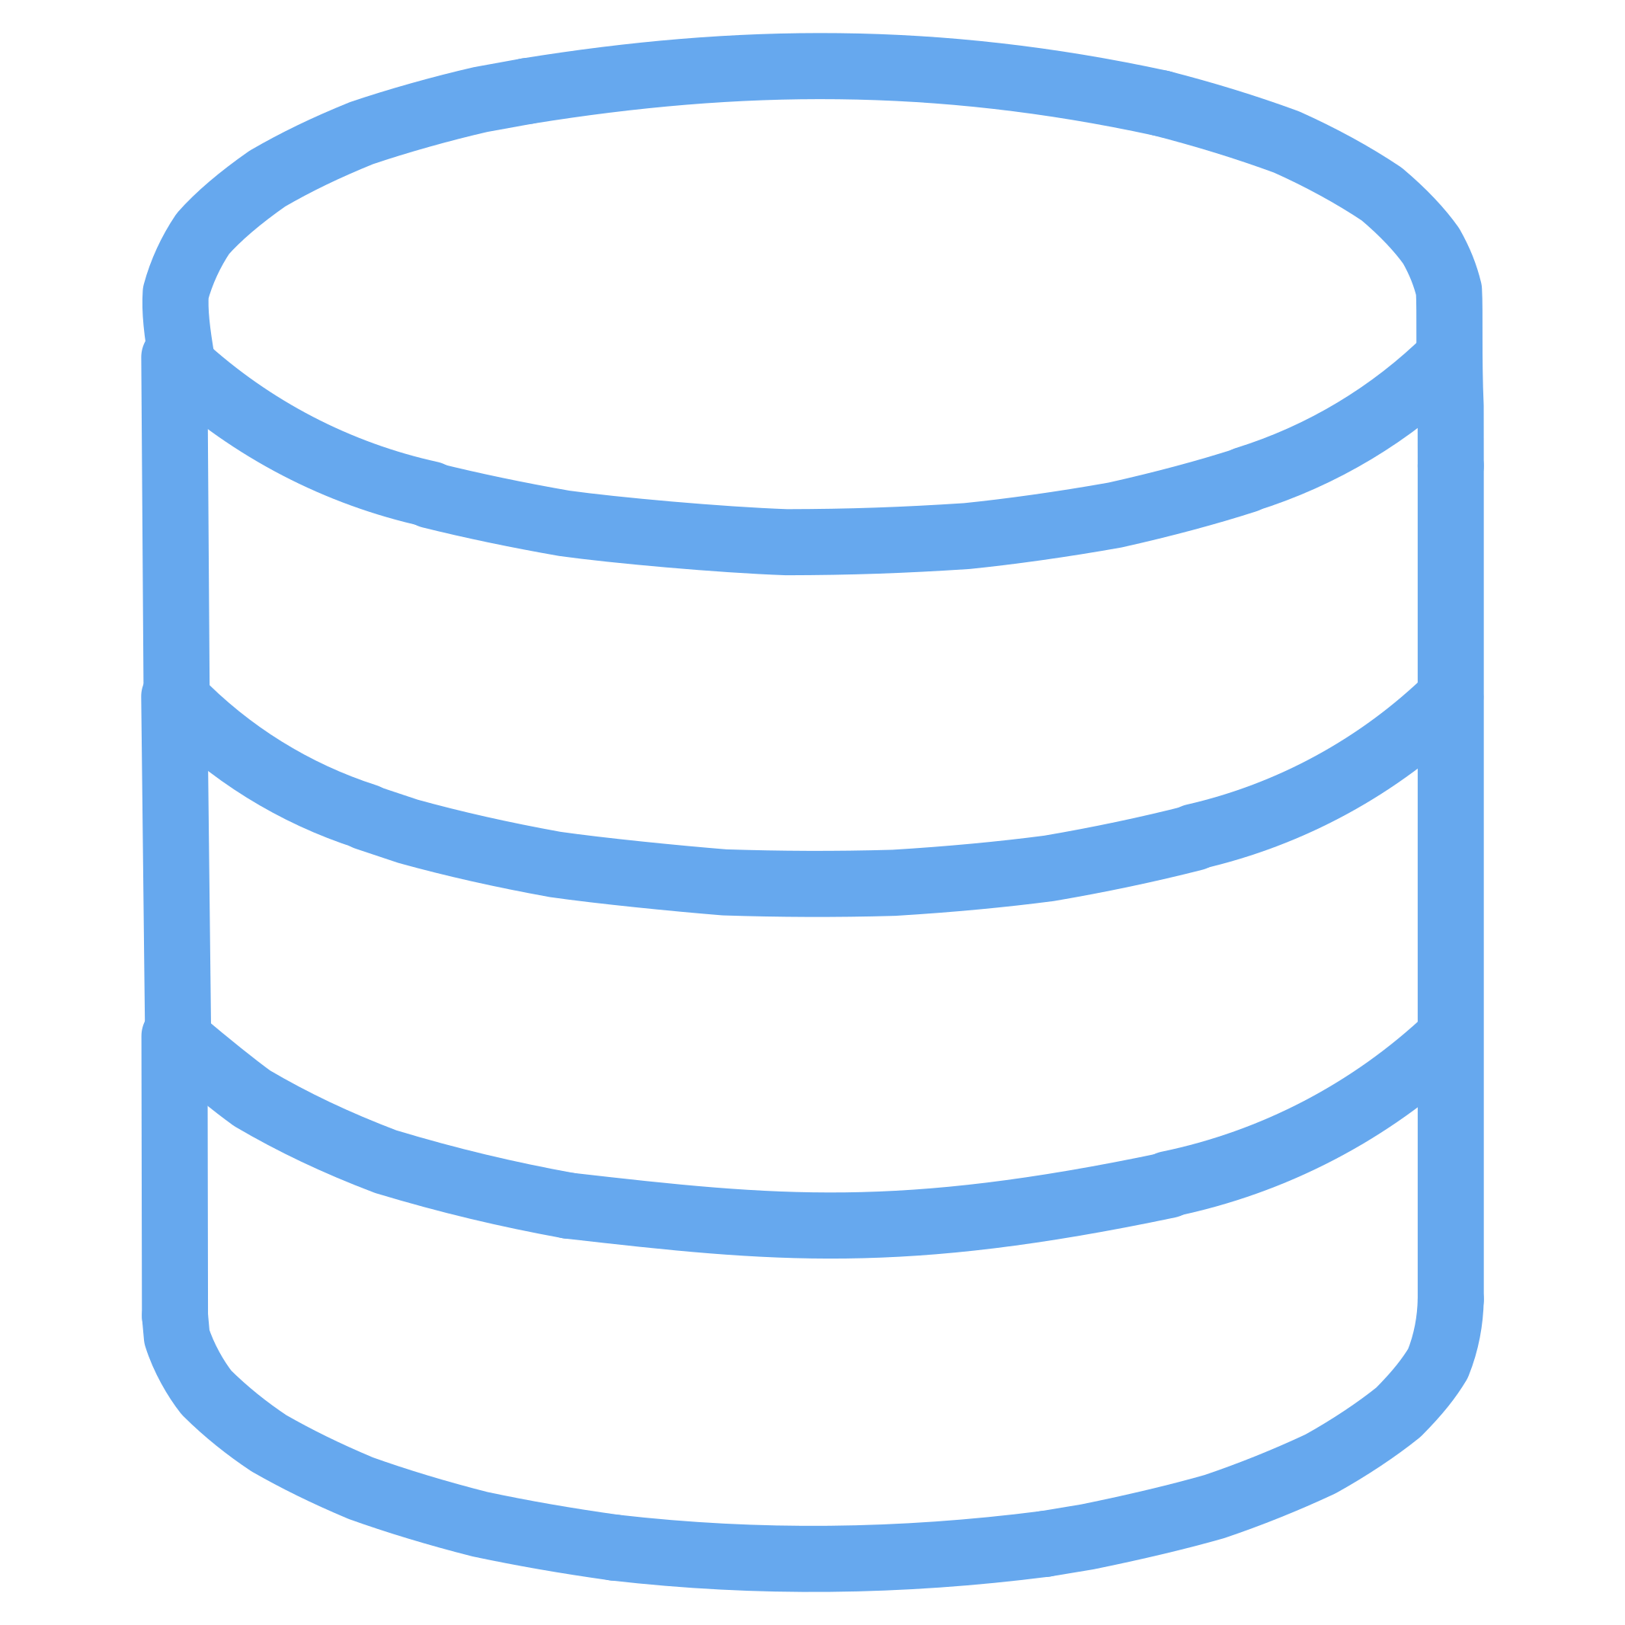

Microsoft Azure Services
Microsoft Entra ID
Azure App Service
Azure Key Vault
Authentication, RBAC, and OIDC integration for secure access control
Managed application hosting with built-in scaling and runtime management
Centralized secrets, certificate, and key management — zero secrets in code
Azure Storage
Azure Functions
Azure Cosmos DB
Blob Storage for assets, Queue Storage for async messaging between services
Event-driven serverless processing triggered by Storage Queue messages
Mongo API database with global distribution and low-latency reads
Azure Front Door + WAF
Global entry point with DDoS protection and web application firewall

Slide 6







Terraform Project Structure
Folder Layout
Module Benefits
terraform/
├── modules/
│ ├── resource-group/
│ ├── app-service/
│ ├── storage/
│ ├── key-vault/
│ ├── cosmos/
│ ├── function/
│ └── front-door/
├── environments/
│ ├── dev/
│ └── prod/
├── backend.tf
├── main.tf
├── variables.tf
└── outputs.tf
Reusability
Maintainability
Modules shared across dev, staging, and prod environments
Single module update propagates to all environments
Scalability
Add new resources without rewriting existing infrastructure
Each module encapsulates a single Azure resource type with inputs, outputs, and best-practice defaults.

Slide 7
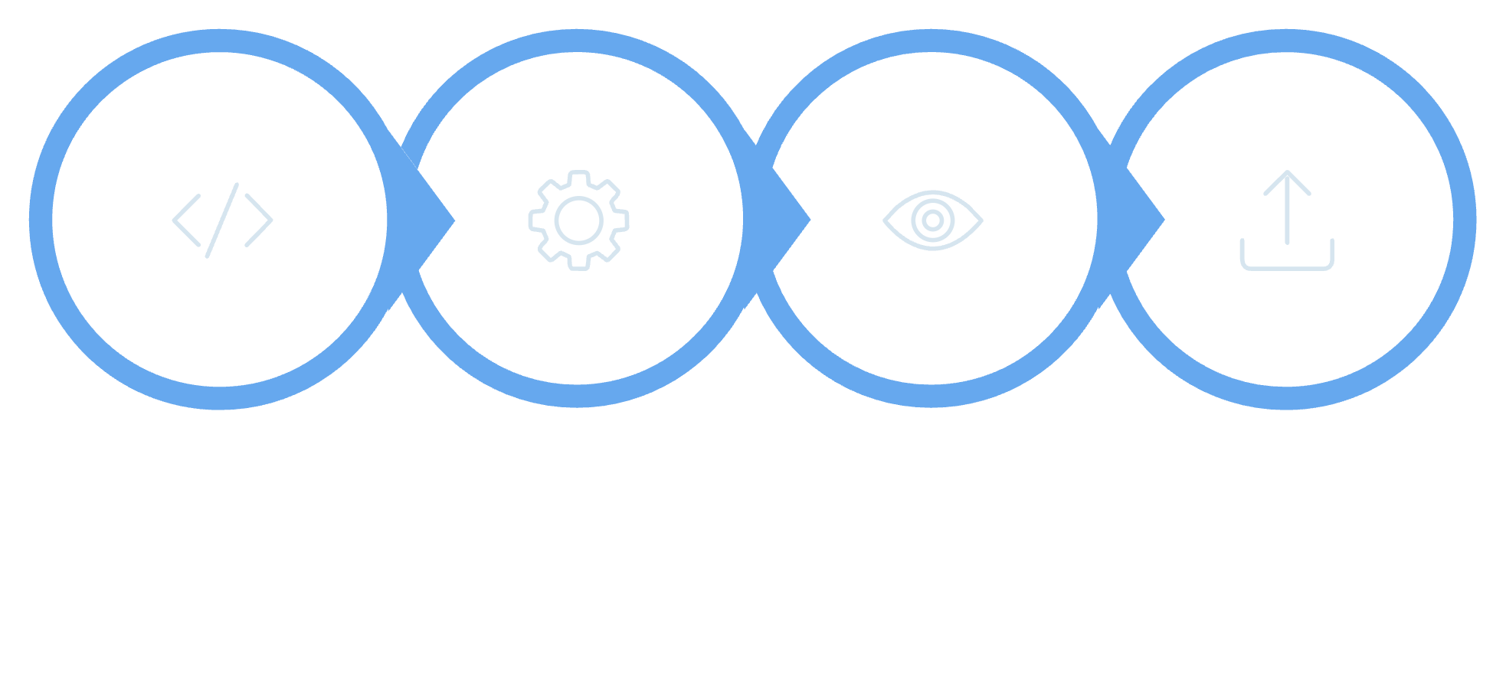
Core Terraform Concepts
Write Code
terraform init
terraform plan
terraform apply
Terraform follows a predictable lifecycle: write declarative configuration, initialize the working directory, preview changes with plan, and apply them to Azure. State is tracked remotely with locking to prevent conflicts.
Providers
Modules
Variables & Outputs
Plugins that interface with Azure APIs (azurerm)
Reusable, parameterized resource bundles
Parameterize and expose module values
Workspaces
Remote State
Isolate state per environment (dev/prod)
State stored in Azure Storage with locking

Slide 8
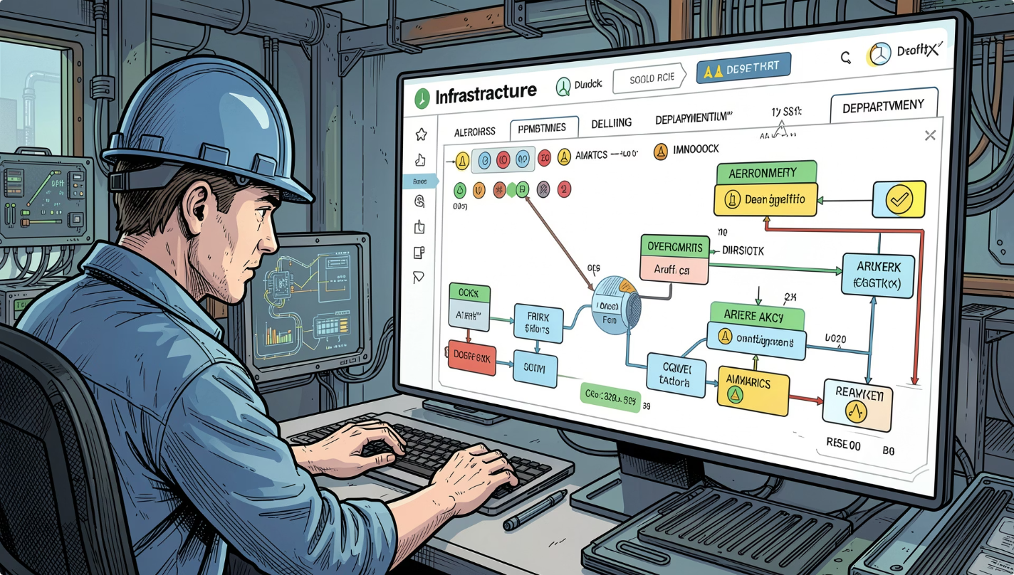
Terraform Production Features
1
Drift Detection
terraform plan detects when Azure resources deviate from declared state — critical for compliance audits
2
Taint & Recreate
terraform taint marks corrupted resources for forced recreation on next apply
3
Import Existing Resources
Bring manually created Azure resources under Terraform management without disruption
4
Dependency Graph
Terraform automatically resolves resource dependencies for correct provisioning order
5
State Locking
Prevents concurrent modifications via Azure Storage lease — eliminates race conditions in CI/CD pipelines

Slide 9
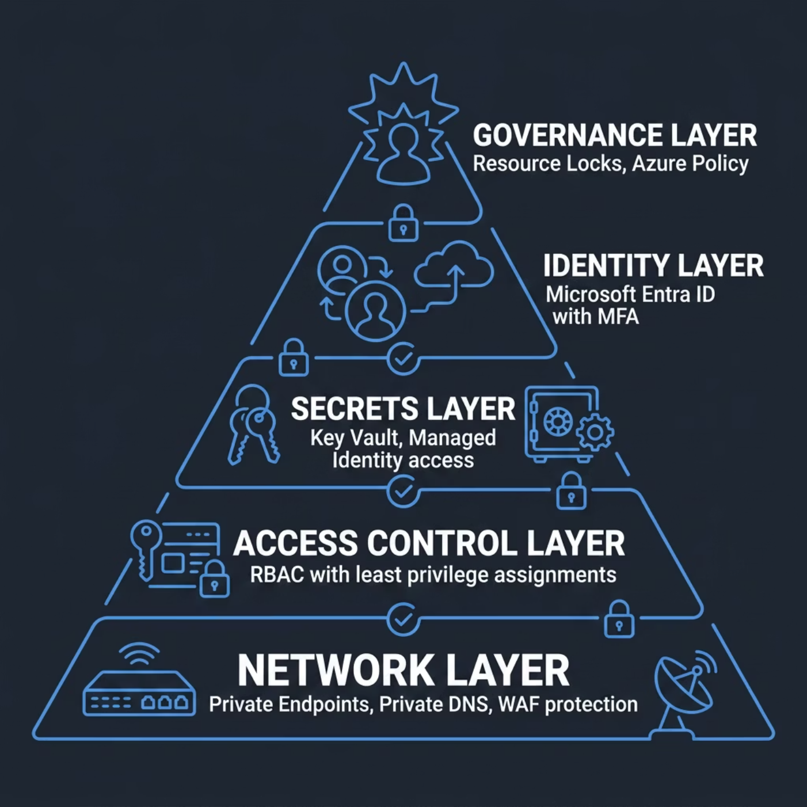



Security Architecture — Zero Trust by Design
Zero Trust Principles Enforced
No Secrets in Code
Least Privilege Access
All credentials stored in Key Vault, accessed via Managed Identity
RBAC scopes limited to minimum required permissions per service
Private Network Isolation
Continuous Monitoring
Azure Monitor + WAF logs provide real-time threat visibility
Private Endpoints + Private DNS eliminate public data exposure
Compliance Ready: Architecture supports SOC 2, ISO 27001, and GDPR requirements through enforced policies and audit trails.

Slide 10
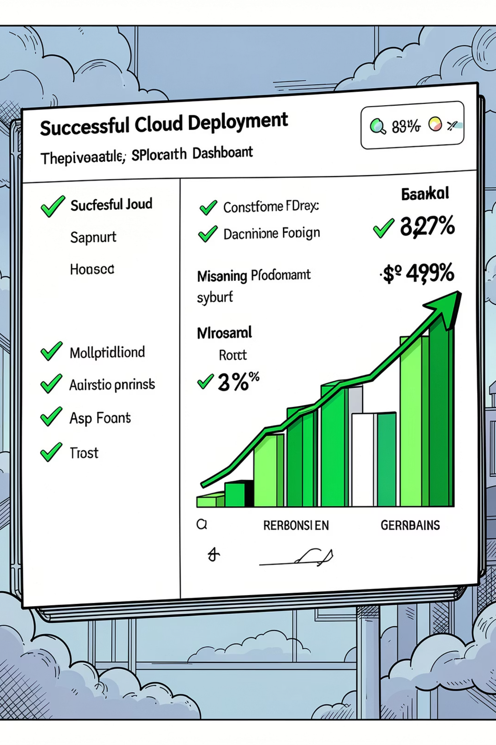




Project Outcomes & What's Next
✅ Infrastructure as Code
Full Azure environment defined, versioned, and repeatable
✅ Environment Separation
Isolated Dev & Prod workspaces with remote state
✅ Secure by Default
Zero secrets in code, Managed Identity, Private Endpoints
✅ Production-Ready
Drift detection, state locking, WAF, and monitoring enabled
Future Enhancements
Multi-Region Deployment
DR Automation
Cost Optimization
Blue-Green Deployment
"Automating Azure Infrastructure with Terraform for Secure, Scalable, and Reliable Cloud Solutions"

