Slide 1
My Weekly Journey PPT- 1
(23/09/2024 – 27/09/2024)
Name – Shubhadip Paul
Axis Bank Quality Assurance Trainee

Slide 2
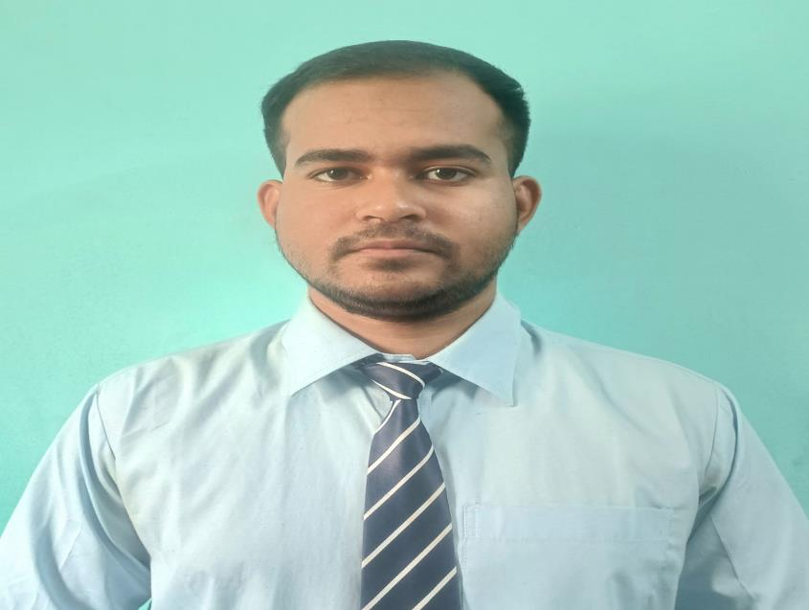
About Me
"Ensuring quality in my work, exploring the heights in my life, and embracing every challenge along the way."

Slide 3

My learnings from this week – 1
(23/09/2024 – 27/09/2024)

Slide 4
Key Components Covered | Soft Skills
Types Of Communication
i)Accepted Communication
ii)Not Accepted Communication
Styles Of Communication
i)Passive Communication
ii)Assertive Communication
iii)Passive Aggressive Communication
iv)Aggressive Communication
Profession
Trades of a professionalism
Attitude

Slide 5

Learning 1 | Soft Skills
Campus to Corporate – Soft Skills
Listening+understanding+empathy+knowledge+clarity+thinking process+body language = communication skills
Styles Of Communication
Passive
Assertive
Passive Aggressive
Aggressive

Slide 6
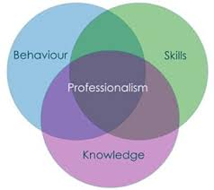
Learning 1 | Soft Skills
Professionalism:
Professionalism is the commitment to excellence, integrity, and continuous growth in every endeavor.
Trades of a professionalism:
Communicate effectively
Do more than expected
Do what you say and say what you can do
Make expertise you specially
Put customer satisfaction first
Positive outlook

Slide 7
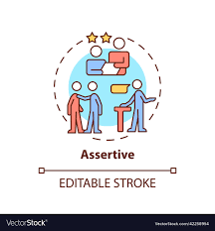
Learning 2 | My takeaways : -
Body Language: -
Effective Eye contact + Facial Expression + Hand Gesture = Good body language.
Different Communication Style: -
1. Assertive Communication.
2. Aggressive communication.
3. Passive Communication.
[N: B – Recommended communication Style in the workplace is Assertive communication ]

Slide 8

Learning 5 | Corporate Dresscode:
Corporate dress code typically refers to the formal or semi-formal attire expected in a professional business environment. The key elements often include:
Men's Attire:
Suits: Usually in dark colors like black, navy, or gray, paired with a dress shirt and tie.
Dress Shoes: Black or brown leather shoes.
Accessories: Minimal jewelry, leather belts, and a watch.
Women's Attire:
Suits or Dresses: Tailored pantsuits, skirt suits, or formal dresses. The colors are usually conservative.
Blouses: Paired with skirts or trousers.
Shoes: Closed-toe heels or flats.
Accessories: Minimal jewelry, often understated.
General Guidelines:
Neat and Clean: Clothes should be well-pressed, without wrinkles, and well-fitted.
Colors: Avoid loud or bright colors; stick to neutral or muted shades.
Grooming: Personal grooming is essential—hair should be tidy, nails trimmed, and overall appearance professional.

Slide 9

Learning 3 | My takeaways
We did a team-based exercise based on Assertive Communication.
We got a deep insight into how it works for the organization.
How Assertive behavior can solve all problems.
For working in a team Assertive communication is very important.

Slide 10

Understanding Of Microsoft Office
- By Vinod Krishna Sir ,

Slide 11
Learning 1 | Shortcut Keys Of MS Excell,
Ctrl + Arrow Keys: Move to the edge of data regions
Ctrl + Shift + "+": Insert a new cell/row/column
Ctrl + "-": Delete the selected cell/row/column
Alt + =: AutoSum
Ctrl + Shift + L: Apply/Remove Filter
F2: Edit the selected cell
Ctrl + Space: Select the entire column
Shift + Space: Select the entire row
Ctrl + Shift + Arrow Keys: Select cells to the edge of the data
Ctrl + Enter: Fill selected cells with the current entry

Slide 12
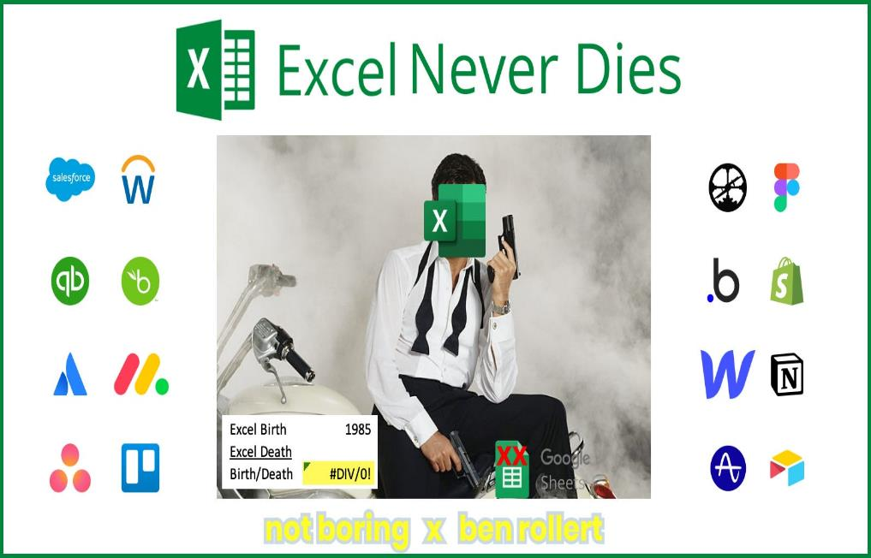
Key Components Covered | Microsoft Excel
Tools in Excel
Text Functions
Key Features of Excel Application
Number Formatting
Conditional Formatting
Freezing Techniques
Basic Formulas in Excel
Lookup Functions
Logical Functions
Date and Time Functions
Statistical Functions
Data Validation
Pivot Table
Dashboards

Slide 13
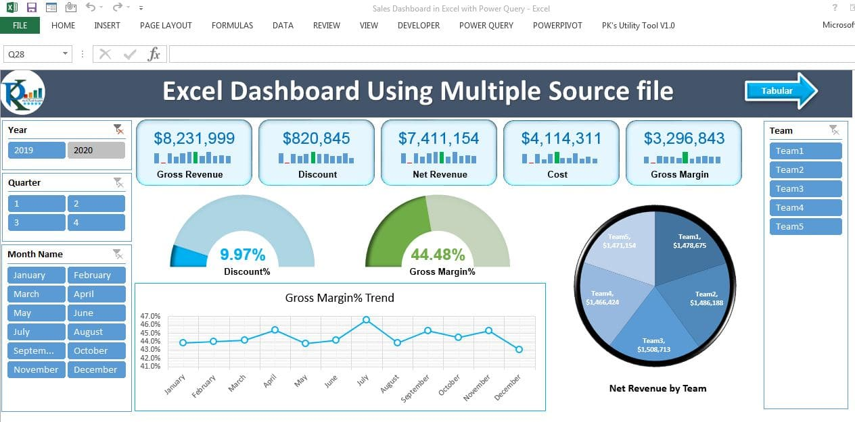
Learning 2 | Microsoft Excel
Microsoft Excel: Dashboard
Data Visualization: Excel dashboards effectively present complex data through charts, graphs, and tables, making it easier to interpret and analyze information at a glance.
Interactive Elements: Dashboards can include slicers, drop-down menus, and buttons, allowing users to interact with the data and filter it according to their needs.
Real-time Updates: By linking to live data sources, Excel dashboards can provide up-to-date information, ensuring that decision-makers have access to the latest insights.
Enhanced Decision-Making: With a clear visual representation of data, Excel dashboards aid in quick and informed decision-making, helping teams respond promptly to changing circumstances.

Slide 14
Understanding Of Retail Banking
- By Neelam Raina Ma’am,

Slide 15
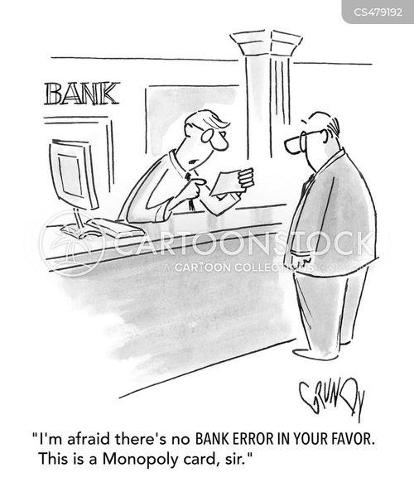
Key Components Covered | Banking Domain
Core Banking Solutions
Certificate of deposit
Bulk Deposits
Balance Sheets
Retail Banking
Money Laundering
HUF Account
Mandate Holder
Wealth Management
Asset Management
Corporate Lending
Bank Guarantee
Letter Of Credit(LOC)
Working Capital
Corpoate Loan Cycle
Payment System
Digital Wallet
Point Of Sale

Slide 16

Learning 3 | Banking Domain
Banking Domain Knowledge:
Retail Banking:
Retail banking refers to the provision of financial services to individual consumers, including personal loans, mortgages, savings accounts, and checking accounts.
Types of Current Accounts:
Partnership Account
sole proprietorship Account
Private limited companies
Public limited companies

Slide 17

Learning 3 | Banking Domain
Recurring Deposit:
A recurring deposit (RD) account is a type of term deposit that allows you to save money regularly and earn interest on your investment. It's a popular investment option in India, and is offered by banks and India Post.
Hindu Undivided Family (HUF):
A Hindu Undivided Family (HUF) bank account is a bank account for a family that is considered a joint Hindu family. HUFs can be formed by Buddhists, Hindus, Sikhs, and Jains.
[Add a graphic that provides view of how Shell implements this learning]

Slide 18

Learning 3 | Banking Domain
Bank Guarantee:
A bank guarantee is a financial instrument that ensures a party's financial obligations are met, even if they fail to do so. The bank acts as a guarantor, promising to pay a third party if the applicant doesn't fulfill their obligations.
Letter of Credit:
A letter of credit (LC) is a financial instrument that guarantees payment from a buyer to a seller in a business transaction. It's a contractual commitment by the buyer's bank to pay the seller once the seller ships the goods and provides the required documentation.
[Add a graphic that provides view of how Shell implements this learning]

Slide 19

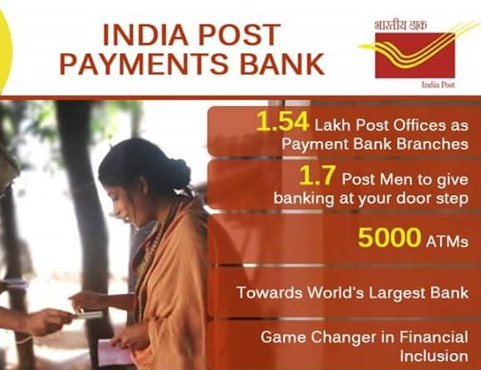
Learning 7 | Banking Domain
India Post Payments Bank :
IPPB stands for India Post Payments Bank, a subsidiary of the Indian postal department. The bank is a government-owned entity that offers a variety of services to the public,including
Financial inclusion: IPPB's primary goal is to provide financial services to under-banked and unbanked populations, including low-income households, migrant laborers, and micro, small, and medium enterprises (MSMEs)
[Add a graphic that provides evidence of what you did to overcome this challenge]

Slide 20
Challenge Faced while implementing Learning 1
I tackled the challenges of developing my soft skills by first enhancing my self-awareness through introspection and seeking feedback from trusted individuals. This process enabled me to recognize my strengths and pinpoint areas for growth. I consistently reached out to colleagues and mentors for balanced feedback. To shift ingrained behaviors, I concentrated on making small, gradual changes while practicing mindfulness to increase my awareness during interactions. I built my confidence by engaging in low-pressure situations, which helped me overcome my fear of judgment. I also actively sought real-life experiences to apply my soft skills, reinforcing my learning. I learned to balance authenticity with adaptability, remaining true to myself while adjusting to different social contexts. Lastly, I made a deliberate effort to understand cultural differences by interacting with diverse groups, which enhanced my ability to communicate effectively in multicultural environments.

Slide 21
Challenge Faced while implementing Learning 2
I faced several challenges in learning Microsoft Excel, but I overcame them through consistent practice and exploration of its features in real-world tasks. Initially, I struggled with understanding the interface and navigating the software efficiently. To address this, I focused on mastering the basics, including formulas, formatting, and data entry, before gradually progressing to advanced functions like pivot tables, VLOOKUP, and conditional formatting.
As I advanced, I encountered difficulties with data analysis and visualization. To deepen my understanding, I utilized online tutorials, forums, and Excel templates to troubleshoot issues and learn best practices. Additionally, I often found myself overwhelmed by the vast array of functions available, so I prioritized learning those most relevant to my work.
To reinforce my skills, I applied Excel in my daily tasks, which allowed me to see the practical applications of what I was learning. I also sought help from experienced colleagues, who provided valuable insights and shortcuts. Staying updated on new Excel features and tools further enhanced my proficiency. Through perseverance and a willingness to learn, I gradually transformed my challenges into strengths, ultimately becoming more confident in my Excel capabilities.

Slide 22
Challenge Faced while implementing Learning 3
I navigated the challenges of learning the basics of the banking domain by committing time to grasp fundamental concepts, including banking products, financial regulations, and the different types of accounts and services. I actively studied key areas such as loans, credit, deposits, and interest rates, utilizing industry-related resources and online platforms to build a solid foundation.
To deepen my understanding, I engaged with mentors in the classroom and participated in relevant discussions, which provided practical insights and real-world applications. I also faced challenges in keeping up with the constantly evolving regulatory environment and understanding complex financial instruments. To address this, I followed industry news, attended webinars, and joined online forums where professionals discussed current trends and best practices.
Additionally, I sought hands-on experience through internships and practical exercises, allowing me to apply theoretical knowledge in real-life scenarios. Collaborating with peers on projects helped me enhance my understanding and develop critical thinking skills related to problem-solving in banking situations. Through dedication and a proactive approach, I overcame these challenges and established a comprehensive understanding of the banking sector.
This Is ongoing I guess this will be more fun

Slide 23
Thank You

