Slide 1
My Weekly Journey PPT- 2
(30/09/2024 – 04/10/2024)
Name – Shubhadip Paul
Axis Bank Quality Assurance Trainee

Slide 2
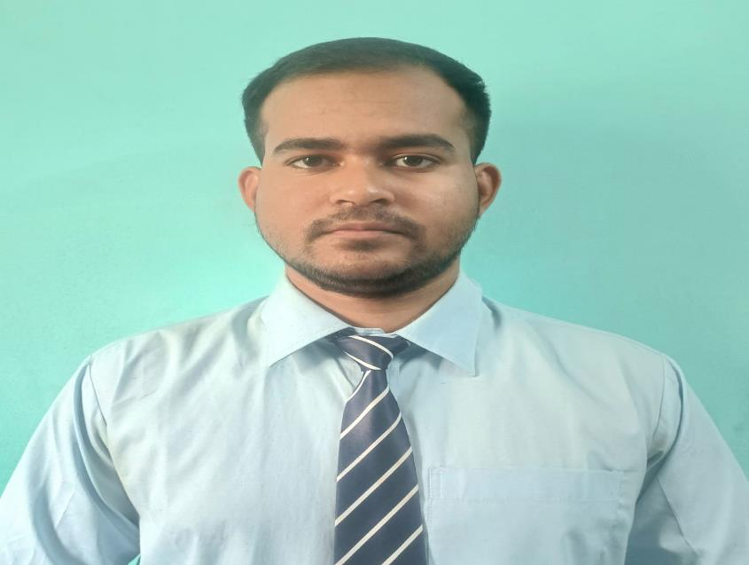
About Me
"Ensuring quality in my work, exploring the heights in my life, and embracing every challenge along the way."

Slide 3

My learnings from this week – 2
(30/09/2024 – 01/10/2024)
1)Banking domain and technology
-Digital banking.
-Digital lending solution.

Slide 4
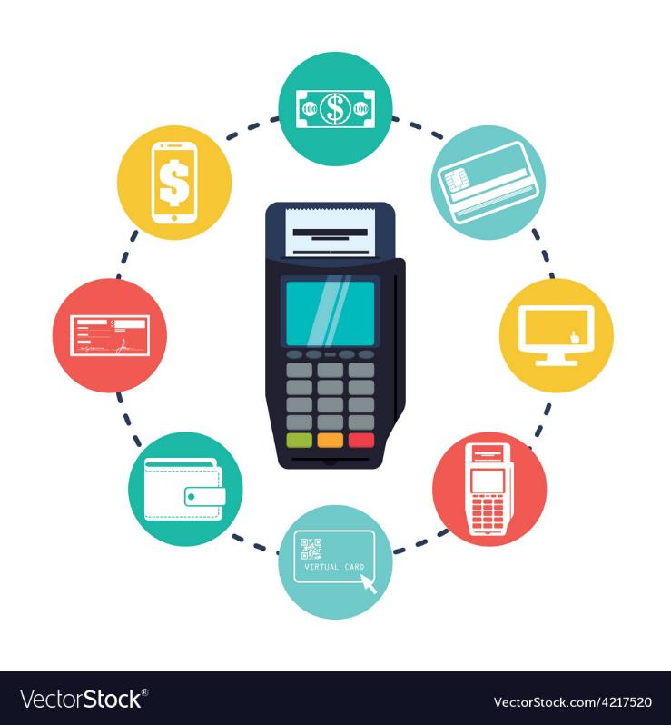
My takeaways| Banking Domain | 30th Sept- 1st Oct
Digital Payment Systems:
Covers Missed Call Banking, Chatbot Banking, and Mobile Banking.
Focuses on "Faceless, Paperless, Cashless" transactions.
Offers offline options such as USSD banking.
Includes AEPS (Aadhaar Enabled Payment System) and CBDC (Central Bank Digital Currency).
UPI requires a Virtual Payment Address (VPA).
POS Types: Physical POS (store machines), Mobile POS (QR codes), Virtual POS (online payments).
The BHIM app is linked with NPCI.
ECS vs. NACH: NACH operates faster than ECS.
Digital Lending Solutions:
Loan-related steps: Origination, Management, Leasing, Collateral, Limit setting, Digital onboarding.
Benefits include faster processing, cash-free transactions, reduced errors, and consistency.
CRM:
Software for managing modifications of non-monetary transactions.

Slide 5
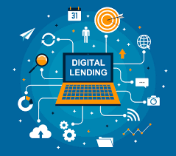
My takeaways| Banking Domain | 30th Sept- 1st Oct
Digital Lending System:
Key Points:
Focuses on providing loans digitally.
Faster, error-free, and cashless process.
Increases efficiency and consistency.
Process:
Loan Origination: Application and evaluation of loan eligibility.
Loan Management: Monitoring and servicing of active loans.
Leasing: Handling lease-related financing.
Collateral: Securing loans with collateral.
Limits: Setting borrowing limits for customers.
Digital Onboarding: Customer onboarding using digital methods.

Slide 6
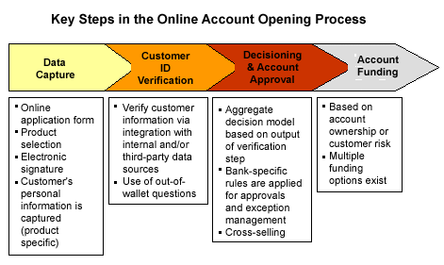
My takeaways| Banking Domain | 30th Sept- 1st Oct
Account Opening Process:-
Online Account Opening:
Digital process using bank websites or apps.
Upload KYC documents online.
Usually includes e-signature and video KYC.
Instant Account Opening:
Quick account opening through banking apps.
Requires Aadhaar and PAN for verification.
Account is usually activated instantly after verification.
Assisted Account Opening:
Done via banking agents or representatives.
Common in rural areas.
Agents assist with document collection and submission.

Slide 7

My learnings from this week
(03/10/2024 -04/10/2024)
IT Domain and Software Testing
IT Industry
Introduction of QA
Project getting steps
SDLC Life Cycle
SDLC Phases
SDLC Model
Software Bugs and Error
Types of Testing
Steps of Reproduce
Introduce to JIRA

Slide 8
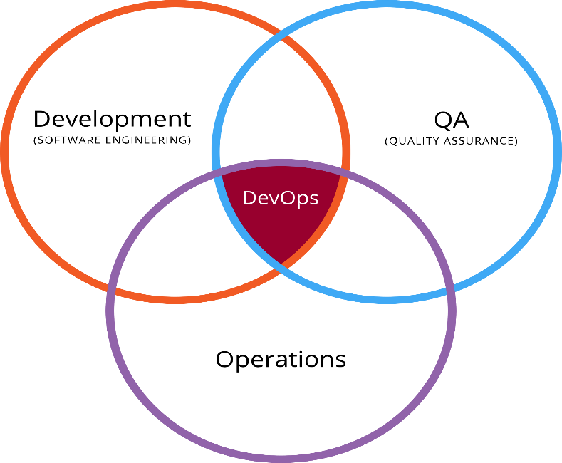
Learning 1 | Different IT Domain And Brief History.
Project Manager: Oversees project planning, execution, and delivery, ensuring all goals and deadlines are met.
Developer: Writes and maintains code to create software applications.
DevOps: Bridges development and operations teams to automate workflows and ensure smooth software deployment and infrastructure management.
Quality Assurance (QA): Tests software to ensure it meets quality and defects-free standards.
Business Analyst (BA): Analyzes business needs, gathers requirements, and bridges the gap between stakeholders and the development team.
Support: Assists users by troubleshooting and resolving technical issues post-release.

Slide 9
Learning | How Project is allocated:
Project Allocation and Responsibilities:
Project Allocation:
Projects are assigned based on resource availability, expertise, and workload.
The Project Manager ensures each team member is matched to tasks aligning with their skills and experience.
Responsibilities:
Project Manager: Defines project goals, timelines, and ensures team collaboration.
Developer: Builds and codes the solution based on requirements.
QA: Tests the product to ensure it meets quality standards.
BA: Gathers and analyzes requirements, acts as a bridge between stakeholders and the team.
Support: Handles issues post-deployment and assists end users.
DevOps: Manages deployment, automation, and infrastructure to ensure smooth delivery.

Slide 10
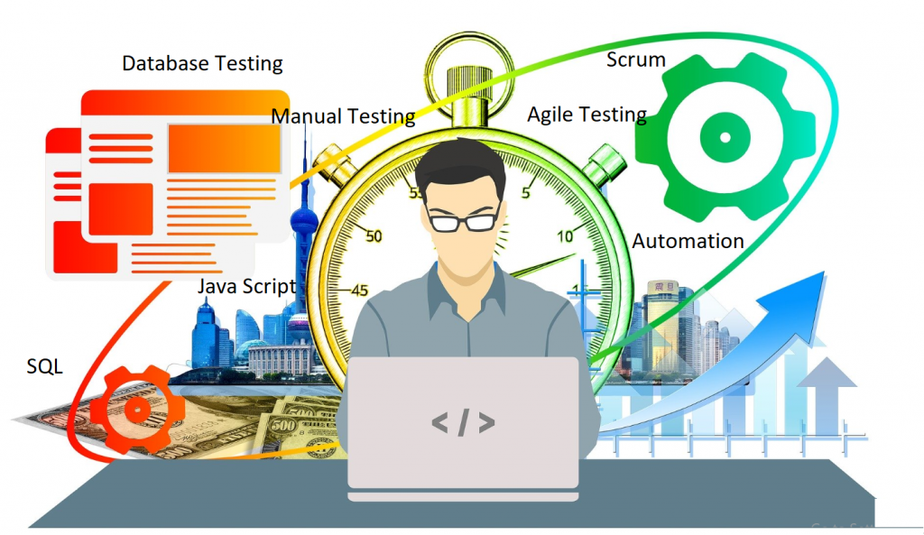
My takeaways I QA : -
Quality Assurance (QA) systematically monitors, evaluates, and improves the quality of software products to ensure they meet defined standards and customer expectations. QA aims to prevent defects and ensure reliability, functionality, and usability.
QA Process in 3 Steps:
Test Planning: Analyze requirements, define testing objectives, and create a test plan.
Test Execution: Test cases, document defects, and verify their resolution.
Test Closure: Summarize the testing activities, prepare a report, and assess overall product quality.
If there is no Defect = There is No QA

Slide 11
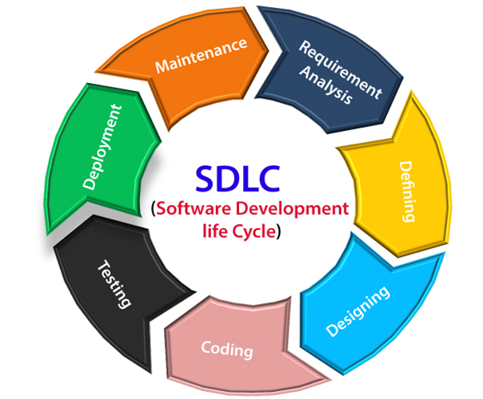
Learning | Software Development Life Cycle (SDLC):
Software Development Life Cycle (SDLC) Brief Overview:
Requirement Analysis: Gather and understand business requirements from stakeholders to define what the software should do.
Planning: Outline project scope, costs, resources, and schedules to create a roadmap.
Design: Develop system architecture, database design, and user interface.
Development: Write the code and build the application based on design specifications.
Testing: Conduct testing to find and fix bugs, ensuring the software meets requirements.
Deployment: Release the completed software for users to access.
Maintenance: Provide support, make enhancements, and fix issues post-release.

Slide 12
Learning | Software Development Life Cycle (SDLC) Models:
Different SDLC Models:
Waterfall Model: A linear sequential model where each phase must be completed before the next begins.
Agile Model: An iterative and incremental model that emphasizes flexibility, collaboration, and delivering small, functional software units in sprints.
V-Model (Verification and Validation): Similar to Waterfall but each development phase is directly associated with a corresponding testing phase.
Iterative Model: Builds an initial version of the software, then continuously improves it through multiple iterations.
Spiral Model: Combines iterative development with risk analysis, focusing on reducing risks through iterations.
Big Bang Model: Developers start coding without much planning, used for small projects with undefined or changing requirements.

Slide 13
Learning | Agile Model 99% Used Model :
Agile Model Overview
The Agile Model is a flexible and iterative approach to software development that emphasizes collaboration, customer feedback, and rapid delivery of functional software. It breaks down projects into smaller, manageable units called sprints, allowing teams to adapt to changes and continuously improve the product.
Key Principles of Agile
Customer Collaboration: Engage with customers throughout the development process to ensure their needs are met.
Iterative Development: Develop software in small increments, allowing for regular feedback and adjustments.
Flexibility: Respond to changing requirements, even late in the development process.
Cross-Functional Teams: Encourage collaboration among team members with different skill sets.

Slide 14
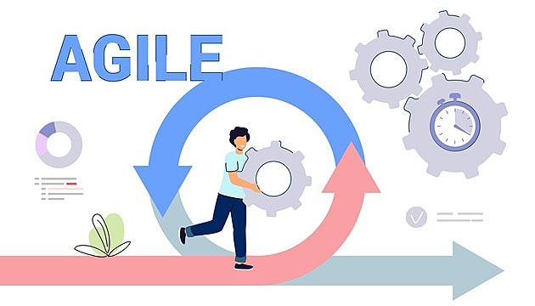
Learning | Agile Model 99% Used Model :
Agile Process Steps in 3 Basic Sprint Steps
Sprint Planning:
Define the sprint goal and select user stories from the Product Backlog to be completed during the sprint.
Estimate effort and assign tasks to team members.
Sprint Execution:
Develop the selected features collaboratively within the sprint time frame.
Conduct daily stand-up meetings to discuss progress and address any challenges.
Sprint Review and Retrospective:
Demonstrate the completed work to stakeholders and gather feedback during the Sprint Review.
Reflect on the sprint process in the Retrospective to identify improvements for future sprints.

Slide 15
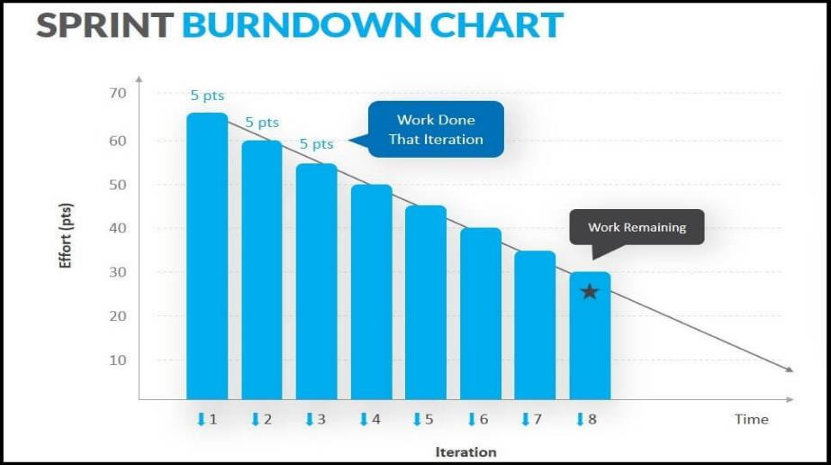
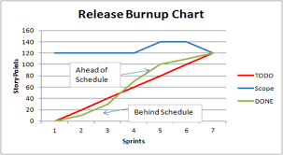
Learning | Agile Model 99% Used Model :

Slide 16
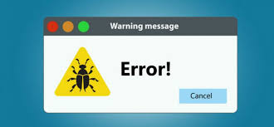
Learning | Software Bugs And Error :
Software Bugs: Flaws or mistakes in the code that lead to unexpected behavior or incorrect results. They can be classified as syntax bugs (code errors), logical bugs (algorithm flaws), or runtime bugs (issues during execution).
Software Errors: Issues that arise from executing the software, often caused by bugs. They can include system errors (hardware-related failures), application errors (problems within the software), or user errors (mistakes made by users due to unclear instructions).
In essence, bugs are the root problems, while errors are the symptoms observed during software operation.

Slide 17
Learning | Different type of testing :
Basic Types of Testing
Functional Testing: Tests the software against specified requirements to ensure that all features work as intended.
Non-Functional Testing: Evaluates aspects like performance, usability, and security to ensure the software meets quality standards beyond just functional requirements.
Intermediate Types of Testing
Integration Testing: Verifies the interaction and data flow between integrated components or systems to ensure they work together correctly.
Regression Testing: Confirms that new code changes do not negatively impact existing functionalities, ensuring previously working features still function as intended.

Slide 18
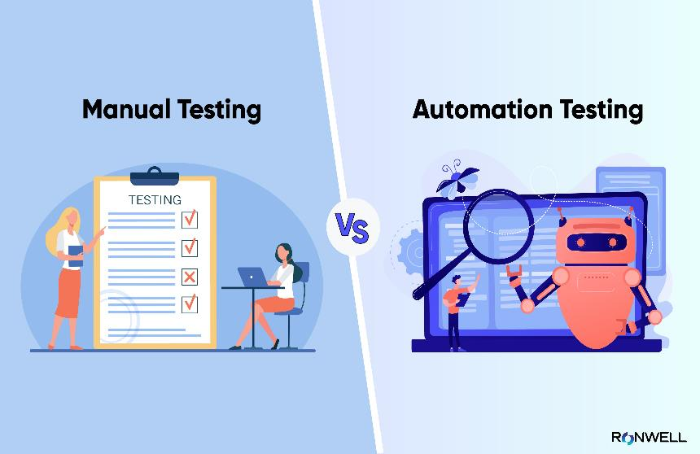
Learning |Different type of testing :
Automation Testing
Definition: Uses specialized tools and scripts to automate the execution of tests, reducing the need for human intervention.
Advantages:
Increases testing efficiency and speed, allowing for rapid execution of repetitive tests.
Ensures consistency in test execution and reduces human error.
Facilitates testing across multiple platforms and configurations.
Manual Testing
Definition: Involves human testers manually executing test cases without automation tools.
Advantages:
Allows for exploratory testing and intuitive judgment, which is valuable in understanding user experience.
Easier to perform for short-term projects or applications with frequently changing requirements.
Useful for usability testing and assessing user interfaces.

Slide 19
Learning | One Manual testing Example
Title: Delivery Status Not Updating to "Delivered" on Zomato App
Description: After placing an order and receiving the delivery, the order status remains stuck at "Out for Delivery" and does not update to "Delivered". This creates confusion about the status of the order and affects the user experience.
Steps to Reproduce:
Place an order on the Zomato app.
Wait for the delivery to arrive.
Observe that after receiving the delivery, the app still shows "Out for Delivery" instead of "Delivered".
Expected Behavior: Once the order is delivered, the status should update to "Delivered".
Actual Behavior: The delivery status remains as "Out for Delivery" even after the order is received.
Severity: Medium
Priority: High

Slide 20
Challenge Faced while implementing Learning 1
I tackled the challenges of developing my soft skills by first enhancing my self-awareness through introspection and seeking feedback from trusted individuals. This process enabled me to recognize my strengths and pinpoint areas for growth. I consistently reached out to colleagues and mentors for balanced feedback. To shift ingrained behaviors, I concentrated on making small, gradual changes while practicing mindfulness to increase my awareness during interactions. I built my confidence by engaging in low-pressure situations, which helped me overcome my fear of judgment. I also actively sought real-life experiences to apply my soft skills, reinforcing my learning. I learned to balance authenticity with adaptability, remaining true to myself while adjusting to different social contexts. Lastly, I made a deliberate effort to understand cultural differences by interacting with diverse groups, which enhanced my ability to communicate effectively in multicultural environments.

Slide 21
Challenge Faced while implementing Learning 2
I faced several challenges in learning Microsoft Excel, but I overcame them through consistent practice and exploration of its features in real-world tasks. Initially, I struggled with understanding the interface and navigating the software efficiently. To address this, I focused on mastering the basics, including formulas, formatting, and data entry, before gradually progressing to advanced functions like pivot tables, VLOOKUP, and conditional formatting.
As I advanced, I encountered difficulties with data analysis and visualization. To deepen my understanding, I utilized online tutorials, forums, and Excel templates to troubleshoot issues and learn best practices. Additionally, I often found myself overwhelmed by the vast array of functions available, so I prioritized learning those most relevant to my work.
To reinforce my skills, I applied Excel in my daily tasks, which allowed me to see the practical applications of what I was learning. I also sought help from experienced colleagues, who provided valuable insights and shortcuts. Staying updated on new Excel features and tools further enhanced my proficiency. Through perseverance and a willingness to learn, I gradually transformed my challenges into strengths, ultimately becoming more confident in my Excel capabilities.

Slide 22
Challenge Faced while implementing Learning 3
I navigated the challenges of learning the basics of the banking domain by committing time to grasp fundamental concepts, including banking products, financial regulations, and the different types of accounts and services. I actively studied key areas such as loans, credit, deposits, and interest rates, utilizing industry-related resources and online platforms to build a solid foundation.
To deepen my understanding, I engaged with mentors in the classroom and participated in relevant discussions, which provided practical insights and real-world applications. I also faced challenges in keeping up with the constantly evolving regulatory environment and understanding complex financial instruments. To address this, I followed industry news, attended webinars, and joined online forums where professionals discussed current trends and best practices.
Additionally, I sought hands-on experience through internships and practical exercises, allowing me to apply theoretical knowledge in real-life scenarios. Collaborating with peers on projects helped me enhance my understanding and develop critical thinking skills related to problem-solving in banking situations. Through dedication and a proactive approach, I overcame these challenges and established a comprehensive understanding of the banking sector.
This Is ongoing I guess this will be more fun

Slide 23
Thank You

