Slide 1
My Weekly Journey PPT- 3
(07/10/2024 – 18/10/2024)
Name – Shubhadip Paul
Axis Bank Quality Assurance Trainee

Slide 2

About Me
"Ensuring quality in my work, exploring the heights in my life, and embracing every challenge along the way."

Slide 3

My learnings from this week – 3
(07/10/2024 – 15/10/2024)
Software Testing Fundamentals
-Test Scenario-Test cases
- Test Case Design Technique.
- Software Testing Life Cycle phases
- Bug Life Cycle .

Slide 4
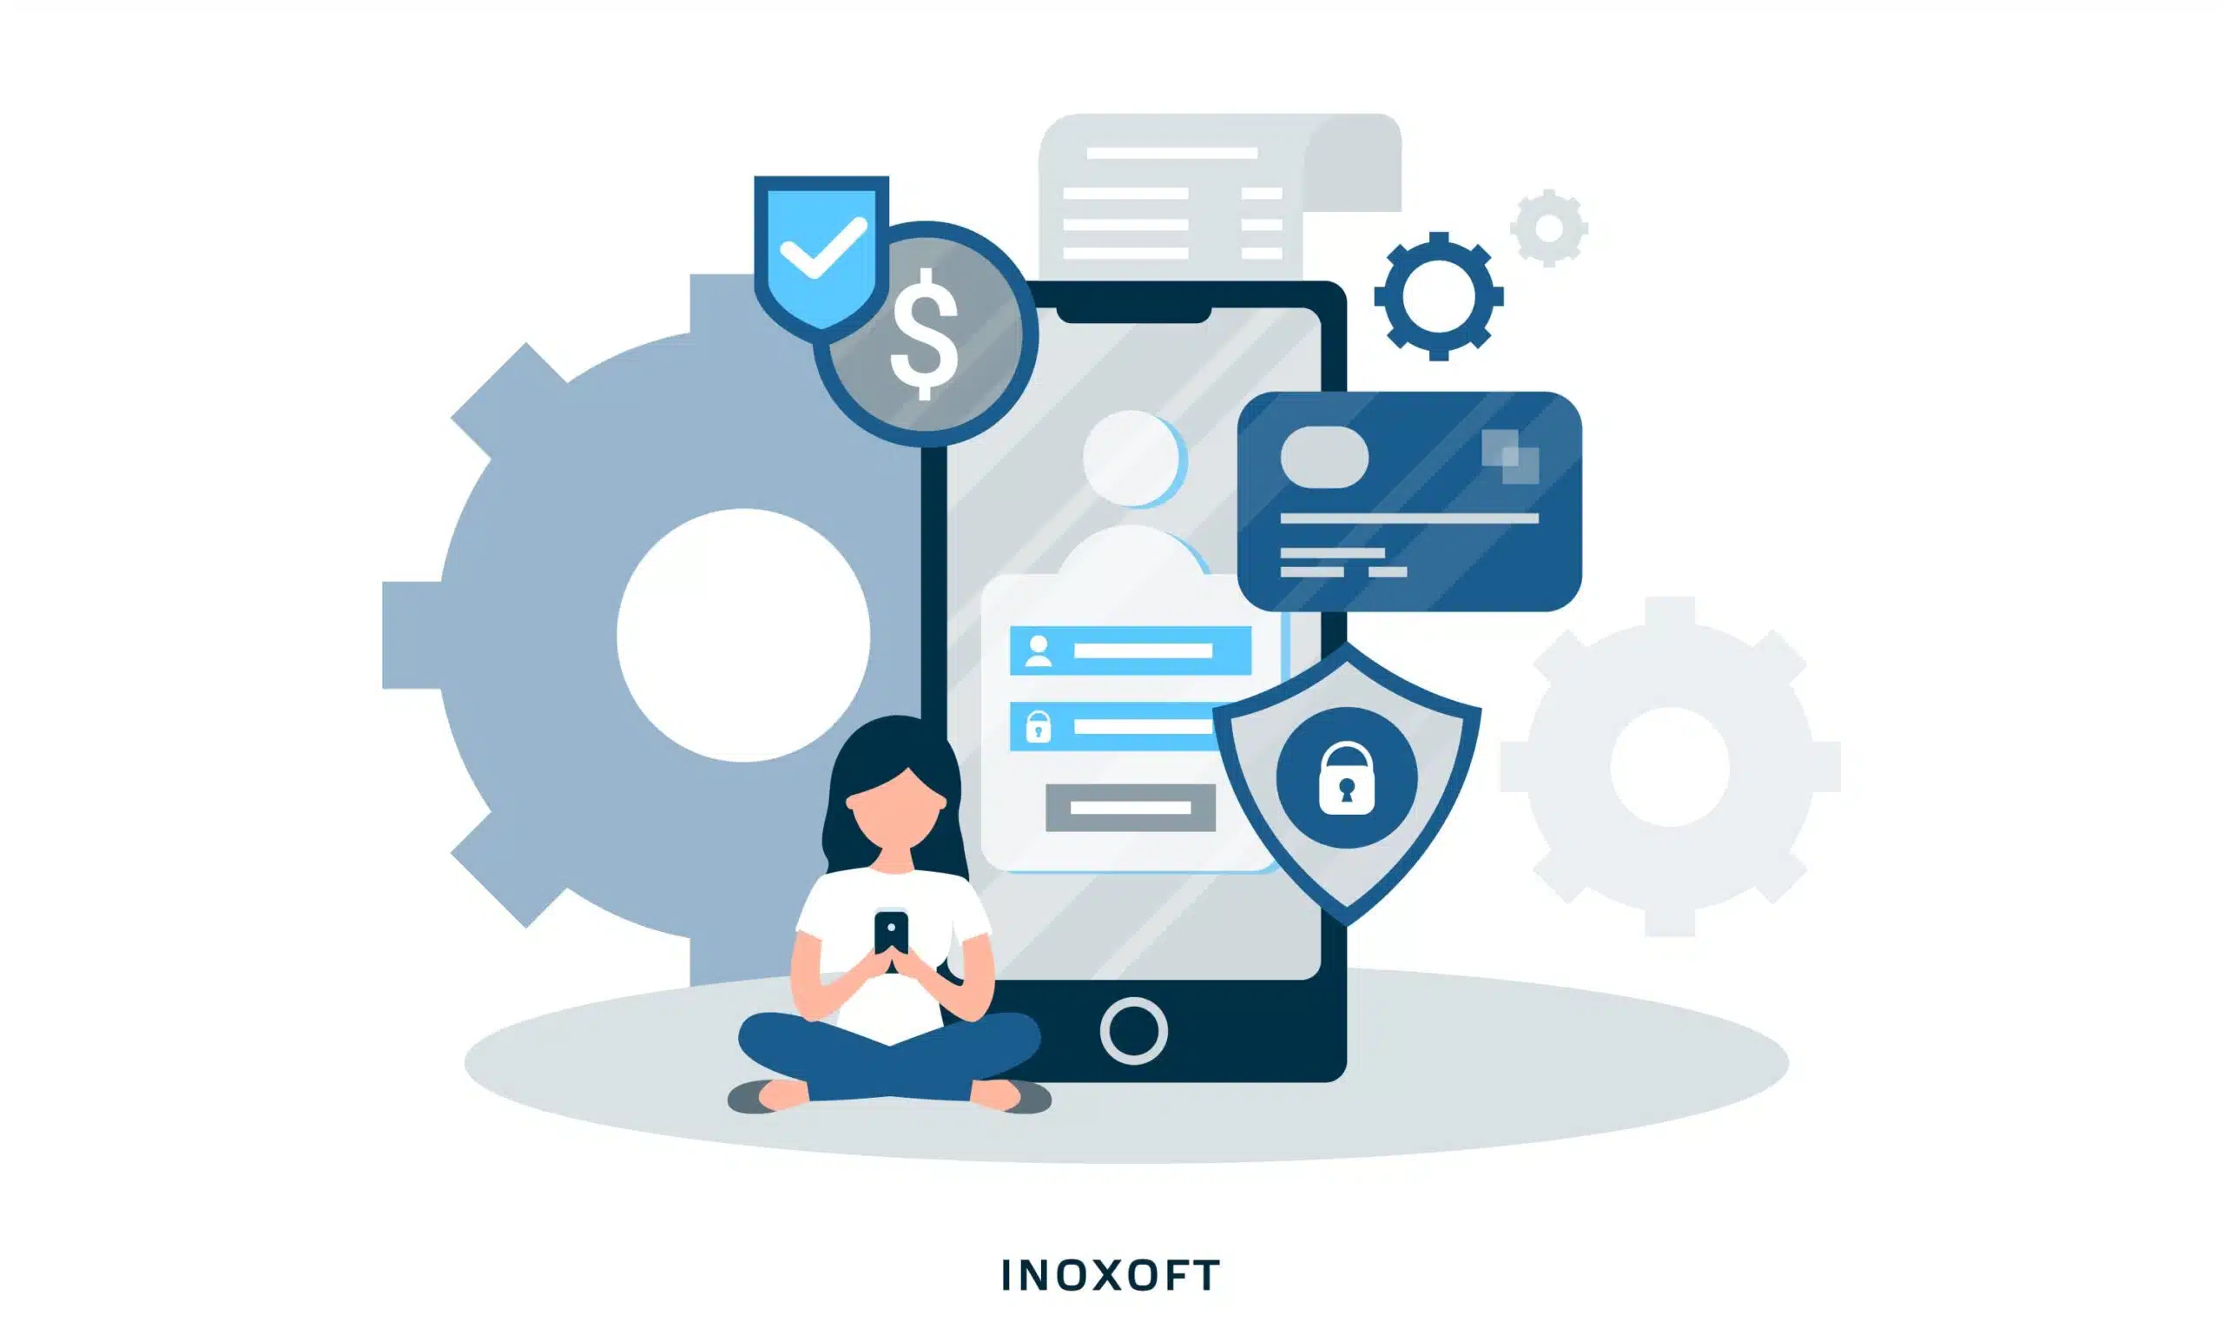
Learning 1 | My takeaways
Test Scenarios:-
Test scenarios describe high-level actions or functions that need to be tested. They define the "what" of testing without going into the "how," providing a broader understanding of the application’s workflow. Each test scenario can be broken down into multiple test cases.
e.g:- Banking Application
Test Scenario 1: Account Creation
Verify that users can create new bank accounts successfully.
Test Scenario 2: Funds Transfer
Verify that users can transfer funds between their own accounts and to third-party accounts.
Test Scenario 3: Balance Inquiry
Verify that users can view their account balance in real time.
Test Scenario 4: ATM Withdrawals
Verify that users can withdraw money from ATMs using their card and PIN.
Test Scenario 5: Bill Payments
Verify that users can make bill payments to registered payees.

Slide 5
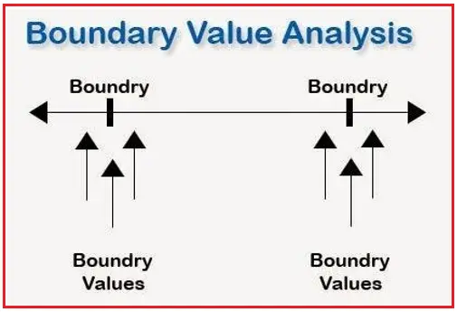
Learning 2 | My takeaways
Test case Design techniques:
1. Boundary value analysis:
Boundary value analysis is a software testing technique that focuses on the finding the errors near the boundaries of the input ranges.
Example:-
Facebook username accepts 5 to 25 characters
Lower limit:- 5
Upper limit:- 25
So, according to the BVA technique,
lower limit +/-1
Upper limit +/- 1
So, the characters should be:-
4, 5, 6, 24, 25, 26

Slide 6
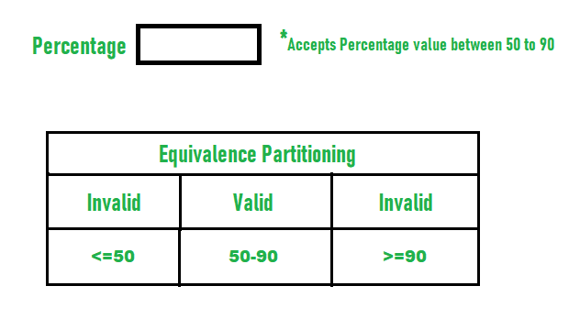
Learning 3 | My takeaways
2. Equivalence class partitioning:
ECP is a black testing technique that divides data into partition or classes.
Example:-
Facebook user is accepting 5 to 25 character
So, according to ECP technique,
valid partition: Between 5 to 25
Invalid partition: less than or equal to 5 and more than or equal to 25

Slide 7
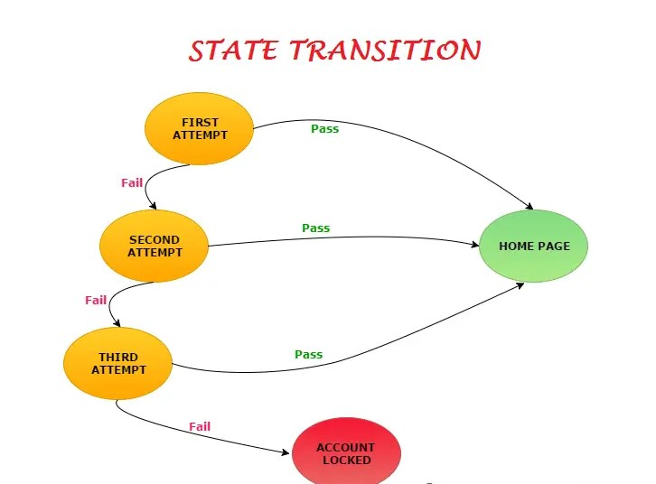
Learning 4 | My takeaways
3. State Transition technique:
3. State Transition technique:
It is a black box testing technique that evaluates how software behaves when transitioning between states or mode of the operation. IT focuses on state of activity.
Example:-
State 1: User is on the login page.
Event: User enters valid credentials and clicks login.
Transition: Moves to the dashboard state.
State 2: User is logged in and can access their dashboard.
If the credentials are incorrect, the state transitions back to the login state with an error message.

Slide 8
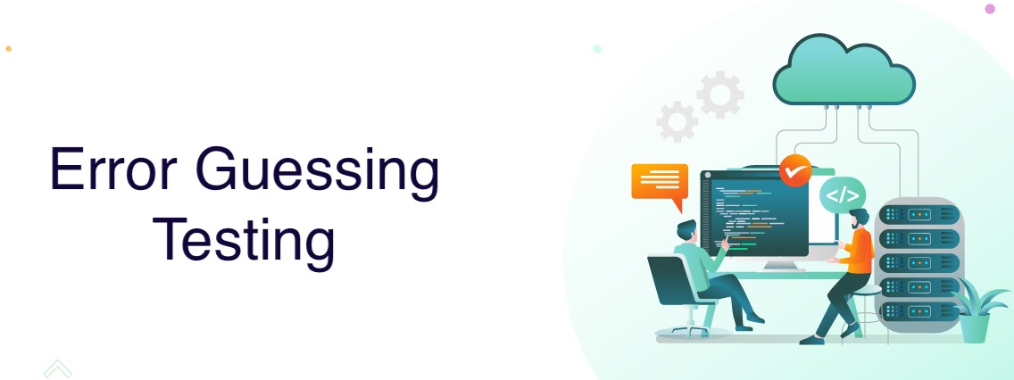
Learning 5 | My takeaways
4. Error guessing techniques:
It is software testing techniques that is best used for similar kind of pattern of testing results, system configuration is of low configurations etc.
Example:-
For a password field in a login form, testers may guess potential errors like:
Entering fewer than the required characters.
Using only numbers or special characters.
Leaving the field blank.
Copy-pasting the password.
Exceeding the character limit.
This technique relies on the tester's experience to predict areas where the system might fail

Slide 9
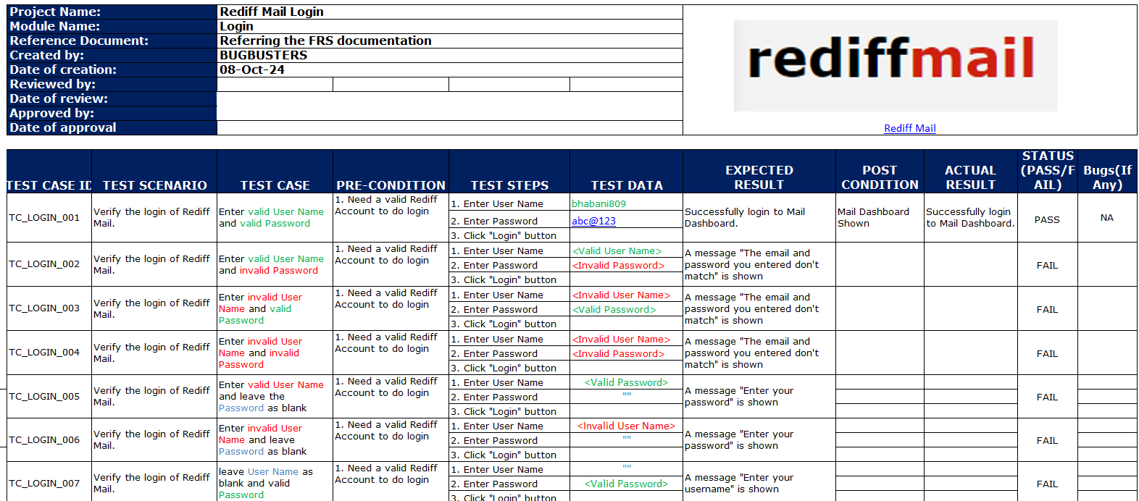
Learning 6 | My takeaways

Slide 10
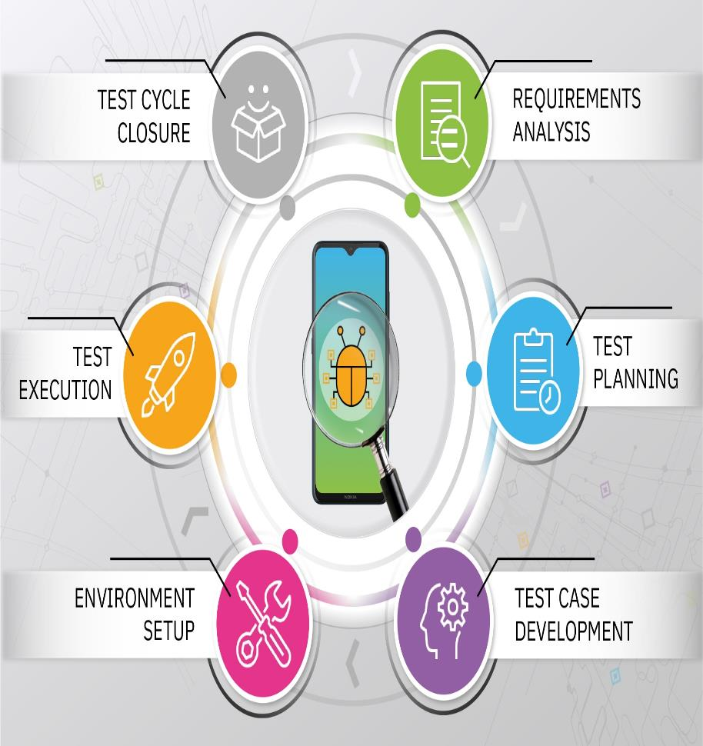
Learning 7 | My takeaways
Software Testing Life Cycle phases:
Requirement analysis:- To analyse the customer’s requirement.
Test planning
A test plan document would be required in details about the testing approach.
Test Development.
Test cases are being prepared.
Test scenarios would be identified.
Full coverage of testing would have been covered.
Test Environment setup
Here, we have to set up and launch the testing environments.
During this time, many testing instruments/techniques would be implemented.
Multiple environment would be launched in order to test the product perfectly.
Test execution:
Test execution are to be done by executing the test cases in order to validate the feature in the deployed environment.
The test data should be using appropriately in order to get the best results.
Test Closure:
All the test cases are executed.
All the tests should be summarized along with the results.
All the test result should be published to the team.

Slide 11
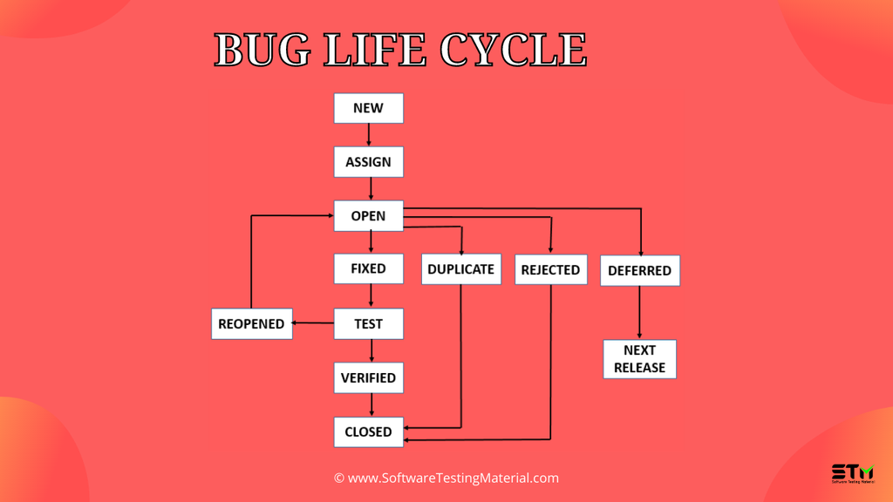
Learning 8 | My takeaways
BUG Life cycle:-
The point when you raise the Bug and the point when you close the Bug, is known as Bug Life Cycle.
Stages:-
New:- When a QA arises the Bug.
Assign:- When the QA assign to a developer to fix the Bug.
Open:- The Developer open the Bug task and going to analysis the bug.
Fixed:- After Analysis, the Developer going to fix the bug by modifying in their code.
Test:- After fixing the Bug, the QA going to test whether it is working correctly or not according to the customer's requirement.
Verified:- After all test cases passed, The QA going to verify the application and marked the app is bug free and that it was resolved.
Closed:- Then the QA going to close the Bug ticket.
Reopened:- If any Bug found in future, then the QA reopened the bug issue and arise a ticket.
Duplicate:- If some development team already worked with the same Bug, then the assigned development team make them duplicate bug issue and close the ticket.
Rejected:- If the Bug is not according to the requirement, then the development team going to reject the Bug issue.
Deferred:- The development team already being assigned with the new Bug issue and the team worked in other bug issue with high priority, then the team deferred the bug issue and planned for next sprint.
Next Release:- It is the Next sprint.

Slide 12
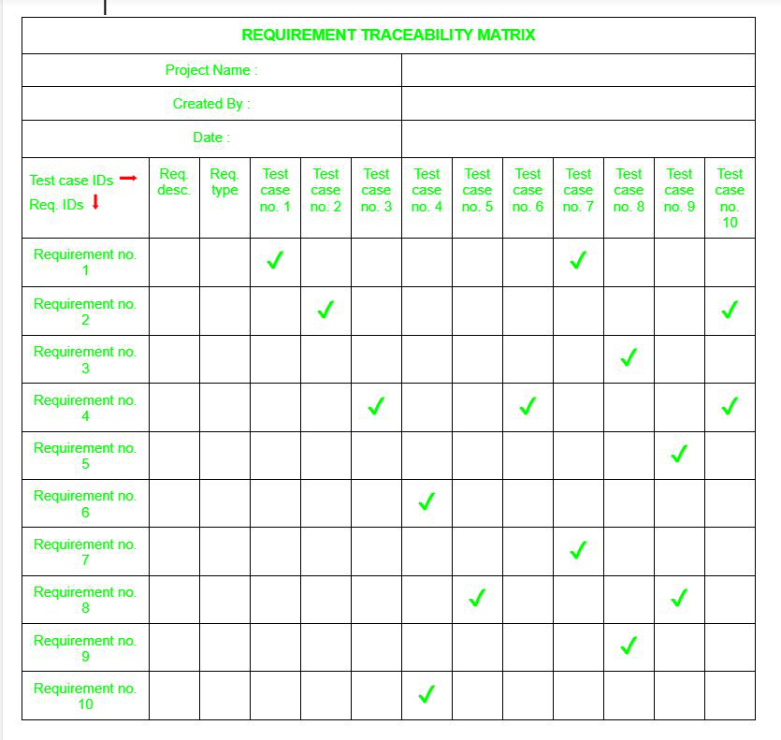
Learning 8 | My takeaways
Requirement traceability matrix:
RTM stands for Requirement Traceability matrix. RTM maps all the requirements with the test cases. By using this document one can verify test cases cover all functionality of the application as per the requirements of the customer.
Requirements: Requirements of a particular project from the client.
Traceability: The ability to trace the tests.
Matrix: The data which can be stored in rows and columns form.

Slide 13
Learning 9 | My takeaways
Types of Testing:-
Smoke testing:- It is a type of testing where entire system is verified from end to end testing.
Sanity testing:- It is a build readiness testing which gives flag to do other testing.
Alpha testing:- It is a type of testing stage in software development that helps to identify and fixed issues in a product before it release to public.
Beta testing:- It is a type of software testing i.e a pre release testing where product is been tested by small group of real user in real time environment.
Gamma testing:- It is a software testing stage that take places after beta testing to make sure product is ready for release to customer
Grey box testing:- It is a type of software testing technique that combines black and white box testing.
White box testing:- It is a type of testing done by developer to make sure the code developed by developer is correct. it is also called a structural testing
Black box testing:- It is a type of testing done by QA to check the functionality of the application is working correctly.
Unit testing:- It is a again a part of white box testing where developer test the smallest functional unit of code.
Integration testing:- It is a type of testing where we will combine unit testing to see or verify the entire unit work together or not.
System testing:- It is a type of testing that evaluate fully integrated software system to ensure that fulfill the requirement.
Monkey testing:- It is a type of testing where will test the application randomly there is no fix plan for that.
User acceptance testing:- It is a type of testing it is a final stage of testing that happens right before the software released.
e.g:- usually we will test different types of business scenario that is real life of example
Re testing:- It is a type of testing when any defect fixed we need to test the defect or affected area to make sure the defect is fixed.
Regression testing:- It is a type of testing that runs after every changes made in the application to make sure other area not getting effected.

Slide 14
My learnings from this week – 4
(16/10/2024 – 18/10/2024)
Fundamentals Of Database Testing & Core Java.
- Fundamentals of SQL
( Create, Read, Update, Select, Drop and Delete
quarry)
- Fundamentals Of Core Java.
(Object-Oriented Programming Concepts)

Slide 15
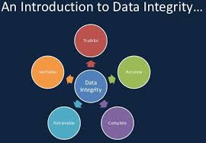
Learning 10 | Database testing :
Database Testing is a software testing process that validates a database's integrity, accuracy, and performance. It ensures that:
Data Integrity is maintained across CRUD (Create, Read, Update, Delete) operations.
Data Consistency remains intact after transactions.
Data Validity adheres to defined constraints (e.g., primary/foreign keys, data types).
Stored Procedures/Triggers function correctly.
Performance of queries and database responsiveness meets requirements.
Database testing focuses on the schema, tables, relationships, and the overall reliability and security of the data stored in the system.

Slide 16
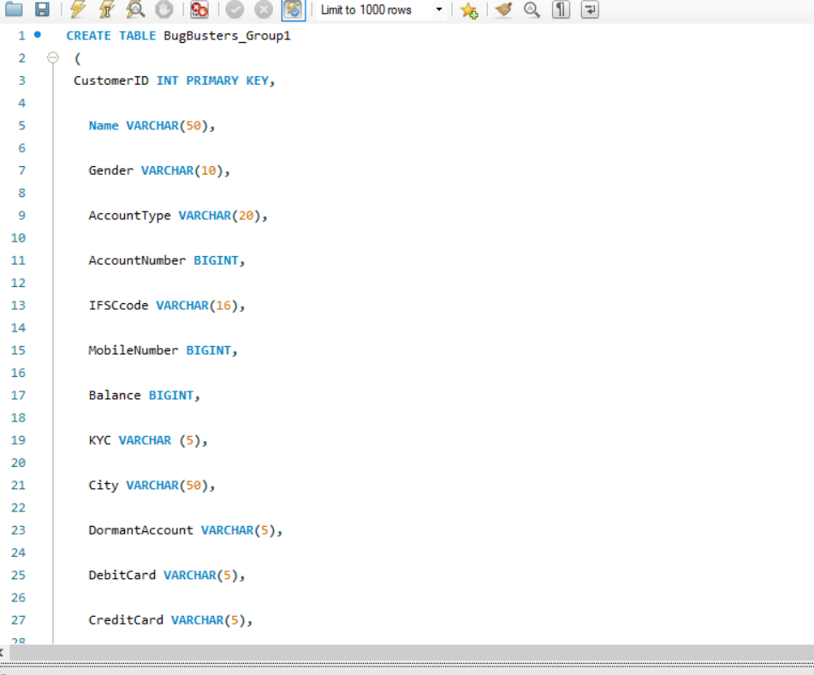
Learning 11 | Database testing: Practical
We have performed the Database Testing Practically:

Slide 17
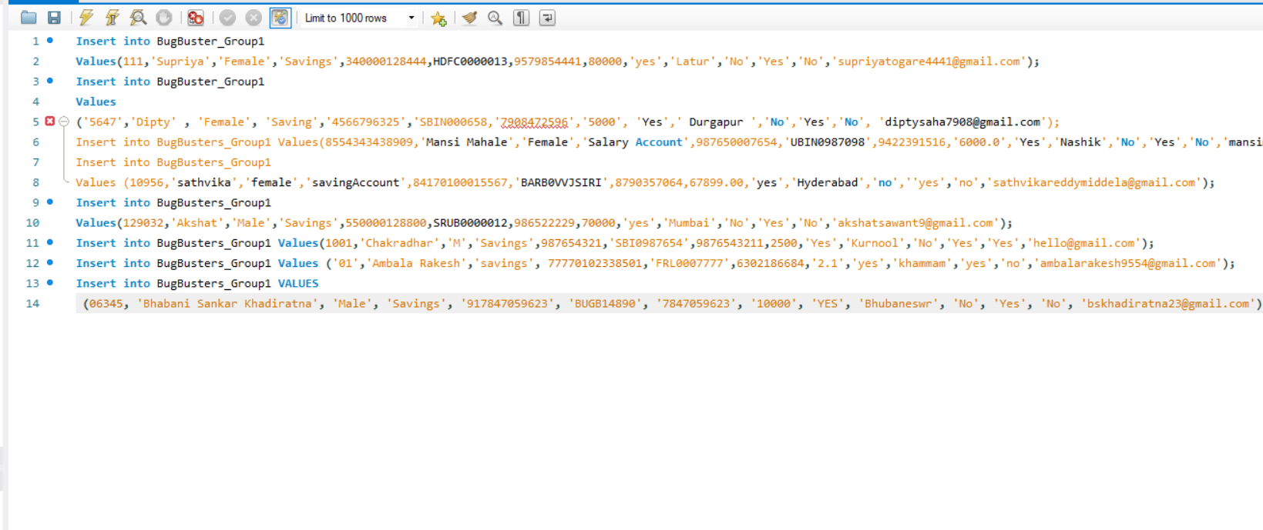
Learning 12 | Database testing: Practical
Data Insert Operation in Database Table:

Slide 18
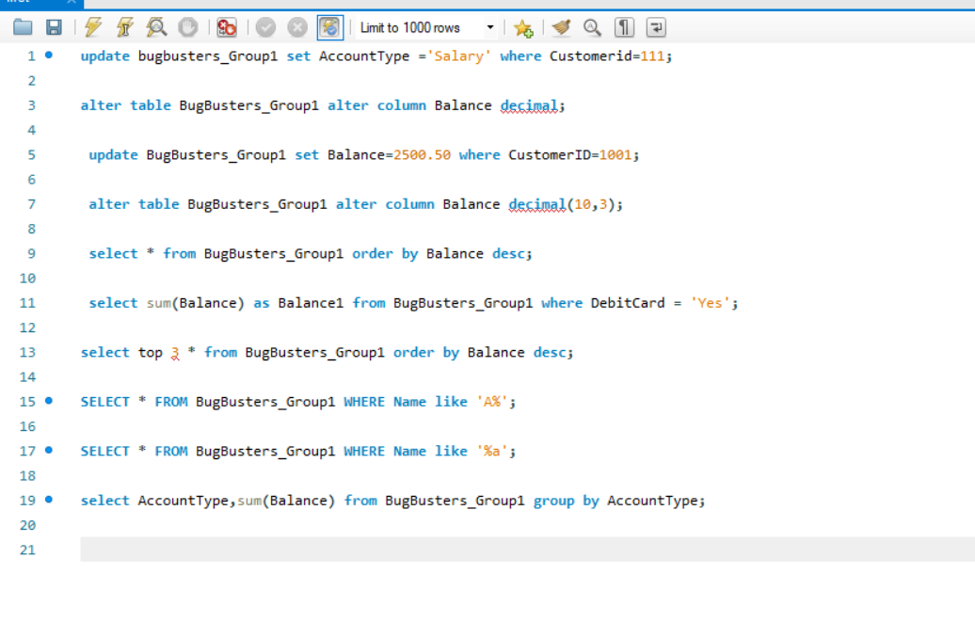
Learning 13 | Database testing: Practical
Select , Update , Alter Data Quarry into the Database:

Slide 19
Learning 14 | Core Java Concepts:
Classes and Objects in OOP
Class:
A blueprint or template that defines the attributes (properties) and methods (functions) that an object can have.
It serves as a blueprint to create objects.
Object:
An instance of a class.
Objects are created from classes and can have their values for properties the class defines.

Slide 20
Learning 15 | Core Java Concepts:
Inheritance in programming refers to a mechanism where a new class (called a subclass) acquires the properties and behaviors (methods and attributes) of an existing class (called a superclass). Here's an outline you can use for your PPT on Inheritance:
1. Introduction to Inheritance
Definition of inheritance
Importance of inheritance in OOP (Object-Oriented Programming)
2. Types of Inheritance
Single Inheritance: One subclass inherits from one superclass
Multiple Inheritance: A subclass inherits from more than one superclass (not supported in some languages like Java, but can be achieved with interfaces)
Multilevel Inheritance: A subclass inherits from another subclass
Hierarchical Inheritance: Multiple subclasses inherit from one superclass
Hybrid Inheritance: A combination of two or more types of inheritance

Slide 21
Learning 16 | Core Java Concepts:
Polymorphism in OOP
Definition: The ability of a method or object to take on multiple forms.
Types:
Compile-time:
Method Overloading: Same method name, different parameters.
Operator Overloading: Custom behavior for operators (e.g., C++).
Run-time:
Method Overriding: Subclass redefines a superclass method.
Advantages:
Enhances code flexibility and reusability.
Improves maintainability.
Disadvantages:
Increases complexity.
Can complicate debugging.

Slide 22
Learning 17 | Core Java Concepts:
Abstraction in OOP
Definition Hiding complex implementation details and showing only the essential features of an object.
Purpose Simplifies complex systems Enhances code readability and maintainability
Types Abstract Classes: Cannot be instantiated; can have abstract and concrete methods Interfaces: Defines a contract with only method signatures (no implementation)
Advantages Reduces complexity by hiding unnecessary details Promotes code reusability and flexibility
Disadvantages Can introduce a learning curve for new developers Overhead of maintaining abstract classes and interfaces

Slide 23
Learning 17 | Core Java Concepts
Definition A contract that defines a set of methods that a class must implement, without providing any implementation details
Purpose Facilitates multiple inheritance Enforces a standard structure for classes
Characteristics Can contain only method signatures and constants A class can implement multiple interfaces Supports loose coupling and high cohesion
Advantages Promotes code reusability and flexibility Allows for polymorphism and dynamic binding Simplifies testing and maintenance
Disadvantages May introduce complexity with multiple interfaces Requires additional code to implement interface methods

Slide 24
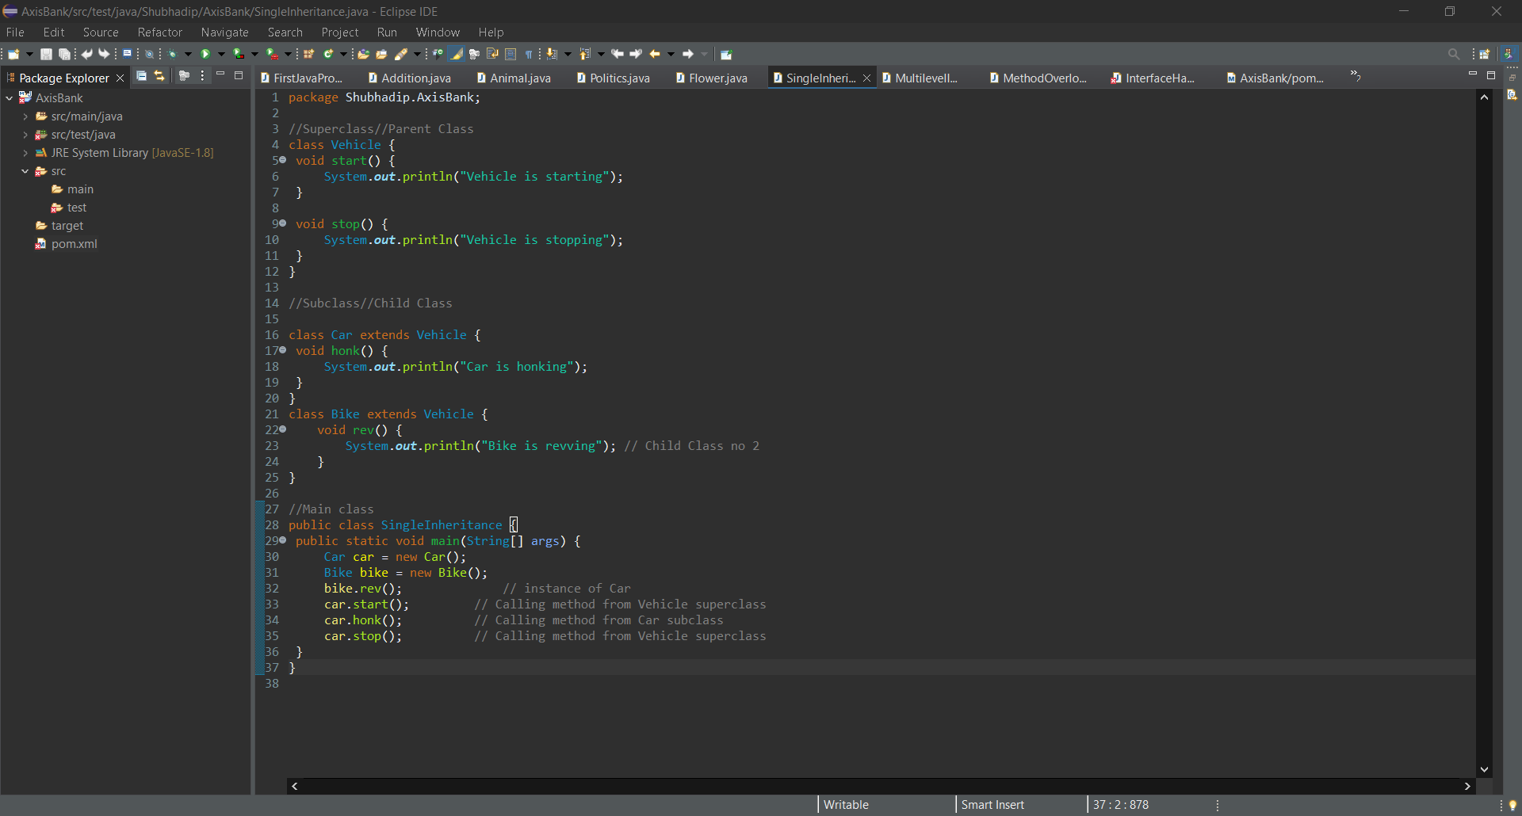
Learning | Core Java practical

Slide 25
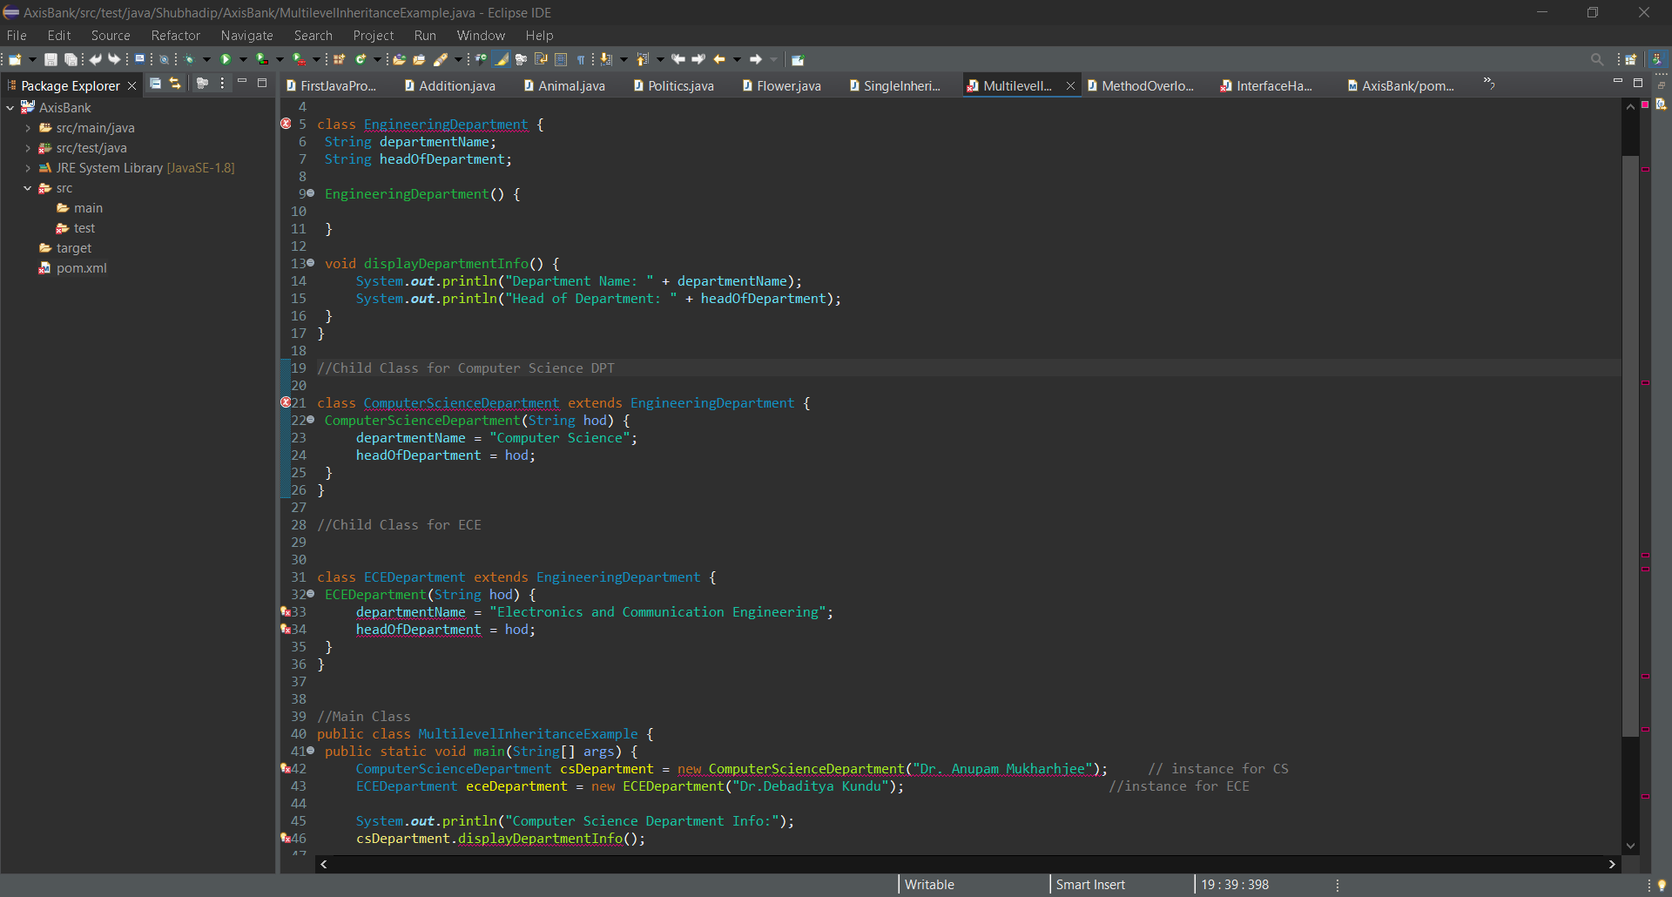
Learning 17 | Core Java Concepts

Slide 26
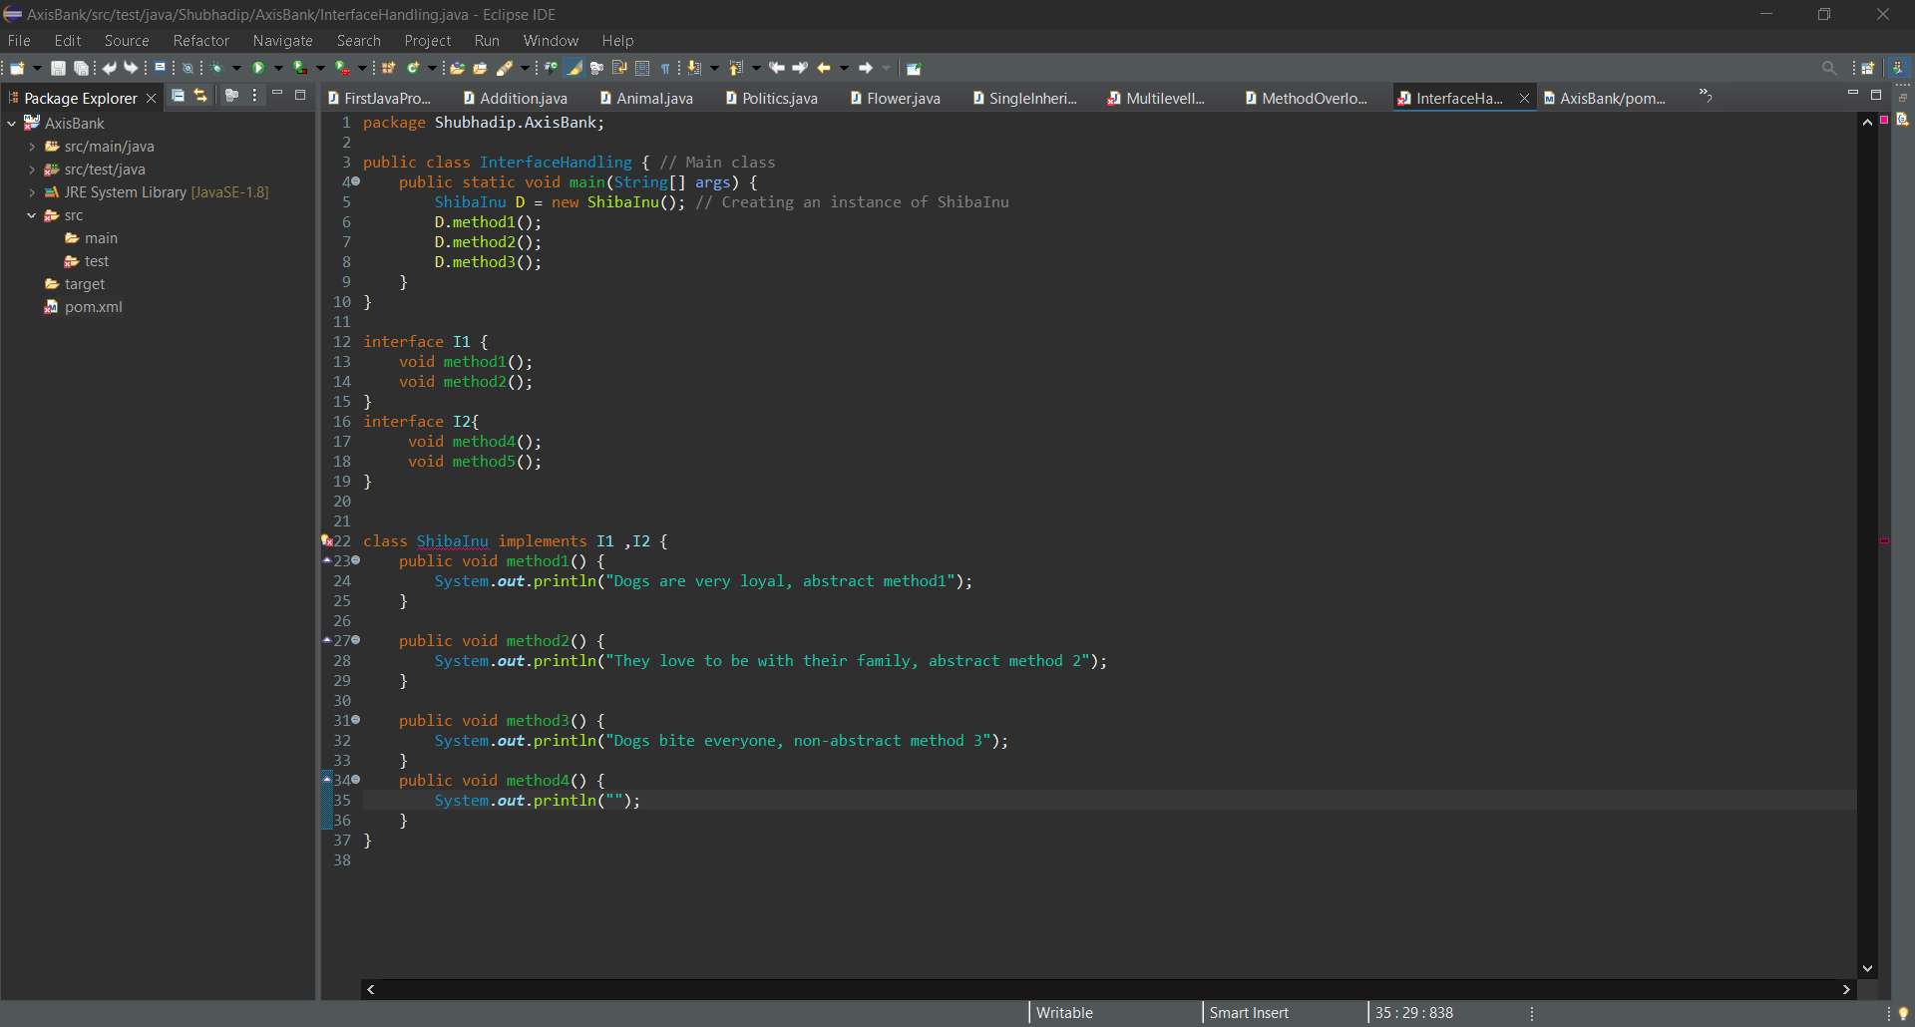
Learning 17 | Core Java Concepts

Slide 27

Learning 17 | Core Java Concepts

Slide 28
Challenge Faced while implementing Learning
I tackled the challenges of developing my soft skills by first enhancing my self-awareness through introspection and seeking feedback from trusted individuals. This process enabled me to recognize my strengths and pinpoint areas for growth. I consistently reached out to colleagues and mentors for balanced feedback. To shift ingrained behaviors, I concentrated on making small, gradual changes while practicing mindfulness to increase my awareness during interactions. I built my confidence by engaging in low-pressure situations, which helped me overcome my fear of judgment. I also actively sought real-life experiences to apply my soft skills, reinforcing my learning. I learned to balance authenticity with adaptability, remaining true to myself while adjusting to different social contexts. Lastly, I made a deliberate effort to understand cultural differences by interacting with diverse groups, which enhanced my ability to communicate effectively in multicultural environments.

Slide 29
Thank You

