Slide 1
GRINDING BURN
Purpose of Grinding
Types of Burn
Effect of Grinding Variables
Residual stresses caused by Grinding
Effect of Burn

Slide 2
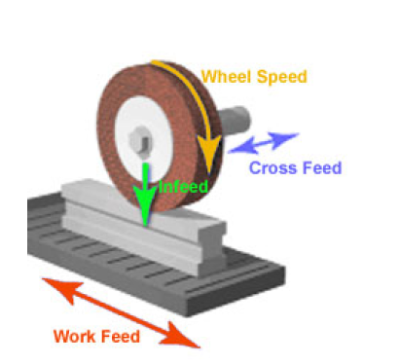
Purpose of Grinding
Grinding removes adverse surface features present after Heat treatment (eg., inaccuracies due to distortion and growth, Surface roughness, detrimental metallurgical features).
It is done primarily to provide accuracy & finish.
Grinding employed to remove the heat treated
surface.

Slide 3
Grinding Burn
Types of burn:
Over temper burn
Re hardening burn
Over temper burn:
If the heat generated at carburized s/f is great and is not transferred to any significant extent, then this temperature induce tempering on the surface. Such local tempering is termed “ Overtemper burning” and the result of microstructure is referred as “Retempered Martensite”. The hardness of the overtempered burn area are lower than unburn area.
Rehardening burn:
If during grinding the surface temp exceeds critical tempearture ( above 723’C), thereby producing thin layer of austenite, rapidly cools to give hard martensite. This defect is known as rehardening burn and the result of microstructure is referred as “ reformed Martensite”.
The hardness of the reharden burn area are higher than unburn area. However the rehardening burn must be surrounded by an intermediate layer of overtempered burn and reduced hardness.

Slide 4
Effect of Grinding variables
Influence on depth of cut ( Feed)
Influence on wheel peripheral speed
Influence on workpiece speed
Influence on wheel grit and hardness
Influence on Grinding fluid
Grinding wheel dressing frequency
Degree of difficulty
Influence of workpiece Metallurgical condition on Grinding

Slide 5
Effect of Grinding variables
Influence on depth of cut ( Feed)
Excessive down feeds and cross feeds can cause burning & cracking.
Influence on wheel peripheral speed
Slower peripheral speed can lead to an inferior ground surface. It is considered more favorable to employ a softer wheel, because softer wheel tend to wear more rapidly, which exposes fresh abrasive cutting edges. ( Self sharpening characteristics)
Influence on workpiece speed
Within limits, an increase of workpiece speed can be beneficial, because it improves the feed of coolant in to wheel/workpiece contact zone. If the contact time is reduced, the quantity of heat removal is great.
Influence on wheel grit and hardness
The grit size quantifies the coarseness of the abrasive, where as hardness refers to the hardness of the bond holding the grit. Hard wheels are employed for Grinding soft steel surfaces and soft wheels are better suited for Grinding harder steel surfaces. If the wheel surface loses abrasive particles during grinding, the bonding must quickly wear away to expose fresh abrasive particles.
Abrasive materials(grit) are Aluminum oxide or Cubic boron nitride (CBN). CBN is twice as hard as Aluminum oxide. Wear rate of CBN is 50 times less than Aluminum oxide. CBN have better thermal conductivity hence heat passes to workpiece is very less.

Slide 6
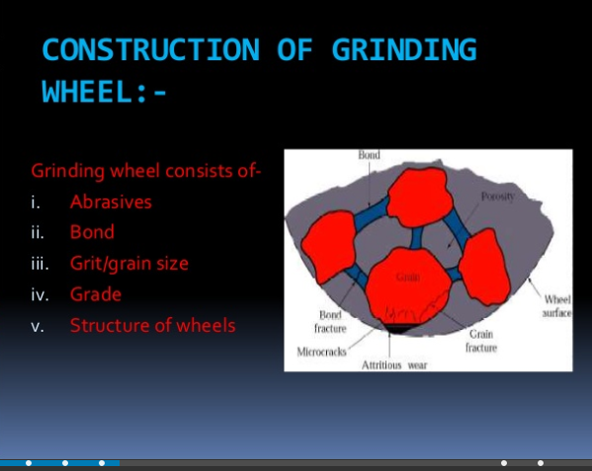
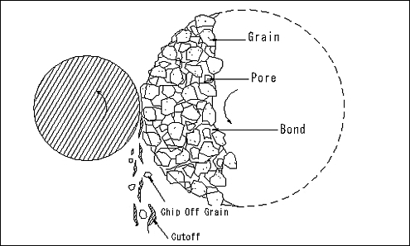
Effect of Grinding variables
Influence on Grinding fluid
It Reduces the coefficient of friction between wheel and workpiece, thus frictional heat is controlled.
It Acts as coolant by extracting heat from the work piece also helps to keep the wheel clean and remove debris. It is good practice to monitor the working temp of the fluid.
Degree of difficulty
There are some design features that are difficult to Grind and / or cool ( eg. Side walls of Grooves and slot ), it affect the quality of Grinding.
Influence of workpiece metallurgical condition on grinding:
HTTP products ( Ferrite, Pearlite, Bainite ), Higher the Retained austenite and intergranular oxidation affect the Grinding quality adversely.

Slide 7
Residual stresses caused by Grinding
Type I represent abusive Grinding, surface burning is likely to happen. The residual stresses at surface is tensile, although if cracking take place, the stresses will be relieved to some extent.
Type III occurs when extremely good Grinding technique employed. The surface residual stresses are compressive.

Slide 8
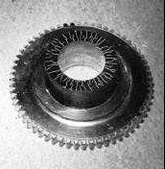
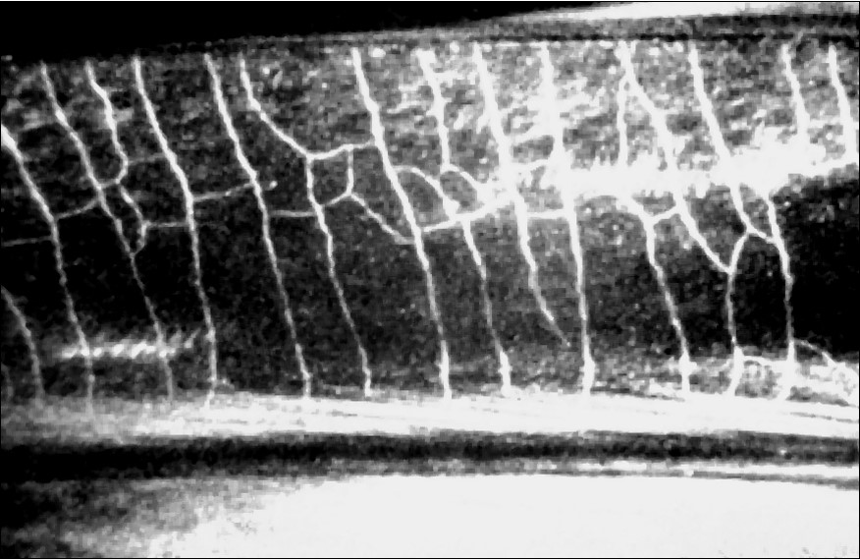
Grinding cracks – Effect of Burning
Grinding cracks found in hardened surfaces are often associated with Grinding burn. Narrow continuous burn marks are likely to produce straight cracks ( Traverse to Grinding direction ). Broad areas of Burn with surface over tempering can produce surface network ( mud ) cracks. Grinding cracks form perpendicular to Grinding direction and penetrate at right angle to the surface. Also the penetration of the crack is deeper, many times higher than burn.
Grinding cracks may or may not be obvious and the detection method shall be Magnetic particle inspection.
Straight cracks
Network ( mud ) cracks

Slide 9
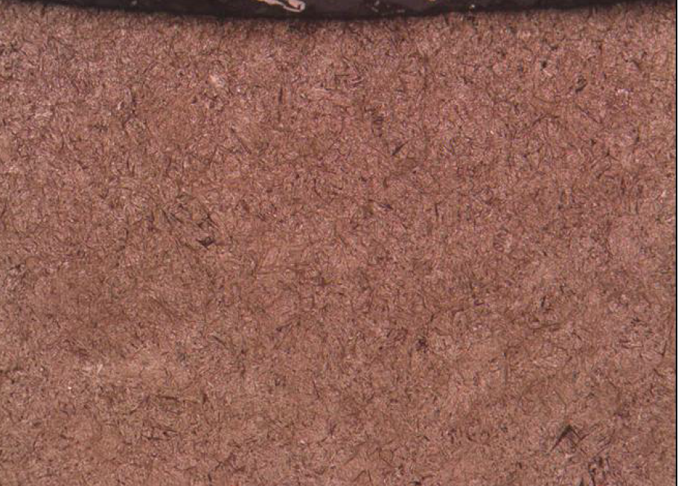
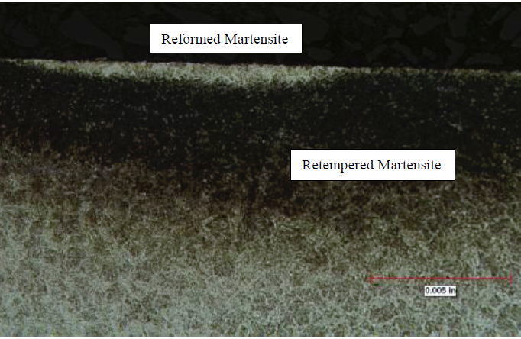
Grinding burn checking by Microstructure
OK
NOT OK
Note :
Part to be cross sectioned from Surface after Carburizing & mounted , polished and evaluated for Grinding burn by etching with 3% Nital.
Evaluation to be done at 400X or 500X magnification in microscope.
As per HT Spec 100, no reformed martensite & retempered martensite are acceptable at any location.

Slide 10
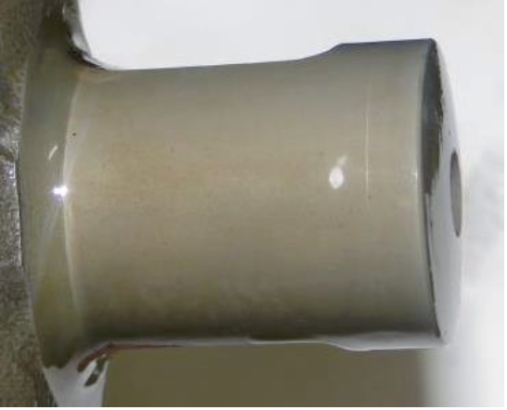
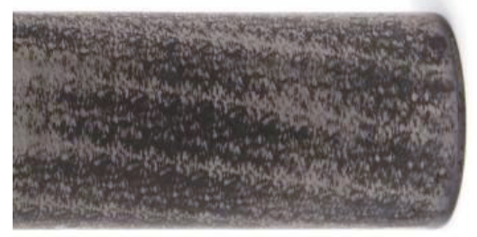
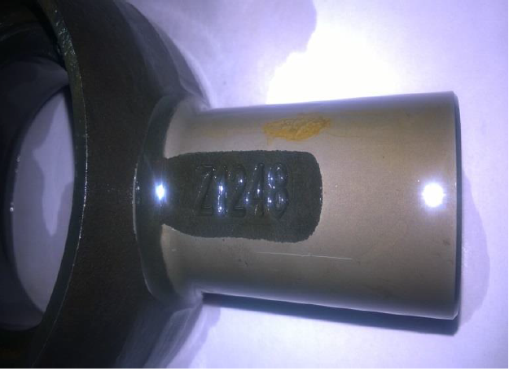
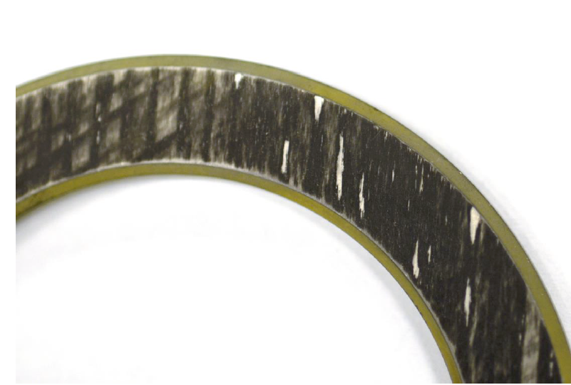
Grinding burn checking – Macro (Gleason solution) etching
OK
NOT OK
OK
NOT OK
Turned s/f
Ground s/f

Slide 11
Thank you

