Slide 1
EE 456: Digital Image Processing Spring 2018 Brain Tumors Detection using Magnetic Resonance Imaging (MRI) Images
Instructor: Dr. Reza Fazel-Rezai
Presenting by: Shubha Majumder

Slide 2
Objectives:
Detecting whether the patient has tumor cells or not.
Determining the size and other characteristics of the brain tumor.

Slide 3

Brain Tumor:
“A brain tumor is a mass or growth of abnormal cells in brain.”
Occur in people of all ages, more frequent in children and older adults.
32% of brain and Central Nervous System (CNS) tumors are malignant.
Nearly 700,000 people in the U.S. living with a primary brain and CNS tumor.
Almost 17,000 people lose their battle each year.
Reference:
http://www.abta.org/about-us/news/brain-tumor-statistics/?print=t?referrer=https://www.google.com/

Slide 4
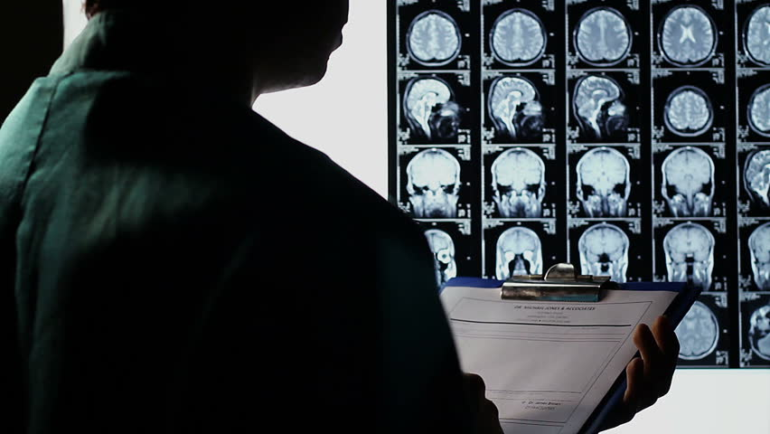
MRI and Brain Tumor Detection:
MRIs are commonly preferred to diagnose a brain tumor
Performed manually by medical experts.
Time-consuming and difficult task.

Slide 5
Tumor detection from MRI Images:
Read the MRI image
Preprocessing for noise removal
Segmentation
Detection of Brain tumor (Graphical User Interface (GUI))

Slide 6
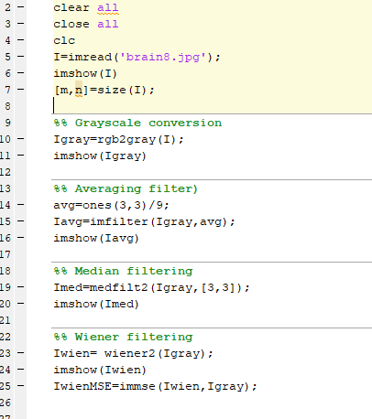
Preprocessing:
Filters used:
Averaging filter
Median filter
Wiener filter
Gaussian

Slide 7
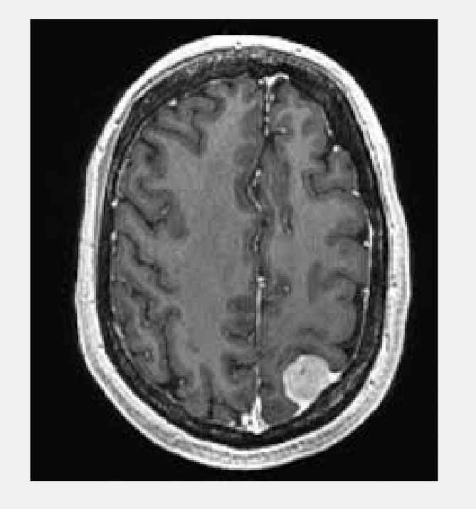
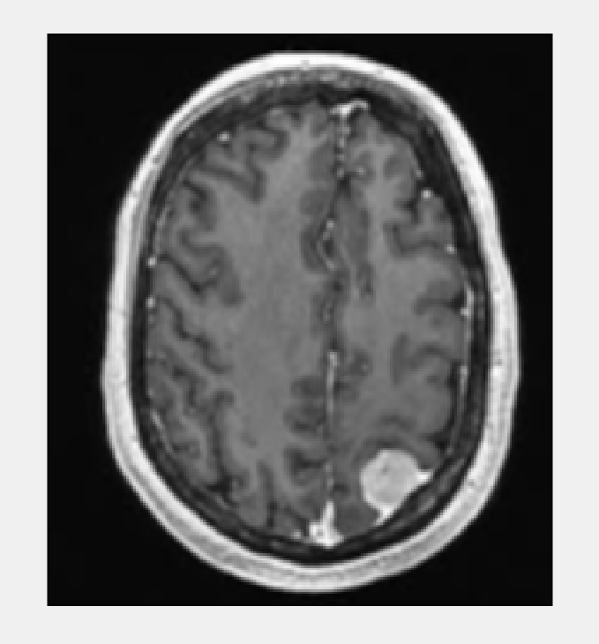
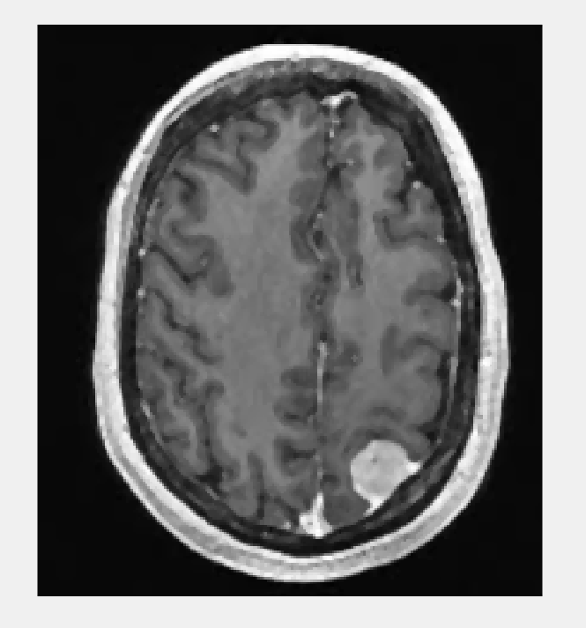
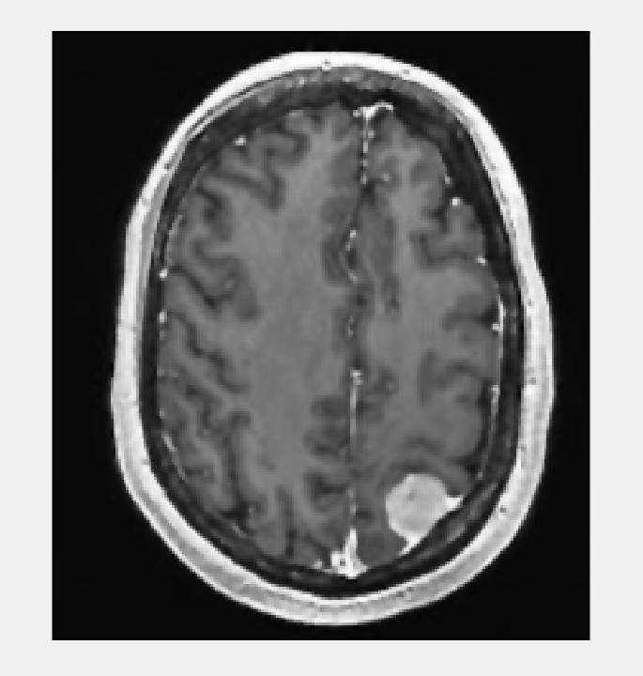
Preprocessed Images:
Original Image
Averaging filter,
MSE: 123.59
Median filter,
MSE: 64.19
Wiener filter,
MSE: 39.58

Slide 8
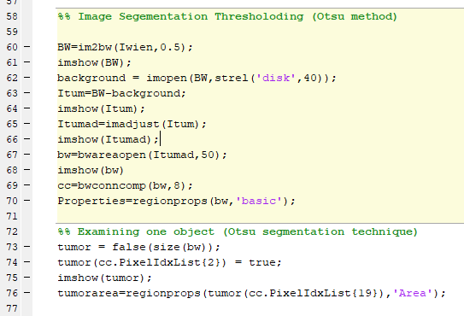
Segmentation Methods:
K-means Clustering
Otsu Method
Watershed Segmentation

Slide 9
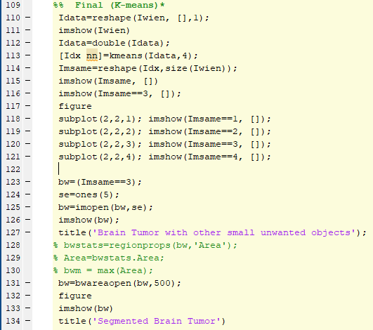
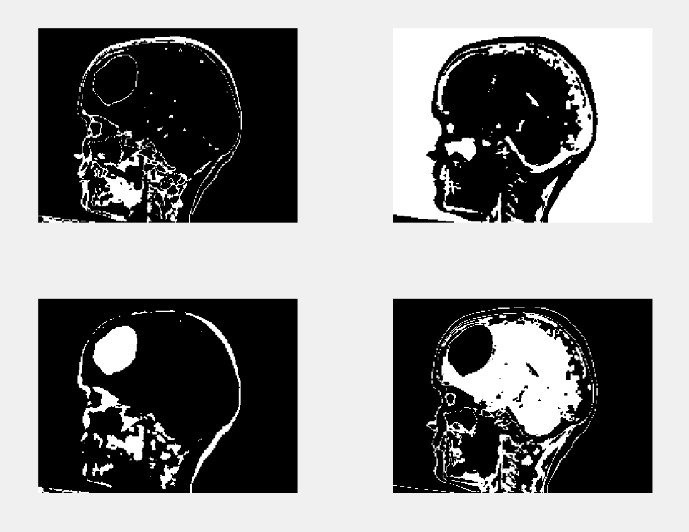
K-means Clustering:
4 Cluster

Slide 10
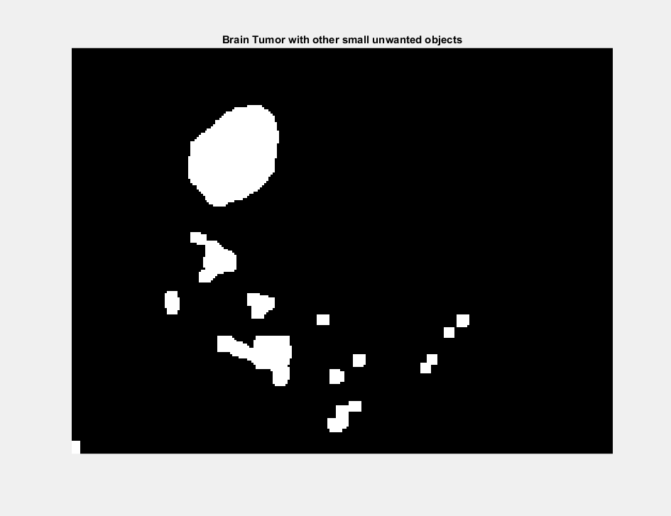
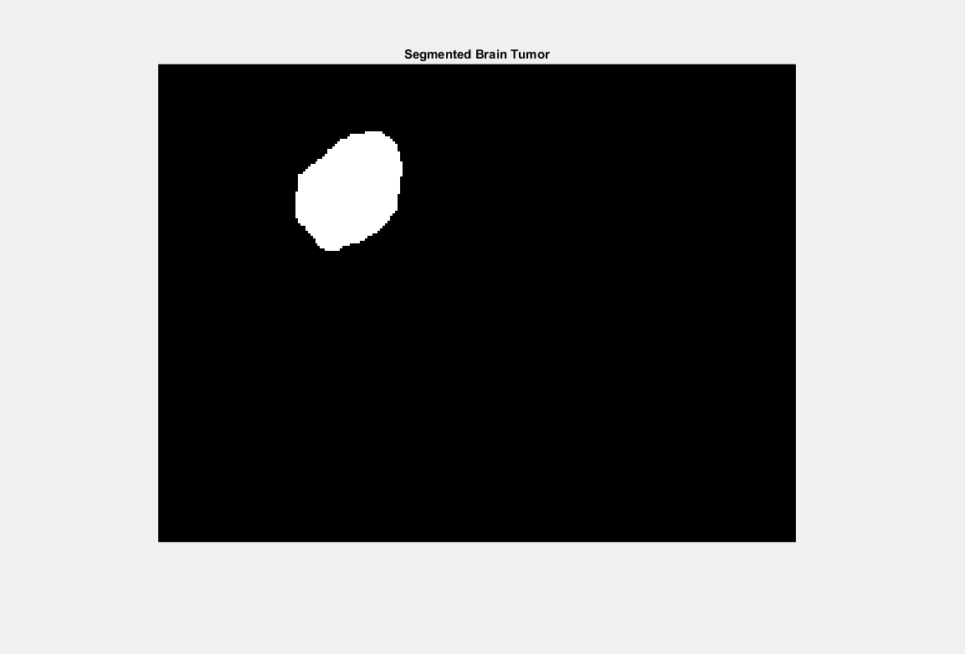
Segmented Brain Tumor:
Brain Tumor with other small objects
Detected Brain Tumor

Slide 11
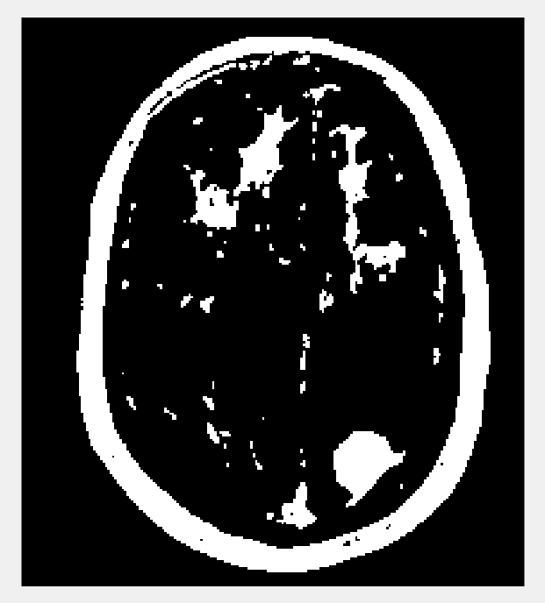
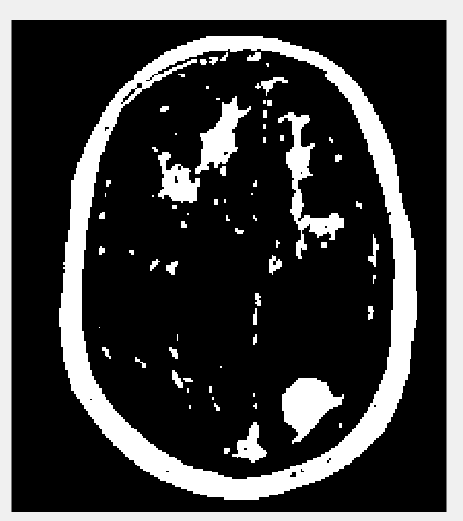
Otsu Method:
After Morphological Opening
Initial Binary Image

Slide 12
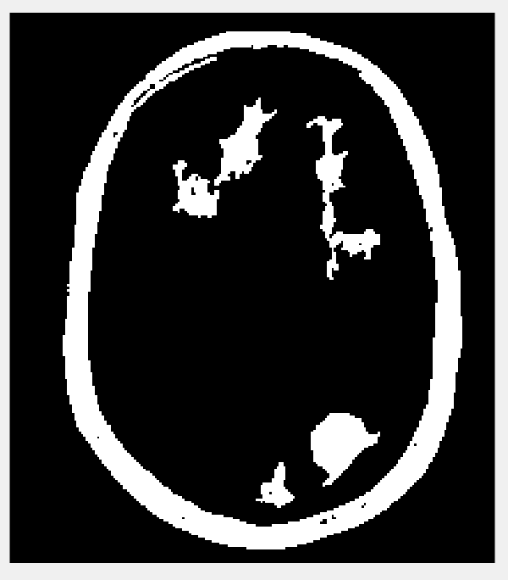

Otsu Method:
After removal of small objects
Segmented Brain Tumor

Slide 13
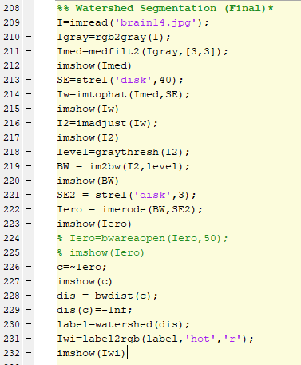
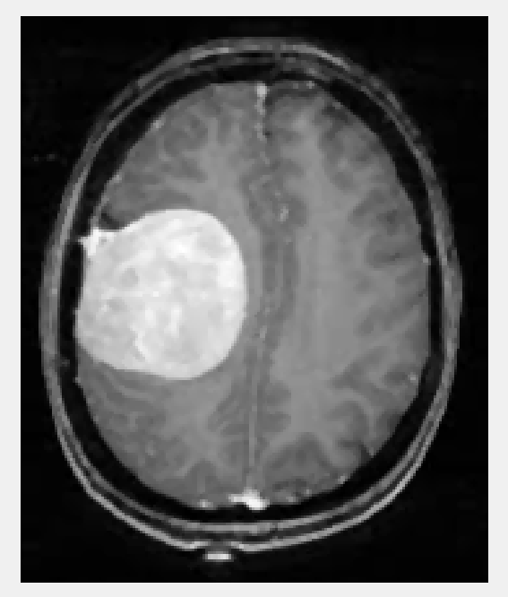
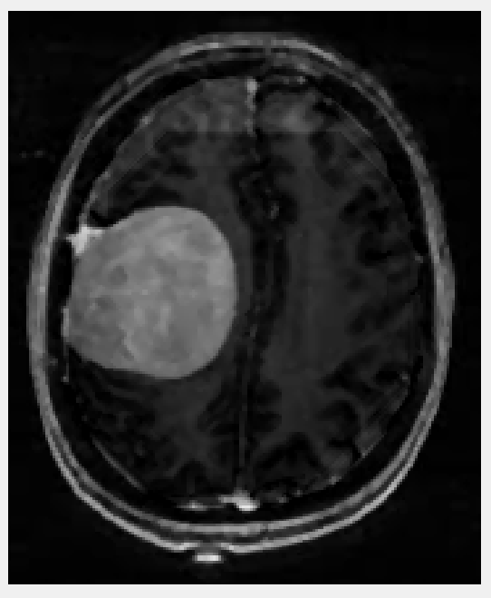
Watershed Segmentation:
Morphological Top-hat filtered image
Preprocessed image

Slide 14
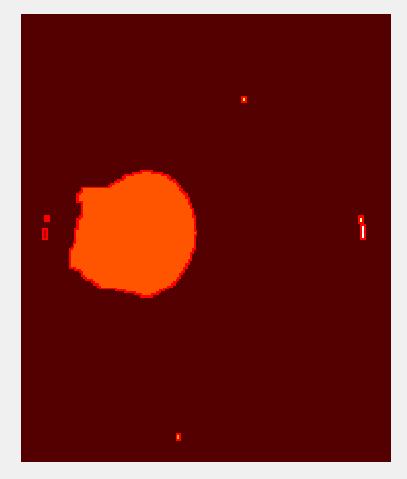
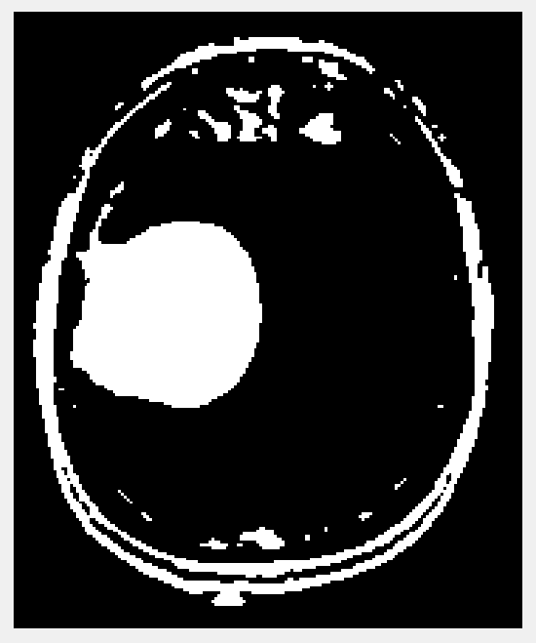
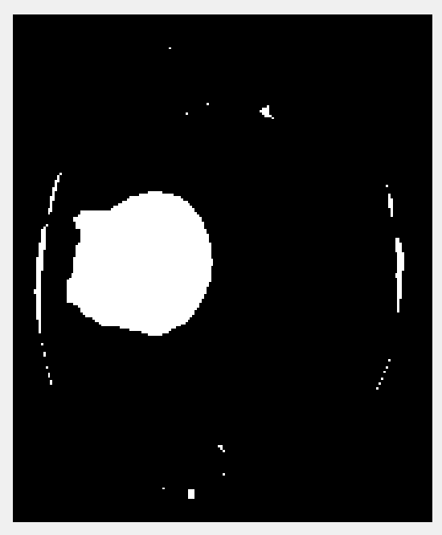
Watershed Segmentation:
After Erosion
Brain tumor detected
Binary Image

Slide 15
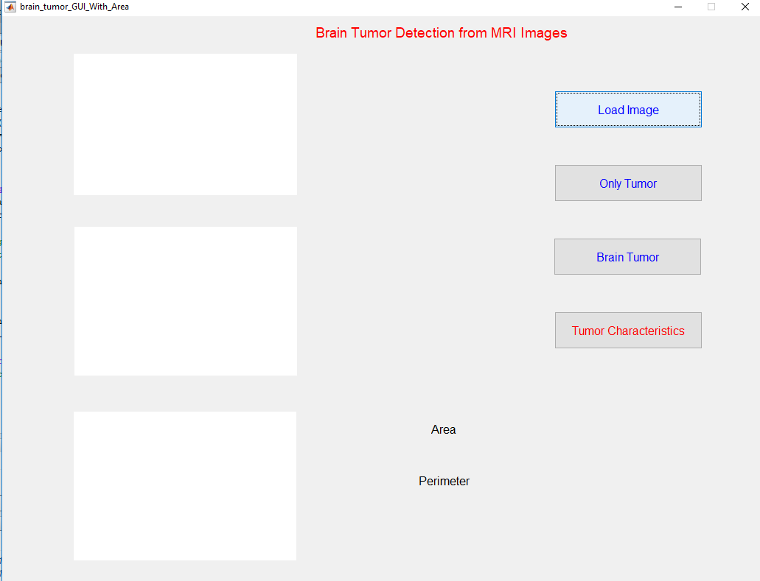
Graphical User Interface:

Slide 16
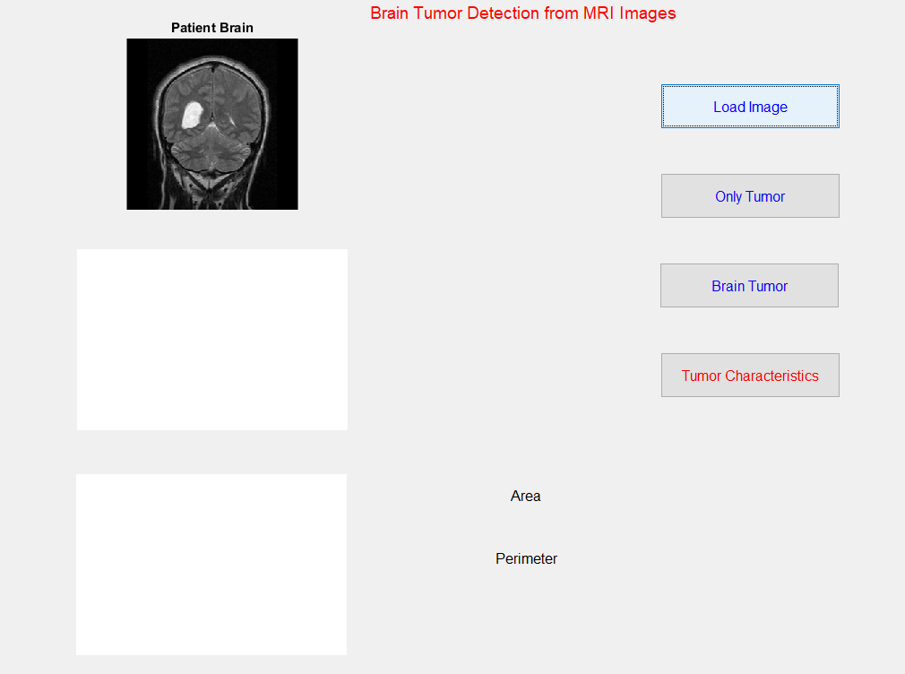
Graphical User Interface:

Slide 17
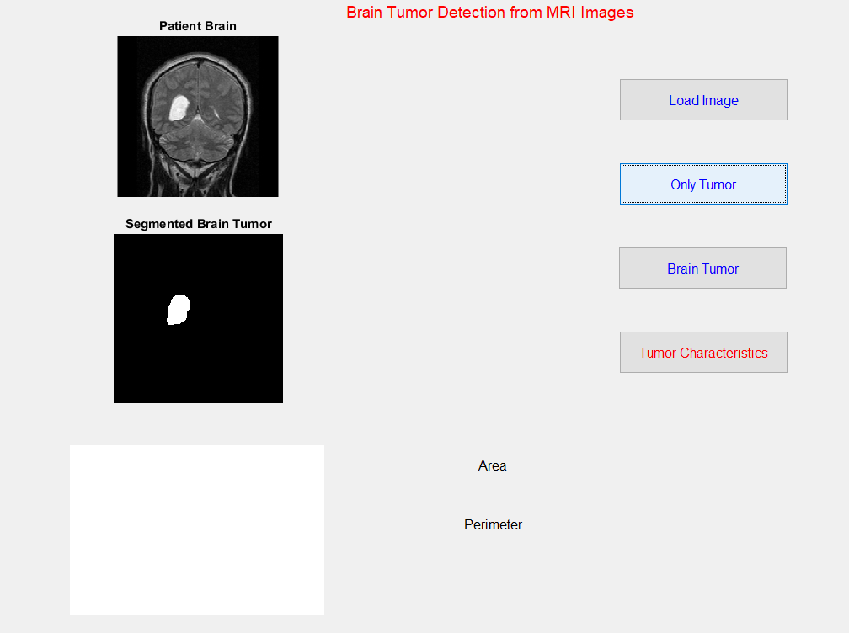
Graphical User Interface:

Slide 18
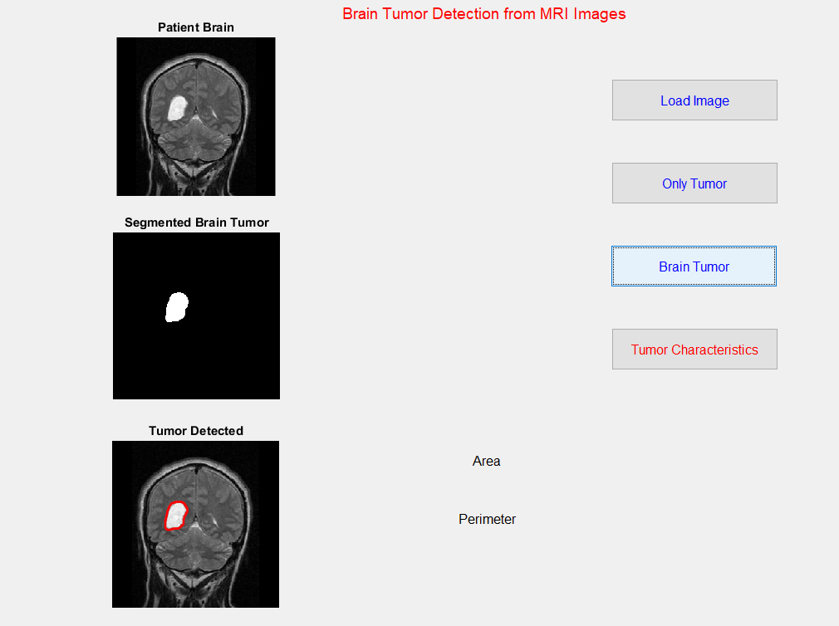
Graphical User Interface:

Slide 19
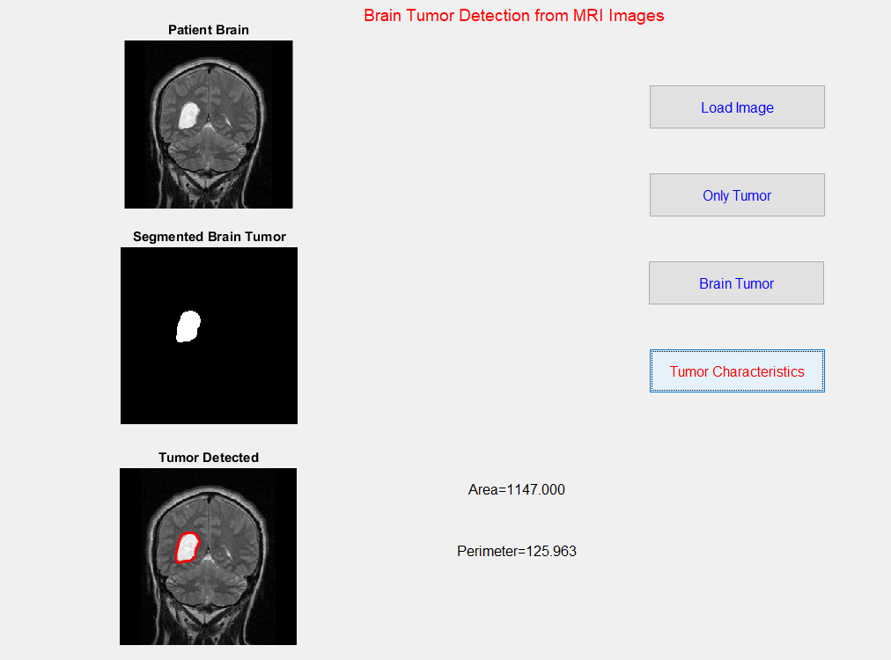
Graphical User Interface:

Slide 20
Advantages:
It can detect the tumor with a good accuracy level.
Very easy to use

Slide 21
Limitations and Future Directions:
Sometimes failed to detect the tumor properly.
More features / characteristics can be extracted.

Slide 22

Questions and Answers:

Slide 23


