Slide 1


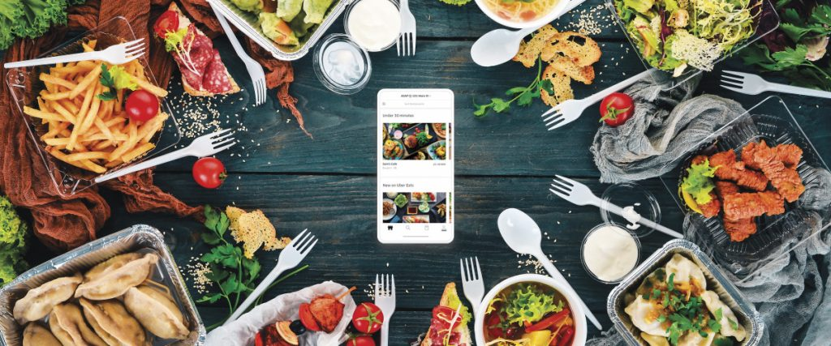
Food ordering system

Slide 2
Group-4
Chaitali Samudre
Shubhangi Kittur

Slide 3
Contents
Problem Statement
Business Requirement
Tools and Technologies
Conclusion

Slide 4
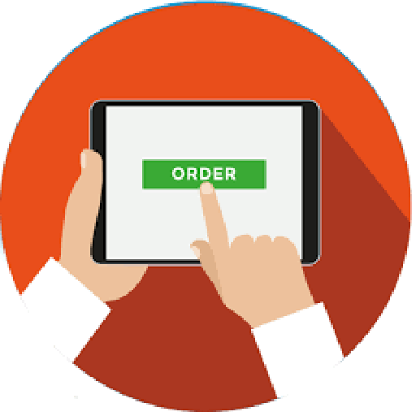
Problem Statement
To build the food ordering clone app like Zomato.
Food ordering app allows users to get their food delivered at their doorsteps.
Allow users to view food and restaurants available for orders and bookings.

Slide 5
Business Requirements.
This application has the login and registration option for the users.
Allow users to view the list of food items and restaurants.
Users can order the food or book a table to visit the restaurant.
Users can also view the membership details to get subscribed for Zomato pro membership.
All the user details and order details are being stored in the database.

Slide 6
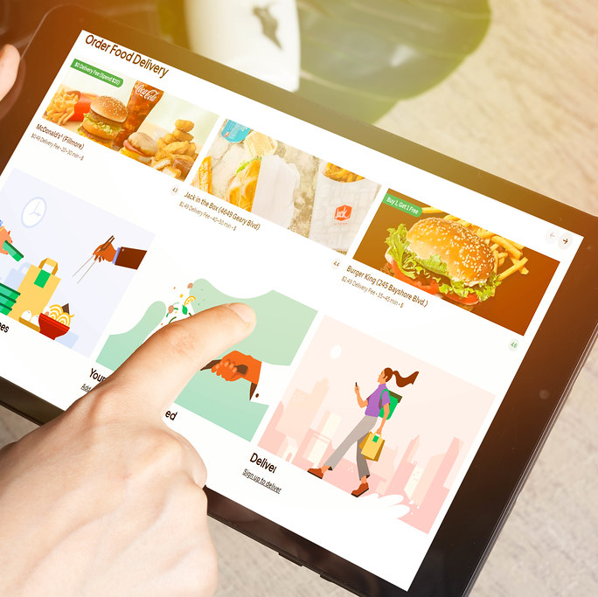
Features of food ordering app
It makes ordering process simple
Efficient order management.
Easy login and registration.
User-friendly interface.
Schedule option.
Feedback from the user.

Slide 7



Tools and Technologies
Angular
MySQL
HTML,CSS
Bootstrap
Postman

Slide 8
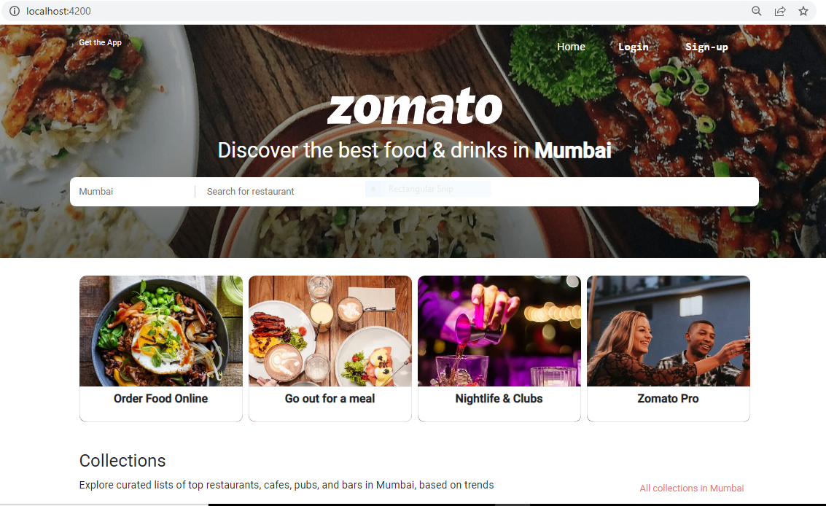
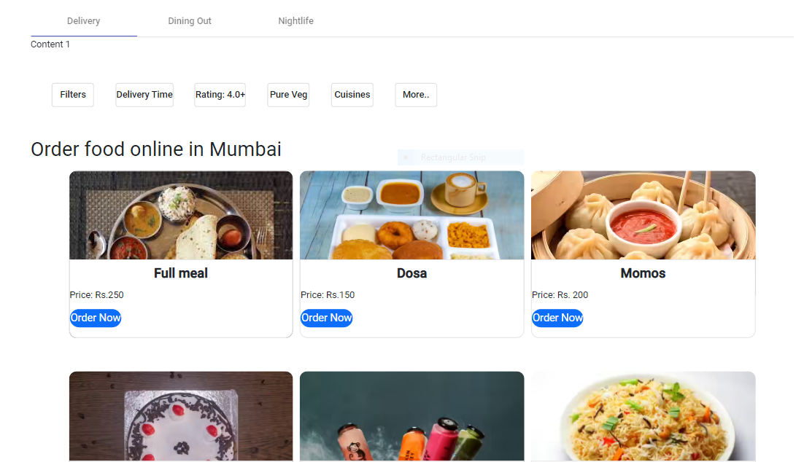
Snapshots
Home Page and Listing page

Slide 9
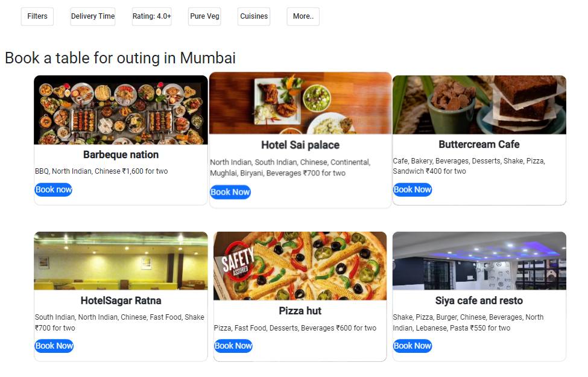
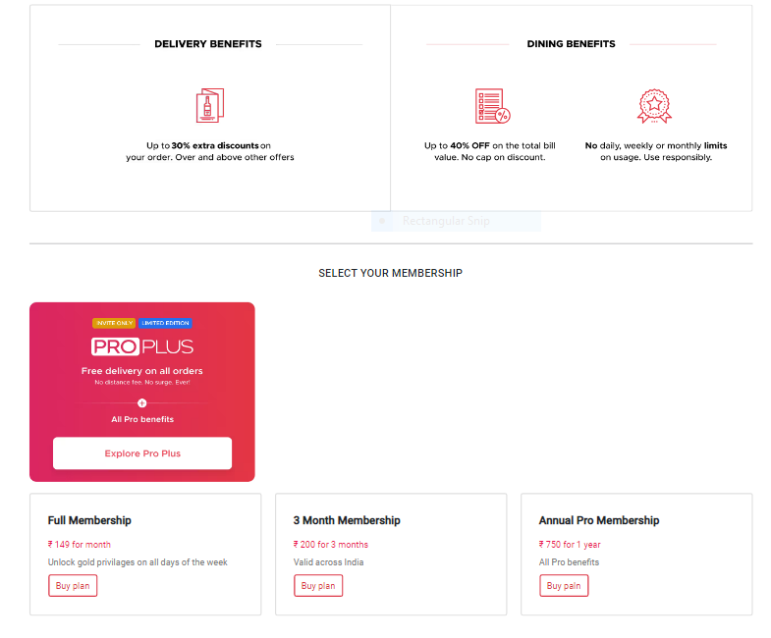
Restaurants and Pro-page

Slide 10
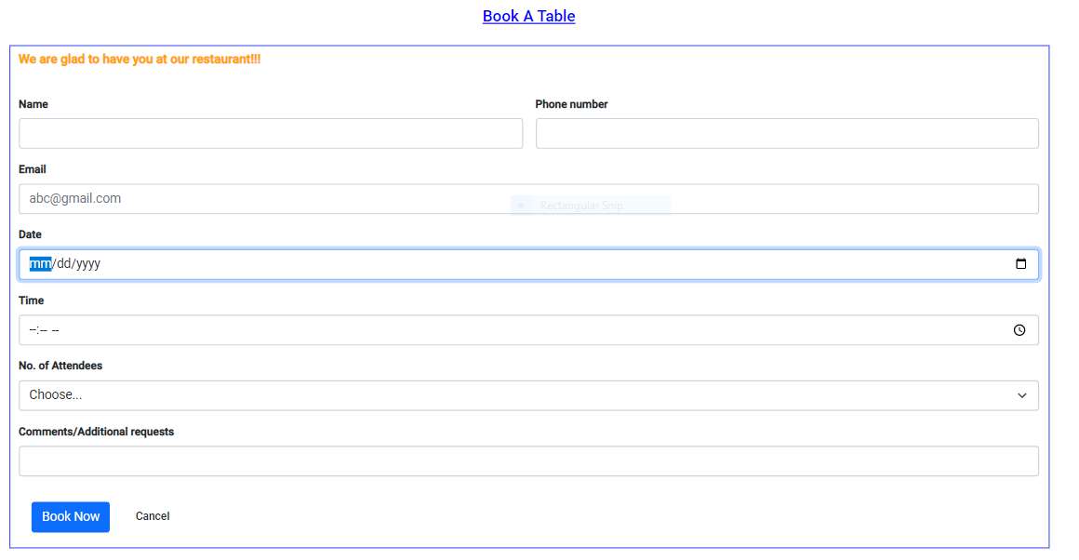
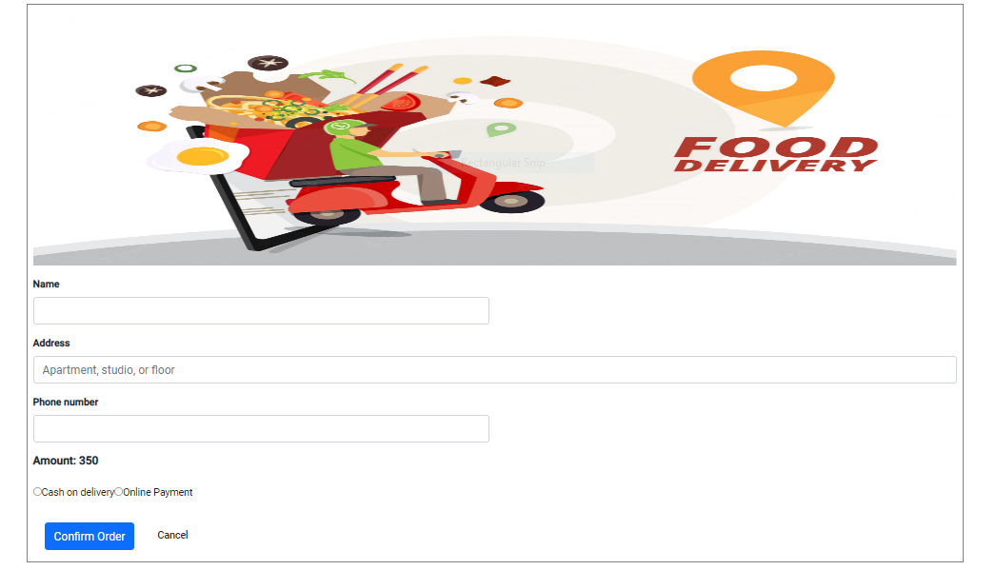
Order-now and book-now

Slide 11
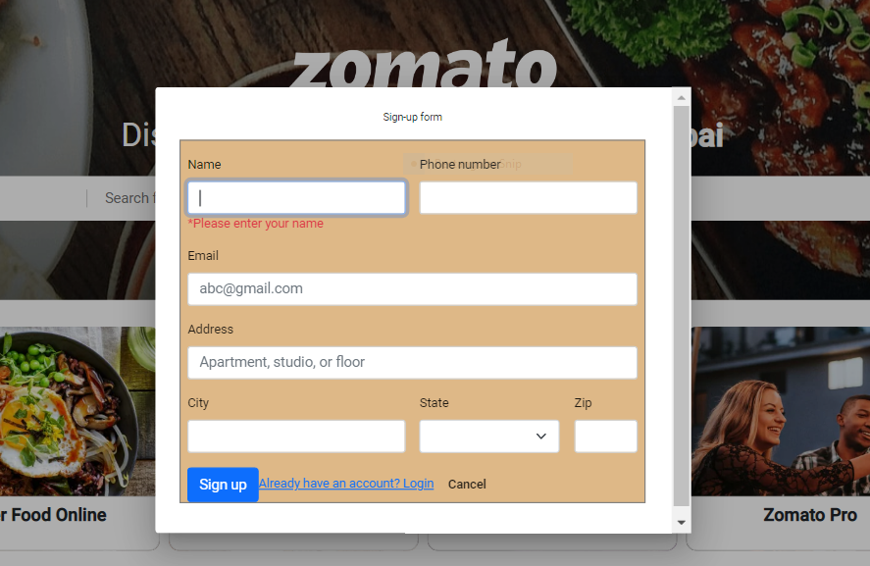
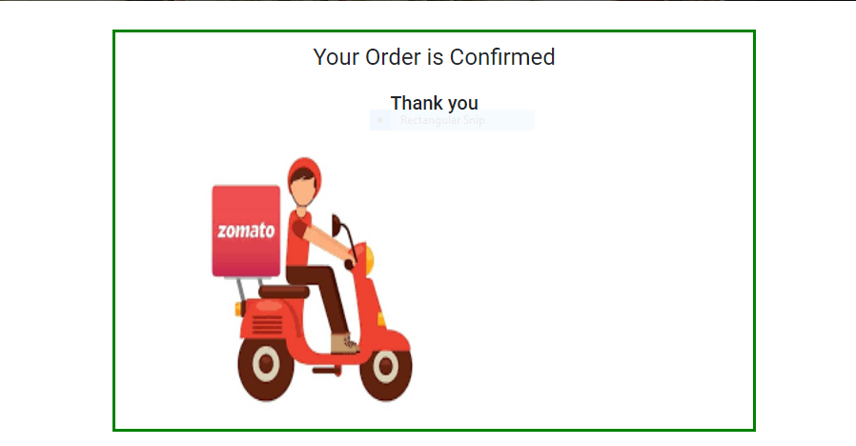
Confirmation and sign-up page

Slide 12
Conclusion
Food ordering application helps the user to view variety of food and order.
Used to avoid last moment rush by providing the option for booking the table.
This app provides user friendly interface which is easy to navigate and search.

Slide 13
THANK YOU

