Slide 1

PORTFOLIO
SHUBHA CHAUDHARY
24 September, 2018

Slide 2
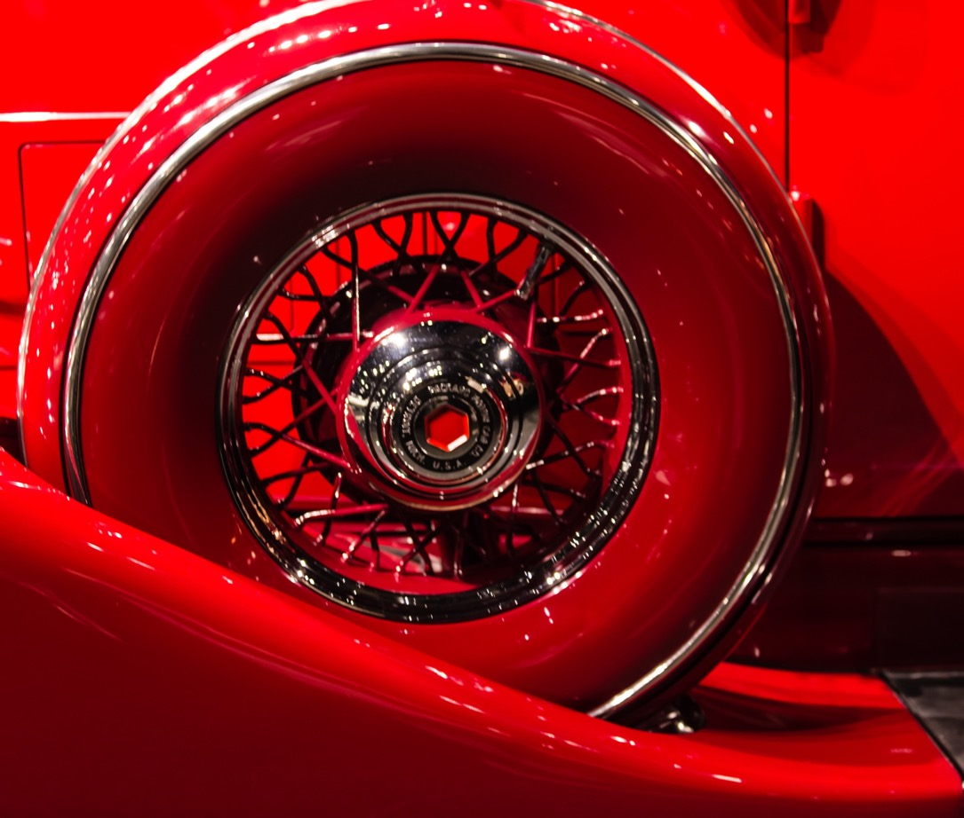

Objective
Portfolio
(Potential
Employers)
Skills
Experience
Talent

Slide 3
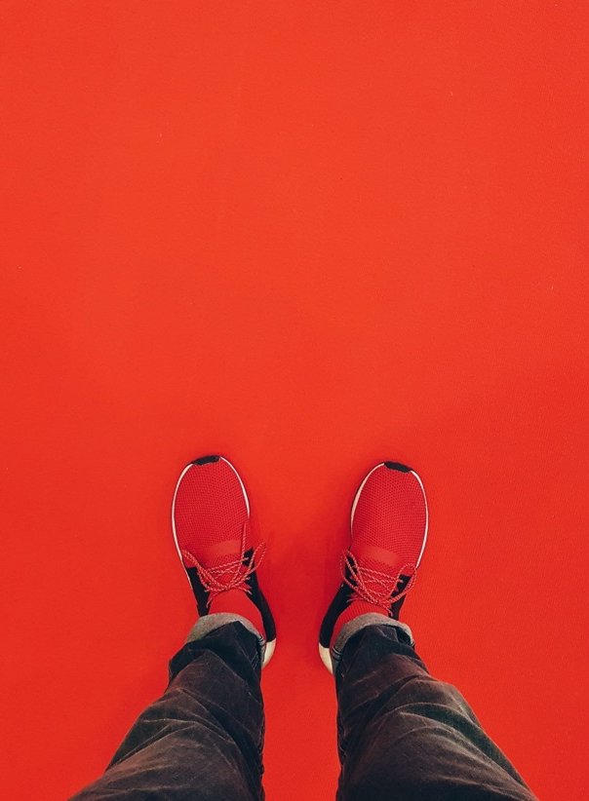

Design Flow
Design Flow
Wireframe.cc
CANVA
MOODZER
Keep it simple and crisp.
Make it responsive across different devices.
Selection of colours ,font size and wireframe.
Flow of the content and nesting the information of same kind in same section.
Include fun without overuse of animation.
TOOLS

Slide 4
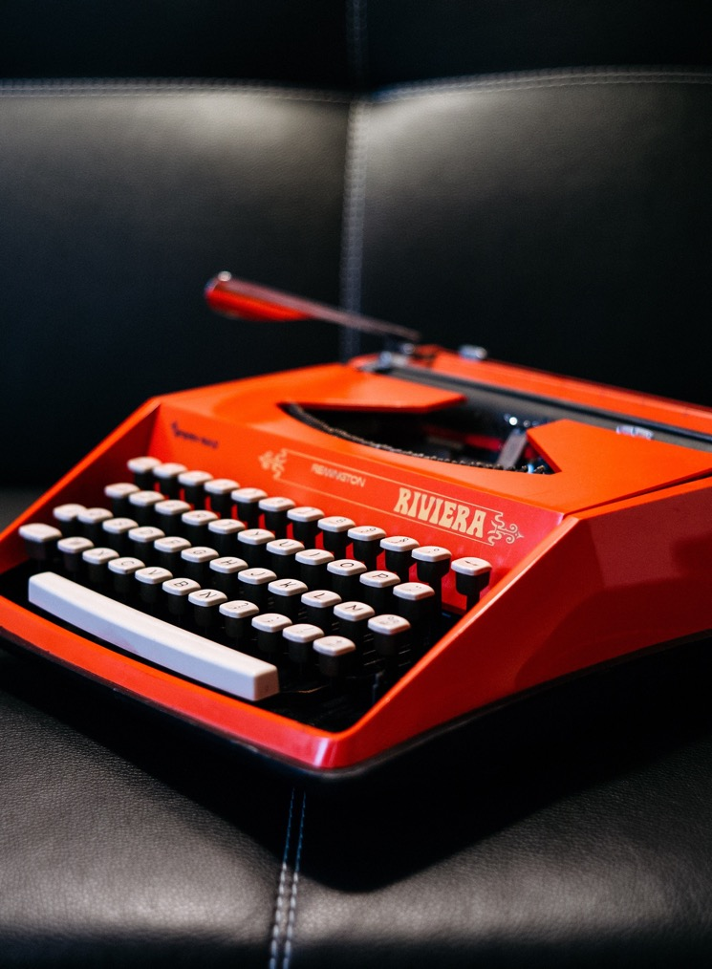
Challenges
From where to start?
Adding responsiveness.
Adding tailor made icon to web-page
Choice of right colour palette.
Animation type.
Right content.

Slide 5
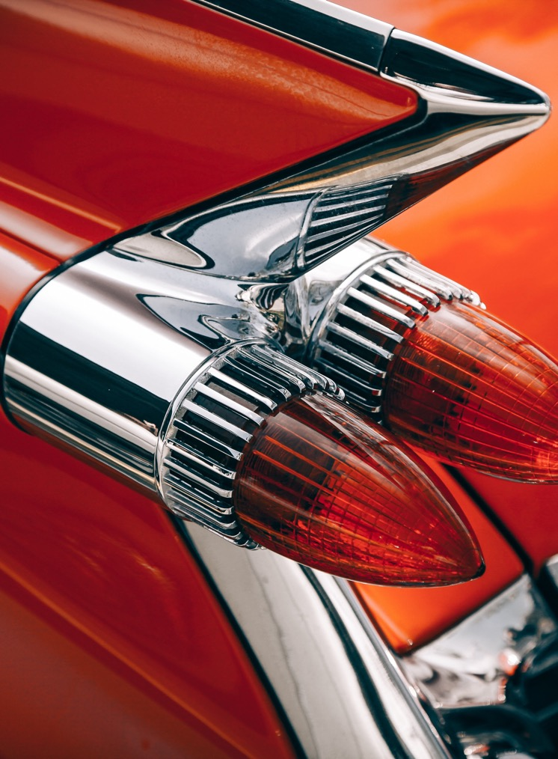
FUTURE IMPLEMENTATION
Index.html | Index2.html | Style2.css
Include typewriter effect | Adding Resume and project page | Adding Scss file
Overlay effect | Addition of more content as the course advance | Java-script to make it more interactive

Slide 6

Quote “We will all die. The goal isn’t to live forever, the goal is to create something that will”

Slide 7

Feedback: Any feedbacks are more than welcome.

Slide 8





THANK YOU
Shubha Chaudhary
0467587988
Shubha.learning@gmail.com
ShubhaChaudhary.github.ib

