Slide 1
FOODBRIDGE AI
Turning surplus food
into timely community support
Agentic food-rescue coordination | SDG 2: Zero Hunger
AICTE | IBM SkillsBuild Machine Learning & Applied AI Internship 2026 | BharatCares
Shubha Sakshi
Dr. Akhilesh Das Gupta Institute of Professional Studies (ADGIPS), GGSIPU
13 October 2026
Working student prototype • Human review required
FOODBRIDGE AI • STUDENT PROTOTYPE
01

Slide 2
01 • PROBLEM
Surplus food is time-sensitive; coordination is fragmented
FoodBridge AI focuses on the handoff between a donor and a potential recipient.
Short pickup window
Uncertain recipient fit
Safety needs people
Surplus may only be available for a limited period. Donors need a quick way to describe quantity, category, location and deadline.
Capacity, food type, travel distance and availability all affect whether a recipient is a plausible match.
Allergens, handling, temperature, transport and actual pickup must be confirmed by responsible humans.
The project opportunity
Help a coordinator go from listing → shortlist → draft plan, while keeping verification and real-world decisions with people.
Alignment: United Nations Sustainable Development Goal 2 — Zero Hunger
FOODBRIDGE AI • STUDENT PROTOTYPE
02

Slide 3
02 • SOLUTION
A guided workflow for food-rescue coordination
The app supports the coordinator; it does not autonomously approve or execute a donation.
For donors
For recipients
For coordinators
Campus canteens, restaurants, bakeries and event organisers can enter surplus-food details in a structured listing.
NGOs and community kitchens are represented in the demo shortlist, with profile fields such as area, capacity and accepted categories.
The workflow makes required checks visible and prepares a draft enquiry for human review.
Prototype outputs
1
Valid listing
2
Match shortlist
3
Priority class
4
Message draft
Missing required details stop the workflow.
Explainable heuristic score and reasons.
Experimental ML: Low / Medium / High.
Gemini or local template; never auto-sent.
FOODBRIDGE AI • STUDENT PROTOTYPE
03

Slide 4
03 • WORKFLOW
Plan → tools → results → human review
A bounded sequence of separate functions provides a traceable path from input to draft.
1
Validate listing
Guardrails
Required fields, positive quantity and safety-check confirmation.
2
Match recipients
No message sending
Heuristic score considers category, capacity, illustrative distance and demo flag.
No pickup confirmation
3
Predict priority
Demo directory only
Saved Random Forest demo estimates Low / Medium / High coordination priority.
4
Draft message
Human approval mandatory
Gemini wording with a safe template fallback.
5
Human checkpoint
Review organisation, capacity, allergens, handling, transport and pickup.
FOODBRIDGE AI • STUDENT PROTOTYPE
04

Slide 5
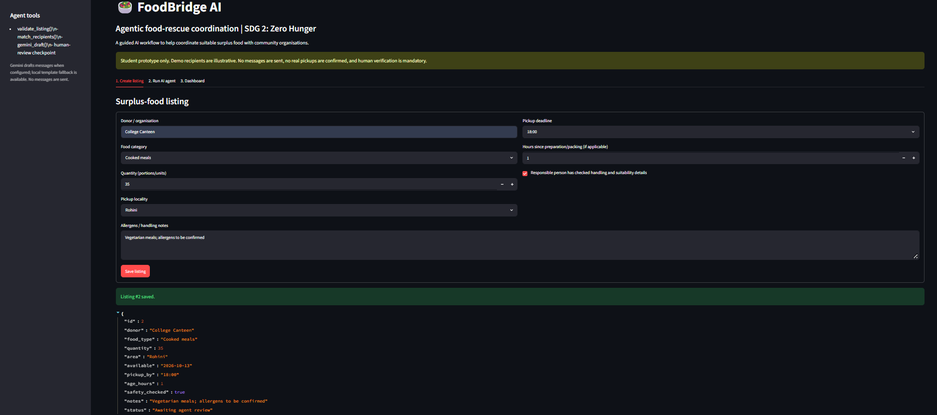
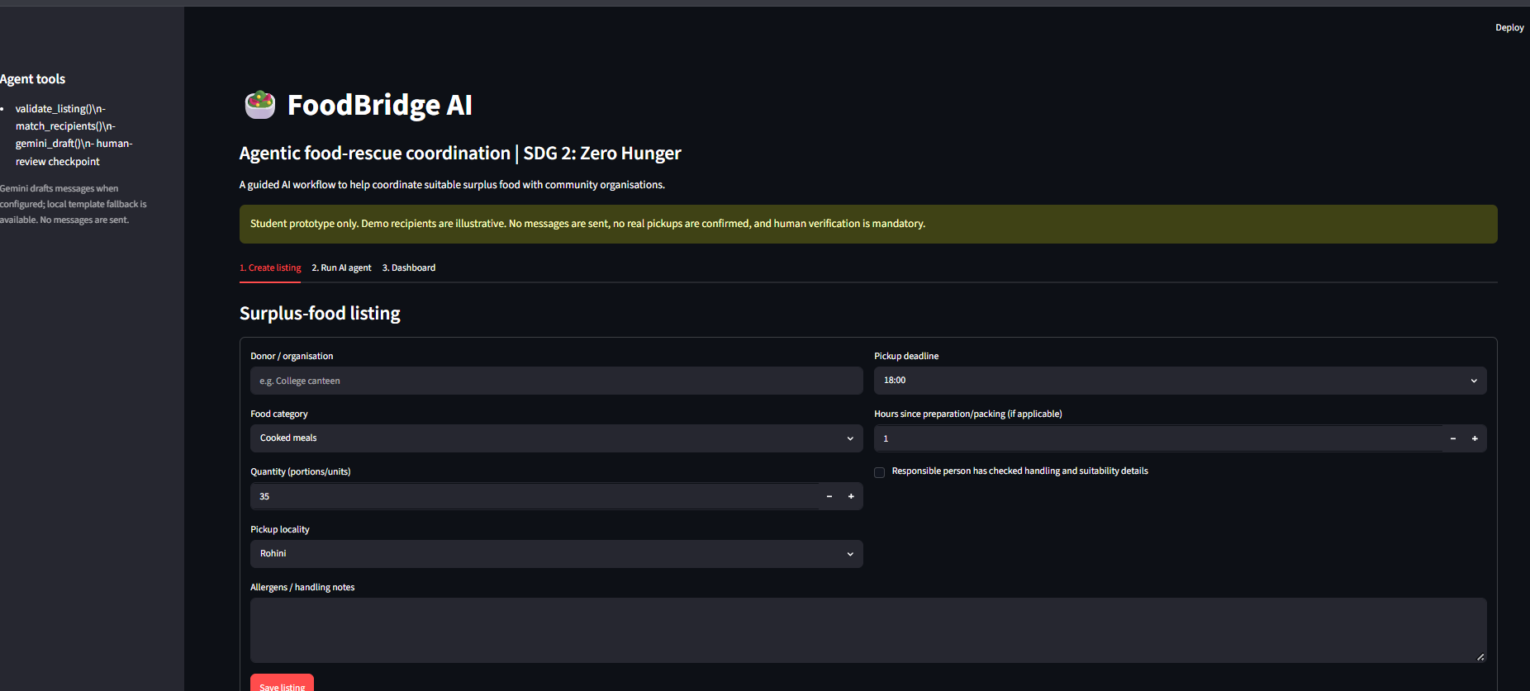
04 • WORKING PROTOTYPE
Screen 1 — Create a food listing
Actual screenshot from the running Streamlit prototype.
Inputs captured
Donor / organisation
Food category and quantity
Pickup locality and deadline
Preparation / packing age
Handling and allergen notes
Validation blocks incomplete listings.
Captured from the working app; the donor fills in fields and confirms the handling-check input.
FOODBRIDGE AI • STUDENT PROTOTYPE
05

Slide 6
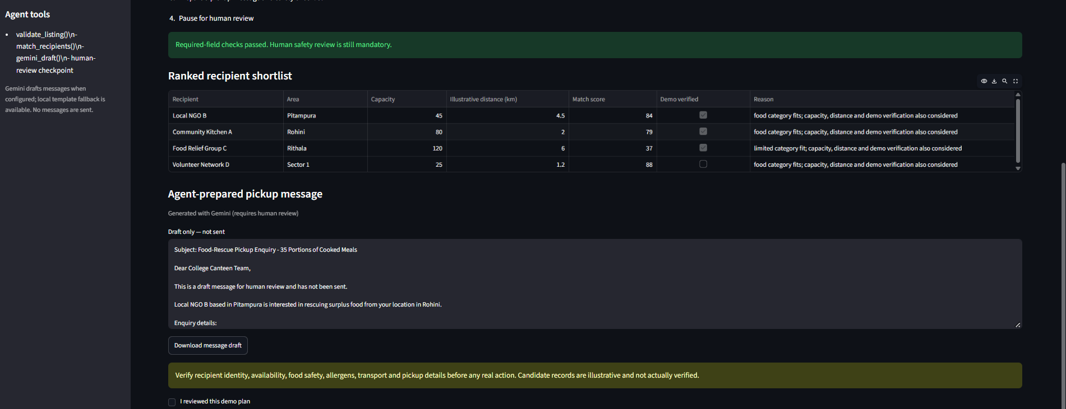
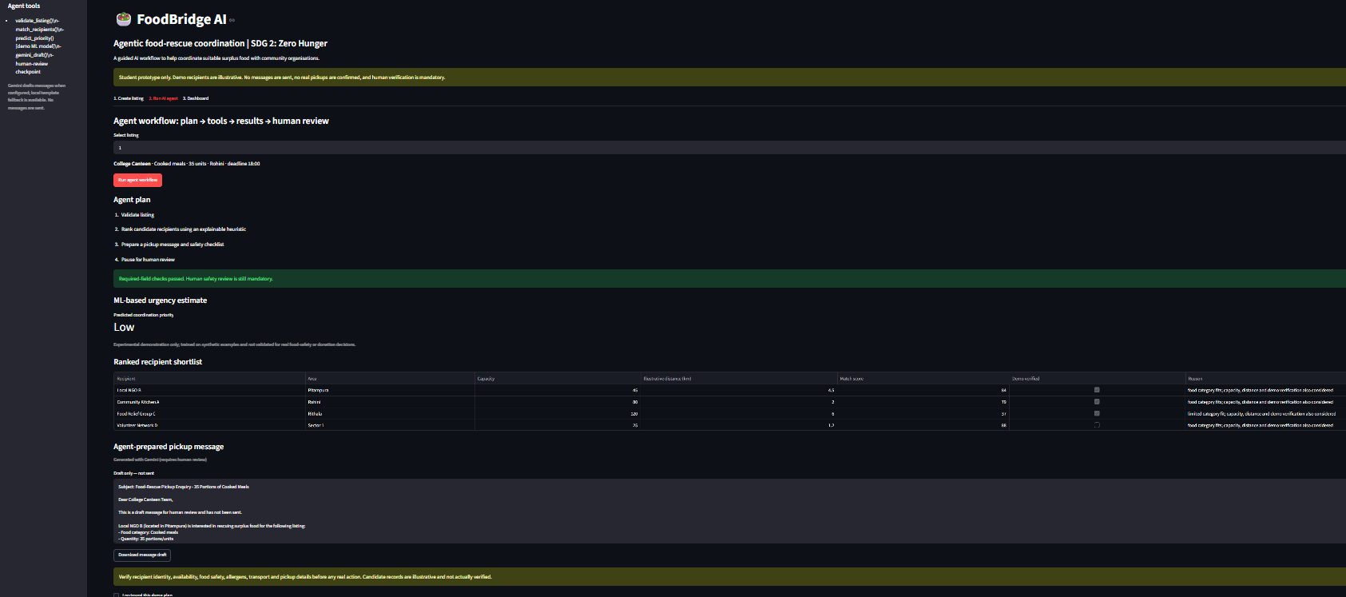
05 • WORKING PROTOTYPE
Screen 2 — Recipient shortlist + Gemini draft
Actual screenshot showing recipient match scores, Gemini-generated wording and the human-review warning.
What this demonstrates
Required-field checks passed
ML priority estimate is available in the workflow
Recipient scores have explanations
Gemini generated a draft
Human review remains mandatory
No email or pickup is executed.
The app remains in demo mode; records are illustrative and the message is not sent.
FOODBRIDGE AI • STUDENT PROTOTYPE
06

Slide 7
06 • MACHINE LEARNING
A genuine training pipeline — with an important data caveat
The saved model is loaded by the app and returns a Low / Medium / High coordination-priority class.
Model
Features
Training data
RandomForestClassifier
120 trees • max depth 8
Saved with joblib
Food category code
Quantity (portions / units)
Age in hours • hours to deadline
1,200 programmatically generated synthetic examples
Stratified 80/20 train/test split
92.1%
Interpretation
The target labels are generated from a hand-crafted urgency score. Accuracy shows the model approximates that synthetic rule; it is not validated real-world performance and must not be used to assess food safety.
holdout accuracy on synthetic data
Future upgrade: identify a real dataset with suitable documented labels before changing the target or claiming real-world predictive ability.
FOODBRIDGE AI • STUDENT PROTOTYPE
07

Slide 8
07 • RECIPIENT MATCHING
Matching is explainable — but not a trained ML model
The shortlist uses a transparent weighted heuristic over illustrative recipient profiles.
Category fit
40%
Important
Capacity fit
30%
The app sorts demo-flagged records ahead of unflagged records, then by score. “Demo verified” is not real-world partner verification.
Proximity
20%
Demo flag
10%
Designed for explanation and testing; not evidence that any real organisation can accept a donation.
FOODBRIDGE AI • STUDENT PROTOTYPE
08

Slide 9
08 • GENERATIVE AI
Gemini drafts language; it does not make operational decisions
The app uses Gemini for wording only and falls back to a local template if the API fails.
Inputs
Prompt guardrails
Output
Donor, food category, quantity, locality, proposed deadline, age notes and illustrative candidate details.
Do not invent facts, certify food safety, claim verification, promise pickup or say the message was sent.
A subject line and pickup enquiry asking a human to verify capacity, availability, allergens, handling, transport and pickup details.
Draft only — not sent
No email integration or external message sending is implemented. The human reviewer must verify every material detail.
FOODBRIDGE AI • STUDENT PROTOTYPE
09

Slide 10
09 • IMPLEMENTATION
Small, modular stack that can be extended
The current implementation is a single-file Streamlit prototype supported by a saved model and dependencies.
1
UI
2
Logic
3
ML
4
GenAI
Streamlit tabs
Listing • Agent • Dashboard
Python functions
Validation • Heuristic matching
scikit-learn + joblib
Random Forest demo model
Google Gen AI SDK
Gemini draft + template fallback
Project files
Security note
app.py — main Streamlit app
Keep .streamlit/secrets.toml local; never commit the Gemini API key to a public repository. Add the secrets file to .gitignore before any GitHub upload.
train_model.py — trains demo classifier
foodbridge_priority_model.joblib — saved model
requirements.txt — Python dependencies
FOODBRIDGE AI • STUDENT PROTOTYPE
10

Slide 11
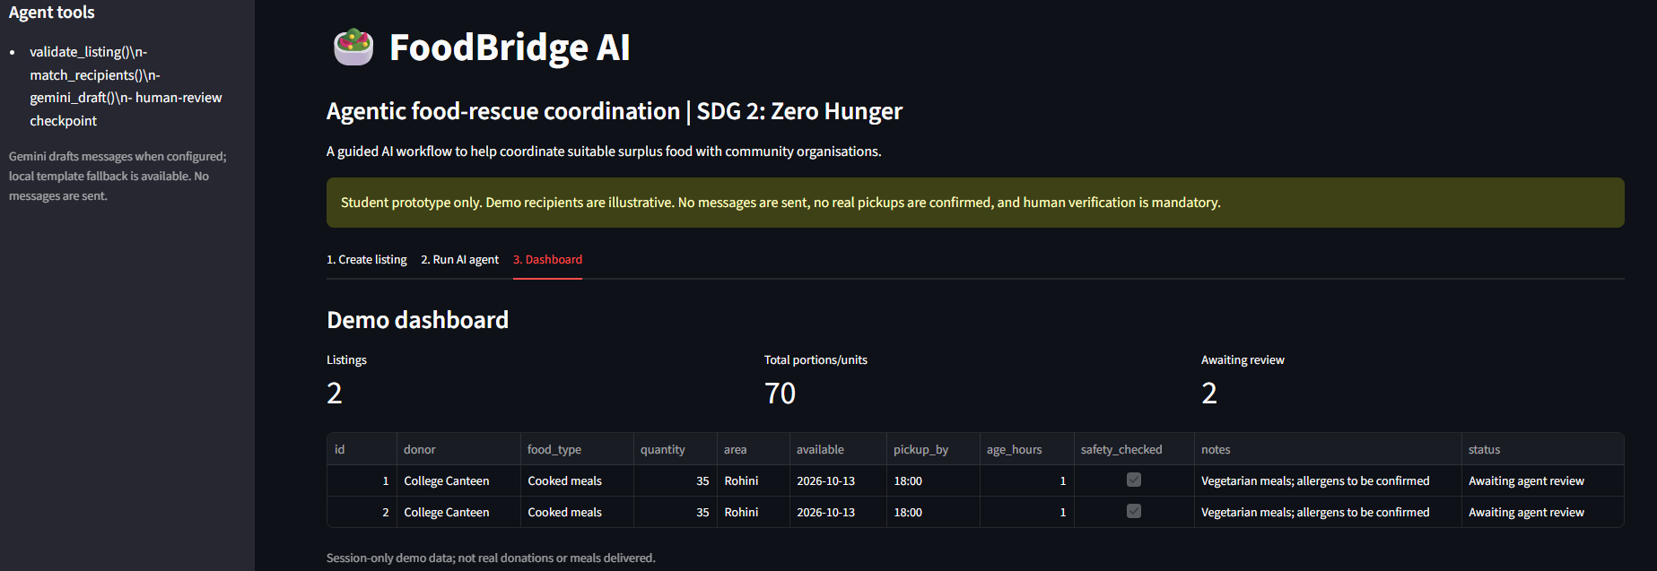
10 • DASHBOARD
Dashboard — session-only activity summary
Actual screenshot from the current app; figures reflect sample entries in one session, not real-world impact.
Metrics shown in this demo
2
sample listings
70
total portions / units
2
awaiting review
Actual app screenshot • session-only sample data
Important: these are session-only demo entries. They do not represent meals delivered, confirmed pickups, verified partners or measured impact.
FOODBRIDGE AI • STUDENT PROTOTYPE
11

Slide 12
11 • RESPONSIBLE NEXT STEPS
From classroom prototype to a credible minor project
The next two months can focus on evidence, model quality and a supervised pilot—not just extra features.
Now — submission-ready prototype
Weeks 1–2 — data discovery
Document current behavior accurately; include real screenshots; keep the synthetic-data limitation visible; protect the API key.
Find a real dataset with documented provenance and a target that aligns with the proposed task. Inspect labels, licence and missingness.
Weeks 3–6 — model study
Weeks 7–8 — validation
EDA, preprocessing, baseline, model comparison, leakage-aware evaluation and error analysis on suitable real labels.
Integrate cautiously; test with verified partners only if available and consented; document limitations and measure actual outcomes.
Safety principle: no model prediction can certify food safety or replace responsible human judgement.
FOODBRIDGE AI • STUDENT PROTOTYPE
12

Slide 13
FOODBRIDGE AI
AI that supports people
coordinating food rescue.
Validate • Rank • Estimate priority • Draft • Review
Thank you
Shubha Sakshi | Dr. Akhilesh Das Gupta Institute of Professional Studies (ADGIPS), GGSIPU
Current prototype: illustrative recipient data, synthetic-data ML demo, Gemini message drafts, human approval required.
FOODBRIDGE AI • STUDENT PROTOTYPE
13

