Slide 1
KINEMATICS AND PATH PLANNING OF 8 DOF ANTHROPOMORPHIC ROBOTIC ARM
ROBOTIC MANIPULATORS (ME 512): TERM PAPER FINALS
SHUBHA TANAYA (2021MEB1325)
HARSH GUPTA (2019MED1008)
DEPARTMENT OF MECHANICAL ENGINEERING INDIAN INSTITUTE OF TECHNOLOGY, ROPAR

Slide 2
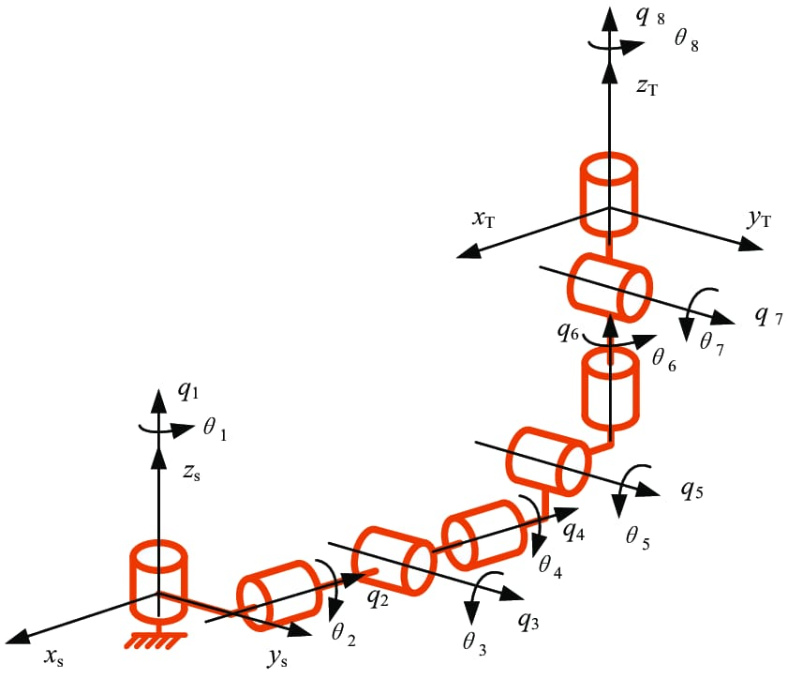
MAJOR ELEMENTS PROPOSED IN PRELIMS:
Major focus will be on the following topics about the 8 DOF Anthropomorphic robotic arm:
Understanding and computing the Denavit-Hartenberg (DH) parameters.
Developing the kinematic model for the arm based on the DH parameters.
Computing the forward kinematics of the manipulator.
Going through the derivations of the cubic joint path planning algorithm, and its coding in the MATLAB environment.
Discussion pertaining to the results (like torque generated at each point, joint position, angular velocity of the member links) obtained for the input trajectories derived using the path planning algorithm coded in MATLAB, and also analyzed with the help of the RoboAnalyzer software.

Slide 3
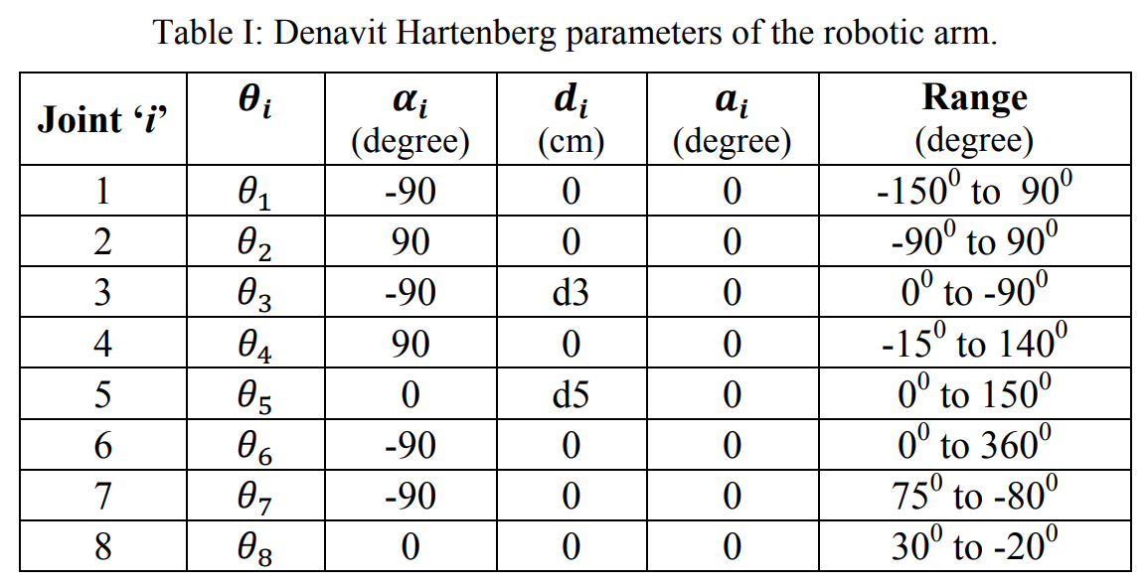
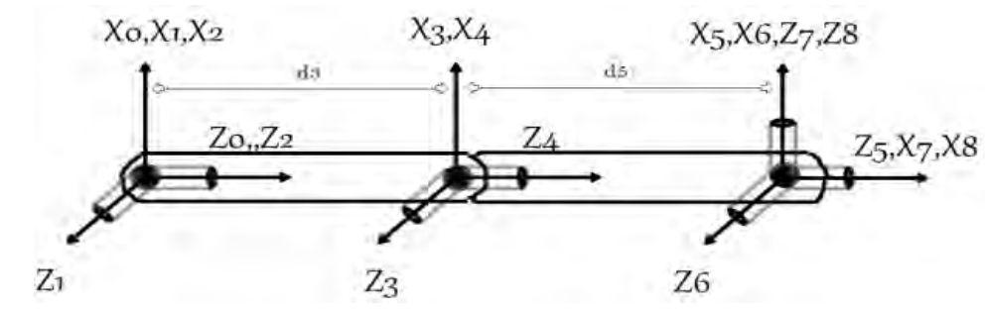
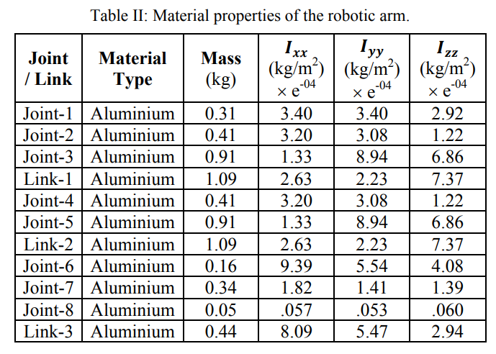
METHODOLOGY DETAILS:
Modelling of Anthropomorphic Arm:
Frame assignment and setting DH conventions
Computation of Transformation Matrices

Slide 4
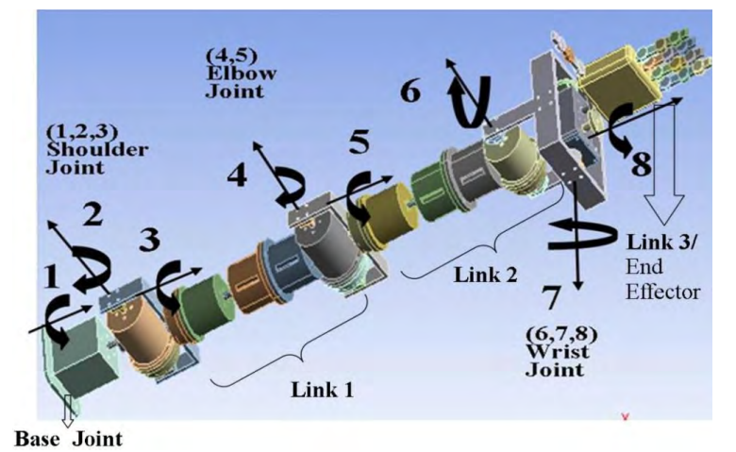
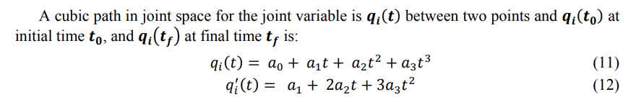

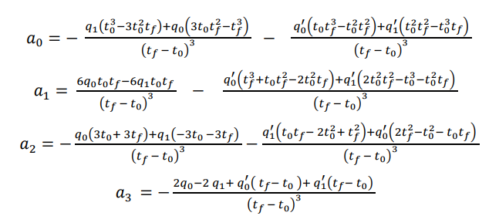
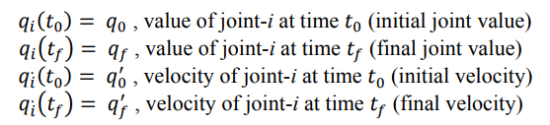
METHODOLOGY DETAILS:
Derivation of Joint Cubic Path Algorithm:
Frame assignment and setting DH conventions:

Slide 5
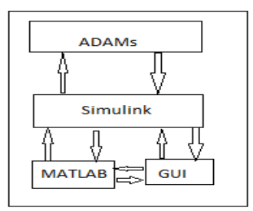
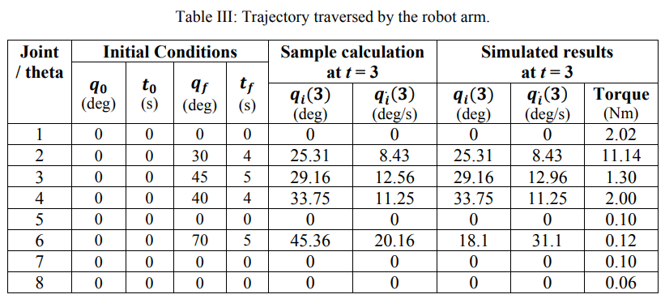
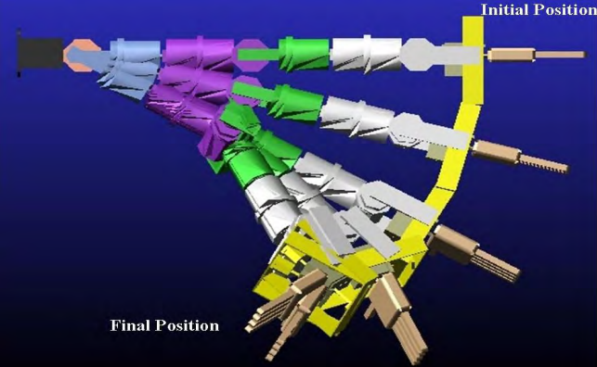
APPROACH (ANALYTICAL/MODELLING):
Adopted by Research Paper:
Design using Pro-E tool, invocation in ADAMS software,
Co-simulation along with Simulink.
Adopted by us:
Verification of results of algorithm via MATLAB code,
RoboAnalyzer Software,
Robotics Toolbox.

Slide 6
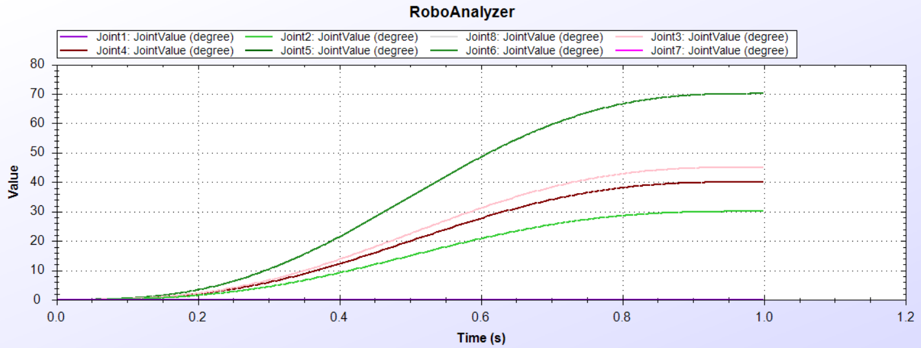
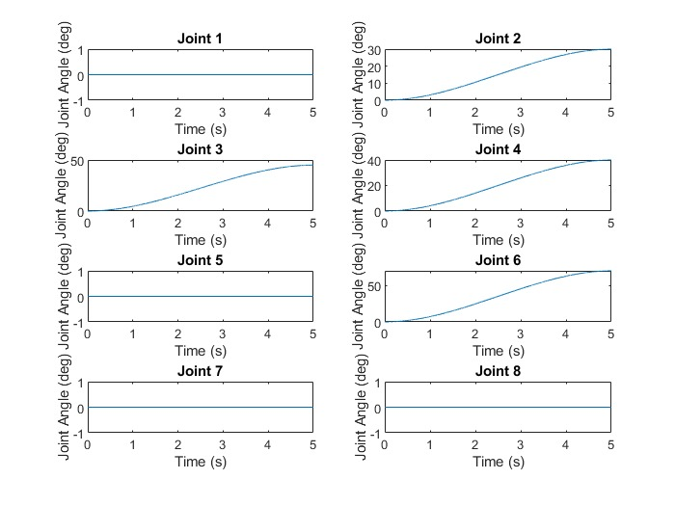
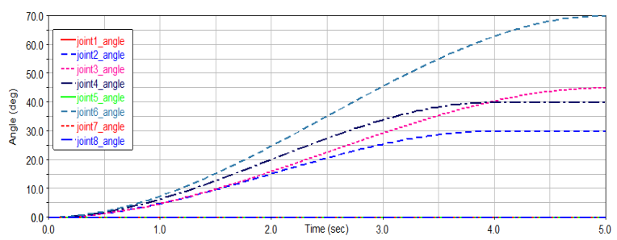
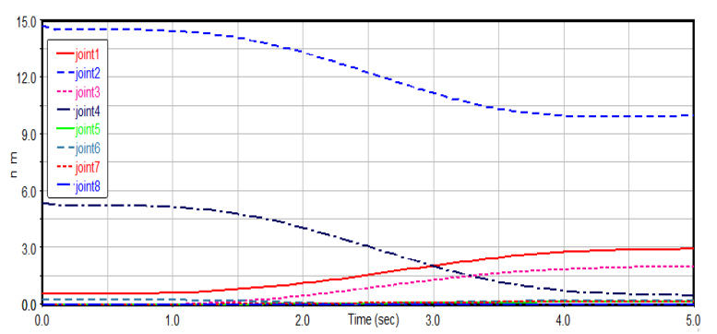
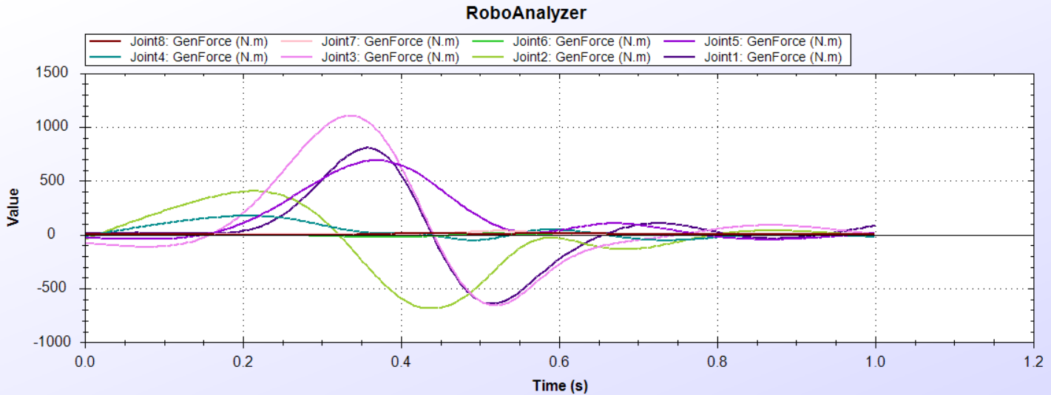
RESULTS:
JOINT ANGLE VALUES
(RoboAnalyzer)
JOINT TORQUE VALUES
(RoboAnalyzer)
JOINT ANGLE VALUES
(MATLAB code of Path Planning ALgorithm)
RESEARCH PAPER RESULTS

Slide 7
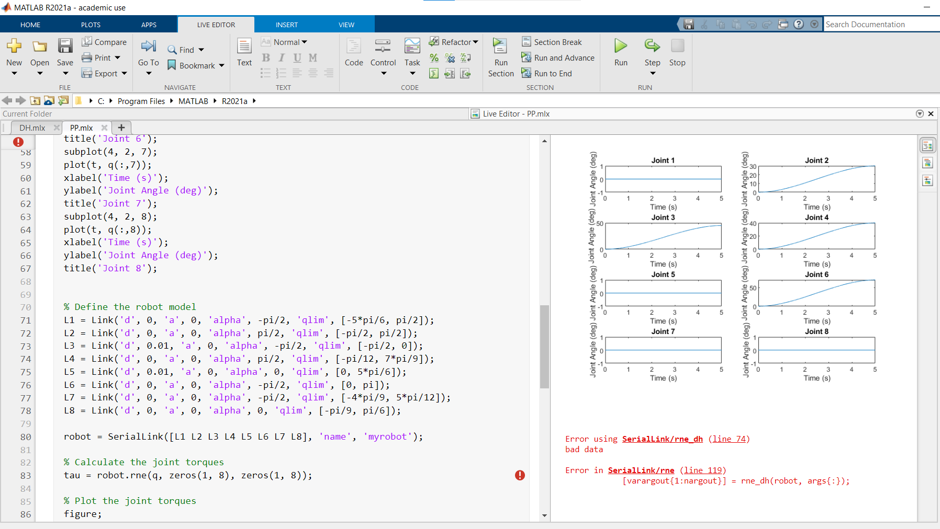
DISCUSSIONS:
Limitations??
DH parameters rendered invalid by Robotics Toolbox
Results achieved in the paper, as well as those obtained from RoboAnalyzer and MATLAB are quite similar, within the range of the path traversed by the Anthropomorphic Arm.
Due to the dynamic motion of the arm, some amount of torque is generated at joints where motion is not applied.
The angular velocity of these points is zero, which infers this is the holding torque during this motion, which keeps the arm stable.
Suitable selection of the actuators is very important to keep this torque into consideration, as it significantly impacts the efficiency of motion generated by the arm.

Slide 8
CONCLUSIONS AND FUTURE SCOPE:
In this study, an 8 DOF Anthropomorphic Robotic Arm was developed, its kinematics was calculated and its path planning was done, using the Joint Cubic Path Planning algorithm.
Such an arm with extended functions is useful for several applications, including Industrial Automation, Medical Robotics, Inspection and Maintenance, Space exploration, Military and Defense, Rehabilitation, precise manipulation of objects, and so on.
The methods adopted in this study suggested that the path planning algorithm was successful since the arm traversed in the desired path (verified by MATLAB code, RoboAnalyzer Software and the results from the research paper).
The procured results also give a clear idea about the joint angles, torque generated at the joints etc. for the system, which are important for the accurate selection of actuators for control.
In future, this model may be developed upon and further enhanced with the usage of much advanced autonomous control algorithms designed using neural networks, as well as the fuzzy logic toolbox present in MATLAB, in order to control the Humanoid arm.
THANK YOU!!

