Slide 1
Workout & diet planner
CAPSTONE PROJECT
Presented By:
1. Shubhagaman Singh, AKTU, CSE

Slide 2
OUTLINE
Problem Statement
System Development Approach
Algorithm & Deployment
Result
Conclusion
Future Scope
References

Slide 3
Problem Statement
Most fitness and wellness applications provide generic workout and diet plans that fail to consider individual differences such as body type, fitness goals, health conditions, cultural food preferences, or access to specific ingredients and equipment. As a result, students often find these plans impractical, expensive, or difficult to maintain, leading to poor consistency and limited results
Problem: There is a critical need for an AI-powered personalized fitness and diet planning system that adapts to each student’s unique lifestyle, food habits, fitness goals, and available resources—ensuring the recommendations are realistic, affordable, and sustainable for long-term health improvement..

Slide 4
System Approach
Frontend | Streamlit app for user interaction (chat UI, input/output display)
Backend | Python logic to handle chat flow, model inference, and session state
Model Engine | LLaMA-based model (e.g., via HuggingFace Transformers or llama.cpp)
Data Handling | Optional logging, feedback collection, or prompt templates

Slide 5
Algorithm & Deployment
1. Privacy & Security
User conversations must be confidential and not stored without consent.
No personally identifiable information (PII) should be collected or exposed.
Secure communication using HTTPS.
2. Availability
The chatbot should be accessible 24/7 to support users during emotional distress.
Minimal downtime during updates or maintenance.
3. Performance
Response time should be under 2 seconds for typical queries.
Efficient memory usage to support low-resource devices (especially if using LLaMA locally).
4. Usability
Clean, intuitive interface with empathetic tone and easy navigation.
Mobile-responsive design for accessibility on phones and tablets.
Use of icons and emotional cues to guide user interaction.
5. Scalability
Should support increasing user load without degradation in performance.
Modular architecture to allow future integration (e.g., journaling, voice input, multilingual support).

Slide 6
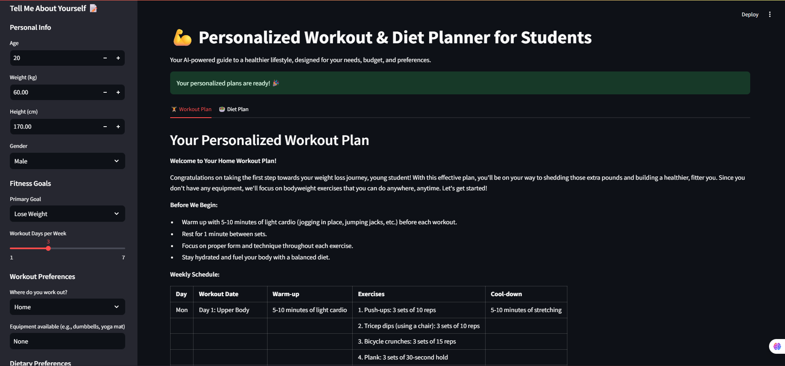
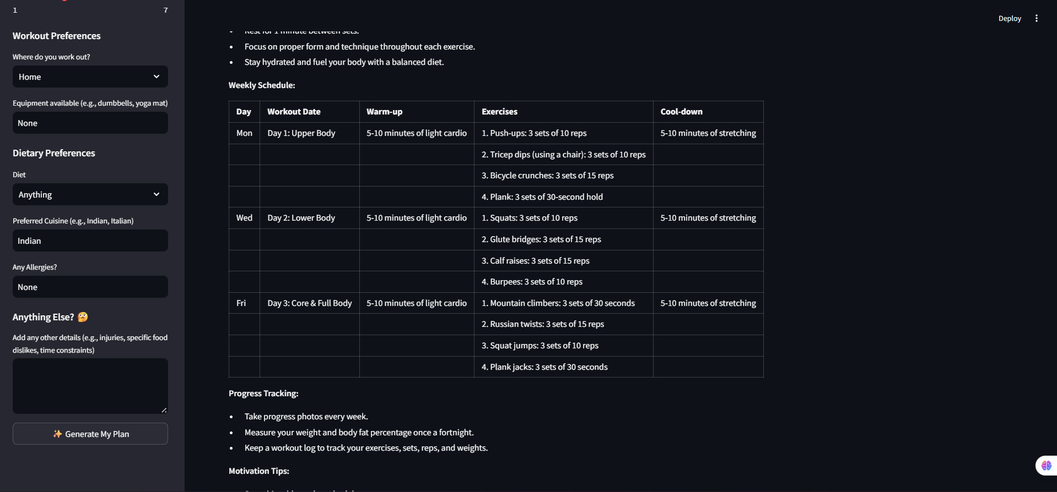
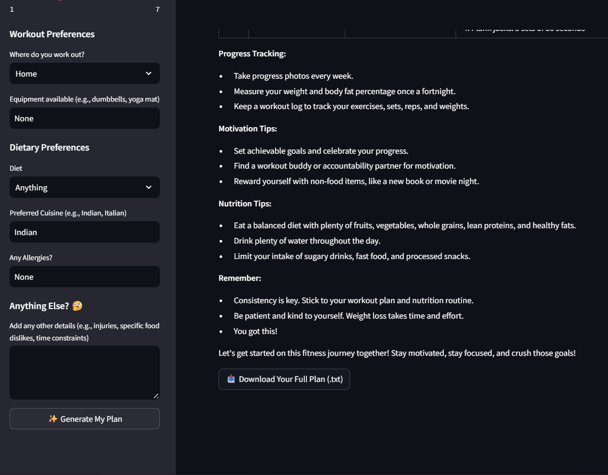
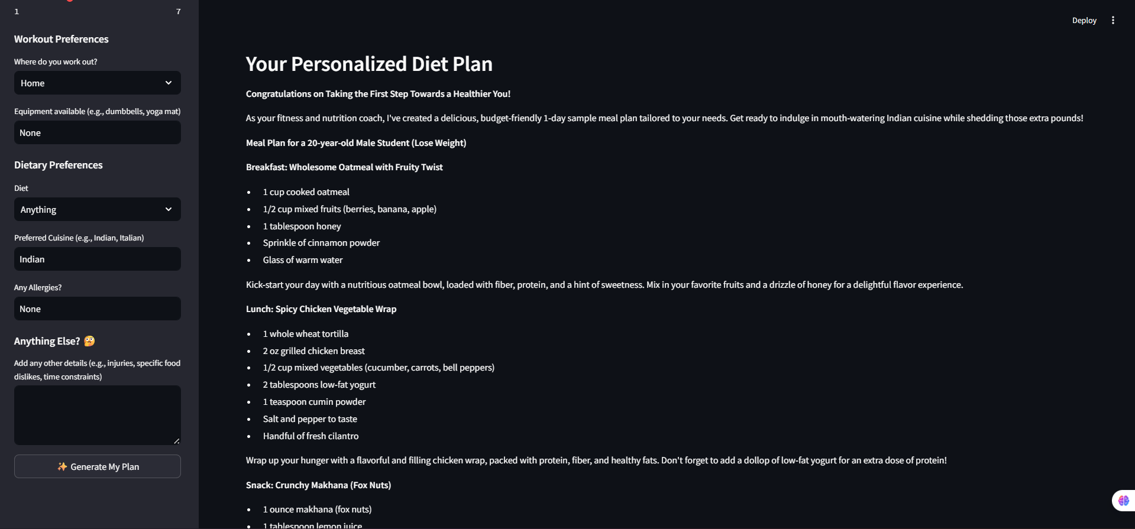
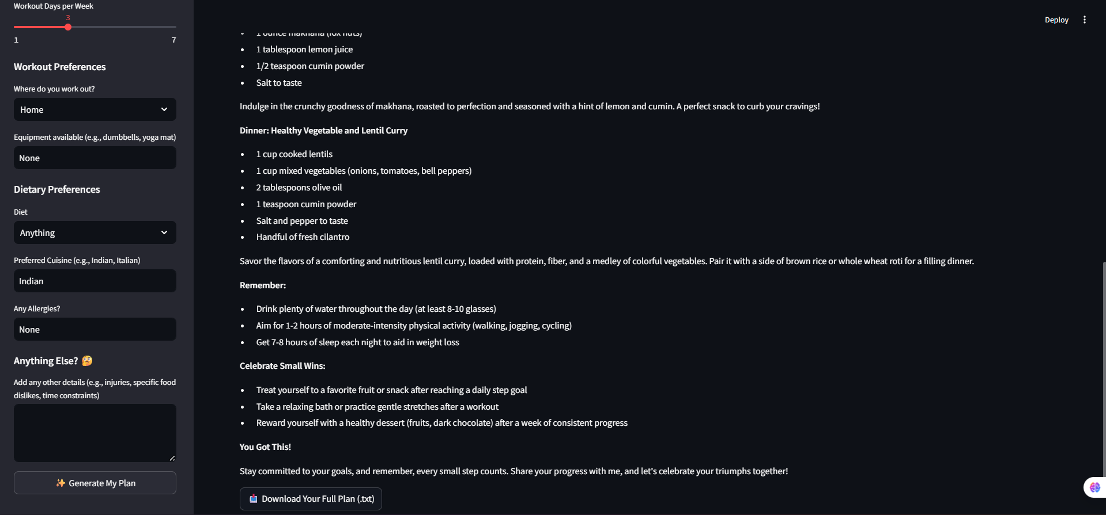
Result

Slide 7
GITHUB AND DEPLOYMNET LINK
Attach your Github Link : coding files GITHUB https://github.com/ShubhagamanSingh/workout_planner
Deployment link: Streamlit Community Cloud
https://workoutsingh.streamlit.app/

Slide 8
Conclusion
The development of a Personalized Workout & Diet Planner using AI represents a significant advancement toward making fitness guidance accessible, adaptive, and culturally inclusive. By combining intelligent recommendation algorithms with an easy-to-use interface, the system provides customized workout routines and diet plans tailored to each student’s lifestyle, goals, and available resources—promoting sustainable health, affordability, and long-term well-being.

Slide 9
Future scope(Optional)
Add Voice Support: Allow users to interact with the planner through voice commands and hear AI-generated responses for better accessibility.
Support More Languages: Integrate regional languages like Hindi, Tamil, and Marathi to make the platform more inclusive.
Work Without Internet: Enable offline functionality using lightweight AI models so users in low-connectivity areas can still access personalized plans.
Integrate Wearable Data: Connect with smartwatches or fitness bands to adjust plans based on real-time activity, heart rate, and sleep patterns.
Track Progress & Insights: Include visual progress tracking and weekly reports to motivate users and improve accountability.
Add Community Support: Create a student fitness community for sharing experiences, tips, and mutual motivation.
AI Health Advisor: Expand the AI system to detect early signs of fatigue, nutrient deficiency, or overtraining and provide preventive suggestions.

Slide 10
References
NanthiniMoha/TNSDC-FWD-DIGITAL_PORTFOLIO
Get started with Bootstrap · Bootstrap v5.3
Streamlit Documentation. Build Interactive Web Apps for Machine Learning and Data Science. https://docs.streamlit.io/
Project Link: Personalized Workout & Diet Planner using AI. https://workoutsingh.streamlit.app/

Slide 11
THANK YOU

