Slide 1
Sport Analysis
Data Analysis Capstone Project
EDA Questions

Slide 2

Question 1 - Are there any trends or patterns in the frequency of hosting Olympic Games?
The frequency of hosting Olympic Games shows a balance between continuity (with some cities hosting multiple times) and rotation (with a variety of host cities over time), reflecting the diverse and evolving nature of the Olympic movement.

Slide 3

Question 2 -How has the duration of Olympic Games changed over time?
Over time, the length of the Olympic Games has changed. At first, they were sometimes shorter, sometimes longer, ranging from 2 to 8 years. But since the mid-20th century, they've mostly stayed the same, lasting about 2 weeks each time. This makes it easier for athletes and organizers to plan ahead and know what to expect.

Slide 4

Question 3 -Are there any notable events or occurrences associated with specific Olympic Games?
In conclusion, the Olympics serve as a platform not only for athletic competitions but also for showcasing the evolution of sports, cultural aspects, and advancements in gender inclusion and technical aspects over time.

Slide 5

Question 4 -Are there any emerging sports that have been recently added to the Olympics?
In recent years, the Olympic Games have welcomed new sports into their lineup, such as Badminton in 2014, Judo in 2012, and Gymnastics in 2016. This illustrates the Olympic Committee's readiness to embrace emerging sports, demonstrating a commitment to adaptability and inclusivity in reflecting the evolving landscape of athletic competition.

Slide 6

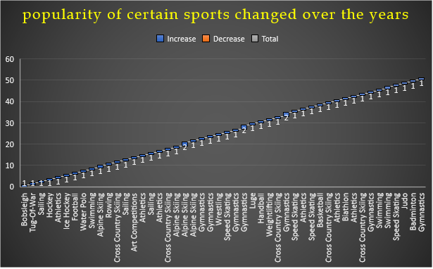
Question 5-How has the popularity of certain sports changed over the years?
Over the years, the popularity of sports in the Olympic Games has seen shifts. While traditional sports like Athletics and Gymnastics have remained consistently popular, newer additions such as Badminton, Judo, and Speed Skating have also gained traction. This highlights the Olympics' ability to adapt to evolving sporting interests, showcasing a blend of tradition and innovation that contributes to the event's enduring appeal.

Slide 7

Question 6 - Are there any sports that are specific to a particular region or culture?
The information shows that Gymnastics is enjoyed by people from many different parts of the world, with athletes participating from a wide variety of countries. This means that Gymnastics is liked and practiced by people everywhere, making it a sport that brings together individuals from different cultures and backgrounds at the Olympics.

Slide 8
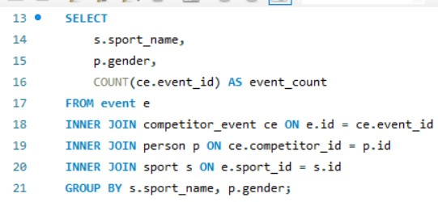
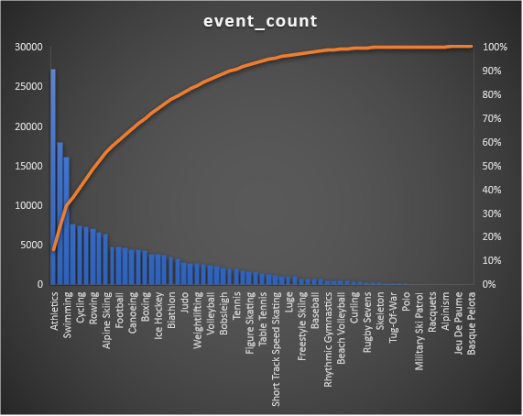
Question 7-Are there any sports that have a higher number of events for one gender compared to others?
In this data some sports show a higher number of events for one gender compared to the other. For example, Gymnastics has significantly more events for males (13,431) compared to females (4,508), while Swimming has more events for males (11,829) than females (4,252). This indicates a disparity in event allocation between genders in certain sports within the Olympic program.

Slide 9

Question 8-Are there any new events that have been introduced in recent editions of the Olympics?
In recent Olympic Games, several new events have been introduced across different sports, such as Athletics, Gymnastics, Swimming, and Judo. These additions demonstrate the Olympic Committee's commitment to evolving the games, keeping them fresh and engaging for athletes and audiences alike. By introducing new events, the Olympics continue to adapt to the changing landscape of sports, ensuring excitement and diversity in the world's premier sporting event.
Event Name | Games Year
Athletics Women's 100 metres | 2000
Cross Country Skiing Men's 10/15 kilometres Pursuit | 2002
Gymnastics Men's Team All-Around | 2004
Swimming Men's 200 metres Breaststroke | 2006
Swimming Men's 400 metres Breaststroke | 2008
Speed Skating Men's 500 metres | 2010
Judo Men's Extra-Lightweight | 2012
Badminton Men's Singles | 2014
Gymnastics Men's Individual All-Around | 2016

Slide 10
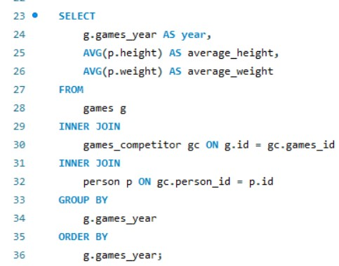
Question 10-Are there any notable trends in the height and weight of participants over time?
Over time, people have been getting taller, especially since around the middle of the 20th century, which could be because of better food and healthcare. But when it comes to weight, it's been up and down with no clear pattern. This might be because of different things like how we live and what we eat. So, while people are definitely getting taller, their weight doesn't show such a clear trend.

Slide 11
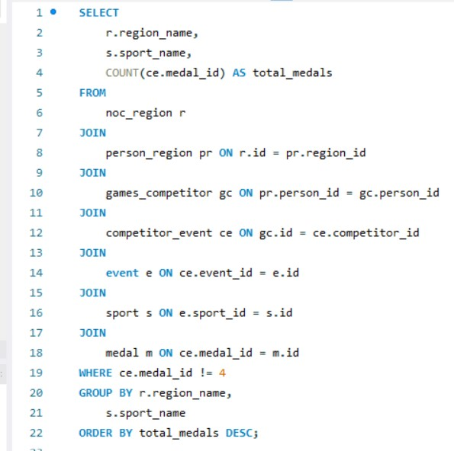
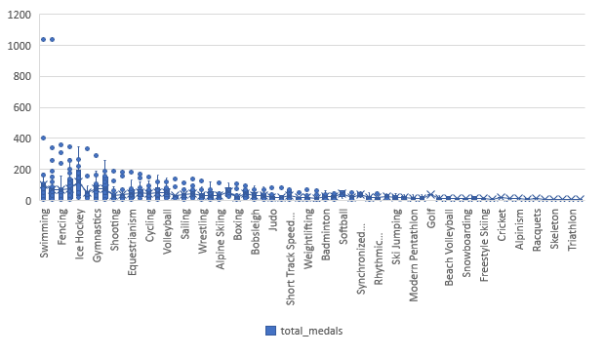
Question 11-Are there any dominant countries or regions in specific sports or events?
The data shows which countries are really good at certain sports. For example, the USA is great at swimming, athletics, and basketball. Australia is awesome at swimming, and Italy excels in fencing. Canada does really well in ice hockey and rowing. The Soviet Union, Germany, and the UK are also pretty good at lots of different sports. This tells us that different countries have different strengths when it comes to sports.

Slide 12
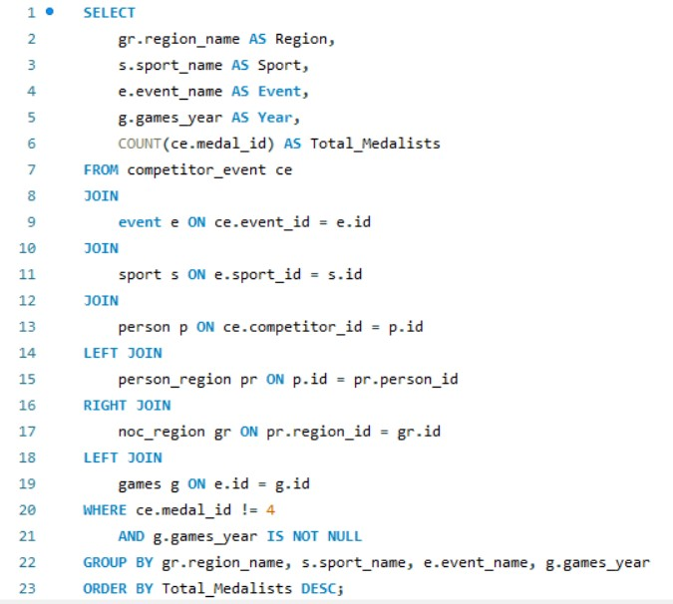
Question 13-Are there any countries that consistently perform well in multiple Olympic editions?
We found that some countries keep doing really well in many different Olympic games. The USA, Germany, UK, Italy, France, Canada, Japan, Sweden, Russia/Soviet Union, and Hungary are some examples. They're good at lots of sports like football, basketball, and gymnastics. These countries show how they're really good at sports and keep being great in the Olympics over many years.

Slide 13
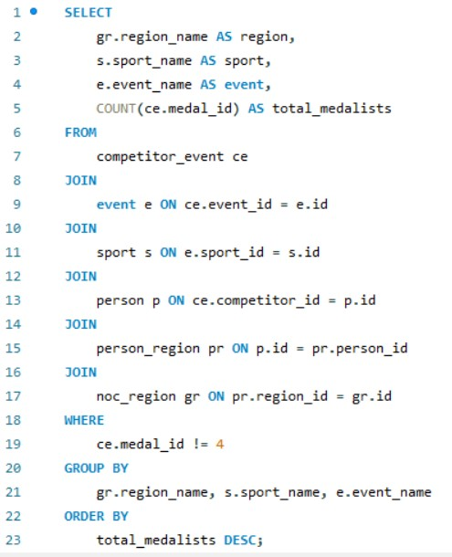
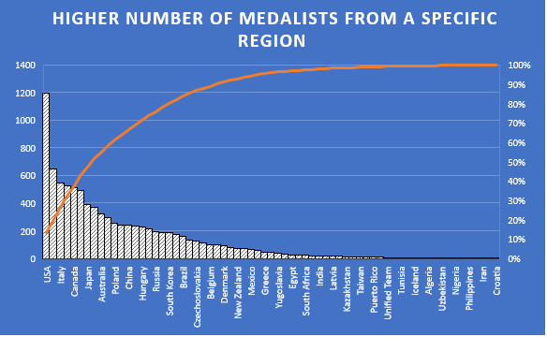
Question 14-Are there any sports or events that have a higher number of medalists from a specific region?
we see that some countries are really good at certain sports. Like the USA excels in many sports such as football and basketball, while Canada is strong in ice hockey. This happens because these countries focus a lot on these sports and spend a lot of money to help their athletes. But in the end, sports bring people together from all over the world, and we can all learn from each other, no matter where we're from.

Slide 14

Question 15-What are some notable instances of unexpected or surprising medal wins?
The data highlights surprising medal wins from smaller delegations, reflecting exceptional talent and dedication in sports. Australasia's 10 athletes demonstrate unexpected competitiveness, possibly indicating specialized expertise within the region. Similarly, Armenia's 31 athletes showcase a high level of performance, underlining the quality of athletes representing the nation. Nations like Albania, Andorra, American Samoa, and Aruba, with limited athlete counts, further emphasize the potential for surprise victories. Despite challenges, Afghanistan's 12 athletes exhibit resilience, contributing to the diverse landscape of medal-winning performances on the global stage.

Slide 15
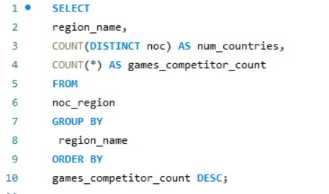
Question 16-Are there any regions that have experienced significant growth or decline in Olympic participation?
In conclusion, the data reveals a consistent pattern in Olympic participation across regions, with each region typically represented by only one country. There is no discernible trend indicating significant growth or decline in participation by region. This suggests a stable level of engagement in the Olympic Games across diverse geographical areas, with representation spanning a wide range of nations worldwide.

Slide 16
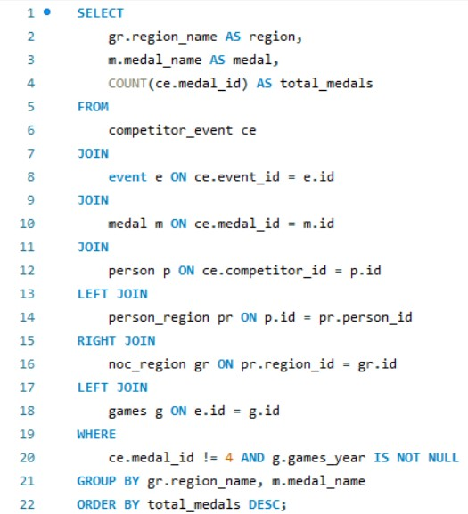
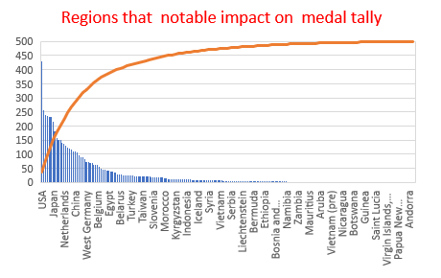
Question 18-Are there any regions that have had a notable impact on the overall medal tally?
The United States, the United Kingdom, Germany, Japan, Italy, and Russia/Soviet Union emerge as dominant forces in the Olympic Games, with significant contributions across Gold, Silver, and Bronze categories. Their consistent performances highlight excellence in diverse sports disciplines, underlining their prowess on the global stage. These regions have left a lasting impact on the overall medal tally, reflecting their longstanding traditions of athletic achievement and competitive spirit in international sporting events.

Slide 17
Data Analysis Capstone Project
Sport Analysis
Power BI Questions

Slide 18
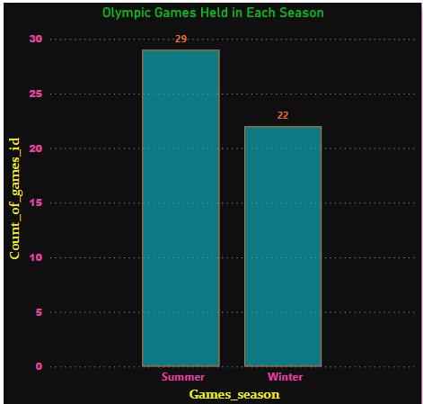
Question1-How many Olympic Games have been held in each season (Summer vs. Winter)?
conclusion :- After looking at all the data, it's clear that there are more events in the Summer Olympics than in the Winter Olympics. We found 29 events in the Summer and only 22 in the Winter. This means the Summer Olympics have more sports and activities for athletes to compete in.
When we compare, the Summer Olympics make up about 57% of all events, while the Winter Olympics make up about 43%. This shows that the Summer Olympics are much bigger and have more

Slide 19
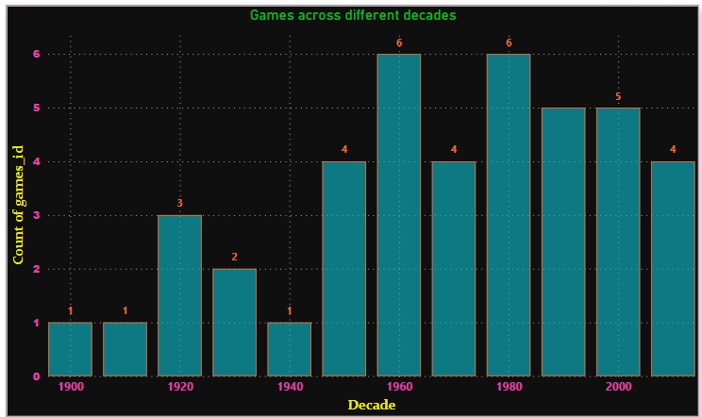
Question 2-What is the distribution of games across different decades?
Analyzing the Olympic Games distribution by decade reveals distinct peaks, notably in the 1960s and 1980s. These decades stand out for hosting a significant number of games, indicative of heightened global participation and sporting fervor. The prominence of these periods underscores their pivotal role in shaping the international sporting landscape. The surge in Olympic activity during the 1960s and 1980s reflects a period of increased cultural exchange and athletic achievement on a global scale. This trend highlights the enduring appeal and significance of the Olympics in fostering unity and competition across nations.

Slide 20
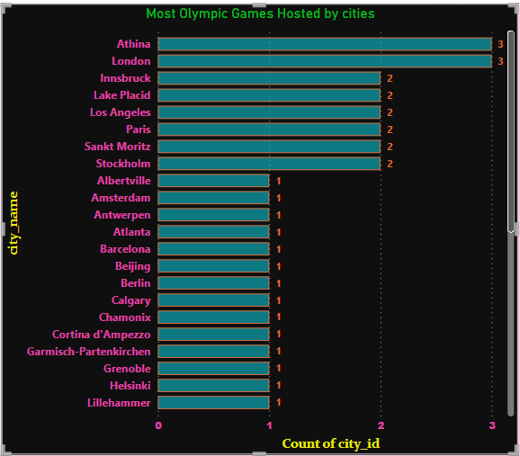
Que 3-Which cities have hosted the most Olympic Games?
In summary, our analysis indicates that London and Athens share the distinction of hosting three Olympic Games each, leading the tally. Paris trails closely with an equal number of games. Examining all 42 city names, we note a range in the count of Olympic events, spanning from 1 to 3. This highlights the diverse distribution of Olympic festivities across various cities, showcasing the global appeal and inclusivity of the Games. These insights underscore the importance of these cities in the Olympic narrative and their representation of diverse cultural landscapes in the international sports arena.

Slide 21
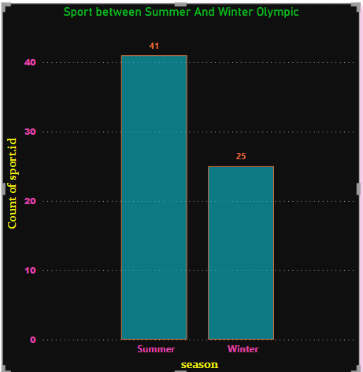
Question 4 - What is the distribution of sports between Summer and Winter Olympics?
Our examination reveals a stark contrast between the Summer and Winter Olympics in terms of the diversity of sports. With 41 sport IDs attributed to the Summer season compared to 25 for the Winter season, the Summer Olympics clearly encompass a broader range of athletic disciplines. The dominance of the Summer season, representing 62.12% of the total sport IDs, underscores its significance as the primary showcase for a multitude of sports on the Olympic stage. This disparity emphasizes the distinct character of each season within the Olympic movement and reflects the diverse interests and preferences of athletes and spectators worldwide.

Slide 22
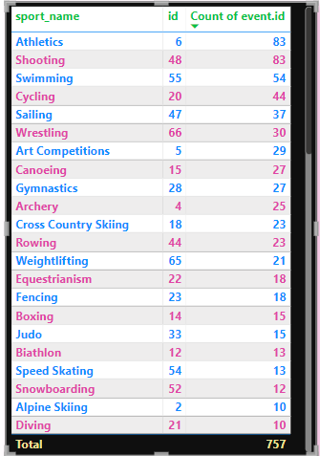
Question 5 - Which sports have the highest number of events in the Olympics?
In the Olympics, Athletics and Shooting have the most events, each having 83. Swimming comes next with 54 events, and Cycling follows with 44. These sports are popular and have lots of different activities. Other sports like Sailing, Wrestling, Art Competitions, Canoeing, and Gymnastics are also important for athletes. They all bring different skills and excitement to the Olympics, making it a fun and diverse event for everyone to enjoy.

Slide 23
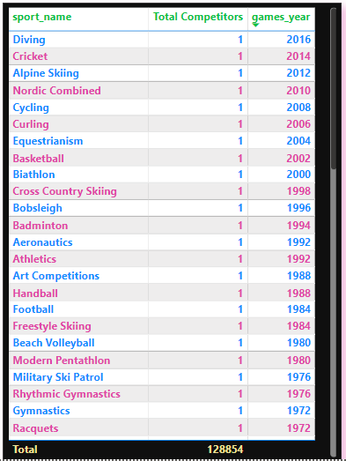
Question 6 - How has the participation in each sport evolved over time?
The data indicates consistent participation in each sport, with one competitor representing each sport annually across the listed years. However, this representation is limited and may not accurately reflect actual participation levels. While the pattern remains uniform over the years, the data lacks depth in understanding the evolution of participation in each sport. Further analysis with comprehensive data showing the number of participants in each sport across multiple years is necessary to gain a more accurate understanding of participation trends over time.

Slide 24
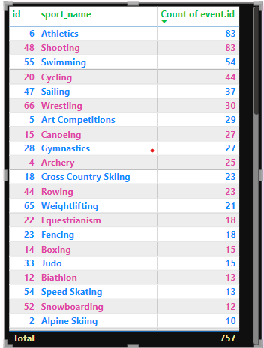
Question 7 - How many events are there in each sport?
In conclusion, the diversity and popularity of sports in the Olympics are evident through the multitude of events offered. Athletics and Shooting lead the pack with 83 events each, showcasing their widespread appeal. Swimming and Cycling follow closely behind, adding further variety to the Olympic program. Additionally, sports such as Sailing, Wrestling, Art Competitions, Canoeing, and Gymnastics provide significant platforms for athletes to demonstrate their skills and passion. Together, these sports contribute to the rich tapestry of the Olympic Games, uniting athletes and fans from around the world in the spirit of competition and camaraderie.

Slide 25
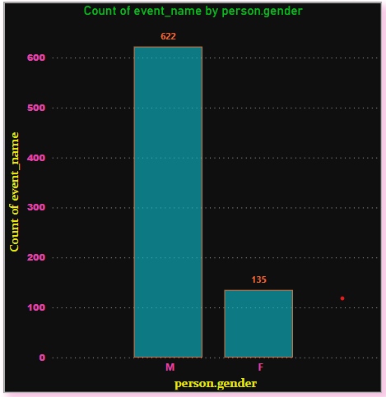
Question 8 - What is the distribution of events by gender (Men, Women, Mixed)?
In conclusion, the dataset demonstrates a clear discrepancy in the number of event names between genders. With males comprising 622 events compared to females' 135, they represent approximately 82.17% of the total count. This disparity underscores the importance of addressing gender balance and inclusivity in Olympic events to ensure equitable representation for all athletes.

Slide 26
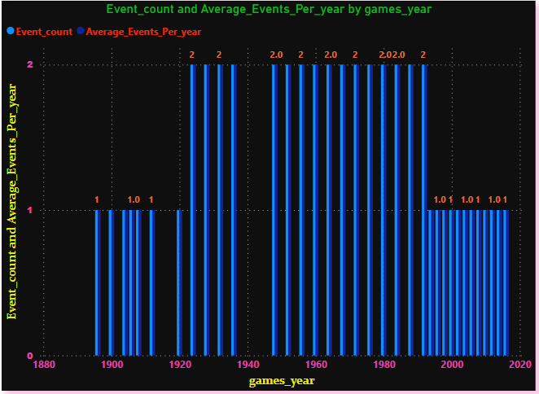
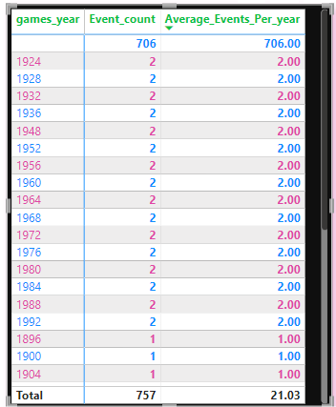
Question 9 - How has the number of events changed over time?
The data shows that the number of events happening each year goes up and down. On average, there are usually about 2 events per year, but sometimes there are fewer. These changes might happen because different sports are included or excluded over time. By looking closer, we can understand more about why these changes occur and what they mean.

Slide 27
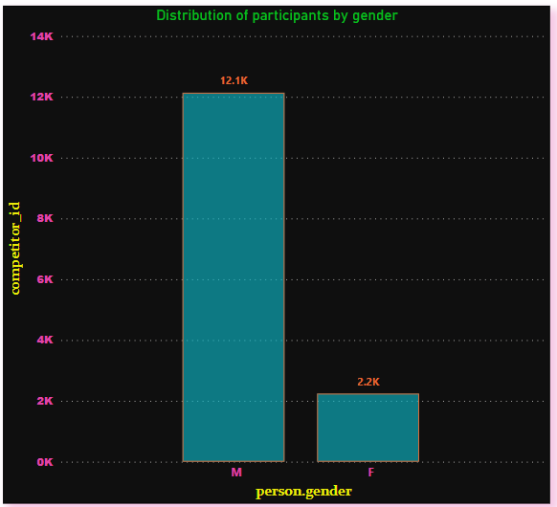
Question 10 - What is the distribution of participants by gender?
In conclusion, the dataset reveals a significant gender disparity in participation, with males accounting for approximately 84.42% of the total participants compared to females at 15.58%. This notable difference underscores the need for careful consideration of gender representation in research and survey studies. Further exploration into the underlying factors driving this gender gap could offer valuable insights for promoting inclusivity and addressing potential biases within the dataset.

Slide 28
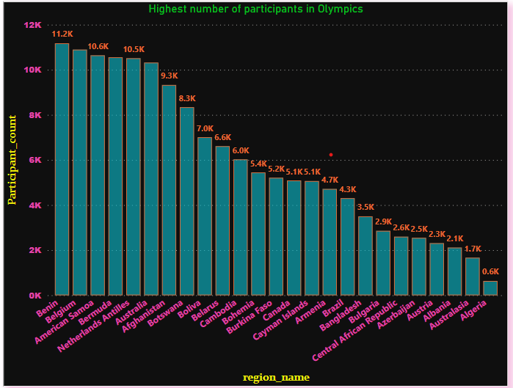
Question 11 - Which countries have the highest number of participants in the Olympics?
Australia: Leads with 10,319 participants, demonstrating significant representation in the Olympics.
Belgium: Follows closely with 10,895 participants, showcasing substantial participation from this country.
American Samoa: Shows strong participation with 10,641 participants, highlighting its presence in Olympic events.
Diverse Participation: The data reveals a broad range of countries involved, with participant counts ranging from 1,666 to 10,895, indicating global representation in the Olympics.
Consistent Commitment: The consistent participation of these countries underscores their ongoing dedication to Olympic competition and the promotion of sports worldwide.
In summary, Australia, Belgium, and American Samoa stand out as the top countries with the highest number of participants in the Olympics, reflecting their significant presence and continued engagement in Olympic events.

Slide 29
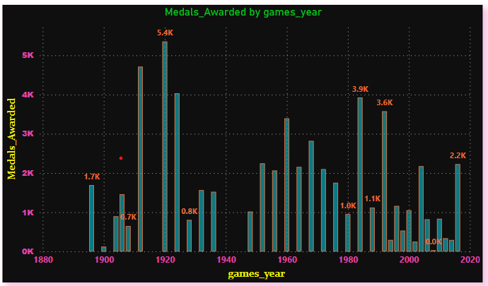
Question 13 - How many medals have been awarded in each Olympics?
Based on the provided data, the number of medals awarded in each Olympic Games varies significantly, showcasing the dynamic nature of the event over time. There's a clear trend of increasing medal counts over the years, likely driven by factors such as the inclusion of more sports and the growing global interest in the games. Notable fluctuations exist, with certain years standing out for exceptionally high or low medal counts. The data reflects the Olympics' evolving significance, with modern editions consistently awarding more medals compared to earlier ones. These variations underscore the complex interplay of factors shaping the Olympics, including changes in sports popularity, geopolitical dynamics, and global participation, highlighting the ever-changing landscape of this celebrated international event.

Slide 30
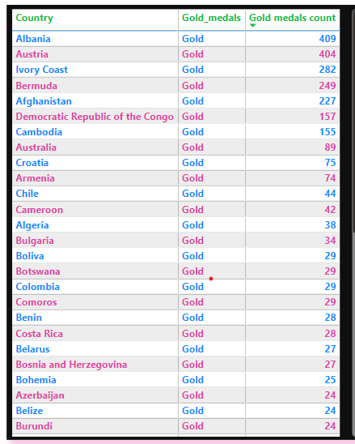
Question 14 - Which countries have the highest number of gold medals?
The countries with the highest number of gold medals are:
1. Albania: 409 gold medals
2. Austria: 404 gold medals
3. Ivory Coast: 282 gold medals
4. Bermuda: 249 gold medals
5. Afghanistan: 227 gold medals
These countries have accumulated the highest counts of gold medals among the listed nations. The data suggests a varying level of success in Olympic competitions across different countries, with Albania and Austria leading by a significant margin.

Slide 31
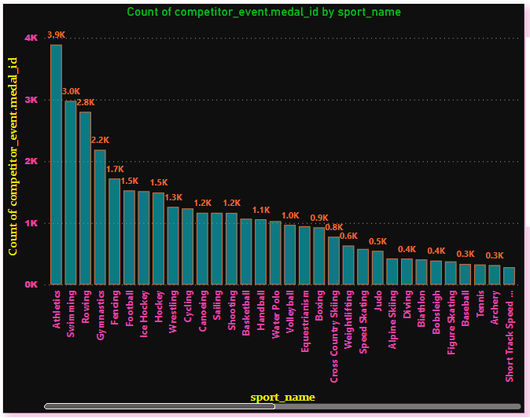
Que 15 - How does the medal distribution vary across different sports?
In conclusion, Athletics, Swimming, and Rowing stand out as the most decorated Olympic sports, highlighting their popularity. Individual disciplines like Athletics and Swimming tend to yield more medalists compared to team sports. The dominance of summer sports underscores their global appeal and participation rates. The varied medal distribution across sports reflects the inclusive nature of the Olympics. Niche sports like Basque Pelota and Aeronautics have fewer medalists due to their specialized appeal.

Slide 32
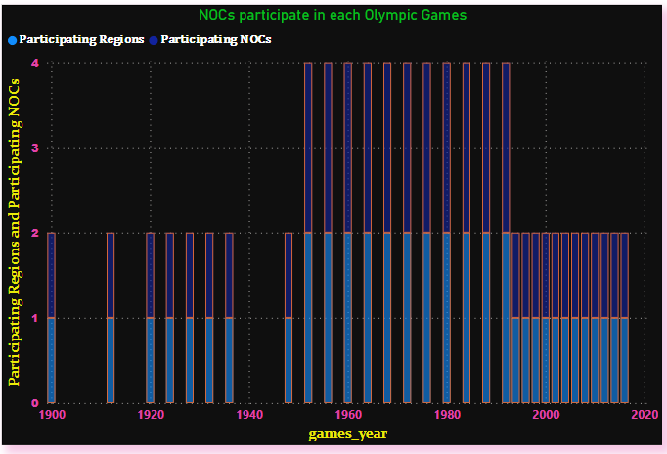
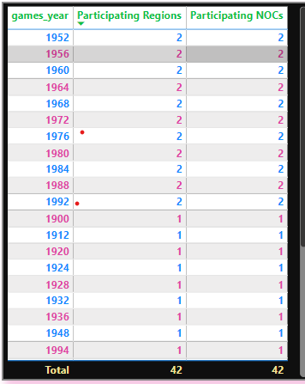
Question 16 - How many regions or NOCs participate in each Olympic Games?
From 1952 to 1988, two regions or National Olympic Committees (NOCs) consistently participated in each Olympic Games. However, in the 1992 Paralympics, the number of participating regions or NOCs dropped to just one. This trend continued in subsequent years, with only one region or NOC participating in each Olympic Games from 1994 onwards. The data suggests a significant shift in participation dynamics, possibly reflecting geopolitical changes, organizational decisions, or other factors impacting global representation in the Olympic Games. This trend underscores the evolving nature of international sporting events and the fluctuating levels of participation across different regions and nations over time.

Slide 33
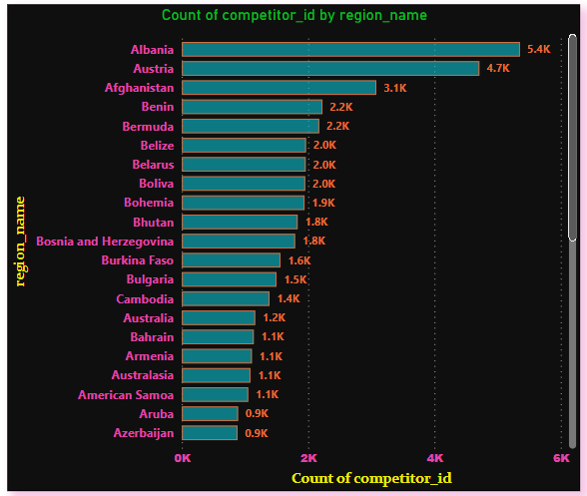
Question 17 - Which regions have the highest number of participants in the Olympics?
It can be concluded that Albania, Austria, and Afghanistan are the regions with the highest number of participants in the Olympics. These regions exhibit significant representation in terms of athlete participation. However, it's essential to consider that participation trends can vary across different Olympic Games and may be influenced by various factors such as population size, funding for sports programs, and national interest in Olympic sports.
Here's a count of the top regions with the highest number of participants in the Olympics:
1. Albania: 5353 participants
2. Austria: 4711 participants
3. Afghanistan: 3078 participants
These counts represent the regions with the most significant representation in terms of athlete participation based on the provided data.

Slide 34
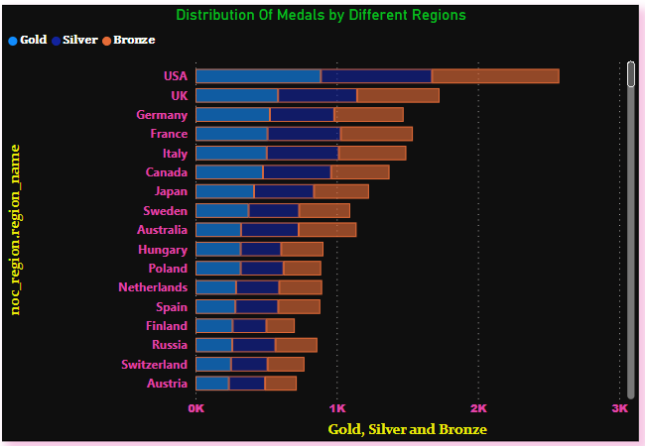
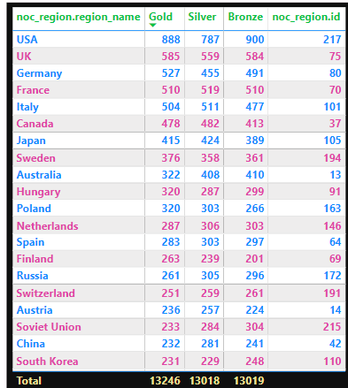
Question 18 - What is the distribution of medals among different regions?
The distribution of medals among regions reflects a blend of historical legacy, investment in sports, and cultural emphasis on athletic achievement. Nations like the USA and the UK lead in total medals, showcasing their commitment to excellence. Variations in medal types highlight specialization in certain sports or events. Understanding these trends aids in assessing regional sporting prowess and guiding future development strategies. By tracking shifts over time, we gain insights into evolving dynamics and emerging forces in the global sports landscape.

