Slide 1


Sales
View in Power BI
Shubham Sahai Saxena
+91 9936699402
LinkedIn
Analytics Engineer

Slide 2
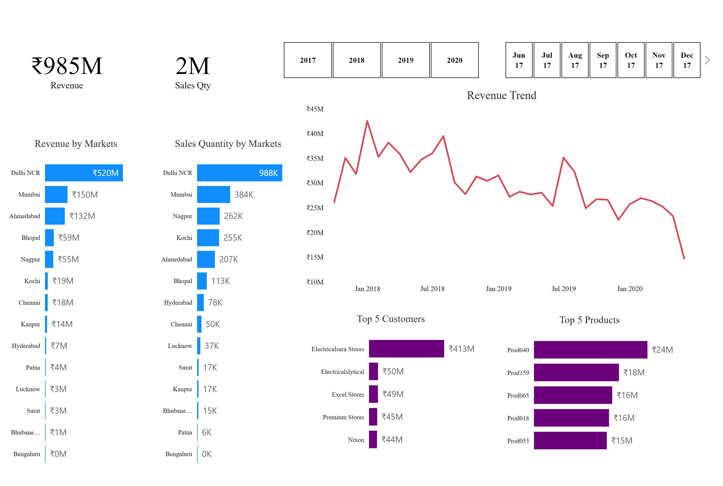
Key Insights
Notes:
card
No alt text provided
card
No alt text provided
Revenue by Markets
No alt text provided
Sales Quantity by Markets
No alt text provided
slicer
No alt text provided
slicer
No alt text provided
Top 5 Customers
No alt text provided
Top 5 Products
No alt text provided
Revenue Trend
No alt text provided

Slide 3
Revenue (₹985 M): By June 2020 we’ve generated nearly a billion rupees in topline—proof that our market strategy drives sustained growth.
Sales Qty (2 M units): Moving two million units shows strong distribution reach, though unit economics vary widely by region.
Revenue by Markets
Insight: Delhi NCR dominates at ₹519.6 M (52.8%), with Mumbai (15.2%) and Ahmedabad (13.4%) trailing—showing that a handful of metros drive most revenue.
Recommendation: Double down on retention and upsell programs in these top‑three markets to defend market share and offset churn elsewhere.
Pattern: “Pareto” distribution—20% of markets deliver ~80% of revenue.
Sales Quantity by Markets
Insight: Delhi NCR sold 988 K units, followed by Mumbai (384 K) and Nagpur (262 K), but smaller markets pull far fewer units.
Recommendation: For low‑volume markets, consider targeted promotions or localized bundles to boost awareness and trial.
Pattern: Volume correlates strongly with population centers; rural/minor markets lag.

Slide 4
Revenue Trend
Insight: Revenue peaked in Q1 2018 (~₹425 M) then gradually declined, hitting a low of ₹147 M by June 2020—signaling seasonality and potential market saturation.
Recommendation: Launch mid‑year campaigns to smooth out the June lull and explore new product introductions to reignite growth.
Pattern: Strong winter quarter performance, dip in monsoon months.
Top 5 Customers
Insight: Electricalsara Stores alone accounts for ₹413 M—over 40% of total—indicating heavy reliance on one key account.
Recommendation: Mitigate concentration risk by diversifying the customer base and developing incentive programs for second‑tier buyers.
Pattern: Highly skewed customer contribution; long tail of smaller accounts.
Top 5 Products
Insight: Prod040 leads with ₹236 M, followed by four others in the ₹152–177 M range—showing product portfolio breadth but dependence on top Stock-Keeping Units.
Recommendation: Bundle top sellers with adjacent mid‑range items to drive lift and reduce product‑level churn.
Pattern: Top 5 products generate ~9% of total revenue each.

Slide 5
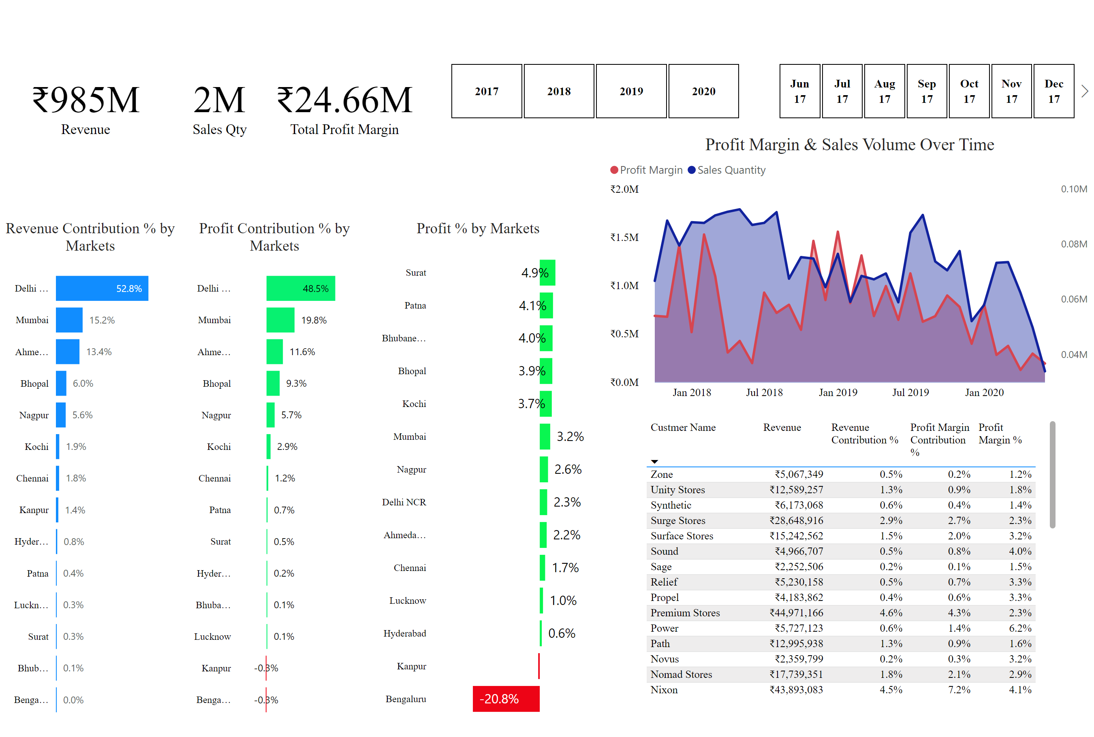
Profit Analysis
Notes:
card
No alt text provided
card
No alt text provided
Profit % by Markets
No alt text provided
Revenue Contribution % by Markets
No alt text provided
slicer
No alt text provided
slicer
No alt text provided
Top 5 Customers
No alt text provided
Profit Margin & Sales Volume Over Time
No alt text provided
card
No alt text provided
Profit Contribution % by Markets
No alt text provided

Slide 6
Revenue (₹985 M): By June 2020 we’ve generated nearly a billion rupees in topline—proof that our market strategy drives sustained growth.
Sales Qty (2 M units): Moving two million units shows strong distribution reach, though unit economics vary widely by region.
Total Profit Margin (₹24.7 M): Despite high revenue, overall profit sits at ~2.5%, highlighting opportunities to tighten cost control or optimize pricing.
Revenue Contribution % by Markets
Insight: Delhi NCR’s 52.8% share dwarfs Bengaluru’s 0.0%, underscoring a very uneven contribution curve.
Recommendation: Reallocate marketing budget toward under‑penetrated regions with high growth potential.
Pattern: Steep drop‑off after the first three markets.
Profit Contribution % by Markets
Insight: Delhi NCR still leads at 48.5% of profit, but Bengaluru actually shows a slight negative contribution—flagging a loss‑making segment.
Recommendation: Conduct cost‑to‑serve analysis in Bengaluru; consider pricing adjustments or scaled‑down service offerings.
Pattern: Profit share roughly mirrors revenue share, but outlier negative in smallest markets.

Slide 7
Profit % by Markets
Insight: Surat tops margin at 4.9%, while Bengaluru’s –20.8% margin is a red flag for unsustainable costs or discounts.
Recommendation: Immediately review contract terms and fulfillment costs in Bengaluru to stop losses.
Pattern: Mid‑tier markets (Surat, Patna) punch above their weight in profitability.
Profit % by Markets
Insight: Surat tops margin at 4.9%, while Bengaluru’s –20.8% margin is a red flag for unsustainable costs or discounts.
Recommendation: Immediately review contract terms and fulfillment costs in Bengaluru to stop losses.
Pattern: Mid‑tier markets (Surat, Patna) punch above their weight in profitability.
Profit Margin & Sales Volume Over Time
Insight: Profit margins spiked in late 2017 (₹1.4 M on 79 K units) then trended downward to ₹0.19 M in June 2018 despite stable volume—highlighting margin erosion.
Recommendation: Introduce dynamic pricing or cost‑optimization initiatives to protect margins, especially in off‑peak months.
Pattern: Profit and volume don’t move in tandem; margins are most volatile in holiday seasons.

Slide 8
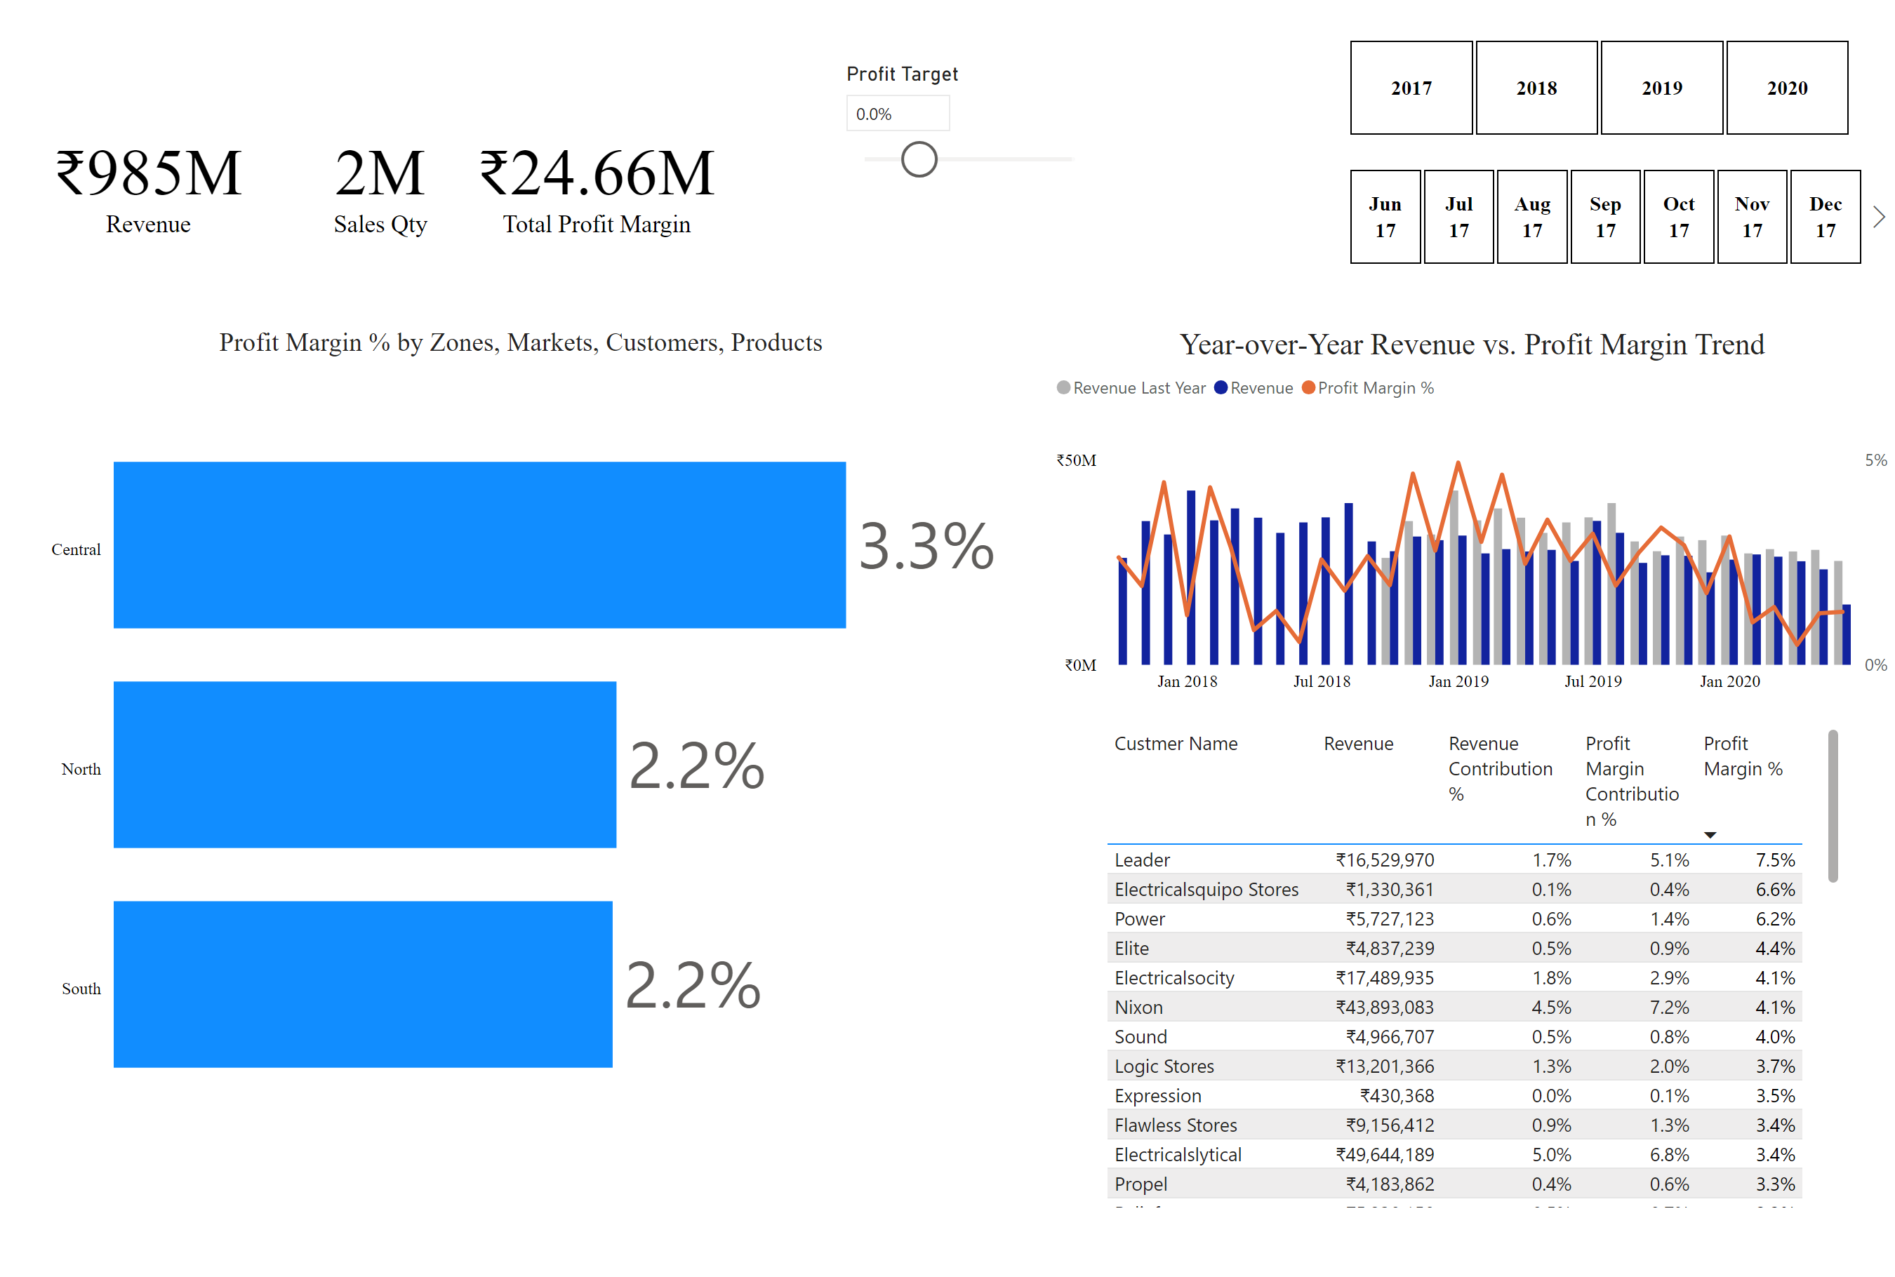
Performance Insights
Notes:
card
No alt text provided
card
No alt text provided
Profit Margin % by Zones, Markets, Customers, Products
No alt text provided
slicer
No alt text provided
slicer
No alt text provided
Top 5 Customers
No alt text provided
Year‑over‑Year Revenue vs. Profit Margin Trend
No alt text provided
card
No alt text provided
slicer
No alt text provided

Slide 9
Revenue (₹985 M): By June 2020 we’ve generated nearly a billion rupees in topline—proof that our market strategy drives sustained growth.
Sales Qty (2 M units): Moving two million units shows strong distribution reach, though unit economics vary widely by region.
Total Profit Margin (₹24.7 M): Despite high revenue, overall profit sits at ~2.5%, highlighting opportunities to tighten cost control or optimize pricing.
Profit Margin % by Zones
Insight: Central zone averages 3.3% margin vs. North/South at ~2.2%, though South dipped to 0.9% in 2020—pointing to regional cost pressures.
Recommendation: Benchmark best practices from Central region across other zones (e.g., supply chain efficiencies).
Pattern: Consistent outperformance by Central region year over year.
Year‑over‑Year Revenue vs. Profit Margin Trend
Insight: Even as revenue held above ₹260 M each month, profit margin % fell from 4.5% (Dec 2017) to ~1.3% by mid‑2020—evidence of margin squeeze.
Recommendation: Couple revenue growth initiatives with margin‑focused strategies like product mix optimization and fixed‑cost absorption.
Pattern: Inverse relationship emerging—flat revenues but eroding margins over time.

Slide 10
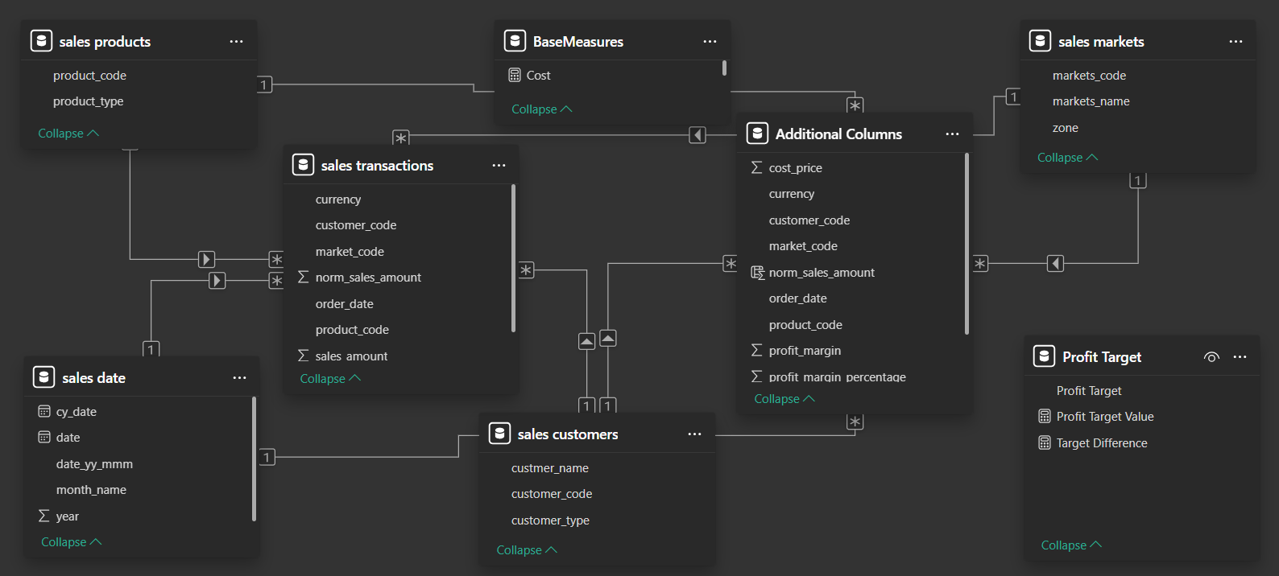
Model View

Slide 11
Overview of the Data Model (Tables & Roles)
Fact
sales transactions: every row is a single sale (quantity, amount, date, customer, product, market).
Dimensions (lookup tables)
sales customers: master list of customers, keyed on customer_code.
sales products: master list of SKUs, keyed on product_code.
sales markets: master list of markets, keyed on markets_code.
Time tables
sales date: raw dates (date, cy_date, year, month_name, etc.).
LocalDateTable_e865… & LocalDateTable_ae4e…: two date‑dimension variants for flexible hierarchies (Year/Quarter/Month/Day).
Measure tables
BaseMeasures & Profit Target: contain all DAX measures (revenue, profit margin %, churn rate), keeping the core model free of calculation clutter.

Slide 12
2. Star Schema
Star schema: a central fact table with direct links to each dimension and date table.
Denormalized design: only 1 hop from any filter to the sales rows—ideal for Power BI’s in-memory engine.
3. Relationships and Cardinality
Date → Calendar A
From sales date.date to LocalDateTable_e865….Date (Many → One)
Date → Calendar B
From sales date.cy_date to LocalDateTable_ae4e….Date (Many → One)
Customer Link
From sales transactions.customer_code to sales customers.customer_code (Many → One)
Product Link
From sales transactions.product_code to sales products.product_code (Many → One)
Market Link
From sales transactions.market_code to sales markets.markets_code (Many → One)

Slide 13
Txn Date → SalesDate
From sales transactions.order_date to sales date.date (Many → One)
Ext. Customer Link
From Additional Columns.customer_code to sales customers.customer_code (Many → One)
Ext. Product Link
From Additional Columns.product_code to sales products.product_code (Many → One)
Ext. Market Link
From Additional Columns.market_code to sales markets.markets_code (Many → One)
Ext. Date Link
From Additional Columns.order_date to sales date.date (Many → One)

