Slide 1
SMART INDIA HACKATHON 2026
TITLE PAGE
• Problem Statement ID – [Enter Problem Statement ID / Student Innovation]
• Problem Statement Title – AI-Powered Pre-Consultation Clinical Intake, OPD Triage & ABDM Health Kiosk
• Theme – MedTech / Healthcare / Smart Health & AYUSH Integration
• PS Category – Software
• Team ID – [Enter Team ID from SIH Portal]
• Team Name (Registered on portal) – Codestreaker
• Project Name – Ayush Setu (आयुष सेतु) — Pre-Consultation Clinical Intelligence System

Slide 2
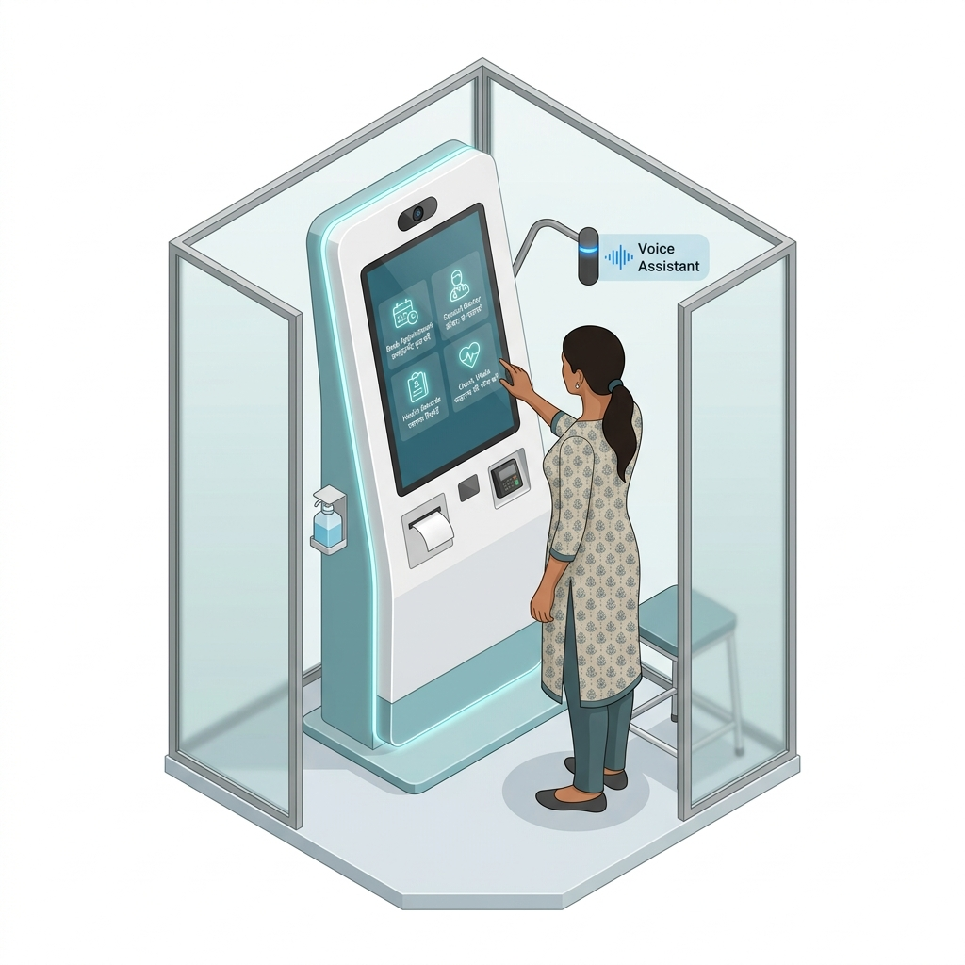
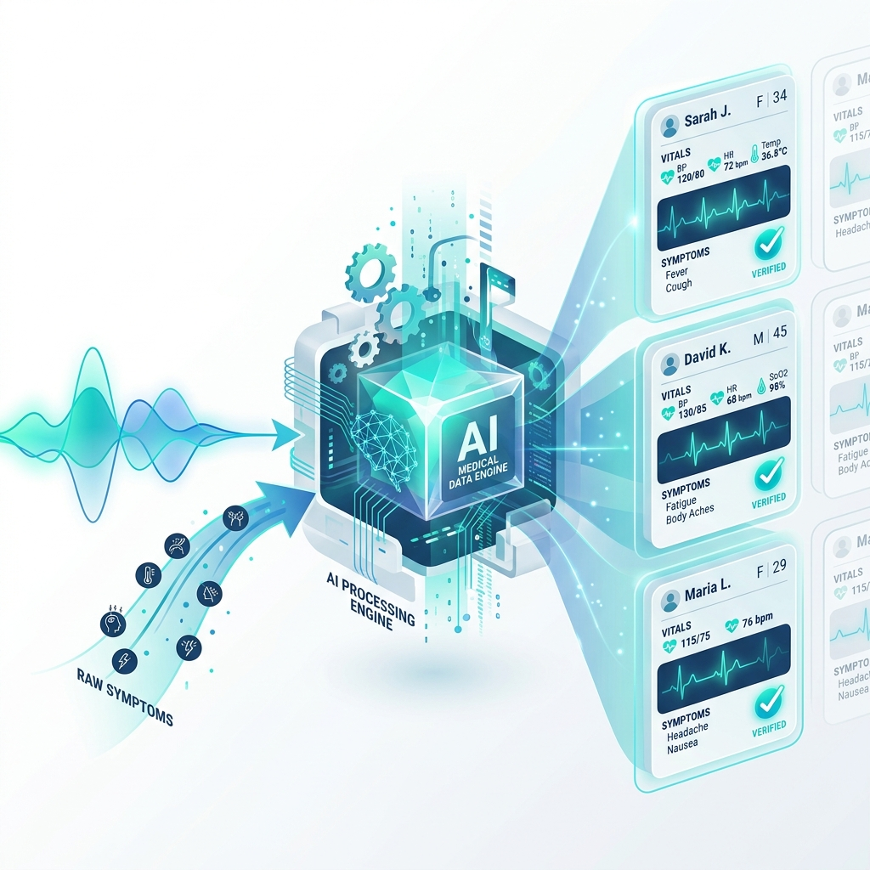

Team:
Codestreaker
AYUSH SETU — SMART CLINICAL INTAKE KIOSK
SMART INDIA
HACKATHON 2026
❖ Proposed Solution (Describe your Idea/Solution/Prototype) — End-to-End Visual Journey
STAGE 01: PATIENT INTAKE
STAGE 02: SMART CLINICAL ENGINE
STAGE 03: DOCTOR BRIEFING
Capture Before Consultation
Patient shares symptoms, medical history & basic vitals at the smart kiosk before meeting the doctor.
🎤 Voice + Text 🌐 8 Indian Languages 📋 Guided Intake
Structure & Synthesize
Transforms raw multilingual answers into a concise, standardized doctor brief & HL7 FHIR R4 record.
[Chief Complaint] [HPI] [Vitals] [🚨 Red Flags]
Doctor Sees Context First
Physician reviews structured patient history beforehand, eliminating repetitive questions.
⚡ Faster Review 🔍 Upfront Context 🚨 Red-Flag Alert
★ WHAT MAKES AYUSH SETU DIFFERENT:
🌐 8 INDIAN LANGUAGES
Voice & text with zero question repetition
🩺 ALLOPATHY + AYUSH
Dual modern clinical & Dashavidha intake
🔐 ABDM / ABHA READY
14-digit ABHA ID & DPDP Act consent
🚨 RED-FLAG HIGHLIGHTING
Instant prioritization of critical symptoms
@SIH Idea submission- Template 2

Slide 3
Team:
Codestreaker
TECHNICAL APPROACH & METHODOLOGY
SMART INDIA
HACKATHON 2026
Technologies Used & Architecture Stack
▪ Frontend (React 19, TypeScript, Vite): Used to build responsive, accessible patient kiosk & physician portals with glassmorphism UI.
▪ Backend (Node.js 24, Express 4, TypeScript): Handles modular REST API routing, session management, and clinical orchestration.
▪ Session Storage & Data Layer: In-memory UUID clinical context store (`server/sessions.ts`) + JSON persistence for users and sessions.
▪ Authentication & Verification: Official ABDM M1 Gateway (`/v0.5/sessions`), Nodemailer (Gmail SMTP), Twilio Verify SMS with SHA-256 Hashing.
▪ AI / Clinical Intelligence: Google Gemini AI (`@google/generative-ai`) with deterministic sequential clinical triage rules & FHIR R4 JSON generator.
▪ Accessibility & Audio Engine: Web Speech API (SpeechSynthesis) for Indic voice consent + Web Audio API for interactive kiosk chimes.
Methodology & End-to-End Implementation Workflow
➔ Step 1: Patient Check-in & Consent
Patient registers via 14-Digit ABHA ID, Phone, or Email; verifies identity with real OTP; grants DPDP Act 2023 consent with spoken voice feedback.
➔ Step 2: Multilingual Adaptive Triage
Sequential clinical questioning across 8 Indic languages for cardiology, respiratory, GI, fever, or AYUSH Dashavidha without question repetition.
➔ Step 3: Document Digitization & Linking
Patient uploads prior paper prescriptions/lab reports; system digitizes metadata and links with ABHA profile.
➔ Step 4: Clinical Summarization & FHIR R4
Engine constructs structured Chief Complaint, HPI chronology, red flags, and HL7 FHIR R4 Bundle ready for hospital EHR transmission.
➔ Step 5: Doctor Pre-Consultation Review
Treating physician reviews structured patient briefing on Doctor Portal BEFORE patient enters, enabling highly focused, efficient clinical care.
@SIH Idea submission- Template 3

Slide 4
Team:
Codestreaker
FEASIBILITY AND VIABILITY
SMART INDIA
HACKATHON 2026
Analysis of Feasibility
• Low-Cost Hardware Deployment: Runs seamlessly on standard touch tablets, Android kiosks, desktop computers, or patient smartphones via QR codes.
• Zero High-End Compute Barrier: Edge-ready web architecture with lightweight REST APIs, running smoothly without requiring expensive GPUs at clinic sites.
• Government Standards Compliant: Fully aligned with Ayushman Bharat Digital Mission (ABDM) M1 standards and DPDP Act 2023 legal consent frameworks.
• Immediate Hospital Adoption: Plug-and-play browser interface requiring zero complex server installations for government OPD clinics.
Potential Challenges & Risks
• Digital Literacy in Rural Patients: Elderly or illiterate patients may struggle with text inputs on digital touchscreens.
• Peak OPD High-Concurrency: Hundreds of patients arriving simultaneously at government hospital registration counters during morning rush hours.
• Telecom Carrier SMS Delays: Network congestion in remote rural areas delaying telecom SMS OTP delivery.
• Data Privacy & Compliance: Risk of sensitive health history exposure without stringent cryptographic safeguards.
Strategies for Overcoming Challenges
• Multilingual Voice Readouts: Web Speech API audio guidance in 8 Indic languages + Staff-Assisted check-in mode for non-tech-savvy patients.
• Lightweight In-Memory Caching: High-throughput Node.js microservices responding in <50ms, easily handling peak hospital loads.
• Multi-Channel Dual OTP: Dual telecom routing (Twilio / Fast2SMS / 2Factor) + instant Nodemailer Email OTP fallback ensures zero patient blocking.
• End-to-End Security: SHA-256 OTP hashing with server salt, 256-bit session tokens, and DPDP Act 2023 digital consent logs.
@SIH Idea submission- Template 4

Slide 5
Team:
Codestreaker
IMPACT AND BENEFITS
SMART INDIA
HACKATHON 2026
Potential Impact on Target Audience
▪ For Patients: Zero intimidation in clinic visits; freedom to express symptoms in native mother tongue (Hindi, Tamil, Marathi, etc.); drastic reduction in overall waiting room anxiety and consultation delays.
▪ For Doctors & Clinicians: Pre-prepared, structured clinical briefing available on screen before the patient walks into the cabin. Zero time wasted repeating basic demographic and chronological symptom questions.
▪ For Hospital Administrators: Significant optimization of outpatient queuing; structured digital records conforming to Ayushman Bharat Digital Mission (ABDM) standards; enhanced hospital operational throughput.
Multidimensional Benefits of the Solution
✔ Social Impact: Democratizes high-quality clinical intake for underserved and non-English-speaking populations across urban and rural India, bridging the gap between traditional AYUSH practices and modern healthcare systems.
✔ Economic Impact: Saves millions of clinical man-hours annually in government and private hospitals; reduces administrative charting expenses; increases daily patient intake capacity per doctor by up to 40%.
✔ Environmental Impact: Enables 100% paperless OPD intake, eliminating physical paper case sheets, manual token slips, and duplicated prescription records through cloud/local FHIR R4 digital exchange.
@SIH Idea submission- Template 5

Slide 6
Team:
Codestreaker
RESEARCH AND REFERENCES
SMART INDIA
HACKATHON 2026
Details / Links of Reference and Research Work
[1] National Health Authority (NHA) & ABDM Architecture Specification
Guidelines on Milestone 1 (M1) ABHA Verification, Health Facility Registry (HFR), and PHR Handle Authentication.
https://sandbox.abdm.gov.in/ | https://abdm.gov.in/
[2] HL7 FHIR R4 (Fast Healthcare Interoperability Resources) Standard
FHIR Document Bundle specifications for Electronic Health Records (EHR) transmission and clinical diagnostic exchange.
https://hl7.org/fhir/R4/
[3] Digital Personal Data Protection (DPDP) Act 2023 Compliance Framework
Government of India statutory guidelines on informed, purpose-bound patient consent, data minimization, and audit trails for digital health platforms.
https://www.meity.gov.in/data-protection-framework
[4] Ministry of AYUSH — Dashavidha & Ashtavidha Pariksha Clinical Guidelines
Traditional Indian systems of medicine clinical examination guidelines for Prakriti, Agni, Koshtha, and Dhatu imbalance triage.
https://ayush.gov.in/
[5] Indian Public Health Standards (IPHS) Guidelines for OPD Queuing & Clinical Consultation
Research on outpatient department wait-time reduction, clinical history-taking time allocation, and physician burnout mitigation.
https://nhsrcindia.org/indian-public-health-standards
@SIH Idea submission- Template 6

