Slide 1
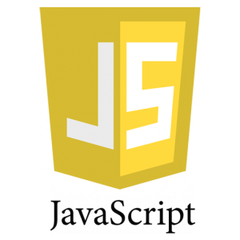

Slide 2
An Introduction to JavaScript
What is JavaScript?
JavaScript was initially created to “make web pages alive”.
The programs in this language are called scripts. They can be written right in a web page’s HTML and run automatically as the page loads.
Scripts are provided and executed as plain text. They don’t need special preparation or compilation to run.
In this aspect, JavaScript is very different from another language called Java.
JavaScript ("JS" for short) is a full-fledged dynamic programming language that, when applied to an HTML document, can provide dynamic interactivity on websites. It was invented by Brendan Eich, co-founder of the Mozilla project, the Mozilla Foundation, and the Mozilla Corporation.

Slide 3
Why is it called JavaScript?
When JavaScript was created, it initially had another name: “LiveScript”. But Java was very popular at that time, so it was decided that positioning a new language as a “younger brother” of Java would help.
But as it evolved, JavaScript became a fully independent language with its own specification called ECMAScript(European Computer Manufacturer's Association.), and now it has no relation to Java at all.

Slide 4
Today, JavaScript can execute not only in the browser, but also on the server, or actually on any device that has a special program called the JavaScript engine.
The browser has an embedded engine sometimes called a “JavaScript virtual machine”.
Different engines have different “codenames”. For example:
V8 – in Chrome and Opera.
SpiderMonkey – in Firefox.
…There are other codenames like “Trident” and “Chakra” for different versions of IE, “ChakraCore” for Microsoft Edge, “Nitro” and “SquirrelFish” for Safari, etc.
The terms above are good to remember because they are used in developer articles on the internet. We’ll use them too. For instance, if “a feature X is supported by V8”, then it probably works in Chrome and Opera.

Slide 5
THE EVOLUTION OF JAVASCRIPT
Javascript is currently being used in more than 94% of websites. That means millions of web developers are using JavaScript for web application development. The ease of use and widespread adoption of this programming language is exactly why it continues to become more important to web developers.

Slide 6
THE EVOLUTION OF JAVASCRIPT
The Ubiquity of Web Browsers – Can you think of a time or place where you aren’t within one click of an internet browser? Nope. The web is available everywhere and this makes JavaScript more important and more commonplace. Plus, the widespread adoption ensures dynamic content gets displayed the way it was intended.
JavaScript Has More Applications – Thanks to innovations like Node.js and ReactJS, JavaScript is useful for both front and back end web development. By using cross-platform runtime engines to write server-side code, JavaScript has even more applications and increases efficiencies for web developers.
Browsers Improved Processing Speeds – Thanks to improvements in web browsers throughout the years, JavaScript is being processed even faster than ever. This makes it the most practical choice for web developers, because speed is everything.
Frameworks like jquery Reduce Learning Times – Frameworks like jquery make the learning curve much easier for web developers to master JavaScript. Plus, these frameworks make it easier to create highly professional and interactive web applications efficiently.

Slide 7
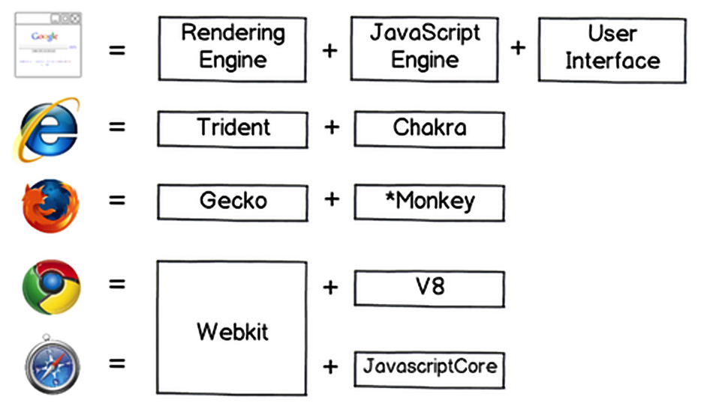
JS engines

Slide 8
How do engines work?
Engines are complicated. But the basics are easy.
The engine (embedded if it’s a browser) reads (“parses”) the script.
Then it converts (“compiles”) the script to the machine language.
And then the machine code runs, pretty fast.
The engine applies optimizations at each step of the process. It even watches the compiled script as it runs, analyzes the data that flows through it, and further optimizes the machine code based on that knowledge.

Slide 9
What can in-browser JavaScript do?
JavaScript’s capabilities greatly depend on the environment it’s running in. For instance, Node.js supports functions that allow JavaScript to read/write arbitrary files, perform network requests, etc.
Add new HTML to the page, change the existing content, modify styles.
React to user actions, run on mouse clicks, pointer movements, key presses.
Send requests over the network to remote servers, download and upload files (so-called AJAX and COMET technologies).
Get and set cookies, ask questions to the visitor, show messages.
Remember the data on the client-side (“local storage”).

Slide 10
What CAN’T in-browser JavaScript do?
JavaScript’s abilities in the browser are limited for the sake of the user’s safety. The aim is to prevent an evil webpage from accessing private information or harming the user’s data.
Examples of such restrictions include:
JavaScript on a webpage may not read/write arbitrary files on the hard disk, copy them or execute programs. It has no direct access to OS system functions.
Modern browsers allow it to work with files, but the access is limited and only provided if the user does certain actions, like “dropping” a file into a browser window or selecting it via an <input> tag.
There are ways to interact with camera/microphone and other devices, but they require a user’s explicit permission. So a JavaScript-enabled page may not sneakily enable a web-camera, observe the surroundings and send the information to the NSA.

Slide 11
What CAN’T in-browser JavaScript do?
Different tabs/windows generally do not know about each other. Sometimes they do, for example when one window uses JavaScript to open the other one. But even in this case, JavaScript from one page may not access the other if they come from different sites (from a different domain, protocol or port).
This is called the “Same Origin Policy”. To work around that, both pages must agree for data exchange and contain a special JavaScript code that handles it. We’ll cover that in the tutorial.
This limitation is, again, for the user’s safety. A page from http://anysite.com which a user has opened must not be able to access another browser tab with the URL http://gmail.com and steal information from there.
JavaScript can easily communicate over the net to the server where the current page came from. But its ability to receive data from other sites/domains is crippled. Though possible, it requires explicit agreement (expressed in HTTP headers) from the remote side. Once again, that’s a safety limitation.

Slide 12
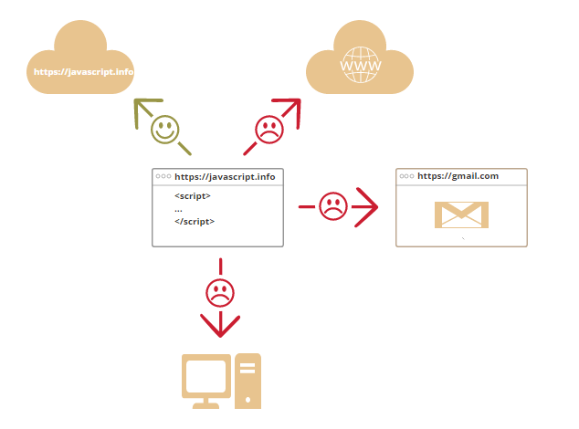

Slide 13
What makes JavaScript unique?
There are at least three great things about JavaScript:
Full integration with HTML/CSS.
Simple things are done simply.
Support by all major browsers and enabled by default.
JavaScript is the only browser technology that combines these three things.
That’s what makes JavaScript unique. That’s why it’s the most widespread tool for creating browser interfaces.
That said, JavaScript also allows to create servers, mobile applications, etc.

Slide 14
Languages “over” JavaScript
The syntax of JavaScript does not suit everyone’s needs. Different people want different features.
That’s to be expected, because projects and requirements are different for everyone.
So recently a plethora of new languages appeared, which are transpiled (converted) to JavaScript before they run in the browser.
Modern tools make the transpilation very fast and transparent, actually allowing developers to code in another language and auto-converting it “under the hood”.
Examples of such languages:
CoffeeScript is a “syntactic sugar” for JavaScript. It introduces shorter syntax, allowing us to write clearer and more precise code. Usually, Ruby devs like it.
TypeScript is concentrated on adding “strict data typing” to simplify the development and support of complex systems. It is developed by Microsoft.
Flow also adds data typing, but in a different way. Developed by Facebook.
Dart is a standalone language that has its own engine that runs in non-browser environments (like mobile apps), but also can be transpiled to JavaScript. Developed by Google.
There are more. Of course, even if we use one of transpiled languages, we should also know JavaScript to really understand what we’re doing.

Slide 15
Summary
JavaScript was initially created as a browser-only language, but is now used in many other environments as well.
Today, JavaScript has a unique position as the most widely-adopted browser language with full integration with HTML/CSS.
There are many languages that get “transpiled” to JavaScript and provide certain features. It is recommended to take a look at them, at least briefly, after mastering JavaScript.

Slide 16
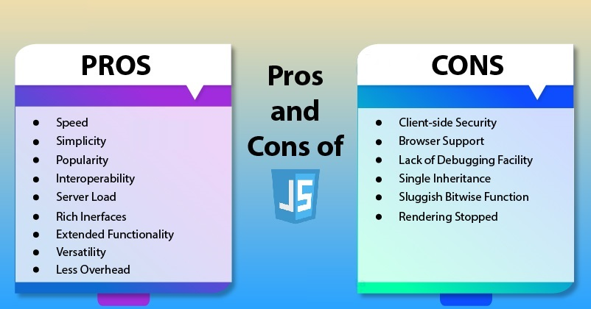

Slide 17
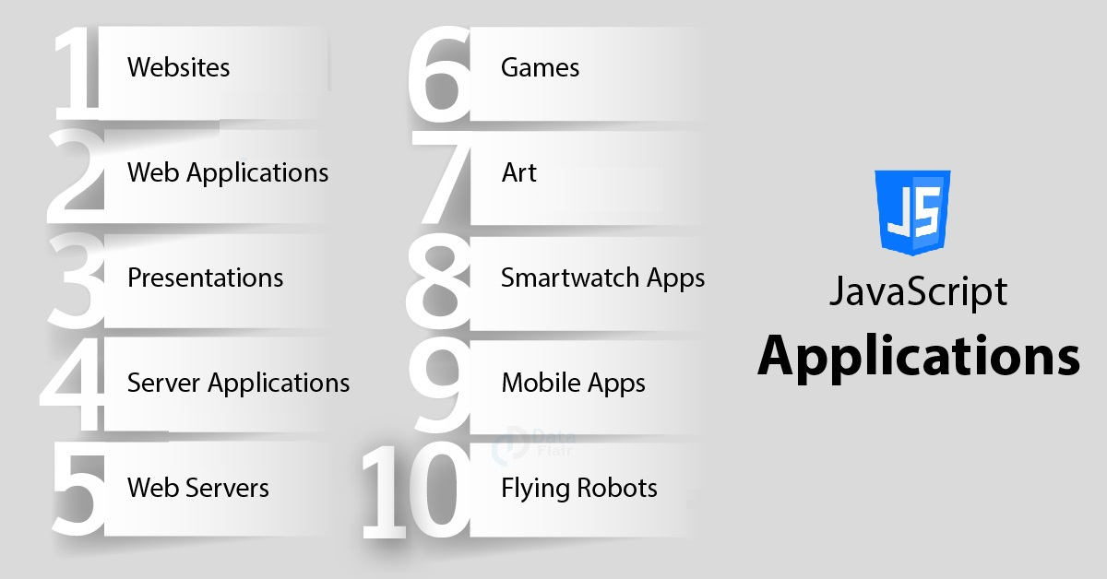
JavaScript Uses in Web Designing

Slide 18
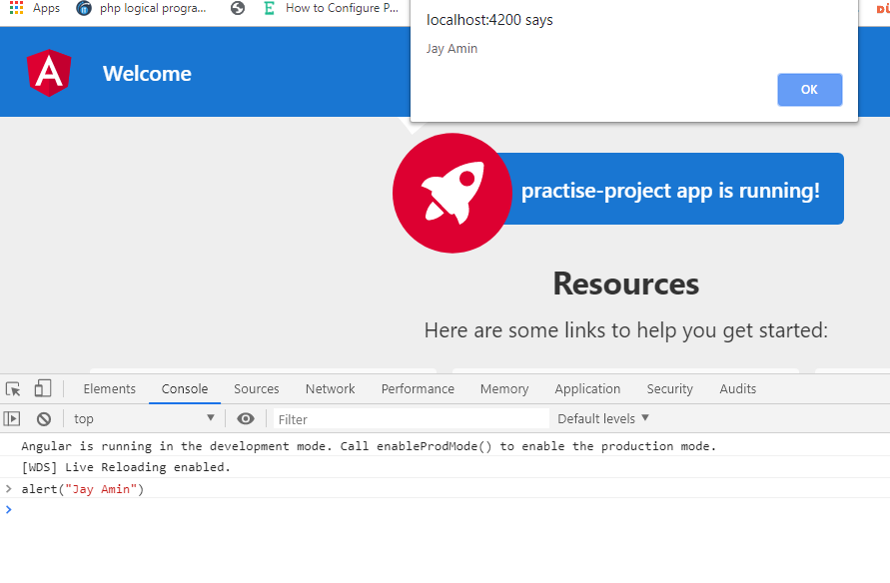

Developer console
Code is prone to errors.
what am I talking about?
You are absolutely going to make errors,
at least if you’re a human, not a robot.
F12 or
Right click inspect element
But in the browser, users don’t see errors by default. So, if something goes wrong in the script, we won’t see what’s broken and can’t fix it.
Most developers lean towards Chrome or Firefox for development because those browsers have the best developer tools. Other browsers also provide developer tools, sometimes with special features, but are usually playing “catch-up” to Chrome or Firefox. So most developers have a “favorite” browser and switch to others if a problem is browser-specific.
Developer tools are potent; they have many features. To start, we’ll learn how to open them, look at errors, and run JavaScript commands.

Slide 19
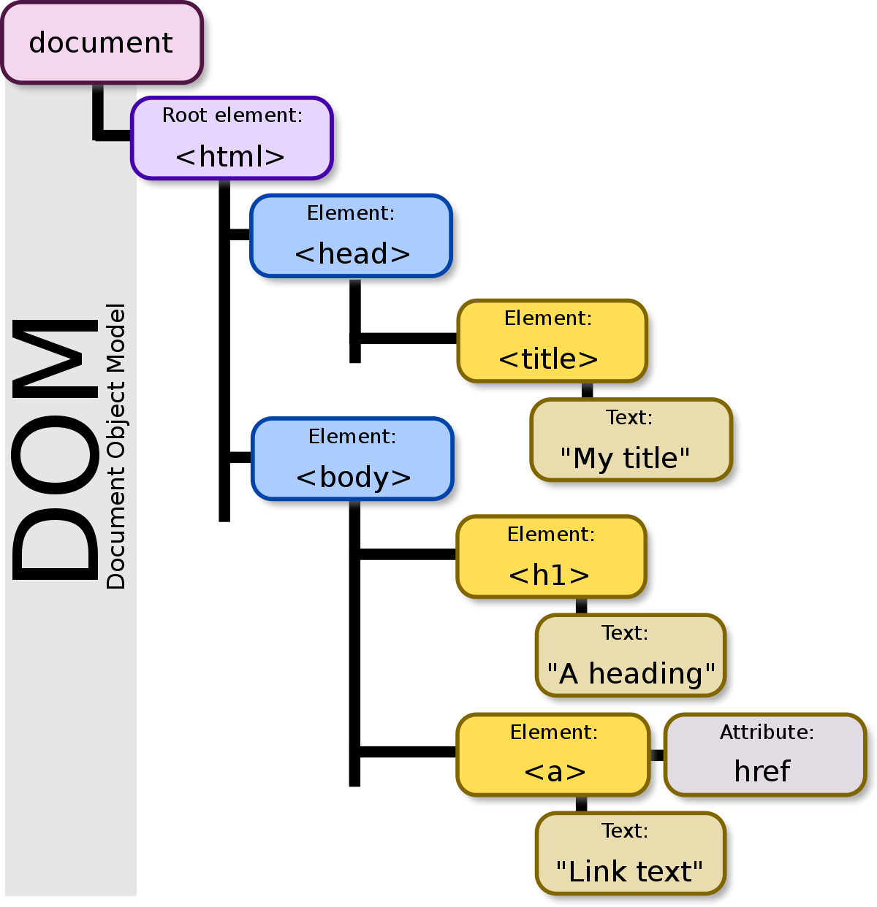

Slide 20
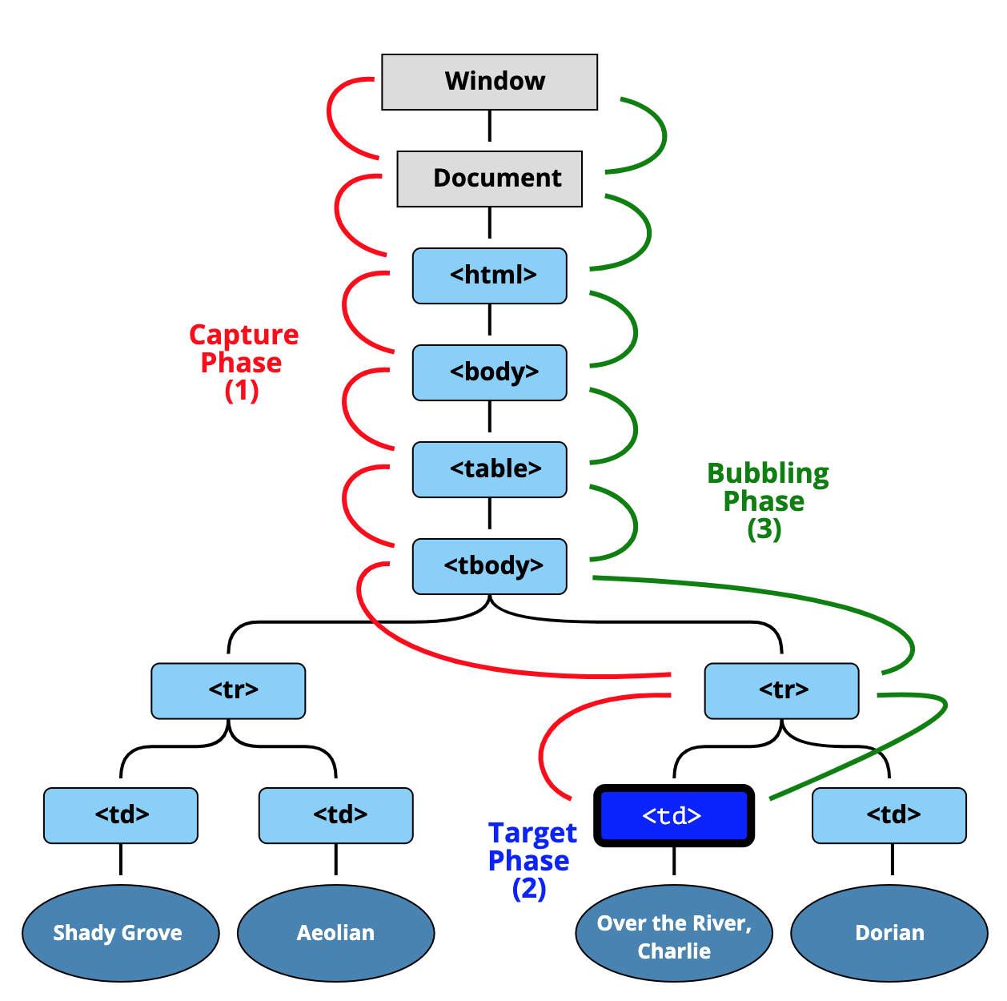
Browser Events

Slide 21
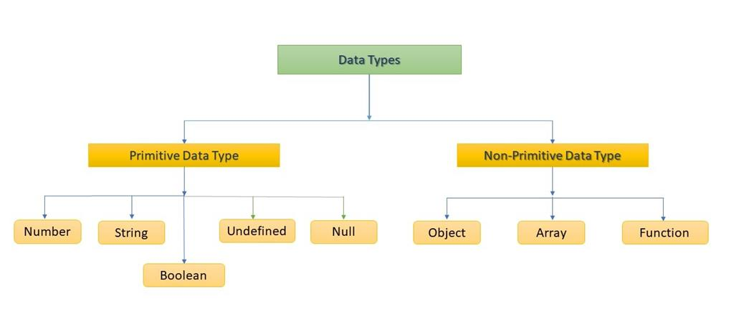
Data Types

Slide 22
What is a JavaScript Loop?
Entry Controlled Loops: Any loop where we check the test condition before entering the loop is an entry controlled loop. In these loops, the test condition determines whether the program will enter the loop or not. These include for, while, etc.
Exit Controlled Loops: Any loop where we check the test condition after the statements are executed once is an exit controlled loop. In these loops, the test condition determines whether or not the program will exit the loop. This category includes do…while loop.

Slide 23
JavaScript Loops
We repeat the sequence of instructions until the test condition is true. JavaScript provides the following loop statements to achieve this:
while statement
for statement
do..while statement
for…in statement
for…of statement
labeled statement
break statement
continue statement

Slide 24
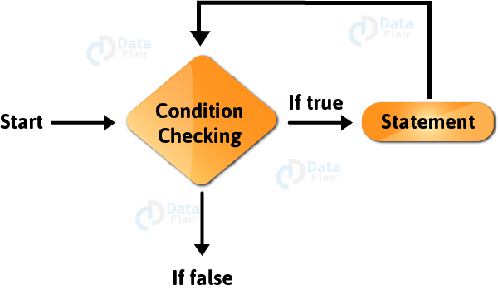
While Statement

Slide 25
while
A while statement in JavaScript executes until our boolean condition evaluates to true. This loop is an entry controlled loop.
If the test condition returns false, then control passes to the statement just after the loop.
If the test condition returns true, the loop body is executed and the condition is tested again.
The syntax for a while statement is as follows:
while ( boolean condition)
statement
For multiple statements, group them with a block statement ({…}).

Slide 26
While
<html>
<body>
<script>
var iterator1 = 0; //iteration variable initialized with 0
while (iterator1 < 5) //testing the condition
{
document.write(iterator1 + 1 + ". " + "DataFlair Tutorial for JavaScript</br>");
iterator1++; //incrementing the value of the variable
}
document.write("</br>Loop end");
</script>
</body>
</html>

Slide 27
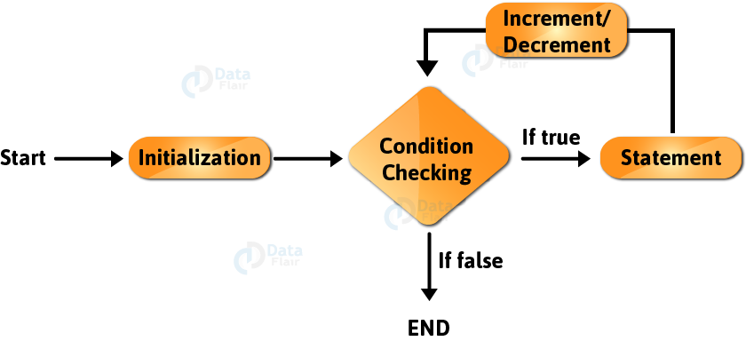
for Statement

Slide 28
For
JavaScript for loops are similar to Java and C language for loops. It’s an entry controlled loop. It consists of three parts, separated with a semicolon:
Initialization: It initializes the loop with an iteration variable and executes once at the beginning of the loop.
Condition: It specifies a certain condition in the loop that determines whether the loop body will execute or not. If the condition returns true, the code inside the for loop will execute. If it returns false, the control moves onto the statement after the loop.
Increment/ Decrement: This section increments or decrements the value of our iteration variable by 1.

Slide 29
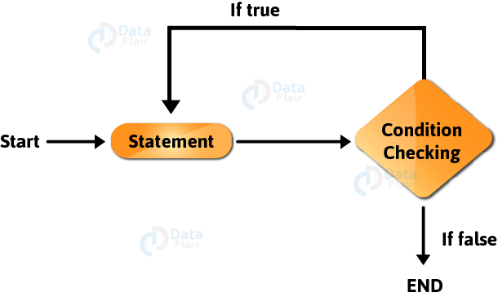
3. do...while Statement

Slide 30
3. do...while Statement
This is an exit controlled loop; the loop body executes at least once, even if the condition is not true. This is because the condition is tested when the loop body ends. If the condition returns true, the code inside the loop executes again. If it returns false, the JavaScript interpreter exits the loop.
do
{
//code executed at least once
}while (condition);

Slide 31
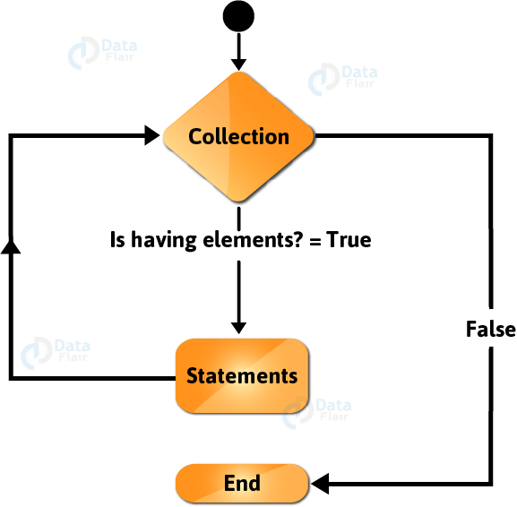
4. for…in Statement

Slide 32
4. for…in Statement
This is a modified for loop that doesn’t require the programmer to know the number of iterations the loop needs to perform. It creates a loop iterating over all the enumerable properties of an object. The keys store the key of the current property and we access the property’s value with it. This means that the loop executes a specific set of statements for each distinct property in a JavaScript Object. The working of a for…in statement in JavaScript is similar to for-each loop in Java.
The syntax of a for…in statement in JavaScript looks like this:
for (keys in objProperties) {
statements
}
The reason why the developers created the for…in loop is to work with user-defined properties in an object. It is better to use a traditional for loop over Array elements with numeric indexes. But, for this example, we are using a numeric array so you can understand how the loop works.

Slide 33
5. for…of Statement
In the last JavaScript statement, we had to access the array’s values with the help of square brackets [ ]. We couldn’t access them directly and it makes your program more error-prone. So the JavaScript developers got us a new way to access these values directly. This makes our code a lot more efficient than before because the values store the property’s value, not the key.
A for…of statement looks as follows:
for (values of objProperties)
{
statements
}

Slide 34
6. Infinite Loop
One of the most common mistakes programmers make while using loops is creating an infinite loop. This happens when we accidentally add a condition that always returns true. It is very important that you avoid them in your code, but I still want you to practice these loops. Try thinking of some situations where the condition is always true. Let me give you an example:
while(1){
//statements
}

Slide 35
Topics
Hello, world!
Code structure
The modern mode, "use strict"
Variables
Data types
Type Conversions
Operators
Comparisons
Interaction: alert, prompt, confirm
Conditional operators: if, '?'
Logical operators
Loops: while and for
The "switch" statement
Functions
Function expressions
Arrow functions, the basics
JavaScript specials

Slide 36
JavaScript Objects
In JavaScript, almost "everything" is an object.
Booleans can be objects (if defined with the new keyword)
Numbers can be objects (if defined with the new keyword)
Strings can be objects (if defined with the new keyword)
Dates are always objects
Maths are always objects
Regular expressions are always objects
Arrays are always objects
Functions are always objects
Objects are always objects
All JavaScript values, except primitives, are objects.

Slide 37
JavaScript Primitives
A primitive value is a value that has no properties or methods.
A primitive data type is data that has a primitive value.
JavaScript defines 5 types of primitive data types:
string
number
boolean
null
undefined

Slide 38
Creating a JavaScript Object
With JavaScript, you can define and create your own objects.
There are different ways to create new objects:
Create a single object, using an object literal.
Create a single object, with the keyword new.
Define an object constructor, and then create objects of the constructed type.
Create an object using Object.create().

Slide 39
Using an Object Literal
This is the easiest way to create a JavaScript Object.
Using an object literal, you both define and create an object in one statement.
An object literal is a list of name:value pairs (like age:50) inside curly braces {}.
The following example creates a new JavaScript object with four properties:
const person = {firstName:"John", lastName:"Doe", age:50, eyeColor:"blue"};

Slide 40
Using the JavaScript Keyword new
const person = new Object(); person.firstName = "John"; person.lastName = "Doe"; person.age = 50; person.eyeColor = "blue";

Slide 41
JavaScript Properties
Accessing JavaScript Properties
The syntax for accessing the property of an object is:
objectName.property // person.age
or
objectName["property"] // person["age"]
or
objectName[expression] // x = "age"; person[x]
The expression must evaluate to a property name.

Slide 42
JavaScript Object Constructors
function Person(first, last, age, eye) { this.firstName = first; this.lastName = last; this.age = age; this.eyeColor = eye; }

Slide 43
Object Types (Blueprints) (Classes)
The examples from the previous chapters are limited. They only create single objects.
Sometimes we need a "blueprint" for creating many objects of the same "type".
The way to create an "object type", is to use an object constructor function.
In the example above, function Person() is an object constructor function.
Objects of the same type are created by calling the constructor function with the new keyword:
const myFather = new Person("John", "Doe", 50, "blue"); const myMother = new Person("Sally", "Rally", 48, "green");

Slide 44
Object Prototpye
JavaScript is a dynamic language. You can attach new properties to an object at any time as shown below.
function Student() { this.name = 'John'; this.gender = 'Male'; }
var studObj1 = new Student();
studObj1.age = 15; alert(studObj1.age); // 15
var studObj2 = new Student();
alert(studObj2.age); // undefined
As you can see in the above example, age property is attached to studObj1 instance. However, studObj2 instance will not have age property because it is defined only on studObj1 instance.
So what to do if we want to add new properties at later stage to a function which will be shared across all the instances?
The answer is Prototype.

Slide 45
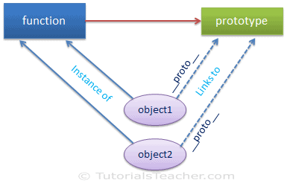
Object Prototpye
The prototype is an object that is associated with every functions and objects by default in JavaScript, where function's prototype property is accessible and modifiable and object's prototype property (aka attribute) is not visible.

Slide 46
Object Prototpye
function Student() {
this.name = 'John';
this.gender = 'M';
}
var studObj = new Student();
console.log(Student.prototype); // object
console.log(studObj.prototype); // undefined
console.log(studObj.__proto__); // object
console.log(typeof Student.prototype); // object
console.log(typeof studObj.__proto__); // object
console.log(Student.prototype === studObj.__proto__ ); // true

Slide 47
Object's Prototype
As mentioned before, object's prototype property is invisible. Use Object.getPrototypeOf(obj) method instead of __proto__ to access prototype object.
function Student() {
this.name = 'John';
this.gender = 'M';
}
var studObj = new Student();
Student.prototype.sayHi= function(){ alert("Hi"); };
var studObj1 = new Student();
var proto = Object.getPrototypeOf(studObj1); // returns Student's prototype object
alert(proto.constructor); // returns Student function

Slide 48
prototype object properties and methods.
Property | Description
constructor | Returns a function that created instance.
__proto__ | This is invisible property of an object. It returns prototype object of a function to which it links to.

Slide 49
prototype object properties and methods.
Method | Description
hasOwnProperty() | Returns a boolean indicating whether an object contains the specified property as a direct property of that object and not inherited through the prototype chain.
isPrototypeOf() | Returns a boolean indication whether the specified object is in the prototype chain of the object this method is called upon.
propertyIsEnumerable() | Returns a boolean that indicates whether the specified property is enumerable or not.
toLocaleString() | Returns string in local format.
toString() | Returns string.
valueOf | Returns the primitive value of the specified object.

Slide 50
Chrome and Firefox denotes object's prototype as __proto__ which is public link whereas internally it reference as [[Prototype]]. Internet Explorer does not include __proto__. Only IE 11 includes it.
The getPrototypeOf() method is standardize since ECMAScript 5 and is available since IE 9.

Slide 51
Changing Prototype
function Student() {
this.name = 'John';
this.gender = 'M';
}
Student.prototype.age = 15;
var studObj1 = new Student();
alert('studObj1.age = ' + studObj1.age); // 15
var studObj2 = new Student();
alert('studObj2.age = ' + studObj2.age); // 15
Student.prototype = { age : 20 };
var studObj3 = new Student();
alert('studObj3.age = ' + studObj3.age); // 20
alert('studObj1.age = ' + studObj1.age); // 15
alert('studObj2.age = ' + studObj2.age); // 15

Slide 52
Inheritance in JavaScript
Inheritance is an important concept in object oriented programming. In the classical inheritance, methods from base class get copied into derived class.
In JavaScript, inheritance is supported by using prototype object. Some people call it "Prototypal Inheriatance" and some people call it "Behaviour Delegation".
Let's see how we can achieve inheritance like functionality in JavaScript using prototype object.
Let's start with the Person class which includes FirstName & LastName property as shown below.

Slide 53
Inheritance in JavaScript
function Person(firstName, lastName) {
this.FirstName = firstName || "unknown";
this.LastName = lastName || "unknown";
};
Person.prototype.getFullName = function () {
return this.FirstName + " " + this.LastName;
}

Slide 54
Inheritance in JavaScript Multiple
function Person(firstName, lastName) {
this.FirstName = firstName || "unknown";
this.LastName = lastName || "unknown"; }
Person.prototype.getFullName = function () {
return this.FirstName + " " + this.LastName; }
function Student(firstName, lastName, schoolName, grade) { Person.call(this, firstName, lastName);
this.SchoolName = schoolName || "unknown"; this.Grade = grade || 0; } //Student.prototype = Person.prototype;
Student.prototype = new Person();
Student.prototype.constructor = Student;
var std = new Student("James","Bond", "XYZ", 10);
alert(std.getFullName()); // James Bond
alert(std instanceof Student); // true alert(std instanceof Person); // true

Slide 55
JavaScript Closure
Closure is one of important concept in JavaScript. It is widely discussed and still confused concept. Let's understand what the closure is.
First of all, let's see the definition of the Closure given by Douglas Crockford: crockford.com/javascript/private.html
Closure means that an inner function always has access to the vars and parameters of its outer function, even after the outer function has returned.
You have learned that we can create nested functions in JavaScript. Inner function can access variables and parameters of an outer function (however, cannot access arguments object of outer function). Consider the following example.

Slide 56
function OuterFunction() {
var outerVariable = 1;
function InnerFunction() {
alert(outerVariable);
}
return InnerFunction;
}
var innerFunc = OuterFunction();
innerFunc(); // 100

Slide 57
Use Of Closure
function Counter() {
var counter = 0;
function IncreaseCounter() {
return counter += 1;
};
return IncreaseCounter;
}
var counter = Counter();
alert(counter()); // 1
alert(counter()); // 2
alert(counter()); // 3
alert(counter()); // 4

Slide 58
Closure
function Counter() {
var counter = 0; setTimeout( function () {
var innerCounter = 0;
counter += 1;
alert("counter = " + counter);
setTimeout( function () {
counter += 1;
innerCounter += 1;
alert("counter = " + counter + ", innerCounter = " + innerCounter) }, 500); }, 1000);
};
Counter();

Slide 59
When to use Closure?
Closure is useful in hiding implementation detail in JavaScript. In other words, it can be useful to create private variables or functions.
var counter = (function() { var privateCounter = 0; function changeBy(val) { privateCounter += val; }
return {
increment: function() {
changeBy(1);
},
decrement: function() {
changeBy(-1);
}, value: function() {
return privateCounter;
} }; })();
alert(counter.value()); // 0
counter.increment();
counter.increment();
alert(counter.value()); // 2
counter.decrement();
alert(counter.value()); // 1

Slide 60
Iterators and Generators
What is Iterables and Iterators?
ES6 introduces a new mechanism for traversing data: iteration. Two concepts are central to iteration:
An iterable is a data structure that wants to make its elements accessible to the public. It does so by implementing a method whose key is Symbol.iterator. That method is a factory for iterators.
An iterator is a pointer for traversing the elements of a data structure (think cursors in databases)

Slide 61
Iterable values in Javascript
The following values are iterable:
Arrays
Strings
Maps
Sets
DOM data structures (work in progress)

Slide 62
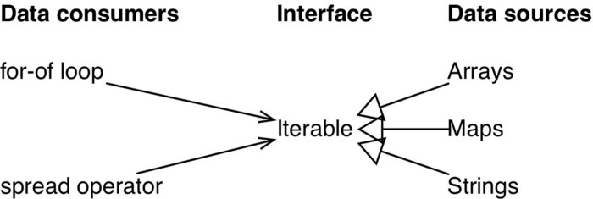
The idea of iterability is as follows.
Data consumers: JavaScript has language constructs that consume data. For example, for-of loops over values and the spread operator (...) inserts values into Arrays or function calls.
Data sources: The data consumers could get their values from a variety of sources. For example, you may want to iterate over the elements of an Array, the key-value entries in a Map or the characters of a string.

Slide 63
The following ES6 language constructs make use of the Iterable:
Destructuring via an Array pattern
for-of loop
Array.from()
Spread operator (...)
Constructors of Maps and Sets
Promise.all(), Promise.race()
yield*

Slide 64
What are Generators?
You can think of generators as processes (pieces of code) that you can pause and resume while executing that particular code :
function* func() { // (A) console.log('First'); yield; console.log('Second'); }
The yield keyword pauses generator function execution and the value of the expression following the yield keyword is returned to the generator's caller. It can be thought of as a generator-based version of the return keyword.

Slide 65
Generator function declarations:
function* genFunc() { ··· } const genObj = genFunc();

Slide 66
Generator function expressions:
const genFunc = function* () { ··· }; const genObj = genFunc();

Slide 67
Generator method definitions in object literals:
const obj = { * generatorMethod() { ··· } }; const genObj = obj.generatorMethod();

Slide 68
Generator method definitions in class definitions
class MyClass { * generatorMethod() { ··· } } const myInst = new MyClass(); const genObj = myInst.generatorMethod();

Slide 69
Usecase of Generators:
Simpler asynchronous code we can execute simple asynchronous block of code.
Receiving asynchronous data using generators
ES8 will have async functions(async/await) which are internally based on generators. With them, the code looks like this:
async function fetchJson(url) { try { let request = await fetch(url); let text = await request.text(); return JSON.parse(text); } catch (error) { console.log(`ERROR: ${error.stack}`); } }

Slide 70
Implementing Iterables
function* objectEntries(obj) { const propKeys = Reflect.ownKeys(obj); for (const propKey of propKeys) { // `yield` returns a value and then pauses // the generator. Later, execution continues // where it was previously paused. yield [propKey, obj[propKey]]; } }
The above function returns an iterable over the properties of an object, one [key, value] pair per property, The objects returned by generators are iterable,using that iterable we can get next yield of [key,value] pair use of for-of loop,

Slide 71
The following code use that Object.entries() method
const user= { name: 'raja', age: 25}; for (const [key,value] of objectEntries(user)) { console.log(`${key}: ${value}`); } // Output: // name: raja // age: 25

Slide 81
https://javascript.info/first-steps

