Slide 1
AI PRODUCT CASE STUDY
Postmeet.
The last mile of meetings.
Every meeting produces commitments. Most of them evaporate. Postmeet turns a raw transcript into distributed, owned action — in about five seconds, with zero setup.
Shubham Mittal · AI Product Manager
🏆 Top 10 Finalist → 2nd Runner-Up
PromptWars Chennai 2026 · Google for Developers × Hack2Skill
Live demo: postmeet.onrender.com Repo: github.com/Shubham-33/postmeet

Slide 2
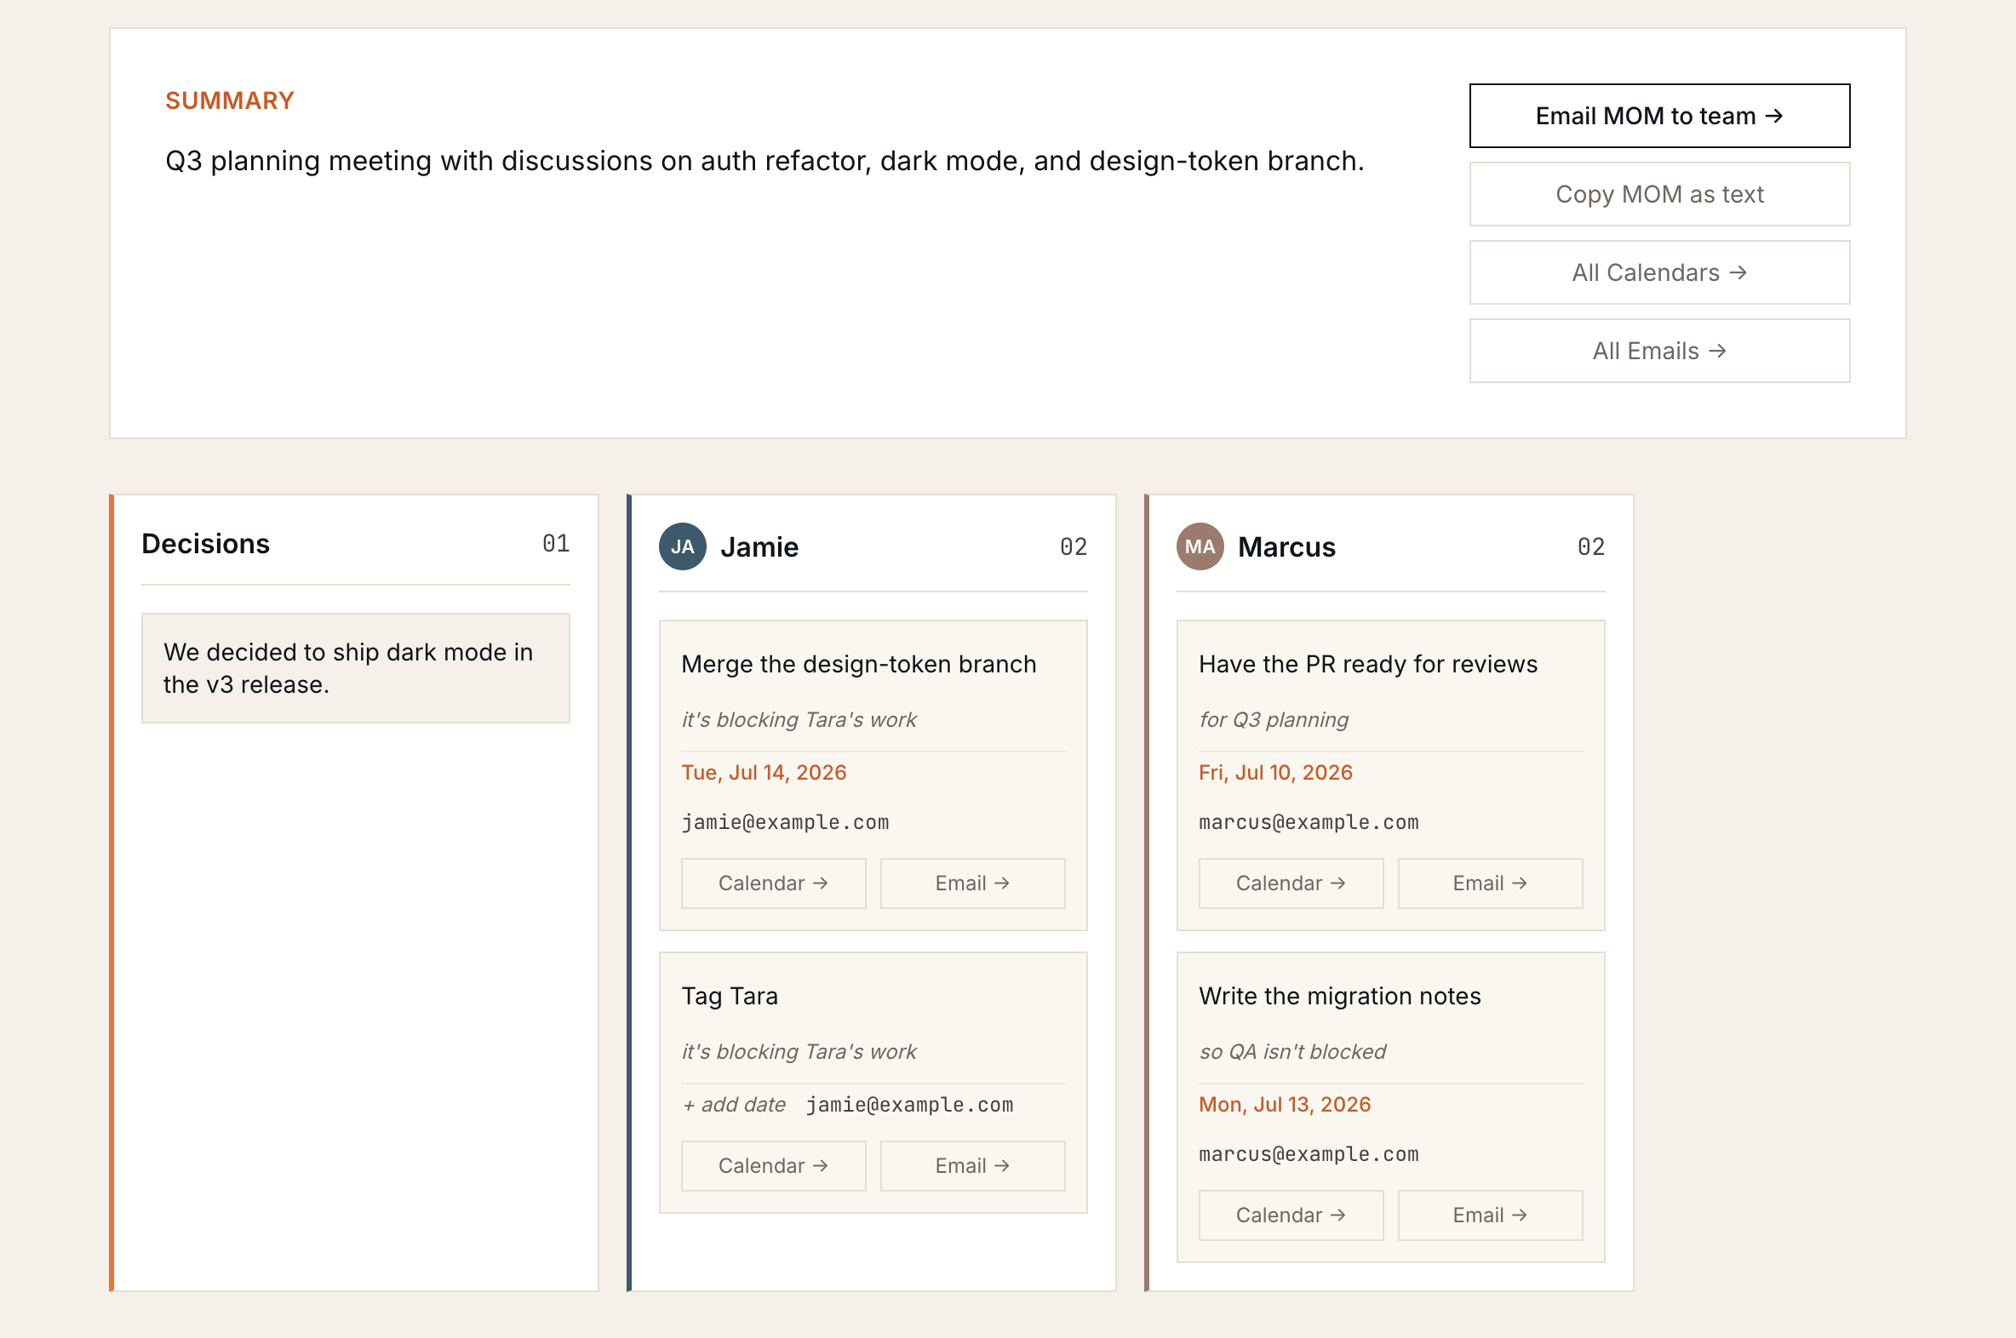
— SEE IT WORK
Paste a transcript → the board writes itself.
Real output from the live app — extracted in ~3s: summary, decisions, and one column per owner, each card one click from a prefilled Calendar event or Gmail draft.

Slide 3
01 · THE PRODUCT
Paste a meeting → get owned action → distribute in one click.
INPUT
EXTRACT
DISTRIBUTE
Drop it in
AI structures it
One-click send
Paste a transcript, a public Google Doc URL, or a file. No account.
Summary, decisions, and action items — each with owner, email, due date, context.
Each item opens a prefilled Google Calendar event or Gmail draft. Just Save / Send.
The “no-OAuth trick”: prefilled Calendar / Gmail URLs open in the user's already-logged-in Google. Time-to-value ~10 seconds — no integration, no admin approval, no scope review.

Slide 4
02 · THE PROBLEM
Meetings manufacture commitments. Then the commitments go missing.
~70%
who
Knowledge workers spend a huge share of the week in meetings — what matters is the follow-through, not the recording.
gap
The pain isn't capturing what was said. It's doing what was decided.
of meeting action items are never completed — they live in someone's notes, a Slack thread, a doc nobody reopens.
cost
Dropped commitments = re-work, missed deadlines, and eroded trust.
Industry estimates range ~44–73% never completed (Fellow, Streamli9). Directional — as PM, first job is to validate with first-party instrumentation before over-investing.

Slide 5
03 · THE INSIGHT
Everyone is fighting over capture. The last mile is wide open.
CROWDED — “CAPTURE”
OPEN — “THE LAST MILE”
Transcribe & summarize
Distribute & act
Otter, Fireflies, Fathom, Granola — all competing on better transcripts. Table stakes now. The commitments they surface still die in a doc.
Getting each commitment into the tool the owner actually lives in — their calendar, their inbox — is where follow-through is won or lost.
The blocker on the last mile isn't a smarter model — it's setup friction. So the wedge is zero-setup distribution.

Slide 6
04 · THE AI UNDER THE HOOD
Reliable structure out of an unreliable medium.
transcript → LLM · JSON mode → schema-validated JSON → board + prefilled links
Structured output
Guardrails
Graceful degradation
A fixed JSON contract (summary / decisions / action items), pinned in the system prompt and decoded by a tolerant parser. One call, no retry loop.
Extracts only explicit commitments — no invented tasks. Empty fields when data is absent. The difference between useful and hallucinated.
A model fallback chain: if the primary is cold or errors, it drops to a backup so the request still succeeds.

Slide 7
05 · THE DEFINING DECISION
I shipped the smaller model on purpose.
REJECTED AS PRIMARY
SHIPPED AS PRIMARY
Llama 3.1 70B
Llama 3.1 8B
latency
9s–46s, inconsistent
latency
~2.5s, consistent
reliability
cold-starts, timeouts
reliability
steady across runs
quality
marginally higher
quality
comparable
Model quality is an input to product value, not the goal. A demo that always works in two seconds beats a “smarter” one that sometimes hangs — reliability builds trust faster than marginal accuracy.

Slide 8
06 · HOW I'D MEASURE SUCCESS
One north star, a funnel beneath it, guardrails around it.
NORTH-STAR METRIC
Commitment Completion Rate
Of the action items surfaced, what share actually get done? Everything else is a proxy.
INPUT METRICS — THE FUNNEL
GUARDRAIL METRICS
• Activation: % sessions that extract → distribute ≥1 item
• Hallucination rate (invented items)
• Time-to-value: seconds paste → first send
• Edit rate (proxy for accuracy)
• Extraction quality: precision / recall vs. eval set
• Error / failure rate
• Retention: repeat use / week

Slide 9
07 · MAKING AI DECISIONS RIGOROUSLY
Vibes don't scale. Evals do.
set
Build a golden eval set: labelled transcripts with the “true” decisions and action items.
THE COMPOUNDING LOOP
Every edit is a label
score
Measure precision (did we invent tasks?), recall (did we miss commitments?), and field accuracy.
Users correct the extracted items before sending. Those corrections are free, in-domain training data → fine-tune on accepted output → org-specific accuracy competitors can't match without the same data. The eval loop becomes the moat.
use
That's how I'd choose 8B vs 70B, catch regressions, and set a launch quality bar — not by gut.

Slide 10
08 · PRIORITIZATION
What I deliberately left out — and why that's the point.
MVP scope is a hypothesis test, not a feature checklist. I cut everything not needed to validate one thing: will people extract, then actually distribute?
CUT · PERSISTENCE
CUT · REAL INTEGRATIONS
No database. A refresh clears everything — and “no data stored” removes privacy friction for testers.
The URL-prefill trick proves value without OAuth. Real APIs are a scaling investment, made once the loop is proven.
CUT · ACCOUNTS & TEAMS
KEPT · THE CORE LOOP + TRUST
Single-session, no login. Multi-user is a growth concern, not a validation one.
Extraction reliability, one-click distribution, honest guardrails, 100%-tested logic.

Slide 11
09 · ROADMAP & MOAT
From a one-click helper to the system of record for follow-through.
NOW · VALIDATE
NEXT · AUTO-CAPTURE
LATER · OWN THE OUTCOME
The core loop
Capture everywhere
Proactive follow-through
• Paste → extract → distribute
• Extension + AI notetaker
• Persistence + team workspaces
• Zero setup, no OAuth
• Auto-joins Zoom / Teams / Meet
• Nudges: “did you ship X?”
• Reliable structured output
• Native Gmail, Outlook, Calendar
• Completion tracking → closes the loop
Moat = the feedback loop. Accepted & edited action items become proprietary training data → accuracy that compounds with usage.

Slide 12
10 · WHY THIS MATTERS FOR THE ROLE
I don't just use AI tools. I make product decisions about them.
Problem framing
AI judgment
Metrics rigor
Found the non-obvious wedge — the last mile, not capture; friction, not model size.
Model tradeoffs, evals, guardrails, graceful degradation — decisions, with reasons.
A north star, an input funnel, and guardrails — measurement designed in.
Prioritization
Vision
End-to-end
Scoped an MVP as a hypothesis test; cut with intent; shipped what de-risks it.
A credible path from a one-click tool to a defensible product with a data moat.
Built, tested (100% coverage), and deployed it solo — insight to live URL.
Shubham Mittal · postmeet.onrender.com · shubham-33.github.io/postmeet/case-study/

