Slide 1


PVG’s
College of Engineering and Technology & G. K. Pate (Wani) Institute of
Management, Pune-09
Internship Training Presentation
On
AI Business Intelligence Analyst
By
Exam Seat No. : T1900708536
Name: Khot Shubham Mahadev

Slide 2
Presentation Outline
Brief description of internships completed during A.Y. 24-25.
Company Background Information
Introduction of the Internship Project
Internship Activities / Responsibilities
Progression during tenure
Methodologies
Conclusions of the Internship
References
Internship Log Book

Slide 3
Brief Description of internships completed
during A.Y. 24-25.
Sr.No | Internship Project Title | Organization Name, Address | Internship Starting date | Internship End date | Duration of Internship
1. | AI – Business Intelligence Analyst (AIBIA) | Aspire Knowledge and Skills India Pvt. Ltd. | 01/01/2025 | 29/01/2025 | 29 days (150 hours)
2. | Web Developer Intern | Virtuanexa | 01/01/2025 | 31/01/2025 | 31 days

Slide 4
Description of the Company
Pune-based IT training and skill development organization
Focuses on Developing various skills
Provides industry-relevant, job-oriented training programs
Training partner for government skill initiatives
Serves students, job seekers, and professionals
Over 1 lakh students trained and 50,000+ placed in industry

Slide 5
Introduction of the Internship
Focused on the role of a Business Intelligence (BI) Analyst
BI Analysts help businesses make data-driven decisions
Responsible for collecting, cleaning, and organizing data
Create dashboards and reports using tools like Power BI and Tableau
Use statistical techniques to analyze trends and patterns
Provide insights to improve business performance
Act as a bridge between data teams and decision-makers
Internship offered hands-on training with real-world tools and tasks
2

Slide 6

Internship Activities / Responsibilities
Data Handling
Dashboard Development
Statistical Analysis
📥 Imported, cleaned, and visualized datasets for analysis using Python and R.
📊 Created dynamic dashboards with Power BI and Tableau for data-driven insights.
📈 Performed correlation, regression, and hypothesis testing in RStudio.
Python Scripting
Visualization & Reporting
Soft Skills Growth
🐍 Automated data tasks and analysis using NumPy and Pandas.
🖼️ Presented insights clearly using charts, graphs, and visual tools.
💬 Enhanced communication & teamwork through dedicated training modules.

Slide 7

Progression during internship tenure
Explored Power BI & Tableau for real-time dashboard creation.
01.
02.
AI Foundations
BI Tools Mastery
Learned core AI concepts, statistics, and data fundamentals.
Worked on customer churn prediction and insightful dashboards.
03.
04.
Data Analysis Skills
Hands-on Projects
Used Python and R for scripting and statistical modeling.
Skillset Growth
05.
Improved both
technical proficiency and soft skill communication.

Slide 8


Methodologies
Project-Based Learning
Tool-Driven Training
01.
02.
Focused on real-world projects to apply concepts practically.
Worked with industry-standard tools and real datasets.
Expert-Guided Sessions
03.
04.
Interactive Practice
Learned through hands-on practicals
Guided by industry-persons.
Self-paced tasks, Q&A, and engaging assignments for mastery.

Slide 9
Brief Info of 2nd Internship (Project)
2. | Web Developer Intern (Python Django) | Virtuanexa | 01/01/2025 | 31/01/2025 | 31 days
Project: online rental platform that allows users to rent tools and equipment
Rental Platform Development
Payment & Auth Integration
AI & API Enhancements
Deployment
https://github.com/Shubham-393/rentalhub/tree/main
http://shubham-393.github.io/DailyVibe/
2

Slide 10




Conclusions of the Internship
Learned core AI, BI, data analytics skills. Also learned web dev skills.
Gained hands-on experience with industry tools
Developed communication, reporting, and teamwork skills
Prepared for future job roles in data science and analytics

Slide 11
References
Aspire official course material
Microsoft Power BI Docs
Tableau Learning Resources
RStudio Documentation
Python Docs for NumPy & Pandas
GeeksforGeeks, W3Schools, YouTube (Simplilearn, Great Learning)

Slide 12
Internship Log Book
Sr. No. | Date | Theory Expert Speaker(s) | Practical Session | Module(s) Covered
1 | 1st January 2025 | Dr. Minakshi Atre | - | Module 1
2 | 2nd January 2025 | Dr. Minakshi Atre | - | Module 1
3 | 3rd January 2025 | Prof. Sonam Aslekar, Prof. Vijayalaxmi Kanade | - | Modules 9, 10
4 | 6th January 2025 | Prof. Sonam Aslekar, Prof. Vijayalaxmi Kanade | - | Modules 9, 10
5 | 7th January 2025 | Dr. Minakshi Atre | - | Module 1
6 | 8th January 2025 | Mr. Anirudh Atre | Yes | Modules 1, 10
7 | 9th January 2025 | Dr. Amruta Kapoor | Yes | Module 14
8 | 10th January 2025 | Mr. Shubham Shidture | Yes | Module 3
9 | 11th January 2025 | Mr. Shubham Shidture | - | Modules 3, 4
10 | 13th January 2025 | Dr. Amruta Kapoor | - | Module 14
11 | 14th January 2025 | Dr. Amruta Kapoor | - | Module 13
12 | 15th January 2025 | Dr. Amruta Kapoor | Yes | Modules 12, 13
13 | 16th January 2025 | Mr. Shubham Shidture, Prof. Kanade, Prof. Aslekar | Yes | Modules 4, 9, 14

Slide 13
Sr. No. | Date | Theory Expert Speaker(s) | Practical Session | Module(s) Covered
14 | 17th January 2025 | Dr. Amruta Kapoor | - | Module 12
15 | 18th January 2025 | Mr. Shubham Shidture | - | Modules 4, 5
16 | 20th January 2025 | Mr. Shubham Shidture | - | Module 5
17 | 21st January 2025 | Dr. Amruta Kapoor | - | Module 11
18 | 22nd January 2025 | Dr. Amruta Kapoor | Yes | Modules 11, 15
19 | 23rd January 2025 | Dr. Amruta Kapoor | - | Module 15
20 | 24th January 2025 | Mr. Shubham Shidture | - | Module 5
21 | 25th January 2025 | Mr. Tirthankar Sen | - | Module 2
22 | 27th January 2025 | Mr. Tirthankar Sen | Yes | Modules 2, 6
23 | 28th January 2025 | Mr. Tirthankar Sen | Yes | Modules 6, 7
24 | 29th January 2025 | Mr. Tirthankar Sen | - | Module 7
25 | 21st February 2025 | Mr. Tejas Rane | - | Module 8
26 | 22nd February 2025 | Mr. Tejas Rane | - | Module 8

Slide 14
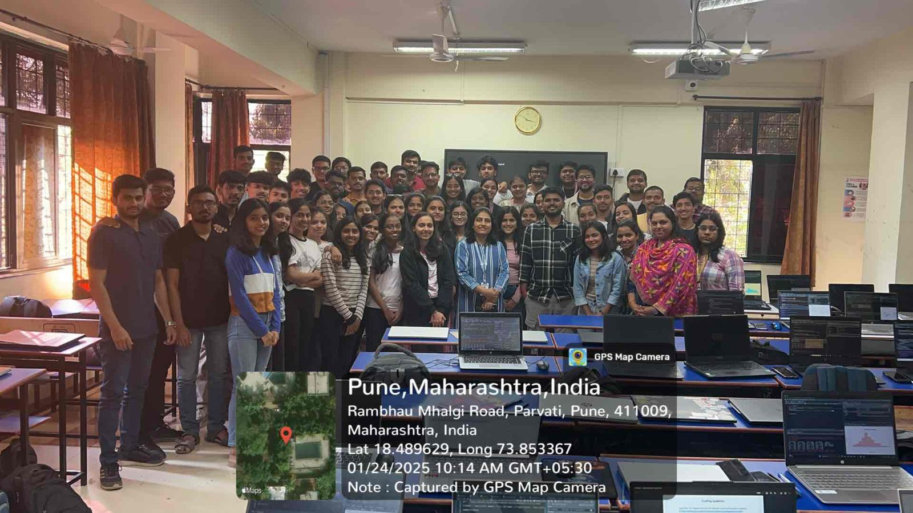
Glimpse of Internship

Slide 15
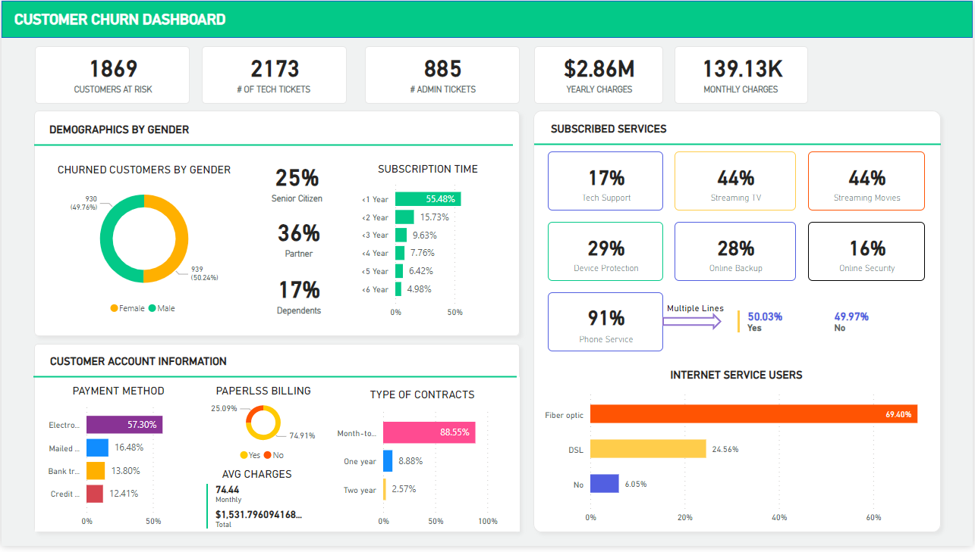

Slide 16
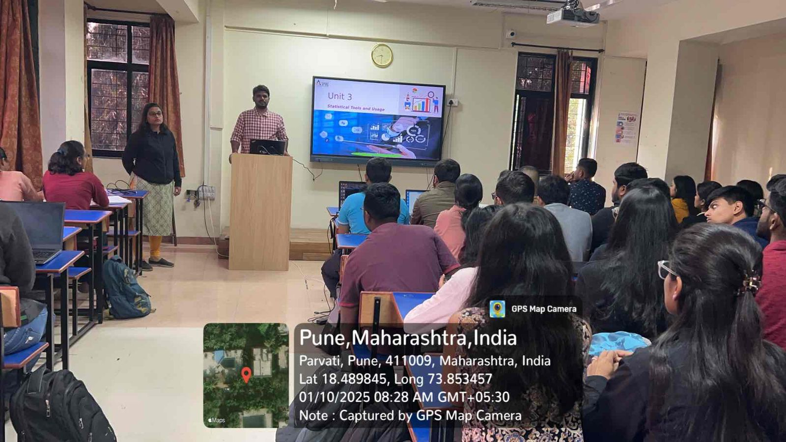

Slide 17
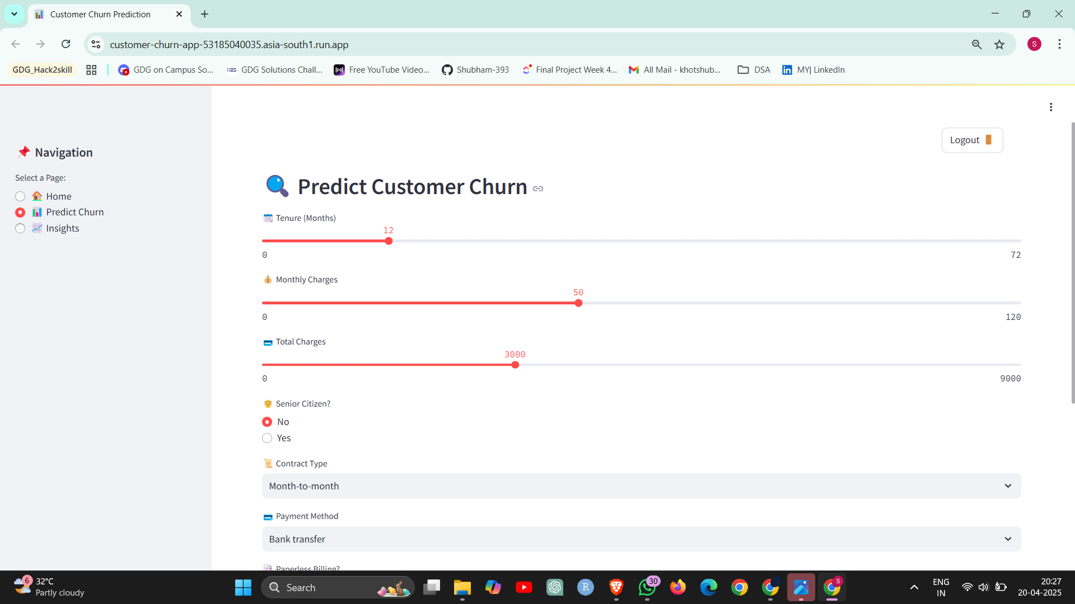

Slide 18
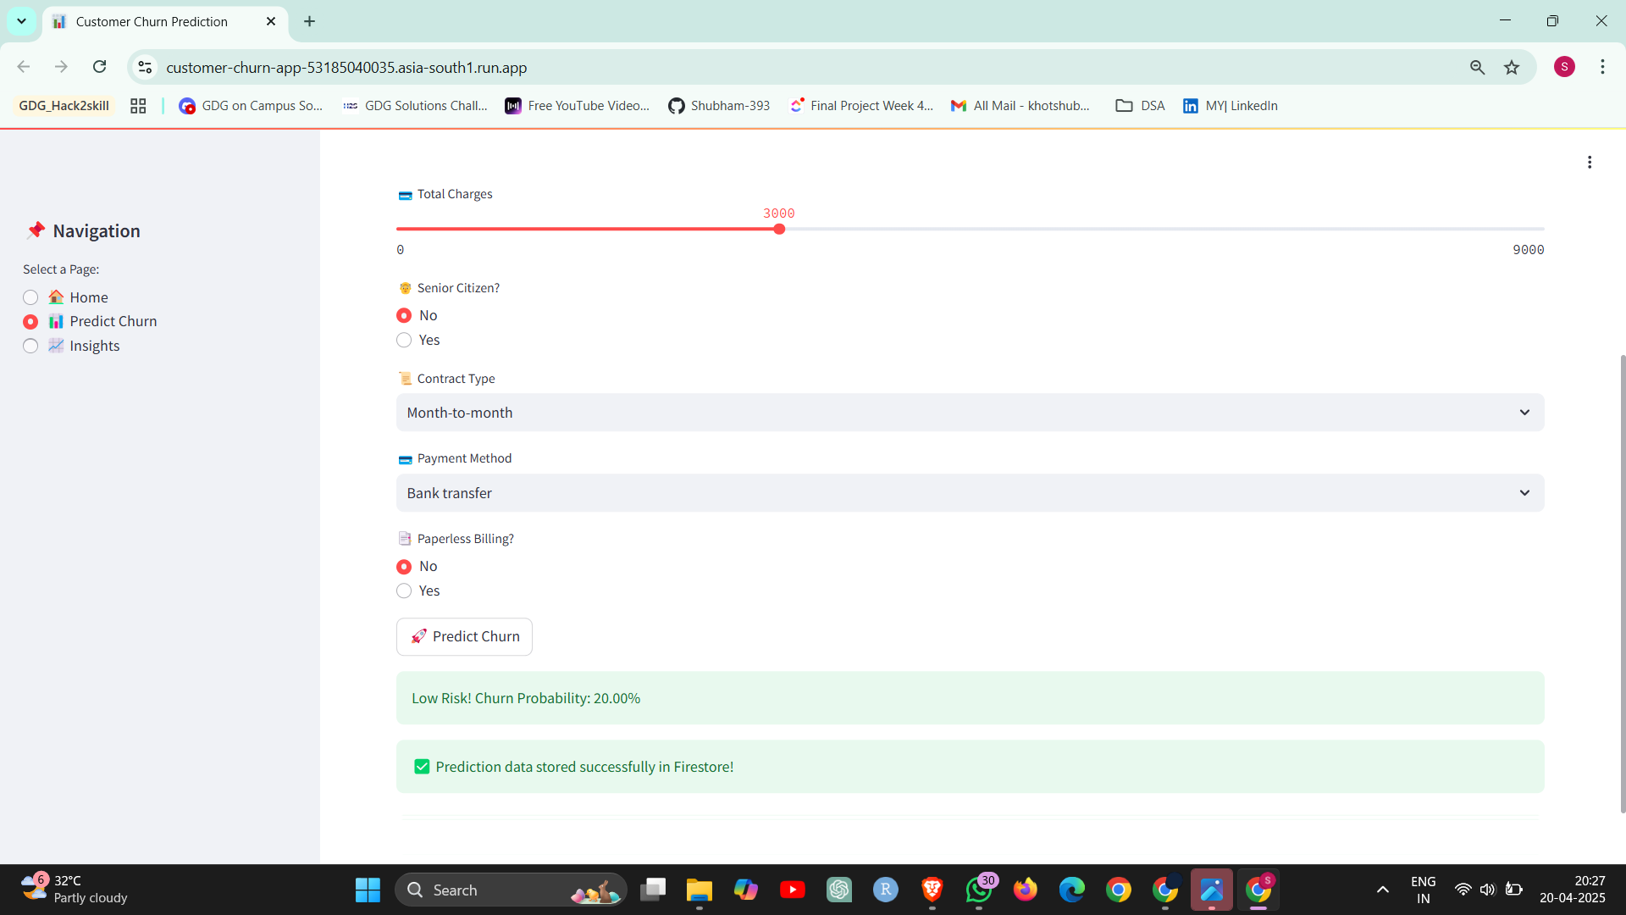

Slide 19
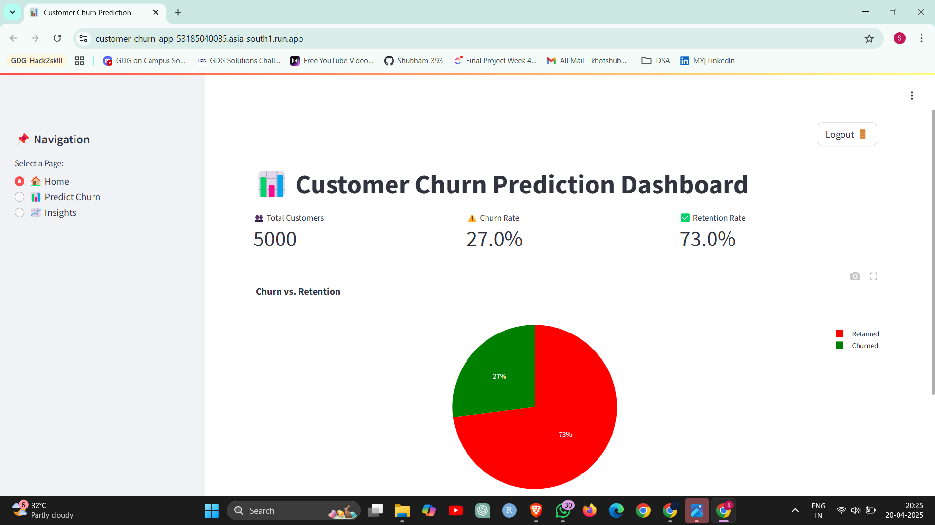

Slide 20


