Slide 1




Student
Performance
DATA MINING USING MACHINE LEARNING ALGORITHM
JENISH DHADUK [20SE02ML010]
SHUBHAM GANDHI [20SE02ML014]
MENTOR :- MR. KAUSHAL SINGH

Slide 2






Contents
01
ABSTRACT
02
INTRODUCTION
03
DATASET
04
IMPLEMENTATION
05
ADVANTAGES
06
CONCLUSION

Slide 3








ABSTRACT
This process aims to identify factors that contribute to student success, develop interventions to improve outcomes, and identify at-risk students who need additional support.

Slide 4



Introduction
The significant growth of educational data in institute
Represent data in an Integrated and Consistent format
Data Warehouses
Data Mining : To find relationship between variables and factors in the Data Warehouses
Student Progression status (Progress retain, Conditional progress)

Slide 5

DATA ANALYTICS IS MORE IMPORTANT TO GROW UP ANY BUSINESS OR INSTITUTE
LEARN MORE

Slide 6
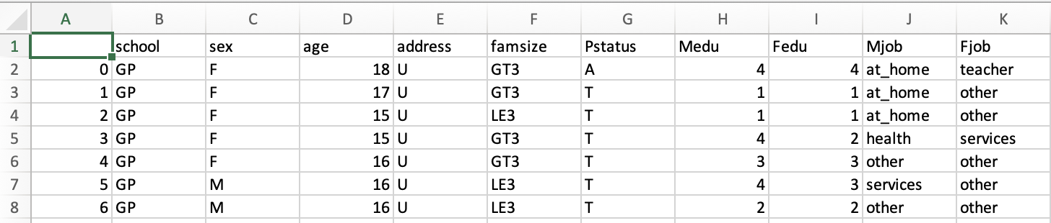
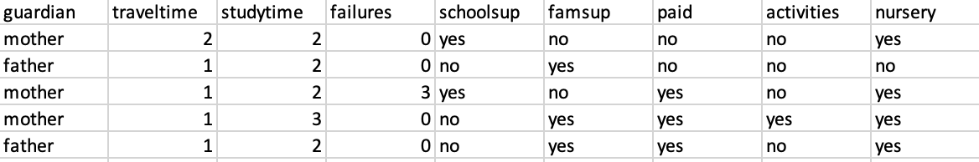
Dataset

Slide 7



Implementation
Random Forest
Logistic Regression
SVC
Correlation Heatmap
Decision Tree

Slide 8
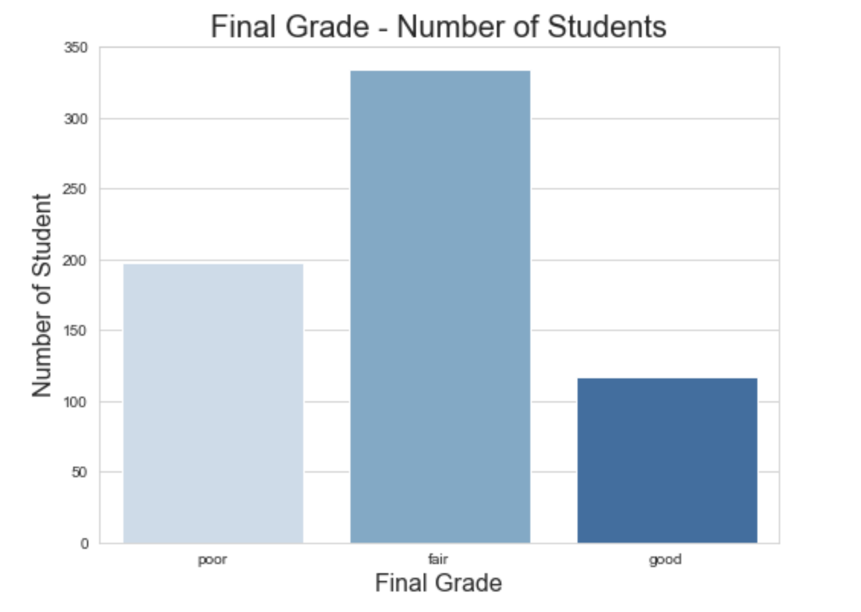
Final Grade – Number of Students

Slide 9
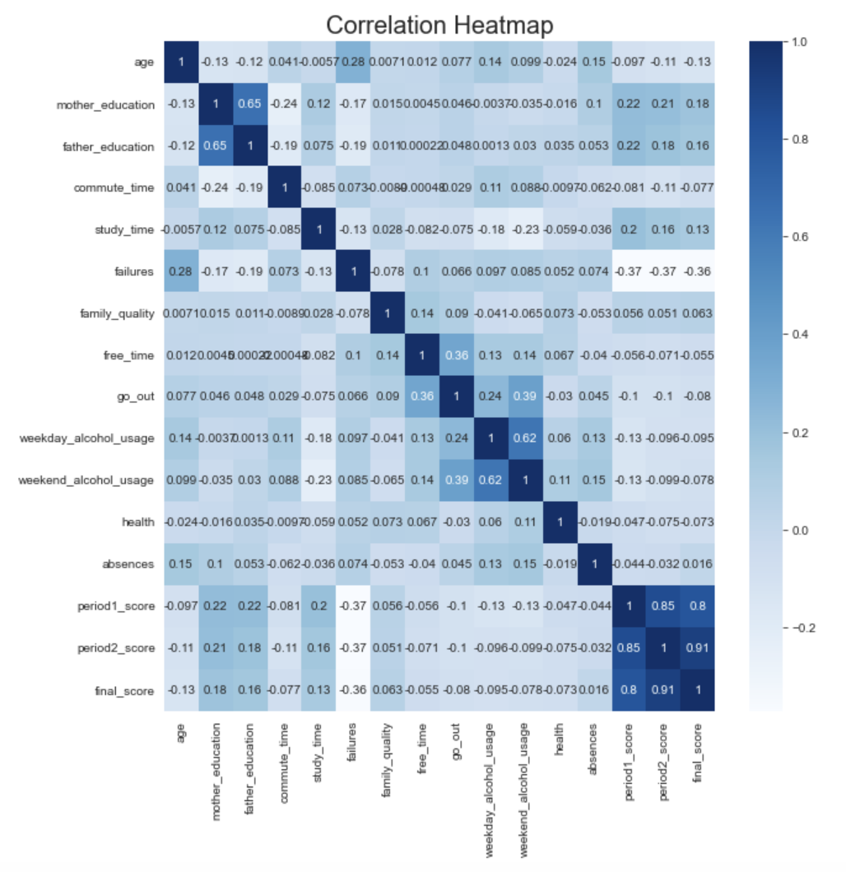
Correlation Heatmap

Slide 10
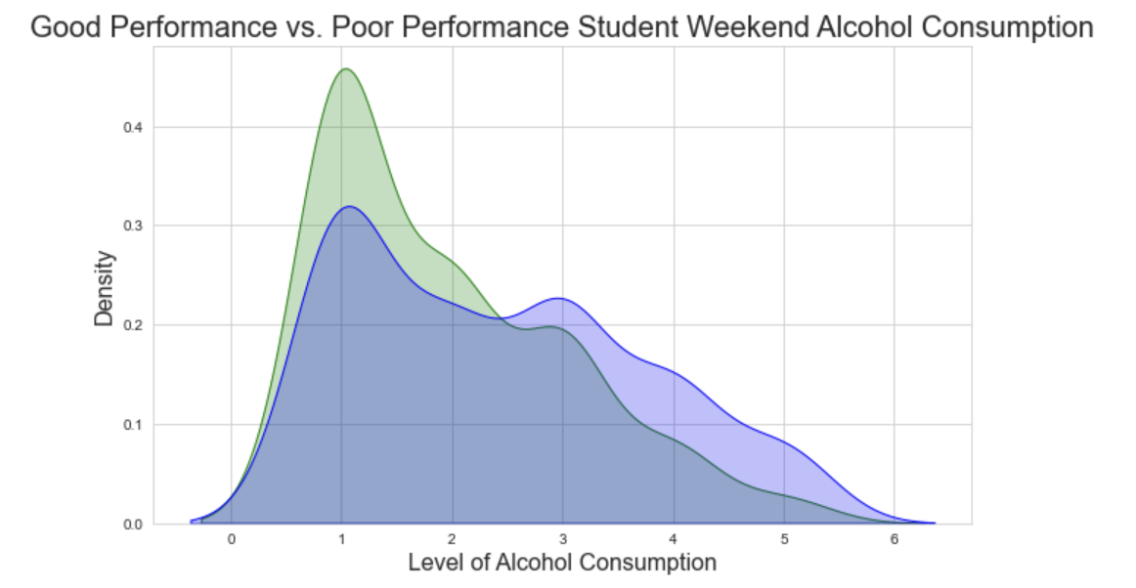
Alcohol Consumption

Slide 11
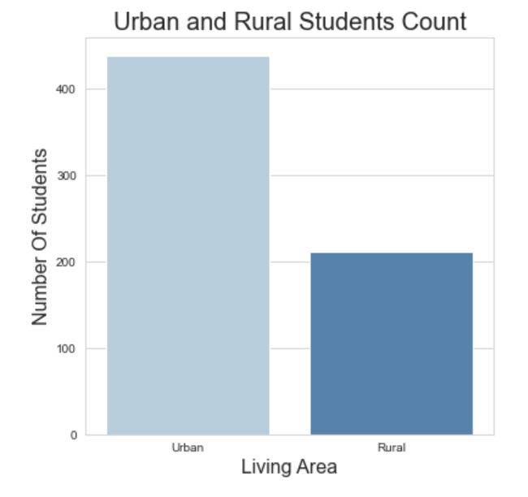
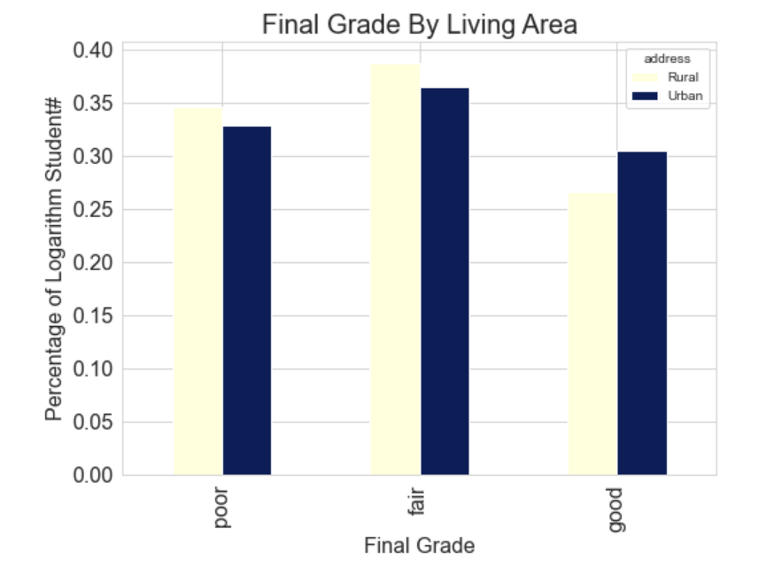
Living Area

Slide 12
Advantages: -
01
Detection Of Undesirable Behaviours
02
Improving The Process Of Studying
03
Feedback For Support Management
04
Finding Problems Leading To Dropping Out
05
Predicting Student’s Performance

Slide 13


Conclusion
Prediction may be inappropriate if the data is incomplete or inconsistent
Help students from the failure
Motivate the highly potential student for better performance
Guide students for their career
Aware students from addiction

Slide 14




Thank You

