Slide 1

VLSI Physical Design Implementation of a Post-Quantum Cryptographic Accelerator SoC
Subham Prasad Gupta (23BVD1039)
Jairus Solomon Samraj (23BVD1040)
Vinayak Shreenivas Salunke (23BVD1062)
Dr. Velmathi G., SENSE

Slide 2
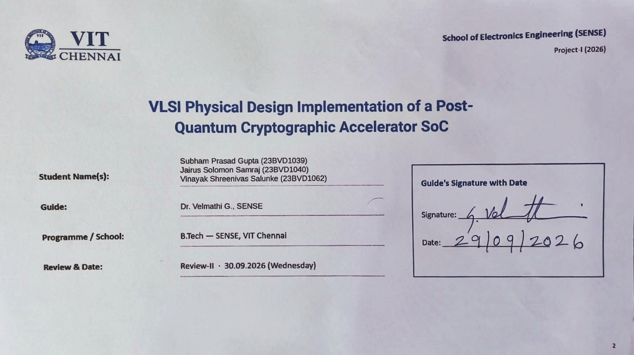

Slide 3
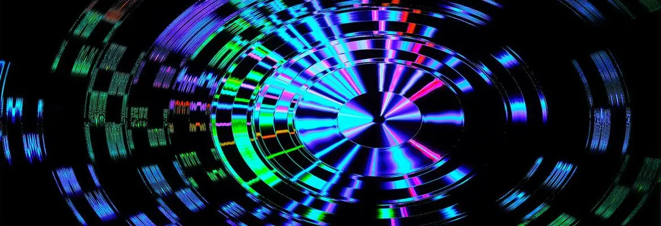





VLSI Physical Design Implementation of a Post-Quantum Cryptographic Accelerator SoC
Project Guide: Dr. Velmathi G.
Team Members:
Subham Prasad Gupta (23BVD1039)
Jairus Solomon Samraj (23BVD1040)
Vinayak Shreenivas Salunke (23BVD1062)

Slide 4
Team Members
01
Subham P. Gupta
23BVD1039
02
Jairus S. Solomon
23BVD1040
03
Vinayak S. Salunke
23BVD1062

Slide 5

Contents of this Presentation
S.No. | Title
1 | Problem Statement & Background
2 | Existing Solutions & Research Gap
3 | Literature Survey
4 | Proposed Solution
5 | Methodology / Approach
6 | Scope & Limitations
7 | Work Completed Till Review 1
8 | Work Completed Since
9 | Results and Graphs
10 | References

Slide 6

Section - 01
Problem & Research Foundation
Problem Statement & Background
Existing Solutions & Research Gap
Literature Survey

Slide 7
Problem Statement:
  The emergence of large-scale quantum computing threatens widely used public-key cryptographic schemes such as RSA and ECC.
  ML-KEM (CRYSTALS-Kyber) is the NIST-standardized post-quantum key-encapsulation mechanism based on the hardness of the Module Learning With Errors (Module-LWE) problem.
  ML-KEM relies heavily on computationally intensive polynomial arithmetic, modular arithmetic, NTT/INTT, sampling and hashing operations.
  Software-only execution of these operations can become a performance bottleneck in resource-constrained embedded systems.
  Dedicated hardware acceleration can exploit parallelism and specialized datapaths to improve execution efficiency.
Notes:
The motivation for this project comes from the expected impact of quantum computing on current public-key cryptography. Algorithms such as RSA and ECC depend on mathematical problems that are computationally difficult for classical machines, but quantum algorithms such as Shor's algorithm could solve the underlying problems much more efficiently on sufficiently capable quantum computers. Therefore, cryptographic systems need algorithms that remain secure in a post-quantum environment.

Slide 8
Post-Quantum Cryptography
Definition
PQC
Cryptographic algorithms designed to remain secure against attacks from both:
Classical Computers + Quantum Computers
NIST Standardized Algorithms :
Key Establishment
Digital Signature
Purpose | Standard | Algorithm
Key Encapsulation | FIPS 203 | ML-KEM
Digital Signature | FIPS 204 | ML-DSA
Digital Signature | FIPS 205 | SLH-DSA
ML-KEM
ML-DSA / SLH-DSA
Notes:
Post-quantum cryptography refers to cryptographic algorithms designed to resist attacks from quantum computers while still running on conventional computing systems. This is important because the cryptography does not itself require a quantum computer. NIST has already standardized ML-KEM for key encapsulation and ML-DSA and SLH-DSA for digital signatures. For our hardware accelerator, we are particularly interested in lattice-based cryptographic computation, especially the computational kernels associated with ML-KEM.

Slide 9
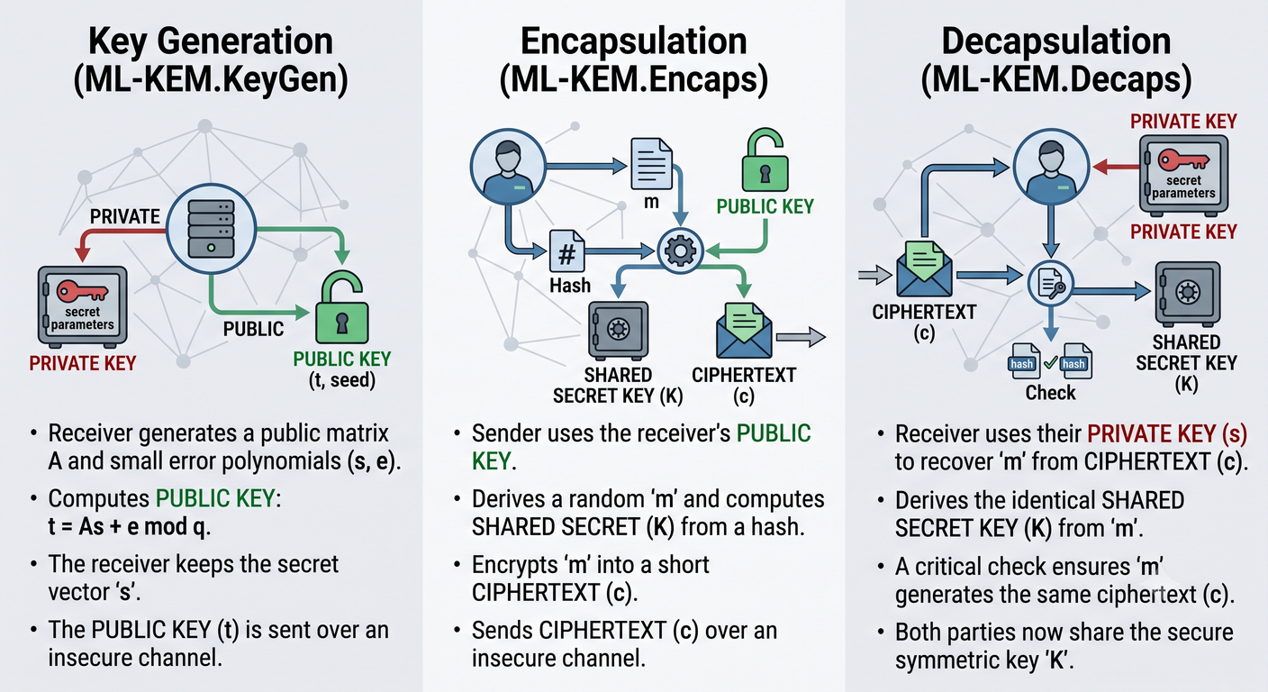
What is ML-KEM?
ML-KEM (Module-Lattice-Based Key-Encapsulation Mechanism) is the post-quantum cryptographic standard finalized by NIST as FIPS 203, derived from the CRYSTALS-Kyber algorithm.
Its primary purpose is secure key establishment: allowing two parties to establish a shared secret key over an insecure channel, even against adversaries equipped with large-scale quantum computers.
Operational Phases:
3 operational phases of the ML-KEM Process
Notes:
Post-quantum cryptography refers to cryptographic algorithms designed to resist attacks from quantum computers while still running on conventional computing systems. This is important because the cryptography does not itself require a quantum computer. NIST has already standardized ML-KEM for key encapsulation and ML-DSA and SLH-DSA for digital signatures. For our hardware accelerator, we are particularly interested in lattice-based cryptographic computation, especially the computational kernels associated with ML-KEM.

Slide 10
Why ML-KEM?
Directly addresses key establishment
ML-KEM is a KEM, rather than a digital-signature algorithm, making it directly relevant to secure key establishment.
Appropriate project scope
Implementing one complete standardized KEM through RTL → synthesis → physical design → GDSII provides a realistic end-to-end VLSI objective within the project duration.
Strong hardware-acceleration opportunity
ML-KEM contains repeated:
  NTT / INTT
  Polynomial multiplication
  Modular multiplication/reduction
  Polynomial arithmetic
  Sampling
  SHAKE/Keccak
These provide clear opportunities for dedicated datapaths and pipelining.
Bottom line
ML-KEM was selected not because the other PQC algorithms are inferior, but because it combines a standardized KEM use-case, substantial hardware acceleration opportunities, and a manageable architecture for an end-to-end ASIC implementation study.
Notes:
Post-quantum cryptography refers to cryptographic algorithms designed to resist attacks from quantum computers while still running on conventional computing systems. This is important because the cryptography does not itself require a quantum computer. NIST has already standardized ML-KEM for key encapsulation and ML-DSA and SLH-DSA for digital signatures. For our hardware accelerator, we are particularly interested in lattice-based cryptographic computation, especially the computational kernels associated with ML-KEM.

Slide 11
Qualitative Analysis of Topic Selection
Algorithm | Standardized role | Mathematical basis | Hardware characteristics | Relevance
ML-KEM | KEM — FIPS 203 | Module-LWE / lattice | NTT, modular arithmetic, polynomial operations | Selected
ML-DSA | Digital signature — FIPS 204 | Module-LWE / lattice | NTT + polynomial arithmetic + hashing | High complexity; signature-focused
SLH-DSA | Digital signature — FIPS 205 | Hash-based | Dominated by hash/tree operations | Different hardware architecture
FN-DSA | Digital signature | NTRU lattice | FFT/Falcon-specific arithmetic | Different datapath requirements
HQC | KEM — future FIPS | Error-correcting codes | Code-based arithmetic | Backup KEM; different architecture

Slide 12
Existing Solution
  Previous research has developed dedicated hardware for:NTT/INTT and polynomial multiplication
  Modular arithmetic and butterfly operations
  RISC-V-based hardware/software co-design
  FPGA-based accelerator implementations
  Recent work has also demonstrated system-level ML-KEM integration with RISC-V SoCs, including the 2026 Chipyard-based accelerator by Tsai et al.
Research Gap
Existing works largely emphasize individual ML-KEM computational kernels, FPGA implementations, or system-level accelerator evaluation. A complete open RTL implementation that integrates the ML-KEM accelerator with a lightweight RISC-V host and carries the design through synthesis, physical design and final GDSII generation is less explored.
Notes:
The motivation for this project comes from the expected impact of quantum computing on current public-key cryptography. Algorithms such as RSA and ECC depend on mathematical problems that are computationally difficult for classical machines, but quantum algorithms such as Shor's algorithm could solve the underlying problems much more efficiently on sufficiently capable quantum computers. Therefore, cryptographic systems need algorithms that remain secure in a post-quantum environment.

Slide 13
Literature Survey
Paper | Year | Relevance to Our Work | Key Contribution | Implementation / Platform | Main Focus
Taghavi et al. – ParallelNTT | 2025 | High – useful for NTT datapath design | Highly parallel NTT architecture eliminating RAM bottlenecks; supports ML-KEM and ML-DSA | FPGA | High-performance NTT/INTT
Kundi et al. – High-Performance NTT Hardware Accelerator | 2025 | High – relevant to polynomial arithmetic | Shared butterfly architecture and multi-path delay commutator for high-throughput NTT/INTT | Zynq UltraScale+ FPGA | Unified NTT/INTT accelerator
Gao et al. – High-Throughput BRAM-Efficient NTT/INTT | 2025 | High – relevant to memory architecture and accelerator interfacing | 32-way parallel streaming datapath with hybrid BRAM/distributed-RAM architecture | FPGA | NTT memory architecture
Ras et al. – PHOENIX | 2025 | Very High – demonstrates processor/accelerator system integration | Shared hardware accelerator for ML-KEM and HQC; integrates accelerator into SoC environment | SoC FPGA | HW/SW co-design and crypto-agility
Ando & Nakashima – NTT Arithmetic on CGLA | 2026 | High – relevant to accelerator/processor interface considerations | Maps ML-KEM NTT onto a programmable linear-array accelerator and examines host/accelerator data movement | FPGA + projected ASIC | Processor/accelerator NTT mapping

Slide 14
Paper | Year | Main Focus | Implementation / Platform | Key Contribution | Relevance to Our Work
Paiva et al. – Tailorable Codes for Lattice-Based KEMs | 2024 | ML-KEM compression/error correction | Software implementations | Error-correction approach allowing increased ciphertext/public-key compression | Moderate – relevant to ML-KEM implementation optimization
Abdulrahman et al. – Microarchitectural Agility | — | ML-KEM/ML-DSA optimization | Cortex-M4/M7 | Uses SLOTHY to optimize assembly across processor microarchitectures | Low–Moderate – relevant to processor-oriented implementation
Arsalan et al. – ML-KEM for Federated Learning | 2026 | System-level ML-KEM application | Software/simulated FL system | Integrates ML-KEM into parameter exchange of a federated-learning system | Low – demonstrates system-level application
Nguyen et al. – Area-Time Efficient ML-KEM Architecture | 2025 | Area-time efficient ML-KEM hardware accelerator | FPGA / ASIC | Merging SHA3 hashing & sampling to remove hash buffer, 3x twiddle factor memoryreduction, tight pipelining | High – Directly addresses hardware pipelining and memory optimizations
Truong et al. – Unified ML-DSA and ML-KEM Architecture | 2025 | Unified PQC hardware acceleration | Xilinx Artix-7 / UltraScale+ FPGA | High-performance unified architecture supporting ML-DSA and ML-KEM with shared NTT/Keccak pipeline units | High – Relevant to unified PQC accelerator architectures and pipeline stage sharing
Jung et al. – Highly-Efficient ML-KEM Architecture | 2025 | Hardware acceleration and pipelining of ML-KEM | FPGA / ASIC | Pipelined polynomial arithmetic core with optimized Keccak and NTT datapath. | Directly mirrors our ML-KEM pipelining work

Slide 15
Paper | Year | Main Focus | Implementation / Platform | Key Contribution | Relevance to Our Work
He et al. – Lightweight Hardware Implementation of Kyber | 2024 | Lightweight ASIC/FPGA hardware design | ASIC / FPGA (Xilinx Artix-7) | Compact Modular Multiplication Unit (MMU) and optimized Schoolbook polynomial multiplication replacing NTT (74% SLICE savings) | High – Provides area-optimized baseline and alternative polynomial arithmetic strategies for SoC integration
Constantin-Sukul et al. – Transient Execution Attacks on Kyber | 2024 | Microarchitectural security & side-channel analysis | CPU/ Microarchitectural Analysis | Key recovery against static Kyber using Downfall (Gather Data Sampling) and Flush+Reload transient execution attacks (<40 mins) | Moderate– Highlights microarchitectural side-channel risks when integrating PQC accelerators into processor pipelines
Research and Literature Gap:
Existing ML-KEM research focuses mainly on accelerator and NTT optimization. Limited work demonstrates a pipelined, optimized ML-KEM-512 accelerator integrated with PicoRV32 and taken through complete RTL verification, synthesis, physical design, and GDSII generation.

Slide 16
OUR OBJECTIVE
To design, optimize, and verify a pipelined ML-KEM-512 hardware accelerator integrated with PicoRV32, and demonstrate its complete ASIC implementation from RTL through logic synthesis and physical design to GDSII.
Notes:
The motivation for this project comes from the expected impact of quantum computing on current public-key cryptography. Algorithms such as RSA and ECC depend on mathematical problems that are computationally difficult for classical machines, but quantum algorithms such as Shor's algorithm could solve the underlying problems much more efficiently on sufficiently capable quantum computers. Therefore, cryptographic systems need algorithms that remain secure in a post-quantum environment.

Slide 17
Section - 02
Proposed Approach
Proposed Solution
System Architecture / Methodology
Scope & Limitations

Slide 18
Proposed SoC Architecture
PicoRV32
RISCV CPU
Memory Mapped Bus
Program Memory
SRAM
Peripherals
UART/GPIO
PQC Accelerator
------------------------------------------------
Control Unit
NTT Engine
Modular Arithmetic
Polynomial Operations
Local Memory
Notes:
The proposed system uses PicoRV32 as the host processor. The processor communicates with the PQC accelerator through a memory-mapped interface. The CPU is responsible for configuring the accelerator, supplying data and retrieving results. The accelerator contains dedicated datapath and control logic for the selected post-quantum cryptographic operations. This allows us to keep the processor architecture unchanged while extending the SoC with specialized cryptographic hardware.

Slide 19
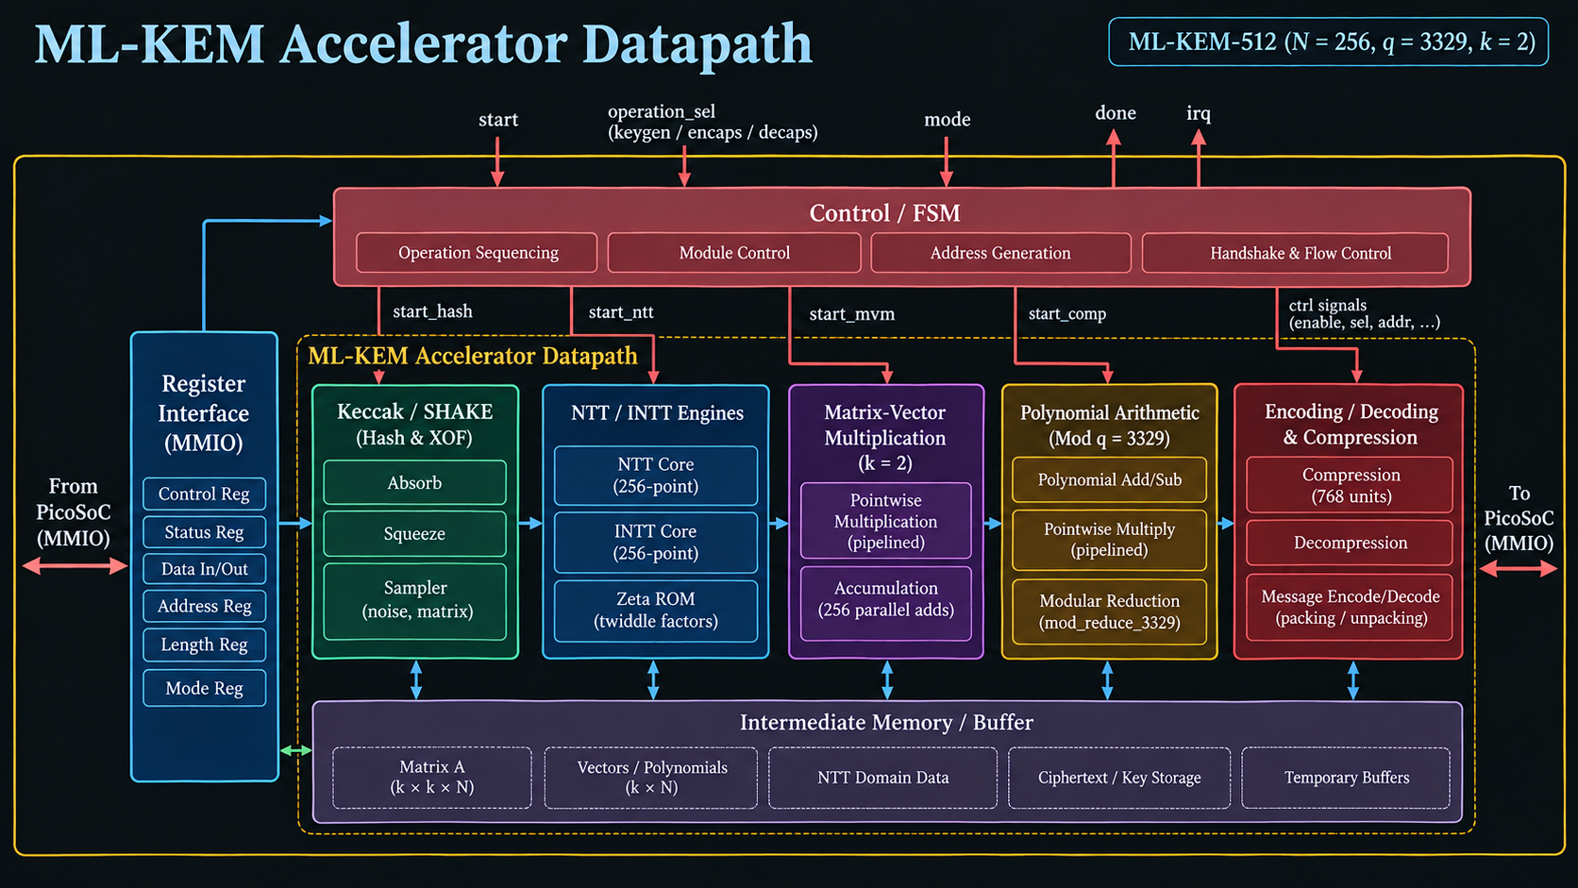
ML-KEM Accelerator Datapath

Slide 20
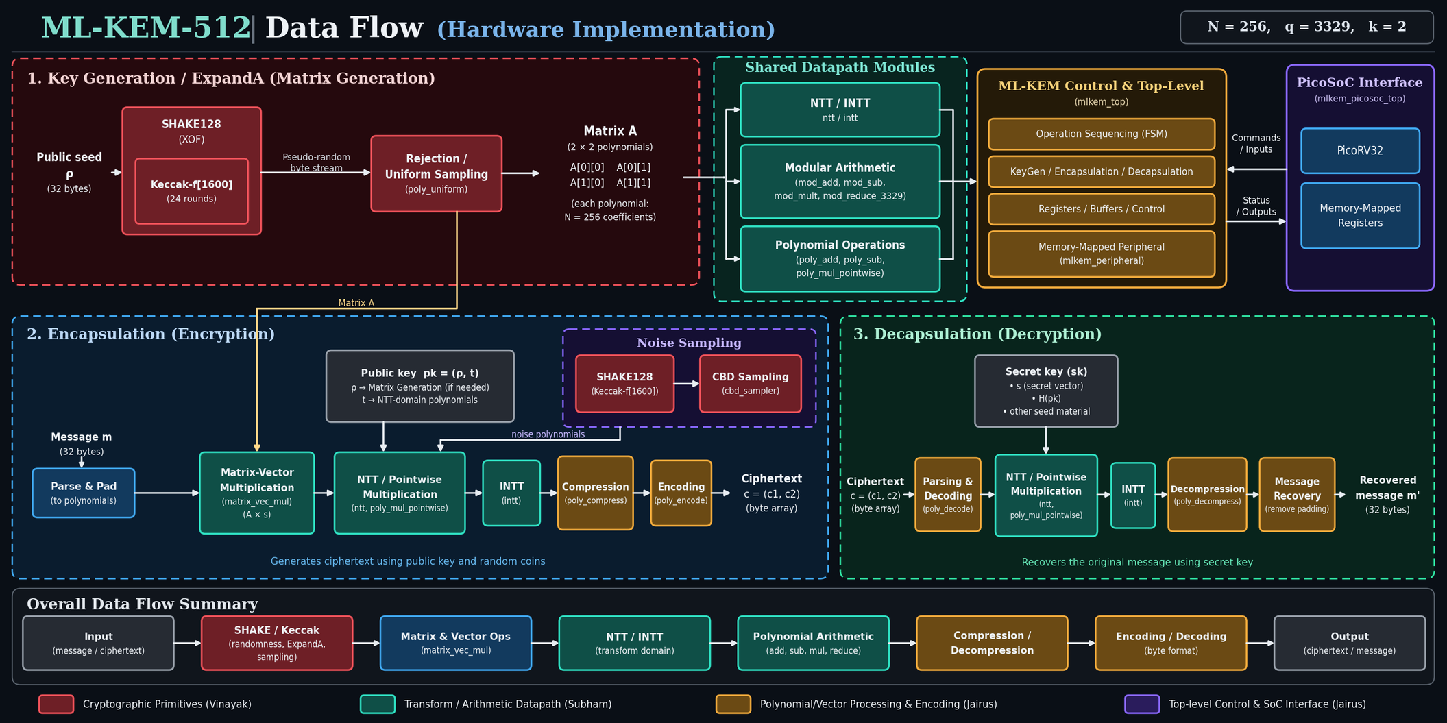
ML-KEM Accelerator Dataflow

Slide 21
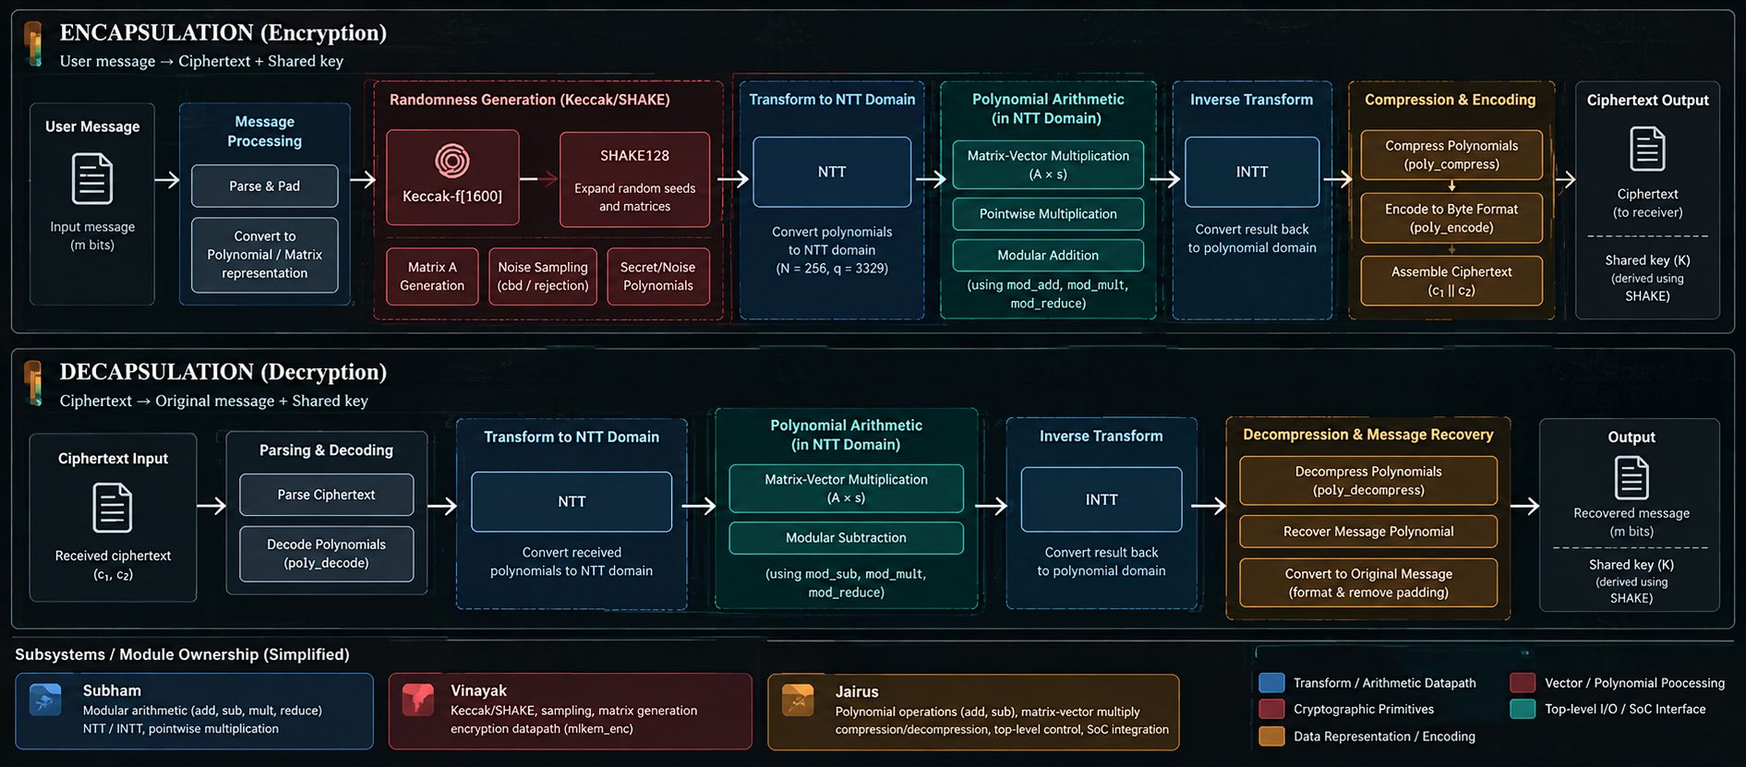

Slide 22
Selected Approach
Original Design
Long Combinational Datapaths
Pointwise Multiplication
Matrix-Vector Accumulation
Barrett Reduction
Encryption Compression
Selected RTL Optimization
Pipeline Registers
Holding Registers
Intermediate FSM States
Shorter Combinational Paths
Improved Synthesis Timing
Selected approach:
Targeted architectural pipelining
rather than:
Global pipelining of every arithmetic primitive
Why this approach?
  Limits unnecessary architectural changes
  Preserves the existing ML-KEM datapath structure
  Breaks the dominant timing paths
  Allows FSMs to explicitly control multi-cycle operations
  Adds latency only where necessary
Notes:
The key objective of this project is not limited to functional RTL. We intend to implement the design through the complete ASIC flow. After architectural design and RTL development, we will perform functional verification, synthesize the design using Cadence Genus, and then perform floorplanning, placement, clock tree synthesis and routing using Innovus. Finally, we will perform timing and physical verification and generate the final GDSII.

Slide 23
Pipelining Strategy in Effect
Module | Original bottleneck | Selected modification | Effect
poly_mul_pointwise.v | Two Barrett modular multiplications cascaded in one cycle | Pointwise multiplication divided into 2 pipeline stages | Critical path reduced from ~14 ns to ~5 ns
mlkem_enc.v | INTT → polynomial additions → 768 compression units formed one long path | Dedicated RUN_COMP state + holding registers | Isolated compression logic; removed ~5 ns from path
matrix_vec_mul.v | Pointwise multiplication directly drove 256 parallel modular adders | Pipeline holding registers + intermediate FSM states | Prevented multiplier/add-tree delay from being combined
mod_reduce_3329.v | Barrett reduction had long reciprocal/remainder computation | Reciprocal multiplication and quotient/remainder calculation divided into 2 stages | Reduction divided into shorter timing stages
Notes:
Post-quantum cryptography refers to cryptographic algorithms designed to resist attacks from quantum computers while still running on conventional computing systems. This is important because the cryptography does not itself require a quantum computer. NIST has already standardized ML-KEM for key encapsulation and ML-DSA and SLH-DSA for digital signatures. For our hardware accelerator, we are particularly interested in lattice-based cryptographic computation, especially the computational kernels associated with ML-KEM.

Slide 24
Proposed Methodology Updated
Algorithm Study
Timing-Driven RTL Optimization: Pipeline insertion
FSM modification
Holding registers
SDC refinement
Architecture Design
Functional Verification
Synthesis (Genus)
Re-Synthesis
Reached Timing Baseline
Critical Path Analysis
Placement, CTS, Routing, Checks
GDSII
Notes:
The key objective of this project is not limited to functional RTL. We intend to implement the design through the complete ASIC flow. After architectural design and RTL development, we will perform functional verification, synthesize the design using Cadence Genus, and then perform floorplanning, placement, clock tree synthesis and routing using Innovus. Finally, we will perform timing and physical verification and generate the final GDSII.

Slide 25
In Scope
Out of Scope / Limitations
  Hardware acceleration of ML-KEM
  RTL implementation of selected ML-KEM computational modules
  PicoRV32-based host processor
  Memory-mapped processor–accelerator communication
  Module-level and integrated functional verification
  Pre-synthesis verification
  Logic synthesis and ASIC implementation
  Physical design leading to GDSII
  Implementation of all NIST-selected/standardized PQC algorithms is outside the project scope.
  The project focuses specifically on ML-KEM due to the available project duration and implementation complexity.
  Full implementation of other NIST PQC schemes such as ML-DSA and SLH-DSA is not attempted.
  The primary objective is end-to-end ASIC implementation of one representative standardized PQC KEM, rather than creating a universal PQC accelerator.
Notes:
The motivation for this project comes from the expected impact of quantum computing on current public-key cryptography. Algorithms such as RSA and ECC depend on mathematical problems that are computationally difficult for classical machines, but quantum algorithms such as Shor's algorithm could solve the underlying problems much more efficiently on sufficiently capable quantum computers. Therefore, cryptographic systems need algorithms that remain secure in a post-quantum environment.

Slide 26
Section - 03
Implementation & Project Status
Work Completed
Results and Graphs
References

Slide 27
Work Completed till Review 1
RTL Development — Completed
  ML-KEM computational modules implemented in synthesizable RTL.
  Modular arithmetic and polynomial arithmetic datapaths completed.
  NTT and INTT hardware completed.
  Auxilary modules including control, sampling, encoding/decoding and Keccak/SHAKE completed.
  Accelerator modules integrated with the PicoRV32-based SoC.
  Memory-mapped processor–accelerator communication implemented.
  Existing PicoRV32 core retained as the host processor.
Verification — Completed
  Individual RTL modules functionally verified.
  Integrated accelerator verified through simulation.
  Pre-synthesis functional verification completed.
  Processor-driven ML-KEM execution verified through the SoC test environment.
  RTL is now considered functionally complete and ready for synthesis.
Notes:
The motivation for this project comes from the expected impact of quantum computing on current public-key cryptography. Algorithms such as RSA and ECC depend on mathematical problems that are computationally difficult for classical machines, but quantum algorithms such as Shor's algorithm could solve the underlying problems much more efficiently on sufficiently capable quantum computers. Therefore, cryptographic systems need algorithms that remain secure in a post-quantum environment.

Slide 28
Work Completed Since
2. Critical-Path Analysis
  Long combinational paths traced to major ML-KEM datapaths
  Identified timing bottlenecks in:
    Pointwise polynomial multiplication
    Matrix-vector multiplication
    Barrett modular reduction
    Encryption compression path
3. RTL Timing Optimization
  Multiple pipelining architectures investigated
  Pipeline registers and intermediate FSM states introduced
  Selected implementation optimized the dominant system-level paths
4. Constraint & Frequency Exploration
  Multiple SDC configurations developed and tested
  50 MHz, 100 MHz and 250 MHz targets evaluated
  100 MHz selected as the current implementation baseline
1. Initial Full-Design Synthesis
  Complete ML-KEM + PicoRV32 design synthesized using Cadence Genus
  Initial synthesis runtime: ~4 hours
  Initial WNS: −8840 ps
  Severe timing violation identified
From functional RTL → timing-driven RTL optimization → synthesis-ready implementation
Notes:
The motivation for this project comes from the expected impact of quantum computing on current public-key cryptography. Algorithms such as RSA and ECC depend on mathematical problems that are computationally difficult for classical machines, but quantum algorithms such as Shor's algorithm could solve the underlying problems much more efficiently on sufficiently capable quantum computers. Therefore, cryptographic systems need algorithms that remain secure in a post-quantum environment.

Slide 29
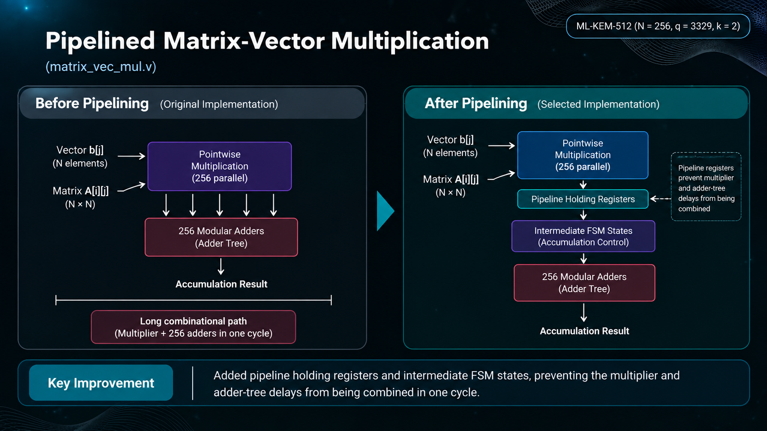
Matrix Vector Multiplication (matrix_vec_mul.v)
Key Improvement:
Prevented multiplier/add-tree delay from being combined
Notes:
The accelerator is organized around a controller and dedicated arithmetic units. When the CPU writes the start command, the controller sequences the required operations. Depending on our final algorithmic scope, the datapath will contain an NTT engine, modular arithmetic units, polynomial operations and local storage. The important design objective is to offload the repetitive computational kernels from the CPU.
"The accelerator is targeted toward the computational kernels of ML-KEM."

Slide 30
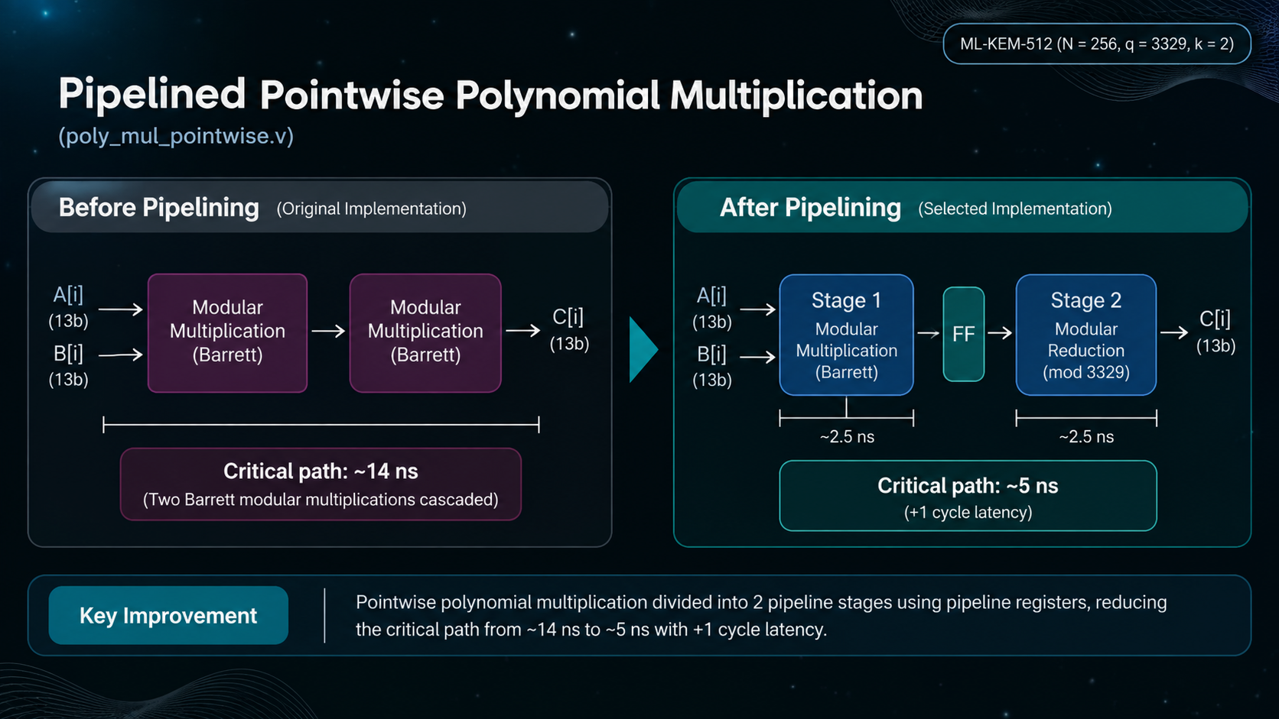
Polynomial Multiplication (poly_mul_pointwise.v)
Key Improvement:
Pointwise polynomial multiplication divided into two pipelined stages reducing critical paths from ~14ns to around ~5ns with a 1 cycle latency
Notes:
The accelerator is organized around a controller and dedicated arithmetic units. When the CPU writes the start command, the controller sequences the required operations. Depending on our final algorithmic scope, the datapath will contain an NTT engine, modular arithmetic units, polynomial operations and local storage. The important design objective is to offload the repetitive computational kernels from the CPU.
"The accelerator is targeted toward the computational kernels of ML-KEM."

Slide 31
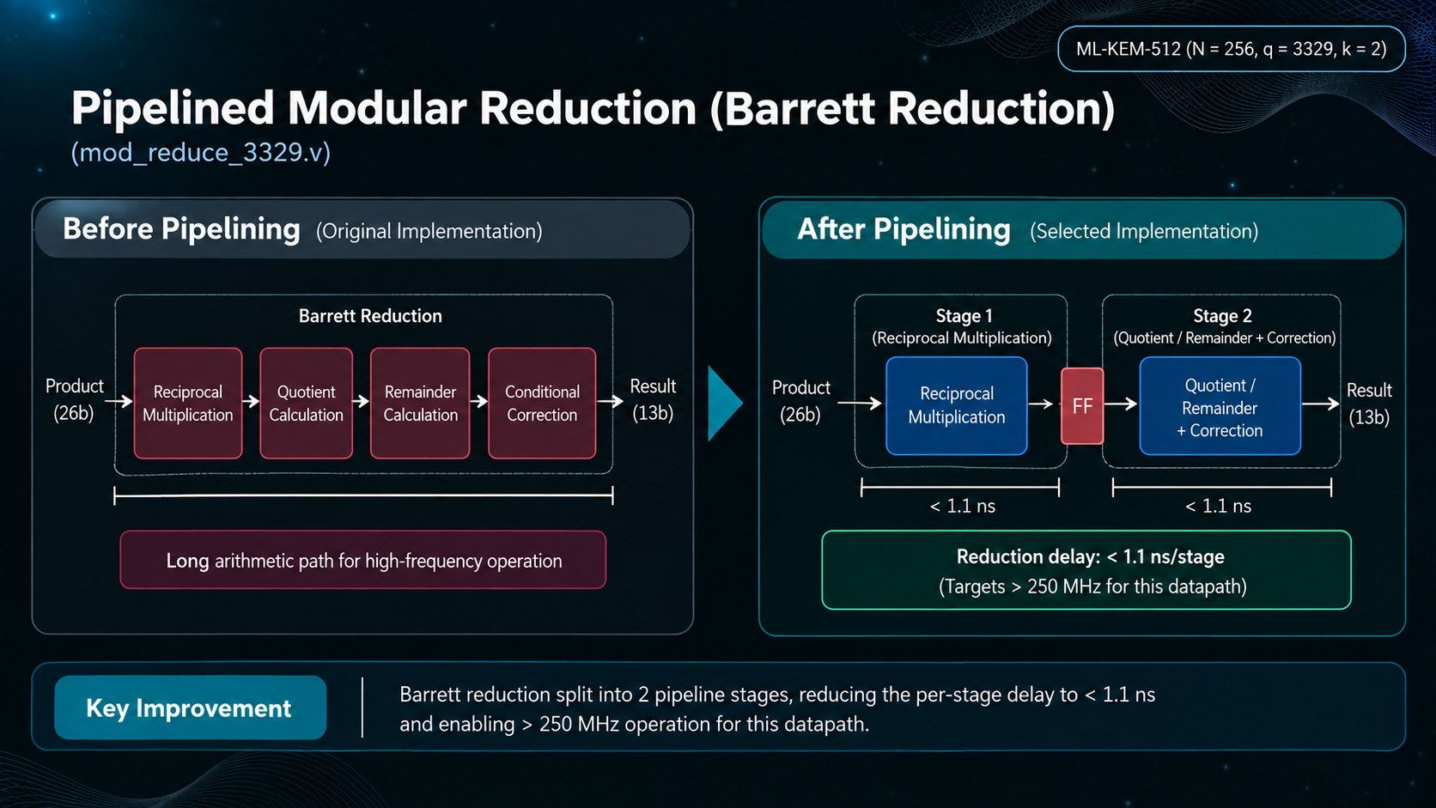
Pipelined Modular Barett Reduction (mod_reduce_3329.v)
Key Improvement:
Barett Reduction split into two pipelined stages reducing the per stage delay to less than 1.1ns
Notes:
The accelerator is organized around a controller and dedicated arithmetic units. When the CPU writes the start command, the controller sequences the required operations. Depending on our final algorithmic scope, the datapath will contain an NTT engine, modular arithmetic units, polynomial operations and local storage. The important design objective is to offload the repetitive computational kernels from the CPU.
"The accelerator is targeted toward the computational kernels of ML-KEM."

Slide 32
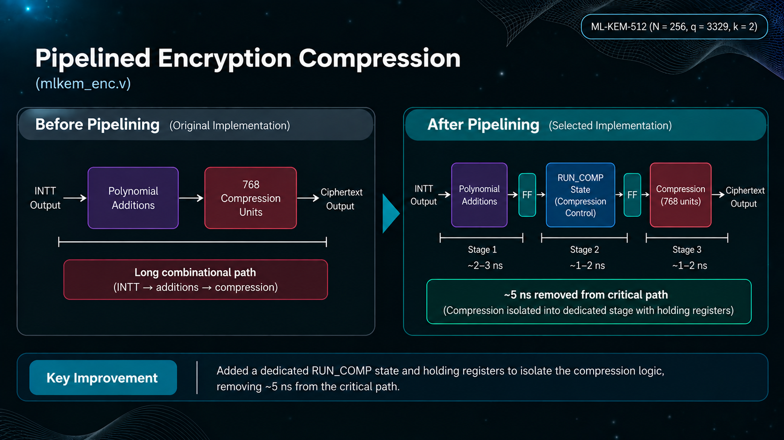
Pipelined Encryption Compression (mlkem_enc.v)
Key Improvement:
Added a dedicated a RUN_COMP state and holding registers to isolate the compression logic, removing ~5ns from the critical path.
Notes:
The accelerator is organized around a controller and dedicated arithmetic units. When the CPU writes the start command, the controller sequences the required operations. Depending on our final algorithmic scope, the datapath will contain an NTT engine, modular arithmetic units, polynomial operations and local storage. The important design objective is to offload the repetitive computational kernels from the CPU.
"The accelerator is targeted toward the computational kernels of ML-KEM."

Slide 33
SDC/Synthesis Iterations
RTL
Clock targets investigated
50 MHz → 100 MHz → 250 MHz
Constraint parameters explored
  Clock period
  Clock uncertainty
  Input/output timing assumptions
  Timing constraints for the integrated design
SDC Definition
7x:
MLKEM (w/o pipeline):
Synth run
50MHz
100MHz
MLKEM (w pipeline):
Pipeline type 1: (Not final)
50MHz
100MHz
Pipeline Type 2: (Final 0slack)
100MHz (0 slack)
250MHz (-3K slack)
Genus Synthesis
Timing Report & Critical Path Analysis
Current baseline:
100 MHz
10-ns clock period
Final constrained report: 0 ps slack
SDC optimization was performed alongside RTL optimization rather than being used as a substitute for architectural timing improvement.
RTL / SDC Modification
Re-synthesis ↺
Notes:
The motivation for this project comes from the expected impact of quantum computing on current public-key cryptography. Algorithms such as RSA and ECC depend on mathematical problems that are computationally difficult for classical machines, but quantum algorithms such as Shor's algorithm could solve the underlying problems much more efficiently on sufficiently capable quantum computers. Therefore, cryptographic systems need algorithms that remain secure in a post-quantum environment.

Slide 34
Key Challenge → Solution
RTL/Datapath Errors → Debugged RTL
↓
−8.8 ns Initial WNS → Critical-path analysis
↓
Multiple timing iterations → Pipelining + SDC refinement
↓
100 MHz → 0 Slack → Timing closure achieved
Challenges Faced
RTL & Datapath Errors
Initial synthesis failures due to RTL/datapath issues.
Severe Timing Violations
Initial WNS of ~−8.8 ns at 100 MHz.
Long Synthesis Runtime
~4 hours per synthesis iteration.
Pipelining & SDC Optimization
Multiple iterations to break critical paths and refine constraints.
Server & Lab Limitations
Intermittent server errors and incomplete runs due to lab closure.
Notes:
The motivation for this project comes from the expected impact of quantum computing on current public-key cryptography. Algorithms such as RSA and ECC depend on mathematical problems that are computationally difficult for classical machines, but quantum algorithms such as Shor's algorithm could solve the underlying problems much more efficiently on sufficiently capable quantum computers. Therefore, cryptographic systems need algorithms that remain secure in a post-quantum environment.

Slide 35
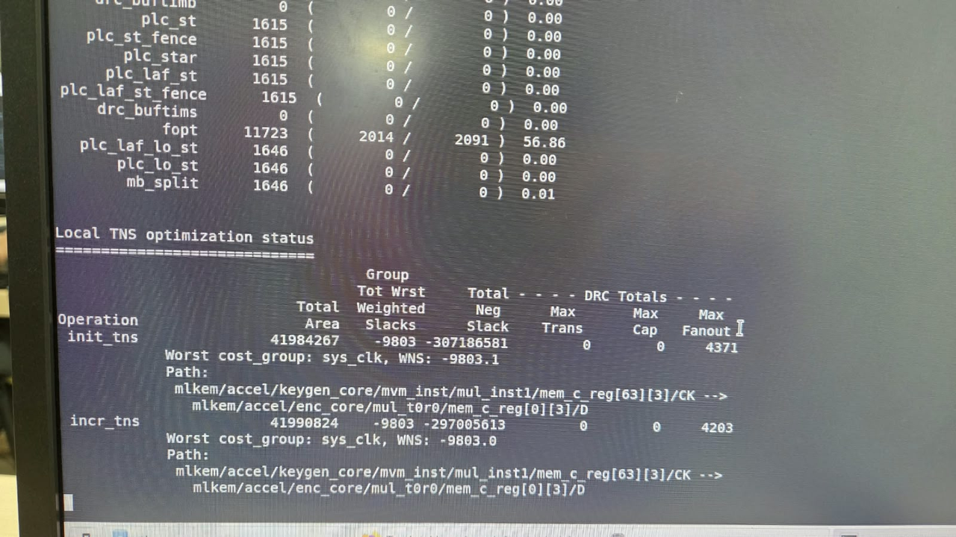
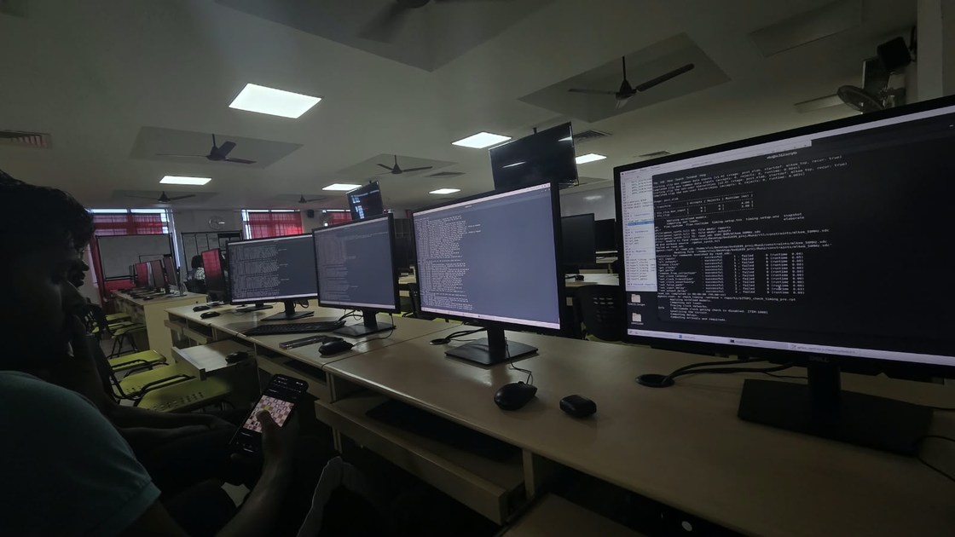
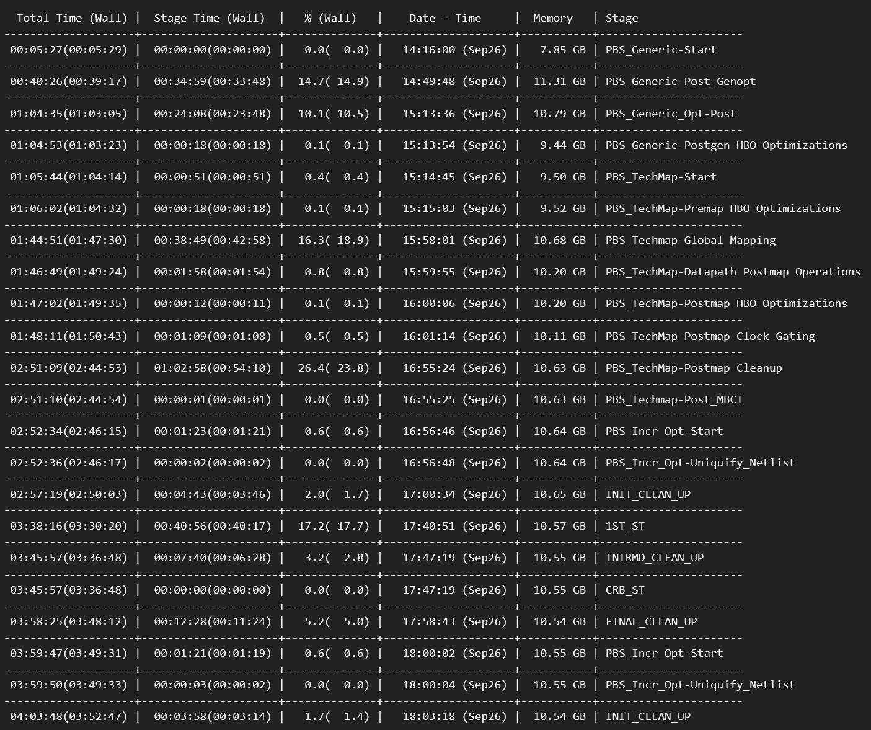
Terrible Initial Timing Results
Relevant Images
Simultaneous Runs
Log Timeline
Notes:
The motivation for this project comes from the expected impact of quantum computing on current public-key cryptography. Algorithms such as RSA and ECC depend on mathematical problems that are computationally difficult for classical machines, but quantum algorithms such as Shor's algorithm could solve the underlying problems much more efficiently on sufficiently capable quantum computers. Therefore, cryptographic systems need algorithms that remain secure in a post-quantum environment.

Slide 36
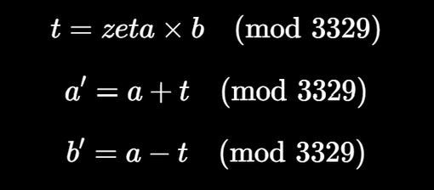
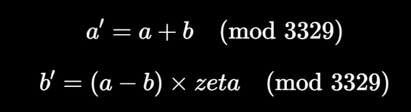
Arithmetic + NTT / INTT TB
Tests the NTT butterfly. It applies random/boundary values of a, b, and zeta.
It independently calculates:
It then compares these expected values against ntt_butterfly's a_out and b_out.
Tests the INTT butterflySimilarly verifies the inverse butterfly using:
This ensures the individual INTT butterfly operation follows the required modular arithmetic.
TB Uses 20,000 test vectors
It deliberately includes boundary cases such as 0, Q-1, and the previousl problematic:
a=100, b=50, zeta=2.

Slide 37
Results 1:
Data Table
Parameter / Metric | Case 1: 8840_slack (Original Baseline) | Case 2: Run2 (Teammate Iteration) | Case 5: Run3 (Pipelined SoC @ 250MHz) | Case 3: test_syn_all (Standalone ML-KEM) | Case 4: test_1_pico_100mhz (Pipelined SoC @ 100MHz)
PicoRV32 CPU Included? | Yes | No | Yes (Preserved) | No | Yes (Preserved)
Technology PDK | TSMC 180nm (slow.lib) | TSMC 180nm (slow.lib) | GPDK 90nm (slow.lib) | GPDK 45nm (slow.lib) | GPDK 90nm (slow.lib)
Worst Negative Slack (WNS) | -8840 ps (-8.84 ns) | -3974 ps (-3.97 ns) | 0 ps (0.00 ns MET) | 0 ps (0.00 ns MET) | 0 ps (0.00 ns MET)
Timing Constraint Status | VIOLATED | VIOLATED | PASSED (MET) | PASSED (MET) | PASSED (MET)
Cell Area (um^2) | 42,122,106.67 | 27,249,898.92 | 10,953,193.70 | Mapped 45nm | 10,953,193.70
Total Power (mW) | 3713.190 mW (3.71 W) | 1307.470 mW (1.30 W) | 850.090 mW (0.85 W) | 818.122 mW (0.81 W) | 850.090 mW (0.85 W)
Notes:
The motivation for this project comes from the expected impact of quantum computing on current public-key cryptography. Algorithms such as RSA and ECC depend on mathematical problems that are computationally difficult for classical machines, but quantum algorithms such as Shor's algorithm could solve the underlying problems much more efficiently on sufficiently capable quantum computers. Therefore, cryptographic systems need algorithms that remain secure in a post-quantum environment.

Slide 38
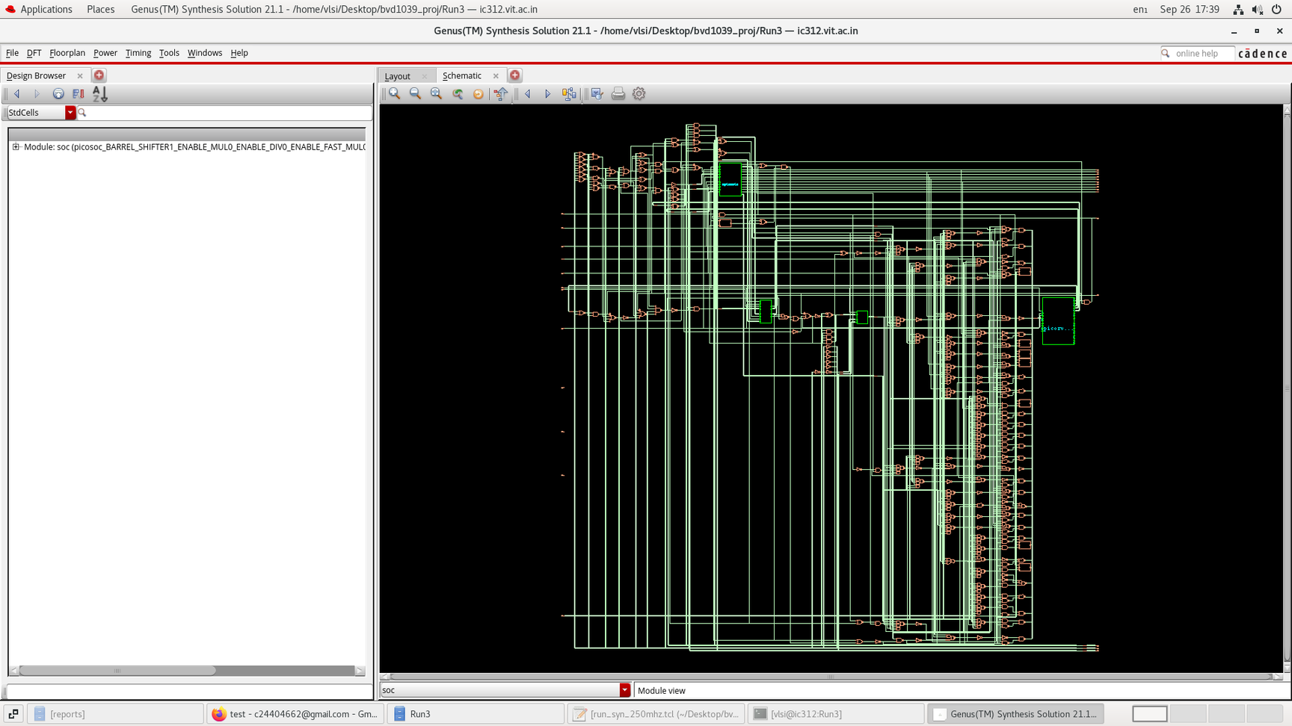
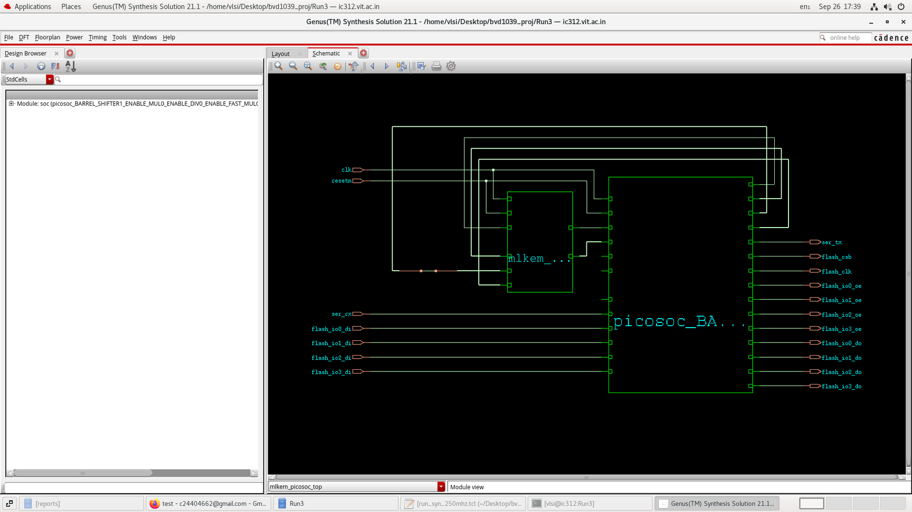
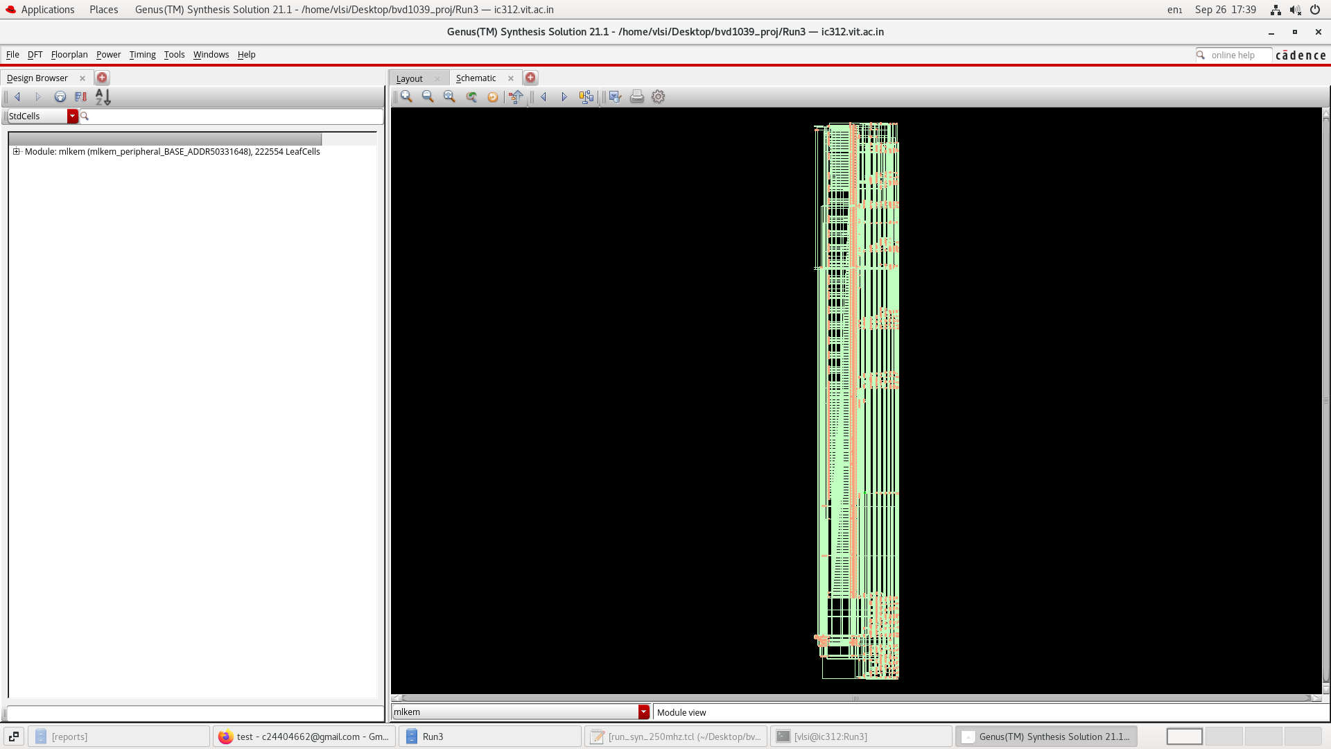
Results 1:
Synthesis Completed
Our ML-KEM SoC
Notes:
The motivation for this project comes from the expected impact of quantum computing on current public-key cryptography. Algorithms such as RSA and ECC depend on mathematical problems that are computationally difficult for classical machines, but quantum algorithms such as Shor's algorithm could solve the underlying problems much more efficiently on sufficiently capable quantum computers. Therefore, cryptographic systems need algorithms that remain secure in a post-quantum environment.

Slide 39

Results 2:
Pre-Placement Timing Analysis
Notes:
The motivation for this project comes from the expected impact of quantum computing on current public-key cryptography. Algorithms such as RSA and ECC depend on mathematical problems that are computationally difficult for classical machines, but quantum algorithms such as Shor's algorithm could solve the underlying problems much more efficiently on sufficiently capable quantum computers. Therefore, cryptographic systems need algorithms that remain secure in a post-quantum environment.

Slide 40
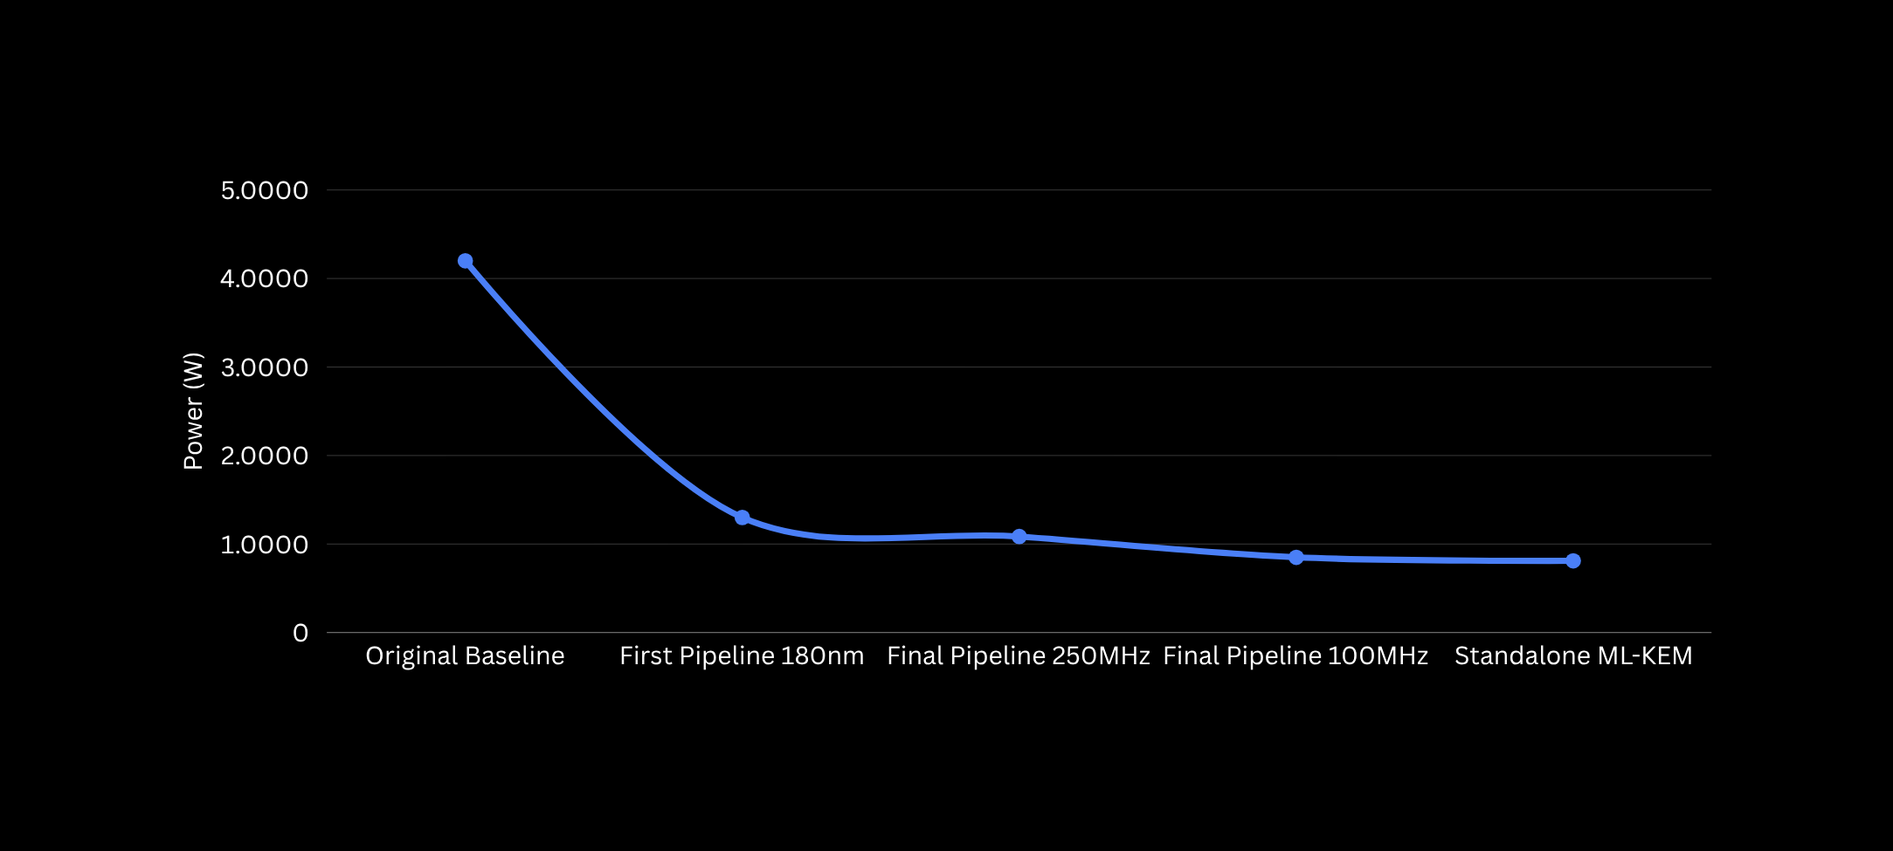
Results 2:
Pre-Placement Power Analysis
Notes:
The motivation for this project comes from the expected impact of quantum computing on current public-key cryptography. Algorithms such as RSA and ECC depend on mathematical problems that are computationally difficult for classical machines, but quantum algorithms such as Shor's algorithm could solve the underlying problems much more efficiently on sufficiently capable quantum computers. Therefore, cryptographic systems need algorithms that remain secure in a post-quantum environment.

Slide 41
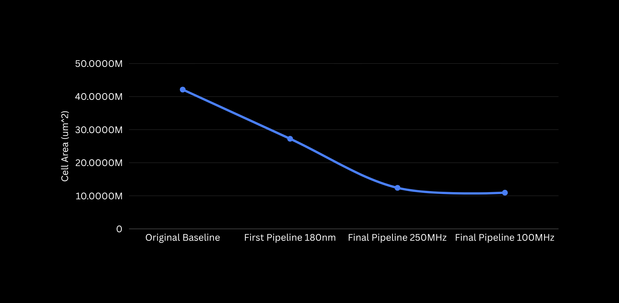
Results 2:
Pre-Placement Area Analysis
Notes:
The motivation for this project comes from the expected impact of quantum computing on current public-key cryptography. Algorithms such as RSA and ECC depend on mathematical problems that are computationally difficult for classical machines, but quantum algorithms such as Shor's algorithm could solve the underlying problems much more efficiently on sufficiently capable quantum computers. Therefore, cryptographic systems need algorithms that remain secure in a post-quantum environment.

Slide 42
References
Paper References:
  J. Bos, L. Ducas, E. Kiltz, T. Lepoint, V. Lyubashevsky, J. M. Schanck, P. Schwabe, G. Seiler, and D. Stehlé, “CRYSTALS-Kyber: A CCA-Secure Module-Lattice-Based KEM,” Proc. IEEE European Symposium on Security and Privacy (EuroS&P), pp. 353–367, 2018, doi: 10.1109/EuroSP.2018.00032.
  National Institute of Standards and Technology, “Module-Lattice-Based Key-Encapsulation Mechanism Standard,” FIPS 203, Aug. 2024.
  S. Ricci, P. Jedlička, P. Cíbik, P. Dzurenda, L. Malina, and J. Hajný, “Towards CRYSTALS-Kyber VHDL Implementation,” 2021.
  C. Zhang et al., “Towards Efficient Hardware Implementation of NTT for Kyber on FPGAs,” Proc. IEEE ISCAS, 2021, doi: 10.1109/ISCAS51556.2021.9401170.
  H. Li, N. Mentens, and S. Picek, “A Scalable SIMD RISC-V Based Processor with Customized Vector Extensions for CRYSTALS-Kyber,” Proc. ACM/IEEE Design Automation Conference (DAC), pp. 733–738, 2022, doi: 10.1145/3489517.3530552.
  J. Sun and X. Bai, “A High-Speed Hardware Architecture of an NTT Accelerator for CRYSTALS-Kyber,” Integrated Circuits and Systems, vol. 1, no. 2, pp. 92–102, 2024, doi: 10.23919/ICS.2024.3419562.
  A. Alhassani and M. Benaissa, “High-Speed Polynomials Multiplication HW Accelerator for CRYSTALS-Kyber,” IEEE Trans. Circuits Syst. I: Regular Papers, vol. 71, no. 12, pp. 6105–6113, 2024, doi: 10.1109/TCSI.2024.3427011.
  M. Saoudi, A. Kermiche, O. H. Benhaddad, N. Guetmi, and B. Allailou, “Low Latency FPGA Implementation of NTT for Kyber,” Microprocessors and Microsystems, vol. 107, p. 105059, 2024, doi: 10.1016/j.micpro.2024.105059.
  Y.-C. Tsai, Y.-H. Lin, and W.-J. Hwang, “An Open Hardware ML-KEM Polynomial Ring Accelerator on Chipyard RISC-V SoC: System-Level Integration and Evaluation,” Electronics, vol. 15, no. 12, p. 2511, 2026, doi: 10.3390/electronics15122511.
Development References:
  C. Wolf, “PicoRV32 — A Size-Optimized RISC-V CPU,” GitHub repository, YosysHQ. [Online]. Available: PicoRV32 source repository.
  AI-assisted development, technical discussion, and image generation.

