Slide 1


NexGen
Pioneers

Slide 2




Our Team
Shubham Gaddi
Tanisha Singla
Roopesh Athmuri
Aishwarya
Sanamandra

Slide 3
Problem Statement
XYZ Corporation relies on two water sources:
The Water Co. – Purchased water at a contracted price per gallon.
Water Storage Tank – Precipitation collected and stored with an associated per-gallon cost.
The corporation faces increasing water costs and must determine the most cost-effective water allocation strategy while ensuring :
Operational sustainability (meeting demand without shortages).
Regulatory compliance (maintaining a minimum water storage level).
Environmental commitments (ensuring at least 25% of water usage is from storage).

Slide 4

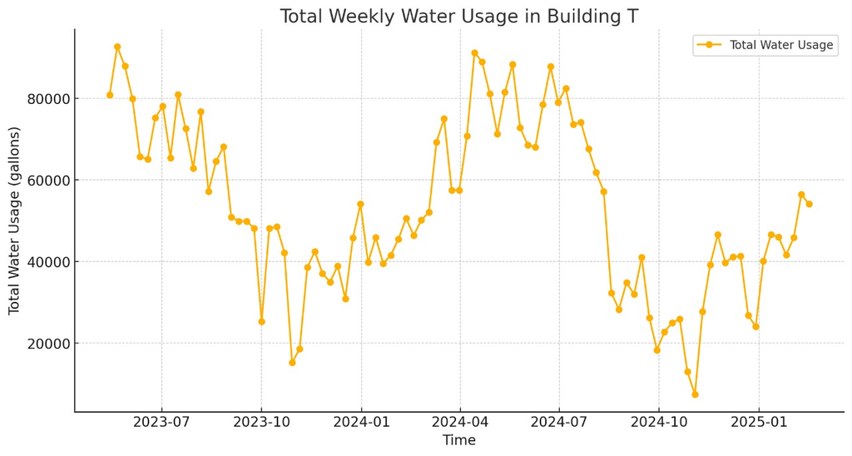
Forecasting Water Demand for Next 4 Weeks
Historical Data
1.5 years of weekly water usage data
Cooling (temperature regulation)
Main (employee usage)
Categories of Usage
Objective
Predict total water demand for each of the next 4 weeks
Uncertainty in water demand:
Through the historical data of 1.5 years, there were fluctuation in water consumption encountered. Due to seasonal or operational factors.

Slide 5
Objective
To develop an optimized water sourcing strategy that minimizes total water costs over the next four weeks by:
Forecasting future water demand based on historical usage trends.
Selecting the optimal contract tier from The Water Co. based on pricing and purchase constraints.
Balancing water purchases and storage usage while maintaining cost efficiency.
Constraints:
Minimum water storage limit: 30,000 gallons
Precipitation replenishes storage weekly
Treatment costs vary over time.

Slide 6


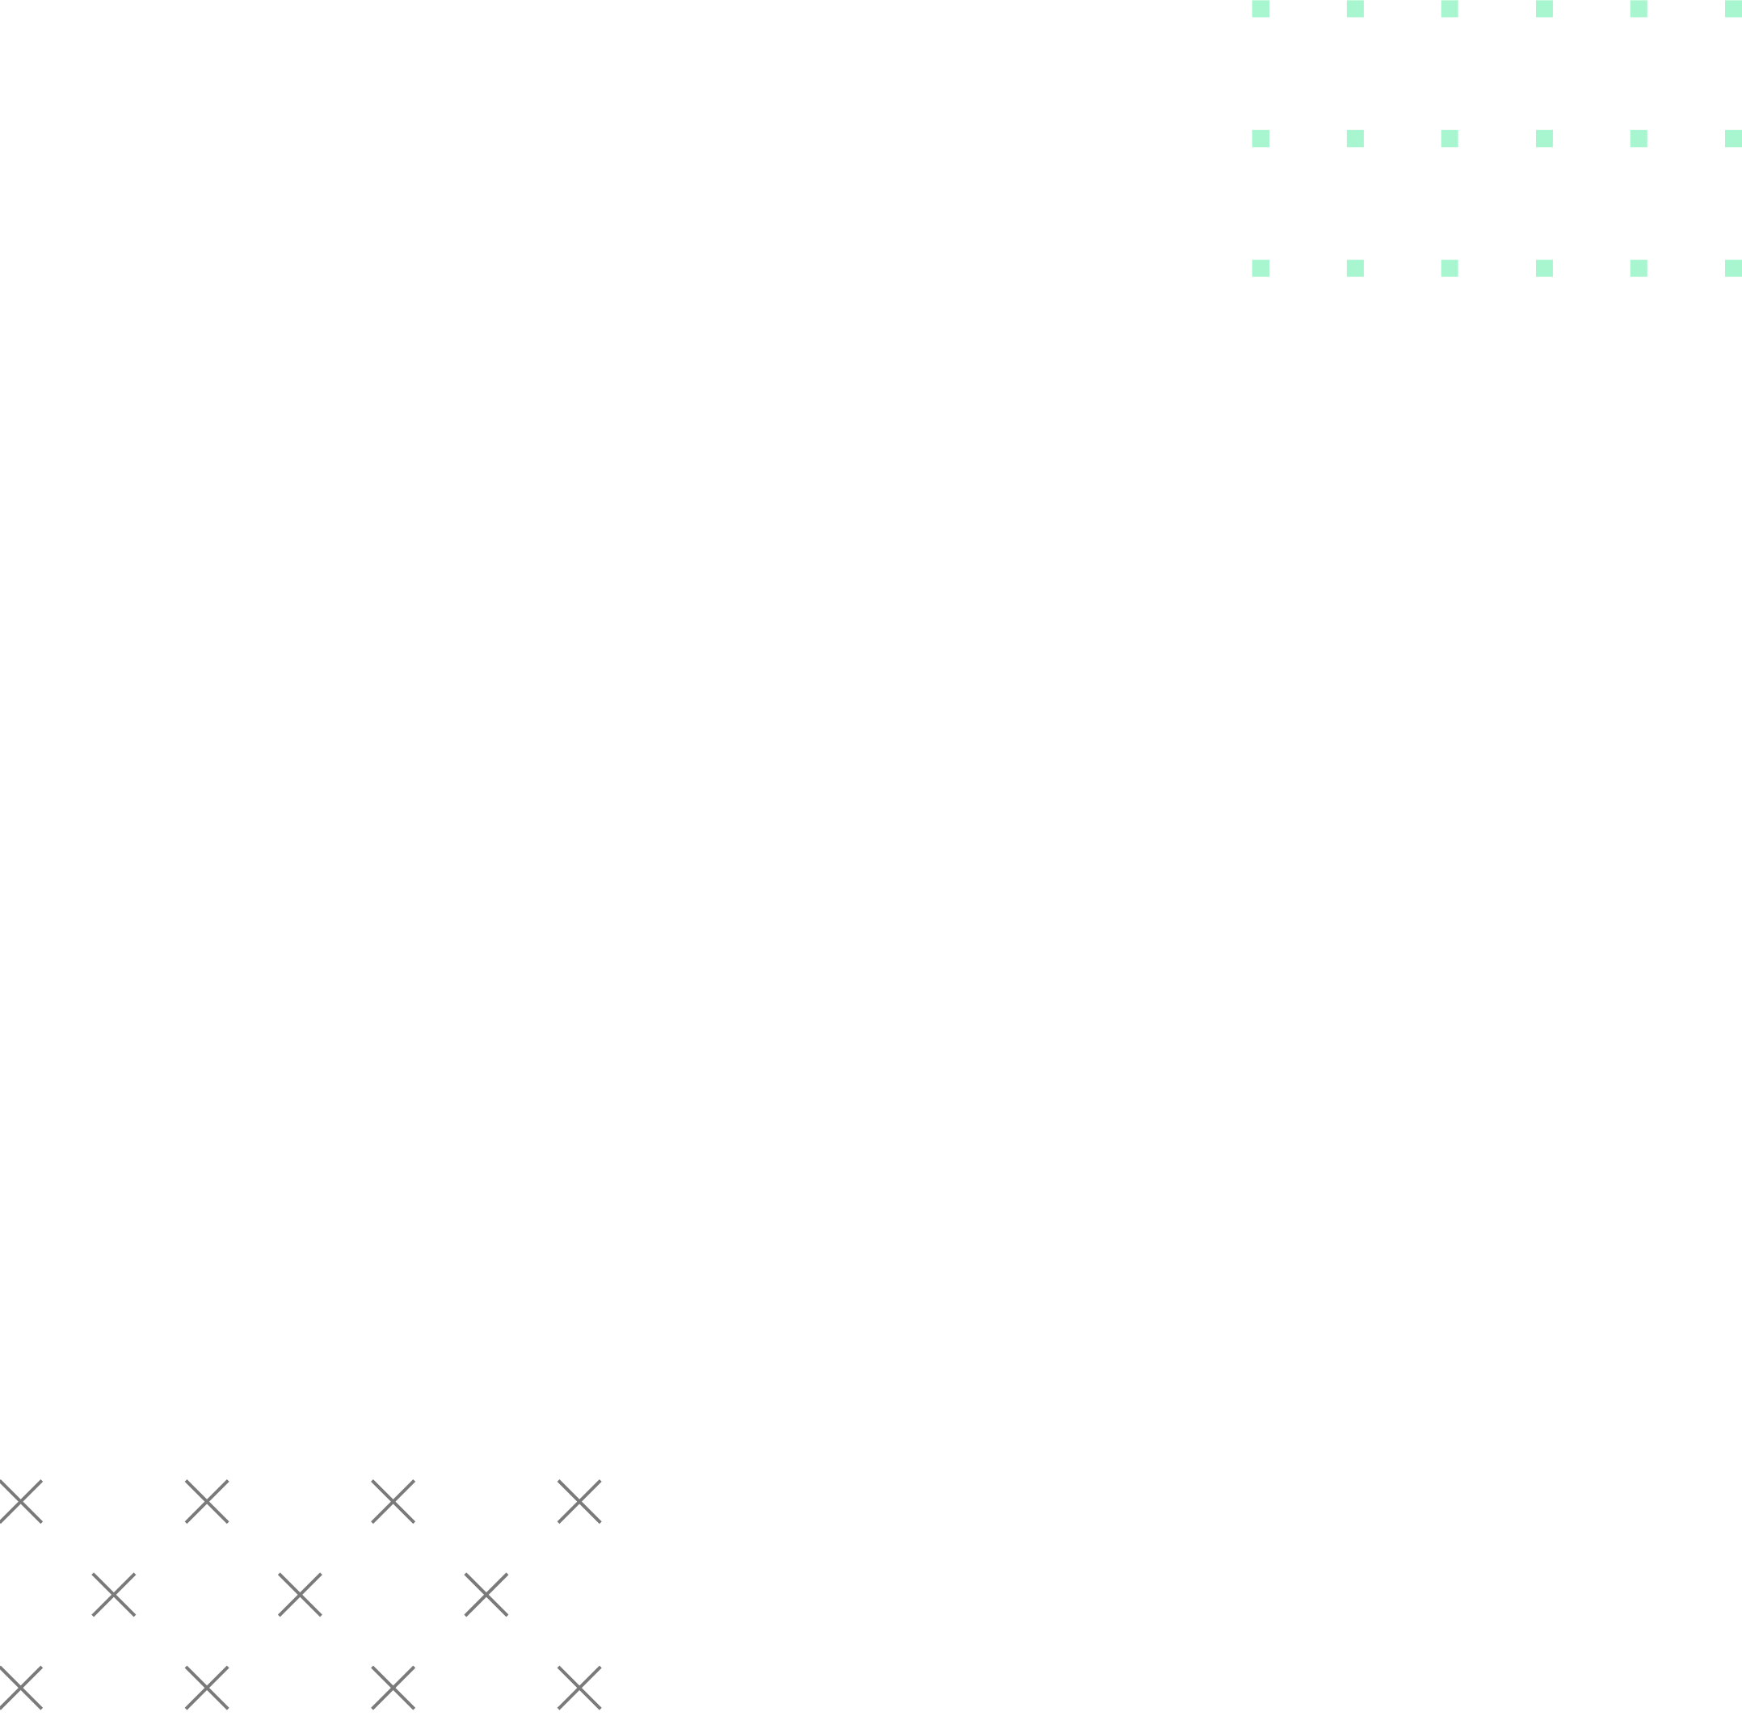
Objective
01
Forecasting

Slide 7
Challenges in Forecasting Water Usage :
Seasonal Trend & fluctuations.
No single model is perfect
Model Name | Weighted Mean Absolute Error | Weighted Mean Absolute Percent Error | Weighted Mean Absolute Scaled Error | Weighted Absolute Scaled Error | Weighted Root Mean Square Error | Weighted Absolute Percent Error
Arimax | 5,122.39 | 24.986 | 0.9281 | 3.8841 | 6,698.97 | 0.1801
ESM Model | 5,445.42 | 25.4269 | 0.9733 | 1.4926 | 7,299.37 | 0.1903
Seasonal Model | 5,069.82 | 24.1201 | 0.9149 | 3.8943 | 6,637.12 | 0.1781
Stacked Model (NN + TS) | 3,147.95 | 20.768 | 0.5907 | 3.6971 | 4,138.66 | 0.1118
IDM Model | 5,441.24 | 25.5172 | 0.9726 | 1.3997 | 7,297.81 | 0.1902
Ensemble (ARIMA/ETS/Stacked/Seasonal) | 3,147.95 | 20.768 | 0.5907 | 3.6971 | 4,138.66 | 0.1118
Ensemble (ARIMA/ETS/Seasonal) | 5,069.82 | 24.1201 | 0.9149 | 3.8943 | 6,637.12 | 0.1781
Ensemble (Stacked/Seasonal) | 3,147.95 | 20.768 | 0.5907 | 3.6971 | 4,138.66 | 0.1118
Ensemble (ARIMA/ETS/Stacked) | 3,147.95 | 20.768 | 0.5907 | 3.6971 | 4,138.66 | 0.1118
Regression for Time Series | 3,029.82 | 13.5862 | 0.5259 | 2.1913 | 4,174.77 | 0.1021
Non-seasonal Model | 5,069.82 | 24.1201 | 0.9149 | 3.8943 | 6,637.12 | 0.1781
Ensemble (ARIMA/ETS/Stacked/Seasonal/Non-seasonal/Regression) | 2,665.43 | 14.8154 | 0.4692 | 3.3703 | 3,638.44 | 0.0888
Auto-forecasting | 5,069.82 | 24.1201 | 0.9149 | 3.8943 | 6,637.12 | 0.1781
Hierarchical Forecasting | 5,339.92 | 25.6279 | 0.9599 | 3.5359 | 7,164.84 | 0.188
Our Approach :
Tested multiple individual and combined forecasting models.
Selected champion model based on evaluation of multiple error metrics - WMAPE, WMAE, WRMSE

Slide 8
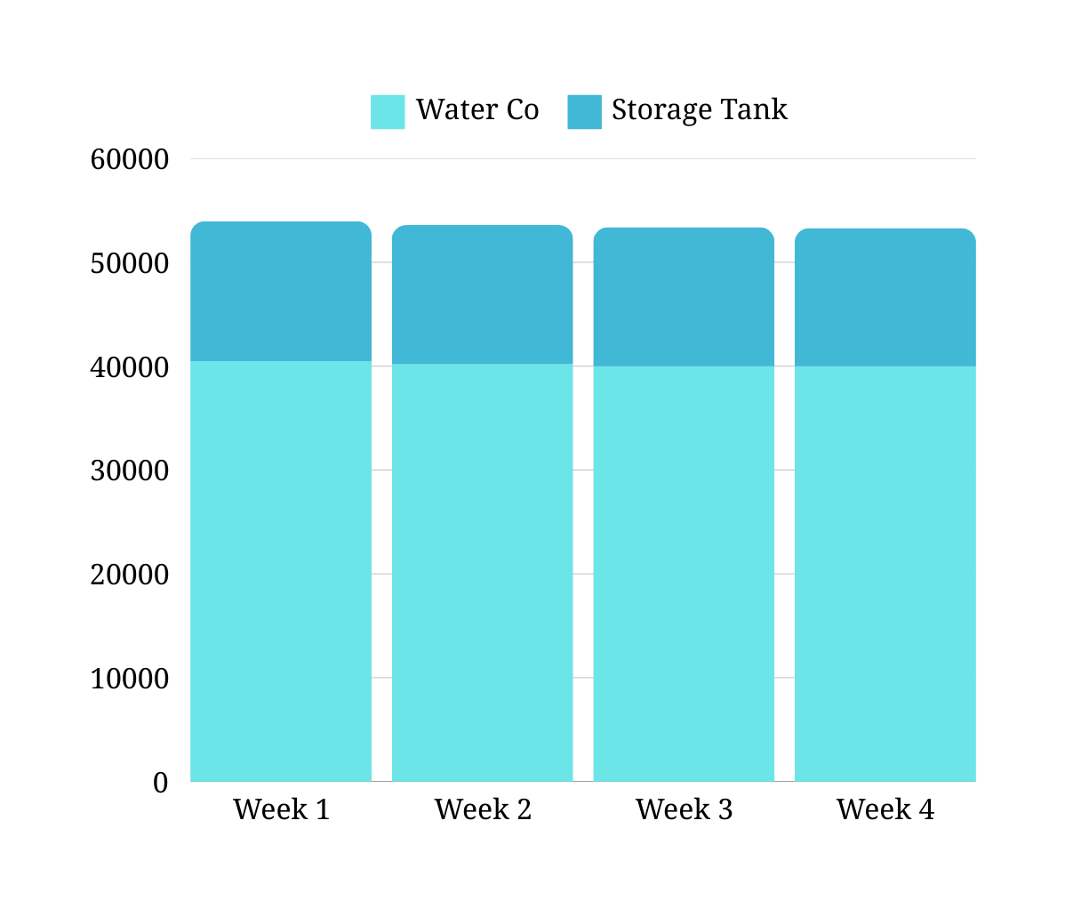
Final Forecasts
Week 1 : 53,953 gallons
Week 2 : 53,591 gallons
Week 3 : 53,369 gallons
Week 4 : 53,215 gallons

Slide 9
Objective
02
Optimization

Slide 10
Finding the Most Cost-Effective Water Purchase Strategy
Identify the cheapest way to meet water demand
Goal
Decisions to be made
Which contract tier to choose?
How much to buy from The Water Co. vs. Storage Tank?
Treatment cost changes over weeks 3 & 4
At least 25% of water must come from Storage Tank
Storage minimum limit of 30,000 gallons
Constraints to consider

Slide 11
Water Co. Contract Pricing
Contract Tier | Price per Gallon | Minimum Purchase (Gallons per Week)
Tier1 | 0.25 | 10,000
Tier 2 | 0.20 | 15,000
Tier 3 | 0.18 | 20,000
Tier 4 | 0.16 | 25,000
Tier 5 | 0.14 | 30,000
Tier 6 | 0.13 | 35,000
Tier 7 | 0.12 | 40,000
Tier 8 | 0.11 | 45,000
Tier 9 | 0.10 | 50,000
Tier 10 | 0.07 | 100,000

Slide 12
Factors That Affect Optimization
Weeks 1-2: $0.18 per gallon
Weeks 3-4: $0.10 per gallon
Treatment cost variations
Week 1: 12,000 gallons
Week 2: 18,000 gallons
Week 3: 20,000 gallons
Week 4: 22,000 gallons
Water Storage Tank
replenishments
Sustainability Rule
At least 25% of water usage must be from the storage tank

Slide 13
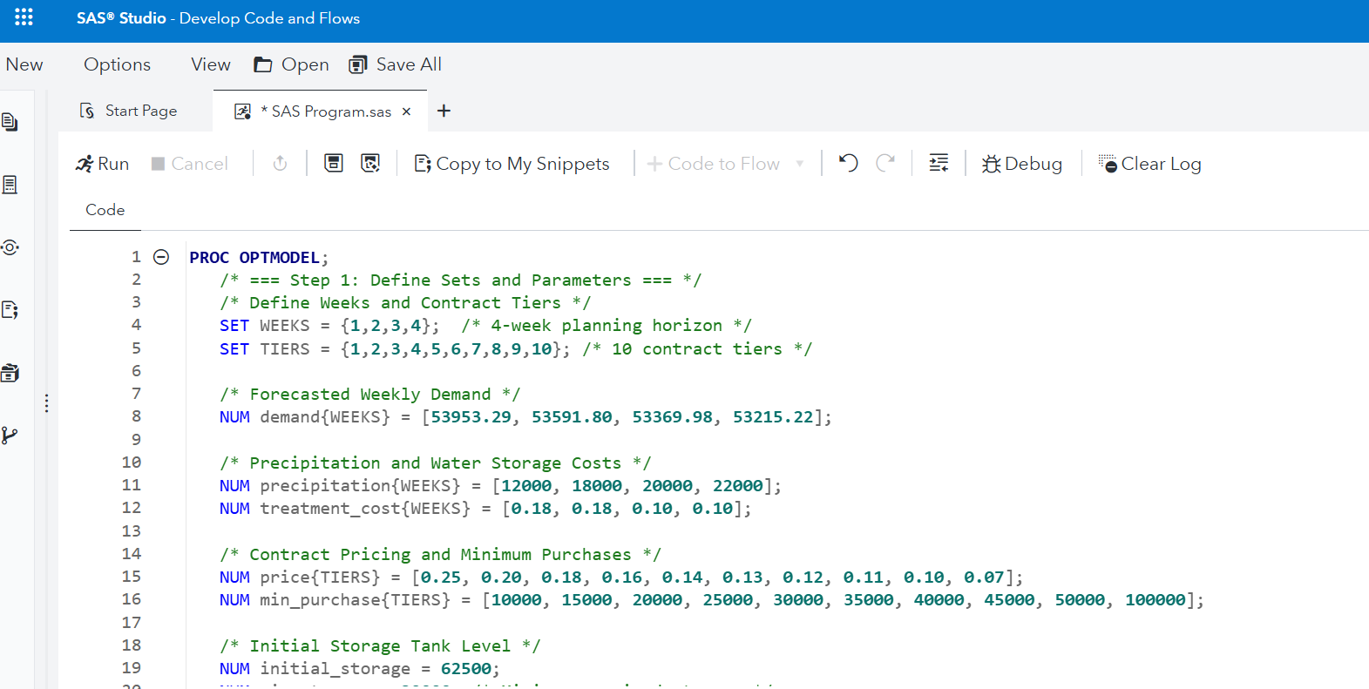
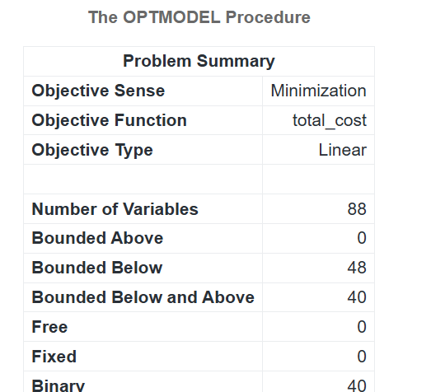
Optimization Strategy and Methodology
We used PROC OPTMODEL in SAS to define decision variables, assign constraints, and optimize the objective function, which minimizes total water procurement costs while meeting operational and sustainability requirements.

Slide 14
Best Contract Selection & Cost minimisation
The model identified Tier 7 ($0.12 per gallon, min. 40,000 gallons per week) as the most cost-effective contract.
Purchase from The Water Co. : ~40,000 gallons per week
Use from Storage Tank: ~13,000–14,000 gallons per week
Total Cost Over 4 Weeks: $26,785.97
Reasons for choosing Tier-7 :
Lower per-gallon price than smaller tiers.
Meets weekly demand without overcommitting to unnecessary gallons.
Ensures compliance with sustainability requirements.

Slide 15
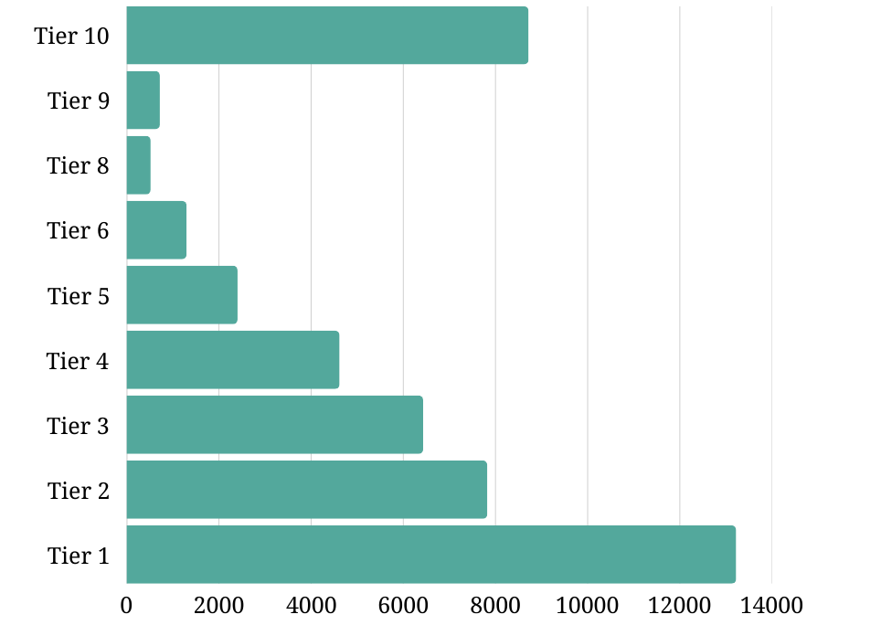
Cost Savings Comparison Across Contract Tiers
Tier 1 ($0.25/gal, min. 10,000 gal): $40,008.48 → $13,222.51 more expensive
Tier 3 ($0.18/gal, min. 20,000 gal): $33,216.64 → $6,430.67 more expensive
Tier 5 ($0.14/gal, min. 30,000 gal): $29,190.29 → $2,404.32 more expensive
Tier 9 ($0.10/gal, min. 50,000 gal): $27,504.16 → $718.19 more expensive
Insights:
Higher-priced tiers result in significantly higher costs.
Lower-priced tiers (Tier 9, Tier 10) force over-purchasing, leading to unnecessary expenses.
Tier 7 provides the best balance of price and purchase commitment.

Slide 16
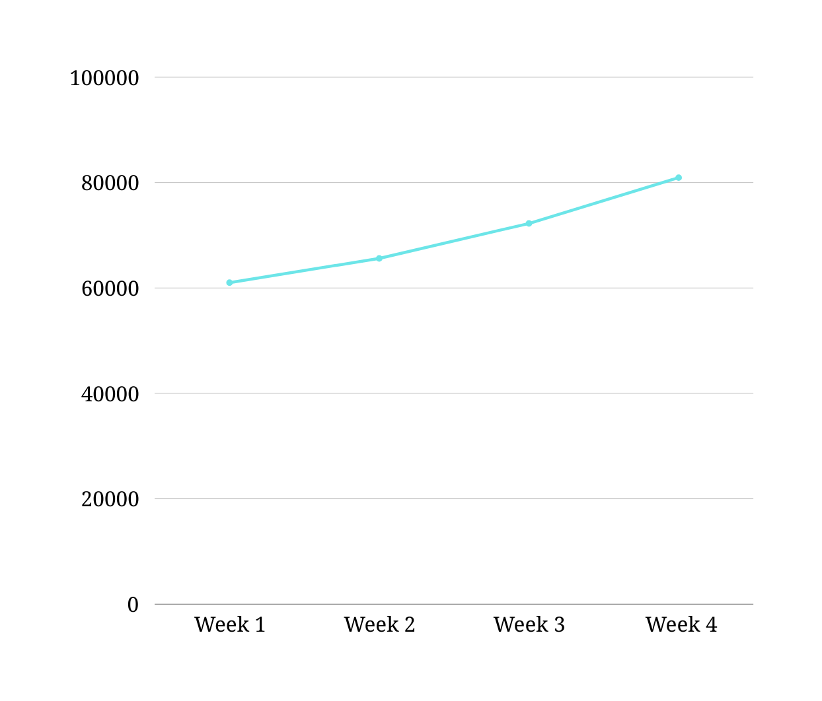
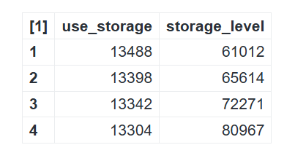
Projected Ending Storage Levels

Slide 17
Conclusion & Next Steps
Total Spend: $26,785.97 over 4 weeks, saving thousands vs. alternatives.
Sustainability & Security: Ensures compliance while minimizing costs.
Approach :
Use Tier 7 procurement & optimized storage.
Track water consumption for better forecasting.
Negotiate flexible terms with The Water Co.
Improve water treatment to cut storage costs.
Quarterly strategy reviews for cost & demand adjustments.

Slide 18
Final Recommendation
Best Selected Contract Tier: Tier 7
Cost Components:
Purchased Water Cost (from The Water Co.): Based on Tier 7 price per gallon ($0.12).
Water Storage Treatment Cost: Varies across weeks ($0.18 for weeks 1-2, $0.10 for weeks 3-4).
Total Cost Calculation: Includes both purchased water cost + storage treatment cost.
For future Optimization:
Explore flexible contract negotiations
Invest in improved water treatment efficiency
Monitor demand trends continuously to refine forecasts and purchasing

Slide 19
Thank You

