Slide 1

Insulin And Glucagon Pump Simulation
Group D:
Shubham Girdhar 1323003
Kshitij Yelpale 1322509
Safir Mohamm 1322554
Faiz Usmani 1323197
Asad Ahmed 1321474
Project Supervisor:
Prof. Dr. Matthias F. Wagner

Slide 2
Mapping AGILE SCRUM to SAFETY STANDARD
All the phases listed in the safety standard IEC-61508 will be followed and mapped to AGILE methodologies. All the steps in the safety standard needs to be followed mandatorily but AGILE processes are optional. In case of conflict priority will be given to the safety standard.
The Product Backlog from Scrum method will be applied for the SW safety requirements specification additionally. The Sprint Review and Sprint Retrospective element from Scrum will be applied for the Software safety lifecycle step of SW aspects of system safety validation, as well, to facilitate stakeholder involvement and continuous improvement of the product and process.

Slide 3
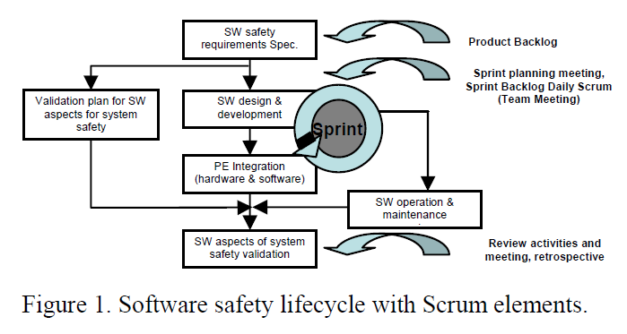
(Image taken from “An Integrated Process for Developing Safety-critical Systems using Agile Development Methods: Zhensheng Guo, Claudia Hirschmann, ICSEA 2012 : The Seventh International Conference on Software Engineering Advances”)

Slide 4
PROCESS MODEL (V model with Agile Scrum)
The project development will be split into sprints of 1-2 weeks. There will be sprint planning meeting 1 day before the start of the sprint.
This will be followed by the sprint work which will include requirement analysis, design, development and testing.
There are usually daily scrum meetings to monitor the progress, but in our case, it can be replaced by bi-weekly meetings.
A sprint will be marked as complete only if all the tasks associated with it has been completed and validated.
There will be system testing after every sprint and progress will be displayed in the form of a DEMO (internally within the team/ preferable with PO).
The last day of sprint will have a sprint retrospective meeting and can also have a sprint backlog meeting to prioritise the remaining features (this step may be merged in sprint planning due to time constraints).

Slide 5
Two factors that make it difficult to implement AGILE for the development of SCS:
“Everybody has licence to change anything” – this is handled by proper monitoring (safety manager), review process, validation and verification.
“Working software over comprehensive documentation” – this is handled by enabling comprehensive documentation on a sprint wise basis. Traceability is also taken care of.

Slide 6
TEAM ORGANIZATION and TASK DISTRIBUTION
The entire team will work as one self-organising cross functional scrum team.
Scrum Master and Safety Manager will overlook the entire project.
Each team member will act as developer as well as tester within every sprint.
The developer and tester must document the requirement analysis and test cases must be prepared and documented accordingly (PDR). The developer should document the Technical Design Document (TDD).
Unit testing has to be done by the developer and there has to be code review before testing phase within the sprint (CDR).
Test cases should be marked as pass/fail before the end of the sprint.

Slide 7
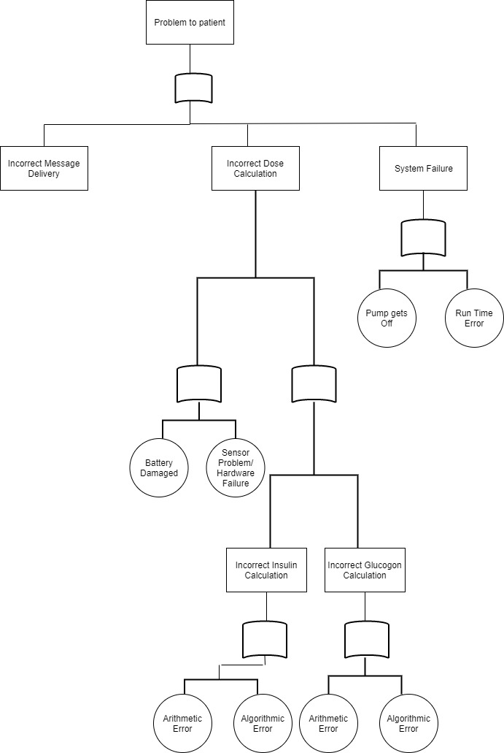
Fault Tree Analysis Diagram

Slide 8
Hazards Analysis
Infusion Pump System Hazards | System Hazard Definitions
Infusion Delivery Error | Intended medication selected and delivery attempted, but
 | failure to deliver within the right time, dose, volume,
 | patient, or anatomical or physiologic site specifications.
 | This can include over-delivery, under-delivery or delay
 | in delivery situations.
Incorrect Therapy | Failure to select or deliver the intended medication
 | because the wrong substance was selected for delivery.
Biological/Chemical Contamination | Unintended contact with biological or chemical
 | substance, or unintended patient or provider physiologic
 | response to intended biological or chemical substance.
Traumatic Injury | Burns, cuts, abrasions, air embolisms, electric shock, etc.
The objective of the hazard analysis is to identify hazards and potential causes of the hazards. Specifically, the objective is to identify circumstances in which users or patients are exposed to a potential source of harm.

Slide 9
Operation Sources
Hazard | Potential Causes
Air in Infusion Line | Incorrect/incomplete priming processes
 | Broken, loose, or unsealed delivery path
 | The pump is unable to release gas or air
 | The pump is set up with an incompatible infusion set
Occlusion | Delivery path obstructed, e.g., kinked tubes
 | Chemical precipitation inside the delivery path
 | Bolus occurring after an occlusion
Uncontrolled Flow of Infusate (e.g. | Valves in the delivery path are broken
free flow) | The pump is positioned much higher than the infusion site, causing unintentional drug flow
 | The delivery path is damaged, creating a vent on the path
 | that allows unintentional gravity flow
Retrograde Flow of Infusate (e.g. | The pump is positioned much lower than the infusion

Slide 10
Hazard | Potential Causes
Failure to operate / Pump malfunction | Temperature / Humidity / Air pressure too high or too low
The pump is exposed to pathogens, | Contamination due to spillage / exposure to toxins
allergens, or other hazardous | Battery leak
substances
Disruption/malfunction of pump | Electromagnetic interference (EMI) related to:
due to electromagnetic interference | - Radiofrequency (RF) emitters, e.g., mobile radios, cellular telephone
(EMI)
 | - Electrostatic discharge (ESD)
 | - Conducted RF, e.g., via power line
 | - Poor AC power quality, e.g., voltage surges or sags.
 | Magnetic fields: e.g., electric motors, power lines
 | Inadequate shielding, filtering, or other electromagnetic
 | compatibility (EMC) design or mitigation
Environmental Sources

Slide 11
Electrical Sources
Hazard | Potential Causes
Overheating | Incorrect or loose interconnections between devices
 | Supply processor charge too high
 | Insufficient cooling/faulty heat sink
Charge Error | Battery could not be charged
 | AC supply exceeds limits
Supply Voltage Error | Battery voltage exceeds limits
 | Battery depleted
 | Voltage conversion failed
Battery Failure | Battery voltage too low
 | Battery depleted
 | Battery overcharged
Leakage Current too high | Inadequate shielding

Slide 12
Hardware Sources
Hazard | Potential Causes
System failure | Malfunctioning component
 | Synchronization error between pump components
 | Watchdog failure
 | Reliability specification not met
Network error | Network congestion
 | Communication problem
 | Loss of (wireless) signal
 | Pump not compatible with networked / integrated device
Memory failure | Attempted write to memory failed
 | Critical value data integrity error
False alarm | False watchdog interrupt
 | Device or sensor contaminated
 | Device or sensor out of calibration
Failure to alarm | Sensor failure
Incorrect dose value entered | Key de-bounce prevention failed

Slide 13
Software Sources
Hazard | Potential Causes
Data error | Failure to backup
 | Data store/retrieval error
 | Communication problem
Software runtime error | Buffer overflow/underflow
 | Null pointer dereference
 | Memory leak
 | Uninitialized variable
 | Incorrect dynamic libraries
System malfunction | Software runtime error
 | Communication error
Corrupted infusion commands | Data store/retrieval error
 | Communication problem
Pump could not be silenced | Alarm priority set incorrectly
Incorrect software version | Software updates not installed
 | Incorrect drug library loaded
 | Incorrect version installed
Failure to alarm / False alarm | Sensor failure
 | Alarm priority set incorrectly
 | Incorrect settings of alarm thresholds

Slide 14
Safety Plan
Appropriate error and warning messages are displayed in scenarios of faulty functioning of the pump or emergency scenarios.
The user is alerted in the event of low pump battery, low insulin and glucagon level in reservoirs.
The configuration settings of the device can be changed by authorized person only.
Deadlocks in database should be avoided
Error messages or Notifications should be proper so user can understand it easily
In case of crashed system should be able to reset itself.

Slide 15
Security Aspects
Patient information and system data should be confidential (Confidentiality)
System should be able to respond according to its specification and design (Availability)
Integrity should be maintained. Data should be undetectable and should not get altered during processing.
The user is alerted in the event of low pump battery, low insulin and glucagon level in reservoirs.
The configuration settings of the device can be changed by authorized person only. (Authentication)

Slide 16
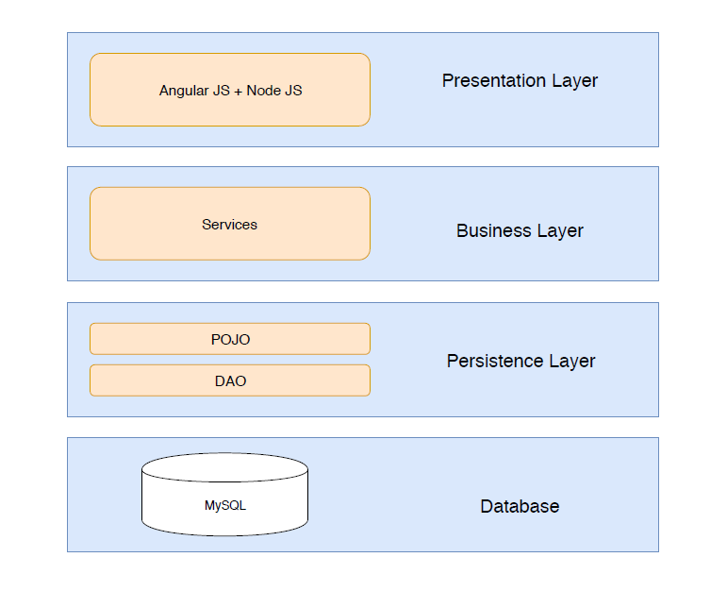
Application Design

Slide 17
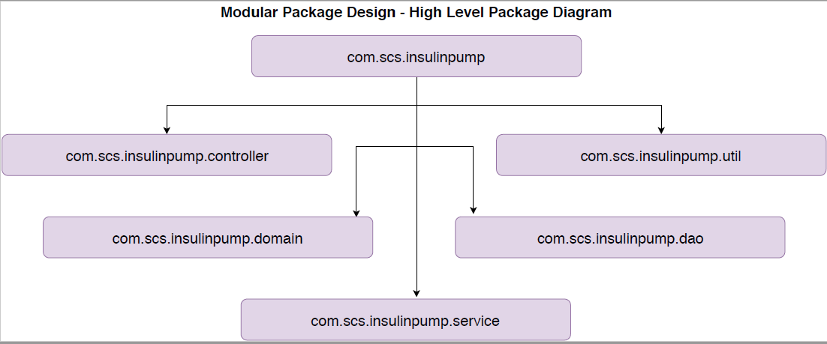
High Level Package Diagram

Slide 18
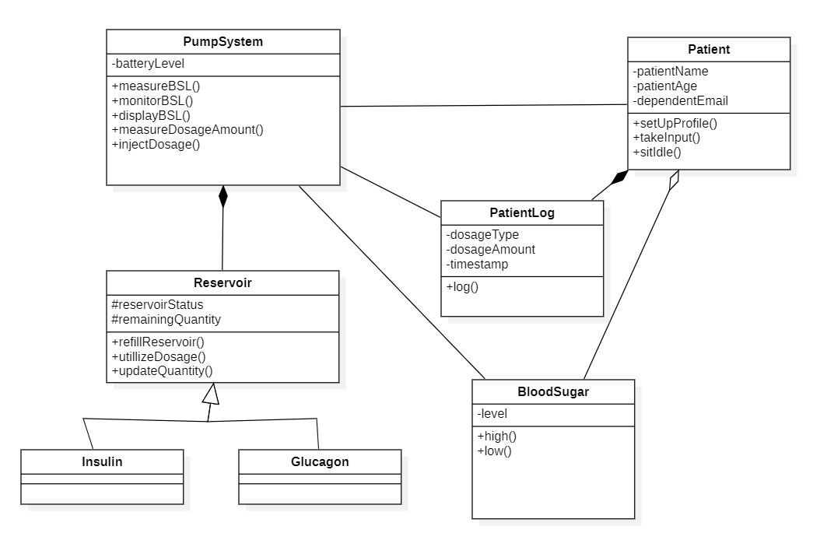
Class Diagram

Slide 19
References
https://www.fda.gov/regulatory-information/search-fda-guidance-documents/infusion-pumps-total-product-life-cycle
“An Integrated Process for Developing Safety-critical Systems using Agile Development Methods: Zhensheng Guo, Claudia Hirschmann, ICSEA 2012 : The Seventh International Conference on Software Engineering Advances”)

