Slide 1

Insulin And Glucagon Pump Simulation
Group D:
Shubham Girdhar 1323003
Kshitij Yelpale 1322509
Safir Mohammad 1322554
Faiz Usmani 1323197
Asad Ahmed 1321474
Project Supervisor:
Prof. Dr. Matthias F. Wagner

Slide 2
Mapping AGILE SCRUM to SAFETY STANDARD
All the phases listed in the safety standard IEC-61508 will be followed and mapped to AGILE methodologies. All the steps in the safety standard needs to be followed mandatorily but AGILE processes are optional. In case of conflict priority will be given to the safety standard.
The Product Backlog from Scrum method will be applied for the SW safety requirements specification additionally. The Sprint Review and Sprint Retrospective element from Scrum will be applied for the Software safety lifecycle step of SW aspects of system safety validation, as well, to facilitate stakeholder involvement and continuous improvement of the product and process.

Slide 3
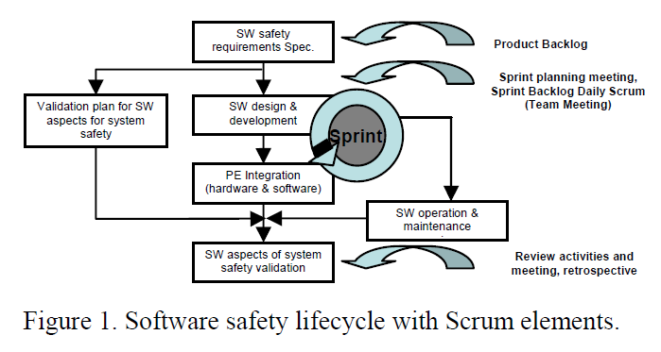
(Image taken from “An Integrated Process for Developing Safety-critical Systems using Agile Development Methods: Zhensheng Guo, Claudia Hirschmann, ICSEA 2012 : The Seventh International Conference on Software Engineering Advances”)

Slide 4
PROCESS MODEL (V model with Agile Scrum)
The project development will be split into sprints of 1-2 weeks. There will be sprint planning meeting 1 day before the start of the sprint.
This will be followed by the sprint work which will include requirement analysis, design, development and testing.
There are usually daily scrum meetings to monitor the progress, but in our case, it can be replaced by bi-weekly meetings.
A sprint will be marked as complete only if all the tasks associated with it has been completed and validated.
There will be system testing after every sprint and progress will be displayed in the form of a DEMO (internally within the team/ preferable with PO).
The last day of sprint will have a sprint retrospective meeting and can also have a sprint backlog meeting to prioritise the remaining features (this step may be merged in sprint planning due to time constraints).

Slide 5
Two factors that make it difficult to implement AGILE for the development of SCS:
“Everybody has licence to change anything” – this is handled by proper monitoring (safety manager), review process, validation and verification.
“Working software over comprehensive documentation” – this is handled by enabling comprehensive documentation on a sprint wise basis. Traceability is also taken care of.

Slide 6
TEAM ORGANIZATION and TASK DISTRIBUTION
The entire team will work as one self-organising cross functional scrum team.
Scrum Master and Safety Manager will overlook the entire project.
Each team member will act as developer as well as tester within every sprint.
The developer and tester must document the requirement analysis and test cases must be prepared and documented accordingly (PDR). The developer should document the Technical Design Document (TDD).
Unit testing has to be done by the developer and there has to be code review before testing phase within the sprint (CDR).
Test cases should be marked as pass/fail before the end of the sprint.

Slide 7
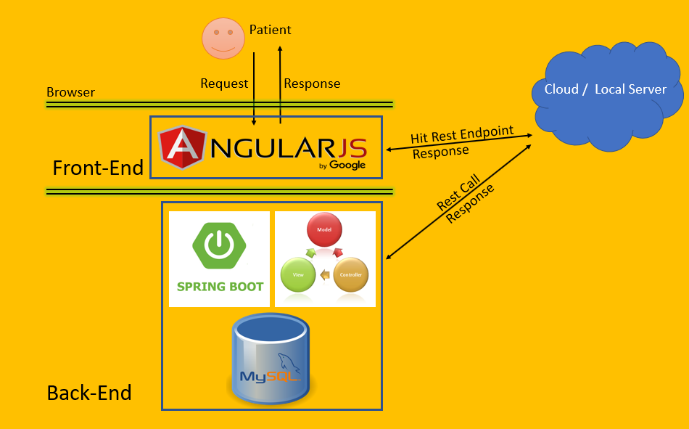
Architecture Diagram

Slide 8
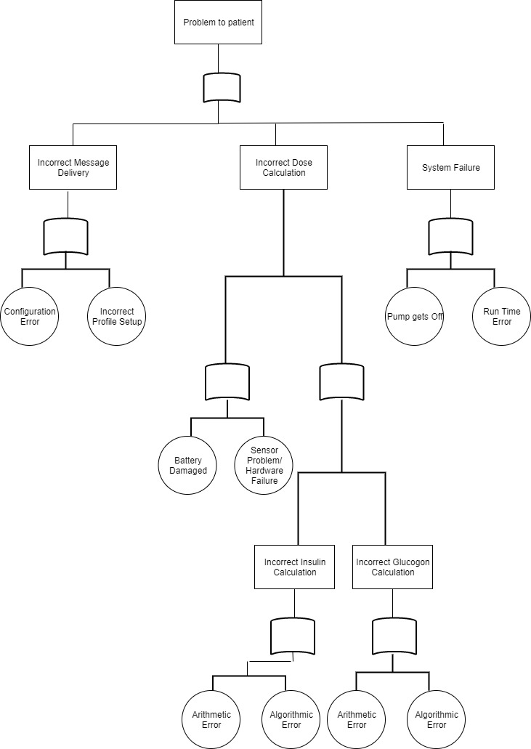
Fault Tree Analysis Diagram

Slide 9
Hazards Analysis
The objective of the hazard analysis is to identify hazards and potential causes of the hazards. Specifically, the objective is to identify circumstances in which users or patients are exposed to a potential source of harm.
Severe Condition/ Patient Death
When an exception occurs someone should be immediately informed so that some action should be taken otherwise the patient may even face death
Critical Situation
Whenever the pump battery is low or reservoirs are becoming empty, an alert should be generated to patient so that he/she can take appropriate action. If not alert patient that he/she may go in severe condition
Software Runtime Error
Software runtime error may occur due to buffer overflow, null pointer reference, memory leak, uninitialized variable.
Data Error
Data error may also occur in data storing and retrieving
Infusion Delivery Error
Intended medication selected and delivery attempted, but failure to deliver within the right time time, dose or volume to patient.

Slide 10
Hazards Analysis
Incorrect Therapy
When Failure to select or deliver the intended medication because the wrong substance was selected for delivery.
Air in infusion line
The pump is unable to release gas or air.

Slide 11
Safety Plan
Following severe hazards were prioritized at the top as per the Safety Criticality and Process Model, which are resolved and put into Safety Plan:
Software Simulation System continuously monitors Pump’s Battery Level and Reservoir’s Status and alerts Patient in case of Low Battery and Reservoirs becoming empty.
While entering the details, the Patient should also provide his/her dependent’s details.
The System sends an Email to the Dependent if any Exception occurs with proper details. The Exception can be:
BSL goes High (Hyperglycaemia),
BSL goes Low (Hypoglycaemia),
Injected Dosage doesn’t work,
Insulin/Glucagon wrongly injected etc.

Slide 12
Security Aspects
Confidentiality
Availability
Integrity
Authentication

Slide 13
STAMP Approach w.r.t our Application
STAMP is basically an accident which occurs as the result of inadequate control actions not enforcing necessary constraints on the system design and operation. We are using this approach to identify the constraints necessary to maintain safety and to ensure that the constraints will be enforced during the system design and operation. As our project is evolving continuously so our application should be able to react to changes and its environment.
Identifying the System Hazards:
There could be infusion delivery error means medication selected and delivery attempted but failure to deliver within the right time, dose and volume.
Wrong substance selected for delivery.
Air in infusion line of pump.
Blocking in delivery path.
Check any problem as delivery path could be damaged.
Check pump positioned as backward flow should not occur.
Pump malfunction due to temperature, humidity or may be airpressure too high or low.
Pump exposed to hazardous substances

Slide 14
Identifying the System level safety related to requirements and constraints:
In this project the constraint would be that it would be only applicable to Insulin/Glucagon dose calculation.
Another constraint would be as we are building a software simulation so no sensor would be involved in it.
In requirements there would be authentication as the system should be secured.
In terms of safety system should display appropriate error and warning messages when required.
The user is alerted in the event of low pump battery, low insulin and glucagon level in reservoirs.

Slide 15
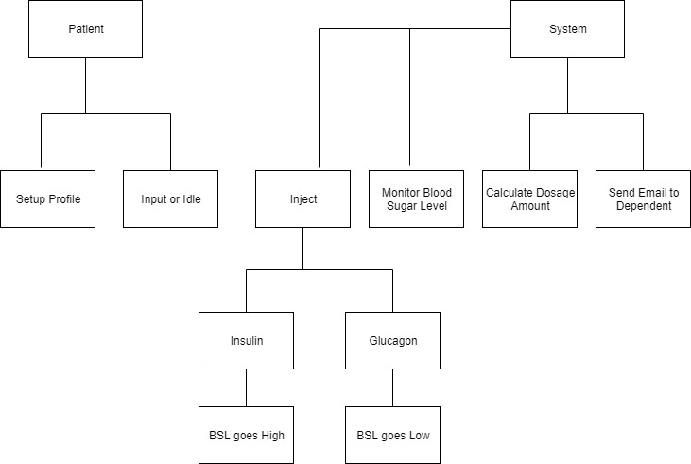
Basic System Control Structure

Slide 16
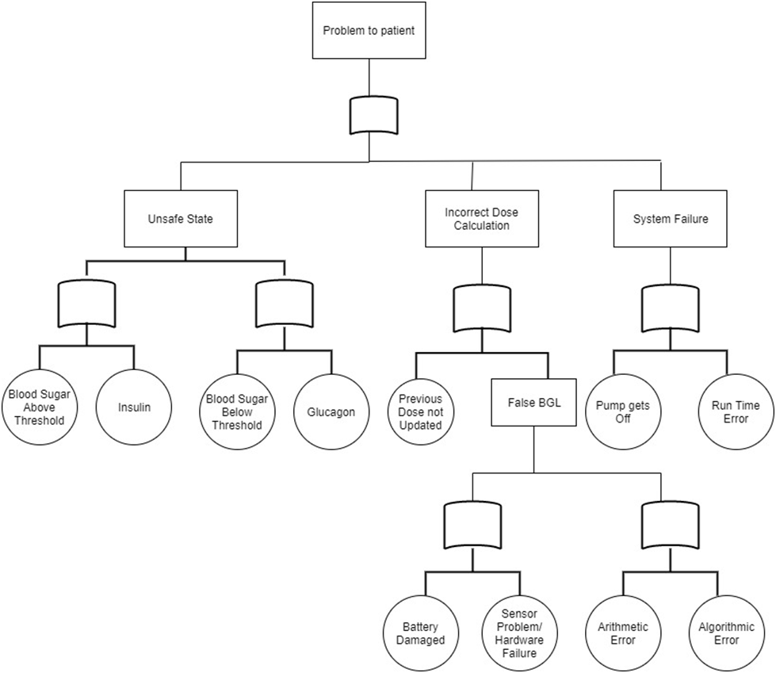
Identifying Inadequate Control Actions that could lead to Hazardous System State :
We have identified inadequate control actions that could lead to hazardous system state through fault tree analysis.

Slide 17
References
“An Integrated Process for Developing Safety-critical Systems using Agile Development Methods: Zhensheng Guo, Claudia Hirschmann, ICSEA 2012 : The Seventh International Conference on Software Engineering Advances”)
https://www.fda.gov/regulatory-information/search-fda-guidance-documents/infusion-pumps-total-product-life-cycle
“Engineering a Safer World: Nancy G. Leveson : The Seventh International Conference on Software Engineering Advances”)
“Infusion Pumps Total Product Lifecycle:US Dept of Health and Human Services)

