Slide 1

TITLE
CUSTOMER'S SPENDING PSYCHOLOGY AND REPAYMENT DISCIPLINE
Presenter:
Shubham Gupta in.sg5447@gmail.com
AI/ML
Amity University Noida

Slide 2


Topics to be covered
Problem Statement
DATASET DESCRIPTION
DATA CLEANING AND PREPROCESSING
CONCEPT USED, METHODOLOY AND RESULTS

Slide 3
Sanity Checks – Data Cleaning
• Note – All tasks need to be completed for month basis i.e. write logic for monthly calculations not cumulative for entire period.
• Provide a meaningful treatment to all values where age is less than 18.
Is there any customer who have spent more than his/her Credit Limit for any particular month.
Tasks
Monthly spend of each customer.
Monthly repayment of each customer.
Highest paying 10 customers.
People in which segment are spending more money.
Which age group is spending more money?
Which is the most profitable segment?
In which category the customers are spending more money?
Impose an interest rate of 2.9% for each customer for any due amount.
Monthly profit for the bank.
TECH AND TOOLS USED: Microsoft EXCEL, Python and Jupyter Notebook.
Problem Statement

Slide 4
Customer Acquisition Sheet
Column Name | Description
Name | Masked name of the customer (e.g., A1, A2, ..., An)
Age | Age of the customer
City | City of residence
Credit Card Product | Type of credit card assigned (Platinum, Gold, or Silver)
Limit | Monthly spending limit on the credit card
Masked Company Name | Anonymized company name (e.g., C1, C2, ..., Cn)
Segment | Employment sector (e.g., Government, Salaried_MNC, Salaried_Pvt, Self-employed)
DATASET DESCRIPTION
Spending Sheet
Column Name | Description
Name | Masked name of the customer
Month | Transaction month (in date format)
Type | Spending category (e.g., Bus Ticket, Shopping, Petrol, Train Ticket, Food, etc)
Amount | Monetary amount spent
REPAYMENT SHEET
Column Name | Description
Name | Masked name of the customer
Month | Repayment month
Amount | Amount to be repaid to the bank

Slide 5
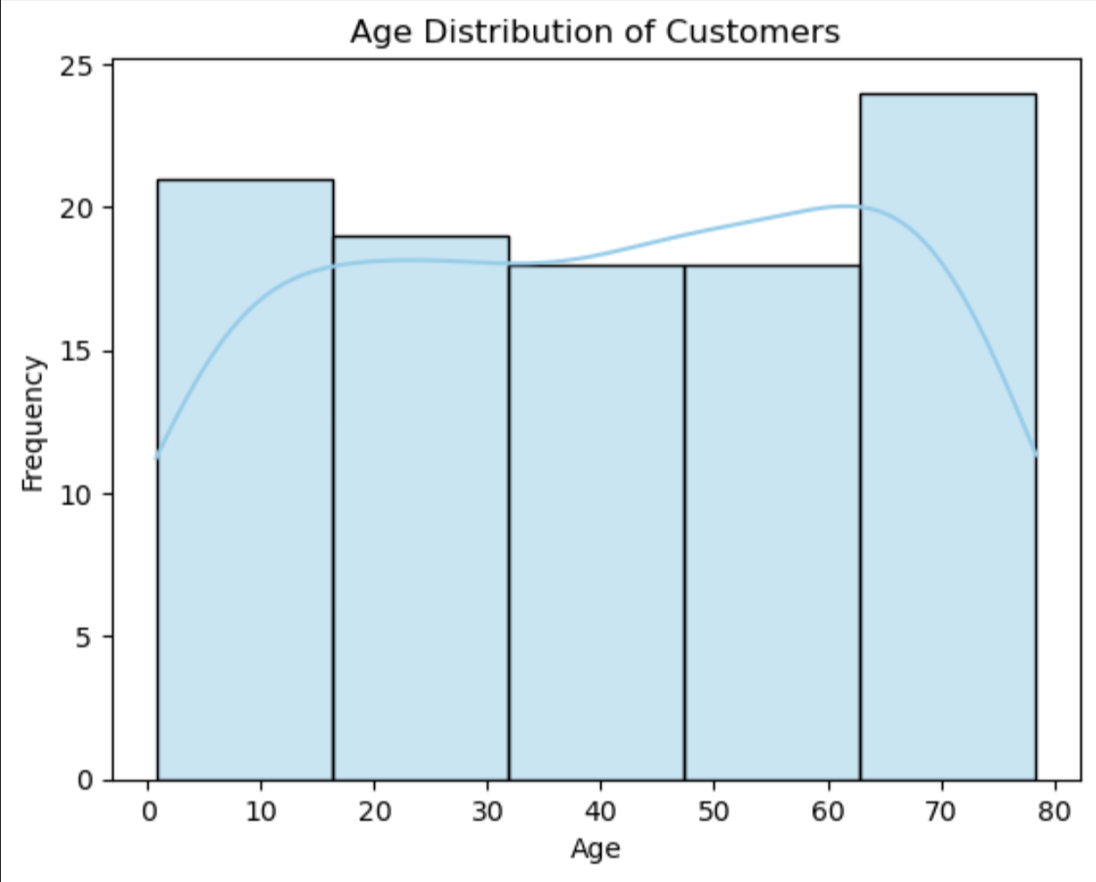
1. Handling Invalid Age Values
The mean age of all customers aged 18 and above was calculated to be 49.29.
All customers with age below 18 were replaced with this mean value.
The ages were rounded down to make them appear as actual, realistic age values.
BUT WHY MEAN ?
DATA CLEANING AND PREPROCESSING
2. Date Format Standardized
Converted dates from YYYY-MM-DD (e.g., 2004-01-12) to Month-Year format for monthly analysis.

Slide 6
3. Age Group Categorization
To enrich the demographic insights, customers were grouped into four meaningful age categories
Age Range | Category
18–29 | Young Adult
30–44 | Adult
45–59 | Middle Aged
60 and above | Senior
DATA CLEANING AND PREPROCESSING
4. Verified Data Types
Ensured all columns had appropriate data types for accurate analysis and processing

Slide 7

CONCEPT USED, METHODOLOY AND RESULTS
Let's dive into the code for better understanding

Slide 8
THANKYOU

