Slide 1
Cascading Style Sheets (CSS)
CS251
Kavi Arya
Based on Guy-Vincent Jourdan & Jeffrey C. Jackson’s slides

Slide 2
Motivation
HTML markup can be used to represent
Semantics: h1 means that an element is a top-level heading
Presentation: h1 elements look a certain way
It’s advisable to separate semantics from presentation because:
It’s easier to present documents on multiple platforms (browser, cell phone, spoken, …)
It’s easier to generate documents with consistent look
Semantic and presentation changes can be made independently of one another (division of labor)
User control of presentation is facilitated

Slide 3
Style Sheet Languages
Cascading Style Sheets (CSS)
Applies to (X)HTML as well as XML documents in general
Focus of this chapter
Extensible Stylesheet Language (XSL)
Often used to transform one XML document to another form, but can also add style
XSL Transformations covered in later chapter

Slide 4
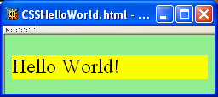
CSS Introduction
A styled HTML document produced by the style sheet style1.css:

Slide 5
CSS Introduction
link element associates style sheet with doc.

Slide 6
CSS Introduction
type attribute specifies style language used

Slide 7
CSS Introduction
href attribute provides style sheet URL

Slide 8
CSS Introduction
title attribute provides style sheet name

Slide 9
CSS Introduction
Alternative, user selectable style sheets
can be specified

Slide 10
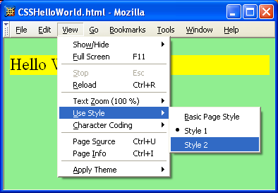
CSS Introduction

Slide 11
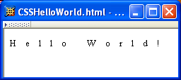
CSS Introduction
A styled HTML document produced by the style sheet style2.css:

Slide 12
CSS Introduction
Note that alternate, user selectable style is not widely supported: firefox 3 and IE 8 do, but IE 6, IE 7 and Chrome don’t.

Slide 13
CSS Introduction
Single document can be displayed on multiple media platforms by tailoring style sheets: This document will be printed differently than it is displayed.

Slide 14
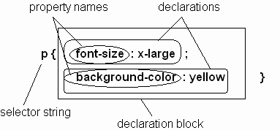
CSS Syntax
Parts of a style rule (or statement)

Slide 15
CSS Syntax: Selector Strings
Single element type:
Multiple element types:
All element types:
Specific elements by id:

Slide 16
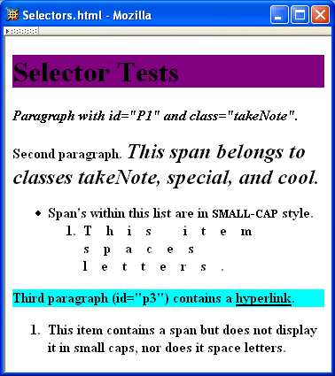
CSS Syntax: Selector Strings

Slide 17
CSS Syntax: Selector Strings
Elements belonging to a style class:
Referencing a style class in HTML:
Elements of a certain type and class:
class selector: begins with a period .

Slide 18
CSS Syntax: Selector Strings
Elements belonging to a style class:
Referencing a style class in HTML:
Elements of a certain type and class:
this span belongs to three style classes

Slide 19
CSS Syntax: Selector Strings
Elements belonging to a style class:
Referencing a style class in HTML:
Elements of a certain type and class:
this rule applies only to span’s belonging to class special

Slide 20
CSS Syntax: Selector Strings
Source anchor elements:
Element types that are descendents:
pseudo-classes

Slide 21
CSS Syntax: Selector Strings
Source anchor elements:
Element types that are descendants:
rule applies to li element that is

Slide 22
CSS Syntax: Selector Strings
Source anchor elements:
Element types that are descendants:
rule applies to li element that is
part of the content of an ol element

Slide 23
CSS Syntax: Selector Strings
Source anchor elements:
Element types that are descendants:
rule applies to li element that is
part of the content of an ol element
that is part of the content of a ul element

Slide 24
CSS Syntax
Style rules covered thus far follow ruleset syntax
At-rule is a second type of rule
Reads style rules from specified URL
Must appear at beginning of style sheet
URL relative to style sheet URL

Slide 25
Style Sheets and HTML
Style sheets referenced by link HTML element are called external style sheets
Style sheets can be embedded directly in HTML document using style element
Most HTML elements have style attribute (value is list of style declarations)

Slide 26
Style Sheets and HTML
Rules of thumb:
Use external style sheets to define site-wide style
Prefer style sheets (either external or embedded) to style attributes
XML special characters
Must use references in embedded style sheets and style attribute
Must not use references in external style sheets

Slide 27
CSS Rule Cascade
What if more than one style declaration applies to a property of an element?
The CSS rule cascade determines which style rule’s declaration applies

Slide 28
CSS Rule Cascade
To find the value for an element/property combination, user agents must apply the following sorting order:
1- Find all declarations that apply to the element and property in question, for the target media type. Declarations apply if the associated selector matches the element in question.

Slide 29
CSS Rule Cascade
2- The primary sort of the declarations is by weight and origin: for normal declarations, author style sheets override user style sheets which override the default style sheet. For "!important" declarations, user style sheets override author style sheets which override the default style sheet. "!important" declaration override normal declarations. An imported style sheet has the same origin as the style sheet that imported it.
Five origin/weight levels:
user/important
author/important
author/normal
user/normal
user agent/normal

Slide 30
CSS Rule Cascade
3- The secondary sort is by specificity of selector: more specific selectors will override more general ones. Pseudo-elements and pseudo-classes are counted as normal elements and classes, respectively.
Specificity:
style attribute
rule with selector:
ID
class/pseudo-class
descendant/element type
universal
HTML attribute

Slide 31
CSS Rule Cascade
4- Finally, sort by order specified: if two rules have the same weight, origin and specificity, the latter specified wins. Rules in imported style sheets are considered to be before any rules in the style sheet itself.
Conceptually, create one
long style sheet. Later
style rules have higher
priority than earlier rules.

Slide 32
CSS Inheritance
What if no style declaration applies to a property of an element?
Generally, the property value is inherited from the nearest ancestor element that has a value for the property
If no ancestor has a value (or the property does not inherit) then CSS defines an initial value that is used

Slide 33
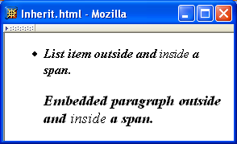
CSS Inheritance

Slide 34
CSS Inheritance
Property values:
Specified: value contained in declaration
Absolute: value can be determined without reference to context (e.g., 2cm)
Relative: value depends on context (e.g., larger)
Computed: absolute representation of relative value (e.g., larger might be 1.2 x parent font size)
Actual: value actually used by browser (e.g., computed value might be rounded)

Slide 35
CSS Inheritance
Most properties inherit computed value
Exception discussed later: line-height
A little thought can usually tell you whether a property inherits or not
Example: height does not inherit

Slide 36
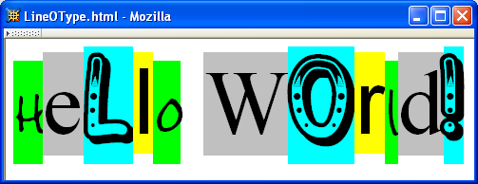
CSS Font Properties
A font is a mapping from code points to glyphs
Glyph (visual representation)
character cell
(content area)

Slide 37
CSS Font Properties
A font is a mapping from code points to glyphs
glyphs do not necessary stay inside cells!

Slide 38
CSS Font Properties
A font family is a collection of related fonts (typically differ in size, weight, etc.)
font-family property can accept a list of families, including generic font families
first choice font

Slide 39
CSS Font Properties
A font family is a collection of related fonts (typically differ in size, weight, etc.)
font-family property can accept a list of families, including generic font families
second choice font

Slide 40
CSS Font Properties
A font family is a collection of related fonts (typically differ in size, weight, etc.)
font-family property can accept a list of families, including generic font families
generic

Slide 41
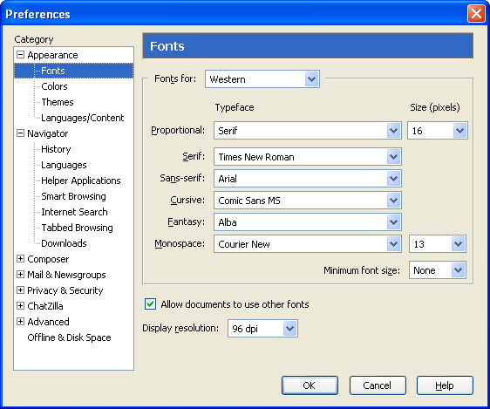
CSS Font Properties
generic
fonts are
system-
specific

Slide 42
CSS Font Properties
Note that most generic font can be easily set on Firefox and Chrome, but such option doesn’t seem to be available on IE 7 and 8. IE will still default to something although maybe not what you had hoped for!

Slide 43
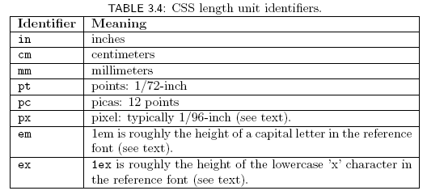
CSS Font Properties
Many properties, such as font-size, have a value that is a CSS length
All CSS length values except 0 need units

Slide 44
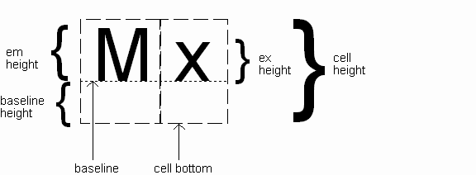
CSS Font Properties
Computed value
of font-size property

Slide 45
CSS Font Properties
Reference font defines em and ex units
Normally, reference font is the font of the element being styled
Exception: Using em/ex to specify value for font-size
parent element’s font is
reference font

Slide 46
CSS Font Properties
Other ways to specify value for font-size:
Percentage (of parent font-size)
Absolute size keyword: xx-small, x-small, small, medium (initial value), large, x-large, xx-large
User agent specific; should differ by ~ 20%
Relative size keyword: smaller, larger
Relative to parent element’s font

Slide 47
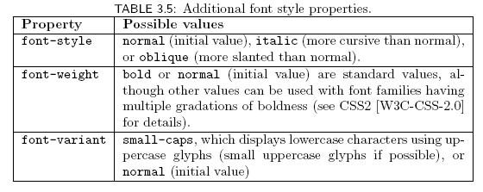
CSS Font Properties

Slide 48

CSS Font Properties
Text is rendered using line boxes
Height of line box given by line-height
Initial value: normal (i.e., cell height; relationship with em height is font-specific)
Other values (following are equivalent):

Slide 49
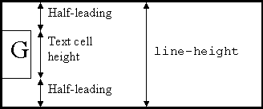
CSS Font Properties
When line-height is greater than cell height:
Inheritance of line-height:
Specified value if normal or unit-less number
Computed value otherwise

Slide 50
CSS Font Properties
font shortcut property:

Slide 51
CSS Font Properties
font shortcut property:
Initial values used if no value specified in font
property list (that is, potentially reset)

Slide 52
CSS Font Properties
font shortcut property:
specifying line-height (here, twice cell height)
any order
size and family required,
order-dependent

Slide 53
CSS Text Formatting

Slide 54
CSS Text Color
Font color specified by color property
Two primary ways of specifying colors:
Color name: black, gray, silver, white, red, lime, blue, yellow, aqua, fuchsia, maroon, green, navy, olive, teal, purple, full list at http://www.w3.org/TR/SVG11/types.html#ColorKeywords
red/green/blue (RGB) values

Slide 55
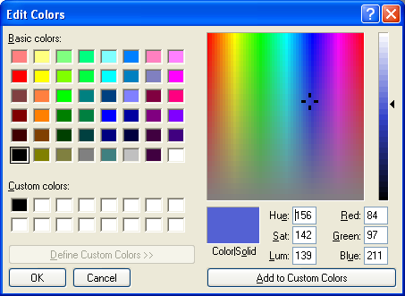
CSS Text Color

Slide 56
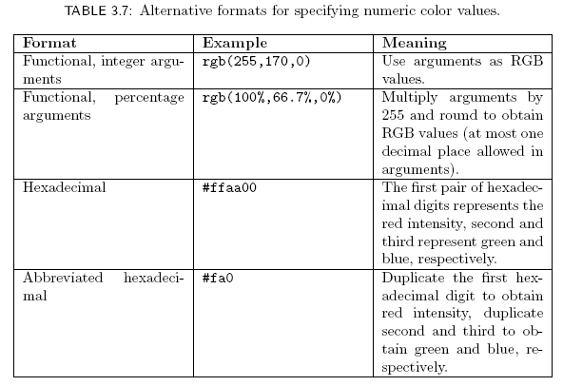
CSS Text Color

Slide 57
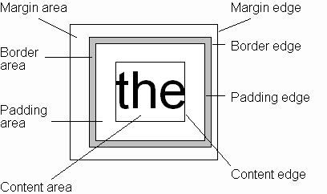
CSS Box Model
Every rendered element occupies a box:
(or outer edge)
(or inner edge)

Slide 58
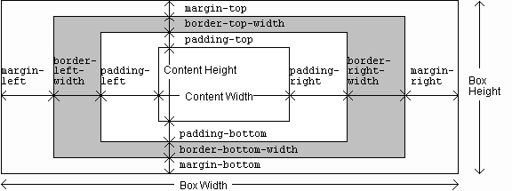
CSS Box Model

Slide 59
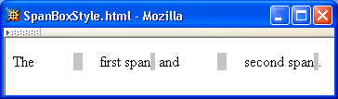
CSS Box Model

Slide 60
CSS Box Model

Slide 61
CSS Box Model

Slide 62
CSS Box Model

Slide 63
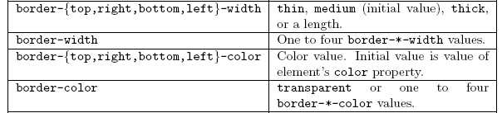
CSS Box Model

Slide 64
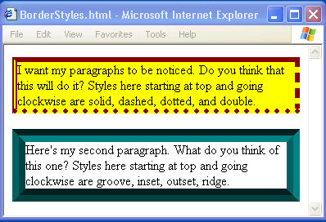
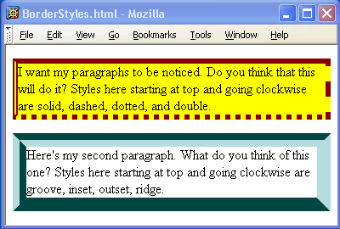
CSS Box Model

Slide 65
CSS Box Model

Slide 66
CSS Box Model
If multiple declarations apply to a property, the last declaration overrides earlier specifications
Left border is 30px wide,
inset style, and red

Slide 67
Backgrounds
background-color
Specifies background color for content, padding, and border areas
Margin area is always transparent
Not inherited; initial value transparent
background-image
Specifies (using url() function) image that will be tiled over an element

Slide 68
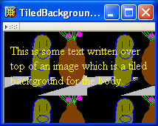
Backgrounds
<body style="background-image:url('CucumberFlowerPot.png')">

Slide 69
Normal Flow Layout
In normal flow processing, each displayed element has a corresponding box
html element box is called initial containing block and corresponds to entire document
Boxes of child elements are contained in boxes of parent
Sibling block elements are laid out one on top of the other
Sibling inline elements are one after the other

Slide 70
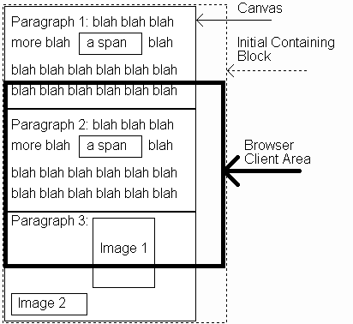
Normal Flow Layout
(body)
(html)

Slide 71
Normal Flow Layout
Block
elements
only

Slide 72
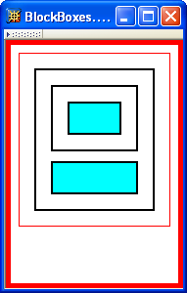
Normal Flow Layout
html
body
div d1
div d2
div d3
div d4
Top edges of
block boxes are
in document order

Slide 73
Normal Flow Layout
What is a “block element”?
Element with value block specified for its display property
User agent style sheet (not CSS) specifies default values; typical block elements include html, body, p, pre, div, form, ol, ul, dl, hr, h1 through h6
Most other elements except li and table-related have inline specified for display

Slide 74
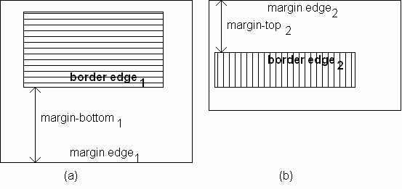
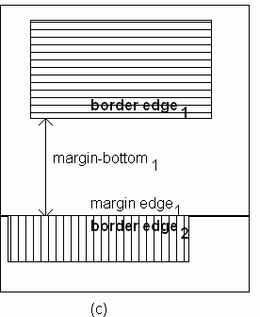
Normal Flow Layout
When blocks stack, adjacent margins are collapsed to the size of the larger margin

Slide 75
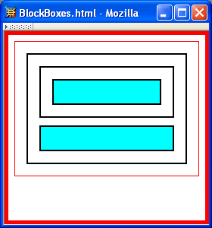
Normal Flow Layout
Initial value of width property is auto, which for block boxes means to make the content area as wide as possible within margin/padding constraints:
Width of block boxes
increases as browser
client area is widened

Slide 76
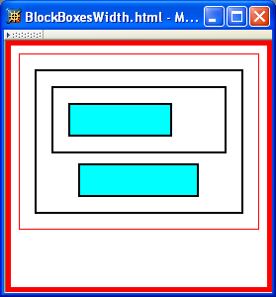
Normal Flow Layout
Can also specify CSS length or percentage (of parent’s content width) for width property
By default, width of right margin is adjusted to accommodate a change to width

Slide 77
Normal Flow Layout
Can also specify CSS length or percentage (of parent’s content width) for width property
Centering can be achieved by setting
both margins to auto

Slide 78
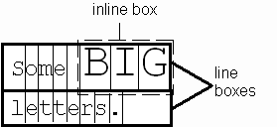
Normal Flow Layout
Boxes corresponding to character cells and inline elements are laid out side by side in line boxes that are stacked one on top of the other
Heights based on
content
Character cells aligned by baseline

Slide 79
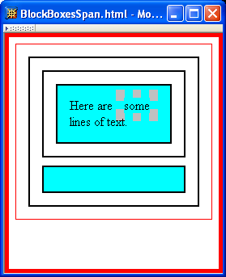
Normal Flow Layout
Padding/borders/margins affect width but not height of inline boxes

Slide 80
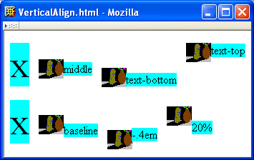
Normal Flow Layout
Specify value for vertical-align to position an inline element within line box:
initial value of vertical-align

Slide 81

Beyond Normal Flow
CSS allows for boxes to be positioned outside the normal flow:
Relative positioning
span’s shifted backwards relative to normal flow

Slide 82
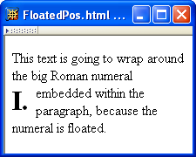
Beyond Normal Flow
CSS allows for boxes to be positioned outside the normal flow:
Float positioning
span taken out of normal
flow and “floated” to the
left of its line box

Slide 83
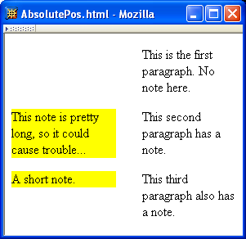
Beyond Normal Flow
CSS allows for boxes to be positioned outside the normal flow:
Absolute positioning
span’s removed from
normal flow and
positioned relative
to another box

Slide 84
Beyond Normal Flow
Properties used to specify positioning:
position: static (initial value), relative, or absolute
Element is positioned if this property not static
Properties left, right, top, bottom apply to positioned elements
Primary values are auto (initial value) or CSS length
float: none, left, or right
Applies to elements with static and relative positioning only

Slide 85
Beyond Normal Flow
Relative positioning
Specifying positive value for right property of relatively positioned box moves it to left
<span style="background-color:red">&nbsp;&nbsp;&nbsp;&nbsp;
</span><span class="right">Red</span>
span
containing
text moves
left

Slide 86
Beyond Normal Flow
Relative positioning
Specifying negative value for left property also moves box to left
<span style="background-color:red">&nbsp;&nbsp;&nbsp;&nbsp;
</span><span class="right">Red</span>
same
effect as
before

Slide 87
Beyond Normal Flow
Float positioning
Specify value for float property

Slide 88
Beyond Normal Flow
Float positioning
Specify value for float property
Floated element becomes a CSS block
element (e.g., can set height and width)

Slide 89
Beyond Normal Flow
Absolute positioning
Specify location for corner of box relative to positioned containing block
p elements are positioned (but don’t move!)
margin area
padding area
containing
block
This second paragraph has a
note.

Slide 90
Beyond Normal Flow
Absolute positioning
Specify location for edges of box relative to positioned containing block

Slide 91

Beyond Normal Flow
Absolute positioning
10em
padding top
edge
padding left
edge

Slide 92
Beyond Normal Flow
Absolute positioning
8em

Slide 93
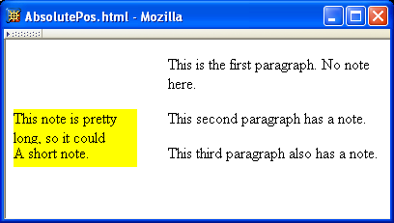
Beyond Normal Flow
Absolutely positioned box does not affect positioning of other boxes!
Second absolutely
positioned box
obscures first

Slide 94
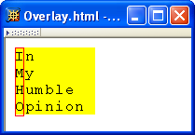
CSS Position-Related Properties
z-index: drawing order for overlaid boxes (largest number drawn last)

Slide 95
CSS Position-Related Properties
display: value none means that element and its descendants are not rendered and do not affect normal flow
visibility: value hidden (initial value is visible) means that element and its descendants are not rendered but still do affect normal flow

Slide 96
Changing the Color of Links
LINK, VLINK, and ALINK attributes can be inserted in the <BODY> tag to define color of a link
LINK defines color of links that have not been visited
VLINK defines color of links that have already been visited
ALINK defines color of a link when a user clicks on it

