Slide 1
ONLINE PIZZA DELIVERY
Guide - Prof. Aparna Sawant
Group 4 -
04 - Aniket Bichare
12 - Ajinkya Deshmukh
18 - Sachin Gajalwad
21 - Kiran Gunjal
24 - Shubham Hingade
Department of IT & MCA
Vishwakarma Institute of Technology , Pune

Slide 2
Content
Aim
Objective & Scope
Technical Feasibility
Diagrams
Output
Conclusion

Slide 3
Aim
Our goal is to deliver a database with a user interface (website) where customers can select various ingredients for their own pizza and place their order. The order will be sent to the “kitchen” where the pizza will be made. The focus is to create an “easy to use” website, which will allow a first time customer to complete their order with ease.
MyDelivery

Slide 4
Objective
Build your own pizza – This system will help customers in ordering custom pizzas. So, the customer will pick exactly the things which he/she wants in their pizza. This will surely enhance the image of the pizzeria and customer satisfaction will be more.
Better Knowledge– This system will provide the customer all the details of his order before making the order. This confirmation will help customers to check the items ordered with their prices.
Improves Efficiency - This system will make things easier for staff as the whole ordering process is done by the customer only.
Reduce Paper Work– As most of the things will be performed online, it will reduce the usage of paper for the pizzeria.

Slide 5
Scope
Online Pizza Ordering System will be a web based application whose main language of programming will be PHP.Its main aim is to simplify and improve the efficiency of the ordering process for both customer and pizza shop owners,minimize manual data entry and ensure data accuracy and security during order placement process.Customer will be able to view product menus and their sizes and be able to have a visual confirmation that the order was placed correctly.

Slide 6
Technical Requirements
SOFTWARE
1. HTML ,CSS
2. Code Editor
3. MYSQL version 5.5 & above.
4. Javascript and Jquery
5. Bootstrap
6. Platform – Windows/Linux Any WEB Browser
HARDWARE
1. Intel Pentium or more
2. 2 GB RAM
3. PC with 80 GB ROM

Slide 7
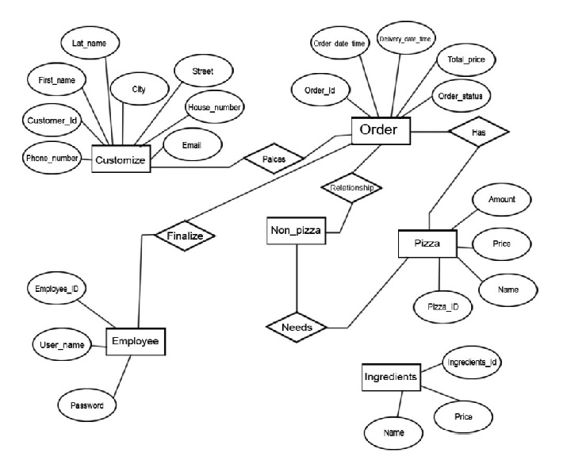
ER Diagram

Slide 8
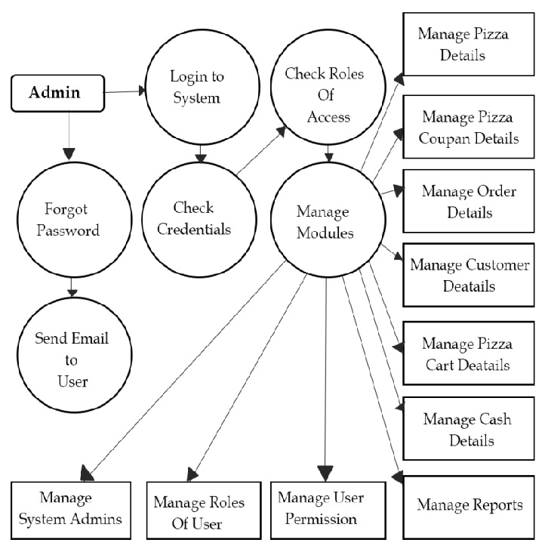

Slide 9
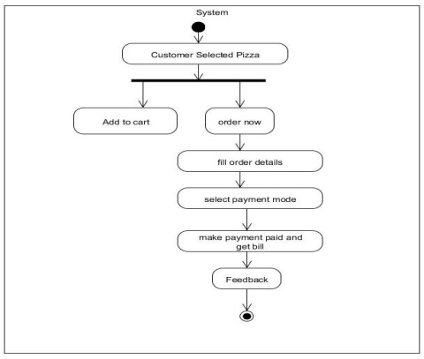
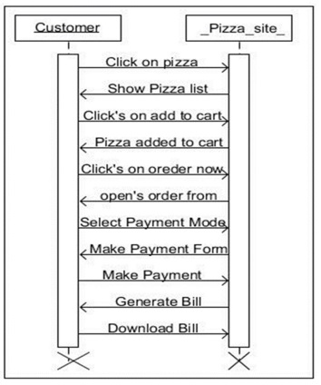
UML Diagrams

Slide 10
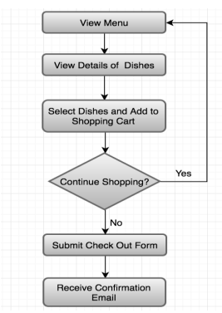
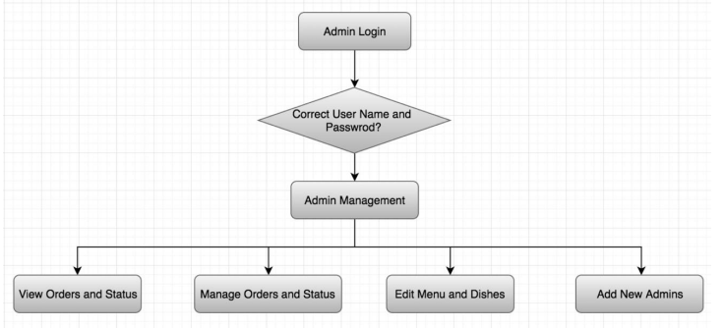
Flowchart
Flowchart for admin
Flowchart for user

Slide 11
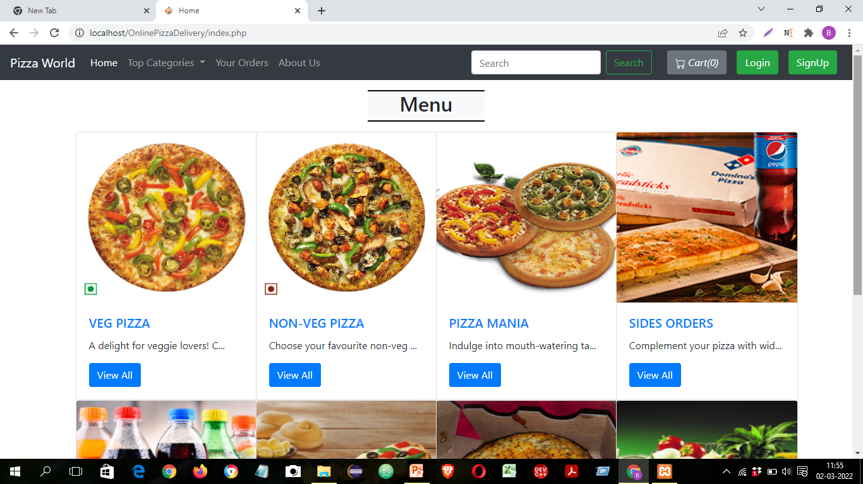
Outputs

Slide 12
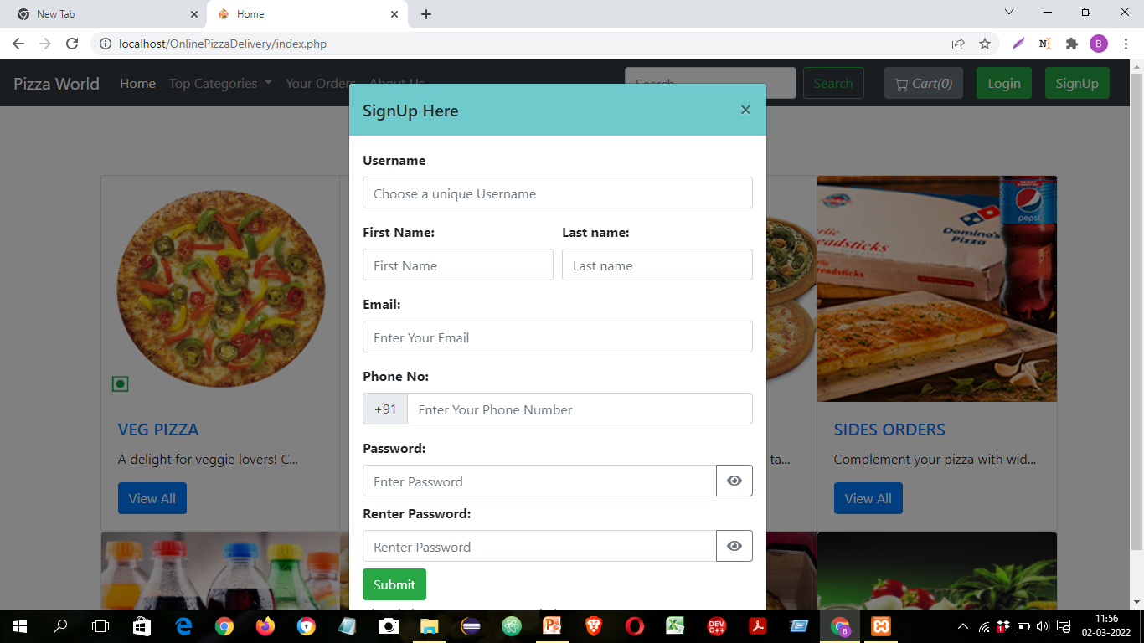
Outputs

Slide 13
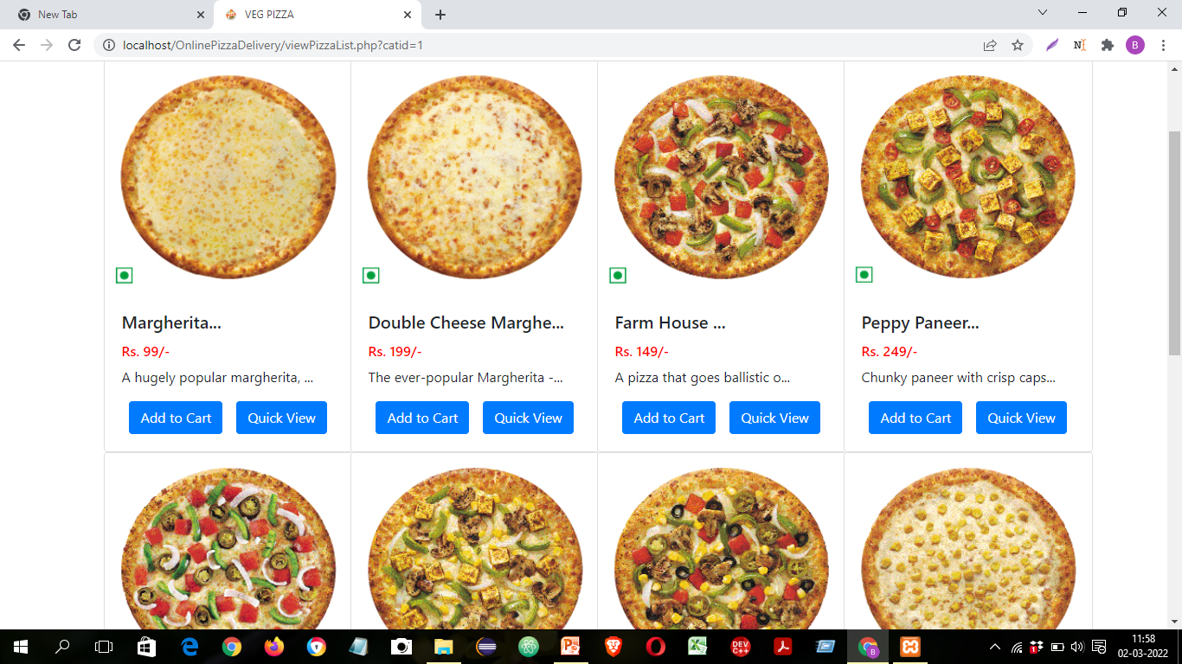
Outputs

Slide 14
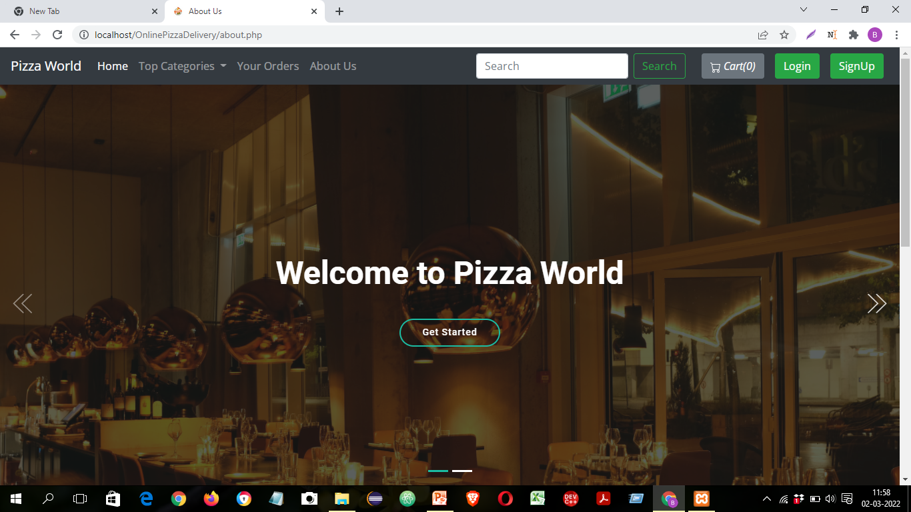
Outputs

Slide 15
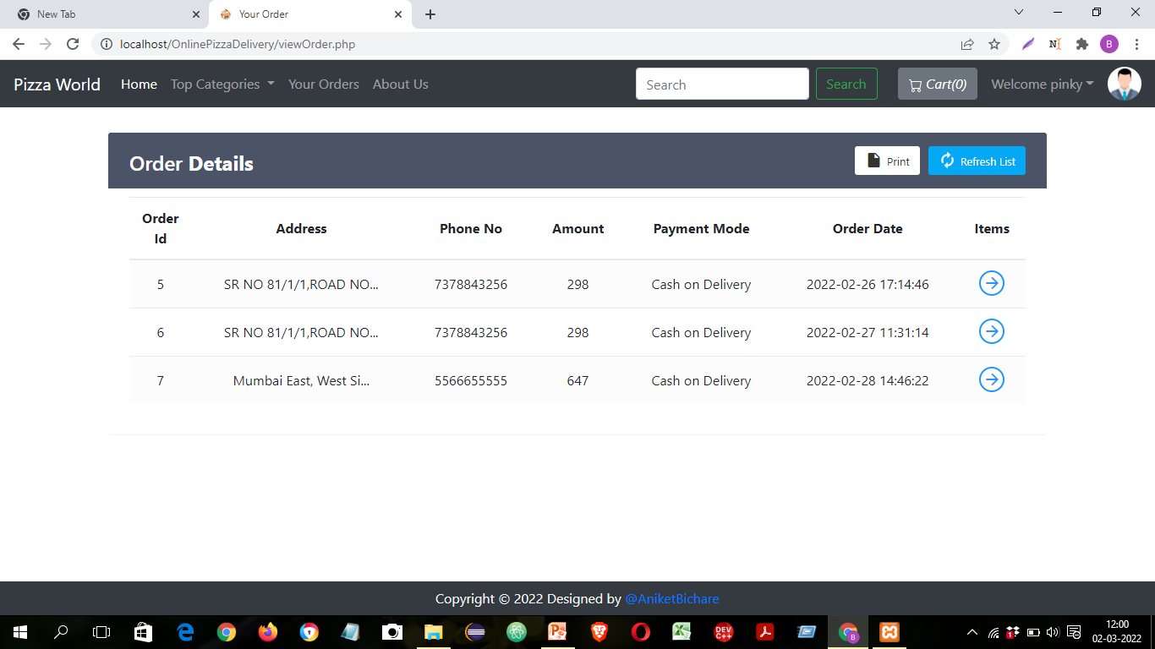
Outputs

Slide 16
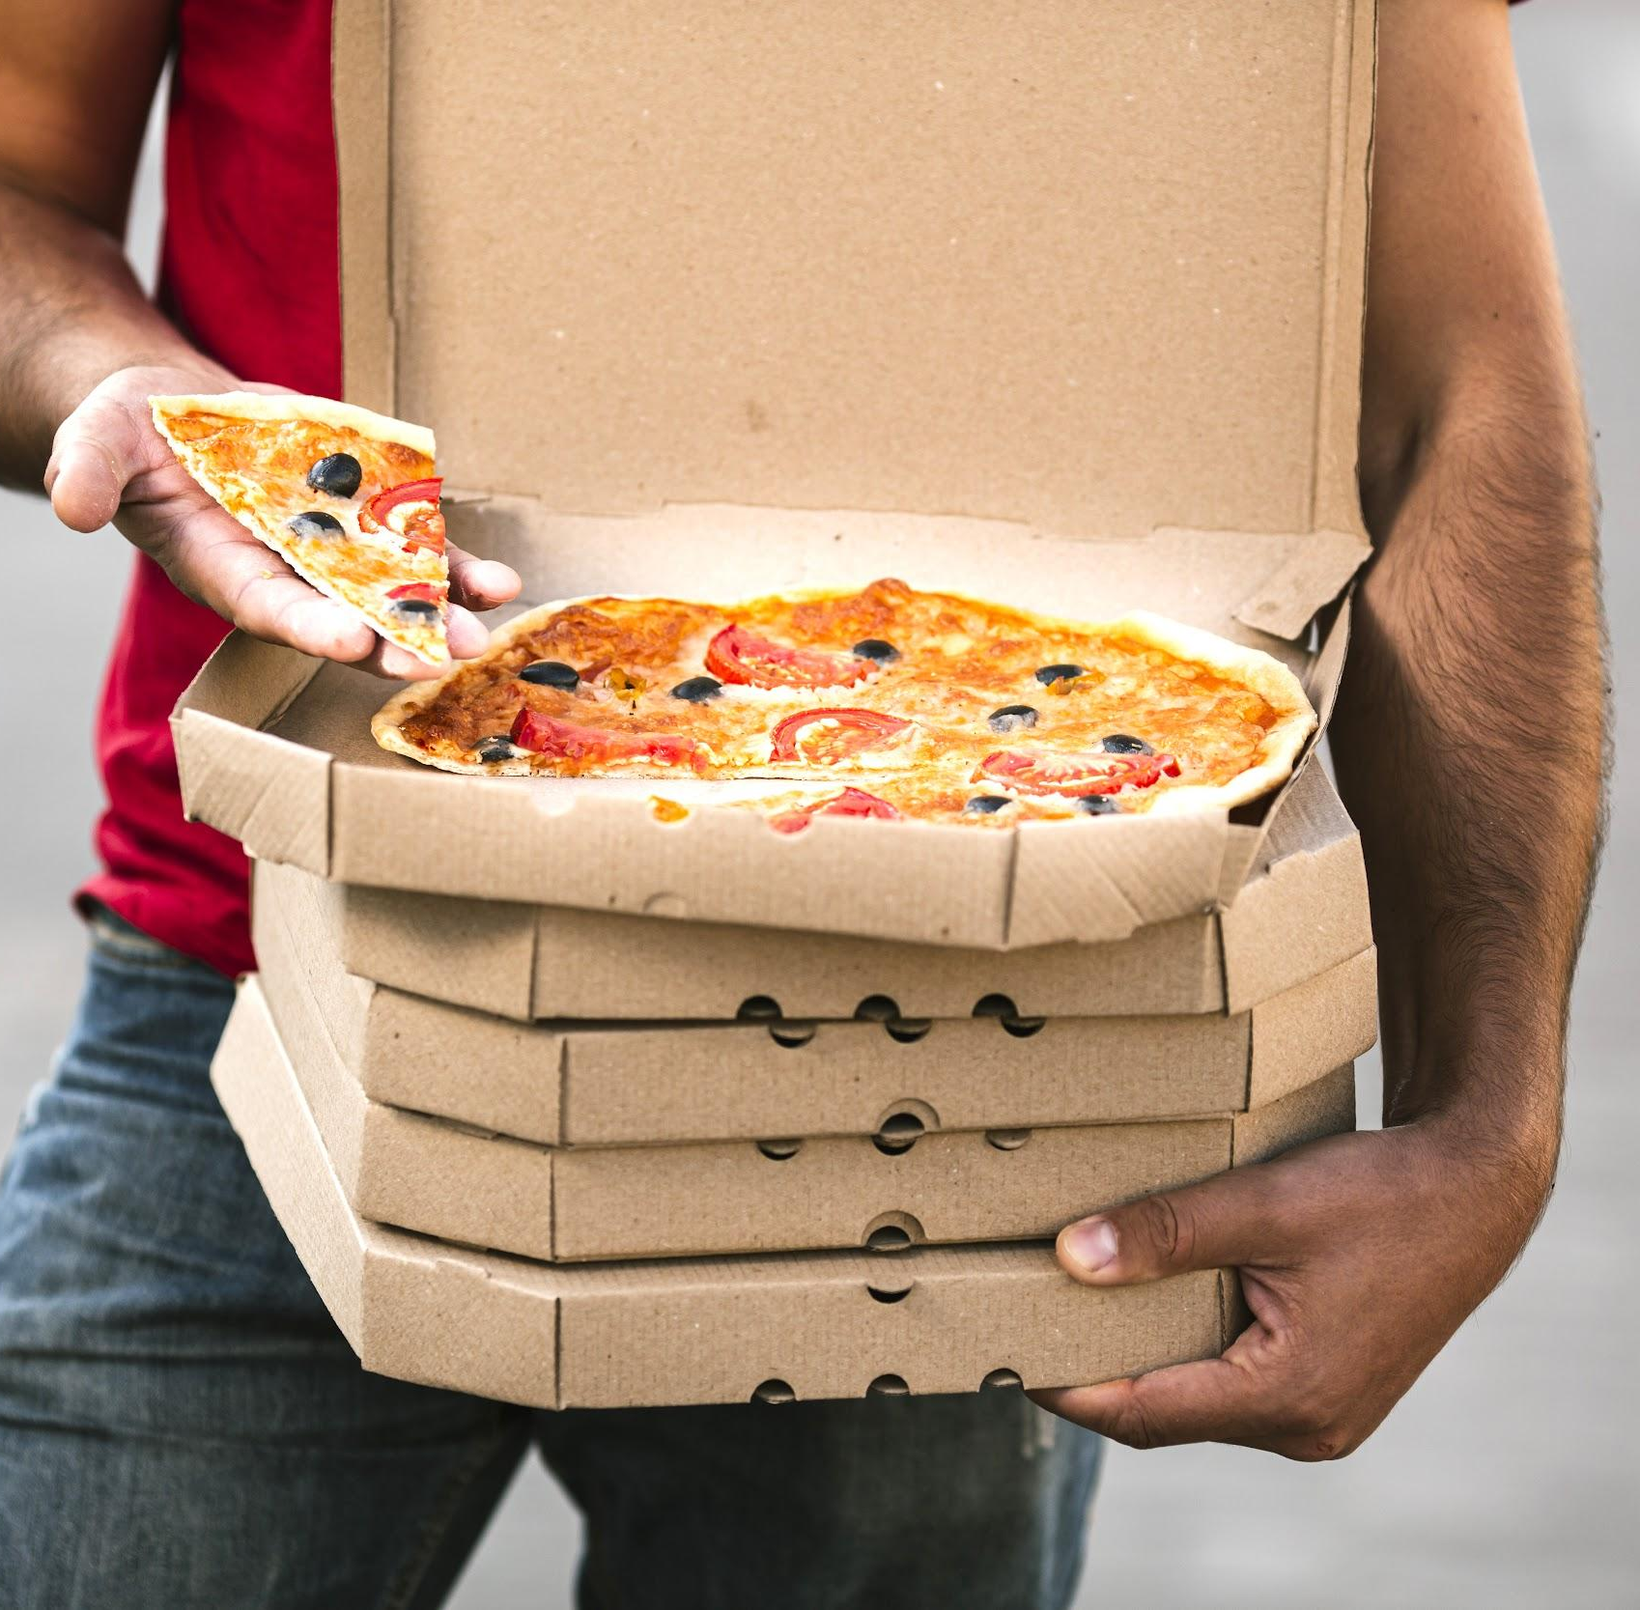
Conclusion
In conclusion, Pizza food delivery system would provide a convenient, thoughtful and reasonable way for customers to order pizza.

