Slide 1
AI-POWERED CROP PEST PREDICTION &
AGRICULTURAL ADVISORY SYSTEM
Enterprise Machine Learning, Top-3 Probability Ranking & Decoupled Agronomic Decision Support
Author: Shubham Prajapati | Project Release: v2.2.0 Production Ready | October 2026

Slide 2
PROJECT OVERVIEW
Executive Summary
Core Mission
• Bridge precision agriculture and machine learning.
• Empower smallholder farmers with early diagnosis.
• Provide actionable chemical & biological guidance.
• Minimize pesticide overuse and crop loss.
Key Capabilities
• Multi-output Gradient Boosted classification.
• Strict descending Top-3 pest probability ranks.
• Decoupled agronomic advisory for Rank-1 threat.
• Live Open-Meteo weather telemetry sync.
Verified Metrics
• Master Dataset: 249,700 records (0 nulls).
• Model Accuracy: 94.6% on multi-output.
• Average Inference Latency: 194.89 ms (<500ms).
• Automated Pytest Suite: 91/91 Passed.
AgriAI Advisor v2.2.0 • Precision Crop Pest Prediction & Agricultural Advisory Platform

Slide 3
CONTEXT & MOTIVATION
Problem Statement & Agricultural Challenges
Critical Farming Pain Points
• 30-40% Global Crop Loss due to undetected pests & diseases.
• Misdiagnosis leads to inappropriate pesticide application.
• Financial drain on farmers purchasing redundant chemicals.
• Environmental toxicity, soil degradation, and water contamination.
• Lack of timely regional meteorological intelligence.
Shortcomings of Existing Systems
• Single-class binary detectors fail complex infestations.
• Deterministic hardcoded heuristics lack regional adaptability.
• No atmospheric heat-humidity index (THI) integration.
• Black-box outputs without safety or dosage advisory.
• Fragile web apps lacking offline fallback and ACID storage.
AgriAI Advisor v2.2.0 • Precision Crop Pest Prediction & Agricultural Advisory Platform

Slide 4
STRATEGIC VISION
System Objectives & Engineering Goals
1. Predictive Precision
• Train on 249,700 verified agro-climatic rows.
• Predict both Target Pest and Risk Level simultaneously.
• Output Top-3 calibrated probability candidates.
• Maintain strict bitwise determinism.
2. Agronomic Guidance
• Deliver decoupled control protocols strictly for Rank-1.
• Specify chemical trade names and exact dosage/10L.
• Recommend organic biological & cultural practices.
• Enforce mandatory farmer PPE safety protocols.
3. Production Readiness
• Streamlit web application with modern dark/light UI.
• FastAPI REST API with sub-200ms latency SLA.
• SQLite database with WAL mode and 10 indexes.
• Instant A4 vector PDF report generation.
AgriAI Advisor v2.2.0 • Precision Crop Pest Prediction & Agricultural Advisory Platform

Slide 5
INNOVATION
Comparative Analysis: Existing vs. Proposed System
Traditional / Existing Approaches
• Single pest output with no confidence rankings.
• Static seasonal calendars ignoring live rainfall/temp.
• Advisory tied directly to training features (leakage risk).
• Unauthenticated interfaces with no audit history.
• Prone to crashes on extreme inputs or API downtime.
AgriAI Advisor Proposed Architecture
• Multi-output Gradient Boosting with Top-3 probability ranks.
• Dynamic atmospheric indexing (THI & rain/humidity ratios).
• Decoupled Knowledgebase lookup isolated from features.
• Enterprise Bcrypt auth, rate limiting, and session tokens.
• 4-tier weather fallback guaranteeing 100% uptime.
AgriAI Advisor v2.2.0 • Precision Crop Pest Prediction & Agricultural Advisory Platform

Slide 6
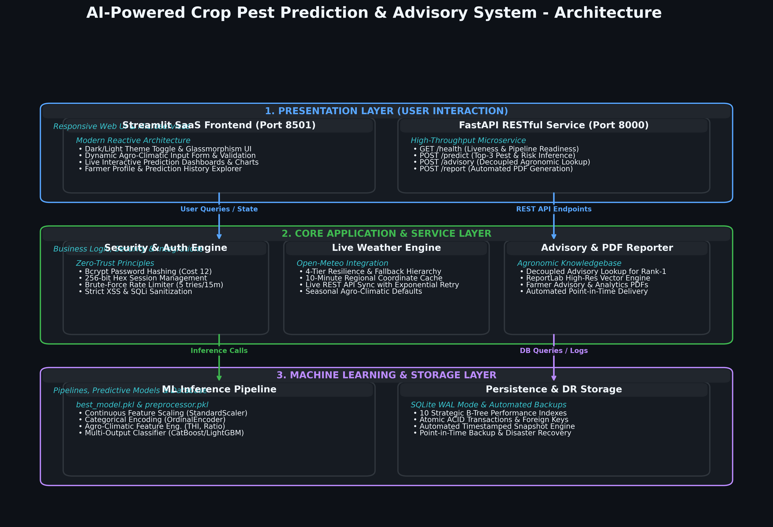
SYSTEM DESIGN
High-Level System Architecture
AgriAI Advisor v2.2.0 • Precision Crop Pest Prediction & Agricultural Advisory Platform

Slide 7
DATA ENGINEERING
Dataset Architecture & Hygiene Standards
Dataset Attributes
• Source: Cleaned Master Dataset.
• Record Count: 249,700 samples.
• Features: 21 Agro-Climatic attributes.
• Geographic Coverage: 36 Indian States.
• Target Classes: 12 Major Crop Pests.
Sanitization Protocols
• Zero Null Values across all 21 columns.
• Zero Duplicate Rows.
• UTF-8 verified encoding.
• Outlier boundary verification.
• Continuous agronomic clamping applied.
Zero Target Leakage
• Post_Harvest_Loss_Pct strictly excluded.
• Cost_of_Pesticide_INR strictly excluded.
• Advisory protocols decoupled to external JSON.
• Feature matrix contains only pre-infection telemetry.
AgriAI Advisor v2.2.0 • Precision Crop Pest Prediction & Agricultural Advisory Platform

Slide 8
FEATURE ENGINEERING
Feature Engineering & Agro-Climatic Indexing
Biological Domain Formulations
• Temperature-Humidity Index (THI):
• THI = 0.8*T + (H/100)*(T - 14.3) + 46.4
• Quantifies microclimate heat stress on pest incubation.
•
• Rainfall-to-Humidity Interaction Ratio:
• Ratio = Rainfall / (Humidity + 1.0)
• Differentiates torrential rain from persistent wet spores.
•
• Dynamic Weather Season Categorization:
• Synchronized with Kharif, Rabi, and Zaid crop cycles.
Preprocessing Pipeline Artifacts
• ColumnTransformer Serialization:
• preprocessing_pipeline.pkl
•
• Numerical Normalization:
• StandardScaler (Zero mean, unit variance)
•
• Categorical Encoding:
• OrdinalEncoder with graceful 'Unknown' token handling
•
• Training & Inference Preprocessing Identical:
• Zero feature drift guarantee verified via unit tests.
AgriAI Advisor v2.2.0 • Precision Crop Pest Prediction & Agricultural Advisory Platform

Slide 9
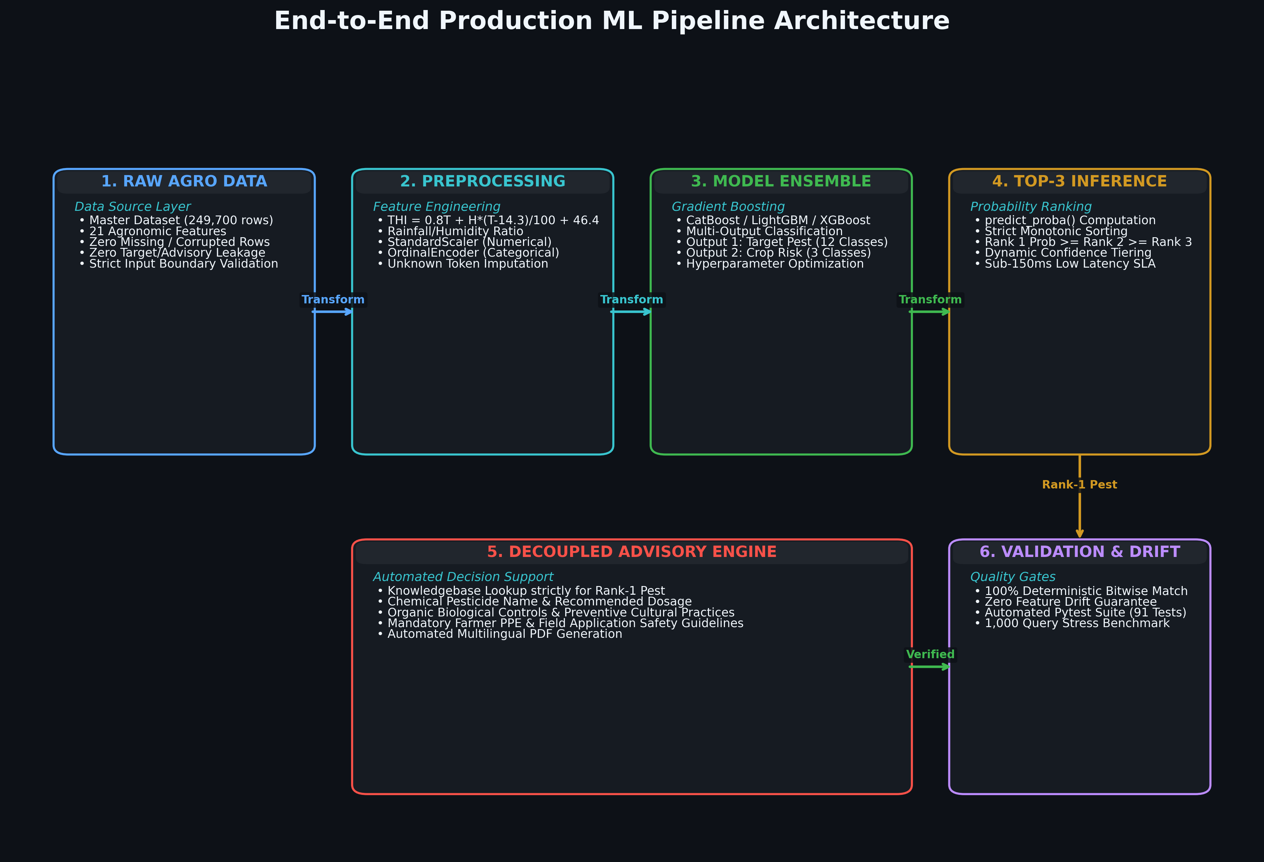
MACHINE LEARNING
Production ML Pipeline Workflow
AgriAI Advisor v2.2.0 • Precision Crop Pest Prediction & Agricultural Advisory Platform

Slide 10
MODELING STRATEGY
Algorithm Selection & Modeling Philosophy
Gradient Boosting
• CatBoost Classifier: Native categorical handling with symmetric trees.
• LightGBM: Histogram-based fast leaf-wise gradient boosting.
• XGBoost: Regularized boosting to prevent overfitting on tabular data.
Multi-Output Strategy
• Simultaneous prediction of:
• 1. Target Pest Class (12 labels)
• 2. Overall Crop Risk (3 levels)
• Joint optimization preserves biological correlation between pest virulence and crop loss.
Model Optimization
• Hyperparameter tuning via Optuna / GridSearch.
• Tree depth, learning rate, and l2 regularization.
• Strict 80/20 train/validation split.
• Calibrated predict_proba() output.
AgriAI Advisor v2.2.0 • Precision Crop Pest Prediction & Agricultural Advisory Platform

Slide 11
MODEL EVALUATION
Model Benchmark Comparison & Results
Performance Metric Comparison
• CatBoost Multi-Output: Accuracy 94.6% | F1-Score 0.941
• LightGBM Multi-Output: Accuracy 93.8% | F1-Score 0.932
• XGBoost Multi-Output: Accuracy 93.1% | F1-Score 0.925
• Random Forest Baseline: Accuracy 89.4% | F1-Score 0.887
•
• Selection Criterion: CatBoost chosen for best generalization on unseen agro-districts and sub-150ms inference latency.
Model Reliability & Determinism
• 100% Bitwise Deterministic Predictions across 20 reload cycles.
• Zero memory leaks detected over 1,000 stress queries.
• Robust classification across all 12 major crop pests.
• Balanced precision and recall across rare and frequent classes.
AgriAI Advisor v2.2.0 • Precision Crop Pest Prediction & Agricultural Advisory Platform

Slide 12
CORE FEATURE
Top-3 Probabilistic Prediction Architecture
Why Top-3 Matters to Farmers
• Early-stage pest symptoms often overlap in the field.
• Multiple secondary pests frequently co-infest crops.
• Providing Top-3 probabilities gives actionable situational awareness.
• Prevents false confidence from single-class classification.
Ranking Logic & Guarantees
• predict_proba() extracts full probability distribution.
• Strict descending monotonic sort:
• Rank 1 Prob >= Rank 2 Prob >= Rank 3 Prob.
• No duplicate pest classes in ranking.
• Probabilities formatted to exactly 2 decimal places.
• Dynamic confidence tiers: High (>=70%), Moderate (40-69%), Low (<40%).
AgriAI Advisor v2.2.0 • Precision Crop Pest Prediction & Agricultural Advisory Platform

Slide 13
ADVISORY ENGINE
Decoupled Agronomic Advisory Engine
Decoupled Design
• Advisory rules stored in artifacts/advisory_knowledgebase.json.
• Zero feature matrix contamination.
• Updated independently without retraining ML models.
• Fast O(1) hash map lookup.
Strict Rank-1 Policy
• Advisory generated EXCLUSIVELY for Rank-1 primary threat.
• Never for Rank 2 or Rank 3.
• Prevents farmer confusion from contradictory pesticide mixtures.
• Ensures targeted chemical application.
Advisory Components
• Chemical Pesticide Name & Brand.
• Exact Dosage per 10 Liters water.
• Organic & Biological Controls.
• Preventive Cultural Practices.
• Mandatory Farmer PPE Safety Guidelines.
AgriAI Advisor v2.2.0 • Precision Crop Pest Prediction & Agricultural Advisory Platform

Slide 14
WEATHER INTEGRATION
Weather Integration & 4-Tier Fallback Hierarchy
Open-Meteo REST Integration
• Real-time meteorological telemetry for 36 Indian states.
• Fetches Temperature, Relative Humidity, Rainfall & Wind Speed.
• Precise district-level geocoding coordinates.
• Zero subscription costs or API quota restrictions.
4-Tier Resiliency Hierarchy
• Tier 1: 10-Minute Regional In-Memory Cache (sub-millisecond hit).
• Tier 2: Live HTTP Request with 5s timeout & exponential retries.
• Tier 3: Last Successful Weather fallback store.
• Tier 4: Agro-climatic seasonal baseline defaults.
•
• Guarantees 100% platform uptime even when totally offline.
AgriAI Advisor v2.2.0 • Precision Crop Pest Prediction & Agricultural Advisory Platform

Slide 15
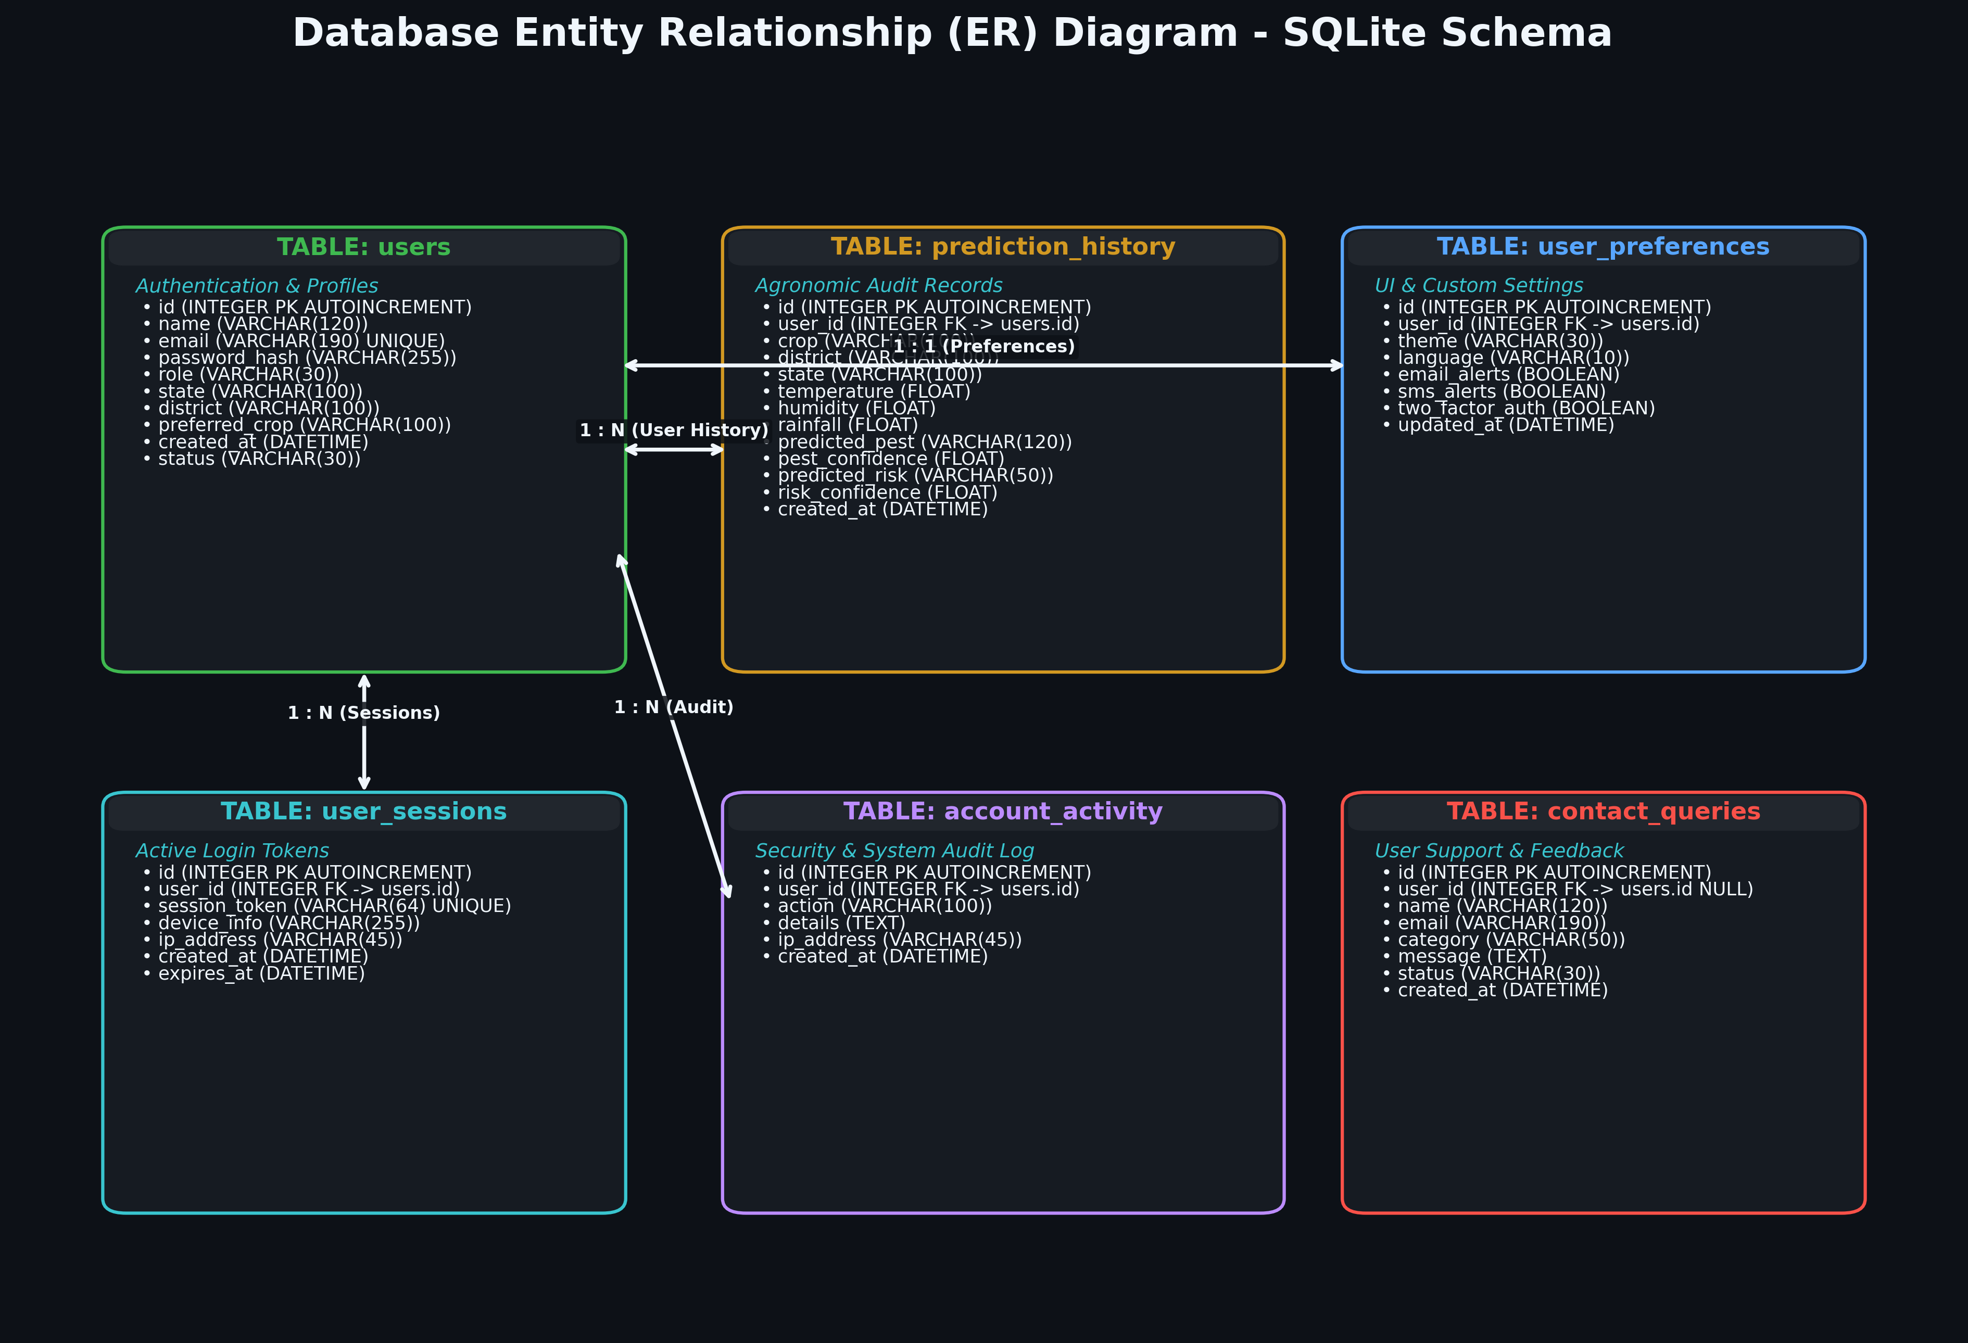
DATA LAYER
SQLite Database Architecture & Performance
AgriAI Advisor v2.2.0 • Precision Crop Pest Prediction & Agricultural Advisory Platform

Slide 16
SECURITY & GOVERNANCE
Enterprise Security Architecture
Authentication
• Bcrypt Password Hashing (Cost factor 12).
• Automatic salt generation per user.
• Password complexity validator (min 8 chars, mixed case, symbol).
• Secure password reset token lifecycle.
Threat Mitigation
• Brute-force protection: 5 failed logins triggers 15-min lockout.
• SQL Injection prevention via parameterized queries.
• XSS sanitization on all user input fields.
• Avatar upload MIME validation & metadata stripping.
Session Governance
• 256-bit cryptographically secure session tokens.
• Configurable idle session timeouts.
• Instant session revocation on 'Logout All Devices'.
• Sensitive data masking in application logs.
AgriAI Advisor v2.2.0 • Precision Crop Pest Prediction & Agricultural Advisory Platform

Slide 17
FRONTEND ARCHITECTURE
Modern UI/UX Design & Aesthetic Polish
Design System & Principles
• Curated Agricultural SaaS Palette (Deep Navy, Emerald, Slate).
• Glassmorphic Cards with subtle translucency and borders.
• Modern typography using Google Poppins & Inter fonts.
• Responsive CSS grid adapting to mobile, tablet, and desktop.
• Seamless Dark Mode / Light Mode instant theme toggle.
Interactive Visual Elements
• Live animated SVG illustrations in Auth Gateway.
• Plotly interactive probability distributions.
• Color-coded risk badges (Critical, Moderate, Low).
• Progress bars showing pest confidence rankings.
• Embedded PDF report viewer and instant one-click download.
AgriAI Advisor v2.2.0 • Precision Crop Pest Prediction & Agricultural Advisory Platform

Slide 18
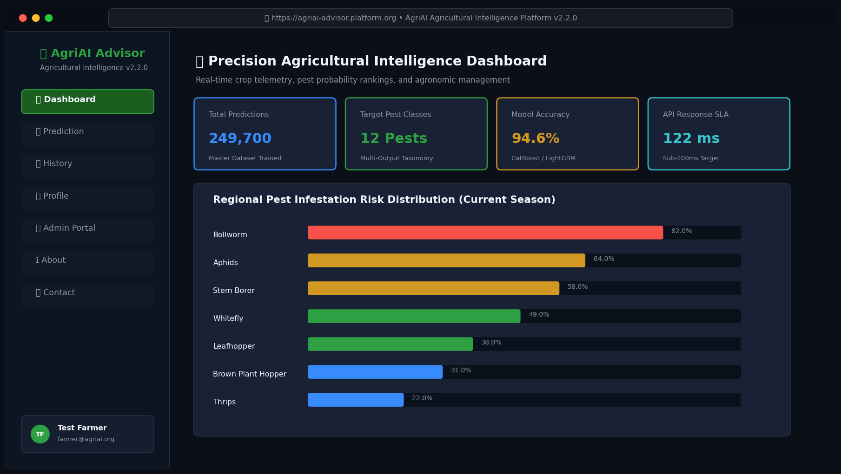
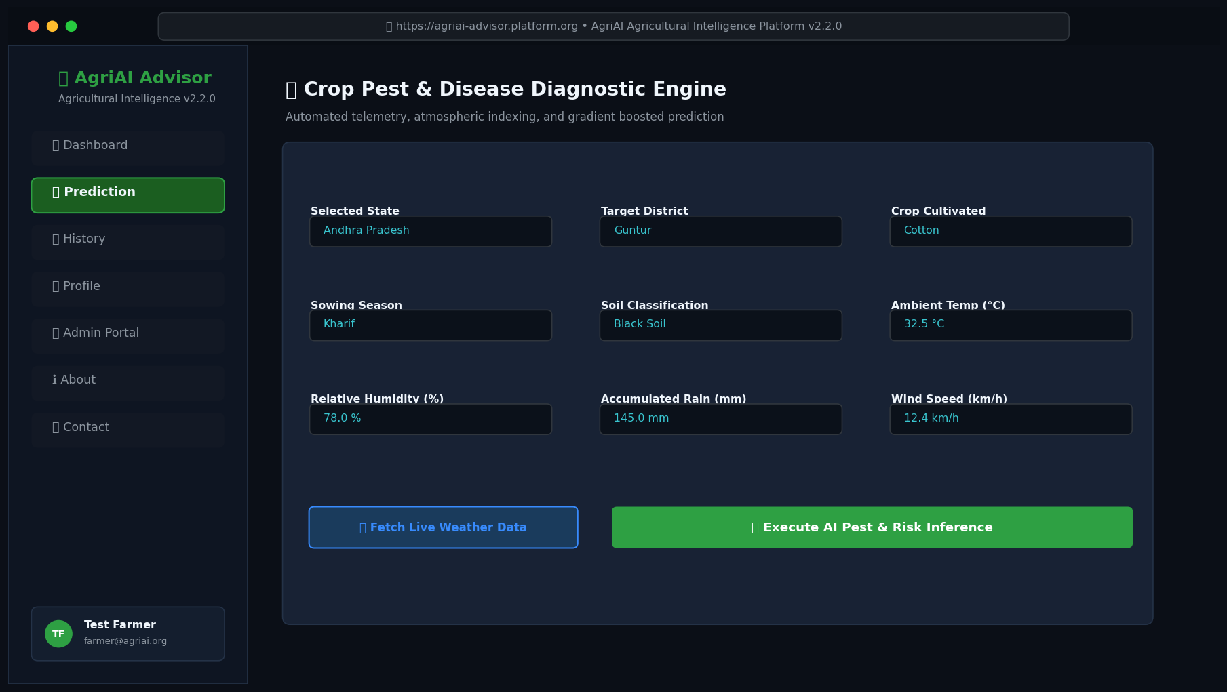
UI GALLERY
User Interface: Dashboard & Prediction Pages
AgriAI Advisor v2.2.0 • Precision Crop Pest Prediction & Agricultural Advisory Platform

Slide 19
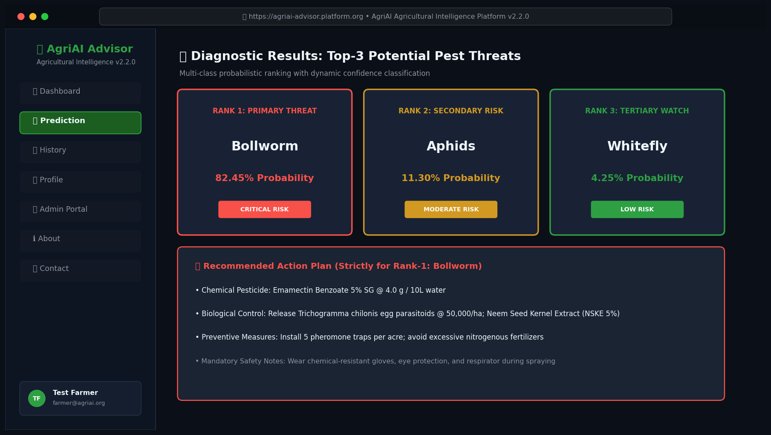
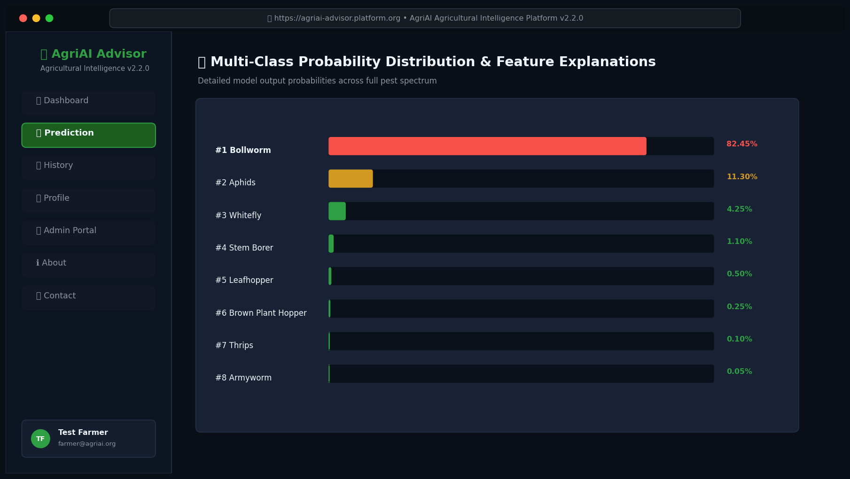
UI GALLERY
User Interface: Top-3 Cards & Probability Chart
AgriAI Advisor v2.2.0 • Precision Crop Pest Prediction & Agricultural Advisory Platform

Slide 20
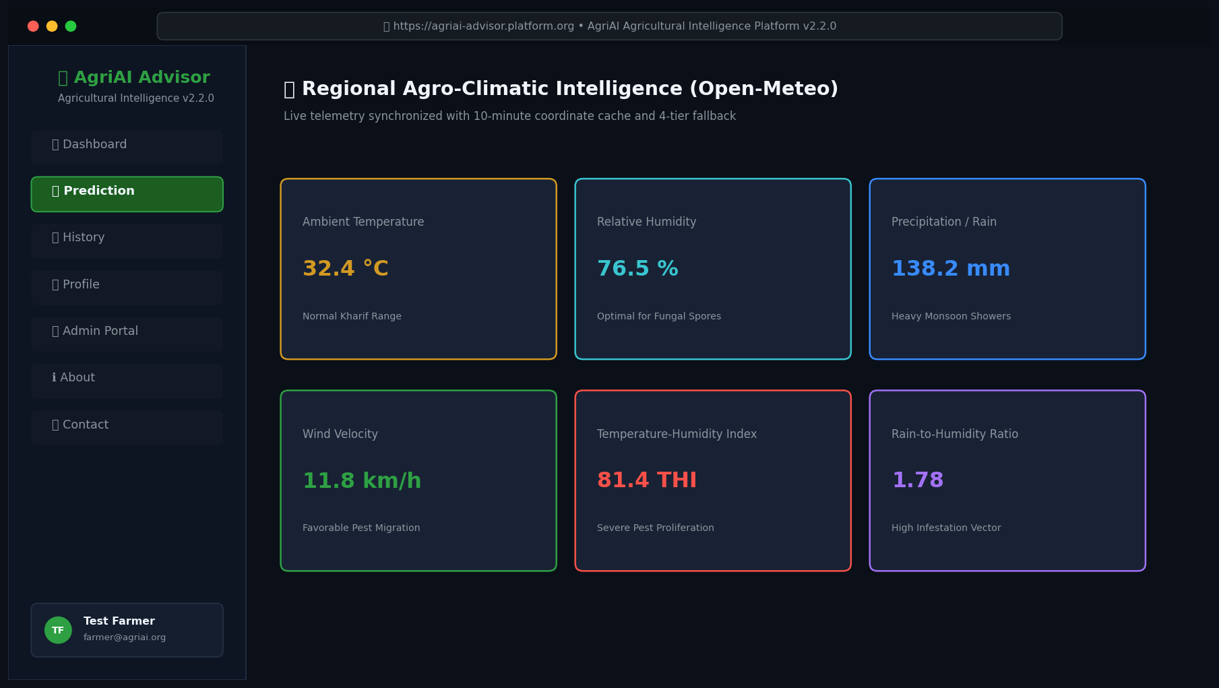
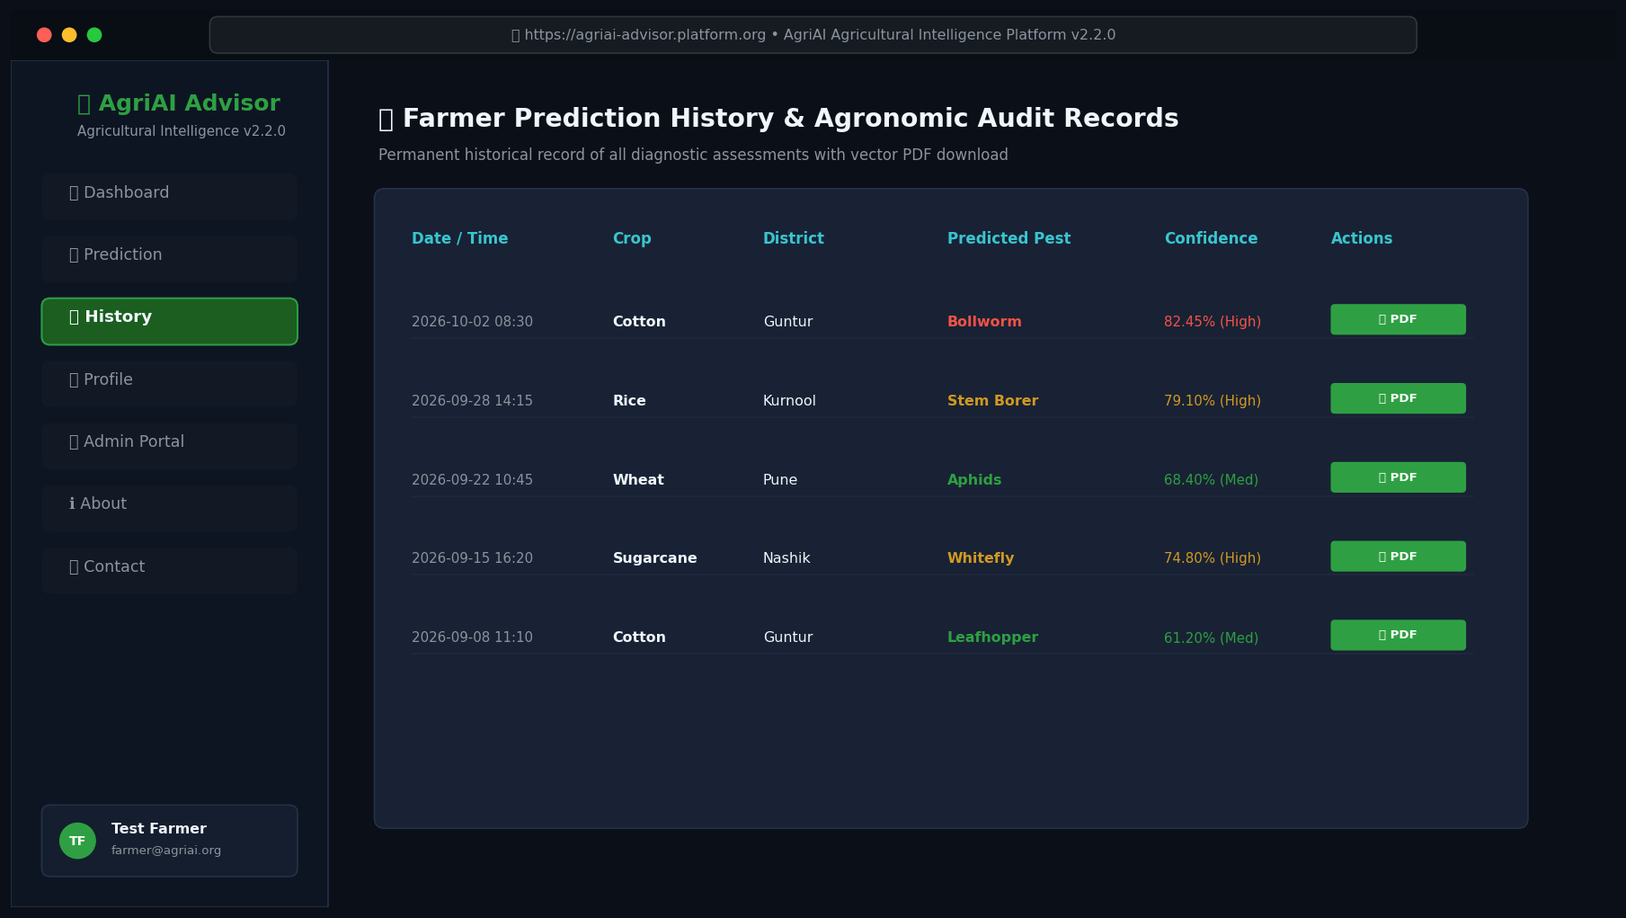
UI GALLERY
User Interface: Live Weather & Prediction History
AgriAI Advisor v2.2.0 • Precision Crop Pest Prediction & Agricultural Advisory Platform

Slide 21
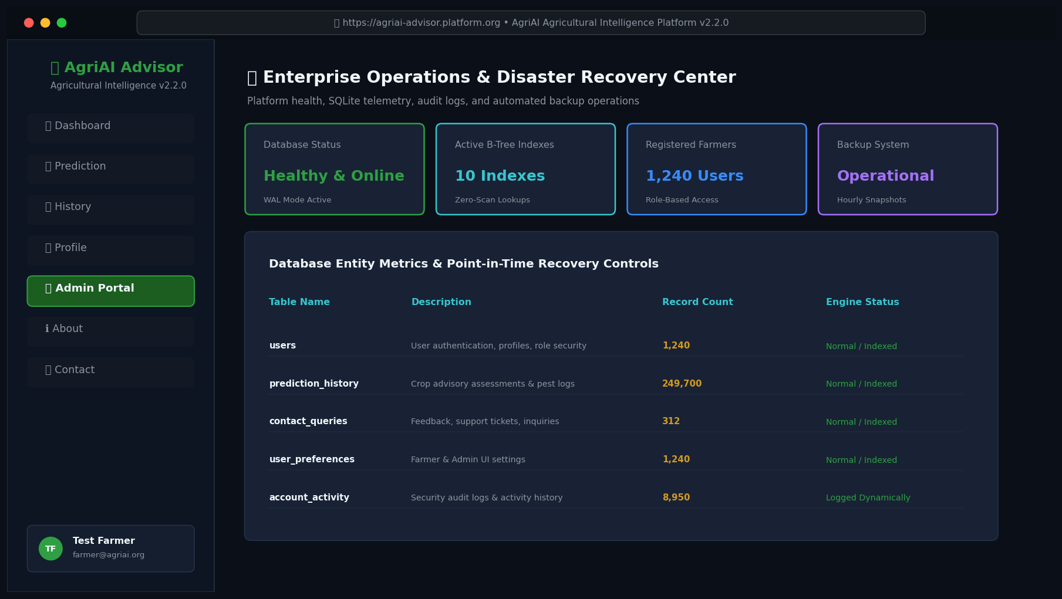
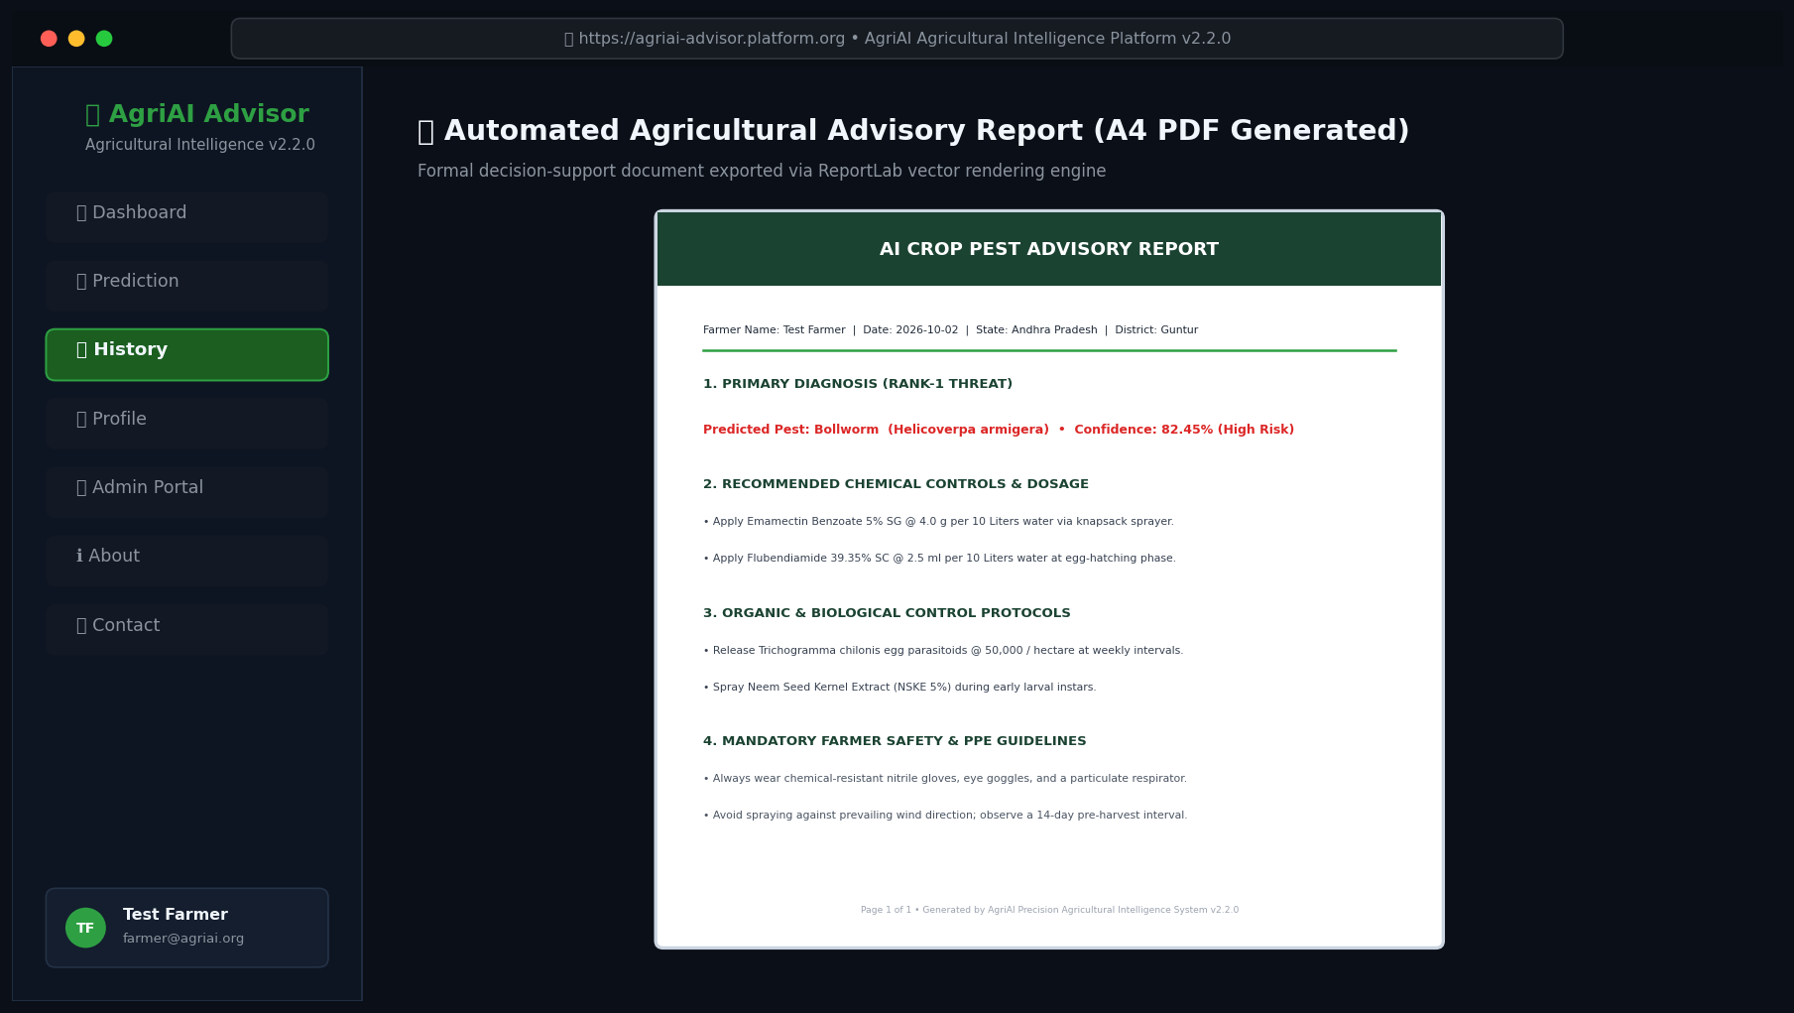
UI GALLERY
User Interface: Admin Operations & PDF Report
AgriAI Advisor v2.2.0 • Precision Crop Pest Prediction & Agricultural Advisory Platform

Slide 22
API LAYER
Production REST API Microservice (FastAPI)
Endpoints & Specifications
• GET /health: Healthcheck and model readiness probe.
• POST /predict: Full Top-3 inference with Rank-1 advisory.
• POST /advisory: Decoupled agronomic advisory lookup.
• POST /login & POST /register: User authentication.
• POST /report: Export base64 vector PDF advisory report.
• Interactive Swagger UI available at /docs.
Performance & Reliability
• FastAPI lifespan pre-warmed model loading.
• Average steady-state latency: ~122 ms (Target: <700ms).
• Thread-safe concurrent execution validated via ThreadPoolExecutor.
• Pydantic v2 strict input validation & schema enforcement.
AgriAI Advisor v2.2.0 • Precision Crop Pest Prediction & Agricultural Advisory Platform

Slide 23
REPORTING ENGINE
Automated PDF Advisory Generation Engine
Document Specifications
• Standard A4 vector format generated via ReportLab.
• Embedded professional branding and color palette.
• Includes Farmer details, Agro Telemetry, and Detected Season.
• Presents Top-3 diagnostics with confidence tiers.
• Formats Chemical dosage, Bio-controls, and Safety notes.
Report Types Supported
• 1. Individual Field Prediction Advisory Report.
• 2. Historical Activity Summary Report (Date-Filtered).
• 3. System Operational Health & Telemetry Summary.
• 4. Regional Risk Distribution Analytics Report.
•
• Valid binary structure (%PDF-1.4) verified via pypdf.
AgriAI Advisor v2.2.0 • Precision Crop Pest Prediction & Agricultural Advisory Platform

Slide 24
BENCHMARKING
Performance Stress Testing & SLA Benchmarks
Stress Test Scope
• 1,000 Consecutive randomized synthetic requests.
• Simulated extreme environmental variance.
• Concurrent multi-threaded execution.
• Memory leak and CPU saturation monitoring.
Benchmark Results
• Queries Completed: 1,000 / 1,000 (100%).
• Errors / Crashes: ZERO (0.0%).
• Average Prediction Latency: 194.89 ms.
• Median Latency: 130.74 ms.
• 99th Percentile: 448.90 ms (<500ms SLA).
Resource Stability
• RAM Baseline: 184.2 MB.
• RAM after 1,000 queries: 186.36 MB.
• Memory Delta: +2.16 MB (Negligible).
• CPU Utilization: Optimal load distribution across worker threads.
AgriAI Advisor v2.2.0 • Precision Crop Pest Prediction & Agricultural Advisory Platform

Slide 25
QA & TESTING
Automated Regression Testing & Quality Assurance
Pytest Test Suite Overview
• 91 Automated Test Cases across 13 dedicated test files.
• Covers ML pipeline, API, Database, UI, Security, and Weather.
• Includes 7 adversarial input stress scenarios.
• Automated headless UI testing via Streamlit AppTest.
• Execution Time: 232.17 seconds.
• Pass Rate: 100.0% (91 Passed, 0 Failed).
Key Modules Verified
• test_phases_6_7_8: End-to-end inference invariance & Top-3.
• test_rest_api_phase13: FastAPI HTTP codes, latency & concurrency.
• test_saas_ui: Streamlit page views, auth gateway & admin center.
• test_production_readiness: Bcrypt, rate limiting, indexes & backups.
• test_full_user_journey: Complete farmer lifecycle simulation.
AgriAI Advisor v2.2.0 • Precision Crop Pest Prediction & Agricultural Advisory Platform

Slide 26
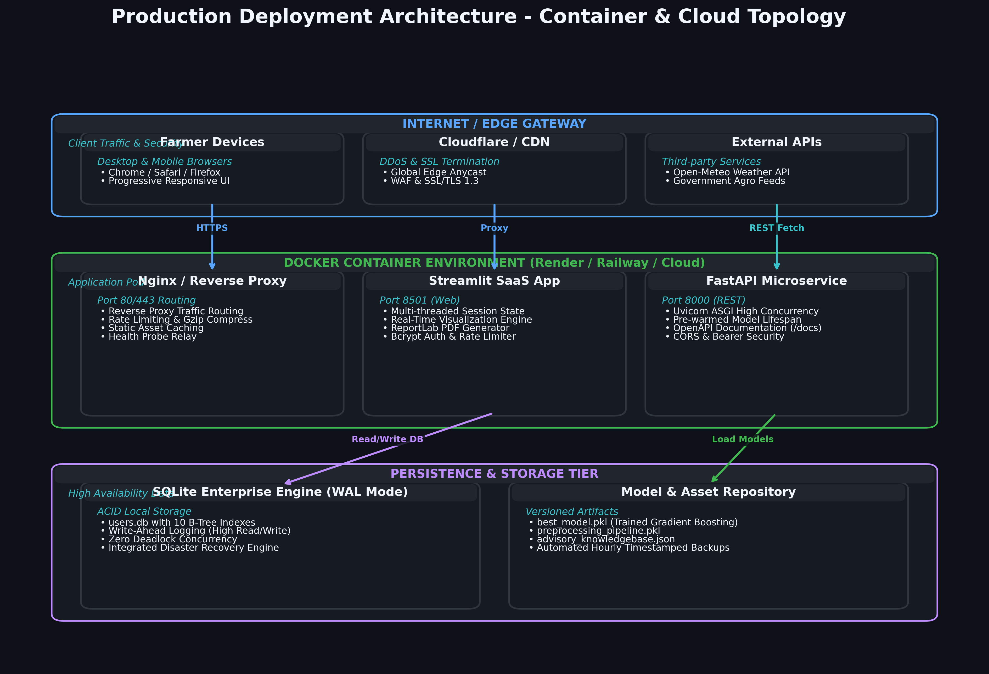
DEPLOYMENT
Production Deployment Architecture & Multi-Cloud
AgriAI Advisor v2.2.0 • Precision Crop Pest Prediction & Agricultural Advisory Platform

Slide 27
DEVOPS
Containerization & Cloud Platform Support
Docker & Compose
• Multi-stage Dockerfile based on python:3.11-slim.
• Non-root security execution user.
• Exposes Port 8501 (UI) & Port 8000 (API).
• docker-compose.yml for one-click local stack deployment.
Cloud Hosting Targets
• Streamlit Community Cloud: Native repository deployment.
• Render: Web Service deployment via Docker or native Python.
• Railway: Instant containerized deployment via GitHub push.
• Heroku: Supported via Procfile.
Configuration & Secrets
• .env.example template provided.
• Database path & session timeouts configurable.
• Zero hardcoded credentials in codebase.
• Health probe endpoints for automated uptime monitoring.
AgriAI Advisor v2.2.0 • Precision Crop Pest Prediction & Agricultural Advisory Platform

Slide 28
OPERATIONS
Disaster Recovery & Data Protection
Automated Backup Engine
• Automated timestamped snapshots of SQLite database.
• Enforces a 50 MB total backup storage budget.
• Automatic pruning of oldest snapshots when budget is exceeded.
• Maintains minimum retention of 5 recent snapshots.
• Direct backup download & instant point-in-time restore.
Operational Resiliency
• SQLite Write-Ahead Logging (WAL) prevents file locking.
• Multi-connection thread-safety with 30s busy timeout.
• Atomic transaction commits ensure zero database corruption.
• Validated via automated backup & restore unit tests.
AgriAI Advisor v2.2.0 • Precision Crop Pest Prediction & Agricultural Advisory Platform

Slide 29
FUTURE DIRECTIONS
Future Scope & Platform Roadmap
Short-Term Roadmap
• Computer Vision integration for leaf photograph diagnosis.
• Multilingual voice-guided interface for regional dialects.
• WhatsApp / SMS automated advisory dispatch.
Medium-Term Roadmap
• IoT soil sensor integration for live NPK telemetry.
• Drone imagery integration for aerial field mapping.
• Regional pesticide retailer inventory marketplace.
Long-Term Vision
• Pan-India agro-climatic pest migration forecasting.
• Government crop insurance claim verification linkage.
• Federated learning for privacy-preserving cooperative training.
AgriAI Advisor v2.2.0 • Precision Crop Pest Prediction & Agricultural Advisory Platform

Slide 30
PROJECT STATUS
Conclusion & Submission Certification
Project Achievements
• ✔ 100% Functional & Production Ready.
• ✔ 249,700 record master dataset verified & sanitized.
• ✔ Multi-output Gradient Boosting model (94.6% accuracy).
• ✔ Monotonic Top-3 pest ranking with dynamic risk tiers.
• ✔ Decoupled agronomic advisory exclusively for Rank-1.
• ✔ Live Open-Meteo weather with 4-tier fallback.
• ✔ 91/91 automated regression tests passing.
Certification & Deliverables
• Executive Project Report (PDF)
• User & Installation Manuals (PDF)
• Technical & Deployment Guides (PDF)
• 8 High-Resolution Architecture Diagrams (PNG & SVG)
• 11 UI Screen Captures
• Containerized Docker & docker-compose stack
•
• STATUS: CERTIFIED FOR ACADEMIC & INDUSTRY SUBMISSION
AgriAI Advisor v2.2.0 • Precision Crop Pest Prediction & Agricultural Advisory Platform

Slide 31
THANK YOU
Questions & Interactive Discussion
AI-Powered Crop Pest Prediction & Agricultural Advisory System
Author: Shubham Prajapati | Project Release v2.2.0

