Slide 1
Spatial Filtering
Experiment - 3
Image Processing Laboratory (EC69502)

Slide 2
What is Spatial Filtering
Name Filter Is Borrowed From Frequency Domain Processing
where “filtering” refers to passing, modifying, or rejecting specified components of an image
For example, a filter that passes low frequencies is called a lowpass filter. The net effect produced by a lowpass filter is to smooth an image by blurring it.
We can accomplish similar smoothing directly on the image itself by using spatial filters.
Image filtering is used to:
Remove noise
Sharpen contrast
Highlight contours
Detect edges

Slide 3
The Mechanics Of Linear Spatial Filtering Convolution Operation
W(-1 ,-1) | W(-1 ,0) | W(-1 ,1)
W(0 ,-1) | W(0,0) | W(0 ,1)
W(1 ,-1) | W(0 ,1) | W(1 ,1)
f(x-1,y-1) | f(x-1,y) | f(x-1,y+1)
f(x,y-1) | f(x,y) | f(x,y+1)
f(x+1,y-1) | f(x,y+1) | f(x+1,y+1)
$$g\left(x,y\right)=w\left(−1,−1\right)f\left(x−1,y−1\right)+w\left(−1,0\right)f\left(x−1,y\right)+$$
$$w\left(0,0\right)f\left(x,y\right)⋯⋯+w\left(1,1\right)f(x+1,y+1)$$

Slide 4
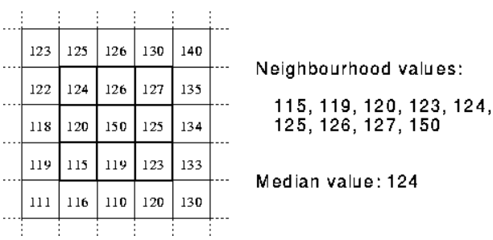
Non-Linear Spatial Filtering
This operation also consist of moving the filter mask from pixel to pixel in an image.
However the filtering operation is based conditionally on the values of the pixels in the neighbourhood.
They do not explicitly use the coefficients of filter in the sum of products manner
Median Filtering
Median filter considers each pixel in the image in turn and modifies the pixel by simply replacing the pixel value with the median of neighbouring pixel values.

Slide 5
Spatial Filtering
Spatial Filters can be classified by effect into two categories:
Smoothing Spatial Filter: also some times called as lowpass filter
Averaging Linear filter.
Order statistics non linear filter.
Sharpening Spatial Filter: also some times called as highpass filter.
For example: Gradient based filters, laplacian filters etc.

Slide 6
Smoothing Filter Example

Slide 7
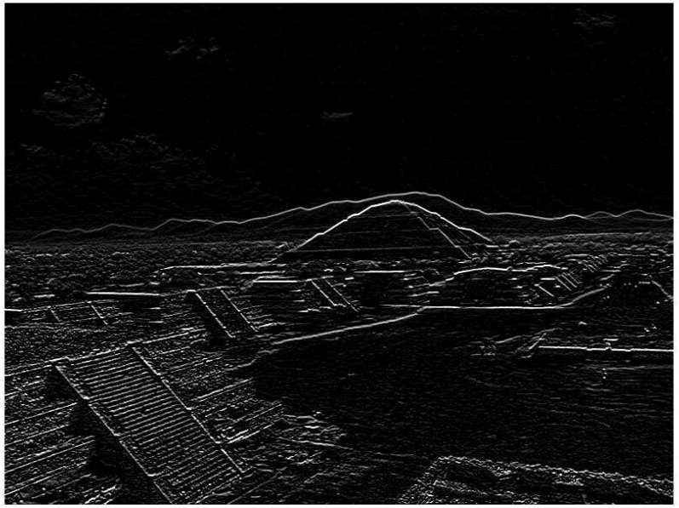

Sharpening Filter Example
Original Image
$$Edges$$

Slide 8
Mean
Gaussian
Median
Prewitt
Sobel kernels (horizontal, vertical, diagonal)
Laplacian
Laplacian of Gaussian
You will be given a stack of grayscale images (including noisy images and normal images).
Use the OpenCV tracker (slider) functionality to show outputs for varying sizes of neighbourhoods. You may have different sliders to select (i) Image (ii) Filter (iii) Neighbourhood size (3x3, 5x5, 7x7 and 9x9)

Slide 9
Thank You

