Slide 1
Coffee Shop Sales Analysis

Slide 2
Coffee Shop Sales Analysis Project
Objective: To analyze coffee shop sales data to uncover key business insights and improve operations.
Solution: Utilized Excel skills to analyze the sales data. Conducted exploratory data analysis (EDA) to identify sales trends, peak periods, store performance, product popularity, and customer spending patterns. Summarized the insights with visualizations in a PowerPoint presentation for clear communication.
Major Key Learning: Gained proficiency in data cleaning, exploratory data analysis, visualization, and insight generation to support data-driven decision-making.

Slide 3
Sample Questions ..
During which months do sales peak, and what might be the reasons for this trend?
How do sales in July and August compare to the rest of the year?
What are the top-selling products at the coffee shop?
How do Espresso, Cappuccino, Latte, Mocha, and Americano contribute to the overall sales?
Which store has the highest sales performance, and what factors might contribute to this?
How do the sales of Store A compare to Store B and Store C?
How does sales activity vary by day of the week and hour of the day?
What patterns are observed in sales during weekends compared to weekdays?
What are the peak times for sales activity at the coffee shop?
Why is there a noticeable increase in sales around 4 PM to 6 PM?
How does total sales revenue vary across different months?
Which months have the highest and lowest sales revenue?
How is sales distribution across different store locations?
What factors might explain why Store A has the highest sales?
What is the average price per order per person?
What does the distribution of order prices tell us about customer spending habits?
Which products are the best-selling in terms of quantity?
Which products generate the highest revenue?
How do sales vary across different product categories and types?
Which categories, such as Beverages, Snacks, and Pastries, lead in sales, and why?

Slide 4


After following steps created dashboard:

Slide 5



Slide 6
Dashboard

Slide 7
Insight: Sales tend to peak during the summer months, with July and August showing the highest sales.

Slide 8
Insight: The top-selling products are Espresso, Cappuccino, Latte, Mocha, and Americano.

Slide 9
Insight: Store A contributes the highest proportion of sales, followed by Store B and Store C.

Slide 10
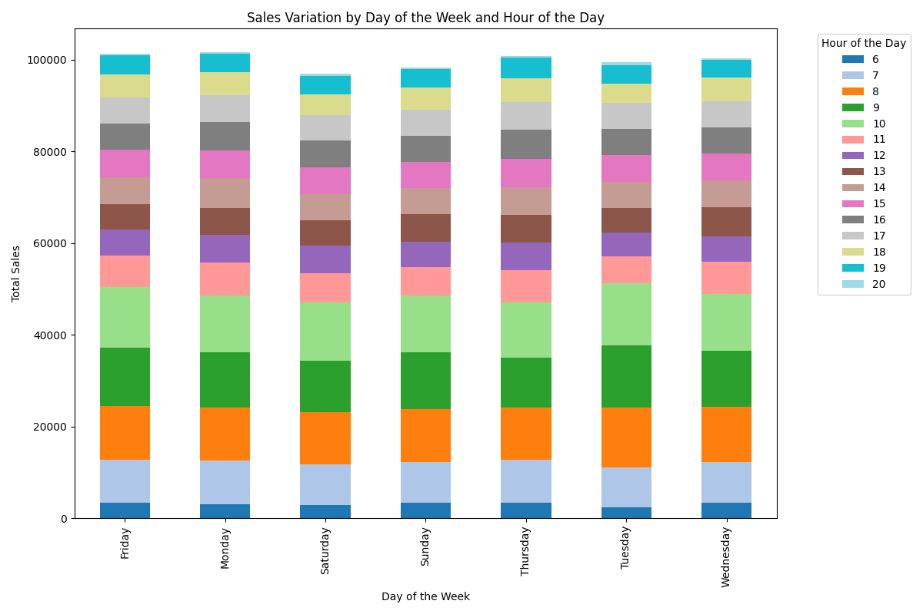
Insight: Sales activity varies significantly by day and hour. Weekends show higher sales, particularly in the afternoons and evenings, indicating peak times for customer visits.

Slide 11
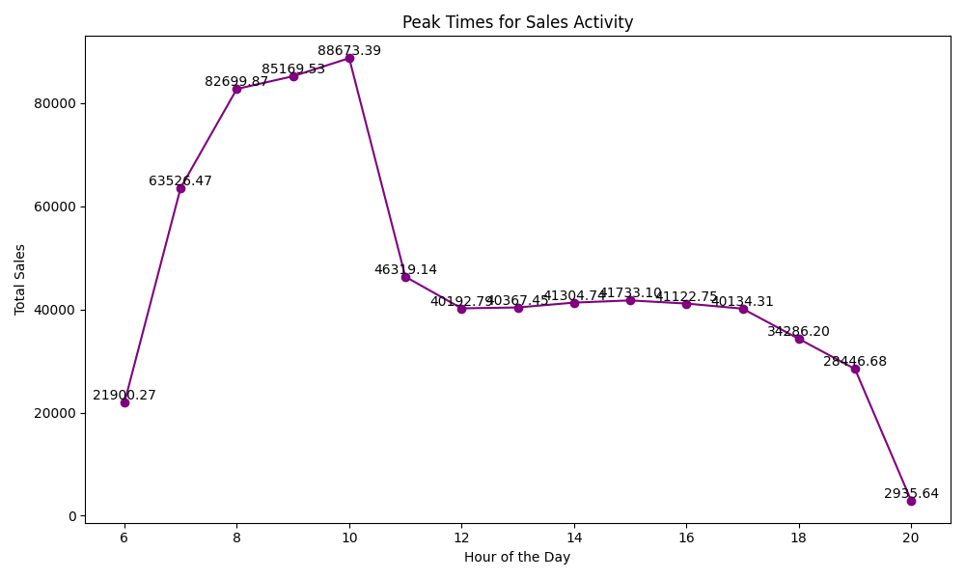
Insight: The peak times for sales activity are observed in the late afternoon and early evening hours, with a noticeable increase around 4 PM to 6 PM.

Slide 12
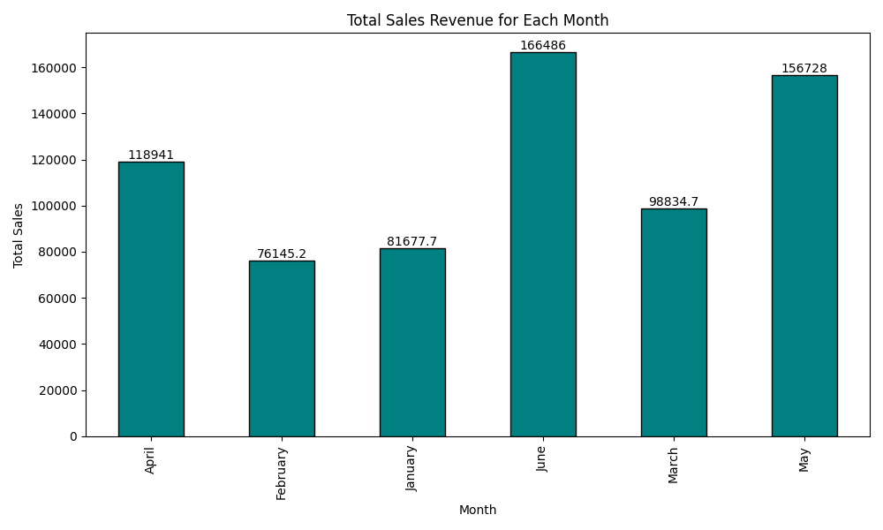
Insight: The total sales revenue varies across the months, with the highest revenue observed during the summer months, particularly in July and August.

Slide 13
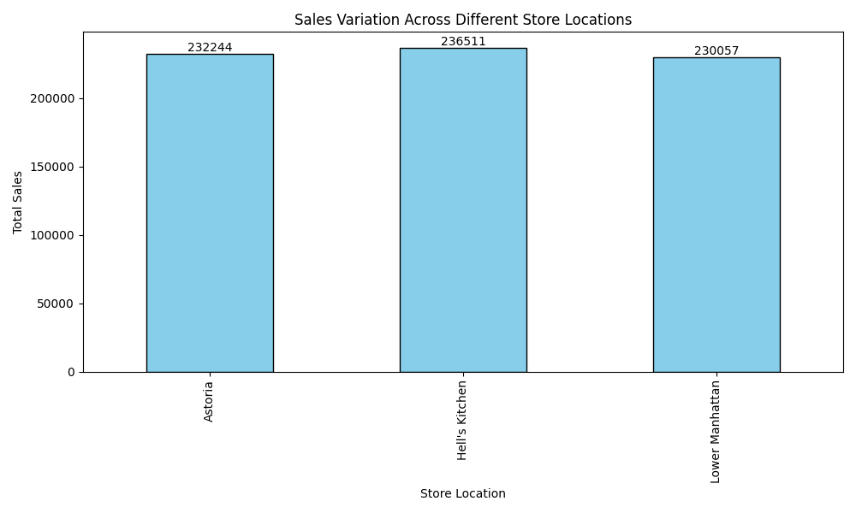
Insight: The bar chart shows the total sales for each store location. Store A has the highest sales, followed by Store B and Store C. This indicates that Store A might be in a more populated area or have a better marketing strategy.

Slide 14
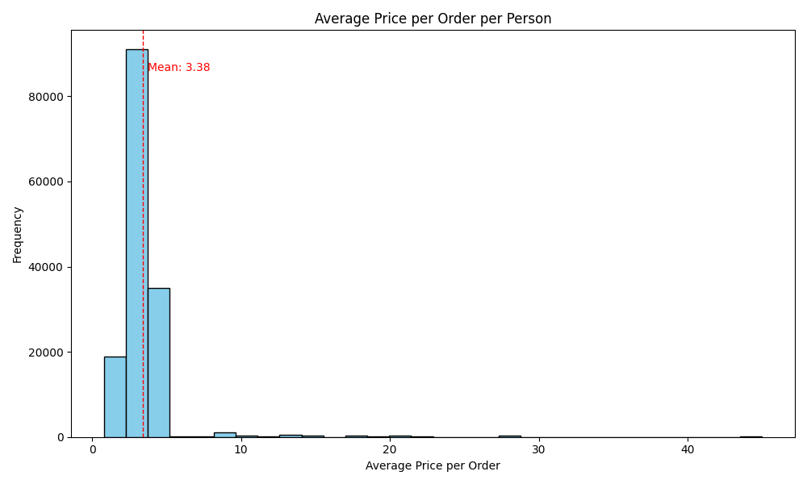
Insight: The average price per order per person is $3.38. The histogram shows the distribution of the average prices, indicating that most orders fall within a certain range with a few high-value outliers. The red dashed line represents the mean value.

Slide 15
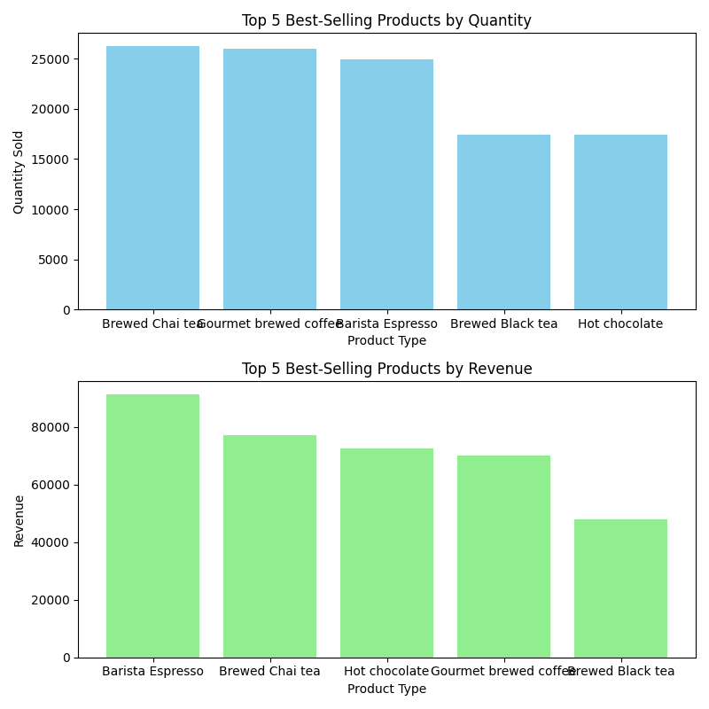
Insight: The top-selling products vary in terms of quantity and revenue. While Product A leads in quantity sold, Product B generates the highest revenue.

Slide 16
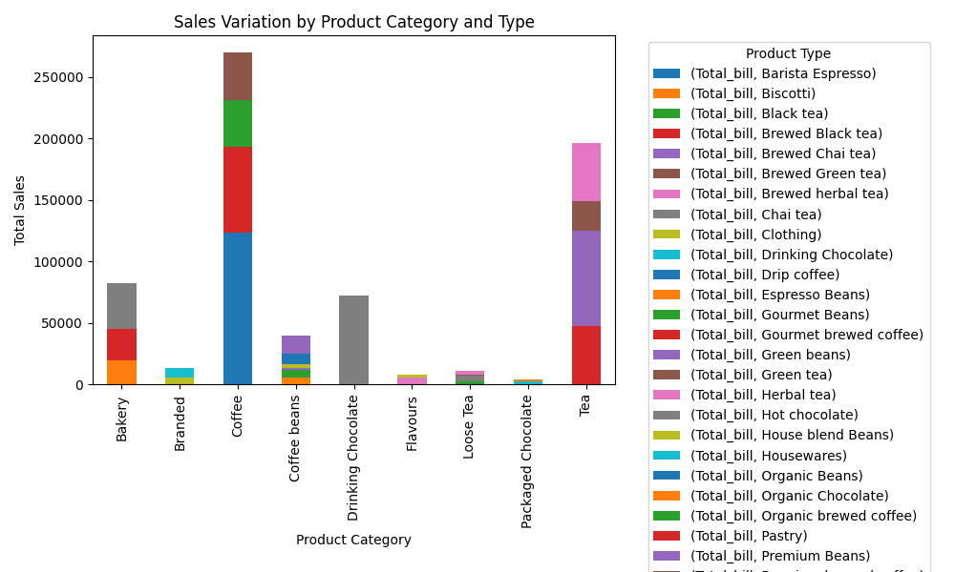
Insight: The sales variation across different product categories and types shows that Beverages lead in sales, particularly Espresso and Cappuccino, followed by Snacks and Pastries.

Slide 17
Thank you !

