Slide 1
ASP.NET Web Controls

Slide 2
Redirection
ASP.Net provides two options to redirect to new page
Response.Redirect Method
Server.Transfer Method

Slide 3
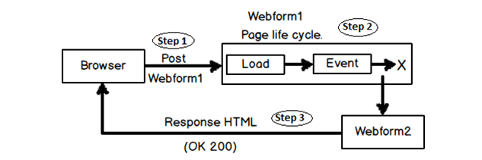
Server.Transfer

Slide 4
Server.Transfer
User sends a request to an ASP.NET page. In the below figure the request is sent to “WebForm1” and we would like to navigate to “Webform2”.
Server starts executing “Webform1” and the life cycle of the page starts. But before the complete life cycle of the page is completed “Server.transfer” happens to “WebForm2”.
“Webform2” page object is created, full page life cycle is executed and output HTML response is then sent to the browser.

Slide 5
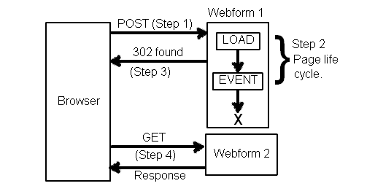
Response.Redirect

Slide 6
Response.Redirect
Client (browser) sends a request to a page. In the below figure the request is sent to “WebForm1” and we would like to navigate to “Webform2”.
Life cycle of “Webform1” starts executing. But in between of the life cycle “Response.Redirect” happens.
Now rather than server doing a redirect , he sends a HTTP 302 command to the browser. This command tells the browser that he has to initiate a GET request to “Webform2.aspx” page.
Browser interprets the 302 command and sends a GET request for “Webform2.aspx”.

Slide 7
Page Class
Every web page is a custom class that inherits from System.Web.UI.Page.
By inheriting from this class, your web page class acquires a number of properties and methods that your code can use.

Slide 8
Page class properties
IsPostBack
EnableViewState
Cache
Request
Response
User

Slide 9
Page Directives
Page directives are the most commonly used directives, and are used to edit a wide variety of settings that control how the page parser and page compiler work.
@ Page language="c#" Codebehind="WebForm1.aspx.cs" AutoEventWireup="false" Inherits="TestWebApp.WebForm1"

Slide 10
Attributes
Language : indicates the language in which the inline script code within the ASP.NET page is written.
Codebehind : indicates the name of the file being used as the code supporting this ASP.NET page.
Inherits :indicates a qualified class from which this ASP.NET page should inherit.
AutoEventWireup : is a Boolean attribute that indicates whether the ASP.NET pages events are auto-wired.

Slide 11
ASP.NET Web Controls

Slide 12
Introduction
With Classic ASP it is impossible to separate executable code from the HTML itself. This makes the page difficult to read, and difficult to maintain.
ASP.NET has solved the problem described above with server controls.

Slide 13
There are three kinds of server controls:
HTML Server Controls - Traditional HTML tags
Web Server Controls - New ASP.NET tags
Validation Server Controls - For input validation

Slide 14
HTML Server Controls
HTML server controls are HTML tags understood by the server.
HTML elements in ASP.NET files are, by default, treated as text. To make these elements programmable, add a runat="server" attribute to the HTML element.

Slide 15
This attribute indicates that the element should be treated as a server control.
The id attribute is added to identify the server control.
The id reference can be used to manipulate the server control at run time.

Slide 16
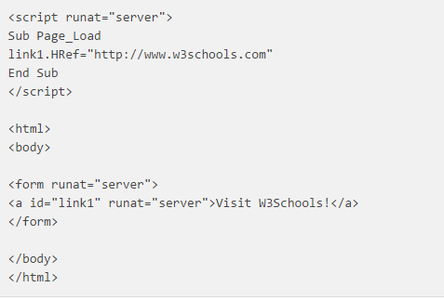
Example

Slide 17
Web Server Controls
Web server controls are special ASP.NET tags understood by the server.
Like HTML server controls, Web server controls are also created on the server and they require a runat="server" attribute to work.
However, Web server controls do not necessarily map to any existing HTML elements and they may represent more complex elements.

Slide 18
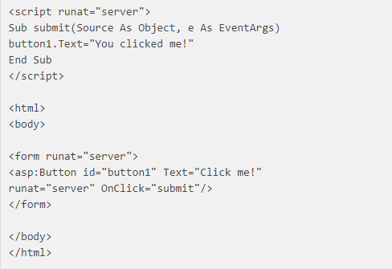
Example

Slide 19
Validation Server Controls
Validation server controls are used to validate user-input. If the user-input does not pass validation, it will display an error message to the user.
Each validation control performs a specific type of validation (like validating against a specific value or a range of values).

Slide 20
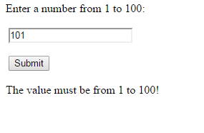
Validation Example

Slide 21
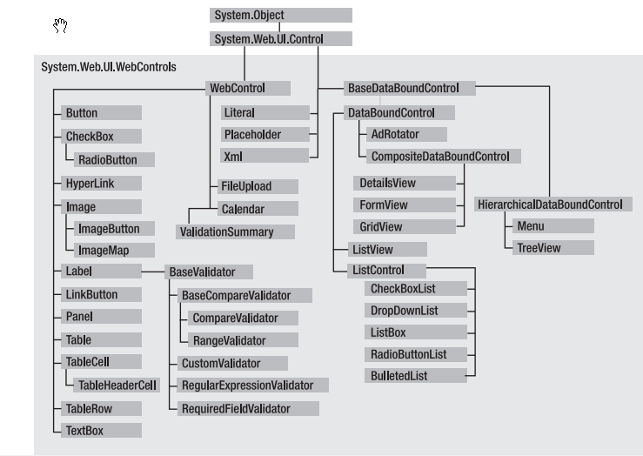
Web Control Classes

Slide 22
Web Control Properties
ID
Height,Width
Font
ToolTip
Visible

Slide 23
Properties and Methods
Properties relate to characteristics of control such as Id, Color, Height, Width etc.
Methods are used to react to specific event for example button click or text change in a text box.

Slide 24
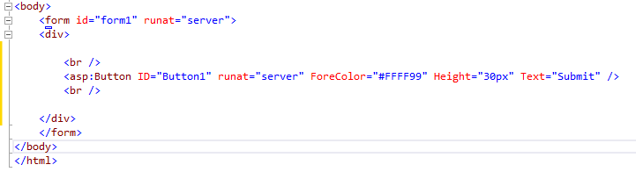
Example

Slide 25
Web Controls
Lable
Button
TextBox
Hyperlink, Linkbutton
Image, Imagebutton
Checkbox
Radiobutton

Slide 26
Web Controls
Drpdownlist
Listbox
Panel
Table

Slide 27
Label
Represents a label control, which displays text on a Web page.
To set Text :
Label1.Text=“Hello”

Slide 28
Button
The Button control is used to display a push button. The push button may be a submit button or a command button.
A submit button does not have a command name and it posts the page back to the server when it is clicked.
A command button has a command name and allows you to create multiple Button controls on a page.

Slide 29
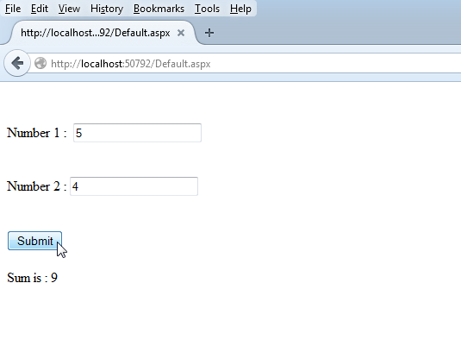
Example (Submit)

Slide 30
Button Event
<asp:Button ID="Button1" runat="server" OnClick="Button1_Click1" Text="Submit" />

Slide 31
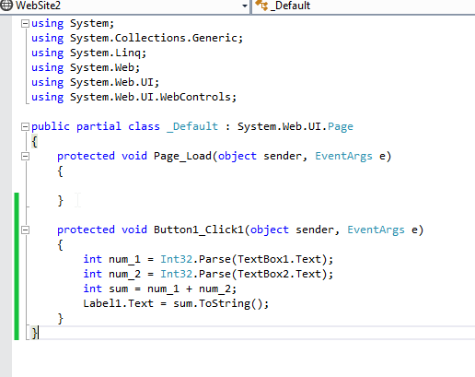
Code file

Slide 32
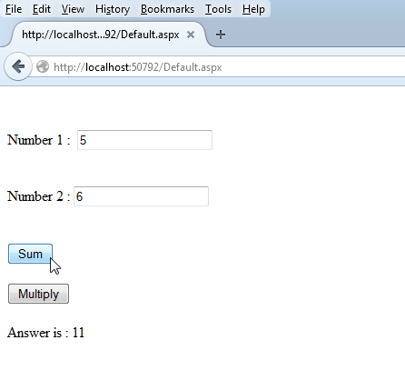
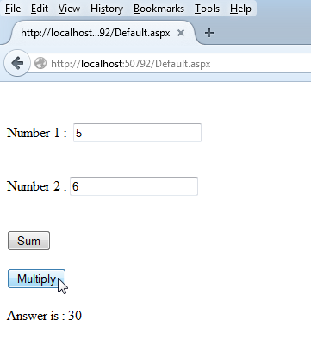
Example(Command)

Slide 33
Example
<asp:Button ID="Button1" runat="server" OnCommand="Button_Command" CommandArgument="sum" Text="Sum" />
<asp:Button ID="Button2" OnCommand="Button_Command" CommandArgument="mul" runat="server" Text="Multiply" />

Slide 34
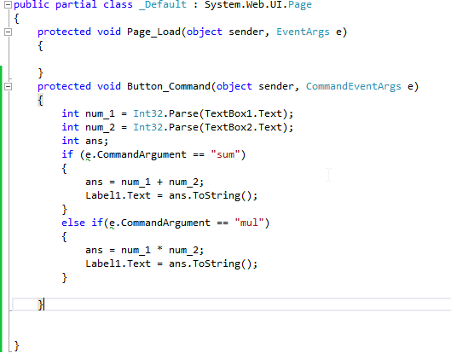
Code

Slide 35
Text Box
The TextBox control is used to create a text box where the user can input text.
Important Properties :
Text : Refers to Text in the box.
Text Mode : Specified mode such as Text, Number, Password, Multiline etc.
MaxLength : Specifies Maximum length to be allowed.

Slide 36
TextChange event
Occurs when the content of the text box changes between posts to the server.
The event is only raised if the text is changed by the user; the event is not raised if the text is changed programmatically.

Slide 37
Radio Button

Slide 38
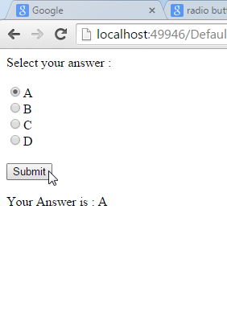
Example

Slide 39
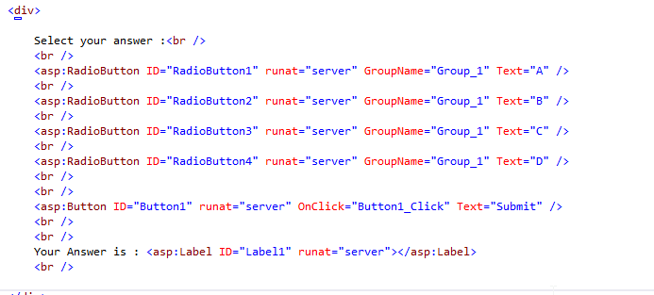
Design

Slide 40
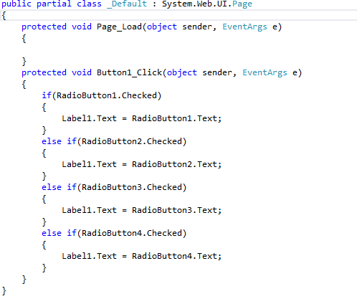
Code

Slide 41
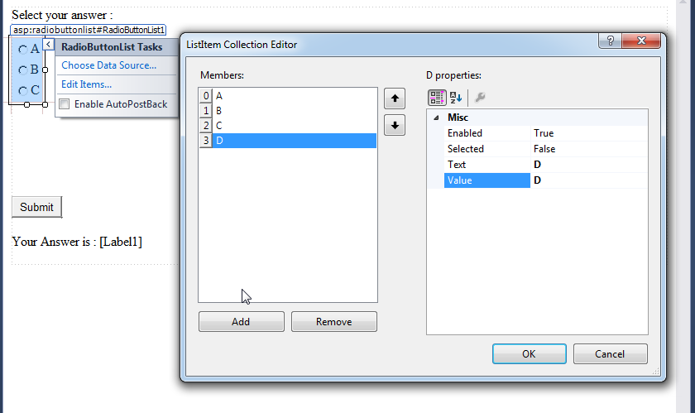
Radiobutton List

Slide 42
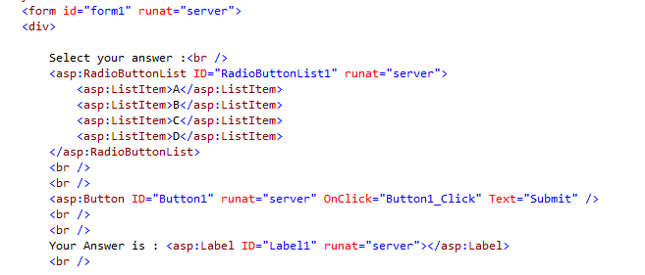
Design

Slide 43
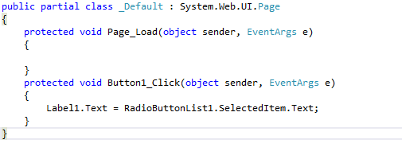
Code

Slide 44
Radio button change Event
Radio button change event is fired when specific radio button is checked or in case of using radiobuttonlist when one of the radio button is selected, change event fires.

Slide 45
CheckBox

Slide 46
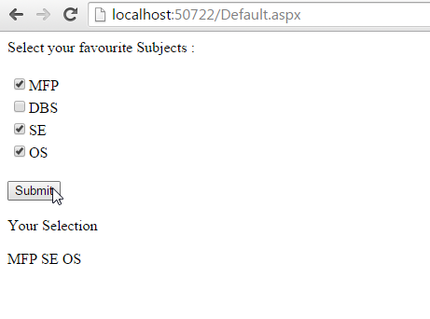
Example

Slide 47
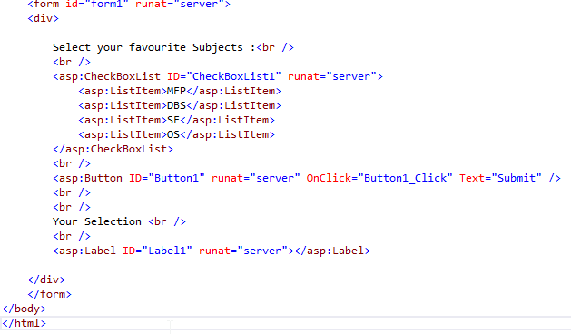
Design

Slide 48
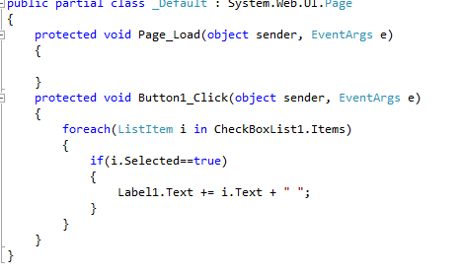
Code

Slide 49
Redirecting page
To Redirect to another page, Response.Redirect method is used.
Code execution in the current page is terminated when the Redirect method is processed, so subsequent code in the page will also be ignored.

Slide 50
Example
To navigate to page named “bill.aspx”, on button click following code is written :
protected void Button1_Click(object sender, EventArgs e)
{
Response.Redirect("bill.aspx");
}

Slide 51
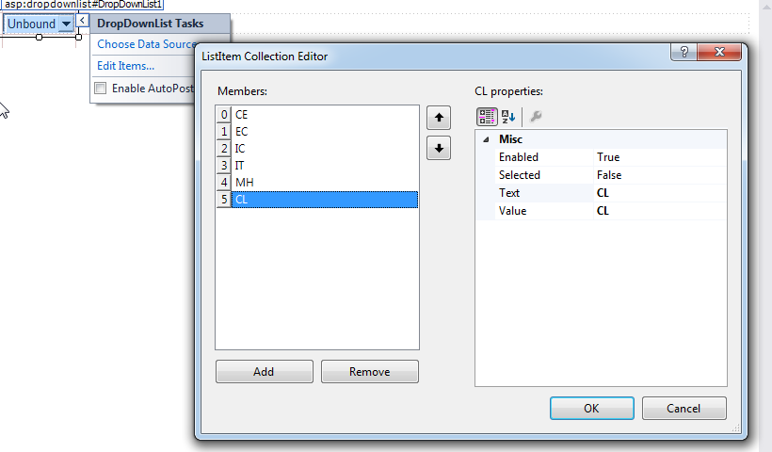
Dropdownlist
Represents a control that allows the user to select a single item from a drop-down list.

Slide 52
Important Methods
SelectedIndex : Returns index of selected item.
SelectedItem.Text : Returns text of selected item.

Slide 53
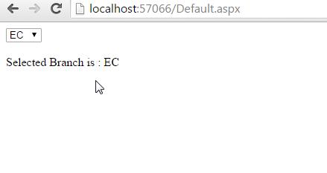
Example

Slide 54
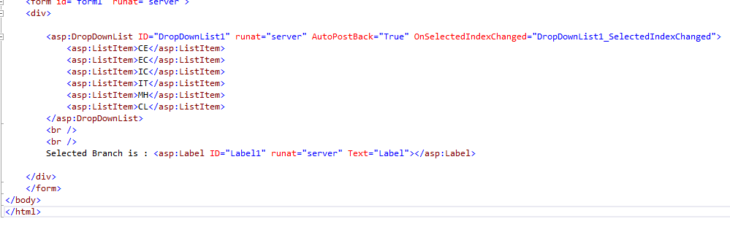
Design

Slide 55
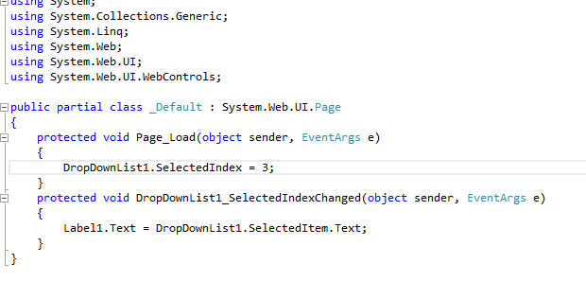
Code

Slide 56
HyperLink
A control that displays a link to another Web page.
Properties :
Text : Display Text.
NevigateUrl : URL to nevigate.

Slide 57
Image
Used to display image on web page.
Property to set Image :
ImageUrl : To set image path to display.

Slide 58
ImageButton
Used to display Image button which can be clicked.
Properties :
ImageUrl
PostBackUrl : Specifies where to Nevigate.

Slide 59
LinkButton
Works in same manner as Hyperlink but it first posts page to the server so any server based task can be done before navigating to the target page.

Slide 60
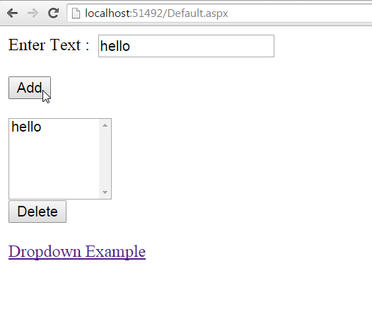
ListBox Example

Slide 61
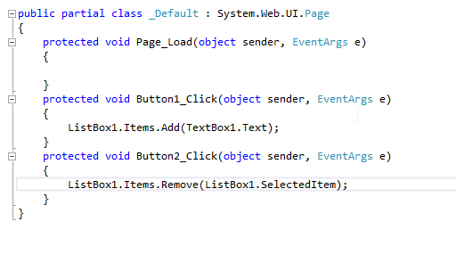
Code

Slide 62
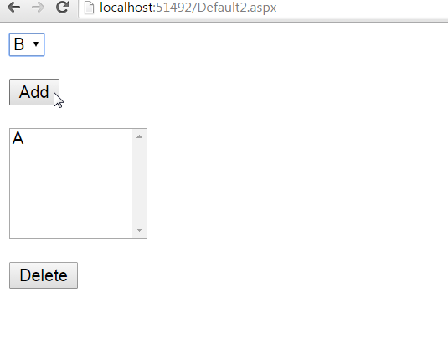

Slide 63
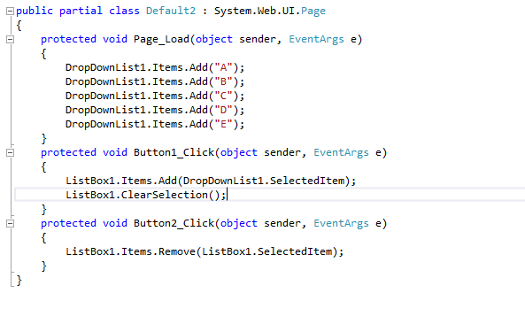
Code

Slide 64
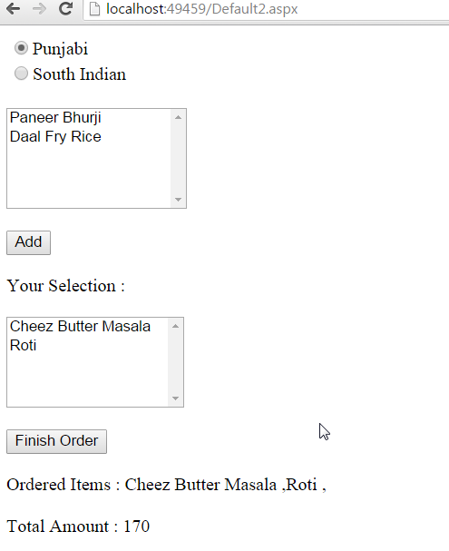

Slide 65
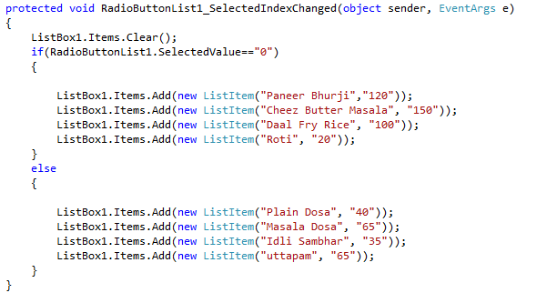
Code

Slide 66
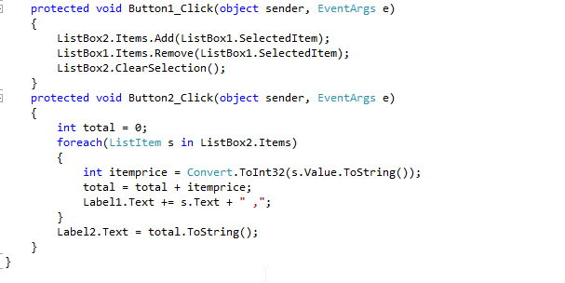
Code

