Slide 1
Ephemeral
A healthcare data marketplace where AI trains on hospital data that never leaves encryption.
ETHGlobal Mumbai 2026
Notes:
Hi, I'm Shubham. This is Ephemeral: a marketplace where hospitals can sell AI access to clinical data without ever handing the raw records to anyone.

Slide 2

WHO BUILT THIS
Shubham Singh Shoora
Solo developer
Contracts, Swarm encryption pipeline, Chainlink CRE workflow, Arkiv catalog and the full frontend: one person, one hackathon.
Solidity
Chainlink CRE
Swarm
Arkiv
Notes:
I built every layer myself: the Solidity contracts, the Swarm encryption pipeline, the Chainlink CRE workflow, the Arkiv catalog and the React frontend.

Slide 3
Too leaky to share. Too scarce to train.
WALL 1 · PRIVACY — CASE STUDY: DATAVANT
Merged with Ciox Health in 2021 ($7B); links patient records across 2,000+ US hospitals.
WALL 2 · DATA SCARCITY
2026–2032
THE BREACH
THE LAWSUIT
BEFORE THAT
When LLMs are projected to run out of public human-written text to train on (Epoch AI)
May 2024
$900K
12,493
A phishing email opened one employee's mailbox: names, SSNs, health data
Class-action settlement, preliminarily approved Apr 2026, ~58,300 people
People affected by an earlier Ciox Health email breach in 2021
Up to 97%
Of hospital data goes unused, siloed inside the systems that created it
The quieter problem: de-identified data falls outside HIPAA, so tokenized records can be linked and licensed to pharma. Critics say patients rarely know. (Datavant says it does not sell patient data.)
The next gains for AI sit in private data like clinical records, which models legally can't touch.
THE PARADOX AI needs the data hospitals can't share, and sharing today means centralizing it, which is what leaks.
Sources: HIPAA Journal, ClassAction.org (Jackson v. Ciox Health), MedTech Dive, Wikipedia, Epoch AI (ICML 2024), MedCity News
Notes:
Two walls. Privacy: Datavant is the leader in privacy-preserving health data linking, yet in May 2024 one phished mailbox exposed names, SSNs and health data, ending in a $900K class-action settlement covering about 58,000 people (preliminary approval, April 2026), after a 2021 Ciox breach of 12,493. De-identified data also sits outside HIPAA; critics say patients rarely know how it's used, though Datavant says it doesn't sell patient data. Scarcity: Epoch AI projects LLMs will exhaust public human-written text between 2026 and 2032, and up to 97% of hospital data goes unused. The next gains are in private data AI can't legally reach. The paradox: AI needs that data, and sharing it today means centralizing it, which leaks.

Slide 4
Demo
Notes:
Demo order: 1) Healthcare: register institution, encrypt a CSV, publish to Swarm with ACT, see the synthetic schema. 2) Arkiv marketplace: browse open datasets, download rebuilt from chunks. 3) AI Company: pick a protected dataset, upload the encrypted model, fund the vault, watch CRE settle.

Slide 5
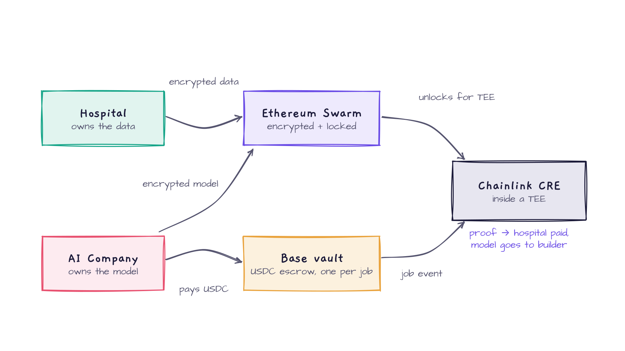
Architecture: the big picture
Notes:
Hospitals put encrypted data on Swarm. AI companies upload an encrypted model and pay into a USDC vault on Base. The vault emits a job event; Chainlink CRE, running in a TEE, is the only thing that can unlock the data. It runs the job, posts a proof, the hospital gets paid and the builder gets the model.

Slide 6
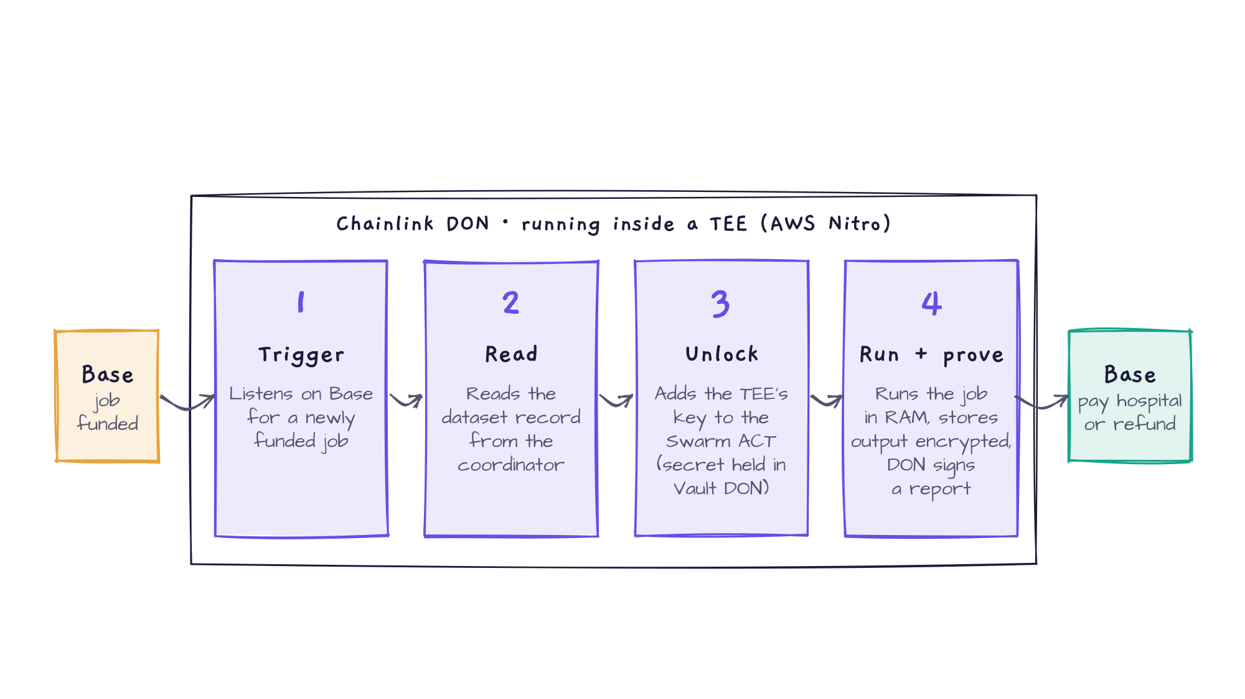
How Chainlink CRE works
CRE is the only thing that can unlock a dataset or move the money, and it acts only when a job is funded on Base.
Notes:
The CRE workflow is the heart of Ephemeral. 1) It listens on Base for the TrainingJobRequested event from a funded vault. 2) It reads the dataset record from the coordinator at a finalized block. 3) Using Confidential HTTP with a secret held in the Vault DON, it asks our Swarm node to add the enclave's key to the dataset's Access Control Trie, so only the TEE can decrypt. 4) It runs the job in memory, uploads the output encrypted, and the DON signs a report. That report goes back to Base: the vault pays the hospital, or the builder is refunded.

Slide 7
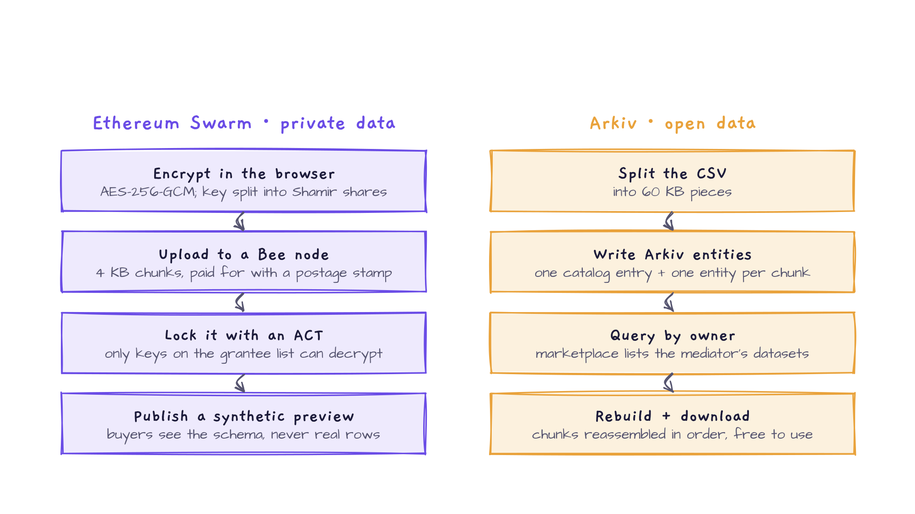
Ethereum Swarm + Arkiv publishing
Notes:
Two storage layers. Swarm holds the private hospital data: it's encrypted with AES-256-GCM in the browser, the key is split into Shamir shares, the ciphertext is uploaded to a Bee node in 4 KB chunks paid with a postage stamp, and an Access Control Trie decides which keys can decrypt it. Buyers only see a synthetic preview. Arkiv holds open datasets: a CSV is split into 60 KB pieces stored as entities, with one catalog entry, owned by the mediator wallet. The marketplace queries by owner, rebuilds the chunks in order and offers a free download.

Slide 8
Business model
Hospitals set the price. The contract splits it the moment a job is funded.
95%
Hospital
Released from the job's vault once CRE posts a valid proof
2.5%
Ephemeral fee
Mediator treasury: the protocol's take rate on every job
USDC
2.5%
Storage reserve
per job
Swapped to xBZZ to keep the encrypted data alive on Swarm
Free funnel
Low-risk buying
Two-sided
Open Arkiv datasets bring AI teams in at zero cost
Failed jobs refund; retries reuse paid storage
Labs pay, hospitals earn from idle data
Notes:
The hospital sets the price. 95% goes to them, 2.5% is our fee, 2.5% funds Swarm storage so the dataset stays available. Open Arkiv data is free and acts as the top of the funnel; refunds and retry credits make buying low-risk.

Slide 9
What's next
1
INFRA
2
SECURITY
CRE workflow on a DON
Hardware attestation
Move from simulation to a production DON, pointed at the live Base coordinator
Verify a real AWS Nitro attestation, instead of today's mock enclave measurement, before any data is unlocked
3
SCALE
4
TRUST
Many jobs per dataset
Hospital & AI company verification
A dataset takes one active job at a time today; queue or parallelize jobs to scale revenue
Verified onboarding on both sides: buyers trust every data source, hospitals know who trains on their data
Notes:
Next: deploy the CRE workflow to a production DON; verify a real hardware attestation before data unlocks; support many concurrent jobs per dataset; and add verified onboarding for both hospitals and AI companies.

Slide 10
Check it out
LIVE APP · ENS + ETHEREUM SWARM
The whole app is censorship-resistant: its files live on Ethereum Swarm, served through ENS.
ephemeralglobal.eth.limo
CODE
github.com/Shubham-Singh-Shoora/Ephemeral-
COORDINATOR · BASE
0x3348145B791245E149Efe0BD9d7f74B69191714a
Thank you.
VAULT FACTORY · BASE
0xB4F9aCA56DE3e757f2720dF058cE6C8aEea925f0
Shubham Singh Shoora · ETHGlobal Mumbai 2026
Notes:
The live app is at ephemeralglobal.eth.limo. It's censorship-resistant: the site's files are on Ethereum Swarm and served through ENS. The code is on GitHub and the Base contracts are on Basescan. Thank you.

