Slide 1

Meet "Yuki"
Your Learning Budd-Hi
By Divine Devs
Abhishek Verma - Backend and AI Agent
Shubham Yadav - Frontend Development and Backend Integration
Vidhik - Research and Market Strategist
Notes:
1

Slide 2
Problem Statement
Super Intelligent Multi AI Agent Educator
The lack of experienced educator is resulting bad learning experience and causing more problems down the hill.
Concepts are unclear to students
Years old learning system
Lack of real guidance
Outdated syllabus and more…
Notes:
2

Slide 3


Solution Framework
1
Description
Innovative Approach
Implementation
AI Agents can be really effective in a learning environment, our Agents have access to user data, this will help us to focus on points which will really help the students to grow and reach their goal indefinitely.
Our AI Agents orchestration and latest context management enables us to deliver unmatched performance.
We are using powerful LLM models and advance architecture for building our Multi AI Agent system with state of the art context management, these AI Agents have access to tools like search, read, generate quiz and so many more custom tools for personalized experience.
Notes:
3

Slide 4
Objectives & Goals
Objectives
Expected Outcomes
Long-term Vision
To provide a new and better way of learning using latest technology.
A new way of learning and growing, where learners have almost no limitations of accurate sources and tools.
Change the way how we pursue learning and skill development.
Notes:
4

Slide 5



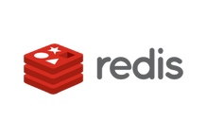
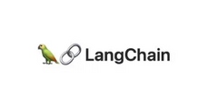

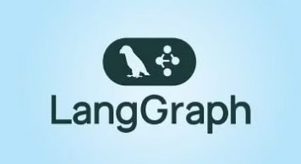
Technology Stack Requirements
Here, is innovative core of our project, showcasing the cutting-edge technologies, robust tools, and dynamic platforms that power our development.
Frontend
Backend
Next.js (scalable React framework), TypeScript for type safety, Tailwind CSS for design
Python (AI Agents orchestration), FastAPI, Redis(caching)
AI & Agents
Database
LangChain and LangGraph for orchestrating multi-agent workflows, OpenAI API for content generation
SQLite (lightweight persistent storage), Radis (real-time caching, workflow states)
Notes:
5

Slide 6

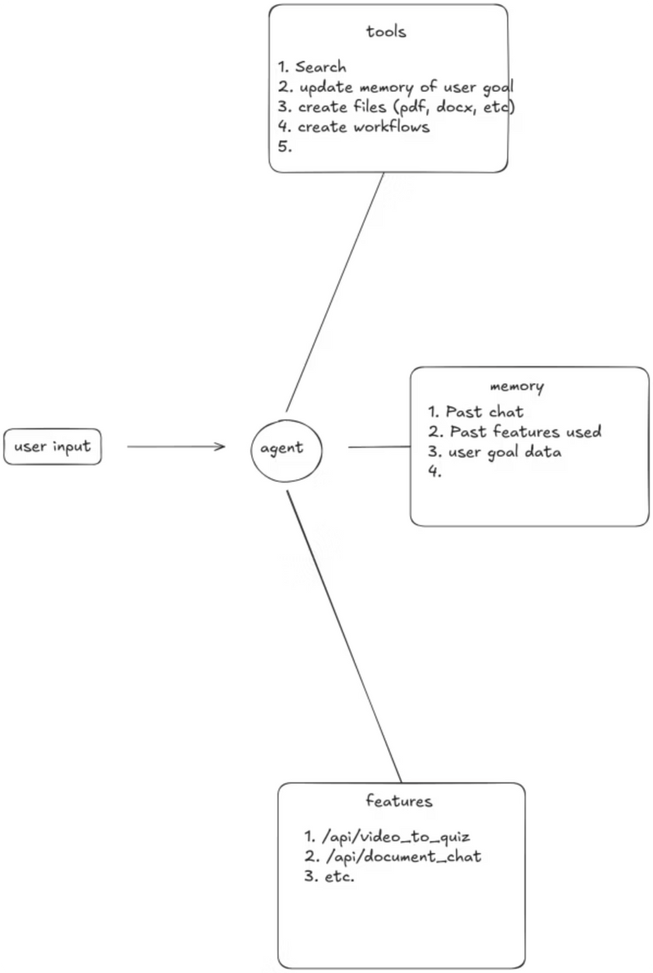




System Architecture Visualization
A comprehensive architecture diagram clearly illustrating the project's workflow and user interaction patterns.
User Login (Clerk): Authentication and role assignment (free/premium).
Goal Input & Profile Setup: User specifies learning goals, target exams, subjects.
Workflow Orchestration (LangGraph): Agents collaborate — Planner (roadmap), Evaluator (progress tracking), Teacher (interactive tutoring).
Database Layer: SQLite stores roadmaps, Redis handles state caching and fast retrieval.
User Interaction: Personalized plan + adaptive feedback through dashboard.
Notes:
6

Slide 7



Innovation & Key Features
Unique Features
AI-driven Personalized Roadmaps: Tailored study plans dynamically updated based on progress.
Technical Innovation
Multi-Agent Collaboration: Agents handle planning, evaluation, and subject tutoring for a seamless experience.
Tiered Model: Free tier (basic roadmaps) Vs premium tier (personalized learning, deep tutoring, adaptive feedback).
Virtual Teacher Interaction: Natural language tutoring that adapts to student queries.
Differentiating Factors
Continuous Adaptation: The system evolves with learner data and behaviour, offering long-term personalized mentorship.
Notes:
7

Slide 8





Development Implementation Plan
Phase 2 – Authentication & Tiers
Add Clerk for login, implement free/premium features, connect database.
Phase 1 – Ideation & Prototype
2
Build a minimal roadmap generator with simple AI integration.
1
Phase 3– Multi-Agent Integration
3
Introduce LangGraph workflows for planner, evaluator, and tutor..
Phase 5 – Deployment & Scaling
5
Deploy to cloud infra, add caching for cost optimization, prepare for larger user base.
4
Phase 4 – Testing & Refinement
Pilot testing with sample users, gather feedback, improve UX & model prompts.
Notes:
8

Slide 9

Risk Management Strategy
Anticipated Challenges
Mitigation Strategies
Caching with Redis, optimizing prompts, batching queries for cost control
Technical Barriers
Scalability: Heavy LLM use can be costly
Validation layers, curated content, and feedback loops for accuracy
Gamification, progress streaks, milestone rewards for engagement
Ensure free tier is useful but premium adds clear value for monetization
Resource Limitations
Content Accuracy: LLMs may hallucinate
Market Factors
User Retention: Learners may lose motivation
Premium Monetization
Balancing free vs. paid features
Notes:
9

Slide 10




Project Impact & Future Vision
Scalability
Adaptability
Benefits
Works for individual learners, coaching institutes, and enterprise training.
Can expand into competitive exams, professional skill training, or even corporate learning.
Provides structure, motivation, and mentorship at scale; empowers self-learners, exam aspirants or any level of learner.
"Yuki" fills the gap of personalization learning and human mentorship, shaping the future of accessible, and adaptive education.
Notes:
10

