Slide 1
Jira Developer Activity
Confluence Teams
Turning Jira and Confluence into an engineering intelligence layer.
Jira History
Jira Cloud
Confluence Cloud
Groq AI
AI to JQL
Prepared by : Team ASK-Y
Yash Gupta
Shubham Kumar
Arpita Priya
Kashish Roy
Excel Reports
Analytics
01

Slide 2
MARKET PAIN
The Problem
Engineering work is visible. Engineering history is hidden.
Scattered activity data
Current state hides history
Manual reports are fragile
1
2
3
Teams live in Confluence. Work lives in Jira. Context lives inside changelogs.
Jira fields show latest assignee/status, not past ownership or movement.
Managers inspect tickets, screenshots, history tabs, and spreadsheets.
Result:
slow reporting,
missed reassigned tickets,
and weak visibility into who did what.
02

Slide 3
PRODUCT
Our Solution
A focused reporting layer over Jira and Confluence.
1
Select team
2
Choose member
3
Analyze history
4
Generate report
5
Export
The product does not copy Jira history.
It reads live source-of-truth data and turns it into management-ready reports.
● Assigned Issues: historical assignee WAS query
● Transitions: changelog replay + assignee-at-time reconstruction
● Advanced AI Search: visible, project-scoped executed JQL
03

Slide 4
METHOD
Assigned Issues: Historical Assignment
The report uses Jira history, not just current fields.
1
Member name
2
Resolve accountId
3
JQL: assignee WAS
4
Jira results
5
Report rows
project = KAN AND assignee WAS "accountId" ORDER BY updated DESC
Why it matters: reassigned tickets still count because Jira evaluates server-side assignment history.
04

Slide 5
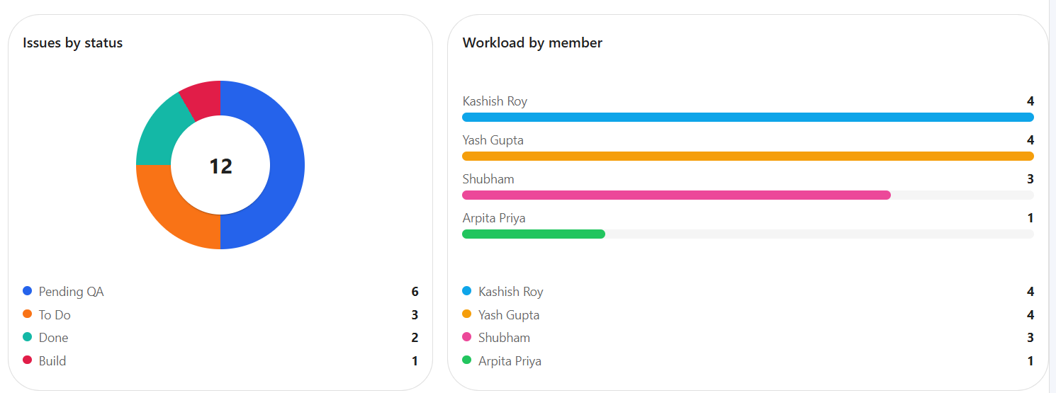
Analytics
The smart, lazy overview.
05

Slide 6
Transparent AI Search
Natural language becomes auditable, scoped JQL.
1
Prompt
2
Groq JSON plan
3
Enforce project
4
Resolve names
5
Execute JQL
1
Guardrail 1
2
Guardrail 2
3
Guardrail 3
Backend forces project scope before Jira execution.
Display names in user clauses are resolved to account IDs.
Executed JQL is shown to the user.
06

Slide 7
ARCHITECTURE
System Architecture
Frontend experience, backend intelligence, external systems as source of truth.
C
Confluence Cloud
Team membership
API
FastAPI Backend
React + Vite
Jira Cloud
Excel
UI
Routers Services Clients Pydantic schemas
J
Issues + changelogs
X
Downloadable reports
Dashboard, tabs, AI panel, export trigger
Groq API
AI
JSON query planning
Security boundary: browser never receives Atlassian or Groq secrets.
07

Slide 8
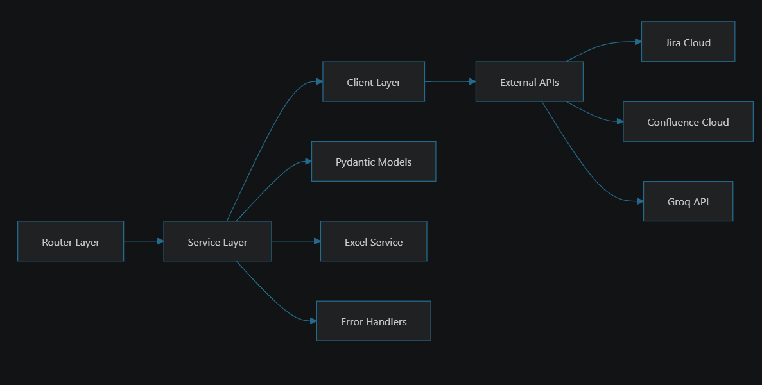
WORKFLOW
Data Flow Diagram
08

Slide 9
CODE QUALITY
SOLID + Clean Code
Clear responsibilities are visible in the folder structure.
SRP
OCP
1 MODULE, 1 JOB
Extension ✔️ Modification ❌
ISP
DIP
Separate separate
Abstraction or injected dependencies
Tests validate the riskiest logic: team parsing, AI JQL scope, forward transitions, and assignee-at-transition reconstruction.
09

Slide 10
ROADMAP
Scalability Roadmap
From working MVP to enterprise reporting platform.
1
MVP Today
2
Version 2
3
Enterprise
Jira + Confluence reports Excel export AI JQL search
Multi-project analytics Caching + background jobs Scheduled delivery
SSO + RBAC Audit logs Marketplace/SaaS packaging
Scaling needs auth, persistence/caching, deployment, and richer analytics. The current layered architecture gives that path a solid starting point.
10

Slide 11
From scattered Jira history to trusted engineering intelligence.
Problem -> Solution -> Impact
1
Problem
2
Solution
3
Impact
Manual reporting misses historical context.
Live Jira + Confluence reporting with AI guardrails.
Faster, fairer, exportable engineering visibility.
Takeaway: turn collaboration systems into decision systems.
11

