Slide 1
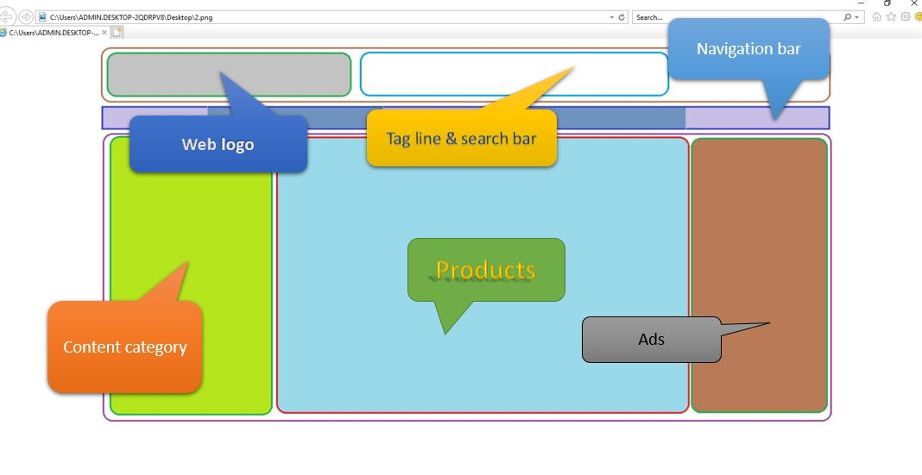
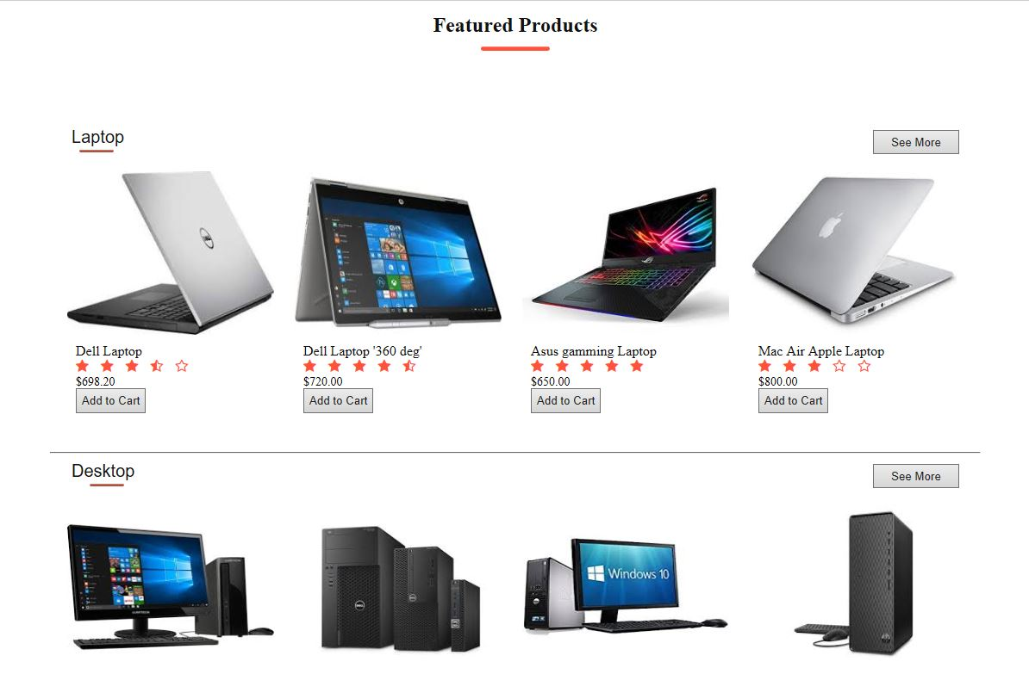
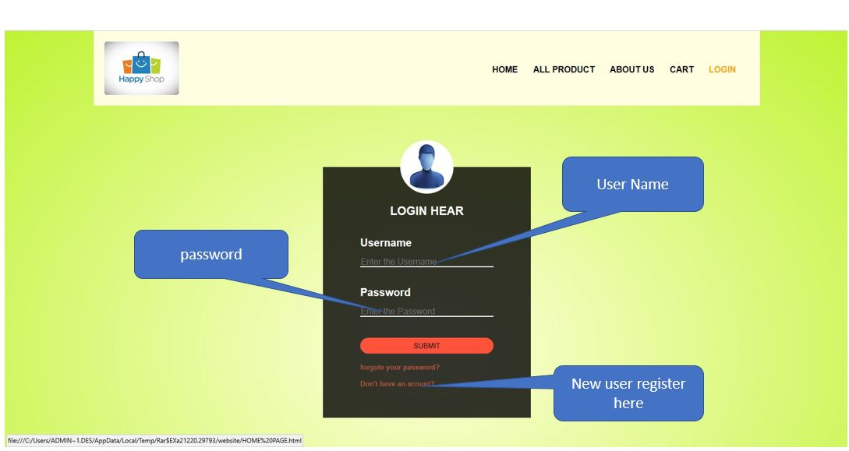



Happy Shop
Two types of shopping
Online shopping
Traditional shopping
Online shopping
Easy to find best online stores.
Searching online styles.
Best coupon to shop.
Good discounts.
Comparisons of prices.
Available 24*7.
Traditional shopping
Time to find best store.
No discount.
No home delivery.
Not available 24*7.
Modes of payment
Cash on delivery.
Debit card.
Credit card.
Postal money order.
Billing on mobile phone.
Online Safety
Check out sellers
Make sore the site is legitimate.
Protect your information.
Keep a paper trail.
Use safe payment option.
Turn your computer off when you are finished shopping.
Tips for protection
Secured site should be used
Spams should be avoided
Keep password private
Read privacy and security policy carefully
Consider alternative payment method
https:// should be preferred
Shubham R Balar
B.Tech Computer Engineering
19SE02CE003

