Slide 1
What Is HTML?
HTML is a markup language for creating web documents / pages
Hyper Text Markup Language
NOT a programming language
It is not case-sensitive language
Stateless Protocol
Markup language – Uses a set of markup tags

Slide 2
HTML Tags
HTML tags define HTML elements which is an individual component of an HTML document or web page.
Keywords surrounded by angle brackets
<p>This is a paragraph element surrounded in paragraph tags</p>

Slide 3
Page Structure
<!DOCTYPE html>
<html>
<head>
title,meta tag,stylesheet,javascript,link
<title>My Webpage</title>
</head>
<body>
Whole Page Design
<p>This is my first web page</p>
</body>
</html>

Slide 4
Page Structure
<!DOCTYPE html> - Declaration defines this document as HTML5
<html> - Describes an HTML document
<head> - Provides information about the document
<title> - Provides a title for the document
<body> - Describes the visible page content

Slide 5
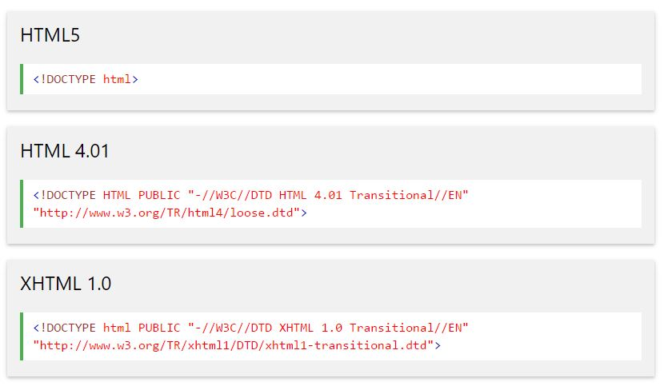
Common Doctype Declarations

Slide 6
Closing Tags
Not all tags have closing tags like <p></p>
Some tags can close themselves
Line-Break Tag - <br>
Self Closing Line-Break Tag - <br /> (Remnant of XHTML)

Slide 7
Common Tags
Paragraph <p>
Headings <h1> - <h6>
Link <a>
Image <img>
Unordered List <ul>
Ordered List <ol>
List Item <li>
Table <table>
Form <form>
Input <input>
Button <button>
Line Break <br>
Horizontal Rule <hr>
Division <div>
HTML <html>
Head <head>
Body <body>
Strong <strong>
<marquee>

Slide 8
Attributes
Attributes provide additional information about any HTML tag/elements.
Syntax:-
<tag attribute name=“value”></tag>
Ex-
<a href=“http://google.com”>Click</a>
<h1 id=“myHeading”></h1>
<link rel=“icon” href=“image/favicon.png”/>

Slide 9
Block Level Elements
Always starts on a new line
Takes up full available width
<div>
<h1> - <h6>
<p>
<form>

Slide 10
Inline Level Elements
Does not start on a new line
Takes only width necessary
Ex-
<b>
<span>
<a>
<img>

Slide 11
Creating A Web Page
Use a text editor/code editor or IDE to create your HTML document/pages
Add elements, tags, attributes, etc
Save file with a .html or .htm extension
Open it up in a browser – No server needed

