Slide 1
CUSTOMER RETENTION PRESENTATION
Shubham Hajari
13 - Oct - 2022

Slide 2
Problem Overview
E-retail factors for customer activation and retention:
A case study from Indian e-commerce customers.
Customer satisfaction has emerged as one of the most important factors that guarantee the success of online store; it has been posited as a key stimulant of purchase, repurchase intentions and customer loyalty.
A comprehensive review of the literature, theories and models have been carried out to propose the models for customer activation and customer retention.
Five major factors that contributed to the success of an e-commerce store have been identified as: service quality, system quality, information quality, trust and net benefit.
The research furthermore investigated the factors that influence the online customers repeat purchase intention.
Combination of both utilitarian value and hedonistic values are needed to affect the repeat purchase intention (loyalty) positively. The data is collected from the Indian online shoppers.
Results indicate the e-retail success factors, which are very much critical for customer satisfaction.

Slide 3
Conceptual Background of the Domain Problem
MACHINE LEARNING AND DATA SCIENCE FOR BUSINESS:
Machine learning is a branch of artificial intelligence (AI) & computer science focusing on the use of data & algorithms to imitate the way that humans learn from experience, make predictions and gradually improving its accuracy. It is an important component of the growing field of data science.
Through the use of statistical methods, algorithms are trained to make classifications or predictions, uncovering key insights within data mining projects. These insights subsequently drive decision making within applications and businesses, ideally impacting key growth metrics.
As big data continues to expand and grow, the market demand for data science will increase, requires to assist in the identification of the most relevant business questions and subsequently the data to answer them. Following are the ways Data science can add value to Business :
• Empowering management and officers to make better decision
• Directing actions based on trends—which in turn help to define goals
• Challenging the staff to adopt best practices and focus on issues that matter
• Identifying opportunities
• Decision making with quantifiable, data-driven evidence
• Testing these decisions
• Identification and refining of target audiences

Slide 4
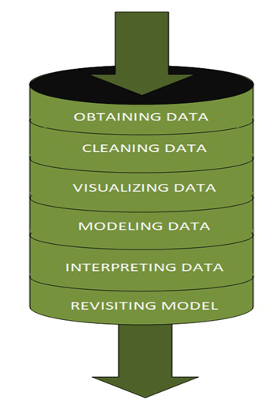
DATA SCIENCE PIPELINE:
The data science pipeline is a collection of connected tasks that aims at delivering an insightful data science product or service to the business organization.
The responsibilities include collecting, cleaning, exploring, modeling, interpreting the data, and other processes of the launching of the product.
“This final product can be used for to achieve Business Goals”
Exploratory Data Analysis (EDA) & IT’s TYPES:
The main purpose of EDA is to help look at data before making any assumptions.
It can help identify obvious errors, as well as better understand patterns within the data, detect outliers or anomalous events, find interesting relations among the variables.
Data scientists can use exploratory analysis to ensure the results they produce are valid and applicable to any desired business outcomes and goals.
EDA also helps stakeholders by confirming they are asking the right questions
TYPES OF EXPLORATORY DATA ANALYSIS:
Univariate Non-graphical
Multivariate Non-graphical
Univariate graphical
Multivariate graphical

Slide 5
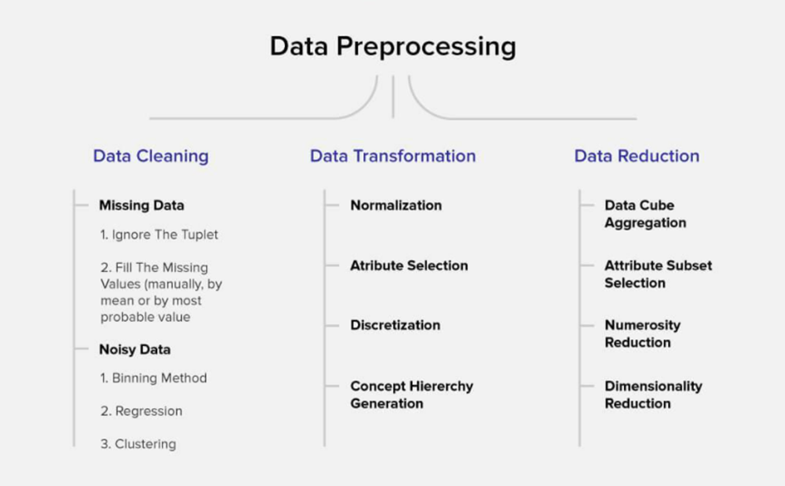
DATA PRE-PROCESSING
Data per-processing is a very vital input to machine learning models, It is to prepare the raw data & make it suitable for efficient machine learning model. These are the methods of data preprocessing and we are going to use the required ones in our project.

Slide 6
FEATURE ENGINEERING
Feature engineering is the process of selecting, manipulating & transforming raw data into features that can be used in supervised learning. In simple terms, is the act of converting raw observations into desired features using statistical or machine learning approaches. It can produce new features for both supervised and unsupervised learning, with the goal of simplifying and speeding up data transformations while also enhancing model accuracy
Techniques Used,
Imputation
Handling Outliers
Log Transform
One-hot encoding/Label Encoding
Scaling
Data Transformation:
Label Encoding:
In library installation, Label Encoder is used to encode labels by assigning them numbers. It is used to encode single or multiple columns. Thus, if the feature is color with values such as [‘white’, ‘red’, ‘black’, ‘blue’]., using Label Encoder may encode color string label as [0, 1, 2, 3]

Slide 7
Review of Literature
ABSTRACT:
E-retail has become the need of the hour for the modern customers nowadays. This project focuses on the key factors for customer activation & retention. Given data-set needs to be analyzed in order to understand the things gone wrong / right to formulate a strategy / layout key points towards the customer activation & retention
Business Goal:
We are required to analysis the India e-retail industry survey response data-set by bifurcating them into hedonistic & Utilitarian values. Understand various influential factors customer encounters during online purchase done on a e-retail platform. Understand the customer’s choice across various platform & layout the key indices which makes them to make repeated purchases on an certain e-retail platform.

Slide 8
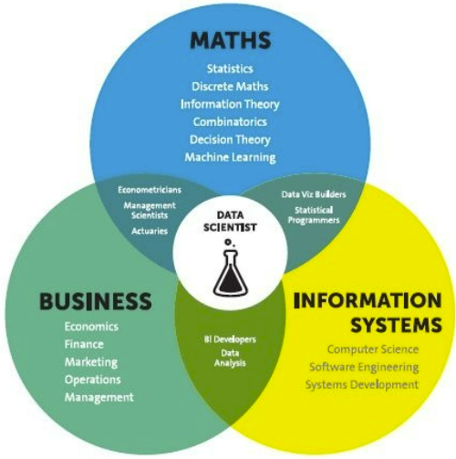
Analytical Problem Framing
Mathematical / Statistical / Analytical Modeling - are three of the most important concepts of Data Science. Data Science revolves around these three fields and draws their concepts to operate on the data.
Mathematical Modelling
Mathematical models are important, selecting the right one to answer the business question can bring tremendous value to the organization. It plays an essential role in the latest technologies like Machine Learning, Artificial Intelligence, Data Science and Deep Learning, etc., It is because every algorithm built in the latest technologies has a mathematical function behind it and aid in identifying patterns
The understanding of various notions of Statistics and Probability Theory are key for the implementation of such algorithms in data science.
Notions include: Regression, Maximum Likelihood Estimation, the understanding of distributions (Binomial, Bernoulli, Gaussian (Normal)) and Bayes’ Theorem
The main reason for a greater significance of mathematics is because of its various concepts like: –
Linear Algebra
Probability
Calculus – Differential & Integral Calculus
Statistics
Descriptive (Mean, Median, Mode, IQR, Std. deviation, Z & T- Statistics, linear regression)
Inferential (Sampling, Confidence interval, chi-square, ANOVA)

Slide 9
Analytical Problem Framing
Regression Models:
Data analysts use regression models to examine relationships between variables. Regression models are often used by organizations to determine which independent variables hold the most influence over dependent variables—information that can be leveraged to make essential business decisions
Classification Models:
Classification is a process in which an algorithm is used to analyze an existing data set of known points. The understanding achieved through that analysis is then leveraged as a means of appropriately classifying the data. Classification is a form of machine learning that can be particularly helpful in analyzing very large, complex sets of data to help make more accurate predictions.

Slide 10
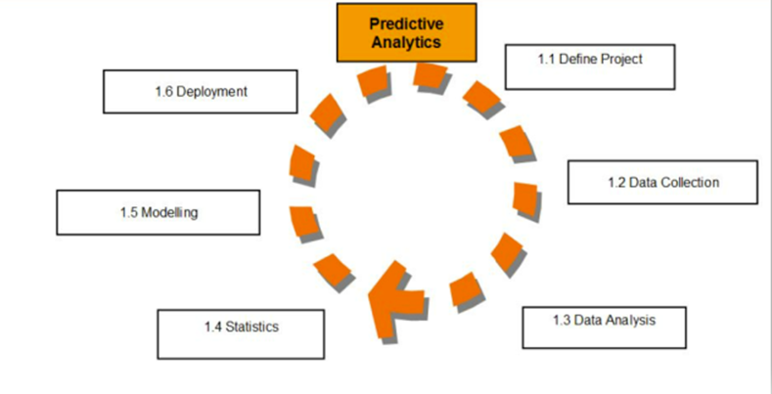
Analytical Models:
An analytical model is quantitative in nature, and used to
answer a specific question or make a specific design decision.
Different analytical models are used to address different aspects
of the system, such as its performance, reliability, or mass properties.
Data analysis comes with the fundamental types of data analytics
encounter in data science: Descriptive, Diagnostic, Predictive, and
Prescriptive.
Descriptive analytics is a statistical method that is used to search and summarize historical data in order to identify patterns or meaning.
Descriptive analysis is often used when reviewing any past or present data. This is because raw data is difficult to consume and interpret, while the metrics offered by descriptive analysis are much more focused.
The example of descriptive statistics or analytics is to calculate the mean, median mode, standard deviation, and similar kinds of statistical calculation on finance or sales data.
Diagnostic analytics takes it a step further to uncover the reasoning behind certain results. Diagnostic analytics is usually performed using such techniques as data discovery, drill-down, data mining, and different type of bivariant data analysis like correlations. etc.,
Predictive Analytics is a statistical method that utilizes algorithms and machine learning to identify trends in data and predict future behaviors. Predictive Analytics can take both past and current data and offer predictions of what could happen in the future.
Predictive models typically utilize variability in data to make the correct prediction and more variability of ingredient data that shows the relationship with what is possible to predict that united together into a prediction or valid score.
Prescriptive analytics automatically synthesizes big data, mathematical sciences, business rules, algorithms, and machine learning to make predictions and then suggests decision options to take advantage of the predictions. Prescriptive means (optimization and simulation).

Slide 11
Data Sources and their formats
Technical Requirements:
• Data contains 269 entries each having 71 variables.
• Data set doesn’t contains Null values. We treated them using the domain knowledge and our own understanding.
• Extensive EDA has been performed to gain relationships of important variable and price.
• Data contains one numerical and all others as categorical variable. We handled them accordingly.
• We built Machine Learning models, applied regularization and determined the optimal values of Hyper Parameters.
• We found important features which affect the price positively or negatively.
The dataset is enclosed in notebook file
The dataset is provided to us by FlipRobo Technologies. And the dataset is in excel file format.

Slide 12
Data Description
Here the columns / data inputs are as below,
How old are you?,How many times you have made an online purchase in the past 1 year?,
What is the Pin Code of where you shop online from?, What is the Pin Code of where you shop online from?, What is the Pin Code of where you shop online from? are categorical ordinal data type. And all other columns are categorical nominal data type.
Our Target column Which of the Indian online retailer would you recommend to a friend? is the categorical nominal data type.
So. It’s a categorical problem.

Slide 13
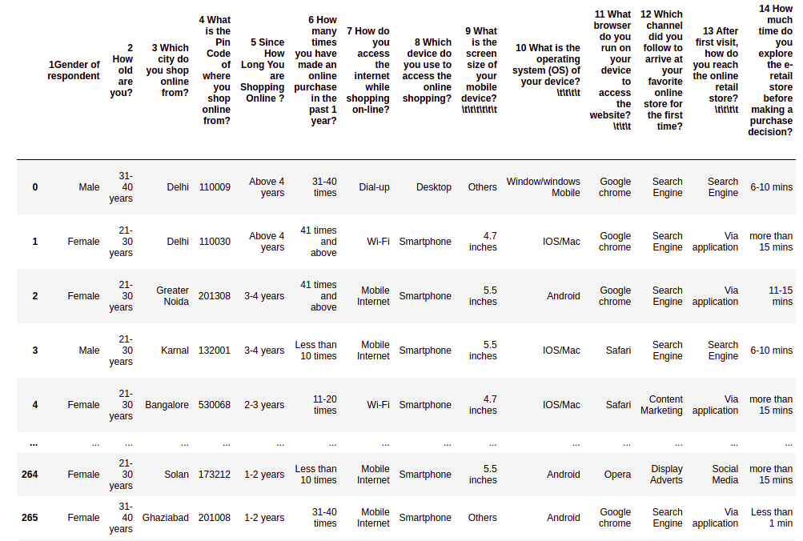

Slide 14
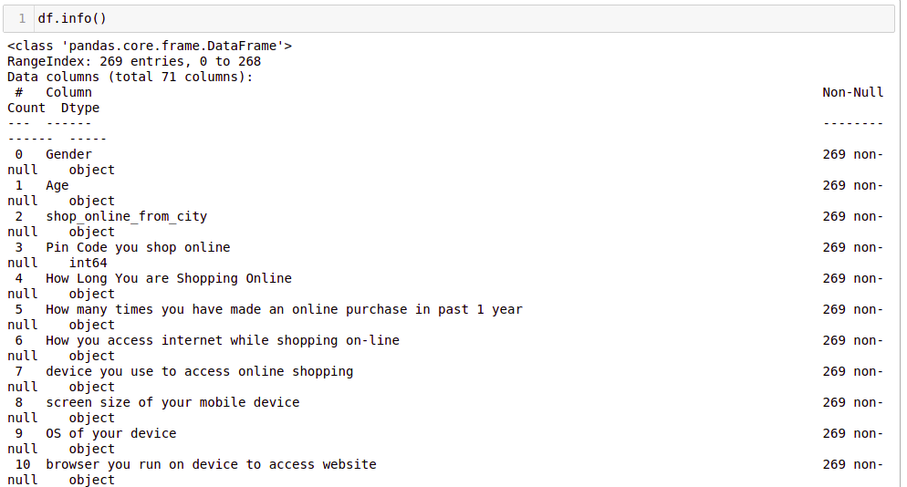
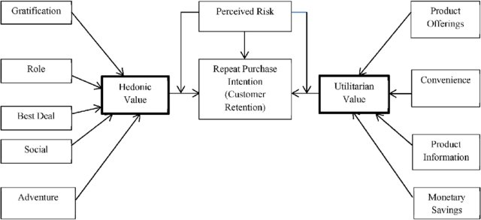
FEATURE DESCRIPTION:
Five major factors that contributed to the success of an e-commerce store have been identified as: service quality, system quality, information quality, trust and net benefit
The left side are Hedonic values and the right side corner values are Utilitarian values. And these values we found in the dataset as attributes. These Attributes contributes as main impactful factors for the Customer Satisfaction and Retention. So our analysis also proved this with more further investigation. And also Found furthermore impactful factors for the E-Retail Business Enhancement.

Slide 15
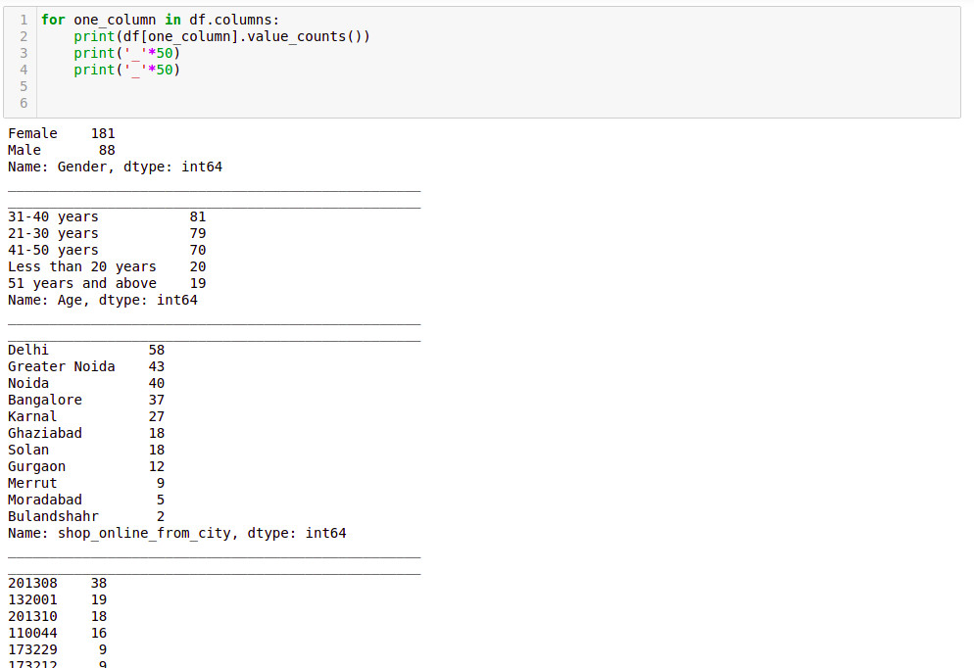
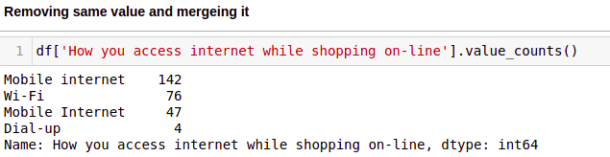
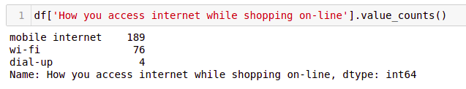
Data Analysis and Pre-peprocessing

Slide 16
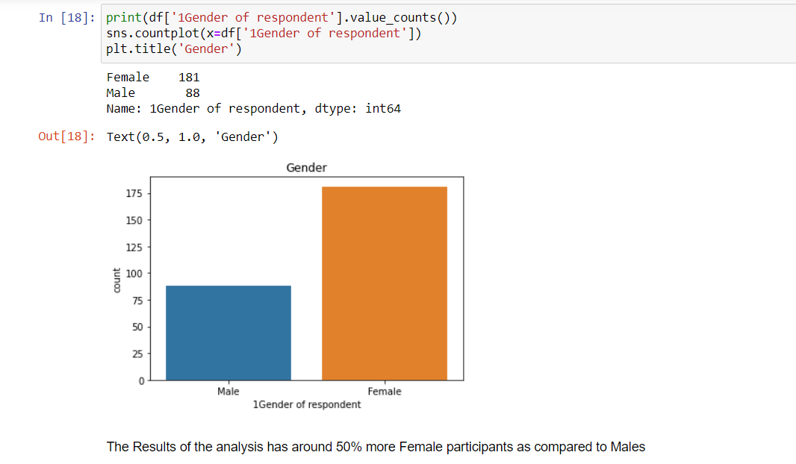

Slide 17
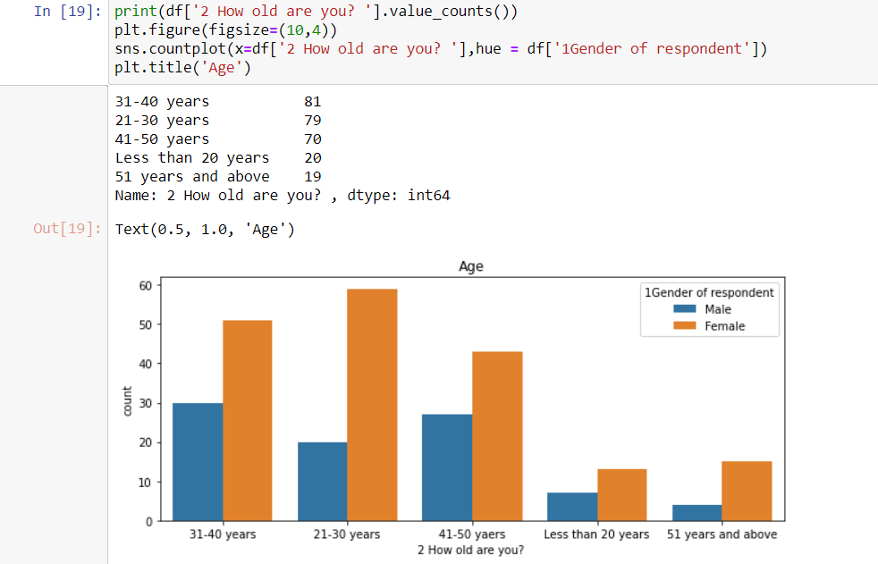

Slide 18
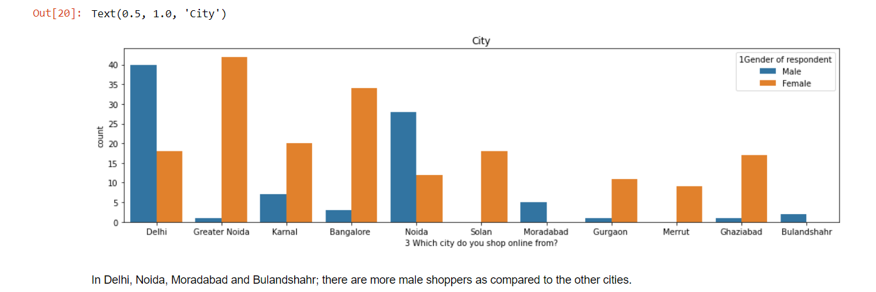

Slide 19
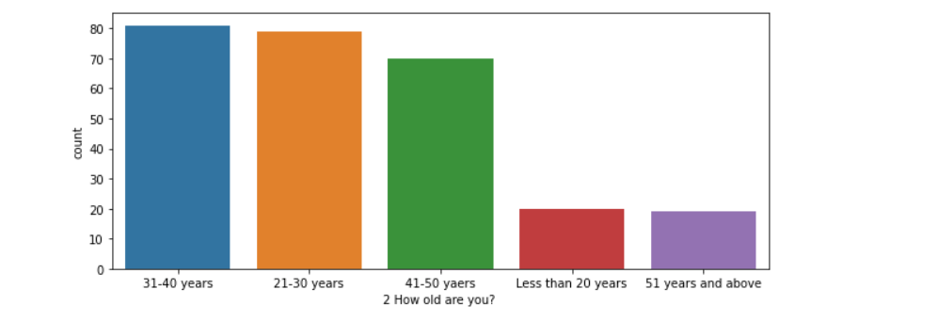

Slide 20
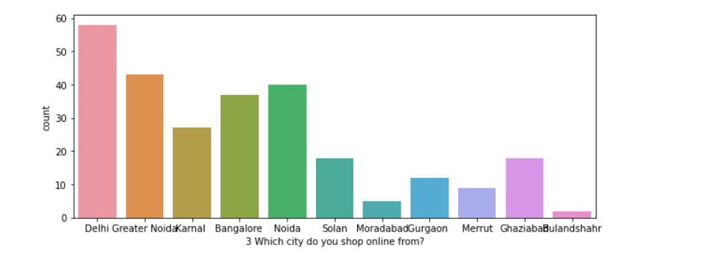

Slide 21
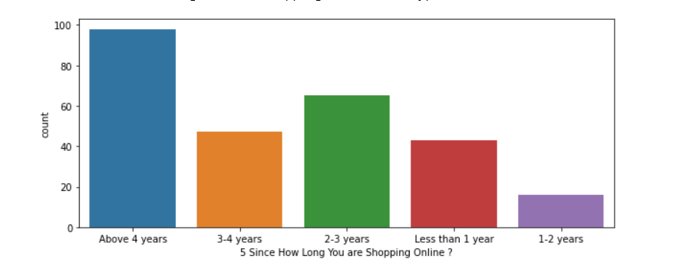

Slide 22
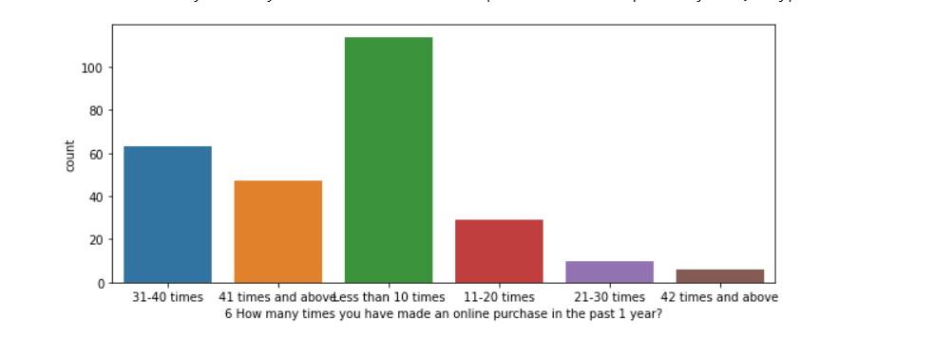

Slide 23
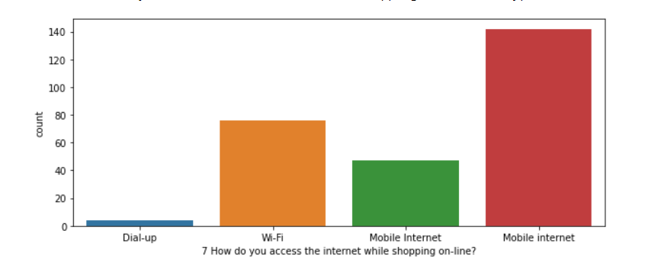

Slide 24
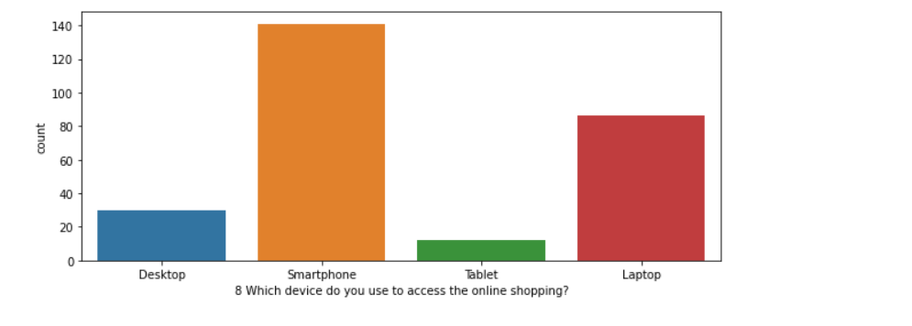

Slide 25
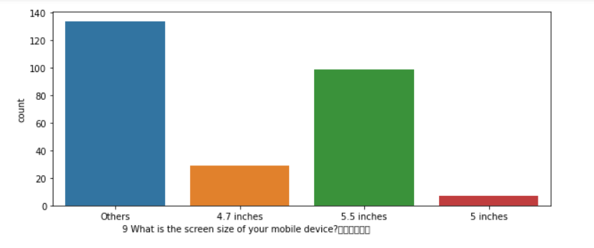

Slide 26
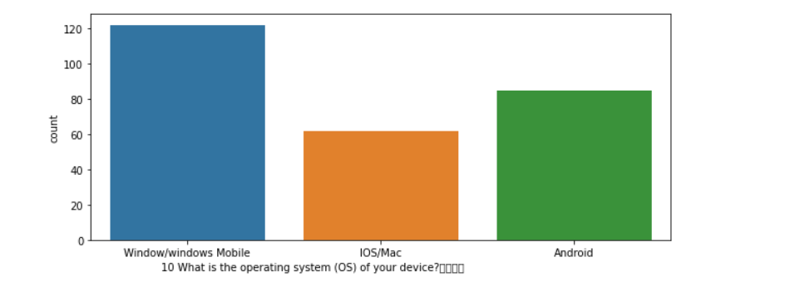

Slide 27
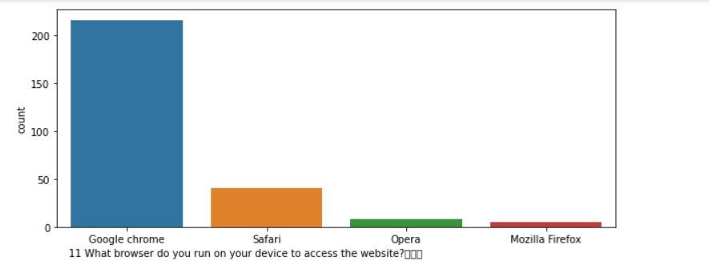

Slide 28
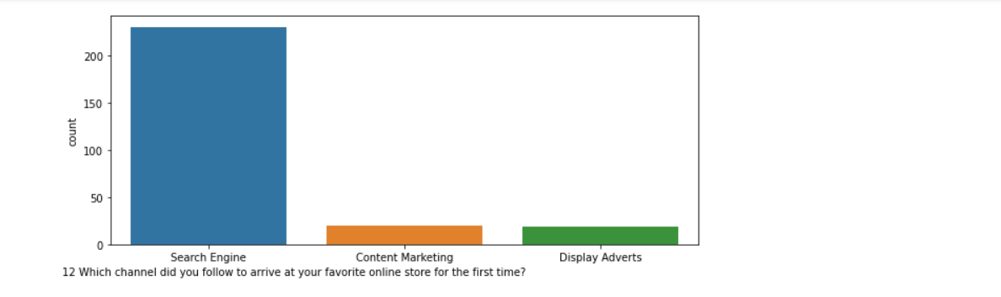

Slide 29
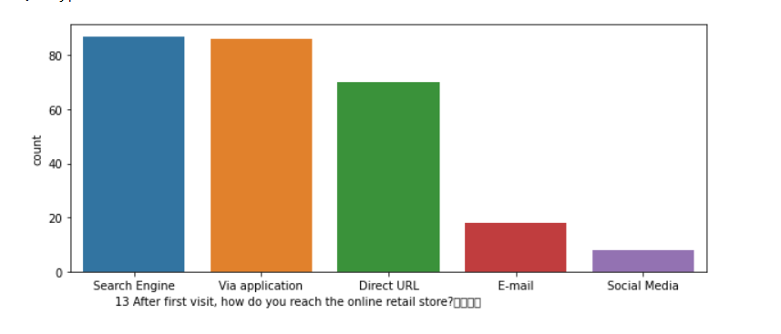

Slide 30
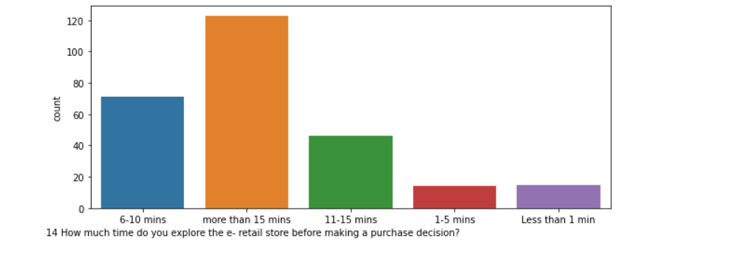

Slide 32
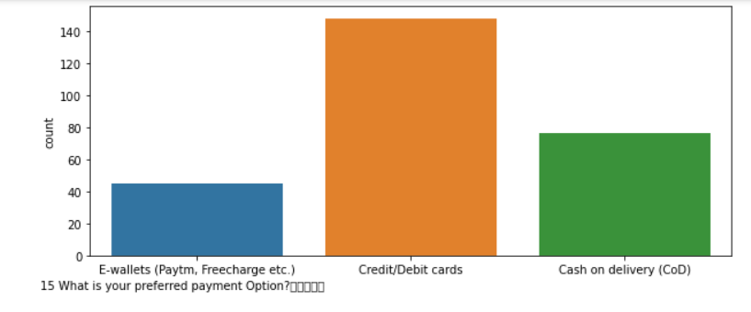

Slide 34
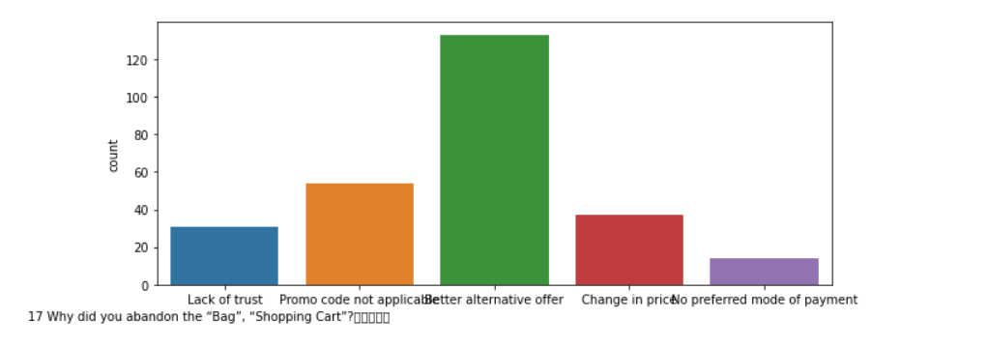

Slide 35
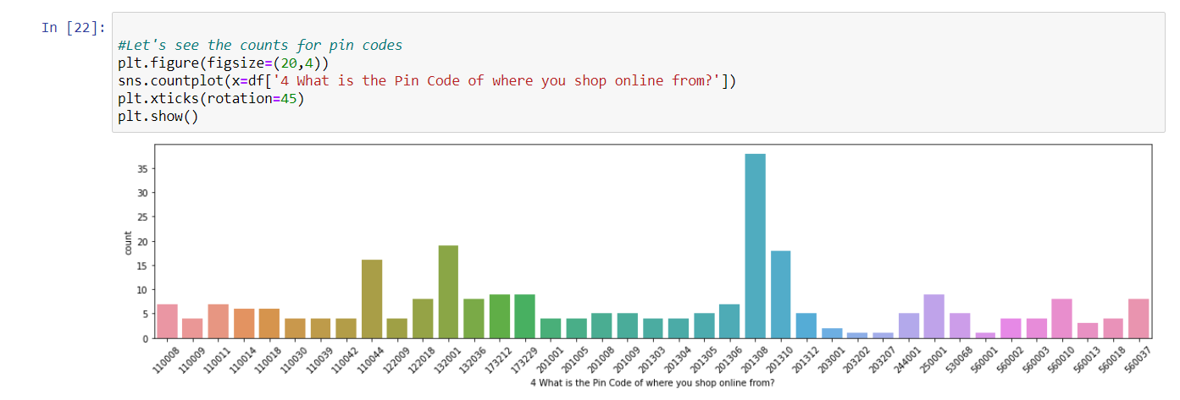

Slide 36
Observations from Multiple Options based Questions
Maximum people have shopped from these 5 companies - Amazon.in, Flipkart.com, Paytm.com, Myntra.com, Snapdeal.com.
Most people find Easy to use website or application are - Amazon.in, Flipkart.com, Paytm.com, Myntra.com, Snapdeal.com Also, Amazon.com and Flipkart.com are the major choices.
In terms of Visual appealing web-page layout also, Amazon.com and Flipkart.com seem to take the lead.
Talking about Wide variety of product on offer: Amazon.com and Flipkart.com are the major choices.
Complete, relevant description information of products: Once again, maximum people have chosen to go with mazon.com and Flipkart.com
Fast loading website speed of website and application: Amazon seems to take the lead in this category, although paytm and Flipkart are not far behind.
Reliability of the website or application: Amazon seems to take the lead in this category too, although Flipkart and paytm are not far behind.
Quickness to complete purchase: Amazon seems to take the lead in this category too, although Flipkart and paytm are not far behind.
Availability of several payment options: Here, Amazon and Flipkart, both are the favourites. Although a lot of people also tend to go towards Myntra
Speedy order delivery: Amazon seems to take the lead in this category too, followed by Flipkart.

Slide 37
Privacy of customers’ information: Amazon has a good reputation for maintaining privacy, followed by Flipkart
Security of customer financial information: Here other than Amazon and Flipkart, Paytm.com, Myntra.com, Snapdeal.com are also trusted by a lot of people. This shows that all compamnies pay special attention to security.
Perceived Trustworthiness: Amazon and Flipkart are winners here as well. Although Myntra.com and Snapdeal.com are also not far behind.
Presence of online assistance through multi-channel: Amazon.in, Flipkart.com, Myntra.com, Snapdeal
Longer time to get logged in (promotion, sales period): Amazon, paytm
Longer time in displaying graphics and photos (promotion, sales period): Amazon.in, Flipkart.com
Late declaration of price: Myntra, Paytm, Snapdeal. These companies should work on this area to improve.
Longer page loading time (promotion, sales period): Myntra and Paytm have bad feedback in this. Flipkart should also have a look into it, as it is at the 3rd place.
Limited mode of payment on most products (promotion, sales period): Snapdeal is the most voted answer for this.
Longer delivery period: Paytm and Snapdeal need to shorten their delivery time.
Change in website/Application design: Amazon.in
Frequent disruption when moving from one page to another: Amazon.in
Website is as efficient as before: Amazon.in
Which of the Indian online retailer would you recommend to a friend?: Amazon/Flipkart

Slide 38
Conclusion
Comparing the Customer's Perceptions and the Company's performance we can conclude that the Companies likely to have
High Customer Satisfaction and Retenton:
Amazon.com Flipkart.com High Risk of Customer Churn:
Myntra.com Snapdeal.com

Slide 39
Inferences:
We can see that the amazon.in and flipkart.com are the e-commerce sites that most customer prefers for shopping
Amazon is the most customer friendly, activated and retention website among others
Amazon is the most shopped website among others for years
Amazon is the most shopping website by the customers and they use credit or debit card for the transaction among other payment methods
Customers abandon the purchase before checkout because there are more better alternative offer available. And also the case when the promo code not applicable most of the times
Amazon and Flipkart are doing well in customer retention with hedonic values among other websites
Amazon is doing well in customer retention with utilitatian values among other websites
Top most good customer retention websites are amazon and flipkart
All the utilitarian values are provided mostly by amazon only when compared with others

Slide 40
Thanks

