Slide 1
Fast-Moving Consumer Goods (FMCG)
Presented By
Shubham Kumar Sahoo

Slide 2
Content
1.Introduction
2.Supply-chain For FMCG Market
3.FMCG Market in INDIA
4.Global FMCG Market
5.FMCG Companies In India
6.Project Growth of FMCG Industry
7.Effect of Covid-19 On FMCG Industry
8.Pareto Principle
9.Benchmarking
10.Research Techniques

Slide 3
Introduction
The Fast Moving Consumer Goods (FMCG) industry primarily deals with the production, distribution and marketing of consumer packaged goods, i.e. those categories of products that are consumed at regular intervals.
Types of Fast-Moving Consumer Goods
Processed foods: Cheese products, Instant food, and boxed pasta
Prepared meals: Ready-to-eat meals
Beverages: Bottled water, energy drinks, and juices
Cleaning products: Baking soda, oven cleaner, and window and glass cleaner
Office supplies: Pens, pencils, and markers

Slide 4
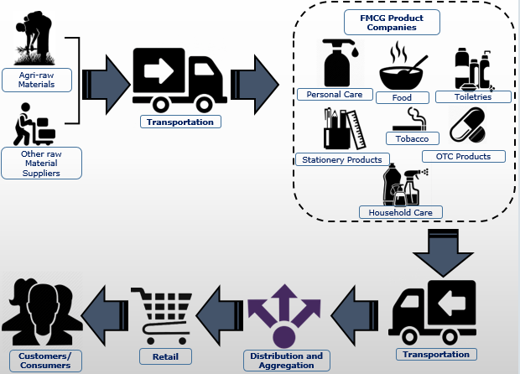
Supply-Chain For FMCG Sector In India

Slide 5
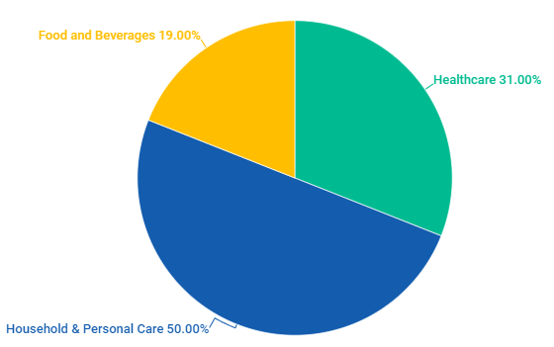
FMCG Market In INDIA
FMCG is the 4th largest sector in Indian economy.
India’s household and personal care is the leading segment ,accounting for 50% of the overall market. And Health Care = 31% , Food and beverages (F&B)=19% comes in term of market share.
Retail market in india is estimated to reach US$ 1.1 Trillion by 2020 , with Morden trade expected to grow at 20-25% per annum, which is likely to boost revenues of FMCG Companies

Slide 6
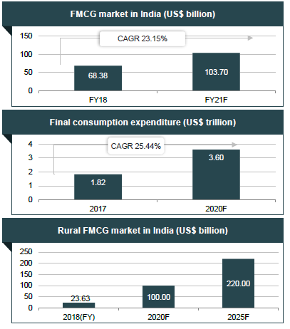

FMCG Market In INDIA
FMCG market in India expected to grow at a Compound annual growth rate of 23.15% to reach US$ 103.70 billion by FY21 from US$ 68.38 billion in FY18.
Final consumption expenditure is set to increase at a CAGR of 25.44% during 2017-2021. It is expected to reach nearby US$ 3.60 trillion by 2020 from US$ 1.82 trillion in 2017.
Rise in Rural consumption will drive the FMCG market. It contributes around 36% to the overall FMCG spending.
The Rural FMCG market in india is expected to grow to US$ 220.00 billion by 2025 from US$ 23.63 billion in FY18.
(Source-www.ibef.org/FMCG-report-june-2020)

Slide 7

Global FMCG Market
According to a report published by Allied Market Research, titled,"Global FMCG Market by Type and Distribution Channel: Opportunity Analysis and Industry Forecast, 2018 - 2025"the global FMCG market size was valued at $10,020.0 billion in 2017 and is projected to reach $ 15,361.8 billion by 2025, registering a CAGR of 5.4% from 2018 to 2025..
Key Findings of the FMCG Market
In 2017, the food & beverages segment accounted for around 89% of global FMCG market share, growing at a CAGR of 5.3% from 2018 to 2025.
In 2017, the healthcare segment accounted for 4% share of the global FMCG market and is expected to growth at the highest CAGR of 8.5%.
Personal care segment has occupied around 5% share of the market share and is expected to growth at the highest CAGR of 6.0%.
(https://www.alliedmarketresearch.com/press-release/fmcg-market)

Slide 8
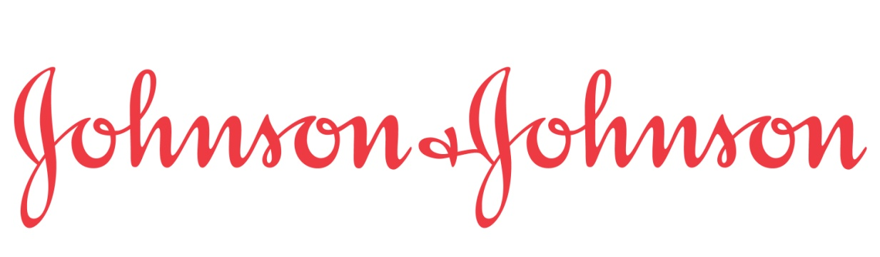
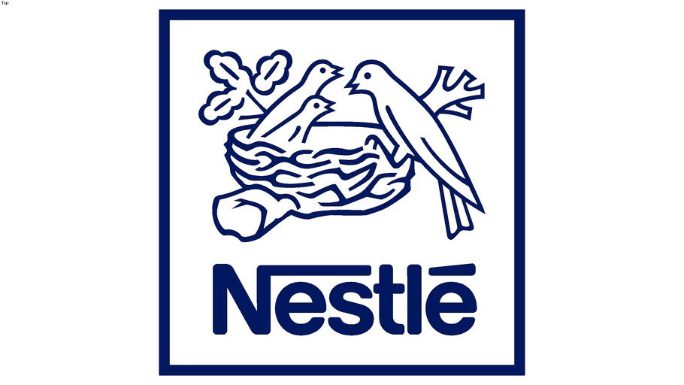
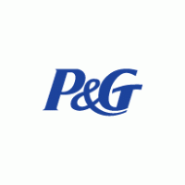
TOP-3 FMCG Company Globally
Johnson & Johnson
Revenue: $366.4 billion
Company Details: Since over 130-years, the US-based company is producing various FMCG goods, from Consumer Health Products to Medical Devices and Pharmaceutical products. The company has a substantial presence in more than 60 countries.
2. Nestle
Revenue: $286.2 billion
Company Details: Based in Switzerland, Nestle is one of the world’s largest food and beverage companies. The company owns more than 2000 brands, ranging from global icons to local favourites. They have proved their presence in 191 countries around the world.
3. Procter & Gamble
Revenue: $ 256.3 billion
Company Details: Globally recognised, one of the top consumer goods product company, Procter and Gamble (also known as P&G) is specialised in home care, fabric care and personal care products. It owns large brands such as Gillette, Ariel, and Pampers.

Slide 9
FMCG Companies In India
Name Of The Company | Revenue (In Rs.)
ITC Ltd (Imperial Tobacco Company) | 51,321 Cr
Britannia Industries Ltd | 11,211 Cr
Godrej Consumer Products Ltd | 10,156 Cr
Dabur India Ltd | 8,813 Cr
Marico Ltd | 7,465 Cr
Varun Beverages Ltd | 6,695 Cr
GlaxoSmithKline Consumer Healthcare Ltd | 4,942 Cr

Slide 10
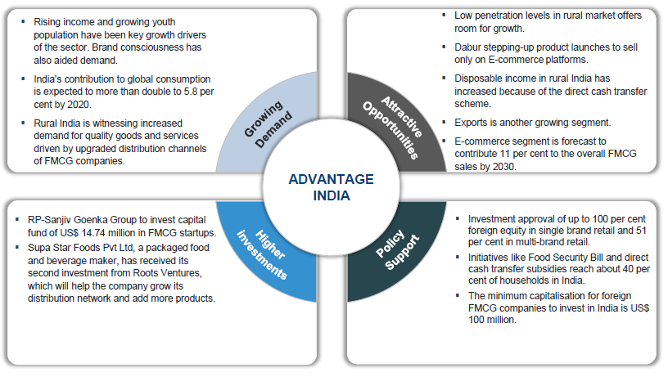

Slide 11
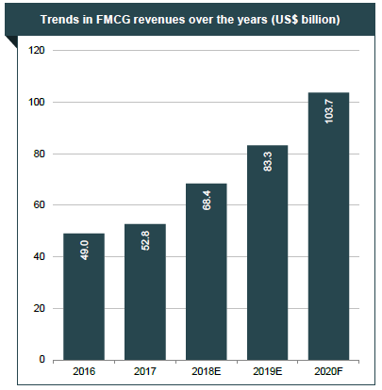
Projected Growth Of FMCG Industry
Revenue of FMCG sector reached US$ 52.8 billion in FY17 and are estimated to reach US$ 103.7 billion in FY20.
(Source-www.ibef.org/FMCG-report-june-2020)

Slide 12
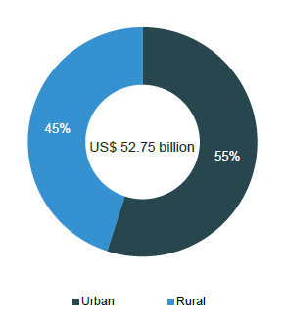
Urban Market Vs Rural Market
In last few years ,the FMCG market has grown at a faster pace in rural india compared to urban india.
Accounting For a revenue share of around 55% Urban segment is the largest contributor to the overall revenue generated by the FMCG Sector in India.
Rural segment is growing at a rapid pace and accounted for a revenue share of 45% in the overall revenues recorded by FMCG sector in India.
The Online FMCG market is forecast to reach US$ 45 billion in 2020 from US$ 20 billion in 2017 . And growth in online users from 90 million in 2017 to estimated to reach 200 million in 2020 .
(Source-www.ibef.org/FMCG-report-june-2020)

Slide 13
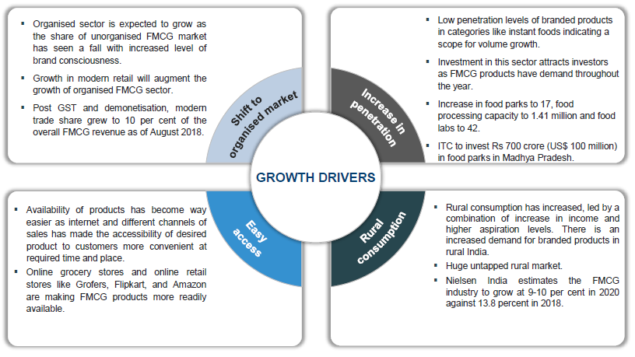

Slide 14
Effect Of Covid-19 On FMCG Industry
The growth of the sector decreased to 3.3% in March 2020 from 6.4% in Jan–Feb 2020.
Immediately after the lockdown, the demand and consumption of FMCG and household products increased massively owing to panic buying by consumers. As a result of the surge in demand, companies had to increase production.
Products such as food, groceries and staples, health and hygiene products including soaps, detergents, hand washes and sanitizers, etc. witnessed massive increase in demand.
Hand sanitizers, hand washes and other health hygiene products have seen the highest growth. The increasing awareness and demand for these products is expected to create lucrative opportunities for related companies till 2022.

Slide 15



Key Challenges
Consumer
Manufacturer
Retailer
Shortage of various essential items due to panic buying by other customers
Certain stores flocked with people are putting the consumers at a higher risk of catching the virus
Online delivery is not available in all regions due to increased border controls ……………………….....
Workforce shortage due to migration and lockdown
Closure of stores and a lesser demand for non-essentials goods have led to excess stock in inventory
Supply chain disruption due to restrictions in the movement of goods has made it difficult for the manufacturers to meet the demand ……………..
OFFLINE
Maintenance of proper hygiene by regularly cleaning and sanitizing shelfs.
Ensure that the customers maintain safe social distancing standards
ONLINE
Increased online demand disrupted the unready retailers leading to coordination issues between online and offline teams
Delivery restriction in most areas due to border controls.

Slide 16
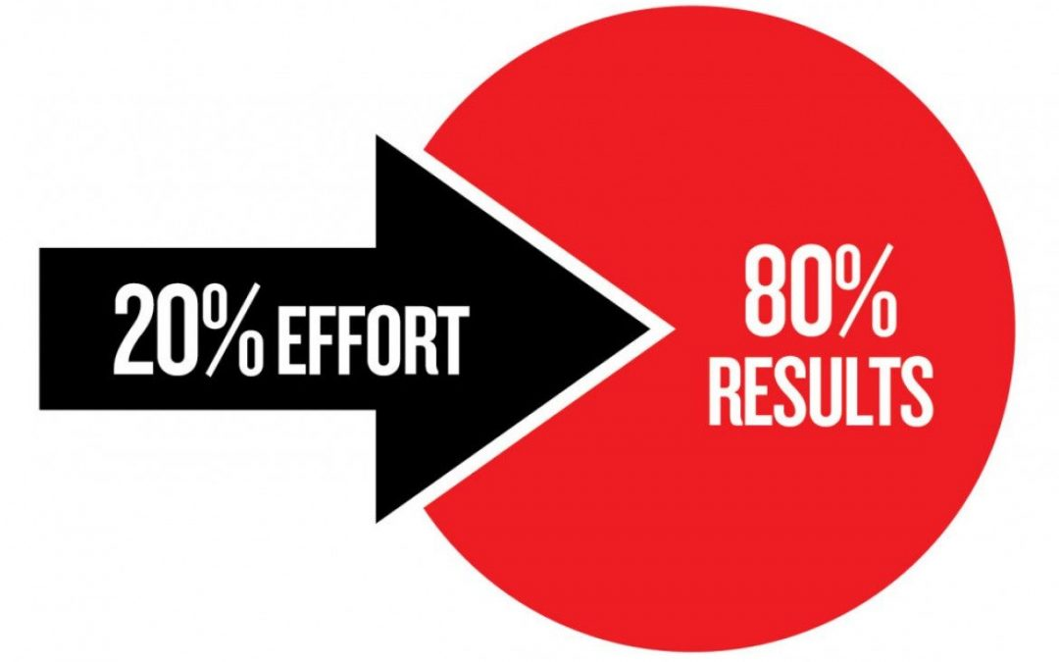
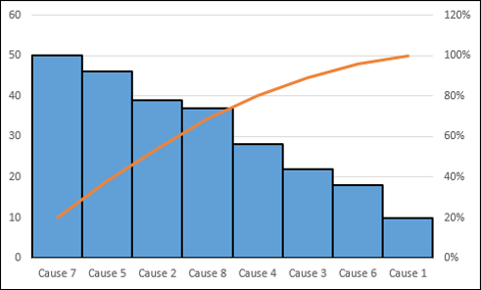
Pareto Principle
It states that 80% of the result come from 20% of the effort. Also referred to as 80-20 rule.
The exact Percentages may vary in different situation.
The Pareto principle used when we have many problems or projects and we wanna
focus on the most significant ones.
Its helps to Improving productivity and Profitability.
Examples-
1.20% of workers do 80% of work.
2.20% of Product are responsibility for 80% of revenue.
The Pareto Chart
A frequency bar chart.
The horizontal axis represents the types of activities
such as Issues ,Problems or causes
The Vertical axis represents the frequencies of those activities.

Slide 17


Benchmarking
Introduction
Benchmarking is mainly used to assess the competitive insight and also gather the information based on the performance which was done throughout the product or organization development process.
With the help of this benchmarking process, we can evaluate and identify the process to eliminate problems which help further in improving and enhancing our performance.
Types of Benchmarking
Internal benchmarking:
In this type of benchmarking the comparison of practices and performance is done between teams, individuals or groups within an organization
2.External benchmarking
In the external benchmarking process, the comparison of organizational performance towards the company peers or across companies.
Following are the type of external benchmarking :-
2.1 Process benchmarking
Benchmarking is usually a process to see how the competitors are working or how they are able to gain success.

Slide 18
Benchmarking
2.2 Performance Benchmarking
In this benchmark we have to comparing competitors or analysing clients, numerical metrics are gathered as information.
2.3 Strategic Benchmarking
Strategic benchmarking analyses how top companies compete and use the best strategies to achieve success in this competitive market. This type is mainly helpful for all the organizations which are aiming for their long term goals.
Benchmarking Process:
Step-1. Determining aspects of the company
Step-2. Planning and research
Step-3. Collection of data
Step-4. Examination
Step-5. Development
Advantages of Benchmarking
Implements creative ideas
Developing improvement
Quality of work
Increased performance

Slide 19
Research Techniques
Research technique is process of collecting, recording, analyzing and interpreting data for aid in solving different problems.
Research Process
Step-1. Identify the Problem
Step-2. Developing a research design
Step-3. Collection Of Data
Step-4. Analysis Of Data
Step-5. Finding Conclusion
Step-6. Reporting

Slide 20


