Slide 1

Note: The data and information in this document is reflective of a hypothetical situation and client. This document is to be used for KPMG Virtual Internship purposes only.
Sprocket Central Pty Ltd
Data analytics approach
[Division Name] - [Engagement Manager], [Senior Consultant], [Junior Consultant]

Slide 2
Note: The data and information in this document is reflective of a hypothetical situation and client. This document is to be used for KPMG Virtual Internship purposes only.
Agenda
1. Introduction
2. Data Exploration
3. Model Development
4. Interpretation

Slide 3
Note: The data and information in this document is reflective of a hypothetical situation and client. This document is to be used for KPMG Virtual Internship purposes only.
Introduction
Gaining a Competitive Edge: Understanding our Target Demographic through Analysis
The primary objective of the analysis is to delve into our customer base intricately, enabling us to discern and prioritize high value customers who will be the focus of our targeted marketing endeavors.

Slide 4
Note: The data and information in this document is reflective of a hypothetical situation and client. This document is to be used for KPMG Virtual Internship purposes only.
Data Exploration
Unraveling and Shaping Insights
In this initial phase, our focus was on gaining a deep understanding of the data by delving into its characteristics, patterns, and distributions. Our approach included:
1. Data Exploration: We conducted a thorough exploration of the dataset, identifying missing values, outliers, and potential data quality issues. This step laid the foundation for subsequent data preprocessing and cleaning.
2. Feature Analysis: Understanding the relevance and significance of each feature within the dataset. We performed correlation analysis and feature importance assessments to determine the most influential variables.
3. Data Preprocessing: Rigorous data cleaning, imputation of missing values, and handling outliers were carried out to ensure the integrity of the dataset. Standardization and normalization techniques were applied to bring consistency to the data.
Place any supporting images, graphs, data or extra text here.

Slide 5
Note: The data and information in this document is reflective of a hypothetical situation and client. This document is to be used for KPMG Virtual Internship purposes only.
Data Exploration
Unraveling and Shaping Insights
We faced various issues in the dataset, after analyzing the dataset based on Data Quality Framework.
In the demographics table:
Multiple fields (last name, dob, tenure) have missing values. Hence, the data is incomplete.
Gender field has some incorrect values(U). Therefore, some records have invalid gender values.
In the default field, there is no formula defined and the values don’t have specific data type as well as have random values. The field might be irrelevant.
In the new customer table:
Some fields (post code, property value, past 3-year bike related purchase) have wrong data type for the values stored in them.
Multiple fields (job title, tenure) have missing values. Hence, the data is incomplete.
Some records have incorrect value(n/a) defined in the job category column.
There is inconsistency in the rank field as multiple customers share the same rank.
In the transactions table:
Multiple fields (order online, product line, product class and product size) have missing values. Hence, the data is incomplete. The standard cost field has missing values for some transactions/purchases.

Slide 6
Note: The data and information in this document is reflective of a hypothetical situation and client. This document is to be used for KPMG Virtual Internship purposes only.
Data Exploration
Unraveling and Shaping Insights
In order to perform exploratory data analysis to accurately measure various variables and find insights, we performed some data cleaning norms.
We filtered out the customers demographics table with blank/null values in D.O.B field. We also filtered the customers having incorrect value ‘U’ in gender field.
In the address table, we encountered multiple values(V, Vic and Victoria) for the same state. We replaced them with single value all across the table.
In the transactions table, there were records with missing values about list price and order date. We excluded those records from our new dataset.

Slide 7
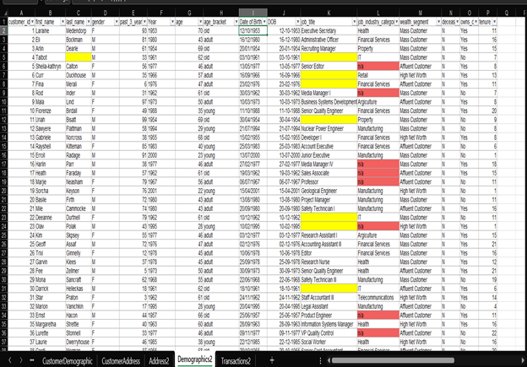
Note: The data and information in this document is reflective of a hypothetical situation and client. This document is to be used for KPMG Virtual Internship purposes only.
Data Exploration
Unraveling and Shaping Insights
Place any supporting images, graphs, data or extra text here.

Slide 8
Note: The data and information in this document is reflective of a hypothetical situation and client. This document is to be used for KPMG Virtual Internship purposes only.
Model Development
Empowering Your Business with Cutting-Edge Model Deployment
Building on the insights gained from Phase 1, we employed advanced modeling techniques to develop a predictive framework. Our methodology involved:
1. Feature Engineering: We crafted new features and transformed existing ones to enhance model performance and ensure optimal representation of the data.
2. Model Selection: A variety of relationships were evaluated and compared to identify the most suitable model for our specific problem.

Slide 9
Note: The data and information in this document is reflective of a hypothetical situation and client. This document is to be used for KPMG Virtual Internship purposes only.
Model Development
Empowering Your Business with Cutting-Edge Model Deployment
Here’s the overview of some steps for model deployment:
We studied the customer segmentation by grouping them based on different fields like age, wealth segment, state, job industry, brand preference, product line and purchase behavior.
We created some calculated field from existing fields to classify data into numerous categories.
We used the concept of relationships and join operations to analyze our customer base on the basis on variables stored in different tables.
This will majorly show our customer base and appropriately target new customers with same specifications in the future. The information could be used to extract insights from new customers dataset that would not be immediately obvious and confirm our hypothesis.

Slide 10
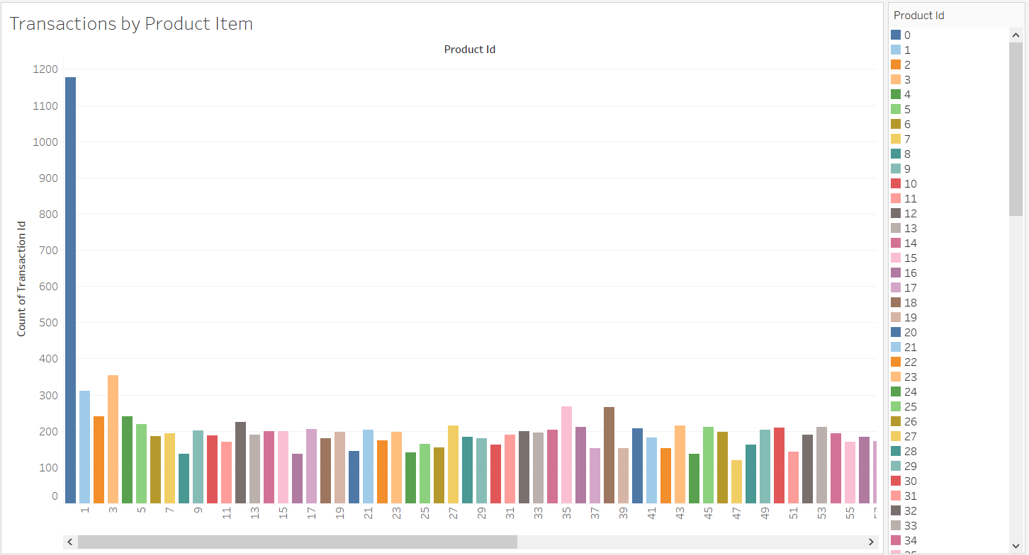
Note: The data and information in this document is reflective of a hypothetical situation and client. This document is to be used for KPMG Virtual Internship purposes only.
Interpretation
Discovering the Key Findings that Lead to Remarkable Results
The culmination of our efforts lies in Phase 3, where we interpret the model results and present them in a clear and actionable manner. This phase includes:
1. Performance Metrics: Presenting comprehensive performance metrics that demonstrate the effectiveness of our models and their alignment with the project objectives.
2. Visualizations and Reports: Utilizing visually appealing charts and graphs, we communicate the findings to both technical and non-technical stakeholders, ensuring accessibility and ease of comprehension.
Place any supporting images, graphs, data or extra text here.

Slide 11
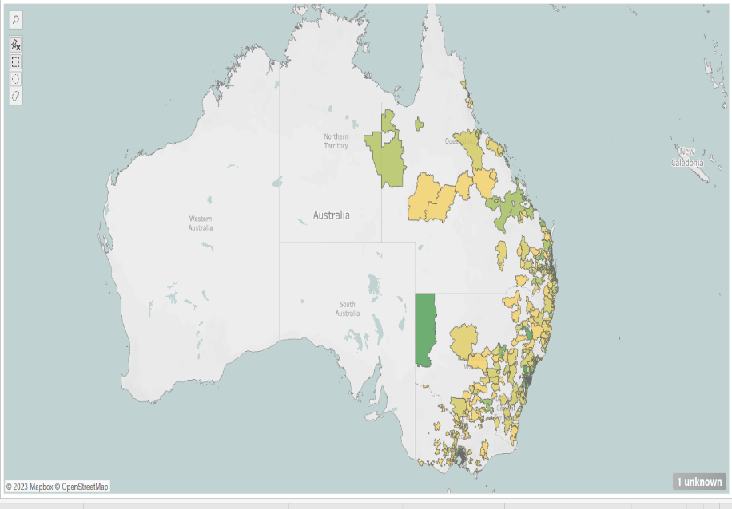
Note: The data and information in this document is reflective of a hypothetical situation and client. This document is to be used for KPMG Virtual Internship purposes only.
Interpretation
Discovering the Key Findings that Lead to Remarkable Results
The map shows the distribution of number of customers by postcode and state.
Green-Gold color scale represents the number of customers with green representing highest and gold representing lowest no of customers.
New South Wales has maximum no of customers(2140), followed by Victoria(1021) and Queensland(838).
Place any supporting images, graphs, data or extra text here.

Slide 12
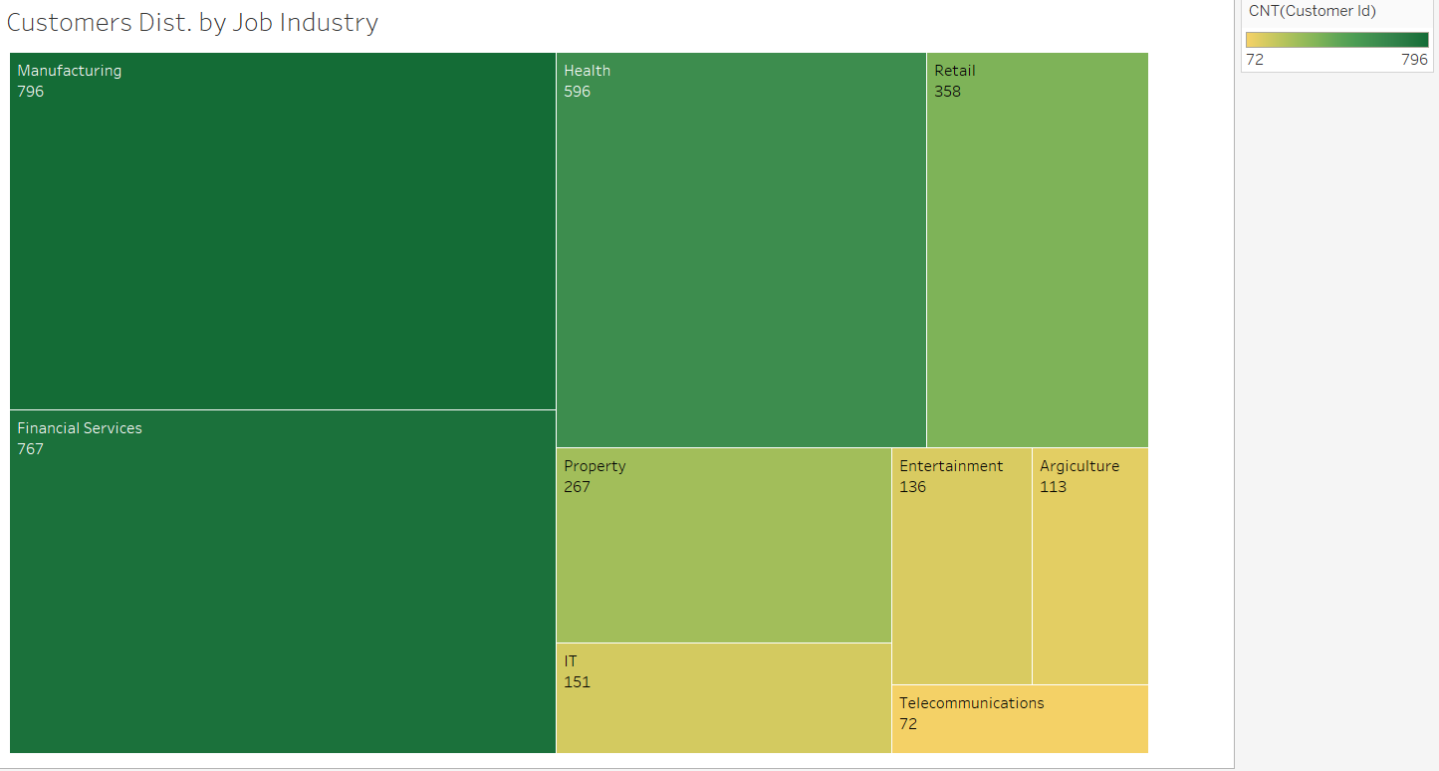
Note: The data and information in this document is reflective of a hypothetical situation and client. This document is to be used for KPMG Virtual Internship purposes only.
Interpretation
Discovering the Key Findings that Lead to Remarkable Results
The tree-map represents the distribution of customers based on job industry.
Highest no of customers belong to Manufacturing industry(796) while Telecommunications has the lowest no of customers(72).
Place any supporting images, graphs, data or extra text here.

Slide 13
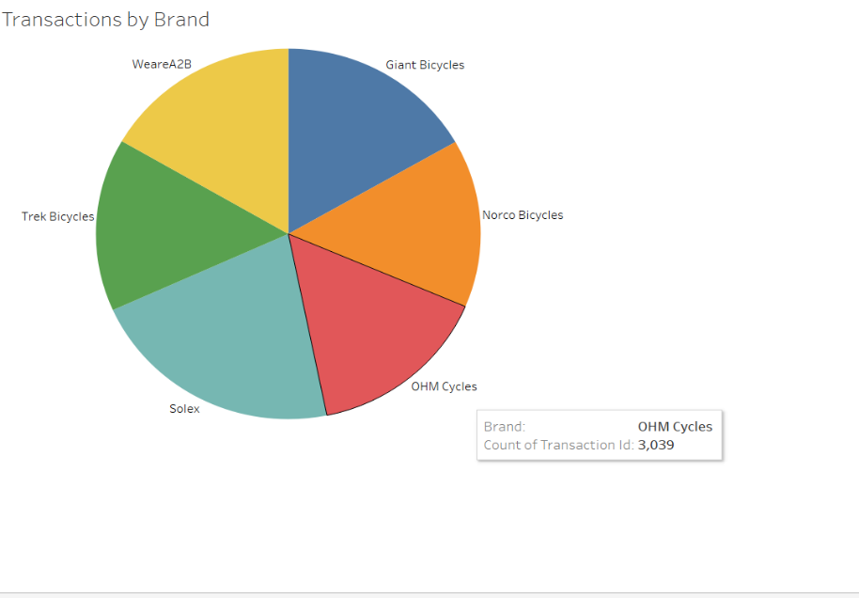
Note: The data and information in this document is reflective of a hypothetical situation and client. This document is to be used for KPMG Virtual Internship purposes only.
Interpretation
Discovering the Key Findings that Lead to Remarkable Results
The pie chart represents the distribution of transactions by brand.
Such more visualizations were mapped for different variables in the dataset.
They will help to identify patterns and trends. This understanding can be used to develop specific marketing strategies and test them.
Place any supporting images, graphs, data or extra text here.

