Slide 1
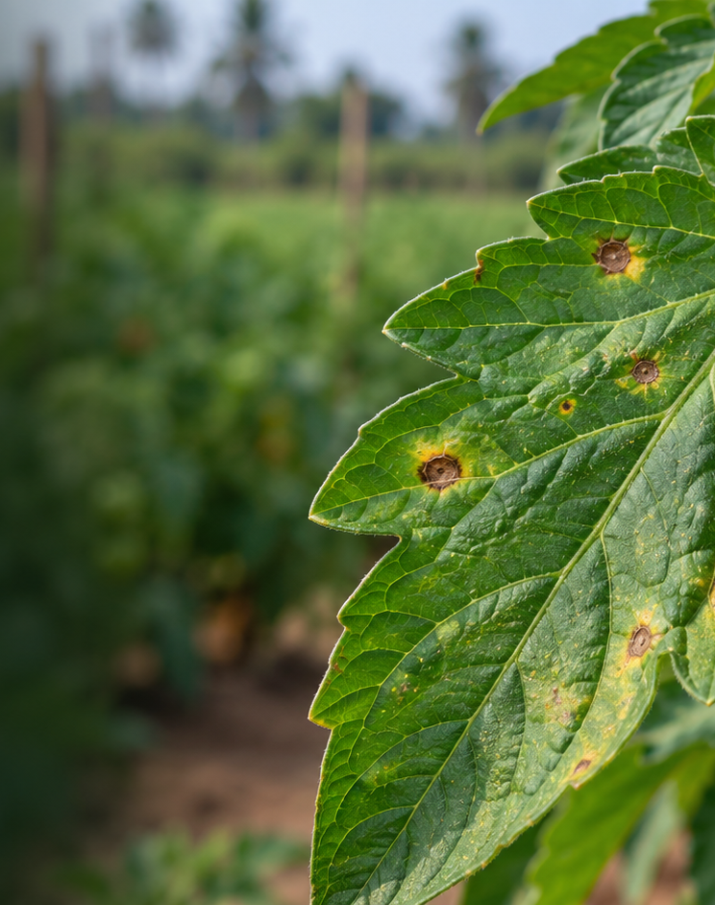
B.TECH CAPSTONE PHASE 2
Plant leaves
disease detection
using CNN
From a 21-paper review to a tested CNN baseline
TEAM
Shubham Kumar CS-2341770
Ujjwal Pratap Singh CS-2341898
Vivek Kumar Prajapati CS-2341881
Shubham Kumar CS-23411370
GUIDE
Dr. Harendra Singh
IILM University Phase 2 results and next research steps
Notes:
Opening: Phase I direction asked the team to review at least 15 papers. The supplied review records 21 entries. Explain that the work now follows that evidence with a reproducible Phase 2 baseline. Official project title and guide name come from the approval form. Team roster and roll numbers come from the Phase I project record; confirm the fourth roll number if it is questioned. Image generated for this presentation, not a model output.

Slide 2
01 LITERATURE REVIEW
The test setting changes what a score means
Phase I asked for 15+ papers. The team recorded 21. Strong benchmark scores still do not prove field performance.
21
99.35%
31.4%
papers reviewed
Mohanty et al., PlantVillage held-out test
Same paper’s separate images from other sources
Approaches span custom CNNs, transfer learning, lightweight networks, attention, transformers, and explanations.
The two scores use different image sources. Read them as a domain-gap signal, not as a direct head-to-head result.
What the survey adds
Field photos expose background and lighting variation.
Smaller models target phones and edge devices.
Macro and class-level measures expose weak classes.
Heatmaps can support review, but do not prove correctness.
LITERATURE AND EVALUATION GAP
02
Notes:
The official records say 21 papers were surveyed. The attached PDF provides 21 notes but not a complete bibliography. This slide uses the fully identifiable Mohanty et al. study as a concrete example. The source reports 99.35% on held-out PlantVillage and 31.4% on images from other sources. The tests differ, so do not describe them as the same split. Other confirmed examples: Kamal et al. report 98.34% Reduced MobileNet on PlantVillage and 36.03% for MobileNet on different-condition images. Sources: https://doi.org/10.3389/fpls.2016.01419 ; https://doi.org/10.1016/j.compag.2019.104948 ; https://arxiv.org/abs/1911.10317. Source for review count and themes: supplied Review of Literature PDF. The updated literature file marks citation gaps and conflicting claims.

Slide 3
02 METHOD CHOICES
Phase 2 controls the main evaluation risks
The project starts with a simple model and makes the evaluation protocol visible.
LITERATURE CONCERN
PROJECT RESPONSE
STATUS
Near-duplicate images can inflate scores
Remove matching groups or hashes; freeze train, validation, and test manifests
DONE
Accuracy can hide weak classes
Report macro-F1, balanced accuracy, per-class scores, and confusion matrix
DONE
Complex models are hard to compare
Establish a four-stage SmallCNN reference before adding attention or transformers
DONE
Validation can leak into final reporting
Select the checkpoint on validation; evaluate the held-out test once
DONE
Controlled images do not prove field transfer
Keep PlantDoc external; map only confirmed shared classes before testing
NEXT
PlantDoc is reserved for an external check. The current score comes only from PlantVillage.
SURVEY FINDING AND PROJECT CONTROL
03
Notes:
Describe each row as a direct design decision. PlantVillage source split included train/test duplicates by group ID or exact hash; 290 training rows were excluded before the development split. The frozen PlantVillage manifests contain 36,762 train, 6,544 validation, and 10,709 test images. Current PlantDoc images are not evaluated. Its label taxonomy differs, so the team must publish a reviewed mapping first. Local sources: reports/split_freeze.json, reports/data_audit.json, data/README.md, reports/phase2_baseline/PHASE2_RESULTS_SUMMARY.md.

Slide 4
03 DATA AND MODEL
Frozen splits support a reproducible baseline
PlantVillage supplies 38 classes. PlantDoc remains a separate future external test.
PLANTVILLAGE SOURCE
FROZEN SPLIT
54,305
290
source images
overlap rows removed
Train 36,762
Validation 6,544
Test 10,709
TRAIN ONLY
Resize to 224 px, normalize, flip, rotate, and adjust color
INPUT
then
BASELINE MODEL
then
OUTPUT
RGB leaf image
SmallCNN (32, 64, 128, 256)
38 crop–disease labels
Validation selects the checkpoint. Test measures it once. PlantDoc archive: 2,578 images found; upstream page says 2,598.
PLANTVILLAGE BASELINE PLANTDOC NOT YET TESTED
04
Notes:
The upstream PlantVillage archive supplies 54,305 rows. The audit removed 290 source-train rows that matched test group IDs or exact hashes. The resulting 54,015 images are split into 36,762 train, 6,544 validation, and 10,709 test. Training-time normalization uses channel mean and standard deviation 0.5. Augmentation applies to train images only. The model uses AdamW, cross-entropy, batch 64, up to 12 epochs, mixed precision, and two Tesla T4 GPUs. PlantDoc contains 2,578 files in the retrieved archive, while its upstream paper reports 2,598; the project data README records this discrepancy. It is not used in the current result. Sources: project data README, split_freeze.json, experiment_config.json; PlantDoc source https://arxiv.org/abs/1911.10317.

Slide 5
04 RESULTS
Held-out PlantVillage test: 96.07% macro-F1
Checkpoint chosen at epoch 12 using validation macro-F1. Test size: 10,709 PlantVillage images.
TRAIN LOSS
VALIDATION MACRO-F1
96.95%
96.02%
96.07%
Accuracy
Balanced accuracy
Macro-F1
Train loss fell across epochs. Validation macro-F1 moved unevenly, so the team kept the best validation checkpoint.
HELD-OUT TEST PLANTVILLAGE ONLY
05
Notes:
Charts use the recorded training_history.csv values for all 12 epochs. The model was selected at epoch 12, validation macro-F1 0.94441. Locked test metrics on 10,709 images: accuracy 0.9694649, balanced accuracy 0.9601606, macro-F1 0.9606802. These are PlantVillage scores only. The validation set did not update model weights; the test set was evaluated after selecting the checkpoint. The curves show non-monotonic validation performance, which supports keeping the checkpoint rule explicit. Source: reports/phase2_baseline/training_history.csv and locked_test_metrics.json.

Slide 6
05 NEXT RESEARCH STEPS
The next test is whether the baseline transfers
Phase 2 establishes an in-domain reference. The field claim remains open.
1
External test
Map shared PlantVillage and PlantDoc labels. Evaluate PlantDoc once. Report unmatched classes.
2
Error review
Use the class report and confusion matrix. Find weak classes and likely failure patterns.
3
Fair comparison
Compare selected transfer-learning models on the same frozen split and metrics.
4
Trust and use
Test calibration and abstention. Add Grad-CAM and a small demo after external evaluation.
CODE AND DATA SOURCES
GitHub github.com/Shubham12864/Plant-leaves-disease-detection-using-cnn
PlantVillage huggingface.co/datasets/mohanty/PlantVillage
PlantDoc github.com/pratikkayal/PlantDoc-Dataset
Next deliverable: a reviewed PlantDoc label map and external test report.
PHASE 2 COMPLETE FINAL PROJECT WORK CONTINUES
06
Notes:
Close with a specific plan. PlantDoc data is present in the project but no PlantDoc model score exists. The label mapping must be reviewed because names differ and no exact string overlap exists. Keep the current PlantVillage test as the frozen baseline. Future proposal items such as Grad-CAM, severity grading, leaf localization, advisory features, and a web demo are not implemented in Phase 2. GitHub: https://github.com/Shubham12864/Plant-leaves-disease-detection-using-cnn. PlantVillage source: https://huggingface.co/datasets/mohanty/PlantVillage. PlantDoc source: https://github.com/pratikkayal/PlantDoc-Dataset. Current results are in reports/phase2_baseline/.

