Slide 1

EY Techathon 6.0 Executive Summary
Date of submission: 12/10/2025

Slide 2
We — Shubham Mirashi, Pranav Kadagadakai, and Sakshi Patanashetti — are final-year students of Information Science and Engineering at KLS Gogte Institute of Technology, Belagavi.
We are passionate about solving real-world problems through innovative and impactful technological solutions. Our motto is simple yet powerful:
“We see our projects as products.”
We have developed several projects that continue to make everyday tasks easier for people, and we are excited to bring our innovative mindset and problem-solving skills to the EY Techathon.

Slide 3
Tell us about yourself.
Highlight a technical skill or skills each member brings to the team
01#
Shubham Mirashi
03#
Pranav Kadagadakai
05#
Sakshi Patanashetti
Python
C++
SQL
Django
MERN
React + Vite
Networking Essentials
Cloud Computing
Operating System(Win, Lin)
Communication, Analytical, Strategic planning, Problem Solving
Analytics
AIML
Python
C++
C
Django
React + Vite
Networking
Cloud Computing
Operating System(Win, mint)
Communication, Analytical, Strategic planning
Bash
AIML
Analytics
Relational Databases
Java
C++
Computer Networks
React + Vite
AIML
Networking
Cloud Computing
Operating System(Win, mint)
Communication, Analytical, Strategic planning
Bash
Salesforce
Analytics
Relational Databases

Slide 4

  Problem Statement:
  Large NBFCs face low conversion rates and revenue loss in their personal loan segment due to slow manual processes, fragmented workflows, and impersonal sales approaches.
  Our solution — SmartLoan Agent — is an Agentic AI-driven system where a Master Agent orchestrates multiple Worker Agents (Sales, Verification, Underwriting, Sanction Generator) to automate, personalize, and accelerate the entire personal loan sales journey from chat to sanction letter.
  Why This Problem Matters:
  Low Conversions: Generic telecalling and delayed responses lead to customer drop-offs.
  Manual Bottlenecks: Verification and underwriting take days instead of minutes.
  Fragmented Systems: Sales, KYC, and underwriting data exist in silos, causing inefficiency.
  Customer Dissatisfaction: Slow turnaround and lack of personalization hurt brand perception.
  Revenue Loss: Missed opportunities to cross-sell loans to existing customers.
  Business Impact if Solved:
  +40% conversion in personal loan approvals.
  -80% processing time through real-time AI orchestration.
  Consistent KYC and underwriting compliance.
  Human-like, 24×7 digital experience improving customer satisfaction (CSAT/NPS).
Problem statement you wish to address and why
(Provide detailed explanation)

Slide 5
Web-Based Chatbot (Agentic AI System)
A web chatbot interface acts as a digital sales assistant, available 24×7.
The Master Agent orchestrates all background activities through Worker Agents:
  Sales Agent → negotiates loan terms persuasively.
  Verification Agent → confirms KYC via dummy CRM.
  Underwriting Agent → checks credit score, evaluates eligibility, requests salary slip if required.
  Sanction Letter Generator → creates an auto-approved PDF sanction letter.
Fully faceless, yet human-like — the customer experiences an empathetic, conversational flow.
Key User Group:
👤 Primary Users:
Existing and prospective NBFC customers seeking quick personal loans via digital ads, website, or marketing emails.
🏢 Secondary Users (Internal):
Sales and Operations Teams: Monitor AI decisions and review edge cases.
Business Analysts / Risk Teams: Track approval trends and conversion metrics via dashboards.
Describe your approach to solving the problem
(Describing Output Form Factor [Mobile App/Web App/Faceless Agent Execution/Chat Bot/Voice Bot Etc], Key User Group, User Journey.

Slide 6
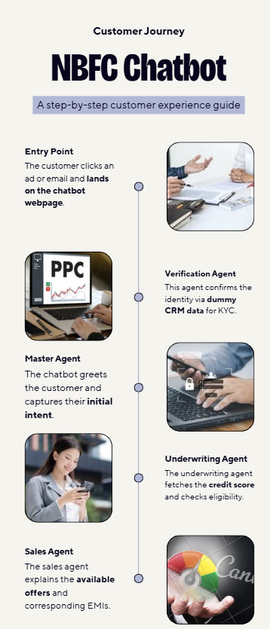
Frontend
React + Vite – High-performance and modular frontend framework
Tailwind CSS – Modern and responsive UI styling
Axios / Fetch API – Seamless communication with backend services
Redux Toolkit / Zustand – Efficient global state management
Backend
FastAPI – Core AI orchestration, chat flow management, async operations
Django + Django REST Framework (DRF) – CRM management, admin dashboards, and analytics layer
JWT + OAuth 2.0 – Unified and secure authentication mechanism
WebSockets – Enables real-time, bi-directional communication for chatbot conversations
Database
MongoDB
Via Motor (for FastAPI) and Djongo/MongoEngine (for Django)Optimized for storing chat logs, user data, and loan application records
preprocessing, trend analysis, and visualization
AI & Analytics
LangChain / OpenAI API / Hugging Face Transformers – Conversational intelligence and orchestration
Scikit-learn / PyTorch / TensorFlow – Credit scoring and loan eligibility modeling
Pandas / NumPy / Plotly – Data preprocessing, trend analysis, and visualization
Integrations
Twilio / WhatsApp API – Multi-channel conversational interface
PDFKit / ReportLab – Automated sanction letter generation
CRM & KYC APIs – Verification and customer data validation layer
Cloud & DevOps
AWS / Azure / Render – Scalable and secure deployment
Docker + Kubernetes – Containerization and microservice orchestration
Security
JWT + OAuth 2.0 – Robust authentication and token management
HTTPS / TLS Encryption – End-to-end secure communication
Role-Based Access Control (RBAC) – Fine-grained user permissions and access control
Planned solution design
(Diagram and Key Technology components planned for use)

Slide 7
Business & Operational Benefits
💬 Seamless Customer Experience:
Customers can complete end-to-end loan processing in a single chat, from inquiry → verification → sanction letter.
Eliminates the need for physical visits or manual document handling.
⚙️ Reduced Operational Overheads:
AI Agents automate tasks like eligibility checks, KYC validation, and document verification — minimizing manpower dependency.
Underwriting efficiency improved by 70–80%.
🚀 Faster Turnaround Time:
Loan sanction time reduced from 2–3 days → under 5 minutes.
Enhances NBFC’s responsiveness to walk-in and online leads.
💡 Improved Lead Conversion:
Conversational engagement improves lead-to-loan conversion by 30–40%.
Personalized responses create trust and improve customer retention.
Customer-Centric Benefits
✅ 24×7 Availability:
Customers can interact with the chatbot anytime — beyond business hours.
📱 Omnichannel Integration:
The system can be deployed via website, WhatsApp, or mobile app, expanding customer touchpoints.
🧾 Instant Sanction Letter:
Immediate gratification via auto-generated sanction PDF, driving satisfaction and transparency.
Potential Benefit from your proposed solution
(Describe in detail the kind of benefit can be planned through your solution, Explain key Matrix, Potential Return on Investment)

Slide 8







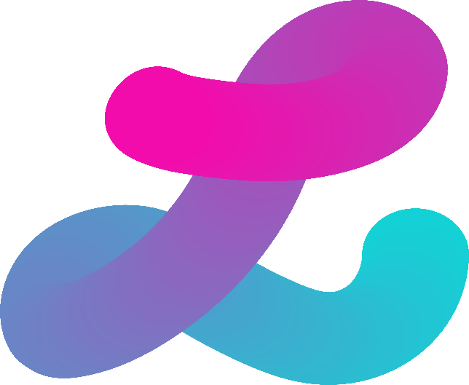
Powered by India's leading enterprises
Thank you for
your attention!

Slide 9


Ernst & Young LLP
EY | Building a better working world
EY is building a better working world by creating new value for clients, people, society and the planet, while building trust in capital markets.
Enabled by data, AI and advanced technology, EY teams help clients shape the future with confidence and develop answers for the most pressing issues of today and tomorrow.
EY teams work across a full spectrum of services in assurance, consulting, tax, strategy and transactions. Fueled by sector insights, a globally connected, multi-disciplinary network and diverse ecosystem partners, EY teams can provide services in more than 150 countries and territories.
All in to shape the future with confidence.
EY refers to the global organization, and may refer to one or more, of the member firms of Ernst & Young Global Limited, each of which is a separate legal entity. Ernst & Young Global Limited, a UK company limited by guarantee, does not provide services to clients. Information about how EY collects and uses personal data and a description of the rights individuals have under data protection legislation are available via ey.com/privacy. EYG member firms do not practice law where prohibited by local laws. For more information about our organization, please visit ey.com.
Ernst & Young LLP is one of the Indian client serving member firms of EYGM Limited. For more information about our organization, please visit www.ey.com/en_in.
Ernst & Young LLP is a Limited Liability Partnership, registered under the Limited Liability Partnership Act, 2008 in India, having its registered office at Ground Floor, Plot No. 67, Institutional Area, Sector - 44, Gurugram - 122 003, Haryana, India.
© 2025 Ernst & Young LLP. Published in India.
All Rights Reserved.
This publication contains information in summary form and is therefore intended for general guidance only. It is not intended to be a substitute for detailed research or the exercise of professional judgment. Neither EYGM Limited nor any other member of the global Ernst & Young organization can accept any responsibility for loss occasioned to any person acting or refraining from action as a result of any material in this publication. On any specific matter, reference should be made to the appropriate advisor.

