Slide 1
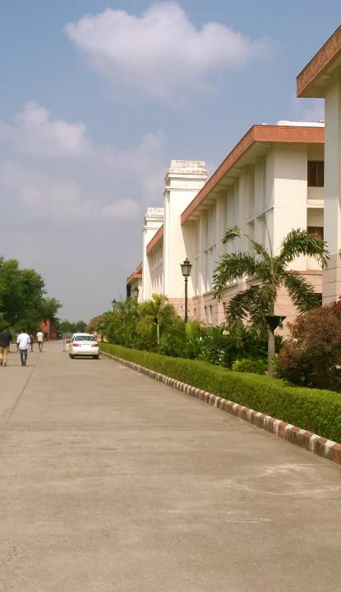

Mini Project Summary
SMART
ATTENDENCE
USING PYTHON
SHUBHAM SHARMA SHUBHNEET MISHRA PRINCE GUPTA

Slide 2
Introduction
In most learning institutions, student attendances are manually taken by the use of attendance sheets issued by the department heads as part of regulation..
This method is tedious, time consuming In this project, we propose the design and use of a face detection and recognition system to automatically detect students attending a lecture in a classroom and mark their attendance by recognizing their faces.
While other biometric methods of identification (such as iris scans or fingerprints) can be more accurate, students usually have to queue for long at the time they enter the classroom, but this is not the case with face recognition.

Slide 3

The Face Recognition Process
To capture a picture and discern all the faces in it.
Concentrate on one face at a time and understand that even if a face is turned in a strange direction or in bad lighting, it is still the same person.
Determine various unique features of the face that can help in distinguishing it from the face of any other person. These characteristics could be the size eyes, nose, length of face, skin color, etc.
Compare these distinctive features of that face to all the faces of people we already know to find out the person’s name.

Slide 4
The Modules of the Project:-
Create Database
Training Faces
Face Detection and Face Recognition
Attendance Retrieval

Slide 5
A. Create Database
The first step in the Attendance System is to create a database of faces that we will be using. Different subjects are taken and a camera is used to detect faces and record their frontal face. The number of frames to be taken for consideration can be modified to our accuracy. These images are then stored in the database with the Registration ID.

Slide 6
B. Training Faces
The images are a unit saved in gray scale, as all faces is recorded by a web camera. The LBPH(Local Binary Pattern Histogram) recognizer is employed to coach these faces.

Slide 7
C. Face Detection and Recognition
The trained faces data is stored in an .yml(YAML Ain't Markup Language) format which contains all the training data. The detector looks for the face using the Harr cascade frontal face module.
The saved and trained faces are stored and the detected faces are compared to the IDs of the students, and recognized. Real Time recording is done to ensure the accuracy of the system.

Slide 8
D. Attendance Processing
An offline spreadsheet can be used to mark attendance for the recognized faces.

Slide 9
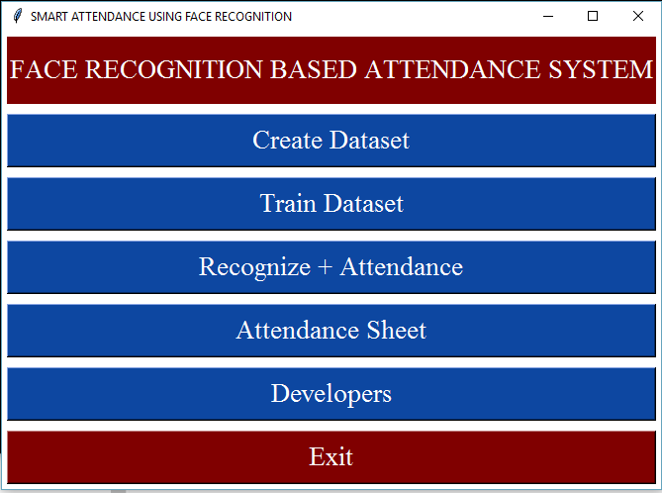
First Page

Slide 10
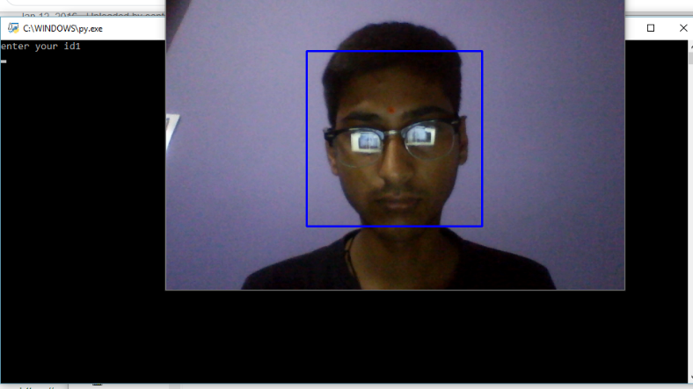
Create Dataset

Slide 11
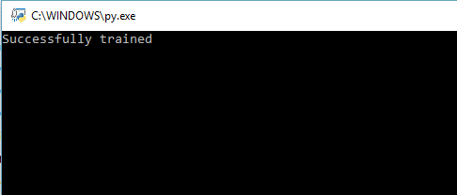
Training

Slide 12
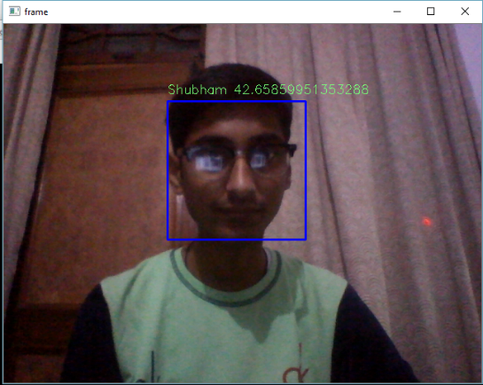
Recognition

Slide 13
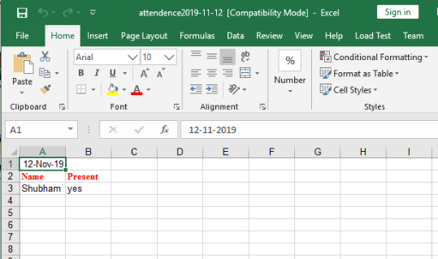
Attendance Sheet

Slide 14
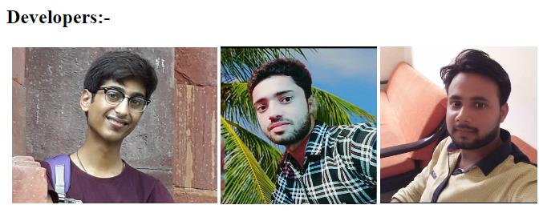
Developer Page

Slide 15
THANK YOU
AND HAVE A NICE DAY

