Slide 1
Adidas Sales Analysis Dashboard
Overview of Performance Metrics, Sales Trends, and Regional Insights
Shubham Srivastav

Slide 2
KeyMetrics Overview
Total Sales: $7.08M
Units Sold: 21K
Operating Profit: $2.59M Insight: April 2021 wasa high-performing month, indicating strong demand and good profitability. Visual: KPI cards from the top section of your dashboard.

Slide 3
Sales and Profit Trend
Monthly Sales vs Operating Profit
April 2021 shows a spike in both total sales and operating profit.
Monthly growth indicates strong market performance. Visual: Line chart from dashboard titled “Sum of Total Sales and Sum of Operating Profit by Year–Month”

Slide 4
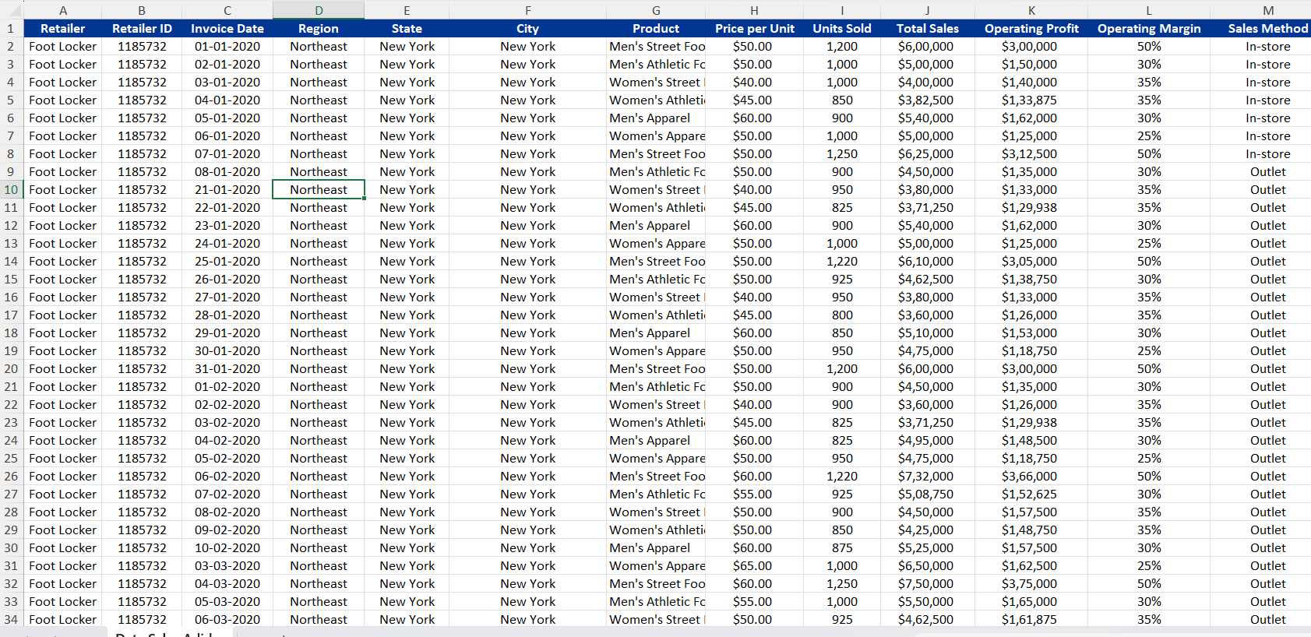

Slide 5
Product Sales Analysis
Sales by Product Category
Products vary in performance, with some crossing $2M in sales.
Units sold are consistent across major products. Visual: Scatter plot from dashboard titled “Sum of Total Sales and Units Sold by Product”.

Slide 6
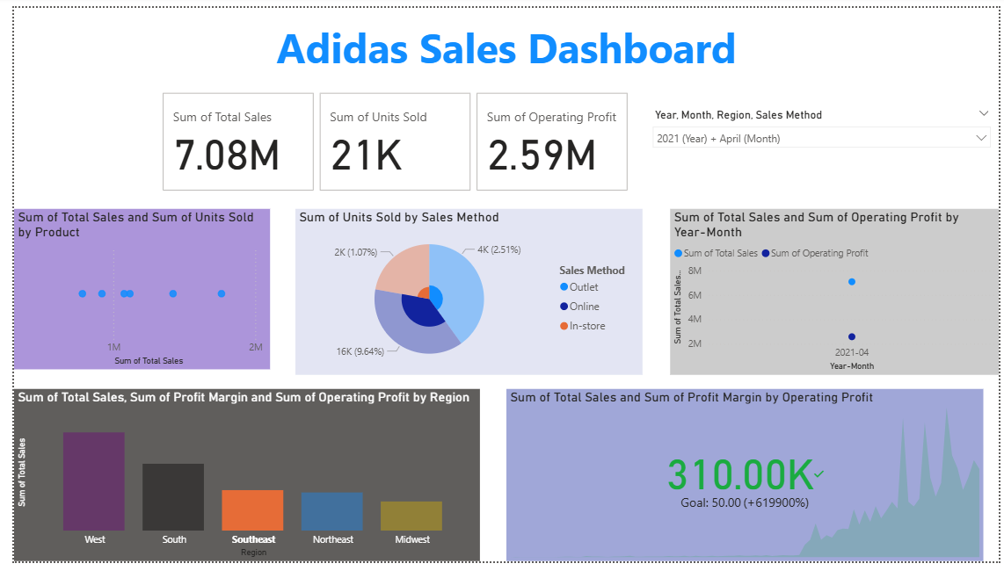

Slide 7
Profit Margin Analysis
Profitability Overview
Operating Profit: $310K (target: 50K)
Surpassed target by +619900% Insight: Exceptional profitability achieved in April 2021. Visual: Bottom chart with green 310K value

