Slide 1

Note: The data and information in this document is reflective of a hypothetical situation and client. This document is to be used for KPMG Virtual Internship purposes only.
Sprocket Central Pty Ltd
Data analytics approach
Lighthouse & Innovation Team – Junior Data Analyst (Shubham Sharma)

Slide 2
Note: The data and information in this document is reflective of a hypothetical situation and client. This document is to be used for KPMG Virtual Internship purposes only.
Agenda
Introduction
Data Exploration
Model Development
Interpretation

Slide 3
Note: The data and information in this document is reflective of a hypothetical situation and client. This document is to be used for KPMG Virtual Internship purposes only.
Introduction
Problem Statement:
Sprocket Central Pty Ltd, a long-standing KPMG client specializing in high-quality bikes and accessible cycling accessories, aims to boost its business by leveraging data-driven insights from their existing customer dataset.
The marketing team seeks to identify customer trends and behaviours to target the right customers effectively.
The objective is to recommend which of the 1000 new customers should be targeted to drive the most value for the organization.
To achieve this goal, we propose a three-week analysis scope, comprising three distinct phases - Data Exploration, Model Development, and Interpretation. The following detailed approach outlines the activities involved in each phase: Data Exploration; Model Development and Interpretation.

Slide 4
Note: The data and information in this document is reflective of a hypothetical situation and client. This document is to be used for KPMG Virtual Internship purposes only.
Data Exploration
Data Quality Assessment
The specific data quality concerns identified :
 | Accuracy | Completeness | Consistency | Currency | Relevancy | Validity
Transactions |  | ‘online_order’, ‘product_line’, ‘product_class’, ‘product_size’, ‘standard_cost’, ‘brand’ and ‘product_first_sold_date’ has blank values |  |  |  | ‘product_first_sold_date' column is expected to contain valid date values
NewCustomerList | ‘past_3_years_bike_related_purchases’ incorrect format ‘postcode’ incorrect format | ‘DOB’ has blank values ‘job_title’ has blank values Missing column ‘Q’, ‘R’, ‘S’, T, ‘U’ | ‘gender’ has inconsistent values | ‘deceased_indicator’ for deceased customers filtered out
CustomerDemographic | ‘DOB’ has inaccurate values | ‘DOB’ has blank values ‘job_title’ has blank values ‘tenure’ has blank values | 'gender' has inconsistent values |  | ‘default’ Has irrelevant values
CustomerAddress |  | ‘customer_id’ is incomplete | ‘state’ has Inconsistent values

Slide 5
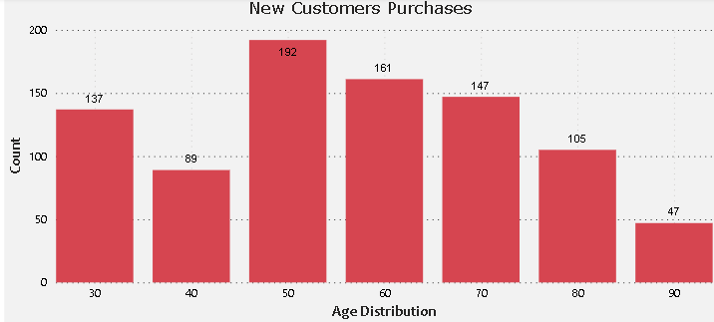
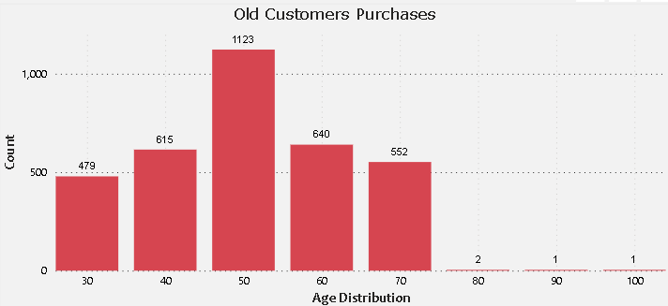
Note: The data and information in this document is reflective of a hypothetical situation and client. This document is to be used for KPMG Virtual Internship purposes only.
Data Exploration
Analysing bike-related purchases in relation to age.
The data reveals that the majority of customers, both new and existing, fall within the age group of 40-49 years.
The middle-aged bracket (40-49 years) represents the segment with the highest potential for attracting customers.
Among the existing or old customers, there is a significant drop in the number of customers as the age increases beyond the middle-aged bracket. Older age groups have considerably fewer customers in the dataset.

Slide 6
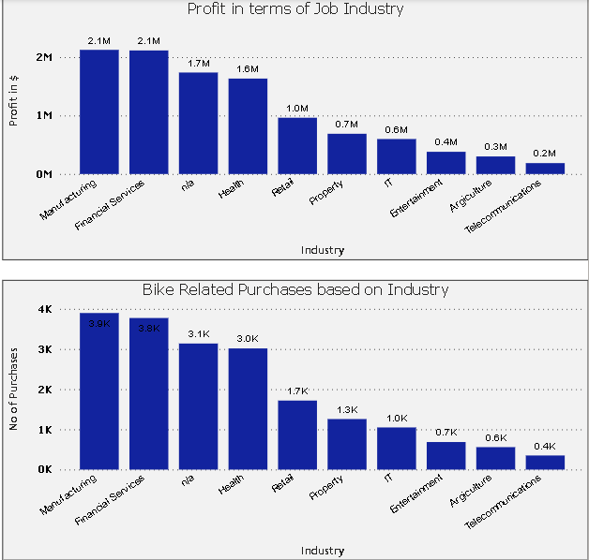
Note: The data and information in this document is reflective of a hypothetical situation and client. This document is to be used for KPMG Virtual Internship purposes only.
Data Exploration
Job Industry
The manufacturing, financial services, and health sectors are the top three industries generating the highest profits.
These industries also experience a significant volume of purchases.

Slide 7
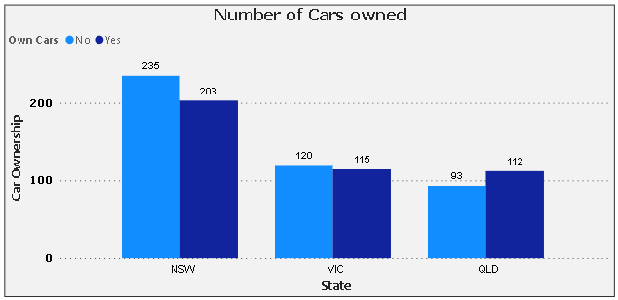
Note: The data and information in this document is reflective of a hypothetical situation and client. This document is to be used for KPMG Virtual Internship purposes only.
Model Development
Number of Cars Owned by State
New South Wales presents a promising market opportunity for the company.
New South Wales holds immense potential as it exhibits a balanced ratio between car owners and non-car owners, indicating a significant opportunity for further growth.

Slide 8
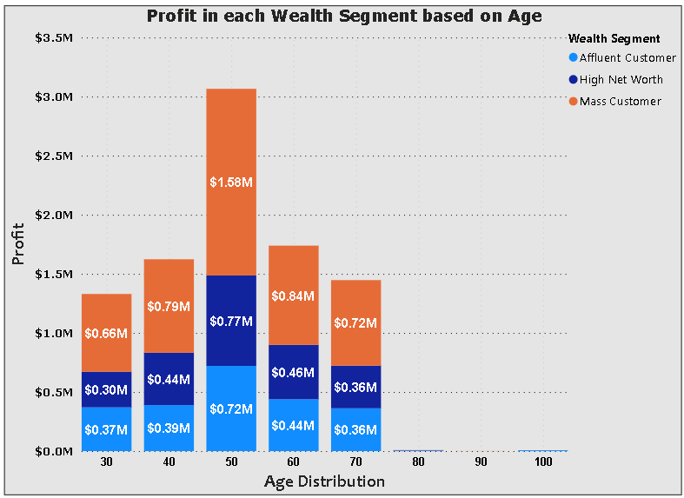
Note: The data and information in this document is reflective of a hypothetical situation and client. This document is to be used for KPMG Virtual Internship purposes only.
Model Development
Profit in each Wealth Segment based on Age
The age group of 40-49 years yields the highest profit.
The highest profit comes from mass customers, with high net worth and affluent customers following closely in terms of profitability.

Slide 9
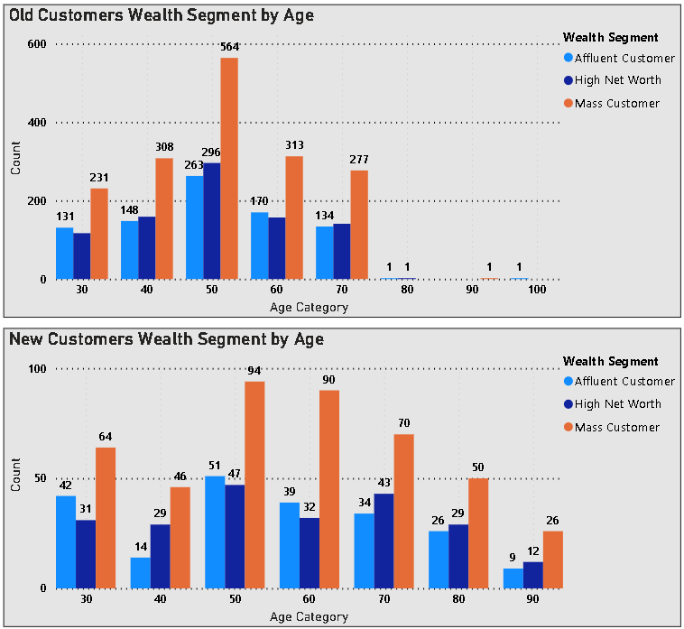
Note: The data and information in this document is reflective of a hypothetical situation and client. This document is to be used for KPMG Virtual Internship purposes only.
Model Development
Wealth Segmentation by Age Category
The age group of 40-49 years yields the highest profit.
The largest number of customers fall under the category of "Mass Customer" and within this segment, the age group of 40-49 dominates both among new and existing customers.

Slide 10
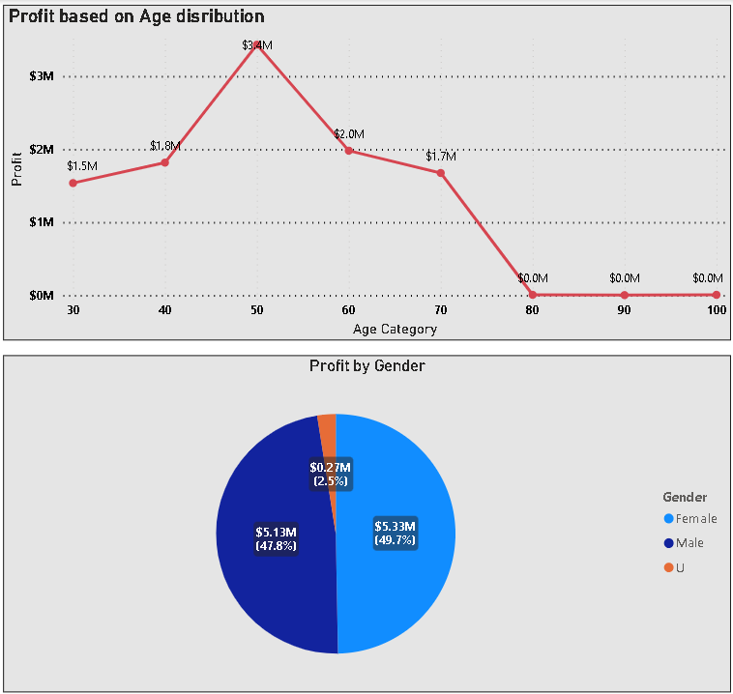
Note: The data and information in this document is reflective of a hypothetical situation and client. This document is to be used for KPMG Virtual Internship purposes only.
Model Development
Profit based on Age Distribution and Gender
The age group 40-49 contributes the highest profit among the customers.
The majority of customers are female, with males being the second-largest group of customers.

Slide 11
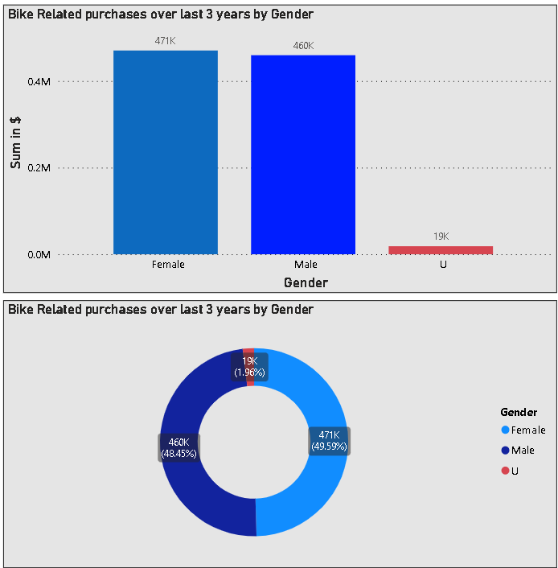
Note: The data and information in this document is reflective of a hypothetical situation and client. This document is to be used for KPMG Virtual Internship purposes only.
Model Development
Bike Related purchases over last 3 years by Gender
The majority of customers are female, they purchase almost 10000 more than males.
Females make up majority of bike related sales.
Approximately 2% were made by unknown gender.

Slide 12
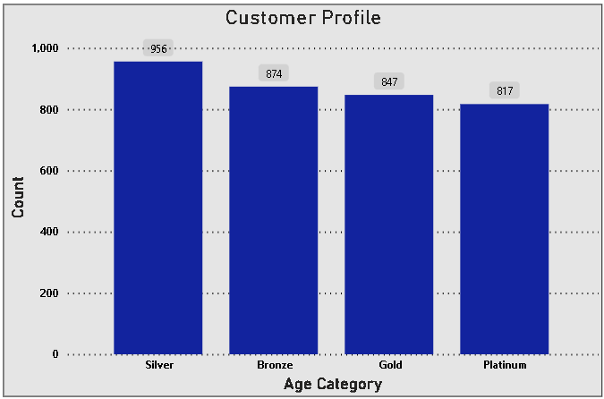
Note: The data and information in this document is reflective of a hypothetical situation and client. This document is to be used for KPMG Virtual Internship purposes only.
Model Development
Customer Classification – Targeting high value customers
RFM analysis is used to create a customer profile by evaluating three key aspects of customer behaviour: Recency, Frequency, and Monetary value. These metrics are used to segment customers into different groups based on their buying patterns and engagement with the company.
The majority of customers fall into the category of “Silver customers“.

Slide 13
Note: The data and information in this document is reflective of a hypothetical situation and client. This document is to be used for KPMG Virtual Internship purposes only.
Interpretation
Customer Classification - Targeting high value customers
Based on the analysis and visuals, the focus for targeting high-value customers should be on the following segments:
1. Customers aged between 40 and 59 years.
2. Customers working in the Financial Service, Manufacturing, and Health industries.
3. Customers residing in New South Wales and Victoria states.
4. The majority of high-value customers are female.
5. The majority of high-value customers belong to the mass wealth segment.

Slide 14
Note: The data and information in this document is reflective of a hypothetical situation and client. This document is to be used for KPMG Virtual Internship purposes only.
Interpretation
Customer Title Definition with RFM values
Rank | Customer Title | Description | No of Customers | RFM Values
1 | Platinum | Customers with the highest RFM scores, indicating recent purchases, high frequency, and significant monetary value. | 817 | 444
2 | Gold | Customers with good RFM scores, reflecting reasonably recent purchases, good frequency, and substantial spending. | 847 | 344
3 | Silver | Customers with moderate RFM scores, indicating somewhat recent purchases, average frequency, and moderate spending. | 956 | 211
4 | Bronze | Customers with lower RFM scores, suggesting less recent purchases, low frequency, and lower spending. | 874 | 111

Slide 15
Note: The data and information in this document is reflective of a hypothetical situation and client. This document is to be used for KPMG Virtual Internship purposes only.
Interpretation
Summary table of top 1000 customers to target
Customer ID | Bike Related Purchases for the last 3 years | Age | Job Industry | Wealth Segment | Owns Cars | State
1842 | 445 | 44 | Financial Services | Mass Customer | No | New South Wales
2001 | 168 | 44 | Manufacturing | Mass Customer | Yes | New South Wales
650 | 486 | 44 | Health | Mass Customer | No | New South Wales
3297 | 234 | 46 | Manufacturing | Mass Customer | No | Victoria
50 | 266 | 41 | Manufacturing | Mass Customer | Yes | New South Wales

Slide 16
Note: The data and information in this document is reflective of a hypothetical situation and client. This document is to be used for KPMG Virtual Internship purposes only.
Thank You

