Slide 1


#LifeKoKaroLift
Data Structures

Slide 2



Module Name- Binary Trees & Binary Search Trees
Topic Name: Binary Trees
Instructor : Rahul Kumar
EditEdit MasterMaster texttext stylesstyles

Slide 3

Today’s Agenda
Tree traversal : BFS
BFS (recursive) pseudocode and code
BFS (Iterartive) pseudocode and code
Mirror of a tree
Spiral View of the Tree

Slide 4

Traversal of Binary Tree
That was all about DFS. Now, let’s move on to the next approach, Breadth First Search(BFS):
In a BFS, all the nodes at a certain level are visited before moving on to the next level.
So basically, you first visit the root node, then all the nodes at level 1, then all the nodes at level 2, and so on.
Hence, in this algorithm, you move along the breadth of a tree, before hopping on to the next level. This is the reason why Breadth-First Search (BFS) traversal is also called the Level-Order Traversal.

Slide 5
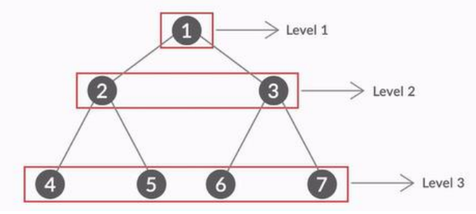
Traversal of Binary Tree
In the figure above, all the nodes of Level 1 are visited first.
Then we move onto Level 2 where all the nodes i.e node 2 and node 3 are visited
Then we move onto Level 3 where nodes 4,5,6 and 7 are visited

Slide 6
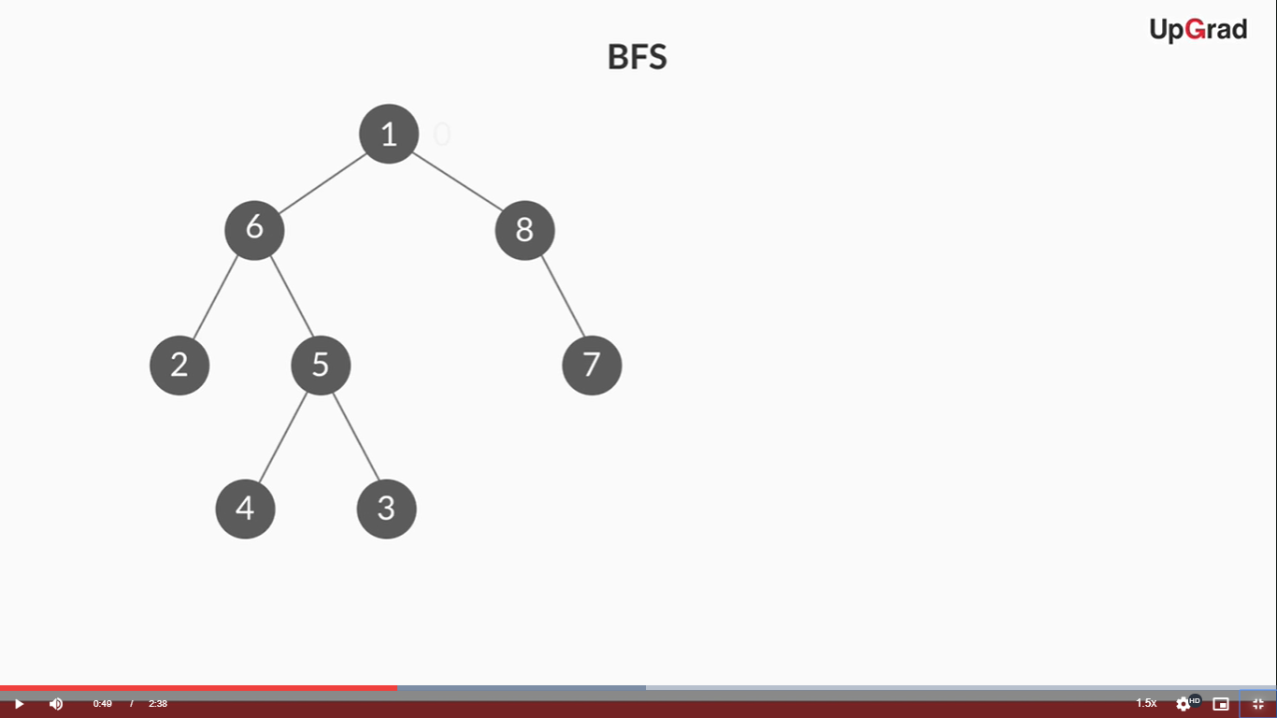
Traversal of Binary Tree
Well, it’s time to visit our favourite example once again. This time you have the print the BFS order of elements. Can you do it?

Slide 7
Traversal of Binary Tree
Let’s solve this example together:
The key function used in BFS traversal is the printNodesAtLevel or PNL function which prints all the nodes at a particular level.
We first find the height of the tree which is 4 here( levels 0,1, 2, 3).
Now we call our PNL function for all these levels one by one.
So what will be the output???

Slide 8
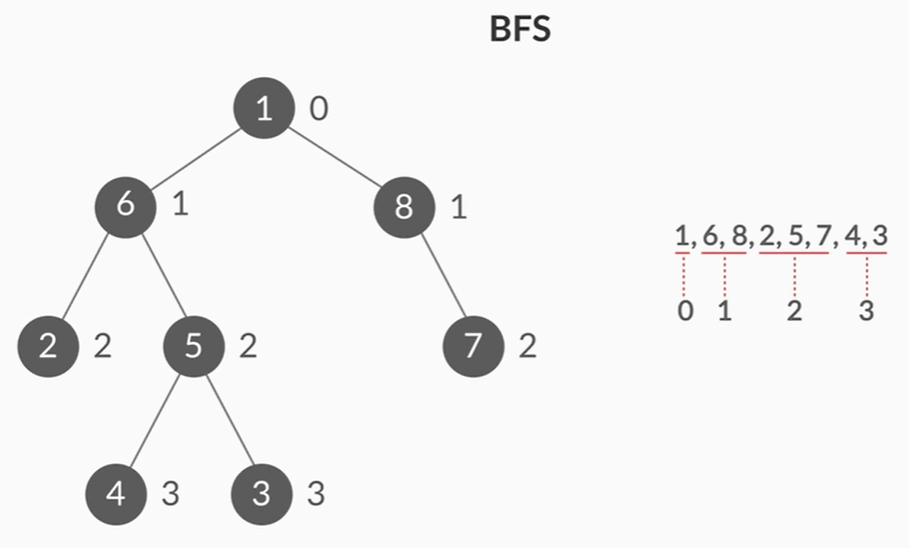
Traversal of Binary Tree
As always, the answer is provided for your verification...
First, the node(s) at 0th level is printed which is the root node(1).
Then, the nodes at 1st(6, 8), 2nd(2, 5, 7) and 3rd level(4, 3) are printed subsequently.

Slide 9
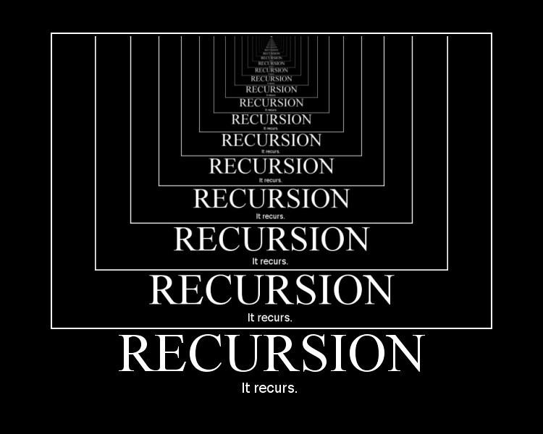
Traversal of Binary Tree
This method is hence called the recursive method of DFS.
This algorithm contains two functions, levelOrderBFS and printNodesAtLevel.
levelOrderBFS contains a loop running from 1 to the height of tree and for each of the levels it calls the PNL or printNodesAtLevel function.
The BFS traversal technique we just saw involved recursively calling the PNL or printNodesAtLevel function for each level.

Slide 10
Traversal of Binary Tree
printNodesAtLevel takes 3 input parameters: root, level and current level. The flow of function is as follows:
If the root is null, then return.
If level equals current level, then print root’s data.
ELSE
printNodesAtLevel( root->left, level, current level +1)
printNodesAtLevel( root->right, level, current level +1)

Slide 11
Traversal of Binary Tree
Let’s perform the dry run of this algorithm on the example we just saw a few slides back:
The first step will be to find the height of the tree which will be performed by a separate function. Here, the height of the tree will come out to be 4.
Now, the levelOrderBFS function is called which will call the PNL function at each level from 1 to height i.e 4. The arguments for this PNL function will be root, loop index i and 1.
Since level is equal to the current level, the root node is printed and we move on to the next iteration.

Slide 12
Traversal of Binary Tree
Again, the arguments for this PNL function call will be root, loop index i and 1 which will be root node, 2 and 1.
Since level is not equal to the current level, the following calls are made:
printNodesAtLevel( root->left, level, current level +1)
printNodesAtLevel( root->right, level, current level +1)
Here, level is 2 and current level is 1.

Slide 13
Traversal of Binary Tree
Since the level and current level arguments of this recursive call are equal, both root->left and root->right are printed. The output becomes 1 6 8. This completes our level 2 traversal.
Similarly, the next iteration calls for PNL(root, 3, 1). Here, the elements at third level are printed in the second recursive call and similarly the fourth level nodes are printed in the third recursive call of the last iteration of levelOrderBFS function.
The final output becomes 1 6 8 2 5 7 4 3.

Slide 14
Traversal of Binary Tree
Now, let’s take a look at the code for our algorithm. Since, the recursive approach uses the height of the tree in the DFS algorithm, we have to build a separate function to find the height.
int height(Node root) {
if (root == null)
return 0;
int leftHeight = height(root.left);
int rightHeight = height(root.right);
if (leftHeight > rightHeight)
return leftHeight + 1;
else
return rightHeight + 1; }

Slide 15
Traversal of Binary Tree
Now, back to the main code:
void levelOrderOrBFS() {
int h = height(root);
for (int i = 1; i <= h; i++)
printNodesAtLevel(root, i, 1); }
void printNodesAtLevel (Node root, int level, int currentLevel) {
if (root == null)
return;
if (level == currentLevel)
System.out.print(root.data + " ");
else {
printNodesAtLevel(root.left, level, currentLevel + 1);
printNodesAtLevel(root.right, level, currentLevel + 1); }}

Slide 16

Traversal of Binary Tree
Let’s now study about the iterative approach for BFS.
The algorithm is implemented with the help of a queue.
The elements in the queue are inserted in such a manner that the nodes at a particular level are first added to the queue and then its children.
Since the queue operates in a FIFO way, the nodes of one level will all be printed and then their children nodes from the next level will be printed.

Slide 17
Traversal of Binary Tree
Let’s now check the pseudocode of the algorithm:
Create empty queue Q.
Enqueue root to Q.
Loop while Q is not empty:
Dequeue node from Q and assign it to temp.
Print temp’s data.
Enqueue temp’s children to Q( first left and then right, if exist).

Slide 18
Traversal of Binary Tree
Let’s perform the dry run of this algorithm on the example we performed the recursive approach on:
We start by creating an empty queue Q and adding the root element to it which is 1.
Since Q is not empty, our loop will execute. The first thing it does is to dequeue 1 and assign it to temp.
Now temp’s data( 1) is printed and it’s children( 6, 8) are enqueued to Q.
Thus, after the first iteration, the queue contains two elements, 6 and 8.

Slide 19
Traversal of Binary Tree
Now, we move on to the second iteration where 6 is dequeued first of all and assigned to temp.
Then, temp(6) is printed and its children (2, 5) are enqueued to Q.
Thus, after the second iteration, Q contains (8, 2, 5).
Now, in the third iteration, 8 is dequeued, assigned to temp, printed and finally, its children( which is only 7 here) is enqueued to Q.
Now, Q, after the 3rd iteration becomes (2, 5, 7).

Slide 20
Traversal of Binary Tree
In the same way, 2 is printed and no children are dequeued since it’s a leaf node.
Then 5 is printed and 4, 3 are enqueued to Q.
Similarly 7 is printed and nothing is enqueued here as well.
And, finally 4 and then 3 are printed. The queue now gets empty and the loop termination condition is reached.
The printed output becomes 1 6 8 2 5 7 4 3.

Slide 21
Traversal of Binary Tree
Let’s look at the java code of the Iterative Approach algorithm:
void levelOrderOrBFS() {
Queue<Node> queue = new LinkedList<Node>();
queue.add(root);
while (!queue.isEmpty()) {
Node temp = queue.peek();
queue.remove();
System.out.print(temp.data + " ");
if (temp.left != null)
queue.add(temp.left);
if (temp.right != null)
queue.add(temp.right); }}

Slide 22
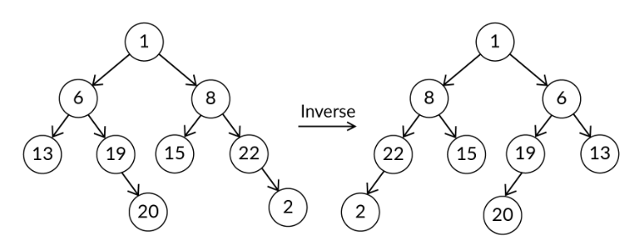
Mirror A Tree
Now, it’s time to try our first problem…
You are given a binary tree and you have to inverse the tree. The inverse of a tree is nothing but the mirror image of the nodes, check the image below for reference:

Slide 23
Mirror A Tree
Let’s discuss the approach to find the mirror of a tree:
We should create a function say MIRROR which should be called recursively until the entire tree is mirrored. This function will have four steps:
If the root (input parameter of our MIRROR function) is null, simply return.
Call MIRROR function on left child of the root node
Call MIRROR function on right child of the root node
Swap left and the right children of the root node

Slide 24
Mirror A Tree
Here’s the java code for the MIRROR function:
public void mirror(Node node) {
if (node == null)
return;
// mirror subtrees
mirror(node.left);
mirror(node.right);
// swap left & right children of node
Node temp = node.left;
node.left = node.right;
node.right = temp;
}

Slide 25
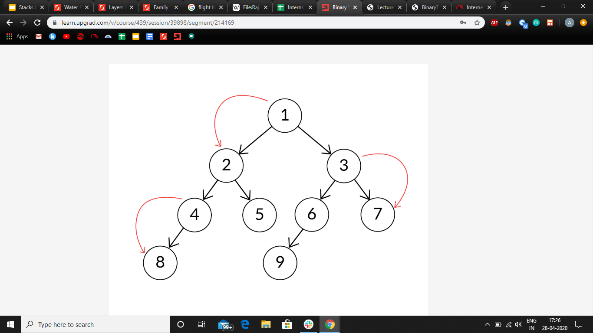
Spiral Level-Order Traversal
Here’s another very common question regarding binary trees. It is to design an algorithm to traverse a tree in spiral order (also called the zigzag order). Let’s understand it better with an example:
For the above given tree, the spiral order traversal is 1, 2, 3, 7, 6, 5, 4, 8, 9.

Slide 26
Spiral Level-Order Traversal
If you were unable to understand the problem, here’s the layman explanation:
The traversal begins with the root node which is the first one to be printed.
Now, for 2nd level, the 2nd level nodes are traversed in the left to right direction. The output becomes 1, 2, 3.
The traversal direction is reversed to right to left direction for the next level and this keeps on repeating till the last level.
The output thus becomes 1, 2, 3, 7, 6, 5, 4, 8, 9.

Slide 27
Spiral Level-Order Traversal
Well, here’s the code for the Spiral Order Traversal. As already told, this code is very similar to the recursive approach for DFS.
Hence, we will use the height function from there to find the height of tree.
Traversal and print node functions however will be modified accordingly.
void spiralOrder() {
int h = height(root);
boolean ltr = false;
for (int i = 1; i <= h; i++) {
printNodesAtLevel(root, i, 1, ltr);
ltr = !ltr; }}

Slide 28
Spiral Level-Order Traversal
void printNodesAtLevel(Node root, int level, int currentLevel, boolean ltr) {
if (root == null)
return;
if (level == currentLevel)
System.out.print(root.data + " ");
else {
if (ltr) {
printNodesAtLevel(root.left,level,currentLevel+1, ltr);
printNodesAtLevel(root.right,level,currentLevel+1, ltr);
}else {
printNodesAtLevel(root.right,level,currentLevel+1, ltr);
printNodesAtLevel(root.left,level,currentLevel+1, ltr);
}}}

Slide 29
#LifeKoKaroLift
Thank You! Happy learning!

