Slide 1

#LifeKoKaroLift
Java
Program
<number>
07/01/2021

Slide 2



Course : Java Program
Lecture On : Object Oriented Programming
Instructor : Rahul Kumar
07/01/2021
<number>

Slide 3
Today’s Agenda
1.) Inheritance and it’s types
2.) Overriding
07/01/2021
Python Program
<number>
Notes:
23

Slide 4
Inheritance
Inheritance in Java is a mechanism in which one object acquires all the properties and behaviors of a parent object. It is an important part of OOPs (Object Oriented programming system).
The idea behind inheritance in Java is that you can create new classes that are built upon existing classes. When you inherit from an existing class, you can reuse methods and fields of the parent class. Moreover, you can add new methods and fields in your current class also.
Inheritance represents the IS-A relationship which is also known as a parent-child relationship.
Why use inheritance in java
For Method Overriding.
For Code Reusability.
07/01/2021
<number>

Slide 5
Inheritance
Terms used in Inheritance
Class: A class is a group of objects which have common properties. It is a template or blueprint from which objects are created.
Sub Class/Child Class: Subclass is a class which inherits the other class. It is also called a derived class, extended class, or child class.
Super Class/Parent Class: Superclass is the class from where a subclass inherits the features. It is also called a base class or a parent class.
Reusability: As the name specifies, reusability is a mechanism which facilitates you to reuse the fields and methods of the existing class when you create a new class. You can use the same fields and methods already defined in the previous class.
07/01/2021
4

Slide 6

Inheritance
The syntax of Java Inheritance
The extends keyword indicates that you are making a new class that derives from an existing class. The meaning of "extends" is to increase the functionality.
In the terminology of Java, a class which is inherited is called a parent or superclass, and the new class is called child or subclass.
07/01/2021
5

Slide 7
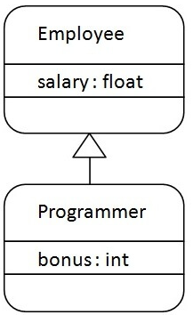
Inheritance
Java Inheritance Example
As displayed in the above figure, Programmer is the subclass and Employee is the superclass. The relationship between the two classes is Programmer IS-A Employee. It means that Programmer is a type of Employee.
07/01/2021
6

Slide 8


Inheritance
Output:
In the above example, Programmer object can access the field of own class as well as of Employee class i.e. code reusability.
07/01/2021
7

Slide 9
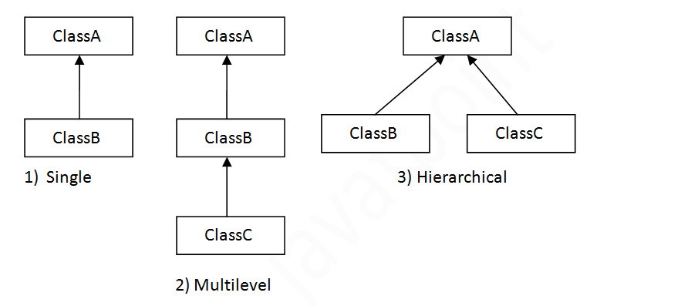
Inheritance
Types of inheritance in java
On the basis of class, there can be three types of inheritance in java: single, multilevel and hierarchical.
In java programming, multiple and hybrid inheritance is supported through interface only.
07/01/2021
8

Slide 10
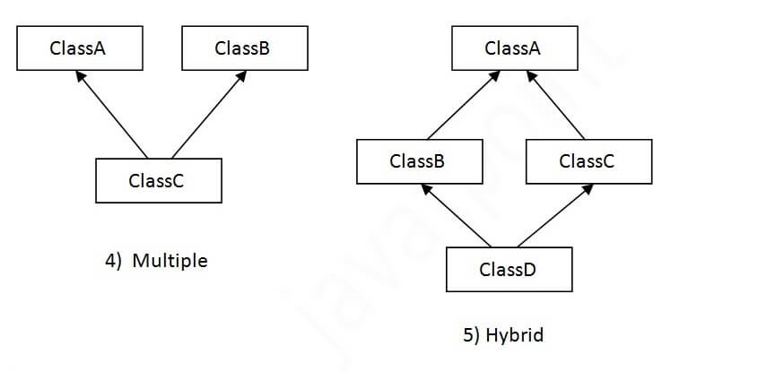
Inheritance
When one class inherits multiple classes, it is known as multiple inheritance. For Example:
07/01/2021
9

Slide 11
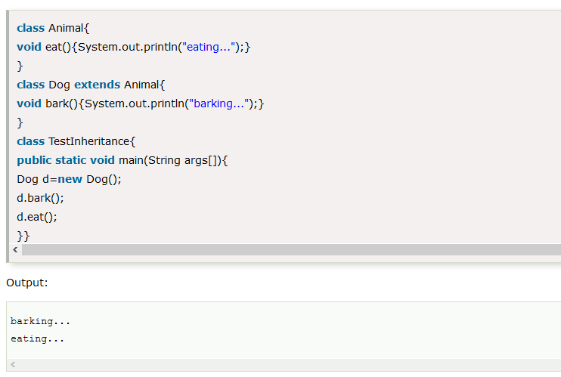
Inheritance
Single Inheritance Example
When a class inherits another class, it is known as a single inheritance. In the example given below, Dog class inherits the Animal class, so there is the single inheritance.
07/01/2021
10

Slide 12
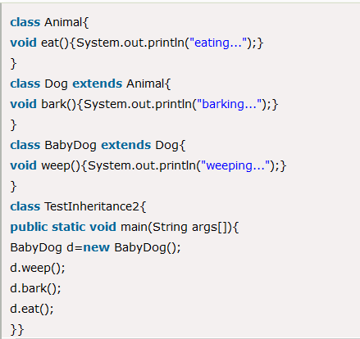
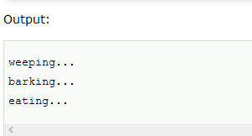
Inheritance
Multilevel Inheritance Example
When there is a chain of inheritance, it is known as multilevel inheritance. As you can see in the example given below, BabyDog class inherits the Dog class which again inherits the Animal class, so there is a multilevel inheritance.
07/01/2021
11

Slide 13
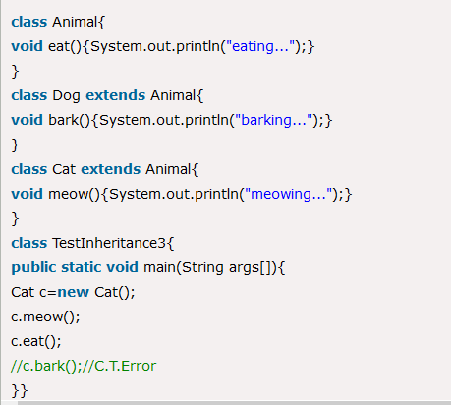
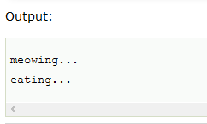
Inheritance
Hierarchical Inheritance Example
When two or more classes inherits a single class, it is known as hierarchical inheritance. In the example given below, Dog and Cat classes inherits the Animal class, so there is hierarchical inheritance.
07/01/2021
12

Slide 14
Inheritance
Subclass and Superclass
In Java, it is possible to inherit attributes and methods from one class to another. We group the "inheritance concept" into two categories:
subclass (child) - the class that inherits from another class
superclass (parent) - the class being inherited from
To inherit from a class, use the extends keyword.
In the example below, the Car class (subclass) inherits the attributes and methods from the Vehicle class (superclass):
07/01/2021
13

Slide 15
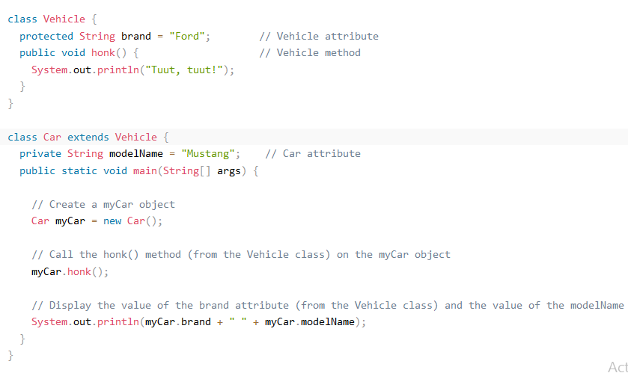
Inheritance
In the example below, the Car class (subclass) inherits the attributes and methods from the Vehicle class (superclass):
07/01/2021
14

Slide 16
Inheritance vs Composition
Inheritance and composition are two programming techniques developers use to establish relationships between classes and objects. Whereas inheritance derives one class from another, composition defines a class as the sum of its parts.
When to use inheritance in Java
In object-oriented programming, we can use inheritance when we know there is an "is a" relationship between a child and its parent class. Some examples would be:
A person is a human.
A cat is an animal.
A car is a vehicle.
In each case, the child or subclass is a specialized version of the parent or superclass. Inheriting from the superclass is an example of code reuse. To better understand this relationship, take a moment to study the Car class, which inherits from Vehicle:
07/01/2021
15

Slide 17
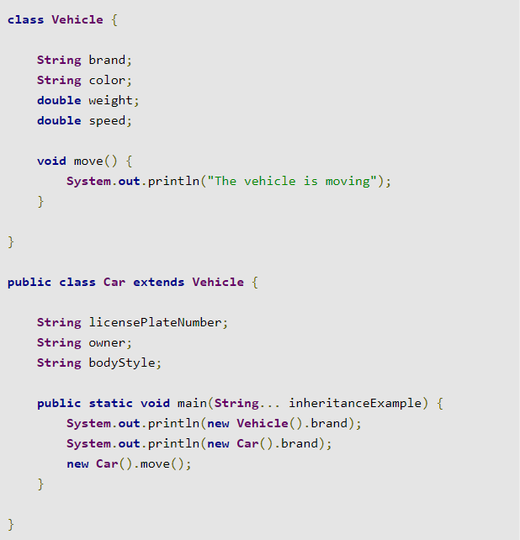
Inheritance vs Composition
When you are considering using inheritance, ask yourself whether the subclass really is a more specialized version of the superclass. In this case, a car is a type of vehicle, so the inheritance relationship makes sense.
07/01/2021
16

Slide 18
Inheritance vs Composition
When to use composition in Java
In object-oriented programming, we can use composition in cases where one object "has" (or is part of) another object. Some examples would be:
A car has a battery (a battery is part of a car).
A person has a heart (a heart is part of a person).
A house has a living room (a living room is part of a house).
To better understand this type of relationship, consider the composition of a House:
07/01/2021
17

Slide 19
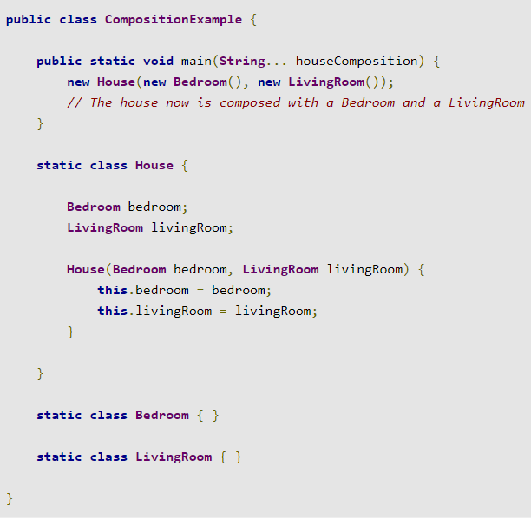
Inheritance vs Composition
In this case, we know that a house has a living room and a bedroom, so we can use the Bedroom and LivingRoom objects in the composition of a House.
07/01/2021
18

Slide 20
Method Overriding in Java
If subclass (child class) has the same method as declared in the parent class, it is known as method overriding in Java.
In other words, If a subclass provides the specific implementation of the method that has been declared by one of its parent class, it is known as method overriding.
Usage of Java Method Overriding
Method overriding is used to provide the specific implementation of a method which is already provided by its superclass.
Method overriding is used for runtime polymorphism
Rules for Java Method Overriding
The method must have the same name as in the parent class
The method must have the same parameter as in the parent class.
There must be an IS-A relationship (inheritance).
07/01/2021
19

Slide 21
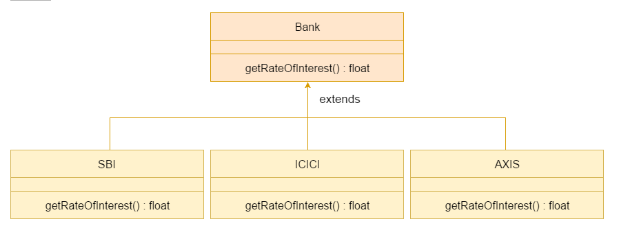
Method Overriding in Java
A real example of Java Method Overriding
Consider a scenario where Bank is a class that provides functionality to get the rate of interest. However, the rate of interest varies according to banks. For example, SBI, ICICI and AXIS banks could provide 8%, 7%, and 9% rate of interest.
07/01/2021
20

Slide 22
Method Overriding in Java
A real example of Java Method Overriding
Consider a scenario where Bank is a class that provides functionality to get the rate of interest. However, the rate of interest varies according to banks. For example, SBI, ICICI and AXIS banks could provide 8%, 7%, and 9% rate of interest.
07/01/2021
21

Slide 23
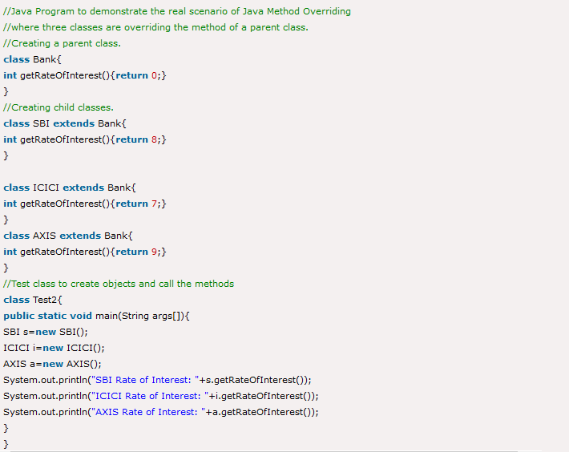
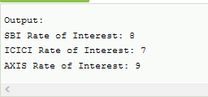
Method Overriding in Java
07/01/2021
22

Slide 24
#LifeKoKaroLift
Thank You!
23
07/01/2021

