Slide 1




Module Name - Dynamic Programming
Instructor – Rahul Kumar
Topic Name: Introduction to DP: Coin Exchange Problem
EditEdit MasterMaster texttext stylesstyles

Slide 2

Today’s Agenda
Introduction to Dynamic Programming
Fibonacci Numbers
Coin exchange problem

Slide 3
Introduction to Dynamic Programming
In the previous modules, you learnt about algorithmic analysis and the divide and conquer technique.
In simple terms, algorithms are methodological approaches to accomplishing tasks or solving problems.

Slide 4
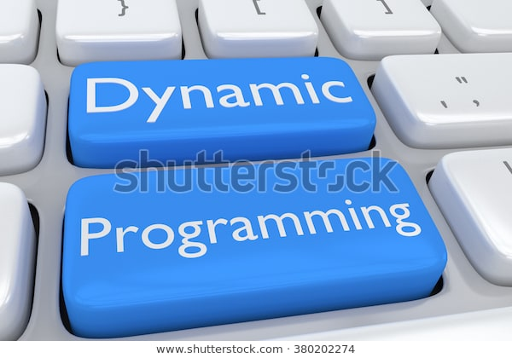
Introduction to Dynamic Programming
In this module, you will learn about dynamic programming, which is a popular technique to solve a particular kind of problem where you are required to find the best possible solution from a number of different solutions.

Slide 5
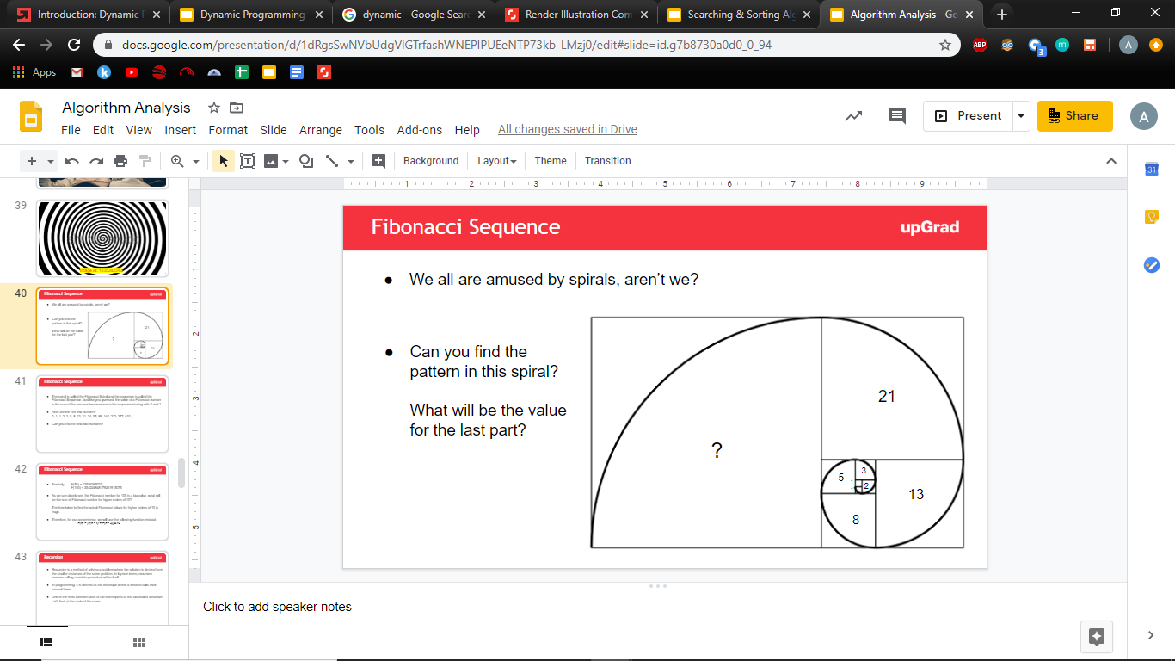
Introduction to Dynamic Programming
Remember the Fibonacci Sequence we discussed in one of the previous modules. There were multiple algorithms to obtain the sequence. Let’s revisit them once again:

Slide 6

Introduction to Dynamic Programming
The most efficient algorithm we found was:
public int fibonacci(int n) {
int a = 0, b = 1, c = n;
for (int i=2; i<=n; i++){
c = (a + b)%10;
a = b;
b = c;}
return c;
}

Slide 7
Introduction to Dynamic Programming
This best, linear time solution is a direct application of Dynamic Problem.
The final solution is obtained by remembering and using the results of smaller similar sub-problems of the same problem.

Slide 8
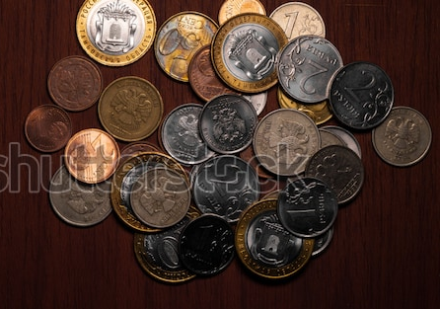
Coin Exchange Problem
Let’s start with one of the basic examples of dynamic programming, The Coin Exchange Problem.
Let’s say you have coins of different denominations, and you have to pay an amount. What is the minimum number of coins you can use to make this payment?
For example if you need 17 rupees but only have coins of rupee 1, 5, 10 and 20. Which coins will you choose?

Slide 9
Coin Exchange Problem
Objective: Given a set of coins and amount, Write an algorithm to find out how many ways we can make the change of the amount using the coins given.
Example:
Amount = 5
coins [] = {1,2,3}
Ways to make change = 5
{1,1,1,1,1} {1,1,1,2}, {1,2,2}, {1,1,3} {2,3}

Slide 10
Coin Exchange Problem
Recursive Solution:
For every coin we have an option to include it in solution or exclude it.
public static int total(int amount, int[] coins, int i) { if (amount < 0) { return 0; } if (amount == 0) { return 1; } // means coins over and amount>0 so no solution if (i == coins.length && amount > 0) { return 0; } return total(amount - coins[i], coins, i) + total(amount, coins, i + 1);
}
Time Complexity : 2^n

Slide 11
Coin Exchange Problem-DP Solution
Create a solution matrix => (solution[coins+1][amount+1]).
Base Cases:
if amount=0 then just return empty set to make the change, so 1 way to make the change.
if no coins given, 0 ways to change the amount.
Rest of the cases:
For every coin we have an option to include it in solution or exclude it.
Check if the coin value is less than or equal to the amount needed, if yes then we will find ways by including that coin and excluding that coin.
Include the coin: reduce the amount by coin value and use the sub problem solution (amount-v[i]).
Exclude the coin: solution for the same amount without considering that coin.
If coin value is greater than the amount then we can’t consider that coin, so solution will be without considering that coin.

Slide 12
Coin Exchange Problem – DP Solution
Equation:
solution[coins+1][amount+1]
solution[i][j] = {
0, if i=0
1, if j=0
solution[i – 1][j] + solution[i][j – v[i – 1]], if(coin[i]<=j)
solution[i – 1][j], if(coin[i]>j)
}

Slide 13
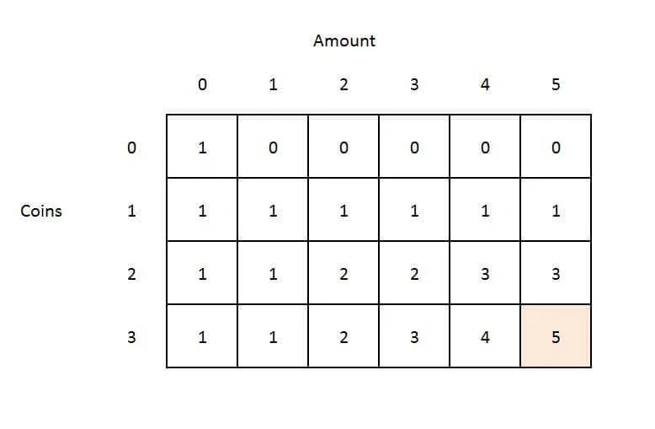
Coin Exchange Problem
Example:
Amount = 5
Coins [ ] = {1,2,3}

Slide 14
Coin Exchange Problem
Can you think of an algorithm to tackle this problem?
The most basic solution is to check usability of the coins in the decreasing order of their denominations.
So, if the highest value coin can be used, then use as much of that denomination as possible and then move on to the next largest denomination.
If any particular denomination can’t be used, simply check for the next largest denomination and so on.
This approach is called the greedy algorithm approach.

Slide 15
Coin Exchange Problem
If you had to summarise the solution, you would need to do the following in dynamic programming:
Define the subproblems.
Write down the recurrence relationship that relates to the subproblems.
Recognise and solve the base cases.
Store the results of the subproblems in a table. (Start with the base case. Then, fill the rest of the table using the recurrence relation that's defined.)

Slide 16

#LifeKoKaroLift
Thank You! Happy learning!

