Slide 1
LLM-based Query System for Traffic Analysis Using CCTV Footage
Argharupa Adhikary Arunoday Ghorai
MT23020 MT23023
Shashank Sharma Shubham Kale
MT23088 MT23094
Nilanjana Chatterjee Neeraj
PhD22020 PhD22016

Slide 2
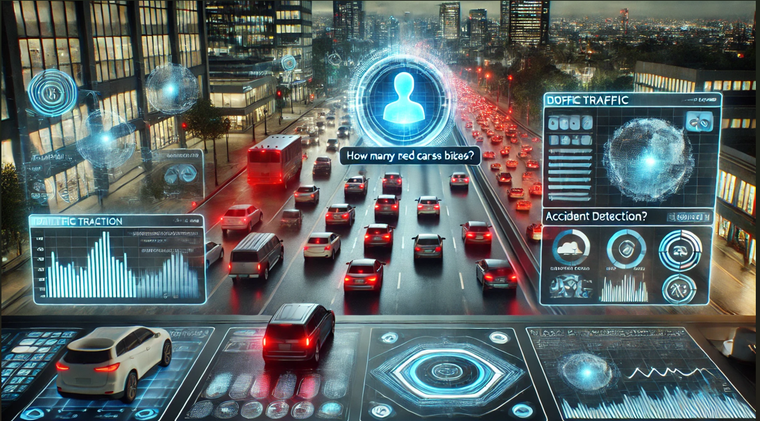
Aim
To develop a robust system that uses Multimodal Large Language Models to query, to extract meaningful insights from traffic footage through Natural Language Queries.
Key Features:
Accident Detection
Vehicle Count
Congestion Level
Continuous QnA Bot

Slide 3
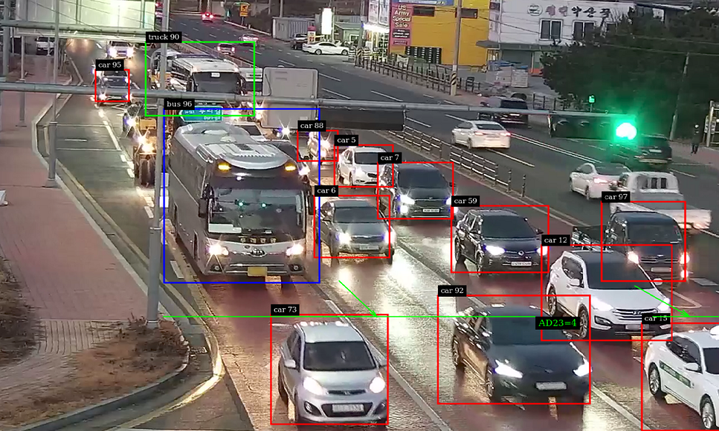
Datasets used
https://www.kaggle.com/datasets/chandlertimm/dota-data
https://usa.honda-ri.com/hevi
We used the DoTA and HEVI datasets.
DoTA: 1,450 annotated accident videos
HEVI: 250 non-accident videos
Dataset split:
Training: 100 accident, 100 non-accident.
Testing: 50 accident, 50 non-accident.
Annotations for vehicle types (cars, trucks, bikes, bicycles) were generated using YOLOv5.

Slide 4
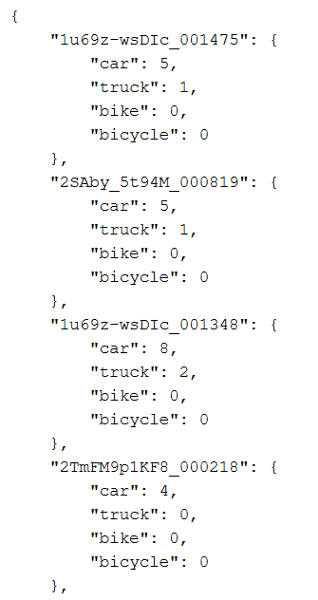
YOLOv5 annotations
accident_vehicle_count_YOLO_test.json
accident_train_vehicle_count_YOLO.json
non_accident_vehicle_count_YOLO_test.json
non_accident_train_vehicle_count_YOLO.json

Slide 5
Pipeline Overview
Frame Extraction: Frames were extracted at intervals for thorough coverage.
Vehicle Detection and Classification: YOLOv5 classified vehicles into predefined categories.
Model Inference: Multimodal LLM Llava (LlavaOnevisionForConditionalGeneration), generated traffic statistics and JSON reports.
Evaluation Metrics: Models were evaluated on accuracy, precision, recall, and mean squared error.
Fine Tuning Pipeline: Initiating the fine tuning process using QLoRA to enhance model performance on our specific dataset.

Slide 6
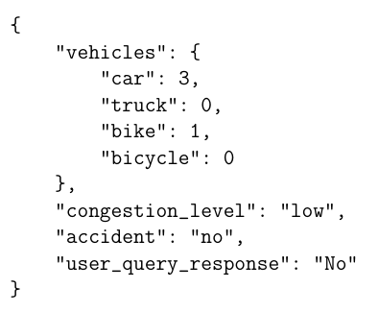
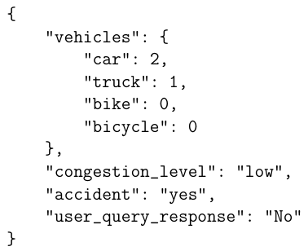
Generated Responses by Llava
The model generates detailed JSON reports for each video, capturing traffic statistics and accident detection outcomes.

Slide 7
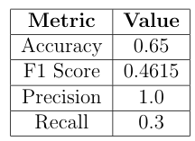
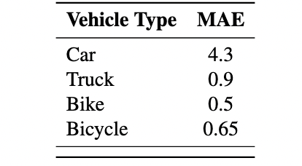
Baseline Results (Llava)

Slide 8
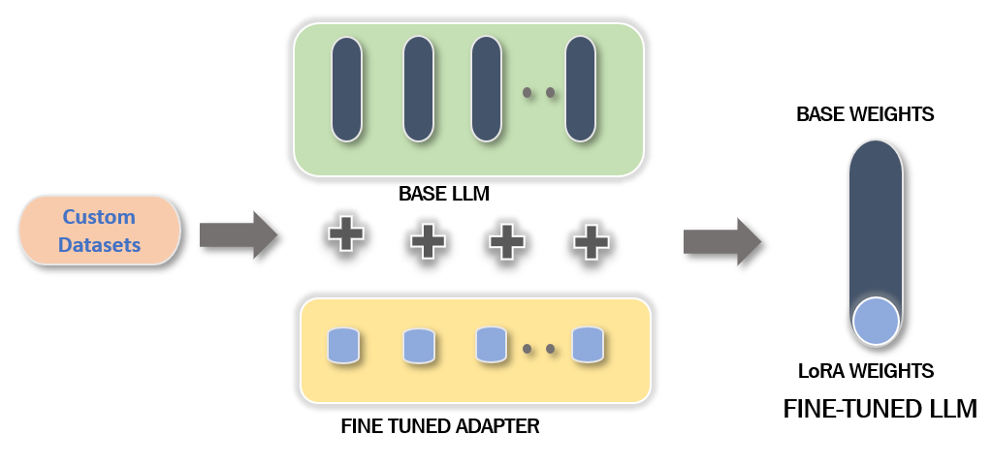
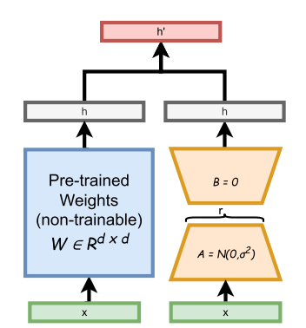
Fine-Tuning LLaVA
LoRA
QLoRA

Slide 9
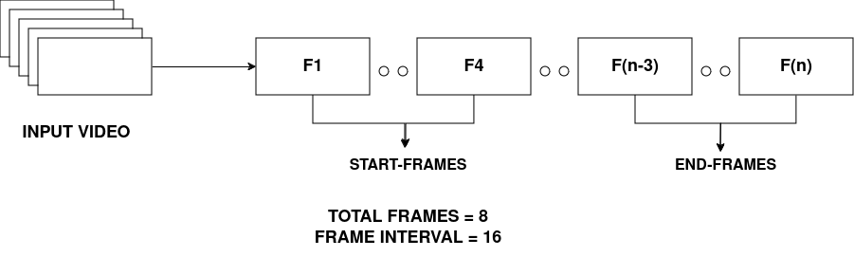
Frame Sampling & Prompt
Same prompt taken from direct inference.
Vehicle Count annotations generated using YOLO-V8.
Frame Resolution = (112, 112)

Slide 10
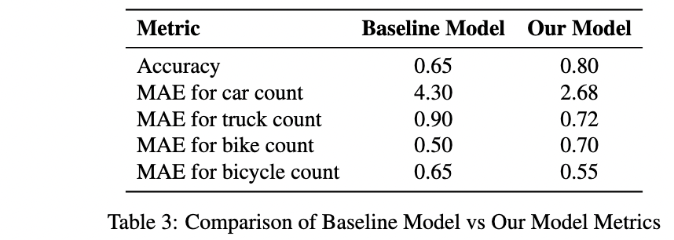
Results on fine-tuned model

Slide 11
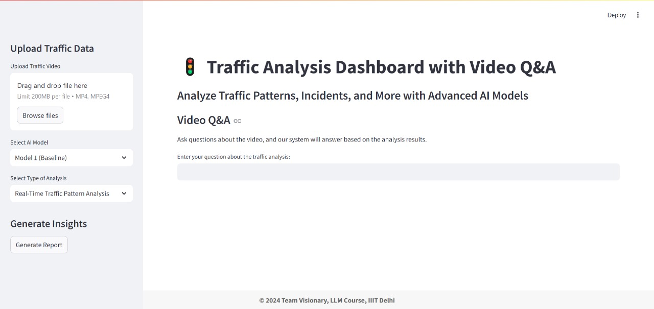
Model deployed as a chatbot

Slide 12
Conclusion
Developed a robust video analysis pipeline for traffic statistics and accident detection.
Generated and annotated datasets; conducted inference with initial results.
Finetuned model using QLoRA, improving event classification, precision, and efficiency.
Future: Deploy in real-world scenarios, expand datasets, and optimize for real-time analysis.

Slide 13
References
[1] A. G. Jangam, A. P. Mohite, D. U. Nayak, and A. V. Nimkar, “Leveraging LLMs for Video Querying,” in 2023 7th International Conference on Computer Applications in Electrical Engineering - Recent Advances (CERA), Oct. 2023, pp. 1–6. doi: 10.1109/CERA59325.2023.10455658.
[2] M. Abu Tami, H. I. Ashqar, M. Elhenawy, S. Glaser, and A. Rakotonirainy, “Using Multimodal Large Language Models (MLLMs) for Automated Detection of Traffic Safety critical Events,” Vehicles, vol. 6, no. 3, Sep. 2024, doi: 10.3390/vehicles6030074.
[3] Q. Kong et al., “WTS: A Pedestrian-Centric Traffic Video Dataset for Fine-grainedSpatial-Temporal Understanding,” arXiv preprint arXiv:2407.15350, Jul. 2024, doi: 10.48550/arXiv.2407.15350.
[4] A. S. Patel, R. J. Nguyen, and M. H. Davis, “Multimodal Video Analysis Using LLMs for Traffic Safety and Efficiency,” in Proceedings of the IEEE International Conference on Advanced Traffic Monitoring, Sep. 2024, pp. 1–10. doi: 10.1109/IEEE.2024.10700744.

Slide 14
THANK YOU
ANY QUESTIONS ?

